Slide 1


Project proposal
MRI Image Synthesis System
using Artificial Intelligence
4AM Team:
Bui Quoc Khoi
Hoang Van Tuyen
Vo Thuc Khanh Huyen
Vuong Tuan Khanh

Slide 2




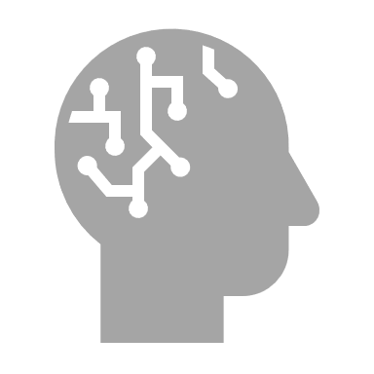
CONTENTS
1. What’s going on
2. Related Works
3. Proposed Method
4. Experimental Results
5. Demo & Challange
‹#›
Notes:
From 1 to 5

Slide 3
01.
What’s going on
‹#›
Notes:
Clustering, which finds the natural groups in a dataset by an unsupervised manner, is a vital research topic in data analysis and machine learning. (structured training labels are difficult to acquired)
With the increasingly of image and text data and deep learning methods,
Clustering is a vital research topic in data analysis and machine learning.
Deep multimodal clustering: is challenging since it needs to learn the appropriate features and find the correct clusters by using the consistency among modalities.
To combine the features from different modalities, the optimization of one does not guarantee the optimization of the other.
In the multimodal clustering tasks, the input pair can contain the contained noise: one modality may contain the non-information or even misleading information.
🡪 Negative information transfer can be occurred and effect to the performance.
Challenge:
Sự phát triển của data nhiều modal
Tại sao cần thiết phải clustering vì data này chưa dễ để gắn nhãn đầy đủ
Các vấn đề của clustering
1. High dimensional
2. Two-stage clustering problem
3. Combinations of modalities of conventional methods.
-Nhưng mà những phương pháp conventional thì dẫn đến nhựng việc như thế nào.
Motivation là gì
Giới thiệu deep clustering là j và có ý nghĩa j
Giới thiệu về multimodal data và việc hiệu qủa của ứng dụng multimodal
Nhưng mà những phương pháp conventional thì dẫn đến nhựng việc như thế nào.
End to end có chỉ đơn giản là feed nó vào neural network
New ideas for attention:
Cause:
In many text and vision task, the input pair can be contained noise.
One modality may contain non-information or even misleading information.
🡪 negative information transfer can be occurred.
🡪 affect to the performance.
Motivation:
- Reduce the affect of one modality over another by using attention to focus on important and ignore the misleading information.

Slide 4
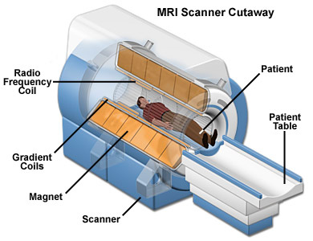
MRI
(Magnetic Resonance Imaging)
‹#›
Notes:
Clustering, which finds the natural groups in a dataset by an unsupervised manner, is a vital research topic in data analysis and machine learning. (structured training labels are difficult to acquired)
With the increasingly of image and text data and deep learning methods,
Clustering is a vital research topic in data analysis and machine learning.
Deep multimodal clustering: is challenging since it needs to learn the appropriate features and find the correct clusters by using the consistency among modalities.
To combine the features from different modalities, the optimization of one does not guarantee the optimization of the other.
In the multimodal clustering tasks, the input pair can contain the contained noise: one modality may contain the non-information or even misleading information.
🡪 Negative information transfer can be occurred and effect to the performance.
Challenge:
Sự phát triển của data nhiều modal
Tại sao cần thiết phải clustering vì data này chưa dễ để gắn nhãn đầy đủ
Các vấn đề của clustering
1. High dimensional
2. Two-stage clustering problem
3. Combinations of modalities of conventional methods.
-Nhưng mà những phương pháp conventional thì dẫn đến nhựng việc như thế nào.
Motivation là gì
Giới thiệu deep clustering là j và có ý nghĩa j
Giới thiệu về multimodal data và việc hiệu qủa của ứng dụng multimodal
Nhưng mà những phương pháp conventional thì dẫn đến nhựng việc như thế nào.
End to end có chỉ đơn giản là feed nó vào neural network
New ideas for attention:
Cause:
In many text and vision task, the input pair can be contained noise.
One modality may contain non-information or even misleading information.
🡪 negative information transfer can be occurred.
🡪 affect to the performance.
Motivation:
- Reduce the affect of one modality over another by using attention to focus on important and ignore the misleading information.

Slide 5
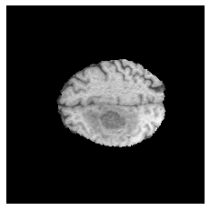
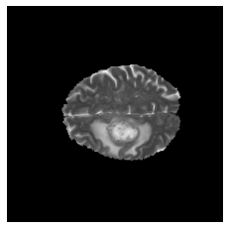
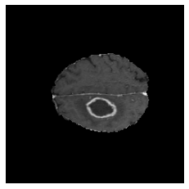
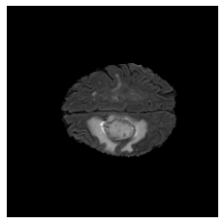
Scanning MRI
T1
T1 - contrast
T2
FLAIR

Slide 6


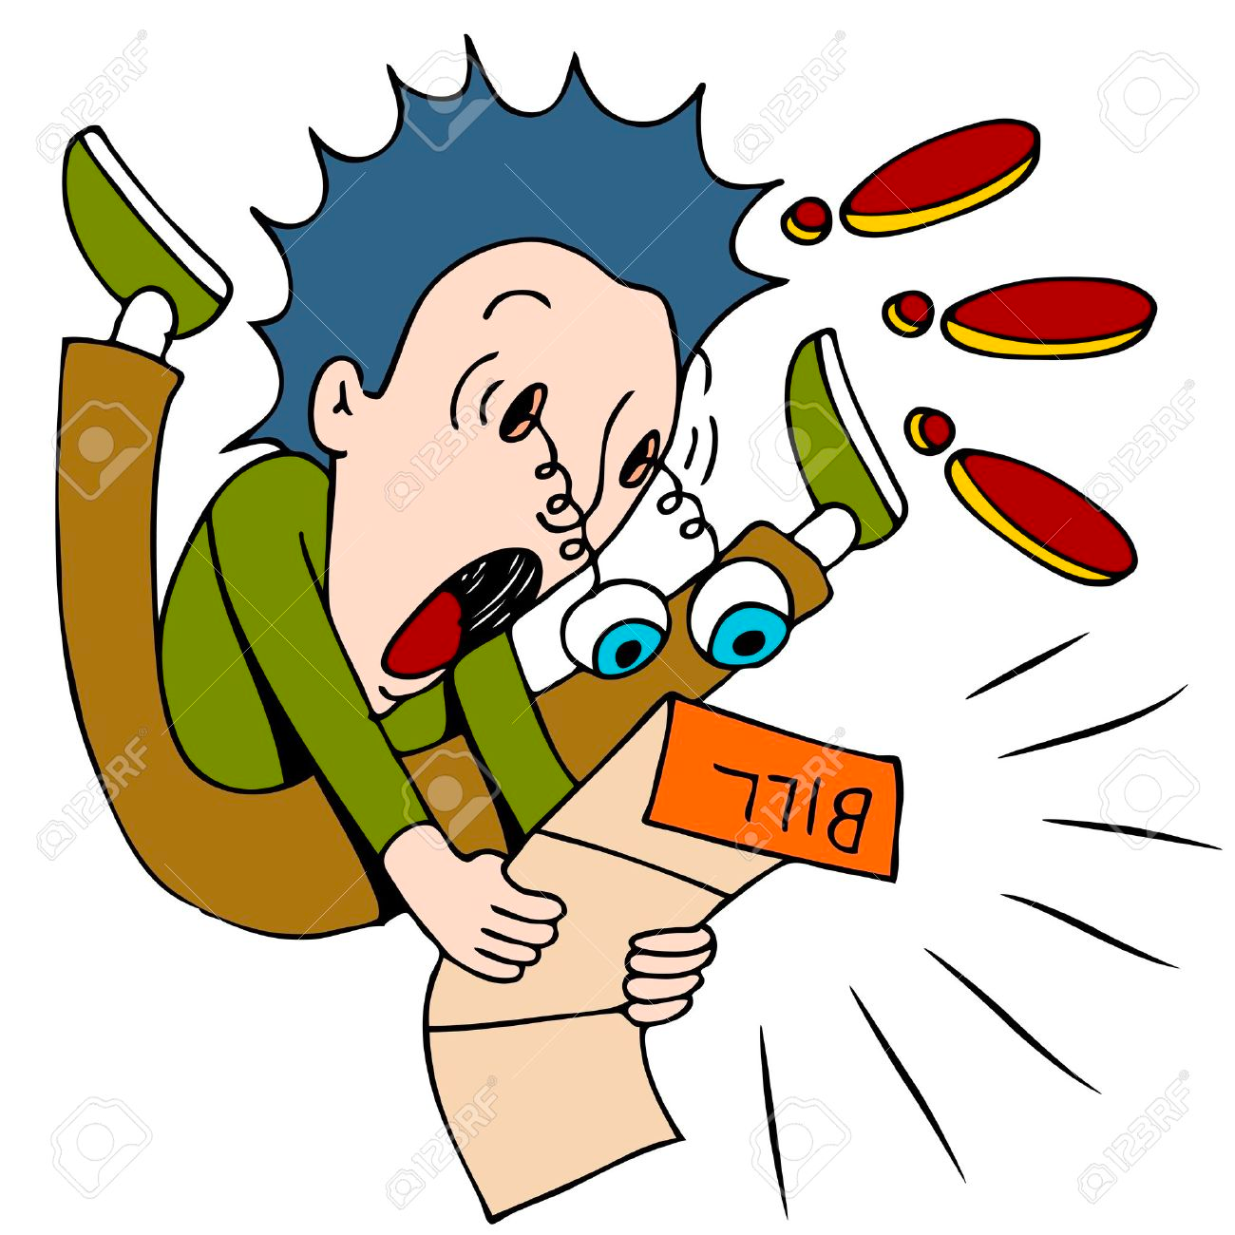
Disadvantage of MRI
Time consuming
Expensive
Discomfort
‹#›
Notes:
Clustering, which finds the natural groups in a dataset by an unsupervised manner, is a vital research topic in data analysis and machine learning. (structured training labels are difficult to acquired)
With the increasingly of image and text data and deep learning methods,
Clustering is a vital research topic in data analysis and machine learning.
Deep multimodal clustering: is challenging since it needs to learn the appropriate features and find the correct clusters by using the consistency among modalities.
To combine the features from different modalities, the optimization of one does not guarantee the optimization of the other.
In the multimodal clustering tasks, the input pair can contain the contained noise: one modality may contain the non-information or even misleading information.
🡪 Negative information transfer can be occurred and effect to the performance.
Challenge:
Sự phát triển của data nhiều modal
Tại sao cần thiết phải clustering vì data này chưa dễ để gắn nhãn đầy đủ
Các vấn đề của clustering
1. High dimensional
2. Two-stage clustering problem
3. Combinations of modalities of conventional methods.
-Nhưng mà những phương pháp conventional thì dẫn đến nhựng việc như thế nào.
Motivation là gì
Giới thiệu deep clustering là j và có ý nghĩa j
Giới thiệu về multimodal data và việc hiệu qủa của ứng dụng multimodal
Nhưng mà những phương pháp conventional thì dẫn đến nhựng việc như thế nào.
End to end có chỉ đơn giản là feed nó vào neural network
New ideas for attention:
Cause:
In many text and vision task, the input pair can be contained noise.
One modality may contain non-information or even misleading information.
🡪 negative information transfer can be occurred.
🡪 affect to the performance.
Motivation:
- Reduce the affect of one modality over another by using attention to focus on important and ignore the misleading information.

Slide 7
Something that helps patients to reduce the number of times scanning?

Slide 8
02.
Related works
‹#›
Notes:
Clustering, which finds the natural groups in a dataset by an unsupervised manner, is a vital research topic in data analysis and machine learning. (structured training labels are difficult to acquired)
With the increasingly of image and text data and deep learning methods,
Clustering is a vital research topic in data analysis and machine learning.
Deep multimodal clustering: is challenging since it needs to learn the appropriate features and find the correct clusters by using the consistency among modalities.
To combine the features from different modalities, the optimization of one does not guarantee the optimization of the other.
In the multimodal clustering tasks, the input pair can contain the contained noise: one modality may contain the non-information or even misleading information.
🡪 Negative information transfer can be occurred and effect to the performance.
Challenge:
Sự phát triển của data nhiều modal
Tại sao cần thiết phải clustering vì data này chưa dễ để gắn nhãn đầy đủ
Các vấn đề của clustering
1. High dimensional
2. Two-stage clustering problem
3. Combinations of modalities of conventional methods.
-Nhưng mà những phương pháp conventional thì dẫn đến nhựng việc như thế nào.
Motivation là gì
Giới thiệu deep clustering là j và có ý nghĩa j
Giới thiệu về multimodal data và việc hiệu qủa của ứng dụng multimodal
Nhưng mà những phương pháp conventional thì dẫn đến nhựng việc như thế nào.
End to end có chỉ đơn giản là feed nó vào neural network
New ideas for attention:
Cause:
In many text and vision task, the input pair can be contained noise.
One modality may contain non-information or even misleading information.
🡪 negative information transfer can be occurred.
🡪 affect to the performance.
Motivation:
- Reduce the affect of one modality over another by using attention to focus on important and ignore the misleading information.

Slide 9
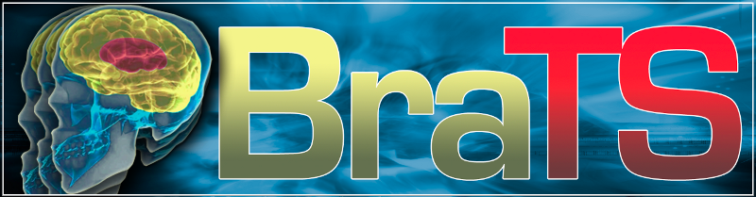
About the data
Entity | Detail
Data count | ~500 MRI images set 150 images each
Modality | Including T1-pre-contrast, T1-post-contrast, T2, FLAIR
Data size | 240x240 images
Training capability | ~77k images for training
Augumentations | Flipping, image patching
Data splitting | 15% for val, 15% for test, the rest is for training
‹#›
Notes:
Clustering, which finds the natural groups in a dataset by an unsupervised manner, is a vital research topic in data analysis and machine learning. (structured training labels are difficult to acquired)
With the increasingly of image and text data and deep learning methods,
Clustering is a vital research topic in data analysis and machine learning.
Deep multimodal clustering: is challenging since it needs to learn the appropriate features and find the correct clusters by using the consistency among modalities.
To combine the features from different modalities, the optimization of one does not guarantee the optimization of the other.
In the multimodal clustering tasks, the input pair can contain the contained noise: one modality may contain the non-information or even misleading information.
🡪 Negative information transfer can be occurred and effect to the performance.
Challenge:
Sự phát triển của data nhiều modal
Tại sao cần thiết phải clustering vì data này chưa dễ để gắn nhãn đầy đủ
Các vấn đề của clustering
1. High dimensional
2. Two-stage clustering problem
3. Combinations of modalities of conventional methods.
-Nhưng mà những phương pháp conventional thì dẫn đến nhựng việc như thế nào.
Motivation là gì
Giới thiệu deep clustering là j và có ý nghĩa j
Giới thiệu về multimodal data và việc hiệu qủa của ứng dụng multimodal
Nhưng mà những phương pháp conventional thì dẫn đến nhựng việc như thế nào.
End to end có chỉ đơn giản là feed nó vào neural network
New ideas for attention:
Cause:
In many text and vision task, the input pair can be contained noise.
One modality may contain non-information or even misleading information.
🡪 negative information transfer can be occurred.
🡪 affect to the performance.
Motivation:
- Reduce the affect of one modality over another by using attention to focus on important and ignore the misleading information.

Slide 10
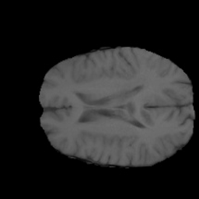
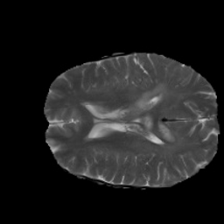
Pix2Pix
T1 images
T2 images
‹#›
Notes:
Clustering, which finds the natural groups in a dataset by an unsupervised manner, is a vital research topic in data analysis and machine learning. (structured training labels are difficult to acquired)
With the increasingly of image and text data and deep learning methods,
Clustering is a vital research topic in data analysis and machine learning.
Deep multimodal clustering: is challenging since it needs to learn the appropriate features and find the correct clusters by using the consistency among modalities.
To combine the features from different modalities, the optimization of one does not guarantee the optimization of the other.
In the multimodal clustering tasks, the input pair can contain the contained noise: one modality may contain the non-information or even misleading information.
🡪 Negative information transfer can be occurred and effect to the performance.
Challenge:
Sự phát triển của data nhiều modal
Tại sao cần thiết phải clustering vì data này chưa dễ để gắn nhãn đầy đủ
Các vấn đề của clustering
1. High dimensional
2. Two-stage clustering problem
3. Combinations of modalities of conventional methods.
-Nhưng mà những phương pháp conventional thì dẫn đến nhựng việc như thế nào.
Motivation là gì
Giới thiệu deep clustering là j và có ý nghĩa j
Giới thiệu về multimodal data và việc hiệu qủa của ứng dụng multimodal
Nhưng mà những phương pháp conventional thì dẫn đến nhựng việc như thế nào.
End to end có chỉ đơn giản là feed nó vào neural network
New ideas for attention:
Cause:
In many text and vision task, the input pair can be contained noise.
One modality may contain non-information or even misleading information.
🡪 negative information transfer can be occurred.
🡪 affect to the performance.
Motivation:
- Reduce the affect of one modality over another by using attention to focus on important and ignore the misleading information.

Slide 11
03.
Proposed method
‹#›
Notes:
Clustering, which finds the natural groups in a dataset by an unsupervised manner, is a vital research topic in data analysis and machine learning. (structured training labels are difficult to acquired)
With the increasingly of image and text data and deep learning methods,
Clustering is a vital research topic in data analysis and machine learning.
Deep multimodal clustering: is challenging since it needs to learn the appropriate features and find the correct clusters by using the consistency among modalities.
To combine the features from different modalities, the optimization of one does not guarantee the optimization of the other.
In the multimodal clustering tasks, the input pair can contain the contained noise: one modality may contain the non-information or even misleading information.
🡪 Negative information transfer can be occurred and effect to the performance.
Challenge:
Sự phát triển của data nhiều modal
Tại sao cần thiết phải clustering vì data này chưa dễ để gắn nhãn đầy đủ
Các vấn đề của clustering
1. High dimensional
2. Two-stage clustering problem
3. Combinations of modalities of conventional methods.
-Nhưng mà những phương pháp conventional thì dẫn đến nhựng việc như thế nào.
Motivation là gì
Giới thiệu deep clustering là j và có ý nghĩa j
Giới thiệu về multimodal data và việc hiệu qủa của ứng dụng multimodal
Nhưng mà những phương pháp conventional thì dẫn đến nhựng việc như thế nào.
End to end có chỉ đơn giản là feed nó vào neural network
New ideas for attention:
Cause:
In many text and vision task, the input pair can be contained noise.
One modality may contain non-information or even misleading information.
🡪 negative information transfer can be occurred.
🡪 affect to the performance.
Motivation:
- Reduce the affect of one modality over another by using attention to focus on important and ignore the misleading information.

Slide 12
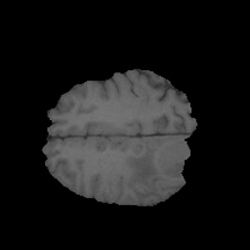
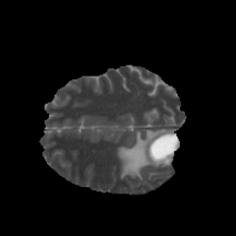
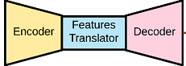
Proposed method
T1 image
T2 image
‹#›
Notes:
Clustering, which finds the natural groups in a dataset by an unsupervised manner, is a vital research topic in data analysis and machine learning. (structured training labels are difficult to acquired)
With the increasingly of image and text data and deep learning methods,
Clustering is a vital research topic in data analysis and machine learning.
Deep multimodal clustering: is challenging since it needs to learn the appropriate features and find the correct clusters by using the consistency among modalities.
To combine the features from different modalities, the optimization of one does not guarantee the optimization of the other.
In the multimodal clustering tasks, the input pair can contain the contained noise: one modality may contain the non-information or even misleading information.
🡪 Negative information transfer can be occurred and effect to the performance.
Challenge:
Sự phát triển của data nhiều modal
Tại sao cần thiết phải clustering vì data này chưa dễ để gắn nhãn đầy đủ
Các vấn đề của clustering
1. High dimensional
2. Two-stage clustering problem
3. Combinations of modalities of conventional methods.
-Nhưng mà những phương pháp conventional thì dẫn đến nhựng việc như thế nào.
Motivation là gì
Giới thiệu deep clustering là j và có ý nghĩa j
Giới thiệu về multimodal data và việc hiệu qủa của ứng dụng multimodal
Nhưng mà những phương pháp conventional thì dẫn đến nhựng việc như thế nào.
End to end có chỉ đơn giản là feed nó vào neural network
New ideas for attention:
Cause:
In many text and vision task, the input pair can be contained noise.
One modality may contain non-information or even misleading information.
🡪 negative information transfer can be occurred.
🡪 affect to the performance.
Motivation:
- Reduce the affect of one modality over another by using attention to focus on important and ignore the misleading information.

Slide 13
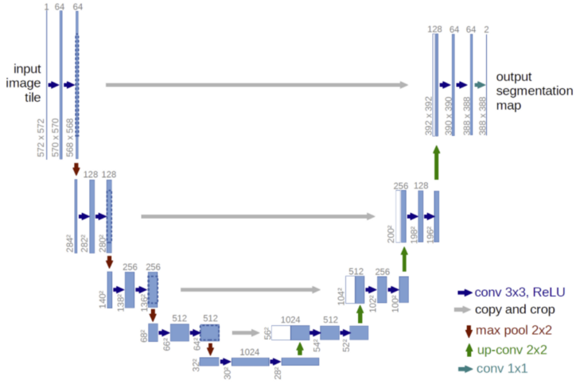
AI Model Details
Using unet-256 as backbone
Training from scratch
Using L1 as loss function
Adam optimizers
Cosine learning rate scheduler
Input and output is images of shape 256x256
‹#›
Notes:
Clustering, which finds the natural groups in a dataset by an unsupervised manner, is a vital research topic in data analysis and machine learning. (structured training labels are difficult to acquired)
With the increasingly of image and text data and deep learning methods,
Clustering is a vital research topic in data analysis and machine learning.
Deep multimodal clustering: is challenging since it needs to learn the appropriate features and find the correct clusters by using the consistency among modalities.
To combine the features from different modalities, the optimization of one does not guarantee the optimization of the other.
In the multimodal clustering tasks, the input pair can contain the contained noise: one modality may contain the non-information or even misleading information.
🡪 Negative information transfer can be occurred and effect to the performance.
Challenge:
Sự phát triển của data nhiều modal
Tại sao cần thiết phải clustering vì data này chưa dễ để gắn nhãn đầy đủ
Các vấn đề của clustering
1. High dimensional
2. Two-stage clustering problem
3. Combinations of modalities of conventional methods.
-Nhưng mà những phương pháp conventional thì dẫn đến nhựng việc như thế nào.
Motivation là gì
Giới thiệu deep clustering là j và có ý nghĩa j
Giới thiệu về multimodal data và việc hiệu qủa của ứng dụng multimodal
Nhưng mà những phương pháp conventional thì dẫn đến nhựng việc như thế nào.
End to end có chỉ đơn giản là feed nó vào neural network
New ideas for attention:
Cause:
In many text and vision task, the input pair can be contained noise.
One modality may contain non-information or even misleading information.
🡪 negative information transfer can be occurred.
🡪 affect to the performance.
Motivation:
- Reduce the affect of one modality over another by using attention to focus on important and ignore the misleading information.

Slide 14
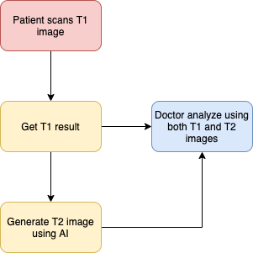
Proposed method
‹#›
Notes:
Clustering, which finds the natural groups in a dataset by an unsupervised manner, is a vital research topic in data analysis and machine learning. (structured training labels are difficult to acquired)
With the increasingly of image and text data and deep learning methods,
Clustering is a vital research topic in data analysis and machine learning.
Deep multimodal clustering: is challenging since it needs to learn the appropriate features and find the correct clusters by using the consistency among modalities.
To combine the features from different modalities, the optimization of one does not guarantee the optimization of the other.
In the multimodal clustering tasks, the input pair can contain the contained noise: one modality may contain the non-information or even misleading information.
🡪 Negative information transfer can be occurred and effect to the performance.
Challenge:
Sự phát triển của data nhiều modal
Tại sao cần thiết phải clustering vì data này chưa dễ để gắn nhãn đầy đủ
Các vấn đề của clustering
1. High dimensional
2. Two-stage clustering problem
3. Combinations of modalities of conventional methods.
-Nhưng mà những phương pháp conventional thì dẫn đến nhựng việc như thế nào.
Motivation là gì
Giới thiệu deep clustering là j và có ý nghĩa j
Giới thiệu về multimodal data và việc hiệu qủa của ứng dụng multimodal
Nhưng mà những phương pháp conventional thì dẫn đến nhựng việc như thế nào.
End to end có chỉ đơn giản là feed nó vào neural network
New ideas for attention:
Cause:
In many text and vision task, the input pair can be contained noise.
One modality may contain non-information or even misleading information.
🡪 negative information transfer can be occurred.
🡪 affect to the performance.
Motivation:
- Reduce the affect of one modality over another by using attention to focus on important and ignore the misleading information.

Slide 15
04.
Experimental result
‹#›
Notes:
Clustering, which finds the natural groups in a dataset by an unsupervised manner, is a vital research topic in data analysis and machine learning. (structured training labels are difficult to acquired)
With the increasingly of image and text data and deep learning methods,
Clustering is a vital research topic in data analysis and machine learning.
Deep multimodal clustering: is challenging since it needs to learn the appropriate features and find the correct clusters by using the consistency among modalities.
To combine the features from different modalities, the optimization of one does not guarantee the optimization of the other.
In the multimodal clustering tasks, the input pair can contain the contained noise: one modality may contain the non-information or even misleading information.
🡪 Negative information transfer can be occurred and effect to the performance.
Challenge:
Sự phát triển của data nhiều modal
Tại sao cần thiết phải clustering vì data này chưa dễ để gắn nhãn đầy đủ
Các vấn đề của clustering
1. High dimensional
2. Two-stage clustering problem
3. Combinations of modalities of conventional methods.
-Nhưng mà những phương pháp conventional thì dẫn đến nhựng việc như thế nào.
Motivation là gì
Giới thiệu deep clustering là j và có ý nghĩa j
Giới thiệu về multimodal data và việc hiệu qủa của ứng dụng multimodal
Nhưng mà những phương pháp conventional thì dẫn đến nhựng việc như thế nào.
End to end có chỉ đơn giản là feed nó vào neural network
New ideas for attention:
Cause:
In many text and vision task, the input pair can be contained noise.
One modality may contain non-information or even misleading information.
🡪 negative information transfer can be occurred.
🡪 affect to the performance.
Motivation:
- Reduce the affect of one modality over another by using attention to focus on important and ignore the misleading information.

Slide 16
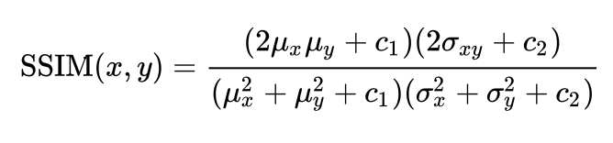
Metrics
SSIM
https://arxiv.org/pdf/2006.13846.pdf
‹#›
Notes:
Clustering, which finds the natural groups in a dataset by an unsupervised manner, is a vital research topic in data analysis and machine learning. (structured training labels are difficult to acquired)
With the increasingly of image and text data and deep learning methods,
Clustering is a vital research topic in data analysis and machine learning.
Deep multimodal clustering: is challenging since it needs to learn the appropriate features and find the correct clusters by using the consistency among modalities.
To combine the features from different modalities, the optimization of one does not guarantee the optimization of the other.
In the multimodal clustering tasks, the input pair can contain the contained noise: one modality may contain the non-information or even misleading information.
🡪 Negative information transfer can be occurred and effect to the performance.
Challenge:
Sự phát triển của data nhiều modal
Tại sao cần thiết phải clustering vì data này chưa dễ để gắn nhãn đầy đủ
Các vấn đề của clustering
1. High dimensional
2. Two-stage clustering problem
3. Combinations of modalities of conventional methods.
-Nhưng mà những phương pháp conventional thì dẫn đến nhựng việc như thế nào.
Motivation là gì
Giới thiệu deep clustering là j và có ý nghĩa j
Giới thiệu về multimodal data và việc hiệu qủa của ứng dụng multimodal
Nhưng mà những phương pháp conventional thì dẫn đến nhựng việc như thế nào.
End to end có chỉ đơn giản là feed nó vào neural network
New ideas for attention:
Cause:
In many text and vision task, the input pair can be contained noise.
One modality may contain non-information or even misleading information.
🡪 negative information transfer can be occurred.
🡪 affect to the performance.
Motivation:
- Reduce the affect of one modality over another by using attention to focus on important and ignore the misleading information.

Slide 17
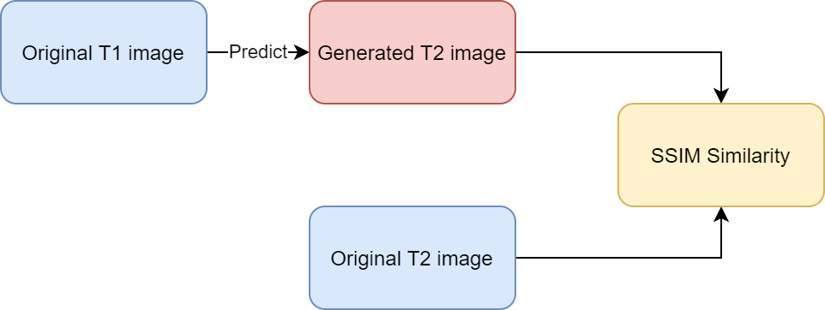
Metrics
‹#›
Notes:
Clustering, which finds the natural groups in a dataset by an unsupervised manner, is a vital research topic in data analysis and machine learning. (structured training labels are difficult to acquired)
With the increasingly of image and text data and deep learning methods,
Clustering is a vital research topic in data analysis and machine learning.
Deep multimodal clustering: is challenging since it needs to learn the appropriate features and find the correct clusters by using the consistency among modalities.
To combine the features from different modalities, the optimization of one does not guarantee the optimization of the other.
In the multimodal clustering tasks, the input pair can contain the contained noise: one modality may contain the non-information or even misleading information.
🡪 Negative information transfer can be occurred and effect to the performance.
Challenge:
Sự phát triển của data nhiều modal
Tại sao cần thiết phải clustering vì data này chưa dễ để gắn nhãn đầy đủ
Các vấn đề của clustering
1. High dimensional
2. Two-stage clustering problem
3. Combinations of modalities of conventional methods.
-Nhưng mà những phương pháp conventional thì dẫn đến nhựng việc như thế nào.
Motivation là gì
Giới thiệu deep clustering là j và có ý nghĩa j
Giới thiệu về multimodal data và việc hiệu qủa của ứng dụng multimodal
Nhưng mà những phương pháp conventional thì dẫn đến nhựng việc như thế nào.
End to end có chỉ đơn giản là feed nó vào neural network
New ideas for attention:
Cause:
In many text and vision task, the input pair can be contained noise.
One modality may contain non-information or even misleading information.
🡪 negative information transfer can be occurred.
🡪 affect to the performance.
Motivation:
- Reduce the affect of one modality over another by using attention to focus on important and ignore the misleading information.

Slide 18
Experimental result
 | Average SSIM Similarity (%) | Min SSIM Similarity (%) | Max SSIM Similarity (%)
Validation data | 90.8 | 85.5 | 93.6
Test data | 88.7 | 83.7 | 90.5
‹#›
Notes:
Clustering, which finds the natural groups in a dataset by an unsupervised manner, is a vital research topic in data analysis and machine learning. (structured training labels are difficult to acquired)
With the increasingly of image and text data and deep learning methods,
Clustering is a vital research topic in data analysis and machine learning.
Deep multimodal clustering: is challenging since it needs to learn the appropriate features and find the correct clusters by using the consistency among modalities.
To combine the features from different modalities, the optimization of one does not guarantee the optimization of the other.
In the multimodal clustering tasks, the input pair can contain the contained noise: one modality may contain the non-information or even misleading information.
🡪 Negative information transfer can be occurred and effect to the performance.
Challenge:
Sự phát triển của data nhiều modal
Tại sao cần thiết phải clustering vì data này chưa dễ để gắn nhãn đầy đủ
Các vấn đề của clustering
1. High dimensional
2. Two-stage clustering problem
3. Combinations of modalities of conventional methods.
-Nhưng mà những phương pháp conventional thì dẫn đến nhựng việc như thế nào.
Motivation là gì
Giới thiệu deep clustering là j và có ý nghĩa j
Giới thiệu về multimodal data và việc hiệu qủa của ứng dụng multimodal
Nhưng mà những phương pháp conventional thì dẫn đến nhựng việc như thế nào.
End to end có chỉ đơn giản là feed nó vào neural network
New ideas for attention:
Cause:
In many text and vision task, the input pair can be contained noise.
One modality may contain non-information or even misleading information.
🡪 negative information transfer can be occurred.
🡪 affect to the performance.
Motivation:
- Reduce the affect of one modality over another by using attention to focus on important and ignore the misleading information.

Slide 19
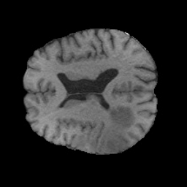
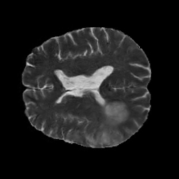

Image result
Input image (T1)
Generated image
Ground truth (T2)

Slide 20
Video result
Input image (T1)
Generated image
Ground truth (T2)

Slide 21
05.
Demo & Challange
‹#›
Notes:
Clustering, which finds the natural groups in a dataset by an unsupervised manner, is a vital research topic in data analysis and machine learning. (structured training labels are difficult to acquired)
With the increasingly of image and text data and deep learning methods,
Clustering is a vital research topic in data analysis and machine learning.
Deep multimodal clustering: is challenging since it needs to learn the appropriate features and find the correct clusters by using the consistency among modalities.
To combine the features from different modalities, the optimization of one does not guarantee the optimization of the other.
In the multimodal clustering tasks, the input pair can contain the contained noise: one modality may contain the non-information or even misleading information.
🡪 Negative information transfer can be occurred and effect to the performance.
Challenge:
Sự phát triển của data nhiều modal
Tại sao cần thiết phải clustering vì data này chưa dễ để gắn nhãn đầy đủ
Các vấn đề của clustering
1. High dimensional
2. Two-stage clustering problem
3. Combinations of modalities of conventional methods.
-Nhưng mà những phương pháp conventional thì dẫn đến nhựng việc như thế nào.
Motivation là gì
Giới thiệu deep clustering là j và có ý nghĩa j
Giới thiệu về multimodal data và việc hiệu qủa của ứng dụng multimodal
Nhưng mà những phương pháp conventional thì dẫn đến nhựng việc như thế nào.
End to end có chỉ đơn giản là feed nó vào neural network
New ideas for attention:
Cause:
In many text and vision task, the input pair can be contained noise.
One modality may contain non-information or even misleading information.
🡪 negative information transfer can be occurred.
🡪 affect to the performance.
Motivation:
- Reduce the affect of one modality over another by using attention to focus on important and ignore the misleading information.

Slide 22
https://drive.google.com/file/d/1vIl5cgvAsbUnBVZcjzZDWX2LAaznzfvE/view?usp=sharing

Slide 23
Thanks for listening
What’s going on
Related works
Proposed method
Experimental result
Demo
‹#›
Notes:
Clustering, which finds the natural groups in a dataset by an unsupervised manner, is a vital research topic in data analysis and machine learning. (structured training labels are difficult to acquired)
With the increasingly of image and text data and deep learning methods,
Clustering is a vital research topic in data analysis and machine learning.
Deep multimodal clustering: is challenging since it needs to learn the appropriate features and find the correct clusters by using the consistency among modalities.
To combine the features from different modalities, the optimization of one does not guarantee the optimization of the other.
In the multimodal clustering tasks, the input pair can contain the contained noise: one modality may contain the non-information or even misleading information.
🡪 Negative information transfer can be occurred and effect to the performance.
Challenge:
Sự phát triển của data nhiều modal
Tại sao cần thiết phải clustering vì data này chưa dễ để gắn nhãn đầy đủ
Các vấn đề của clustering
1. High dimensional
2. Two-stage clustering problem
3. Combinations of modalities of conventional methods.
-Nhưng mà những phương pháp conventional thì dẫn đến nhựng việc như thế nào.
Motivation là gì
Giới thiệu deep clustering là j và có ý nghĩa j
Giới thiệu về multimodal data và việc hiệu qủa của ứng dụng multimodal
Nhưng mà những phương pháp conventional thì dẫn đến nhựng việc như thế nào.
End to end có chỉ đơn giản là feed nó vào neural network
New ideas for attention:
Cause:
In many text and vision task, the input pair can be contained noise.
One modality may contain non-information or even misleading information.
🡪 negative information transfer can be occurred.
🡪 affect to the performance.
Motivation:
- Reduce the affect of one modality over another by using attention to focus on important and ignore the misleading information.

