Slide 1
Group Project Title: Employee Attrition Data Analysis
Project Team: :
Hari Prasad Kotapalli
Kishor Pulagam
Vuthej Krishna Reddy

Slide 2
Employee Attrition Data Analysis
The selected Dataset consists of employee details who voluntarily resigned in 2016 from the employer: IBM.
Industry’s best practice:
Permit ‘Good Attrition’ & be cautious of ‘Bad Attrition’.
Problem statement:
To identify the factors contributing to uncontrolled ‘Bad Attrition’ in this case and predict the key factors in bringing the overall attrition rate under control.
Project Objectives:
Identify the key contributors of Attrition
Identify Good & Bad attrition rate
Apply stages of Data Analytics lifecycle & its processes
Observations made & Measures for employer to arrest the uncontrolled attrition

Slide 3





Employee Attrition Data Analysis
Data overview:
The collection of information gives us a holistic view of employee records, such as
Last pay Compensation, Last Promotion date, skills/trainings acquired, Employee tenure, Stock options provided to staff as Premium employee benefits, rate of billing, Over-time & personal status (gender, marital status).
Concept of learning as related to our objectives:
Data Analytics Life cycle:
Model planning
Model Building
Model Evaluating/Data analyzation
Arrive at conclusions

Slide 4
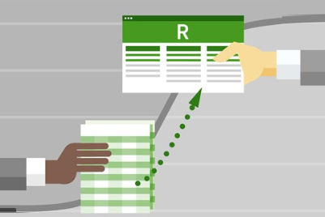

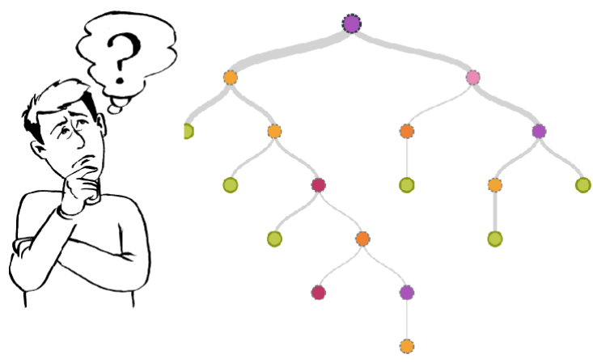


Employee Attrition Data Analysis
Approach / methodology (the plan)
Attempts made are with techniques below:
Decision Tree
Naïve Bayes
Logistic Regression
Evaluation:
Kappa, Accuracy & F-Values
Tools:

Slide 5
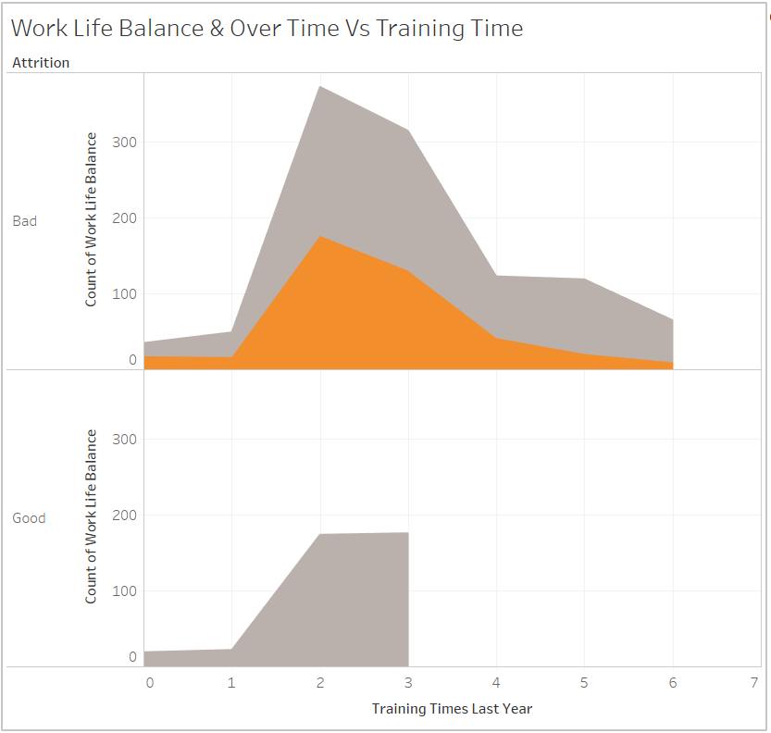
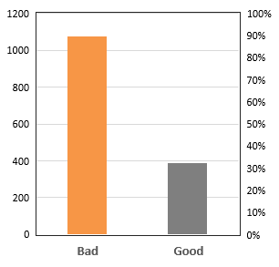
Employee Attrition Data Analysis
Distribution by Year since Last Promotion
Visual exploration:
Tableau
Work life Balance & Overtime Vs Training Time
Worklife Balance
Over Time
Distribution by Revised Compensation (hike)
Worklife Balance

Slide 6
Employee Attrition Data Analysis
Data preparation:
Multiple combination of employee parameters to come-up with a better correlation of information - To classify Good-Bad attrition.
Data Cleaning:
Extensive validation of data revealed no anomalies.
Transformation:
Transformed string to numeric values to specific parameters, to suit the modelling.
Attributes | Transformed Value
Business Travel | Yes = 1, No = 2
Gender | Male = 1, Female = 2
Marital Status | Single = 1, Married = 2, Divorced = 3
Overtime | Yes = 1, No = 2
Attrition | Good = 1, Bad = 0

Slide 7
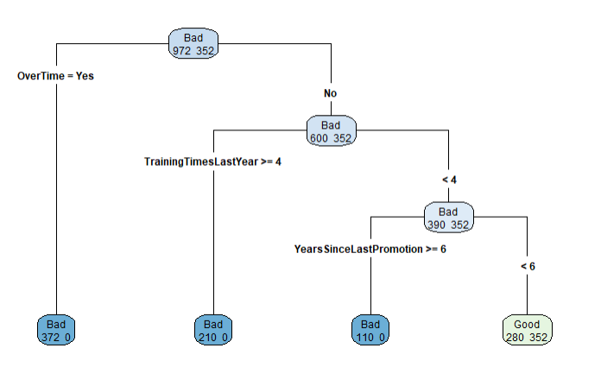
Employee Attrition Data Analysis
Data Modeling :
Decision Tree
Parameters:
Years since last Promotion
Training time
Over Time
Evaluation details:
Industry Standards:
(from recent HR Journals)
Model | Accuracy (%) | Precision | Recall | F | Kappa
Decision Tree | 82.19 | 0.757 | 1 | 0.8616 | 0.6247
Naïve Bayes | 77.55 | 1 | 0.6944 | 0.8196 | 0.5467
Logistic Regression | 82.19 | 0.7757 | 0.9765 | 0.8646 | 0.614
Attrition Type | Good / Bad
Attrition by Billing rate | > 1000 in the Column: DailyRate
Attrition by Over time | Denoted as Yes
Attrition by Training | Trained for 4-6 skills last year
Attrition by hike | 14% and above (Industry standard is 1-13%)
Attrition by Stock-Options | Only level 3 - Premium employee benefits
Attrition by Promotion | > 6 years and above

Slide 8
Employee Attrition Data Analysis
Key points, findings, and/or recommendations:
Higher the correlation among variables, resulted in higher Accuracy & Kappa values
With limited sample of data, Train & test data doesn’t derive accurate value
Experiences (individual and team):
Enormous learnings in Data Analytics life cycle
Challenges faced in arriving at best suitable model
Future work:
- Enhanced model can be built, upon adding more attributes and instances to this dataset.
- Algorithms to achieve accurate results can be programed.
Conclusion:
Due to uncontrolled Attrition:
- Revenue leakage/loss, hard to engage New Business w/o desired avg.Experience of talents
Metrics which would reveal better observations:
1. Employee friendly employee experience for a stable work environment
2. Last Working Day
3. Employee Index
4. Performance Management

Slide 9
Q&A

Slide 10

Thank You..

