Slide 1
Lecture 10: Arrays
Starting Out with Java: From Control Structures through Objects
Fifth Edition
by Tony Gaddis

Slide 2
Lecture 10 Topics
Lecture 10 discusses the following main topics:
7.1 Introduction to Arrays
7.2 Processing Array Contents
7.3 Passing Arrays as Arguments to Methods
7.4 Some Useful Array Algorithms and Operations
7.5 Returning Arrays from Methods
7.6 String Arrays

Slide 3
Introduction to Arrays
Primitive variables are designed to hold only one value at a time.
Arrays allow us to create a collection of like values that are indexed.
An array can store any type of data but only one type of data at a time.
An array is a list of data elements.

Slide 4
Creating Arrays
An array is an object so it needs an object reference.
// Declare a reference to an array that will hold integers.
int[] numbers;
The next step creates the array and assigns its address to the numbers variable.
// Create a new array that will hold 6 integers.
numbers = new int[6];
0
0
0
0
0
0
index 0
index 1
index 2
index 3
index 4
index 5
Array element values are initialized to 0. Array indexes always start at 0.

Slide 5
Creating Arrays
It is possible to declare an array reference and create it in the same statement.
int[] numbers = new int[6];
Arrays may be of any type.
float[] temperatures = new float[100];
char[] letters = new char[41];
long[] units = new long[50];
double[] sizes = new double[1200];

Slide 6
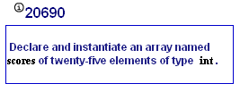
MyProgrammingLab6 – 7.1

Slide 7
Creating Arrays
The array size must be a non-negative number.
It may be a literal value, a constant, or variable.
final int ARRAY_SIZE = 6;
int[] numbers = new int[ARRAY_SIZE];
Once created, an array size is fixed and cannot be changed.

Slide 8
Accessing the Elements of an Array
20
0
0
0
0
0
numbers[0]
numbers[1]
numbers[2]
numbers[3]
numbers[4]
numbers[5]
An array is accessed by:
the reference name
a subscript that identifies which element in the array to access.
numbers[0] = 20; //pronounced "numbers sub zero"

Slide 9
Inputting and Outputting Array Elements
Array elements can be treated as any other variable.
They are simply accessed by the same name and a subscript.
See example: ArrayDemo1.java
Array subscripts can be accessed using variables (such as for loop counters).
See example: ArrayDemo2.java

Slide 10
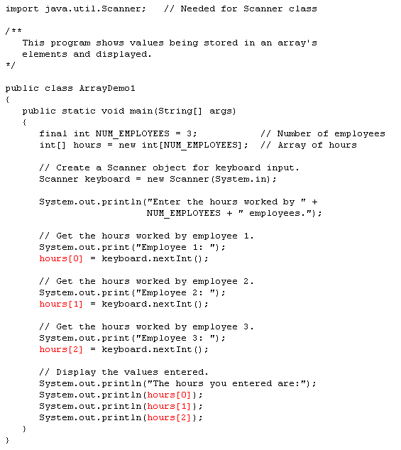
Works great,
but not taking
advantage of
how arrays can
be used

Slide 11
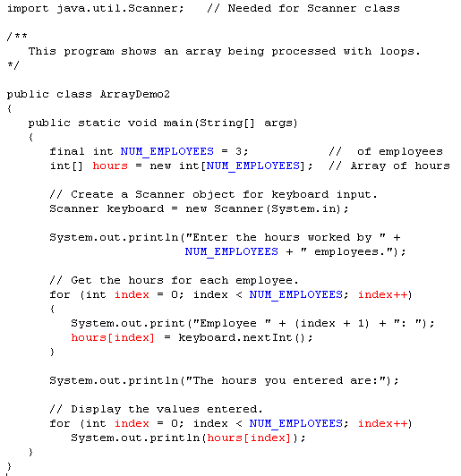

Slide 12
Bounds Checking
Array indexes always start at zero and continue to (array length - 1).
int values = new int[10];
This array would have indexes 0 through 9.
See example: InvalidSubscript.java
In for loops, it is typical to use i, j, and k as counting variables.
It might help to think of i as representing the word index.

Slide 13
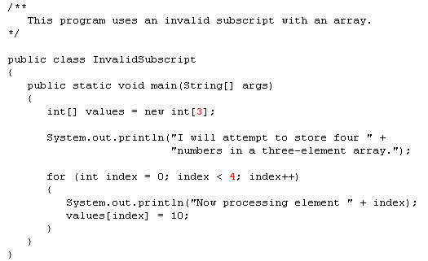
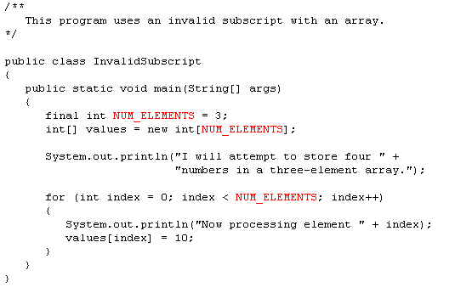
Another good
argument for
using final constants
for array sizes

Slide 14
Off-by-One Errors
It is very easy to be off-by-one when accessing arrays.
// This code has an off-by-one error.
int[] numbers = new int[100];
for (int i = 1; i <= 100; i++)
numbers[i] = 99;
Here, the equal sign allows the loop to continue on to index 100, where 99 is the last index in the array.
This code would throw an ArrayIndexOutOfBoundsException.

Slide 15
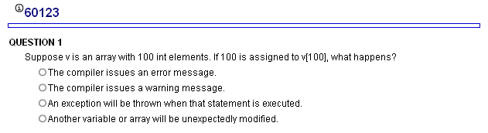
MyProgrammingLab6 – 7.1

Slide 16
Array Initialization
When relatively few items need to be initialized, an initialization list can be used to initialize the array.
int[]days = {31, 28, 31, 30, 31, 30, 31, 31, 30, 31, 30, 31};
The numbers in the list are stored in the array in order:
days[0] is assigned 31,
days[1] is assigned 28,
days[2] is assigned 31,
days[3] is assigned 30,
etc.
See example: ArrayInitialization.java
Notice: no number here

Slide 17
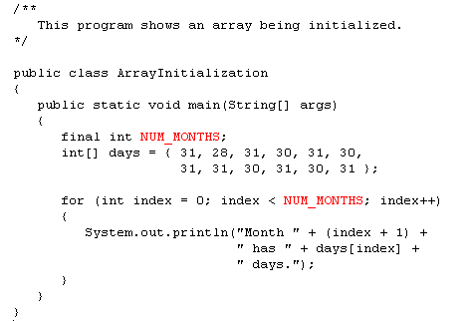
Could I have used index++?
Why (index + 1) here?
No, it would have changed the value of index

Slide 18
Alternate Array Declaration
Previously we showed arrays being declared:
int[] numbers;
However, the brackets can also go here:
int numbers[];
These are equivalent but the first style is typical (preferred).
Multiple arrays can be declared on the same line.
int[] numbers, codes, scores;
With the alternate notation each variable must have brackets.
int numbers[], codes[], scores;
The scores variable in this instance is simply an int variable.

Slide 19
Processing Array Contents
Processing data in an array is the same as any other variable.
grossPay = hours[3] * payRate;
Pre and post increment works the same:
int[] score = {7, 8, 9, 10, 11};
++score[2]; // Pre-increment operation
score[4]++; // Post-increment operation
What is the value of
(scores[2] + scores[3])/2?
scores
79 87 94 82 67 98 87 81 74 91

Slide 20
Processing Array Contents
Array elements can be used in relational operations:
if(cost[20] < cost[0])
{
//statements
}
They can be used as loop conditions:
while(value[count] != 0)
{
//statements
}

Slide 21
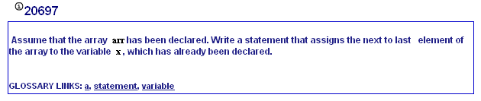
MyProgrammingLab6 – 7.1

Slide 22
Array Length
Arrays are objects and provide a public field named length that is a constant that can be tested.
double[] temperatures = new double[25];
The length of this array is 25.
The length of an array can be obtained via its length constant.
int size = temperatures.length;
The variable size will contain 25.

Slide 23
Array Size
The length constant can be used in a loop to provide automatic bounding.
for(int i = 0; i < temperatures.length; i++)
{
System.out.println("Temperature " + i ": "
+ temperatures[i]);
}
Index subscripts start at 0 and end at one less than the array length.

Slide 24
The Enhanced for Loop
Simplified array processing (read only)
Always goes through all elements
General format:
for(datatype elementVariable : array)
statement;

Slide 25
The Enhanced for Loop (for each loop)
Traverses all elements of a collection:
double[] values = ...;
double sum = 0;
for (double element : values)
{
sum = sum + element;
}
Read the loop as “for each element in values”
Traditional alternative:
double[] values = ...;
double sum = 0;
for (int i = 0; i < values.length; i++)
{
double element = values[i];
sum = sum + element;
}
Big Java by Cay Horstmann
Copyright © 2009 by John Wiley & Sons. All rights reserved.

Slide 26
The Enhanced for Loop
Works for Objects too:
BankAccount[] accounts = ...;
double sum = 0;
for (BankAccount account : accounts)
{
sum = sum + account.getBalance();
}
Equivalent to the following ordinary for loop:
double sum = 0;
for (int i = 0; i < accounts.length; i++)
{
BankAccount account = accounts[i];
sum = sum + account.getBalance();
}
Big Java by Cay Horstmann
Copyright © 2009 by John Wiley & Sons. All rights reserved.

Slide 27
The Enhanced for Loop
The “for each loop” does not allow you to modify the contents of an array:
for (double element : values)
{
element = 0;
// ERROR—this assignment does not
// modify array element
}
Must use an ordinary for loop:
for (int i = 0; i < values.length; i++)
{
values[i] = 0; // OK
}
Big Java by Cay Horstmann
Copyright © 2009 by John Wiley & Sons. All rights reserved.

Slide 28
Array Size
You can let the user specify the size of an array:
int numTests;
int[] tests;
Scanner keyboard = new Scanner(System.in);
System.out.print("How many tests do you have? ");
numTests = keyboard.nextInt();
tests = new int[numTests];
See example: DisplayTestScores.java

Slide 29
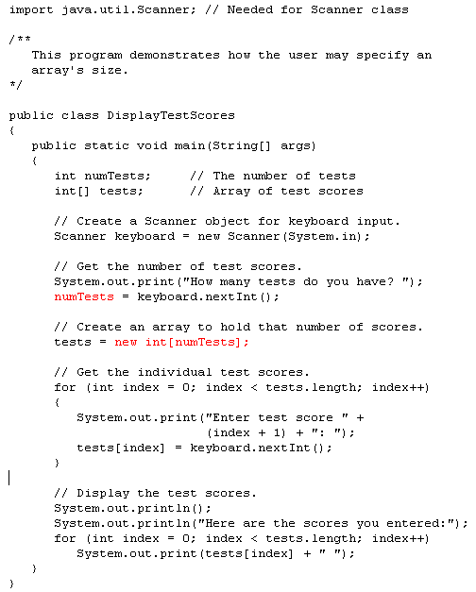

Slide 30
Reassigning Array References
An array reference can be assigned to another array of the same type.
// Create an array referenced by the numbers variable.
int[] numbers = new int[10];
// Reassign numbers to a new array.
numbers = new int[5];
If the first (10 element) array no longer has a reference to it, it will be garbage collected.

Slide 31
Reassigning Array References
int[] numbers = new int[10];
The numbers variable
holds the address of an
int array.
Address

Slide 32
Reassigning Array References
This array gets marked for
garbage collection
The numbers variable
holds the address of an
int array.
Address
numbers = new int[5];

Slide 33
Copying Arrays
This is not the way to copy an array.
int[] array1 = { 2, 4, 6, 8, 10 };
int[] array2 = array1; // This does not copy array1.
2
4
6
8
10
array1 holds an
address to the array
Address
Example: SameArray.java
array2 holds an
address to the array
Address

Slide 34
Copying Arrays (Deep Copy)
You cannot copy an array by merely assigning one reference variable to another.
You need to copy the individual elements of one array to another.
int[] firstArray = {5, 10, 15, 20, 25 };
int[] secondArray = new int[5];
for (int i = 0; i < firstArray.length; i++)
secondArray[i] = firstArray[i];
This code copies each element of firstArray to the corresponding element of secondArray.

Slide 35
Passing Arrays as Arguments
Arrays are objects.
Their references can be passed to methods like any other object reference variable.
showArray(numbers);
5
10
15
20
25
30
35
40
Address
Example: PassArray.java
public static void showArray(int[] array)
{
for (int i = 0; i < array.length; i++)
System.out.print(array[i] + " ");
}

Slide 36
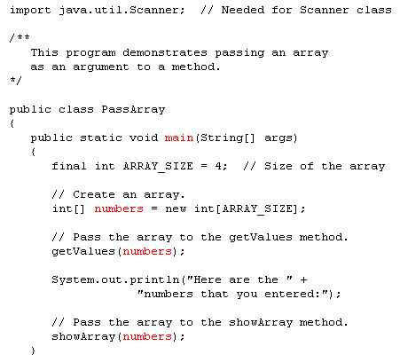
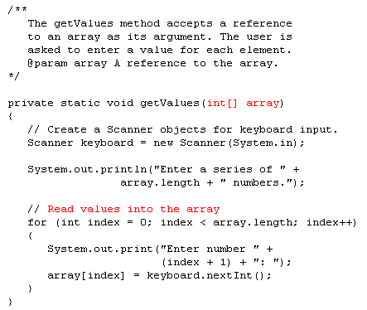
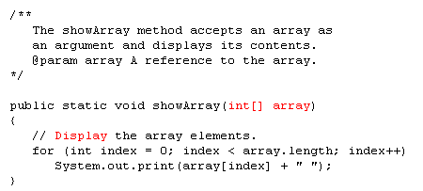

Slide 37
Comparing Arrays
The == operator determines only whether array references point to the same array object.
int[] firstArray = { 5, 10, 15, 20, 25 };
int[] secondArray = { 5, 10, 15, 20, 25 };
if (firstArray == secondArray) // This is a mistake.
System.out.println("The arrays are the same.");
else
System.out.println("The arrays are not the same.");

Slide 38
Comparing Arrays: Example
int[] firstArray = { 2, 4, 6, 8, 10 };
int[] secondArray = { 2, 4, 6, 8, 10 };
boolean arraysEqual = true;
int i = 0;
// First determine whether the arrays are the same size.
if (firstArray.length != secondArray.length)
arraysEqual = false;
// Next determine whether the elements contain the same data.
while (arraysEqual && i < firstArray.length)
{
if (firstArray[i] != secondArray[i])
arraysEqual = false;
i++;
}
if (arraysEqual)
System.out.println("The arrays are equal.");
else
System.out.println("The arrays are not equal.");

Slide 39
Useful Array Operations
Finding the Highest Value
int [] numbers = new int[50];
int highest = numbers[0];
for (int i = 1; i < numbers.length; i++)
{
if (numbers[i] > highest)
highest = numbers[i];
}
Finding the Lowest Value
int lowest = numbers[0];
for (int i = 1; i < numbers.length; i++)
{
if (numbers[i] < lowest)
lowest = numbers[i];
}

Slide 40
Useful Array Operations
Summing Array Elements:
int total = 0; // Initialize accumulator
for (int i = 0; i < units.length; i++)
total += units[i];
Averaging Array Elements:
double total = 0; // Initialize accumulator
double average; // Will hold the average
for (int i = 0; i < scores.length; i++)
total += scores[i];
average = total / scores.length;
Example: SalesData.java, Sales.java

Slide 41
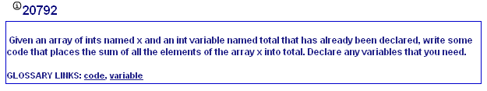
MyProgrammingLab6 – 7.4

Slide 42
Useful Array Operations
Check all elements and count the matches until you reach the end
public class Bank
{
private ArrayList<BankAccount> accounts;
public int count(double atLeast)
{
int matches = 0;
for (BankAccount account : accounts)
{
if (account.getBalance() >= atLeast) matches++; // Found a match
}
return matches;
}
. . .
}

Slide 43
Useful Array Operations
Locate the position of an element so that you can replace or remove it
Use a variation of the linear search algorithm
Example: Locate the position of the first element that is larger than 100:
int pos = 0;
boolean found = false;
while (pos < values.size() && !found)
{
if (values.get(pos) > 100) { found = true; }
else { pos++; }
}
if (found) { System.out.println("Position: " + pos); }
else { System.out.println("Not found"); }
Big Java by Cay Horstmann
Copyright © 2009 by John Wiley & Sons. All rights reserved.

Slide 44
Partially Filled Arrays
Typically, if the amount of data that an array must hold is unknown:
size the array to the largest expected number of elements.
use a counting variable to keep track of how much valid data is in the array.
…
int[] array = new int[100];
int count = 0;
…
System.out.print("Enter a number or -1 to quit: ");
number = keyboard.nextInt();
while (number != -1 && count <= 99)
{
array[count] = number;
count++;
System.out.print("Enter a number or -1 to quit: ");
number = keyboard.nextInt();
}
…
Could I use array.length to print out the values?
input, number and keyboard were previously declared and keyboard references a Scanner object

Slide 45
Arrays and Files
Saving the contents of an array to a file:
int[] numbers = {10, 20, 30, 40, 50};
PrintWriter outputFile =
new PrintWriter ("Values.txt");
for (int i = 0; i < numbers.length; i++)
outputFile.println(numbers[i]);
outputFile.close();

Slide 46
Arrays and Files
Reading the contents of a file into an array:
final int SIZE = 5; // Assuming we know the size.
int[] numbers = new int[SIZE];
int i = 0;
File file = new File ("Values.txt");
Scanner inputFile = new Scanner(file);
while (inputFile.hasNext() && i < numbers.length)
{
numbers[i] = inputFile.nextInt();
i++;
}
inputFile.close();

Slide 47
Returning an Array Reference
A method can return a reference to an array.
The return type of the method must be declared as an array of the right type.
public static double[] getArray()
{
double[] array = { 1.2, 2.3, 4.5, 6.7, 8.9 };
return array;
}
The getArray method is a public static method that returns an array of doubles.
See example: ReturnArray.java

Slide 48
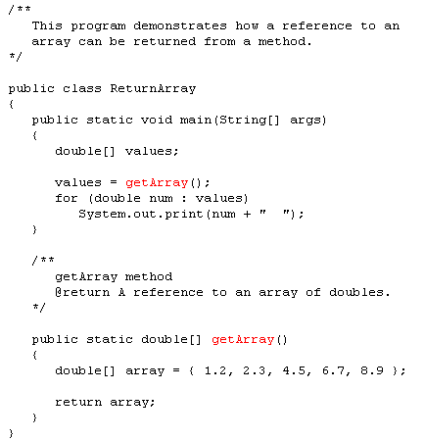

Slide 49
String Arrays
Arrays are not limited to primitive data.
An array of String objects can be created:
String[] names = { "Bill", "Susan", "Steven", "Jean" };
The names variable holds
the address to the array.
A String array is an array
of references to String objects.
Address
names[0]
address
“Bill”
Example: MonthDays.java
names[1]
address
“Susan”
names[2]
address
“Steven”
names[3]
address
“Jean”

Slide 50
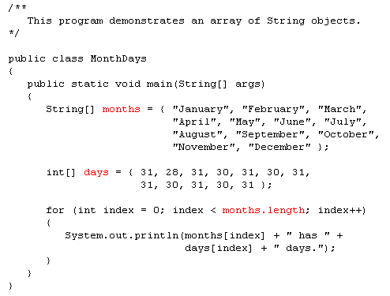

Slide 51
String Arrays
If an initialization list is not provided, the new keyword must be used to create the array: String[] names = new String[4];
The names variable holds
the address to the array.
Address
names[0]
null
names[1]
null
names[2]
null
names[3]
null

Slide 52
String Arrays
When an array is created in this manner, each element of the array must be initialized.
names[0] = "Bill";
names[1] = "Susan";
names[2] = "Steven";
names[3] = "Jean";
The names variable holds
the address to the array.
Address
names[0]
null
“Bill”
names[1]
null
“Susan”
names[2]
null
“Steven”
names[3]
null
“Jean”

Slide 53
Calling String Methods On Array Elements
String objects have several methods, including:
toUpperCase
compareTo
equals
charAt
Each element of a String array is a String object.
Methods can be used by using the array name and index as before.
System.out.println(names[0].toUpperCase());
char letter = names[3].charAt(0);

Slide 54
The length Field & The length Method
Arrays have a final field named length.
String objects have a method named length.
To display the length of each string held in a String array:
for (int i = 0; i < names.length; i++)
System.out.println(names[i].length());
An array’s length is a field
You do not write a set of parentheses after its name.
A String’s length is a method
You do write the parentheses after the name of the String class’s length method.

