Slide 1

Why Customers Leave, and How to Keep Them
Analytical CRM Analysis of Bank Customer Churn
Vivek Ajay Patil | Data Analyst · Tools: Excel · MySQL · Power BI

Slide 2

One in five customers has left, taking 185.59M with them
20.37%
185.59M
2,037
Churn Rate
Balance Lost
Customers Gone
2,037 of 10,000 customers have exited
24% of all balances (764.86M total)
Concentrated in Germany, age 50+, inactive members, 3–4 products
Customers | Lost | Churn Rate | Balance Lost
10,000 | 2,037 | 20.37% | 185.59M
Churn is concentrated — and because it is predictable, it is fixable.

Slide 3

The question we were asked
1
Context
The bank wants to reduce churn, improve service and raise customer satisfaction.
2
Data
Customer demographics, account details and exit status for 10,000 customers who joined 2016 to 2019.
3
Job 1
Find the key factors behind churn.
4
Job 2
Identify profitable segments and target them with tailored services.

Slide 4
How we reached the answer: three tools, one version of the truth
Excel
MySQL
Cleaned and prepared the data — 0 missing values, 0 duplicates.
Answered 26 objective and 14 subjective questions using joins, window functions and CTEs.
Power BI
One Data Fix
A 5-tab dashboard with DAX measures and slicers for interactive exploration.
735 customers were marked "active" but had already exited. Corrected — leaving 4,416 truly active members.

Slide 5
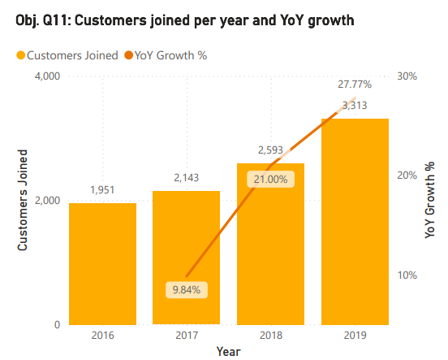
The bank is growing faster every year
Year | Customers Joined | Growth
2016 | 1,951 | n/a
2017 | 2,143 | +9.84%
2018 | 2,593 | +21.00%
2019 | 3,313 | +27.77%
Customers joining in 2019 are 70% more than in 2016. But growth only helps if customers stay.

Slide 6
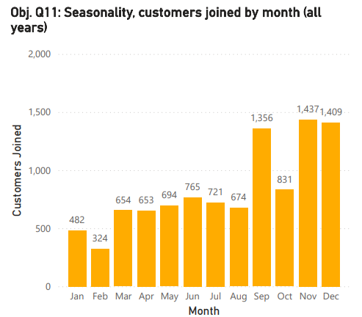

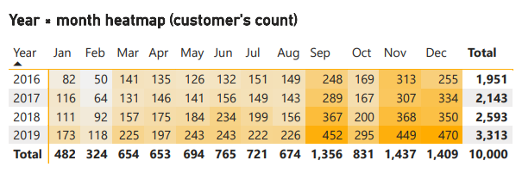
Most customers join in Q4, so that is when retention planning matters
Key Seasonal Insights
Q4 brings 3,677 joiners, against just 1,460 in Q1
Peak months: November 1,437 · December 1,409 · September 1,356
Lowest month: February — only 324 joiners
Peak-month joiners churn at 20.73% vs 20.11% in other months: more volume, not better loyalty
Plan onboarding and welcome offers for September to December.

Slide 7
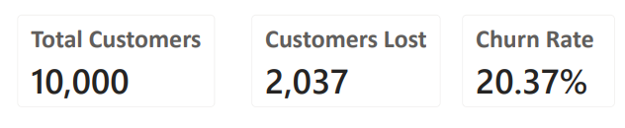
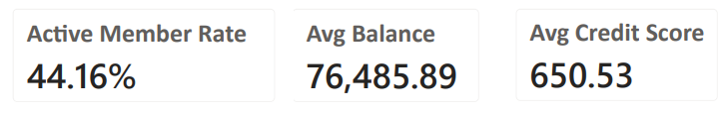
But one in five customers leaves — and the rate has not improved
Joining Year | Customers | Exited | Churn Rate
2016 | 1,951 | 376 | 19.27%
2017 | 2,143 | 479 | 22.35%
2018 | 2,593 | 524 | 20.21%
2019 | 3,313 | 658 | 19.86%
Every joining year sits between 19% and 22%. Growth has not changed churn — this is a structural problem, not a recent one.

Slide 8
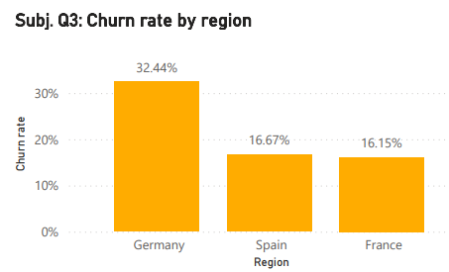
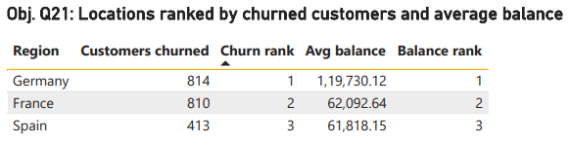
Where: Germany is 25% of customers, 40% of exits and 53% of the lost money
Region | Customers | Churn Rate | Exits | Avg Balance | Active Members
Germany | 2,509 | 32.44% | 814 | 119,730.12 | 37.94%
France | 5,014 | 16.15% | 810 | 62,092.64 | 45.73%
Spain | 2,477 | 16.67% | 413 | 61,818.15 | 47.27%
Salary and credit score are almost identical across all regions. The difference is engagement: Germany has the lowest active member share at 37.94%.

Slide 9
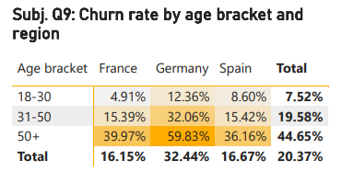

Who: older customers and women leave the most
Age Bracket | Customers | Churn Rate
18–30 | 1,968 | 7.52%
31–50 | 6,771 | 19.58%
50+ | 1,261 | 44.65%
Highest-risk group: women aged 50+ in Germany — 67.03% churn (182 customers). Exited customers are about 7 years older than those who stayed (44.8 vs 37.4).

Slide 10
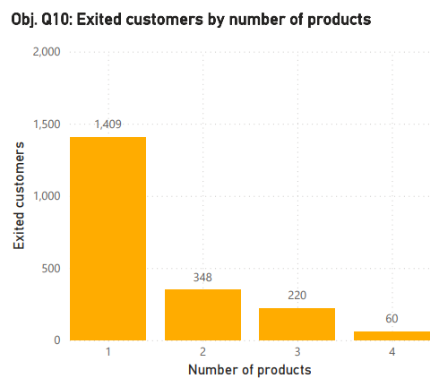
How: customer behaviour predicts churn better than demographics
Products Held | Customers | Churn Rate
1 | 5,084 | 27.71%
2 | 4,590 | 7.58%
3 | 266 | 82.71%
4 | 60 | 100.00%
Inactive members churn at 26.85% vs 14.27% for active members. One-product customers make up 69% of all exits (1,409 customers).

Slide 11
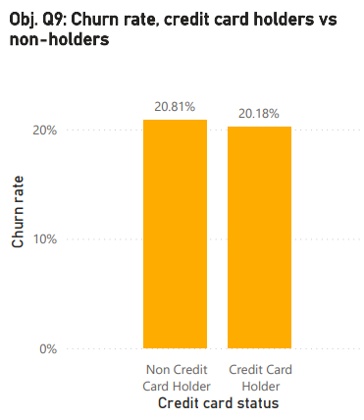
What does not predict churn: four common assumptions the data rejects
Factor | Churn Range | Verdict
Credit score band | 18.62% to 22.02% | Weak
Credit card ownership | 20.18% vs 20.81% | No effect
Tenure (3 to 7 years) | 19.14% to 21.91% | Not significant
Salary quartile | 19.80% to 21.56% | Not significant
Card rewards lower churn by only 1 to 4 points, even inside each risk tier. Do not target retention by salary, tenure or card ownership.

Slide 12
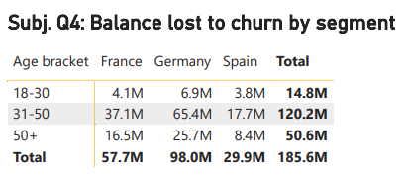
What it costs: we are losing our better customers
Segment | Churn Rate | Balance Lost
31–50, Germany | 32.06% | 65.43M
31–50, France | 15.39% | 37.07M
50+, Germany | 59.83% | 25.66M
31–50, Spain | 15.42% | 17.65M
50+, France | 39.97% | 16.51M
Exited customers held more than those who stayed: 91,109 vs 72,745 on average. Germany alone accounts for 97.97M of the 185.59M lost.

Slide 13
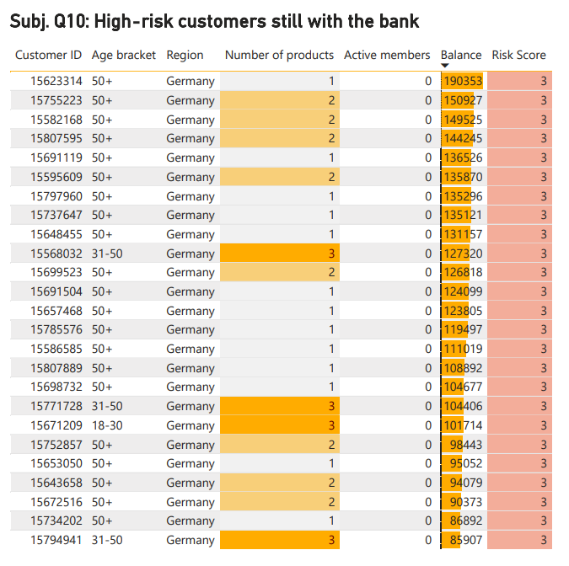

Who to call first: a simple risk score
Risk Score Logic
Score = 1 point each for:
3 or more products held
Inactive member status
Age over 50
Lives in Germany
Risk Level | Customers | Churn Rate
Low (0–1) | 8,120 | 13.42%
Medium (2) | 1,639 | 44.60%
High (3–4) | 241 | 89.63%
25 high-risk customers are still with the bank and hold 3.01M. Contact these 25 first.

Slide 14
Six actions, each tied to evidence
Action | Target Group | Evidence
1. Germany retention programme | 2,509 German customers | 32.44% churn, 53% of lost balance
2. Personal service for 50+ customers, especially women | 1,261 customers aged 50+ | 44.65% churn
3. Re-activate inactive members | Inactive members | 26.85% vs 14.27% churn
4. Fix the 3 to 4 product bundles | 326 customers | 82.71% and 100% churn
5. Cross-sell a second product | 5,084 one-product customers | 7.58% vs 27.71% churn
6. Early-warning risk score and call list | 25 high-risk customers (3.01M) | 89.63% churn

Slide 15


Start small, measure, then scale
KPI Baseline to Track
KPI | Baseline
Overall churn | 20.37%
Germany churn | 32.44%
Active member rate | 44.16%
Balance retained | Track monthly
60 Days
Launch Germany; run 50+ pilots with control groups
30 Days
90 Days
Call 25 high‑risk customers; refresh dashboard
Review churn by segment; scale successful pilots
Illustration: if Germany's churn fell to the France and Spain level (~16%), roughly 400 fewer customers would leave — about 20% of all exits.

Slide 16
What the data cannot tell us yet
No Exit Date or Reason
No Campaign Data
No Regional Economics
Reasons are inferred from patterns — no direct exit survey data available.
Marketing effectiveness cannot be measured without a campaign table.
GDP, unemployment and interest rates are absent — they may explain Germany's gap.
Data Quality Issue
Needed Next
735 contradictory records were found. A data-quality check is needed at the source.
Exit survey · campaign table · transaction history · regional economic data.

Slide 17

Four things to remember
The Scale
20.37% churn with 185.59M of balances lost — exited customers held more than those who stayed.
Where the Risk Sits
Germany · Age 50+ · Inactive members · Customers with 3 to 4 products.
What Doesn't Matter
Salary, tenure, credit score and card ownership do not explain churn. Don't target by these.
Act Now
Call the 25 high-risk customers today. Pilot a Germany programme and a 50+ programme with control groups.

Slide 18

Thank you.
Any Questions?
Vivek Ajay Patil | Data Analyst
Tools: Excel · MySQL · Power BI

