Slide 1
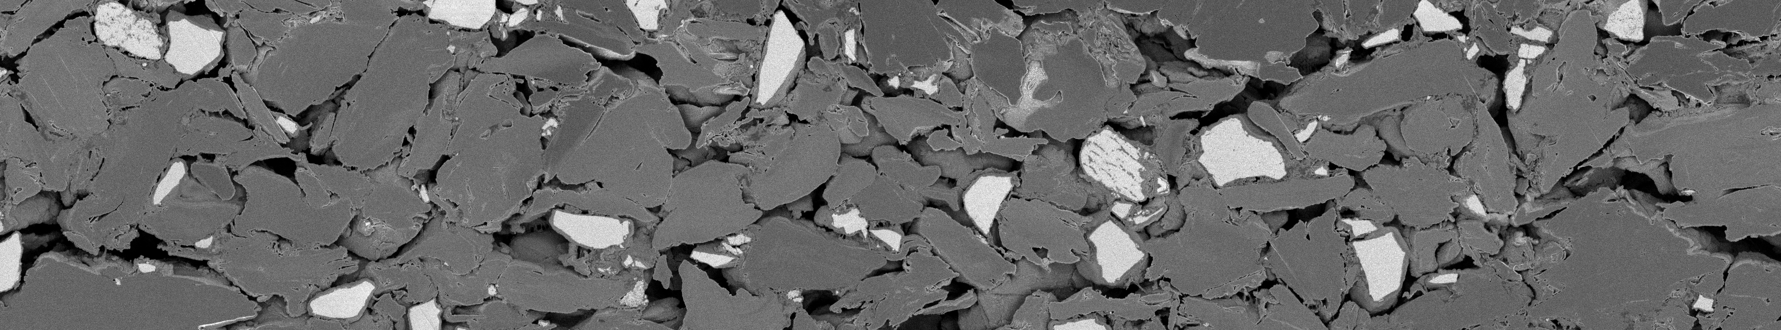
Do new anode batches match the approved one?
An explainable image-analysis pipeline for battery-electrode microscope photos
bright particle — assumed silicon-based
grey flake — assumed graphite
black gap — pore or crack
20 μm
Batch 3 · img_cfe5vt7s · BSE detector · 25 nm per pixel · brightness stretched for display (same 1st–99.5th percentile stretch the pipeline uses)
THE PROBLEM
THE DATA
WHAT IT PRODUCES
WHO COULD USE IT
Does a new delivery of anode coating match the approved Batch 3?
31 cross-section photos (7 + 7 + 17 locations), 3 detectors each
Pixel maps, 20 repeatable measurements, shifts vs Batch 3 with uncertainty
Quality and process engineers, and suppliers deciding what to re-check
What it can
do today
Image comparison: works
measured shifts come with intervals
Anomaly / batch call: not yet
single photos: 15 of 31 correct
Battery simulation: illustrative
optional, model-dependent branch
TeamJester · GitHub main @ 7f0048e (2026-10-04) · explainable SEM batch comparison
1 / 7
Notes:
WHAT TO SAY
This project asks a practical quality question: when a supplier delivers a new batch of anode coating for lithium-ion cells, does it look like the batch we already approved (Batch 3)? Today that judgement is made by eye from microscope photos. The TeamJester pipeline on GitHub main turns those photos into measured, explainable numbers and compares them with Batch 3. The photo is a real cross-section from Batch 3: dark-grey flakes, bright particles and black gaps. Be clear about what works today: comparing structure with uncertainty works; calling a batch from a single photo does not; the battery simulation is an optional illustration.
TERMS
- Anode: the negative electrode; here a coating of graphite flakes with silicon-containing particles (assumed from brightness).
- SEM / BSE: scanning electron microscope; the back-scattered-electron (BSE) detector shows heavier material brighter.
- Cross-section: the coating was cut and polished so we look at its inside.
- Batch 3 = "baseline": the supplier's promised reference; Batch 1 and Batch 2 are later deliveries.
HOW THE NUMBERS WERE OBTAINED
- 31 photos = rows with subset == full in analysis/outputs/tables/features.csv (7 Batch 1, 7 Batch 2, 17 Batch 3); 93 TIFF files = BSE + Inlens + ETD/SE per location (27 ETD, 4 SE).
- 25 nm per pixel: TIFF XResolution tags (segment_info.csv, um_per_px). Frames are 175 μm wide and 40–58 μm tall.
- 20 repeatable measurements: rows of baseline_stats.csv (out of 53 computed; the pruning rule is on slide 2).
- "15 of 31 correct": leave-one-out predictions in loo_predictions_allfeatures.csv (every photo held out once). Always answering "Batch 3" would score 55% (17/31) — so single-photo calls are not useful yet.
ASSUMPTIONS AND LIMITS
- "Bright = silicon-based, grey = graphite" is inferred from brightness only (main states this in every output); no chemical analysis (EDS) was done.
- The image is contrast-stretched for display with the same 1st-99.5th percentile stretch the pipeline uses; nothing else is altered.
- The photos are curated locations; we do not know how they were sampled from each batch.
SOURCES
- Repo README and analysis/NOTES.md at main @ 7f0048ed46715ca63223f5d5be98b50f406ba490: https://github.com/Augustin-Briens/TeamJester/blob/7f0048ed46715ca63223f5d5be98b50f406ba490/README.md
- Photo: Hackathon-Polaron/Batch_3/img_cfe5vt7s_BSE.tif (rows 450-1750 shown).
LIKELY QUESTION
Q: "So can it tell me whether a batch is good?"
A: Not on its own. It can tell you, with stated uncertainty, how a batch's measured structure differs from Batch 3, and it flags photos too poor to trust. It does not measure chemistry or performance, and its batch classifier is not yet reliable on single photos.
PROVENANCE (applies to every number on this slide)
Repository: https://github.com/Augustin-Briens/TeamJester (private; team access)
Branch/commit: main @ 7f0048ed46715ca63223f5d5be98b50f406ba490 (2026-10-04), inspected in a clean detached worktree; nothing from other branches, archived methods or local experiments is used.
Numbers: computed by src/deck_numbers.py from main's committed tables (analysis/outputs/tables/*); each one is listed with file, column and verification status in CLAIM_LEDGER.csv.
Verification: src/verify_main.py re-ran main's own code in a Python 3.10 environment matching main's .devin/blueprint.yaml — all 31 segmentations and all 54 committed feature columns reproduce exactly; baseline and leave-one-out tables reproduce exactly.

Slide 2
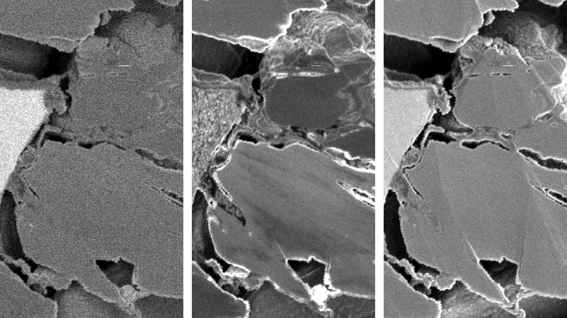
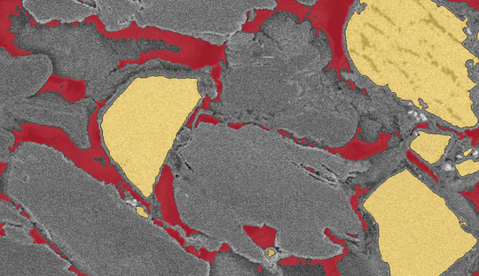
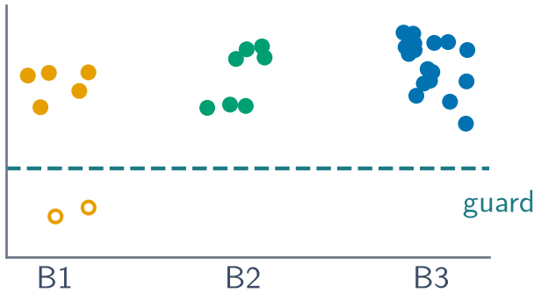
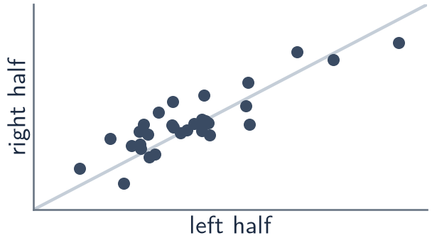
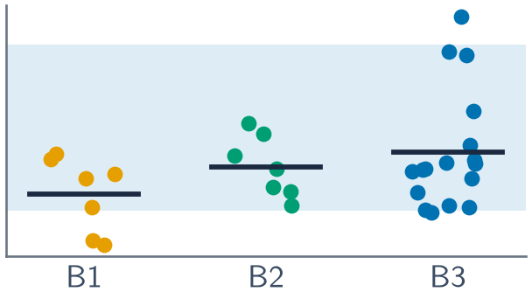
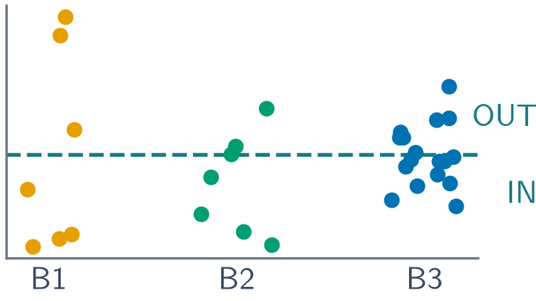
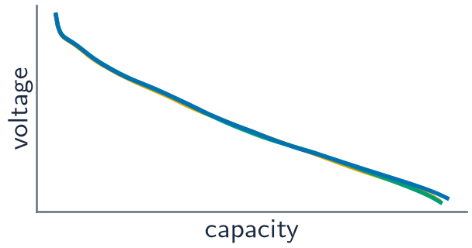
How the algorithm works
One fixed recipe, applied identically to every photo — six steps from picture to comparison
1
Read the images
2
Label the pixels
3
Check quality
4
Measure
5
Compare with Batch 3
6
Classify a sample
Three detectors photograph the same spot
Every pixel becomes pore, grey bulk or bright particle
Is the photo contrasty and clean enough to trust?
Turn the map into numbers; keep only repeatable ones
Is a shift bigger than normal photo-to-photo scatter?
Which batch does a new sample resemble most?
BSE · Inlens · ETD
cut-offs from each photo
2 of 31 photos flagged
53 computed → 20 kept
interval + corrected test
single photos: 15/31 right
measured from the pixels
statistics on those measurements
assumptions begin here
Assumption from step 2 on: bright = silicon-based, grey = graphite. This is read from brightness, not confirmed by chemical analysis (e.g. EDS).
Optional branch — a battery model
Image porosity, phase shares and particle sizes feed a published cell model (PyBaMM DFN); everything else is assumed.
TeamJester · GitHub main @ 7f0048e (2026-10-04) · explainable SEM batch comparison
2 / 7
Notes:
WHAT TO SAY
Walk left to right. (1) Each location is photographed by three detectors. (2) Every pixel is labelled pore, grey bulk or bright particle with one fixed recipe; the brightness cut-offs are read from each photo's own histogram. (3) Quality guards check contrast, noise, sharpness and shading; 2 photos fail (4ih2ggld, 5n1q8atc, both Batch 1). (4) The label map becomes 53 measurements; only those that agree between the left and right half of the same photo, and are not duplicates, are kept (20). (5) Batch 1 and Batch 2 are compared with Batch 3, asking whether a shift is bigger than normal photo-to-photo scatter. (6) A simple classifier says which batch a new sample is closest to. The dashed branch is a battery simulation that uses a few image numbers plus many assumptions. Steps 1-4 (teal bracket) are measurement; steps 5-6 add statistics on those measurements; in the dashed branch, assumptions dominate.
TERMS
- Detectors: BSE (composition contrast), Inlens (fine surface detail), ETD or SE (surface topography). Main uses Inlens only to refine fine cracks next to BSE pores, and texture features from Inlens/ETD.
- Quality guard: a fixed rule on an image property (e.g. bright-vs-grey contrast < 2.8 flags the photo).
- Repeatable: the value computed on the left half of a photo correlates with the right half (r >= 0.5 across photos).
- Centroid: the average of a batch's measurements; the classifier picks the nearest one.
HOW THE NUMBERS WERE OBTAINED (code -> step mapping, main @ 7f0048e)
1. analysis/common.py find_locations(), load_gray() (median of RGB, crop coloured marker stripes), pixel_size_um() (TIFF tags).
2. analysis/segment.py segment(): normalise() 1st-99.5th percentile + Gaussian sigma 1.5 px; thresholds() = 3-class multi-Otsu (bright valley search falls back to multi-Otsu on 31/31 photos); bright_particles() opening r=2, remove < 150 px, fill holes, watershed; pores_at() remove < 24 px; inlens_refine() adds Inlens-dark pixels within 2 px of a pore.
3. segment.py quality_guards() + GUARDS: contrast < 2.8, noise MAD > 11.2, sharpness > 11.0, shading > 55. Flagged photos stay in the data; results are reported with and without them.
4. features.py compute() (53 features), repeatability() (left/right halves segmented independently), prune(): drop if L/R r < 0.5, >50% missing/constant, or |r| > 0.9 with an already kept feature -> 20 kept.
5. baseline.py (Batch 3 median/MAD, 5-95% band) and deltas.py: mean shift, bootstrap 95% CI resampling photos, Mann-Whitney p, Holm correction over the 20 kept features; classes: different (CI excludes 0 and Holm p < 0.05), suggestive (CI excludes 0 only), equivalent (CI within +/-10% of the Batch 3 mean), undetermined.
6. categorise.py: top-6 features by separation, robust Mahalanobis distance to the Batch 3 envelope (IN/OUT at its 95th percentile) and nearest batch centroid with softmax "surety"; validated leave-one-out (15/31 correct; always-"Batch 3" = 55%; shuffled labels 35%).
Branch: dfn.py runs pybamm BasicDFNComposite with Chen2020_composite, setting porosity (measured, or 0.30), graphite/silicon volume shares and particle radii from the images; 30 resamples per batch at C/10, C/2, 1C, 2C. Electrode thickness, chemistry, Bruggeman exponent and all other parameters are assumed.
ASSUMPTIONS AND LIMITS
- Each photo is treated as one independent sample of its batch.
- Two documented reproduction issues on main (do not change the results shown): `run_all.py --clean` crashes because it deletes outputs/ after the folders were created; the DFN stage only re-runs when its output already exists (inverted check in run_all.stage_dfn).
SOURCES
- Pipeline driver: https://github.com/Augustin-Briens/TeamJester/blob/7f0048ed46715ca63223f5d5be98b50f406ba490/analysis/run_all.py
- Segmentation: https://github.com/Augustin-Briens/TeamJester/blob/7f0048ed46715ca63223f5d5be98b50f406ba490/analysis/segment.py#L105
- Feature gates: https://github.com/Augustin-Briens/TeamJester/blob/7f0048ed46715ca63223f5d5be98b50f406ba490/analysis/features.py#L755
- Comparison classes: https://github.com/Augustin-Briens/TeamJester/blob/7f0048ed46715ca63223f5d5be98b50f406ba490/analysis/deltas.py#L65
- Classifier: https://github.com/Augustin-Briens/TeamJester/blob/7f0048ed46715ca63223f5d5be98b50f406ba490/analysis/categorise.py
- Simulation: https://github.com/Augustin-Briens/TeamJester/blob/7f0048ed46715ca63223f5d5be98b50f406ba490/analysis/dfn.py; Chen et al. (2020) Development of experimental techniques for parameterization of multi-scale lithium-ion battery models. J. Electrochem. Soc. 167, 080534. https://doi.org/10.1149/1945-7111/ab9050; Sulzer et al. (2021) Python Battery Mathematical Modelling (PyBaMM). J. Open Res. Softw. 9, 14. https://doi.org/10.5334/jors.309
LIKELY QUESTION
Q: "Is this machine learning?"
A: No black box. Every step is a fixed, inspectable rule (thresholds, morphology, distances). The only fitted parts are averages and spreads of the measurements, and the classifier is a nearest-average rule. That makes it explainable, but it also means it can only be as good as the brightness labels and the small number of photos.
BUILD-STATE CAVEAT (from-scratch rebuild of main's code, provenance/clean_rebuild_summary.json)
Re-running run_all.py at this commit on an empty outputs/ folder reproduces every segmentation table and all committed feature columns exactly, and every % shift and class of the 20 committed markers. However, the current features.py also computes 12 newer columns that the committed features.csv lacks; 8 of them pass main's gates, so a fresh build keeps 28 markers instead of 20. The classifier numbers then change: all-features 15/31 correct (committed 15/31), artefact-safe 20/31 (committed 13/31), held-out Batch 3 called OUT 8/17, shuffled-label control 38%; Holm survivors become: Batch 1 bse_bulk_texture; Batch 1 inl_lbp_flat; Batch 2 bse_bulk_texture. The deck reports the committed run (the tables main's webapp loads); treat classifier accuracy as UNRESOLVED — it depends on the build state — while the structural markers are robust to it.
PROVENANCE (applies to every number on this slide)
Repository: https://github.com/Augustin-Briens/TeamJester (private; team access)
Branch/commit: main @ 7f0048ed46715ca63223f5d5be98b50f406ba490 (2026-10-04), inspected in a clean detached worktree; nothing from other branches, archived methods or local experiments is used.
Numbers: computed by src/deck_numbers.py from main's committed tables (analysis/outputs/tables/*); each one is listed with file, column and verification status in CLAIM_LEDGER.csv.
Verification: src/verify_main.py re-ran main's own code in a Python 3.10 environment matching main's .devin/blueprint.yaml — all 31 segmentations and all 54 committed feature columns reproduce exactly; baseline and leave-one-out tables reproduce exactly.

Slide 3
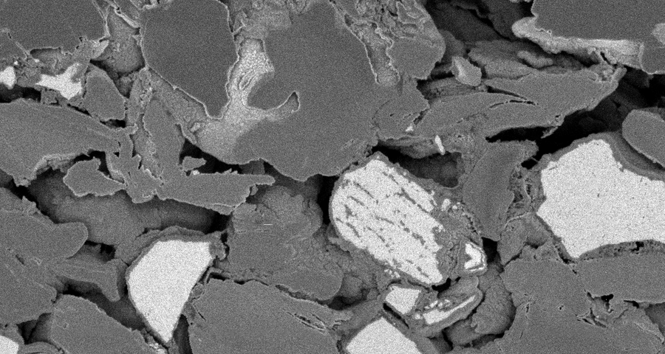
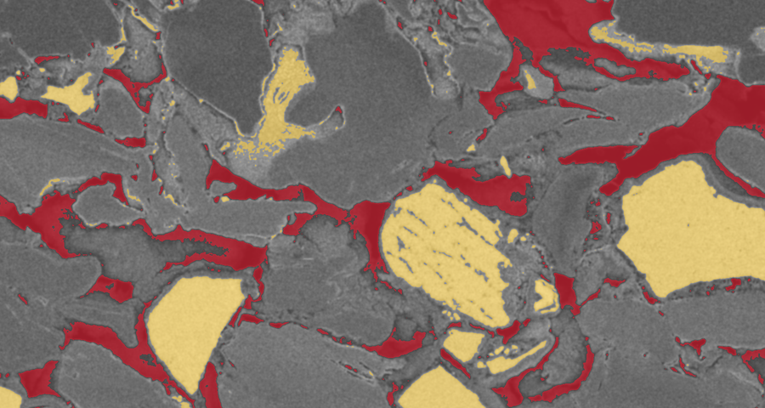
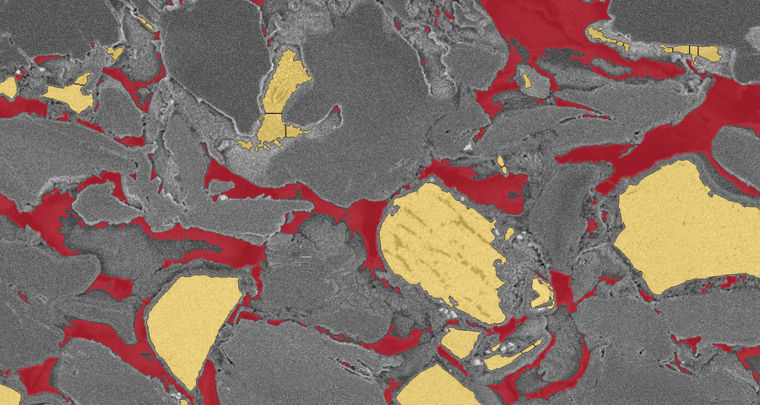
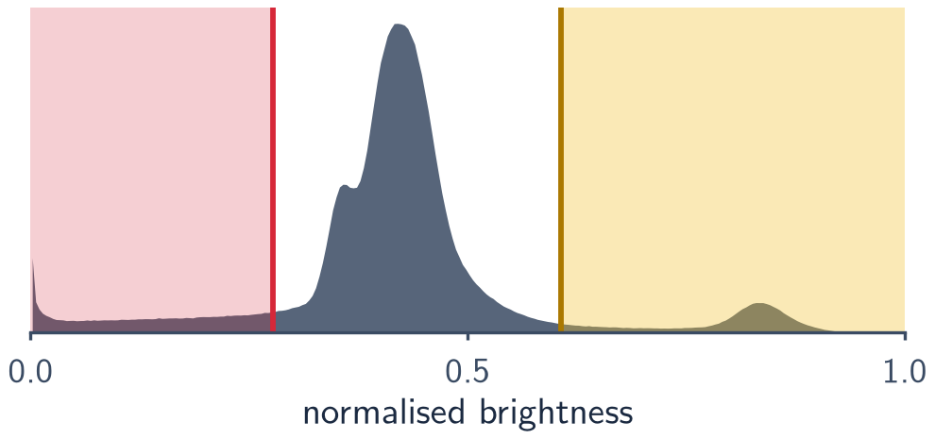
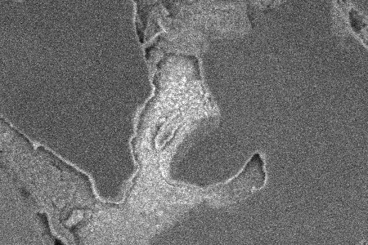
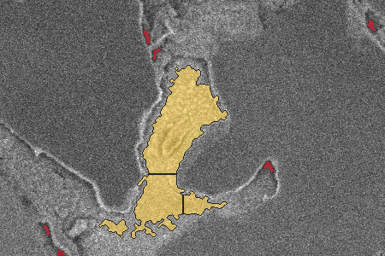
How we segment the images
One recipe for every photo; the cut-offs come from each photo's own brightness histogram
1 · Original photo (BSE)
2 · Brightness cut-offs, before clean-up
3 · Final labels
pore
bright particle
split line
10 μm
Batch 3 · img_cfe5vt7s
pore / crack (dark)
bright particle — assumed silicon-based
grey bulk — assumed graphite
particle outline (watershed)
What the recipe does
1 Stretch & smooth: 1st–99.5th percentile, 1.5-px blur
2 Two cut-offs: darkest group → pore, brightest → particle
3 Clean up: drop specks, fill holes, add Inlens cracks
4 Split touching particles: watershed on distance to edge
Why: transparent, no training, same settings for all photos
This photo's histogram
Close-up: an ambiguous object
pore cut 0.277 · bright cut 0.607
Textured light-grey object: only partly labelled bright, and split into 4 ‘particles’.
Main limitation: brightness is not chemistry — ‘bright = silicon’ is unconfirmed, low-contrast photos inflate the bright class, and gaps under ~50 nm (2 px) are invisible.
TeamJester · GitHub main @ 7f0048e (2026-10-04) · explainable SEM batch comparison
3 / 7
Notes:
WHAT TO SAY
Same patch of a Batch 3 photo, three times. Left: the photo as the BSE detector sees it. Middle: the two brightness cut-offs applied directly — red is darker than the pore cut, gold brighter than the bright cut. You can see why clean-up is needed: thin bright rims on flake edges and tiny specks would be counted as particles. Right: the final labels after removing specks, filling holes and splitting touching particles (dark outlines). The close-up shows an honest ambiguous case: a textured light-grey object is only partly called bright and gets cut into 4 pieces. The main limitation is that brightness is not chemistry.
TERMS
- Histogram: how many pixels have each brightness.
- Multi-Otsu: an automatic rule that splits the histogram into three groups so each group is as uniform as possible (Otsu 1979; 3-class version in scikit-image).
- Watershed: treats each particle like a landscape (distance to its edge) and draws split lines along the valleys between touching particles.
- Inlens refinement: the Inlens detector sees fine cracks better; dark Inlens pixels within 2 px of a BSE pore are added to the pore class.
HOW THE NUMBERS WERE OBTAINED
- Panels: Batch_3/img_cfe5vt7s_BSE.tif, region x 3500-5000, y 600-1400 px (37.5 x 20 um). Panel 2 = main's normalise() output with this photo's committed cut-offs (segment_info.csv: t_lo = 0.277, t_bright = 0.607); panel 3 = main's committed masks (analysis/outputs/masks/Batch_3_cfe5vt7s_masks.npz), which src/verify_main.py reproduced pixel-for-pixel.
- Per-photo cut-offs: the bright "valley" search never finds a separate bright peak, so the upper multi-Otsu cut is used on 31/31 photos (segment_info.csv, bright_method).
- Robustness (threshold_sensitivity.csv, median over photos): shifting the pore cut by -10%/+10% changes the pore fraction by -12%/+13%; shifting the bright cut by -10%/+10% changes the bright fraction by +23%/-10%. Repeatability (left vs right half, repeatability.csv): pore fraction r = 0.87, bright fraction r = 0.74.
- Human check: analysis/outputs/pointcount/point_count_validation.xlsx has 300 random points with crops, but 0 human labels — segmentation accuracy against an expert is therefore UNAVAILABLE.
ASSUMPTIONS AND LIMITS
- Bright = silicon-based and grey = graphite are assumptions from appearance (main's standing assumption). There is no separate class for binder, coatings or "other", so anything bright enough is counted as particle.
- Because cut-offs adapt to each photo, a photo with weak contrast pushes grey material into the bright class: the two flagged Batch 1 photos read 16.9% and 18.4% bright versus 4.5–9.7% for the other 29.
- Pixels are 25 nm; pores narrower than ~2 px (50 nm) and objects below the size filters are not measured, so visible porosity (~10%) understates true porosity.
- Watershed can over-split irregular particles (close-up), which lowers sizes and raises counts.
SOURCES
- https://github.com/Augustin-Briens/TeamJester/blob/7f0048ed46715ca63223f5d5be98b50f406ba490/analysis/segment.py#L105
- Settings: https://github.com/Augustin-Briens/TeamJester/blob/7f0048ed46715ca63223f5d5be98b50f406ba490/analysis/common.py#L50
- Otsu (1979) A threshold selection method from gray-level histograms. IEEE Trans. SMC 9, 62-66. https://doi.org/10.1109/TSMC.1979.4310076
LIKELY QUESTION
Q: "How do you know the labels are right?"
A: We know they are stable — re-running main's code reproduces every mask exactly, left and right halves agree, and +/-10% threshold changes move fractions by about 10-25% in relative terms. We do not yet know they are correct: the 300-point expert check sheet in the repo is still empty, and nobody has confirmed with chemical analysis that bright means silicon.
PROVENANCE (applies to every number on this slide)
Repository: https://github.com/Augustin-Briens/TeamJester (private; team access)
Branch/commit: main @ 7f0048ed46715ca63223f5d5be98b50f406ba490 (2026-10-04), inspected in a clean detached worktree; nothing from other branches, archived methods or local experiments is used.
Numbers: computed by src/deck_numbers.py from main's committed tables (analysis/outputs/tables/*); each one is listed with file, column and verification status in CLAIM_LEDGER.csv.
Verification: src/verify_main.py re-ran main's own code in a Python 3.10 environment matching main's .devin/blueprint.yaml — all 31 segmentations and all 54 committed feature columns reproduce exactly; baseline and leave-one-out tables reproduce exactly.

Slide 4
The markers that matter — and what we can conclude
Five of the 20 retained measurements, chosen for reliability and physical relevance
Marker (plain English) | What the image measurement tells us | Why it might matter for a battery | What we can actually conclude
Visible pore space pore_frac | Share of the section that is dark: gaps wider than ~50 nm | Pores carry the electrolyte: more pore space speeds ion transport but stores less energy per volume [1] | Tentative. Batch 1 is −14% vs Batch 3 (interval excludes zero, not significant after correction). Batch 2: no detected difference.
Bright-particle share silicon_frac | Share of bright particles — assumed silicon-based, not chemically confirmed | Silicon holds ~10× more lithium per gram than graphite but swells up to ~280% [2] | No difference detected once two low-contrast Batch 1 photos are set aside (−2%); with them Batch 1 reads +45%.
Bright-particle size si_d50_um | Median diameter of the bright particles in a photo (equal-area circle) | Smaller particles crack less when they swell [3] but expose more surface to side reactions [4] | Undetermined: Batch 3 averages 0.76 μm; Batch 1 −15%, Batch 2 −12%, both within the noise. A 2-D cut understates true size.
Pore space next to particles ring_porosity_250nm | Pore share of a 250-nm shell around each bright particle | Nearby voids can absorb swelling and let electrolyte in [5]; too much may weaken contact | No difference detected: 8–10% on average in every batch.
Graphite flake alignment gr_chord_ratio_hv | Horizontal vs vertical run length through the grey flakes | Flat-lying flakes lengthen the ion path through the coating thickness [6,7] | Shared feature: about 1.2 in every batch (flakes ~20% wider than tall); equivalent within ±10%.
Comparisons: mean shift vs Batch 3 with a bootstrap 95% interval, Mann–Whitney test, Holm correction over 20 markers; 7 vs 17 photos. Variable names link to their definitions in main.
[1] Singh et al. 2016 [2] Obrovac & Chevrier 2014 [3] Liu, X. H. et al. 2012 [4] Wu & Cui 2012 [5] Liu, N. et al. 2012 [6] Ebner et al. 2014 [7] Billaud et al. 2016
TeamJester · GitHub main @ 7f0048e (2026-10-04) · explainable SEM batch comparison
4 / 7
Notes:
WHAT TO SAY
These five are the markers I would show anyone first. They were picked because they are repeatable on main, have a clear physical meaning, and together describe composition, size, contact and arrangement — not because they show the biggest batch differences. Read the last column carefully: only one is even tentatively different (Batch 1's lower visible pore space), two show no detected difference, one is undetermined, and one is a solid shared feature. Every battery effect in the third column is conditional: "might matter", with trade-offs in both directions.
TERMS
- Pore / porosity: empty space between solids, normally filled with liquid electrolyte in a cell.
- Equal-area diameter: the diameter of a circle with the same area as the particle's cut.
- Run length (chord): length of an uninterrupted straight line through one phase.
- Interval (bootstrap 95%): range of plausible mean shifts from re-sampling the photos.
- Holm correction: makes the significance test stricter because 20 markers are tested per batch.
- Tentative / suggestive: interval excludes zero but the corrected test is not significant. Undetermined: interval includes zero and is too wide to call the batches equivalent. Equivalent: interval within +/-10% of the Batch 3 mean.
HOW THE NUMBERS WERE OBTAINED (exact variables, main @ 7f0048e)
- pore_frac (features.py): pore pixels / all pixels; Batch 3 mean 11.4%; Batch 1 −14% (deltas.csv: CI [-0.0306, -0.00262], Mann-Whitney p = 0.166, Holm p = 1.000, class suggestive); Batch 2 −5% (undetermined). Repeatability r = 0.87.
- silicon_frac: bright pixels / all pixels. Batch 1 +45% with all 7 photos (undetermined), −2% without the 2 flagged photos (deltas_noflag.csv, undetermined). r = 0.74.
- si_d50_um: median (number-weighted) equal-area diameter of watershed particles per photo; Batch 3 mean 0.763 um; Batch 1 −15%, Batch 2 −12% (both undetermined). r = 0.70. Main removed si_d10_um because 2-D cuts through packed particles create a ~0.37 um floor.
- ring_porosity_250nm: pore fraction of the 10-px (~250 nm) shell around all bright particles; batch means 9.6% / 8.2% / 8.4% (B1/B2/B3); classes undetermined / undetermined. r = 0.68.
- gr_chord_ratio_hv: mean horizontal / mean vertical run length through the grey phase; means 1.187 / 1.187 / 1.200; both comparisons equivalent. r = 0.61.
- Not prioritised but available: pores_per_mm2 (pore count density; Batch 1 +11%, undetermined; Batch 2 −1%, equivalent). Counts depend on resolution and on the 24-px minimum pore size, so compare them only between photos taken with the same settings. Pore orientation (pore_anisotropy) was dropped by main's own repeatability gate (r = 0.48 < 0.5).
ASSUMPTIONS AND LIMITS
- With 7 photos per batch, real differences of about one Batch 3 standard deviation can sit in "undetermined" (main lists the minimum detectable difference per marker in deltas.csv, column mdd).
- Everything is a 2-D section: sizes, contact and alignment are section statistics, not 3-D measurements.
- Battery effects are literature mechanisms, not measured on these electrodes.
SOURCES (full references; the bracket numbers on the slide are clickable DOIs)
[1] Singh, Kaiser & Hahn (2016) Effect of porosity on the thick electrodes for high energy density lithium ion batteries for stationary applications. Batteries 2, 35. https://doi.org/10.3390/batteries2040035
[2] Obrovac & Chevrier (2014) Alloy negative electrodes for Li-ion batteries. Chem. Rev. 114, 11444-11502. https://doi.org/10.1021/cr500207g
[3] Liu, X. H. et al. (2012) Size-dependent fracture of silicon nanoparticles during lithiation. ACS Nano 6, 1522-1531. https://doi.org/10.1021/nn204476h (crystalline Si particles below ~150 nm did not fracture on first lithiation)
[4] Wu & Cui (2012) Designing nanostructured Si anodes for high energy lithium ion batteries. Nano Today 7, 414-429. https://doi.org/10.1016/j.nantod.2012.08.004
[5] Liu, N. et al. (2012) A yolk-shell design for stabilized and scalable Li-ion battery alloy anodes. Nano Lett. 12, 3315-3321. https://doi.org/10.1021/nl3014814 (engineered void space lets Si expand)
[6] Ebner, Chung, Garcia & Wood (2014) Tortuosity anisotropy in lithium-ion battery electrodes. Adv. Energy Mater. 4, 1301278. https://doi.org/10.1002/aenm.201301278
[7] Billaud et al. (2016) Magnetically aligned graphite electrodes for high-rate performance Li-ion batteries. Nature Energy 1, 16097. https://doi.org/10.1038/nenergy.2016.97
Definitions: https://github.com/Augustin-Briens/TeamJester/blob/7f0048ed46715ca63223f5d5be98b50f406ba490/analysis/features.py ; comparison rule: https://github.com/Augustin-Briens/TeamJester/blob/7f0048ed46715ca63223f5d5be98b50f406ba490/analysis/deltas.py#L65
LIKELY QUESTION
Q: "Is more pore space good or bad?"
A: Neither by itself. More pore space usually helps ions move (better fast charging and discharging) but leaves less room for active material, so the cell stores less energy per volume. The right amount depends on the cell design — which is why we report the shift and its uncertainty, not a verdict.
PROVENANCE (applies to every number on this slide)
Repository: https://github.com/Augustin-Briens/TeamJester (private; team access)
Branch/commit: main @ 7f0048ed46715ca63223f5d5be98b50f406ba490 (2026-10-04), inspected in a clean detached worktree; nothing from other branches, archived methods or local experiments is used.
Numbers: computed by src/deck_numbers.py from main's committed tables (analysis/outputs/tables/*); each one is listed with file, column and verification status in CLAIM_LEDGER.csv.
Verification: src/verify_main.py re-ran main's own code in a Python 3.10 environment matching main's .devin/blueprint.yaml — all 31 segmentations and all 54 committed feature columns reproduce exactly; baseline and leave-one-out tables reproduce exactly.

Slide 5
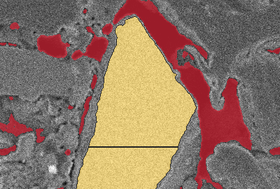
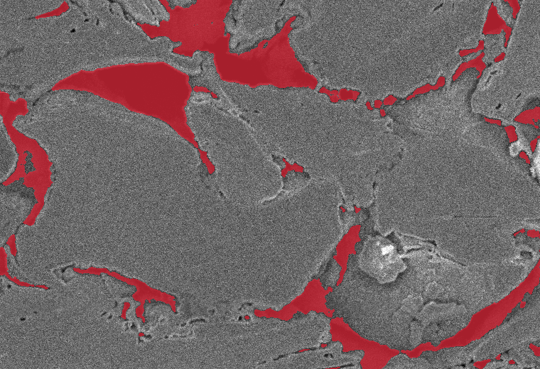
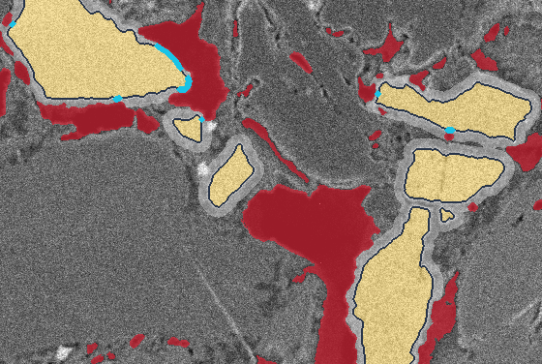
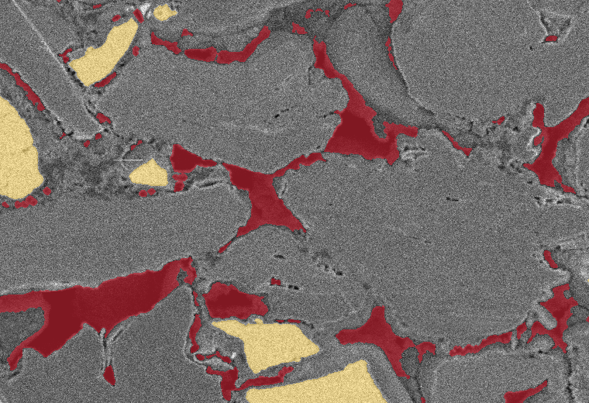
What these markers look like
One typical Batch 3 photo (img_cfe5vt7s) · all outlines are algorithm labels, none expert-confirmed
Particle size
Visible pore space
MAIN METRIC
MAIN METRIC
d = 3.81 μm
diameter of a circle with the same area as this particle's cut
Photo median over 327 particles: 0.66 μm — many small ones pull it down.
10.8%
of this photo's area is pore
Red = darker than the pore cut-off: gaps wider than ~50 nm. Finer pores are invisible.
pore
d = 3.81 μm
2 μm
5 μm
edge within 75 nm of a pore
Particle–pore contact
Flake alignment
2 MAIN METRICS + 2 DERIVED
MAIN METRIC
23% of particles touch a pore (derived)
49% of bright area is in them (derived)
1.7% of particle edge touches a pore (main)
8.6% of a 250-nm shell is pore (main)
ratio 1.21
mean run across 3.75 μm vs down 3.09 μm
Runs through the grey flakes are longer sideways: the flakes lie flat.
5 μm
5 μm
‘Contact’ here is a 2-D distance in one section (edge within 75 nm of a pore) — not wetting, electrical contact or electrochemical activity. Main = a metric computed by main; derived = computed for this slide from main's per-particle table.
TeamJester · GitHub main @ 7f0048e (2026-10-04) · explainable SEM batch comparison
5 / 7
Notes:
WHAT TO SAY
Here is what four of the markers literally measure, on one ordinary Batch 3 photo. Top left: one particle outlined, with the circle of equal area — its diameter is the size number; the photo's median is smaller because there are many tiny particles. Top right: everything red is "visible pore"; 10.8% of this photo. Bottom left: contact. I show four different numbers from the same photo on purpose — share of particles that touch a pore, share of area in those particles, share of particle edge next to a pore, and the pore share of a thin shell around particles. They answer different questions, so we should never say "contact" without saying which one. Bottom right: lines through the grey flakes are longer sideways than up-and-down, so the flakes lie flat. All of this is algorithm output; nobody has hand-checked these outlines yet.
TERMS
- Equal-area diameter: diameter of a circle whose area equals the particle's cut area.
- Shell (ring): the band within 10 pixels (~250 nm) outside every bright particle.
- Contact (here): a particle edge pixel within 3 pixels (75 nm) of a pore pixel in this 2-D section. It is not proof of electrolyte wetting, of an electrical connection, or of electrochemical activity.
- Run length: an uninterrupted straight line through the grey phase, measured row by row (across) or column by column (down).
HOW THE NUMBERS WERE OBTAINED
- Particle: watershed label 188 of img_cfe5vt7s; diam_um = 3.813 um in analysis/outputs/tables/particles.csv; outline traced from the committed label mask. Photo median si_d50_um = 0.6567 um over 327 particles (features.csv).
- Pore space: pore_frac = 0.1078 (features.csv). The crop shown has 12.7% pore.
- Contact, main metrics: si_border_pore = 0.0166 (share of bright-mask edge pixels within 3 px of a pore; exp_newfeat.csv — passed main's gates but is not in the 20-marker decision set); ring_porosity_250nm = 0.0856 (features.csv, a retained marker). Contact, illustration only: 23% of particles and 49% of particle area have min distance to a pore <= 3 px (column d_min_px of main's particles.csv) — these two shares are derived for this deck and are not main features. The drawn cyan/navy edge colouring was recomputed from the committed masks with main's definition and reproduces si_border_pore exactly.
- Alignment: gr_chord_h_um = 3.750 um, gr_chord_v_um = 3.093 um, ratio gr_chord_ratio_hv = 1.213 (features.csv; mean over ALL runs in the photo — the drawn lines are a few sample runs from the committed grey mask).
ASSUMPTIONS AND LIMITS
- Why this photo: Batch_3 photo with the 2nd-smallest mean robust |z| over the five slide-4 markers (rank 2 of 17); chosen over rank 1 (pl8uabbv) for clearer particles in the display crop. Other photos differ.
- Particle sizes and contact are 2-D section statistics; watershed splitting changes counts and sizes.
- Annotations (outline, circle, arrows, run lines) are editable PowerPoint shapes; tints are baked into the image.
SOURCES
- https://github.com/Augustin-Briens/TeamJester/blob/7f0048ed46715ca63223f5d5be98b50f406ba490/analysis/features.py#L383
- si_border_pore definition: https://github.com/Augustin-Briens/TeamJester/blob/7f0048ed46715ca63223f5d5be98b50f406ba490/analysis/features.py#L587
- ring porosity definition: https://github.com/Augustin-Briens/TeamJester/blob/7f0048ed46715ca63223f5d5be98b50f406ba490/analysis/features.py#L131
LIKELY QUESTION
Q: "Only 1.7% of the edge touches a pore, but 23% of particles touch one — which is right?"
A: Both. Most particles that touch a pore do so along a tiny part of their edge, so the share of edge is small while the share of particles is larger. That is exactly why we never report "contact" without saying which quantity it is.
PROVENANCE (applies to every number on this slide)
Repository: https://github.com/Augustin-Briens/TeamJester (private; team access)
Branch/commit: main @ 7f0048ed46715ca63223f5d5be98b50f406ba490 (2026-10-04), inspected in a clean detached worktree; nothing from other branches, archived methods or local experiments is used.
Numbers: computed by src/deck_numbers.py from main's committed tables (analysis/outputs/tables/*); each one is listed with file, column and verification status in CLAIM_LEDGER.csv.
Verification: src/verify_main.py re-ran main's own code in a Python 3.10 environment matching main's .devin/blueprint.yaml — all 31 segmentations and all 54 committed feature columns reproduce exactly; baseline and leave-one-out tables reproduce exactly.

Slide 6
The key measurements, photo by photo
One dot per photo (one imaged location) · lines = batch medians · light diamonds = flagged by the quality guard
A · Visible pore space
B · Bright-particle share
C · Image noise level
Batch 1
n = 7
Batch 2
n = 7
Batch 3
n = 17
Batch 1
n = 7
Batch 2
n = 7
Batch 3
n = 17
Batch 1
n = 7
Batch 2
n = 7
Batch 3
n = 17
Batch 1 sits lower on average (−14% vs Batch 3), but its photos overlap Batch 3's: a tentative shift.
Two low-contrast Batch 1 photos read 16.9% and 18.4%; the other 29 lie between 4.5–9.7%. Without them, no batch differs.
Batch 1 and 2 photos are noisier than most Batch 3 photos. Texture, the one marker passing the corrected test, follows this noise (r = 0.91).
Imaging is entangled with batch: 12 of the 17 Batch 3 photos were taken at lower noise than any Batch 1 or 2 photo, so batch and microscope-settings differences cannot be fully separated.
TeamJester · GitHub main @ 7f0048e (2026-10-04) · explainable SEM batch comparison
6 / 7
Notes:
WHAT TO SAY
Three panels, one dot per photo. A: visible pore space — Batch 1 is a little lower on average, but its dots overlap Batch 3's, which is why we call it tentative. B: bright-particle share — the two light diamonds are the photos the quality guard flagged; they alone create Batch 1's apparent +45%; the other 29 photos all sit in the same range. C: image noise — every Batch 1 and Batch 2 photo is at the upper noise levels, while most Batch 3 photos are cleaner. The one marker that survives the strict test, grey-level texture, rises with exactly this noise. That is the most important caveat on this dataset: some batch differences may be microscope-settings differences.
TERMS
- Median line: the middle value of the batch's photos.
- Image noise: main's quality guard noise_mad — the spread of fine pixel-to-pixel fluctuations inside the grey bulk (median absolute deviation x 1.4826, in grey levels). It takes only a few distinct values: Batch 1 [10.38, 11.86], Batch 2 [10.38], Batch 3 [7.41, 8.9, 10.38].
- Grey-bulk texture: bse_bulk_texture — standard deviation of BSE grey level inside the grey (graphite) class.
- r: Pearson correlation over the 31 photos.
HOW THE NUMBERS WERE OBTAINED
- Data: features.csv (subset == full) joined to quality_guards.csv; exported as provenance/slide6_data.csv. The charts are native, editable PowerPoint charts built from that file (right-click > Edit Data). Each photo has its own slot inside its batch group (order shuffled with a fixed seed), so the horizontal position inside a batch has no meaning; blank cells are gaps.
- Panel A: Batch 1 mean shift −13.6% (suggestive; interval [-0.0306, -0.00262], Holm p 1.000).
- Panel B: flagged photos 4ih2ggld, 5n1q8atc read 16.9% and 18.4%; unflagged range 4.5–9.7%. Batch 1 shift +45% with flagged photos, −2% without (both undetermined).
- Panel C: noise_mad per photo (quality_guards.csv). The texture link: r(bse_bulk_texture, noise_mad) = 0.91; texture shift Batch 1 +18% (Holm p 0.005), Batch 2 +15% (Holm p 0.022). Main itself labels bse_bulk_texture and etd_roughness "artefact-risk" (|r| with noise > 0.7) and excludes them from its artefact-safe classifier. Other noise correlations: inlens_edge_density r = 0.89, etd_roughness r = 0.88, pore_frac r = -0.29.
- Observation unit: one photo = one imaged location; n = 7 / 7 / 17. No error bars are drawn because the photos within a batch may not be independent samples of the batch.
ASSUMPTIONS AND LIMITS
- We do not know how the locations were chosen or whether some photos come from the same piece of electrode; frame heights also differ (1612–2316 px), which hints at different acquisition sessions (not analysed on main).
- The noise measure is coarse (4 distinct values), so panel C shows dots on a few levels only.
SOURCES
- https://github.com/Augustin-Briens/TeamJester/blob/7f0048ed46715ca63223f5d5be98b50f406ba490/analysis/segment.py#L218
- Artefact-risk rule: https://github.com/Augustin-Briens/TeamJester/blob/7f0048ed46715ca63223f5d5be98b50f406ba490/analysis/categorise.py#L37
LIKELY QUESTION
Q: "So is Batch 1 different or not?"
A: Not established. Its pore space is slightly lower on average, but that does not survive the correction for testing 20 markers, the photos overlap, and Batch 1 was photographed under noisier conditions. The honest call is "tentative — re-image under matched settings".
PROVENANCE (applies to every number on this slide)
Repository: https://github.com/Augustin-Briens/TeamJester (private; team access)
Branch/commit: main @ 7f0048ed46715ca63223f5d5be98b50f406ba490 (2026-10-04), inspected in a clean detached worktree; nothing from other branches, archived methods or local experiments is used.
Numbers: computed by src/deck_numbers.py from main's committed tables (analysis/outputs/tables/*); each one is listed with file, column and verification status in CLAIM_LEDGER.csv.
Verification: src/verify_main.py re-ran main's own code in a Python 3.10 environment matching main's .devin/blueprint.yaml — all 31 segmentations and all 54 committed feature columns reproduce exactly; baseline and leave-one-out tables reproduce exactly.

Slide 7
Results by batch — and the next decision
Batch | Main measured observations | Status | Follow-up justified by the evidence
Batch 1 7 photos | Less visible pore space (−14%) and fewer large gaps (−71%) Bright share +45% due to two low-contrast photos (−2% without them) Texture +18%, which tracks image noise | Tentative no material shift survives the correction | Re-image the two flagged locations; add 5+ locations with Batch 3's microscope settings
Batch 2 7 photos | No established structural shift: finest pores −7% and flake texture order −8% are tentative Texture +15%, which tracks image noise | No difference established | No action on structure; keep imaging settings matched to Batch 3
Batch 3 17 photos reference | Defines the normal range for every marker Held out, 7 of 17 of its own photos fall outside its single-photo envelope | Reference envelope too tight for single photos | Judge groups of photos; widen the reference with more known-good batches
New batch results being generated | Pending — the run on the new delivery is in progress; its results are inserted here. | Pending | Write down the expected answer before the results are revealed
Take-home: the pipeline measures structure reproducibly and catches unreliable photos. The batches look broadly alike — Batch 1's lower pore space is tentative — and single-photo batch calls are not yet reliable.
Most useful next validation: a blind test — photograph 5 or more locations of the new delivery with Batch 3's microscope settings, write down the expected answer first, have an expert fill main's 300-point check sheet, and confirm the bright particles chemically (EDS).
Simulation branch (model scenarios, not measurements): at 2C with measured porosity, Batch 1/2 run −2.7%/−2.9% vs Batch 3; with porosity set to 30% they match; at 1C and slower every run stops at the simulation time limit (5.25 Ah).
TeamJester · GitHub main @ 7f0048e (2026-10-04) · explainable SEM batch comparison
7 / 7
Notes:
WHAT TO SAY
Batch by batch. Batch 1 shows the most movement — less visible pore space and fewer large gaps — but nothing material survives the correction for testing 20 markers, its bright-particle "excess" comes from two poor photos, and its texture shift follows image noise. So: tentative, re-image under matched settings. Batch 2 shows no established structural shift; its only significant change is again the noise-linked texture. Batch 3 is the reference, and one honest finding is that its own envelope is too tight for single photos: hold one Batch 3 photo out and it is called "out of spec" 7 of 17 times. The last row is the new delivery we are running now. Take-home: the measurement part works and is reproducible; the decision part needs a blind test on new, properly matched photos.
TERMS
- Envelope: the range of "normal" for Batch 3 — a robust distance from the Batch 3 average with a cut-off at the 95th percentile of Batch 3's own photos.
- Held out (leave-one-out): the photo being judged is removed before the reference is built.
- Blind test: the expected answer is written down before the result is seen, so nobody tunes the method to the answer.
- EDS: energy-dispersive X-ray spectroscopy, a chemical map that could confirm the bright particles are silicon.
HOW THE NUMBERS WERE OBTAINED
- Batch rows: deltas.csv / deltas_noflag.csv (kept markers; Batch 1 and 2 each vs Batch 3). Large gaps = large_gap_frac (share of pore area in pores each bigger than 0.5% of the photo): Batch 1 −71% (suggestive; highly variable between photo halves). Holm-significant rows: Batch_1:bse_bulk_texture; Batch_2:bse_bulk_texture only.
- Graphite texture order = gr_st_coherence (structure-tensor coherence inside the grey class): Batch 2 −8% (suggestive). Finest pores = pore_thick_d10_um (10th percentile of pore local thickness): Batch 2 −7% (suggestive; this marker sits on the 2-pixel resolution floor, 0.05 um).
- Envelope check: loo_predictions_allfeatures.csv, call_inout for the 17 Batch 3 photos (7 of 17 OUT). Note: the committed loo_summary.csv "false_alarm" column divides by all 31 photos and is stale; regenerated summary: provenance/loo_summary_regenerated.csv.
- Batch calls: single photos 15/31 correct (48%; Batch 1 3/7, Batch 2 5/7, Batch 3 7/17); always-"Batch 3" 55%; shuffled labels 35%; artefact-safe variant 42%. Main's README/report quote "~45% vs 37% shuffled" — from the stale summary. Main's "groups of 5+ photos reach ~97-100%" (images_needed.csv: Batch 1 97%, Batch 2 100% at n = 5) is IN-SAMPLE: the centroids are fitted on the same photos that are sampled, so it is not an independent validation.
- Simulation (dfn_capacity.csv, dfn_deltas.csv): at 2C, measured porosity, mean capacity 3.81 Ah / 3.81 Ah / 3.92 Ah (B1/B2/B3) -> −2.7% and −2.9%; the quoted intervals are re-sampling ranges over 30 runs, i.e. scenario spread under fixed assumptions, not confidence intervals for a real cell. With porosity set to 0.30 the batches agree within 0.01%. At C/10, C/2 and 1C every run returns 5.25 Ah with spread 8.5e-15 Ah — the simulation stops at its time limit (dfn.py: t_end = 1.05 x 3600 s / C-rate), so those rates carry no comparison.
ASSUMPTIONS AND LIMITS
- ACCEPT / INVESTIGATE / REJECT labels are not used: main has no validated decision rule of that kind. Status words here describe the evidence, not product quality.
- No quality ranking is implied by batch names.
- With 7 photos per batch, "no difference established" does not mean "identical".
SOURCES
- https://github.com/Augustin-Briens/TeamJester/blob/7f0048ed46715ca63223f5d5be98b50f406ba490/analysis/deltas.py
- https://github.com/Augustin-Briens/TeamJester/blob/7f0048ed46715ca63223f5d5be98b50f406ba490/analysis/categorise.py#L172 (in-sample group calibration)
- https://github.com/Augustin-Briens/TeamJester/blob/7f0048ed46715ca63223f5d5be98b50f406ba490/analysis/dfn.py#L80
- Webapp (same code, artefact-safe 6-feature model): https://github.com/Augustin-Briens/TeamJester/blob/7f0048ed46715ca63223f5d5be98b50f406ba490/webapp/app.py
LIKELY QUESTION
Q: "Should we reject Batch 1?"
A: The evidence does not support a rejection. It supports re-imaging: two of its seven photos are unreliable, its remaining shifts are tentative, and it was photographed under noisier conditions than Batch 3. A matched, blind re-test is cheap and would settle it.
BUILD-STATE CAVEAT (from-scratch rebuild of main's code, provenance/clean_rebuild_summary.json)
Re-running run_all.py at this commit on an empty outputs/ folder reproduces every segmentation table and all committed feature columns exactly, and every % shift and class of the 20 committed markers. However, the current features.py also computes 12 newer columns that the committed features.csv lacks; 8 of them pass main's gates, so a fresh build keeps 28 markers instead of 20. The classifier numbers then change: all-features 15/31 correct (committed 15/31), artefact-safe 20/31 (committed 13/31), held-out Batch 3 called OUT 8/17, shuffled-label control 38%; Holm survivors become: Batch 1 bse_bulk_texture; Batch 1 inl_lbp_flat; Batch 2 bse_bulk_texture. The deck reports the committed run (the tables main's webapp loads); treat classifier accuracy as UNRESOLVED — it depends on the build state — while the structural markers are robust to it.
PROVENANCE (applies to every number on this slide)
Repository: https://github.com/Augustin-Briens/TeamJester (private; team access)
Branch/commit: main @ 7f0048ed46715ca63223f5d5be98b50f406ba490 (2026-10-04), inspected in a clean detached worktree; nothing from other branches, archived methods or local experiments is used.
Numbers: computed by src/deck_numbers.py from main's committed tables (analysis/outputs/tables/*); each one is listed with file, column and verification status in CLAIM_LEDGER.csv.
Verification: src/verify_main.py re-ran main's own code in a Python 3.10 environment matching main's .devin/blueprint.yaml — all 31 segmentations and all 54 committed feature columns reproduce exactly; baseline and leave-one-out tables reproduce exactly.

