Slide 1
Simple Microservice
Kulawut Makkamoltham

Slide 2
Agenda
gRPC, Nats.io, TiDB Overview
Architecture Overview
Demo
Future work

Slide 3
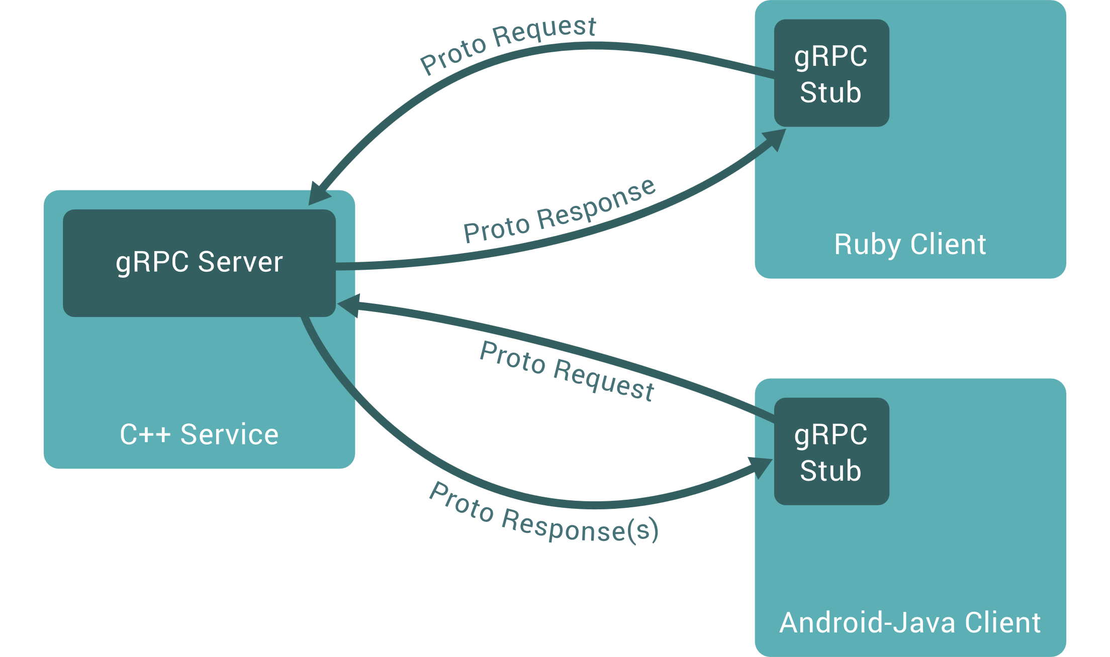
gRPC
An open-source high performance RPC developed by Google.
Using Http/2 as a transfer protocol
By default, it uses Protocol Buffer to serializing structured data.

Slide 4
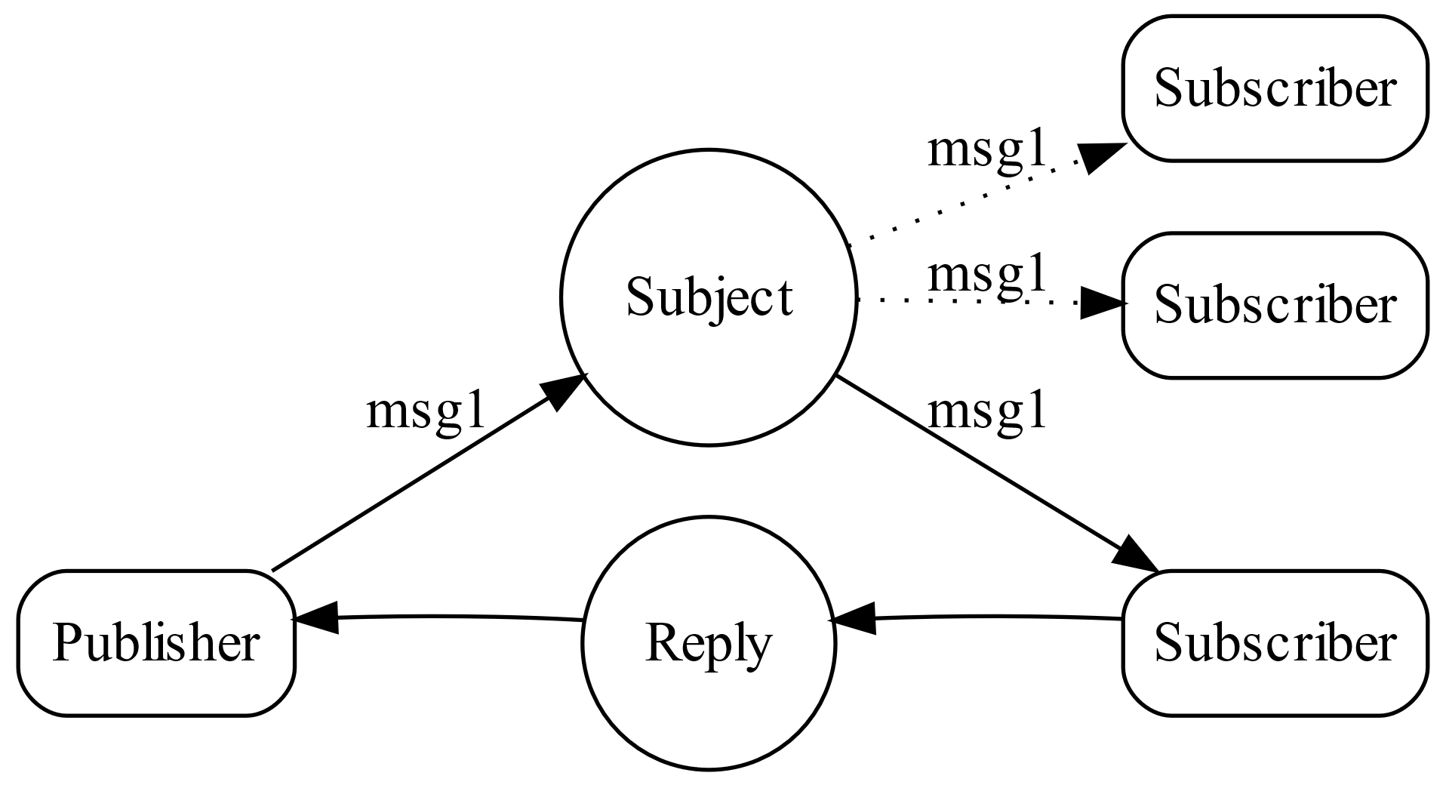
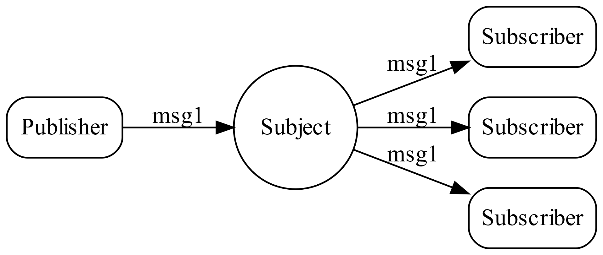
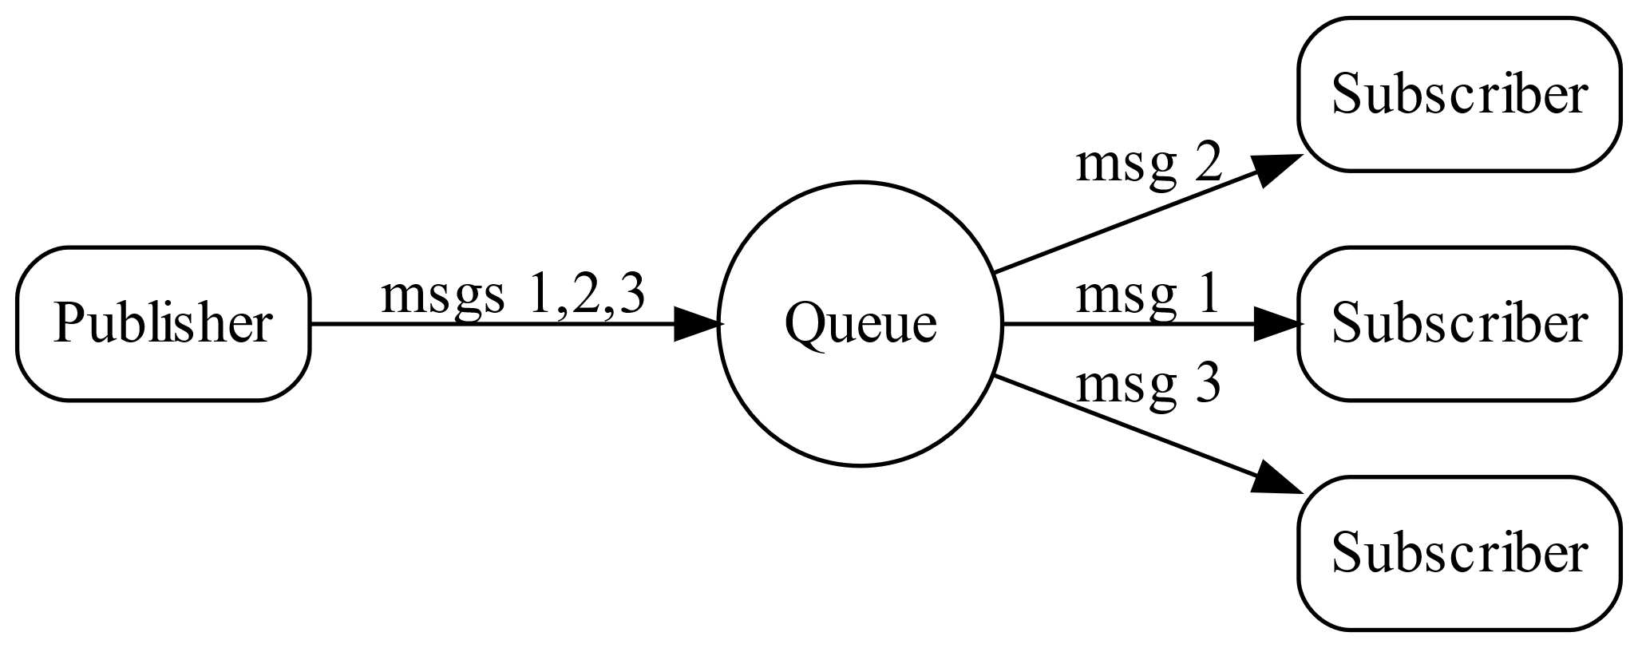
Nats.io
A Message Oriented Middleware, which is an infrastructure that allows data exchange, segmented in the form of messages
Publish-Subscribe
Request-Reply
Queue Groups

Slide 5
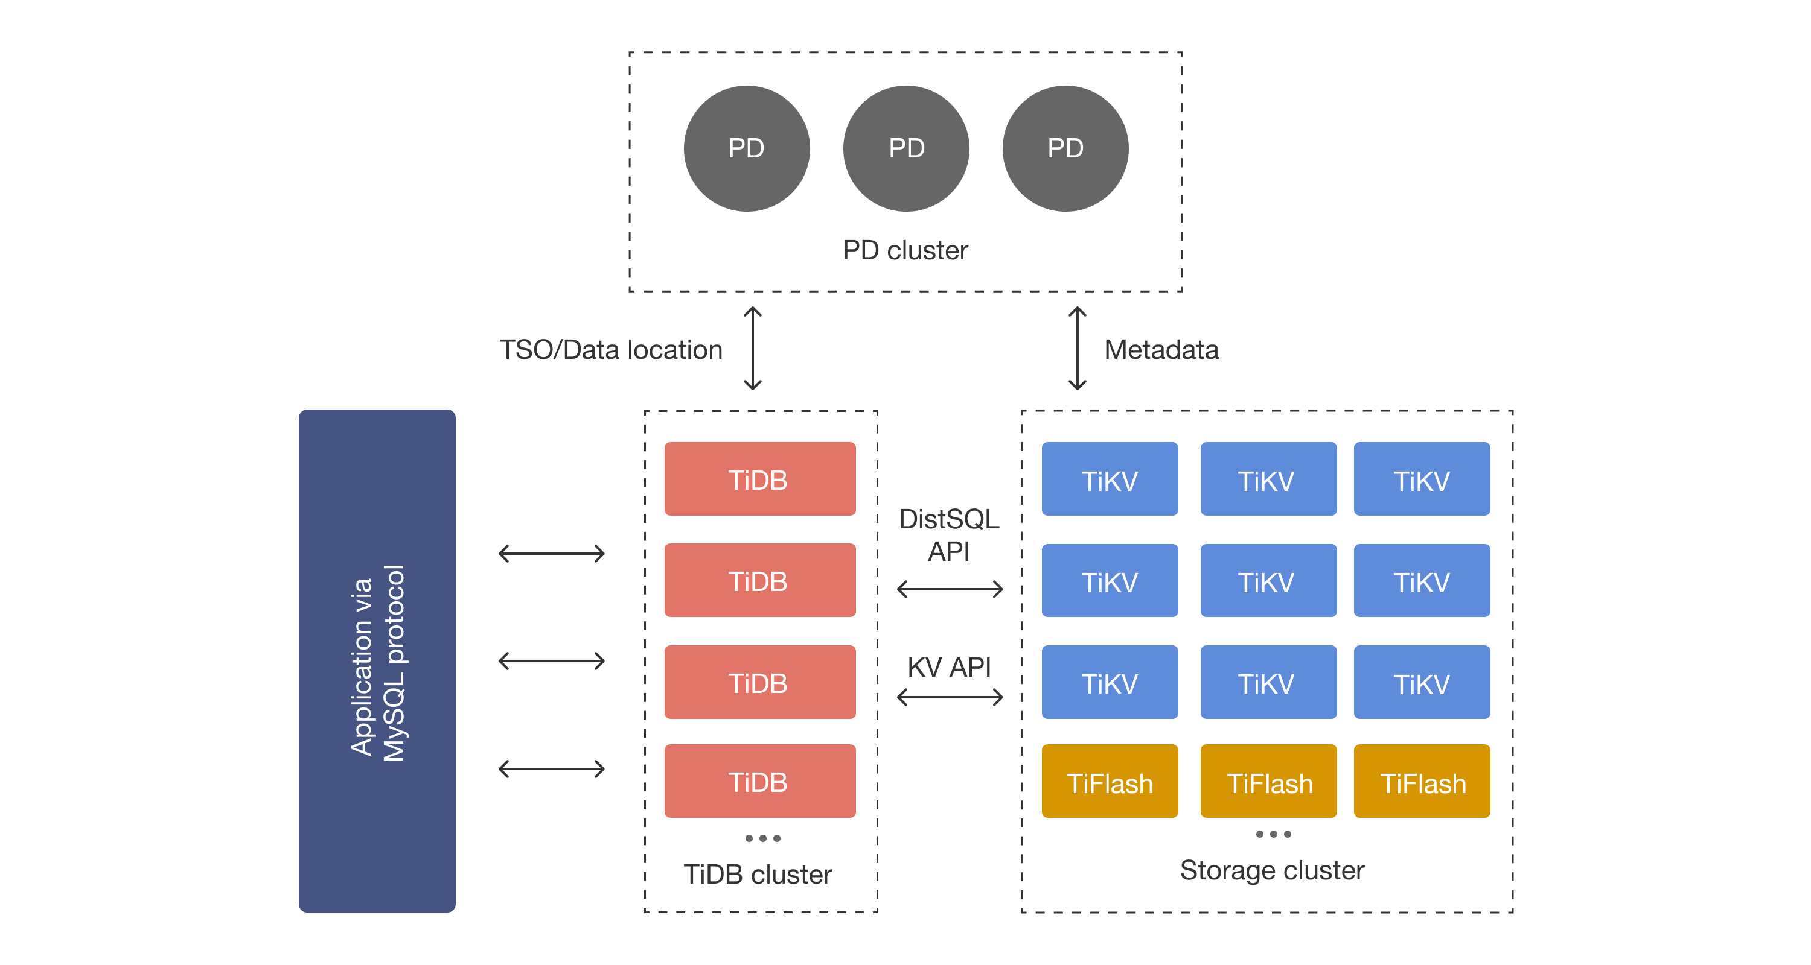
TiDB
an open-source distributed SQL database (MySQL Compatible) that supports Hybrid Transactional and Analytical Processing (HTAP) workloads.
TiDB Cluster Architecture

Slide 6
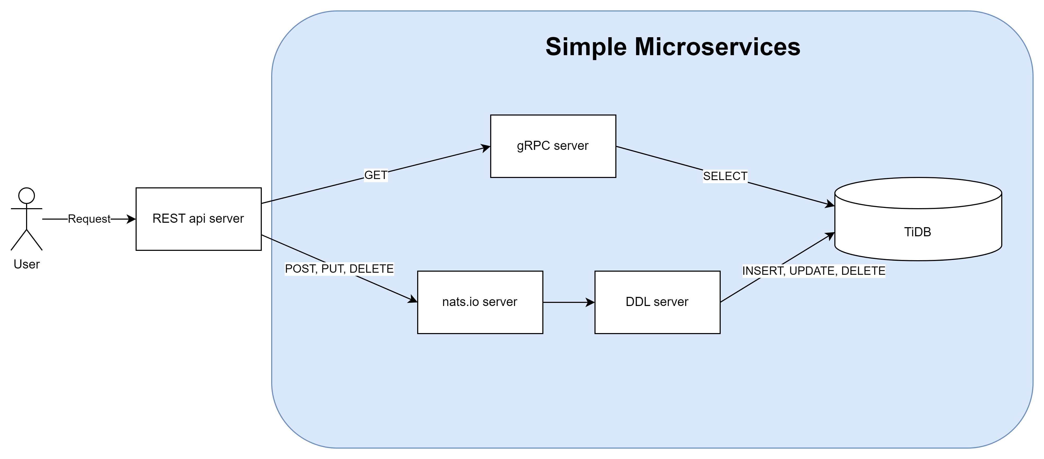
Architecture Overview

Slide 7
Demo

Slide 8
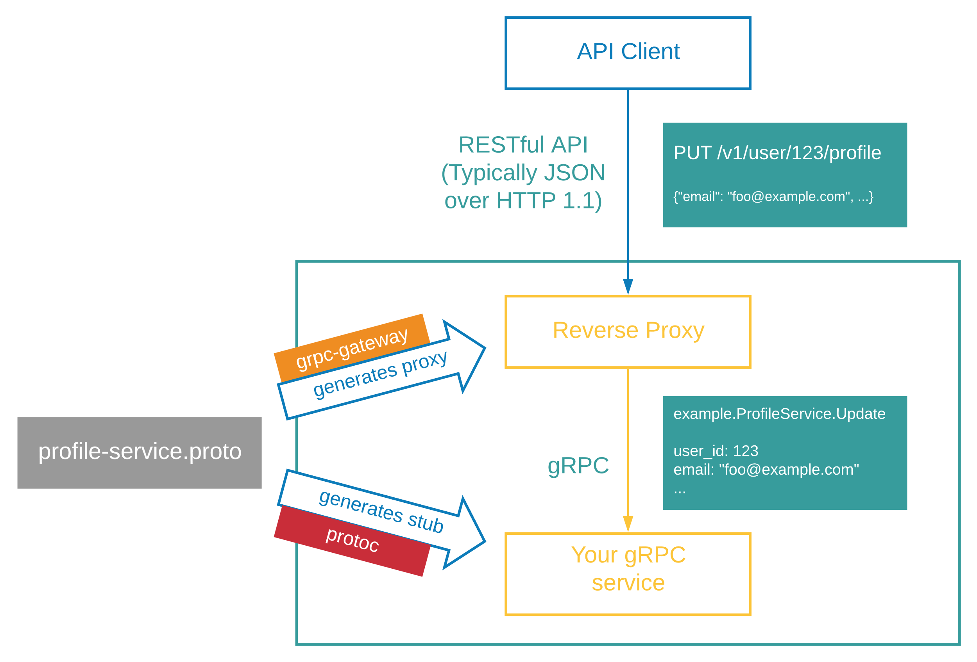
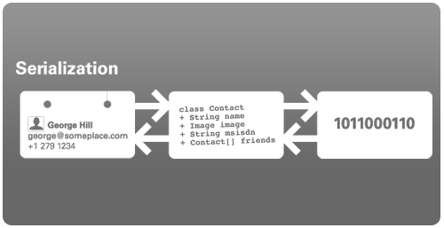
Future work
Implementing gRPC gateway
Distribute workload using nats.io
Encoding with ProtoBuf instead of JSON

Slide 9
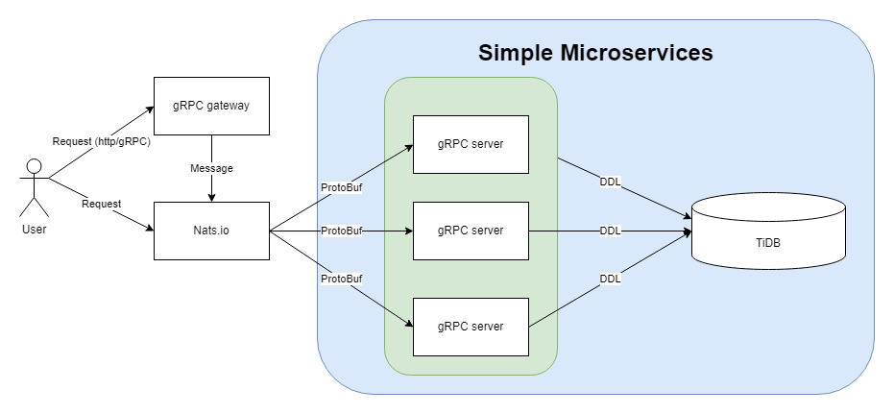
Future work Design

Slide 10
References
https://grpc.io/
https://nats.io/
https://docs.pingcap.com/
https://grpc-ecosystem.github.io/grpc-gateway/
https://sakshichahal53.medium.com/json-vs-protocol-buffer-simplified-dbd6b69ca528

Slide 11
Thank you
Kulawut Makkamoltham

