Slide 1

SMART PARKING
Indra Ganesan College of Engineering, Trichy
Name | Register No | Nan Muthalvan ID
R. OM PRAKASH | 811221106301 | au811221106301
V. VISHAL | 811221106040 | au811221106040
S. PREM KUMAR | 811221106024 | au811221106024
S. VICTORRAJ | 811221106037 | au811221106037
R. VEERA KUMAR | 811221106035 | au811221106035

Slide 2
Indra Ganesan College of Engineering, Trichy
Paper 1; “Smart Parking”,Anusha,Arshitha;2019
Objective : | It Allows drivers to reverse parking spaces in advance through a mobile application or web interface To provide secured parking space for the users in metropolitan cities
Technique Used : | Microcontroller device
Metrics taken : | IR sensor
Limitations : | The user needs to park his vehicle in the slot that is allocated to him

Slide 3
Indra Ganesan College of Engineering, Trichy
Paper 2; “Smart Parking”,Namith,Elakiya;2019
Objective : | The goal is to automate and reduce the time spend manually searching for a parking space To reduce time and increase efficiency of the current parking management system
Technique Used : | Radar Technology
Metrics taken : | Motion sensor
Limitations : | The user should be sensible enough to know that he should vacate the parking space at his specified departure time The system fails if the sensors stop working

Slide 4
Indra Ganesan College of Engineering, Trichy
Paper 3; “Smart Parking”,Supreeth,Ragavendra Prasath;2019
Objective : | This prototype aims to optimize parking space utilization, reduce human error, and enhance overall parking efficiency To offer save and secure parking slots with in limited area
Technique Used : | Smart parking System using Micro controller
Metrics taken : | Ultra sonic sensor
Limitations : | Availability of the space could be found only after the car enters the parking lot.

Slide 5
Indra Ganesan College of Engineering, Trichy
Proposed Work:
Controller:
RFID based car parking using IOT
INPUT:
Takes a user authorization mechanism through a mobile app or license plate scanning
OUTPUT:
To using sensors to collect real time data on parking lot occupancy and transmits this information to the cloud or local network

Slide 6
Indra Ganesan College of Engineering, Trichy
Problems identified from above Literature Survey
Different System Types | Problem idntified
Microprocess or based system | The user needs to park his vehicle in the slot that is allocated to him
Radar technology | The user should be sensible enough to know that he should vacate the parking space at his specified departure time The system fails if the sensors stop working
Ultra Sonic sensor | Availability of the space could be found only after the car enters the parking lot.

Slide 7
Indra Ganesan College of Engineering, Trichy
Research Gap:
The First Generation Microprocessor is small memory size slow speed instructions set limit its usefulness. Large chip size(170*200mil) with 40 pins. More chips on decoding circuits.
Ability to address large memory space (64-K Byte) and I/O ports(256).
Limited parking spaces can be utilized efficiently
Ensuring immediate clearance for emergency vehicles.
To reducing operating costs with efficient smart parking management processes.

Slide 8
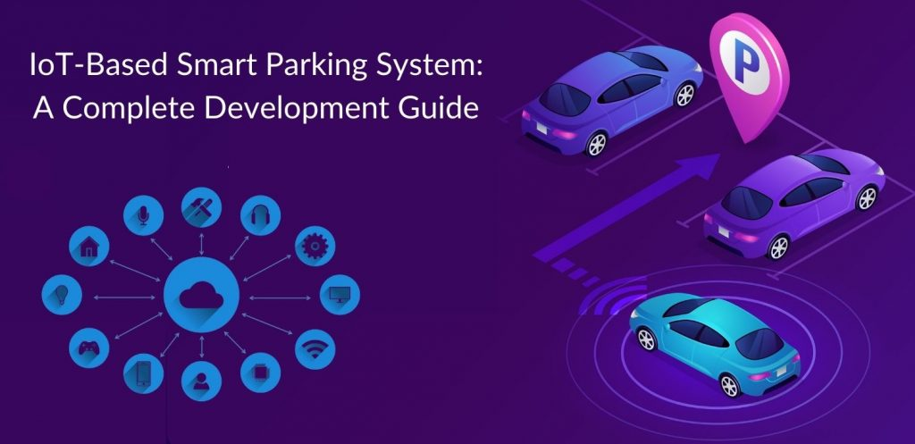
THANK YOU

