Slide 1

Track B – Analytics using python The PyMc's
Team Members - Dhruvil Parekh (Business Design)
Sarthak Pande (Research & Business Analytics)
Vivek Upadhyay (Research & Business Analytics)
Ruchi Sharma (Business Design)
Pratham Agrawal (Business Design)
Problem Statement – Analyse Restaurants in Bangalore using Zomato Data

Slide 2
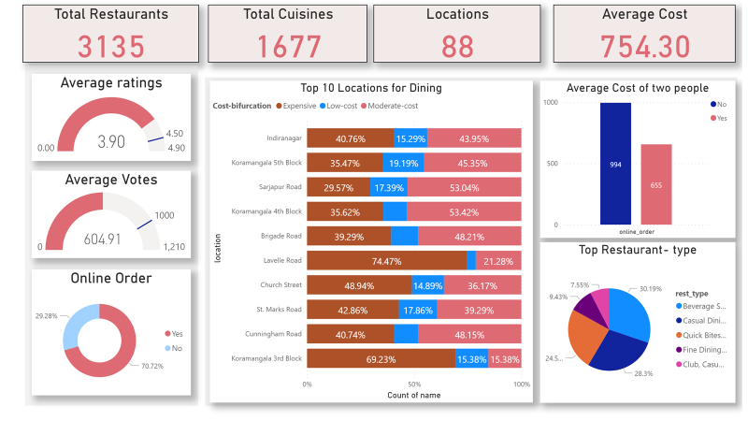
Solution Overview

Slide 3
Detailed working
The Steps Involved
Understanding the significance of each Column in the Dataset
Preprocessing the Data
Analyzing The Data and Creating the Visualizations
The Zomato data for Restaurants in Bangalore given was uncleaned data .
The first step was to drop all the redundant data
Then we Dropped columns such as 'url','address', 'phone', 'menu_item', 'reviews_list' because these were non-significant columns given what we wanted to analyze.
Then the missing values were replaced by the respective mean values of the column.
The Data was then formatted in a way that is suitable for analyzing.
Using the Python Libraries such as pandas , matplotlib and Numpy and the appropriate functions the data was analysed and Visualizations were created for the questions asked.

Slide 4
Uniqueness of solution
The output we got gives in depth analysis of data if analysed properly can help run a well-designed marketing campaign.
Most importantly it will help new restaurants in setting up their themes, menus, cuisines, cost for a particular location.
The existing restaurants can also be benefitted by making the required changes after understanding the behavioral pattern of the customer and match their level with the most successful ones.
Apart from restaurants customers can also go through our analysis to get an overview and get to know more about their favorite dining places.

