Slide 1
Agentic RAG Chatbot for Multi-Format Document QA using MCP
Goal: Build a chatbot to answer questions using uploaded docs (PDF, DOCX, CSV, PPTX, TXT, MD).
Agent-based architecture with message-passing (MCP).
RAG: Ingest, Retrieve, Generate answer using context.
Frontend built using Streamlit.

Slide 2
Agent-Based Architecture with MCP
CoordinatorAgent: Orchestrates all agent interactions.
IngestionAgent: Parses, chunks, embeds docs into vector store.
RetrievalAgent: Retrieves top-k relevant chunks using FAISS.
LLMResponseAgent: Uses retrieved context to generate final answer.
Messages exchanged using structured JSON (MCP format).

Slide 3
System Flow Diagram (Message Flow)
UI → CoordinatorAgent: USER_QUERY
CoordinatorAgent → IngestionAgent: INGEST_REQUEST
IngestionAgent → RetrievalAgent: RETRIEVE_REQUEST
RetrievalAgent → LLMResponseAgent: CONTEXT_RESPONSE
LLMResponseAgent → CoordinatorAgent → UI: ANSWER
Trace_id used for tracking query lifecycle.

Slide 4
Tech Stack Used
Frontend: Streamlit
Embeddings: SentenceTransformers (all-MiniLM-L6-v2)
Vector DB: FAISS
LLM Backend: OpenAI GPT-4 / HuggingFace (mock fallback)
Parsing: PyMuPDF, python-docx, pandas, pptx, markdown
MCP Protocol: Custom in-memory JSON structure

Slide 5
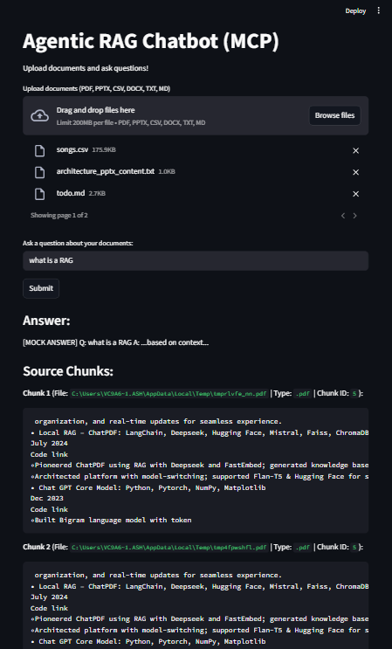
📸 UI Screenshot

Slide 6
Challenges Faced & Future Scope
Challenges: Parsing table-heavy documents, designing reusable MCP, chunking efficiency.
Future Scope:
- Add web/audio agents
- Use Redis or Kafka for distributed MCP
- Token streaming responses
- Stateful multi-turn memory via trace_id

