Slide 1
VELAMPALLI VENKATA SAI SUJEEVAN
Final Project

Slide 2

KEY LOGGER AND SECURITY

Slide 3


AGENDA
Problem Statement
Project Overview
End Users
Solution and Value Proposition
The "Wow" Factor in Our Solution
Modelling
Results
3/21/2024 Annual Review

Slide 4

PROBLEM STATEMENT
Problem:
Keyloggers are a significant threat to cyber security,
leading to unauthorized access to sensitive information,
identity theft, and financial fraud.
Impact:
Affects individuals, businesses, and organizations by
compromising data privacy and security.

Slide 5

PROJECT OVERVIEW
Objective:
Develop a comprehensive understanding of keyloggers,
their types, how they work, and effective security measures
to prevent keylogging attacks.
Scope:
Includes an analysis of hardware and software keyloggers,
legal and ethical implications, security measures, and
best practices.

Slide 6

WHO ARE THE END USERS?
Individuals: Concerned about personal data security and privacy.
Businesses: Need to protect corporate data and ensure compliance with security standards.
Organizations: Require robust security measures to
safeguard sensitive information.
Security Professionals: Aim to understand and mitigate keylogging threats.

Slide 7

YOUR SOLUTION AND ITS VALUE PROPOSITION
To avoid keyloggers
Use anti virus program
Use password manager
Use multi factor authentication
Use a firewall
Avoid suspicious links and downloads
Change password periodically
Update your system
Use Virtual Keyboard to type passwords
and sensitive information

Slide 8
Solution:
Implement a multi-layered security strategy that
includes anti-keylogging software, regular system
scans, software updates, and user education.
Value Proposition:
Enhanced Security: Reduces the risk of data
breaches and identity theft.
User Awareness: Educates users about keylogging threats and protection methods.
Compliance: Helps businesses and organizations comply with data protection regulations.

Slide 9

THE WOW IN YOUR SOLUTION
Innovative Approach: Combining technical
measures with user education for comprehensive
protection.
Demonstration: Real-time demonstration of a simple
keylogger to illustrate the threat and the effectiveness
of security measures.
Impact: Significant reduction in the likelihood of
keylogging attacks through proactive measures.
3/21/2024 Annual Review
9

Slide 10
MODELLING
Architecture Overview:
Modular Design: The keylogger code is structured into modular functions for better readability and maintenance.
Event Handling: Utilizes the pynput library to capture and handle keyboard events.
Data Logging: Implements functions to log captured data into text and JSON files.
10

Slide 11
MODELLING
Components:
Key Press Handling: Function: on_press(key)
Description: Captures and logs the pressed keys.
Details: Appends key press events to a list and
updates the JSON log file.
Key Release Handling: Function: on_release(key)
Description: Captures and logs the released keys.
Details: Appends key release events to a list,
updates the JSON log file, and accumulates keys for the text log.
Logging Functions:
Text Logging: generate_text_log(key)
Description: Writes the recorded keys to key_log.txt.
JSON Logging: generate_json_file(keys_used)
Description: Dumps the list of key events to key_log.json.
11

Slide 12
MODELLING
GUI Integration:
Tkinter Framework: Utilizes tkinter for creating a graphical user interface.
User Interaction:
Start Button: Initiates the keylogger.
Stop Button: Stops the keylogger.
Status Updates: Provides real-time feedback on the status
of the keylogger (running/stopped).
12

Slide 13
MODELLING
Flow Diagram:
Initialization:Set up the main GUI window.Initialize global variables for key logging.
Event Capture:
Start capturing key events when the "Start" button is pressed.Log key press and release events.
Data Logging:
Continuously update text and JSON log files with captured key events.
Stop Logging:
Stop capturing key events when the "Stop" button is pressed.
Update the GUI status to indicate the keylogger is stopped.
13

Slide 14
ADVANTAGES
Using anti keylogging software can help prevent identity theft and cyber attacks that involve the theft of the sensitive information.
Easy to deploy at scale.
Contains Inconspicuous user activity monitoring
14

Slide 15
DISADVANTAGES
It steals sensitive information, spy on individuals and organizations cause a variety of other negative consequences.
Often flagged by antimalware software as malicious.
Incapable of logging BIOS inputs.
15

Slide 16
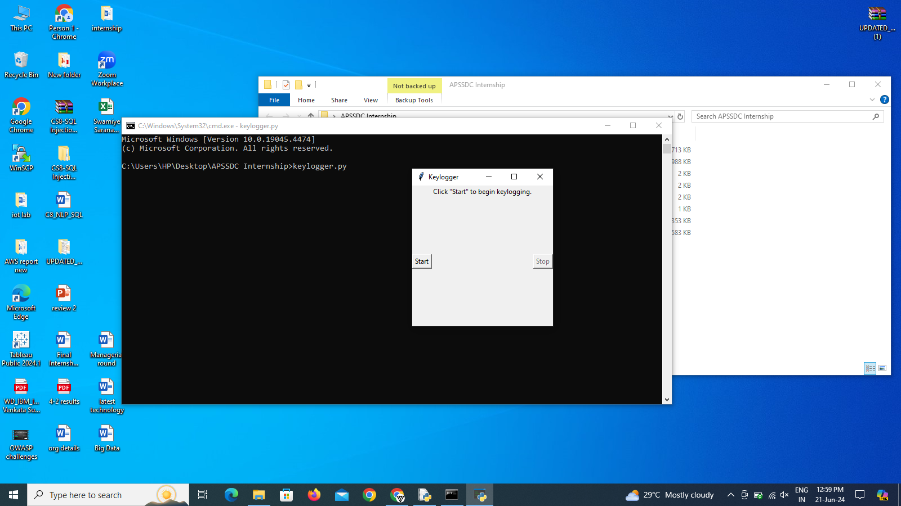
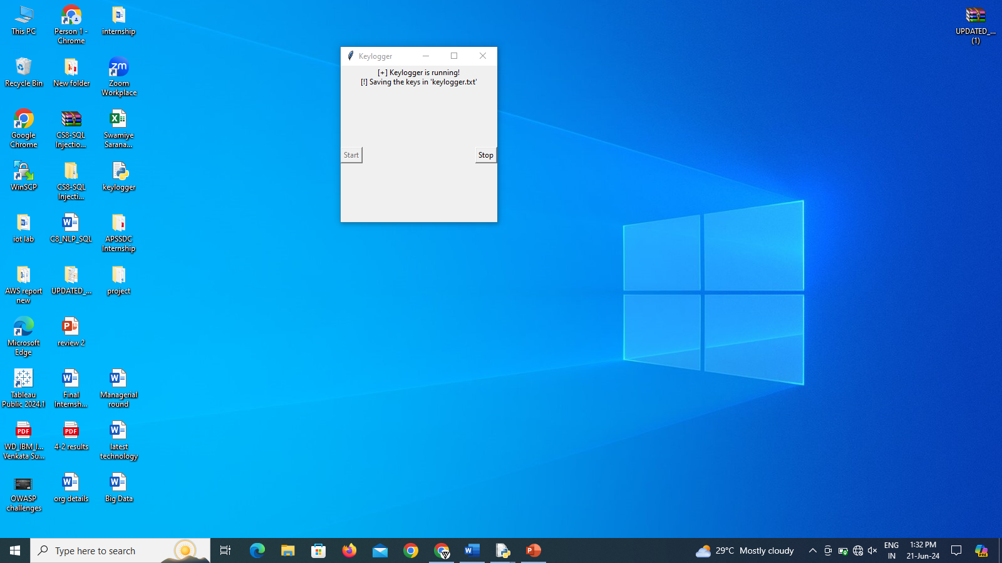
RESULTS
16

Slide 17
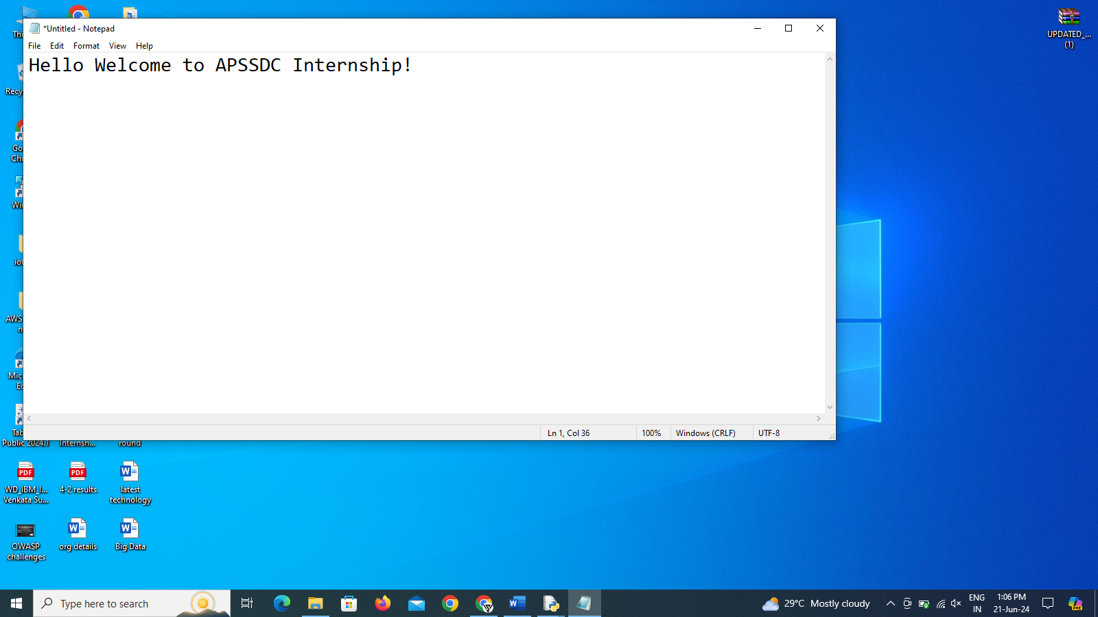
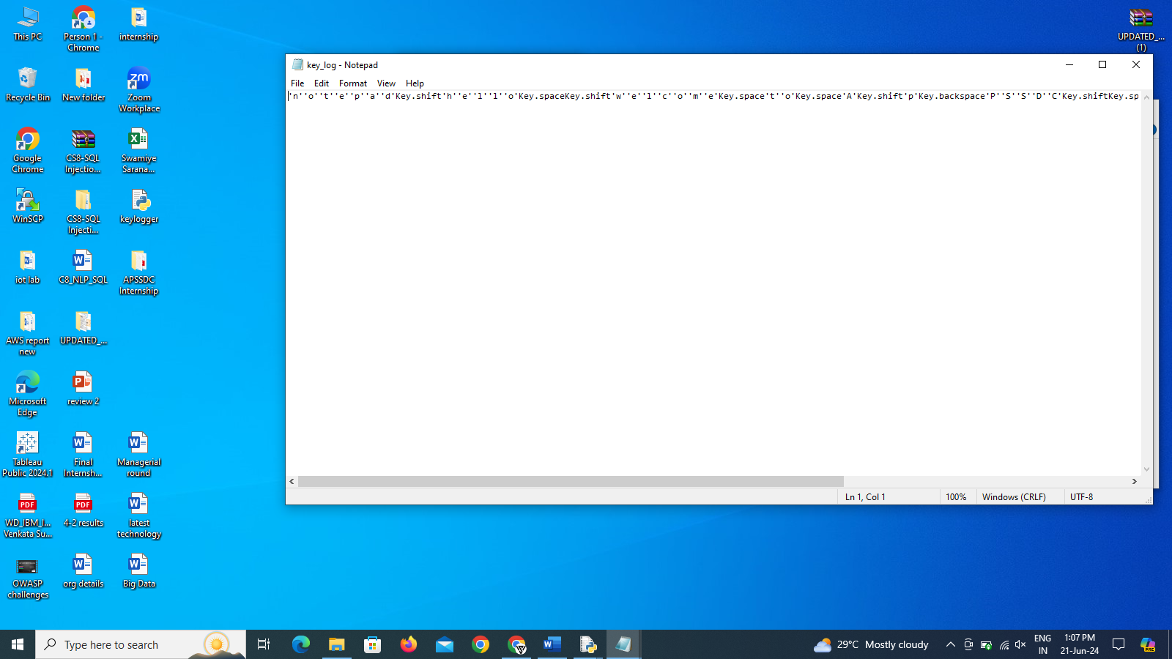
RESULTS
17

Slide 18
RESULTS
Screenshots of the GUI: Display the user interface, including the start and stop buttons and the status label.
Sample Logs: Show examples of the key_log.txt and key_log.json files to illustrate how the keystrokes are recorded.
18

Slide 19
RESULTS
1.Successfully implemented a keylogger that captures keystrokes and records them into both text and JSON files.
2.Real-time keylogging with start and stop functionality
controlled via a simple GUI.
3.The GUI provided a user-friendly way to control the keylogger, making it accessible and easy to use.
4.The keylogger project demonstrated the capability to effectively capture and log keystrokes in real-time.
5.Emphasized the ethical use of keyloggers and the importance of implementing security measures to protect against malicious use.
19

Slide 20
VELAMPALLI VENKATA SAI SUJEEVAN
Presented By:
https://github.com/Vvssujeevan04/Vvssujeevan.git

