Slide 1
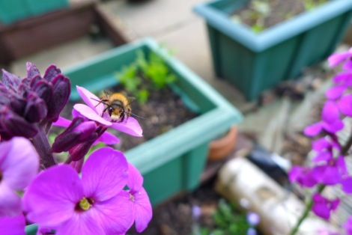
Building a model to estimate abundance of Osmia rufa in Leipzig, Germany

Slide 2


Introduction
As part of a citizen science project,
nesting aids were distributed in the city of:
These nesting aids were then collected after the nesting season of Osmania rufa
Hypothesis: is that presence/absence and abundance our bee deepends on site conditions.
Model → to estimate abundance of O.rufa using various site parameters collected – like placement of the nest, presence of flowers, etc.,

Slide 3

Data
Dependent variable
Main variables
→ some have factors
Similar variables which can be tested by any one variable

Slide 4
The process of model selection
Count data → Poisson distribution? Yes!
Missing data? dependent variable or_chambers has many NAs
We deduced that NAs == 0 abundance
Building a model by dropping non-significant terms using drop1( )
Result → A GLM w/ 6 terms
glmulti( chosen glm ) → a fancy function that gave the best model with interactions
Null deviance of ~ 0.43
or_chambers~1+hang_location.t+juliandays.t+share_int+hang_location_sp.t:share_int+shade.t:juliandays.t
Notes:
Fitted/Residuals

Slide 5
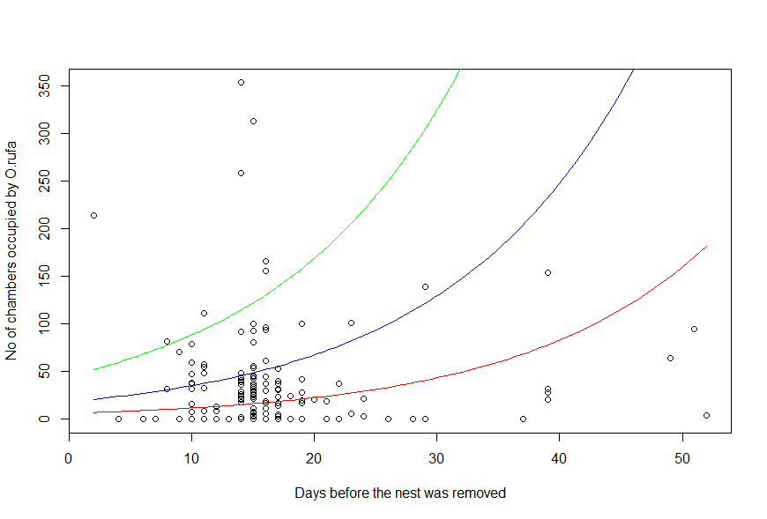
Response to specific factors
Shade = Fully_sunlit(biggest influence) AND hang_location = Garden_or_allotment“ AND class of hang_location
Carport or shelter
Fence or other object
Roof-terrace, balcony

Slide 6
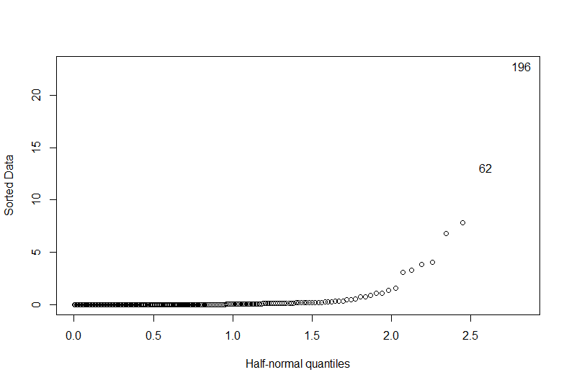
Cook’s distance
Leverage points

