Slide 1
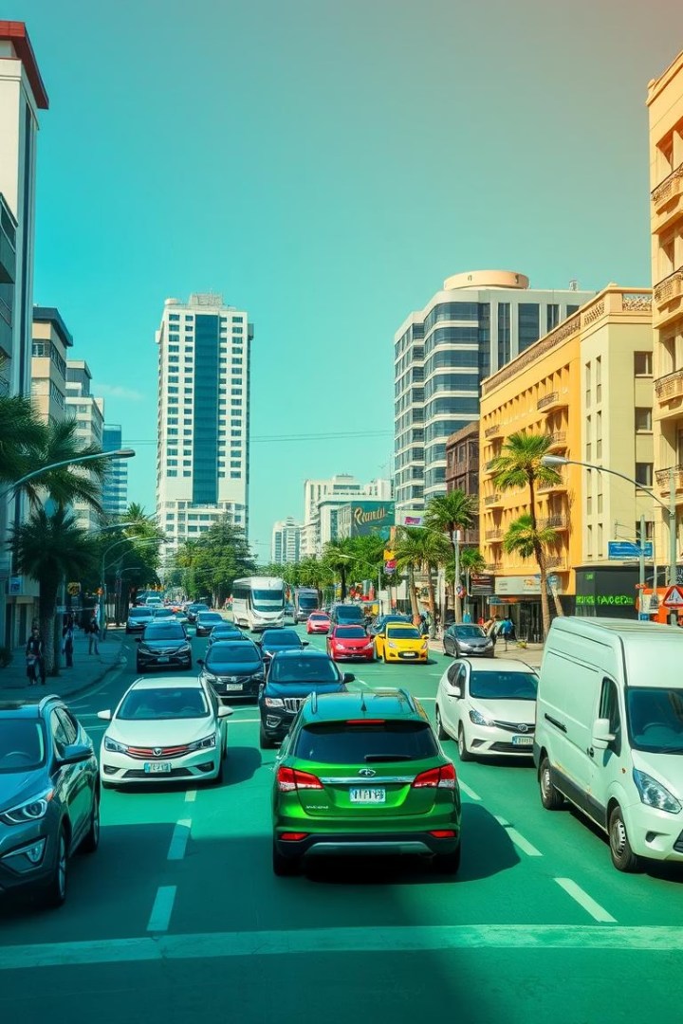
Crash Reporting-Drivers Data Project
Vishnu Sai Dornala

Slide 2
INTRODUCTION:
We will look at the collisions that have happened in Montogomory County in this dataset. The location, involved cars, weather, road, speed limit, date, time, and other crash-related details are all included in the police-collected data. In addition to many other things, we will use this data to identify which roads, hours, and days of the week are collision hotspots.

Slide 3
Data Visualization Techniques: Tools and Methods
Statistical Charts
Technologies Used
Visualizes trends and correlations for deeper analysis.
Tableau, Python (matplotlib, seaborn).

Slide 4
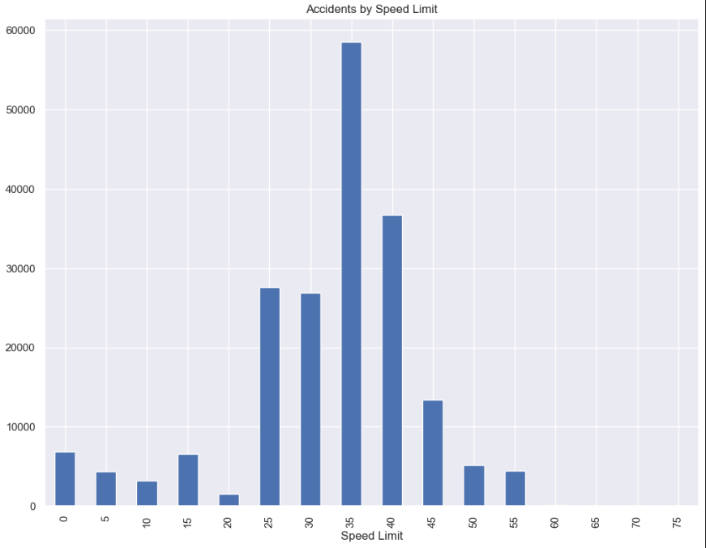
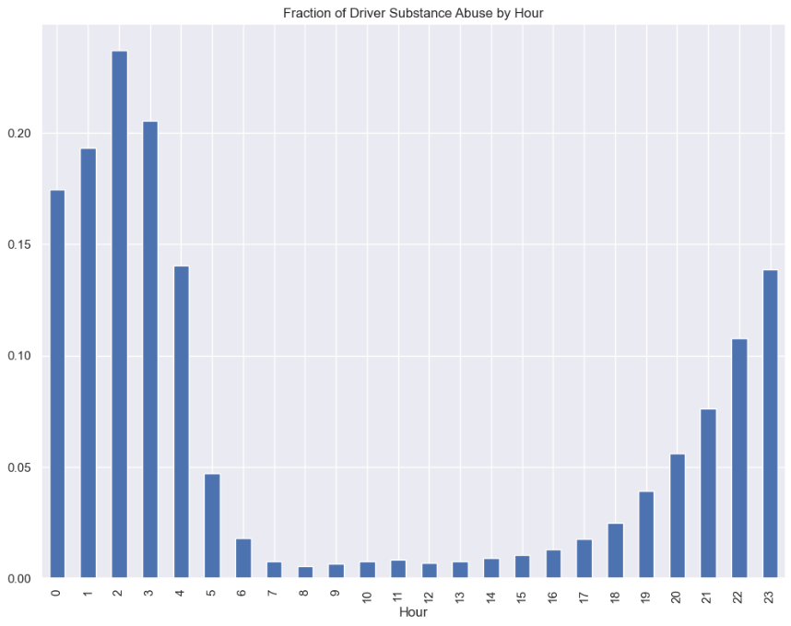
GRAPH ANALYSIS:
Accidents by Speed Limit
Accidents by Hour

Slide 5
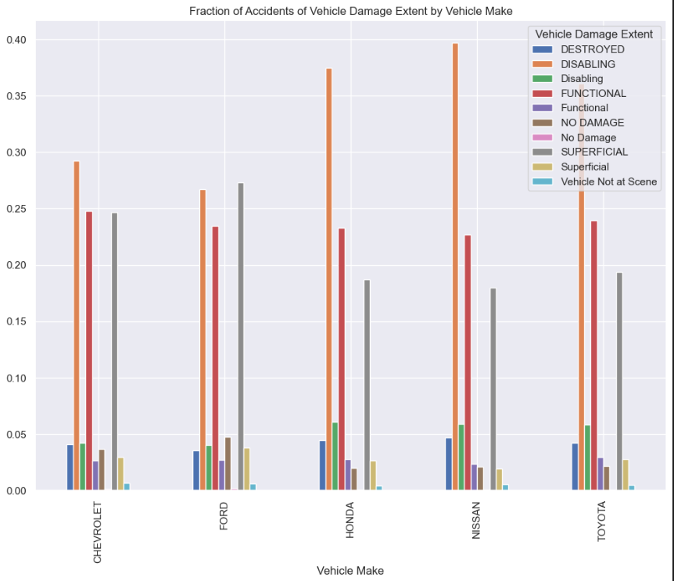
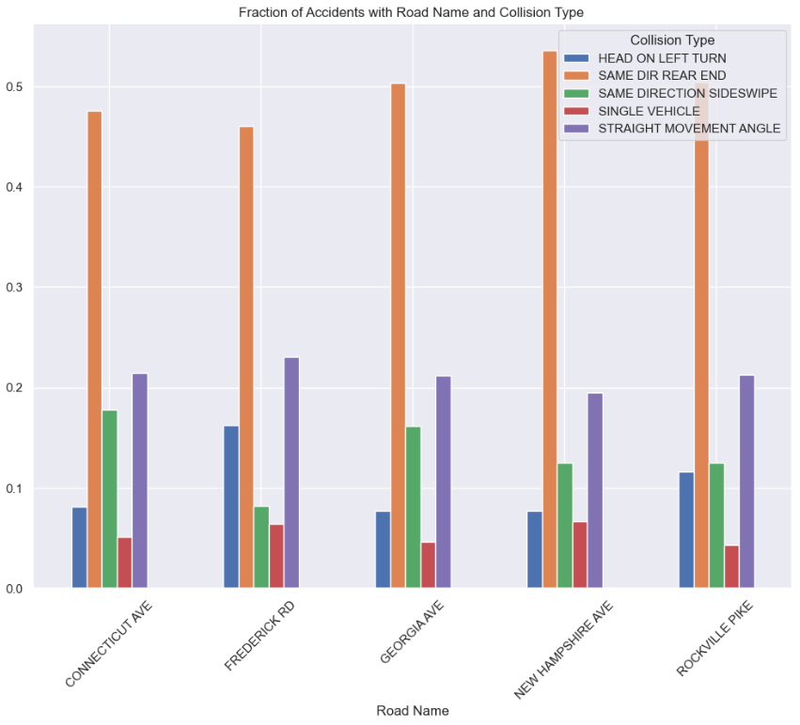
Accidents By Vehicle Make
Accidents By Areas

Slide 6
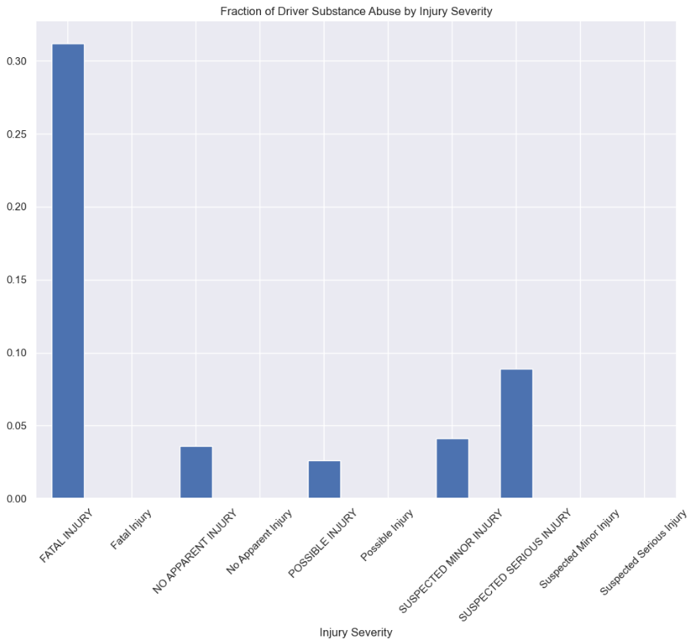
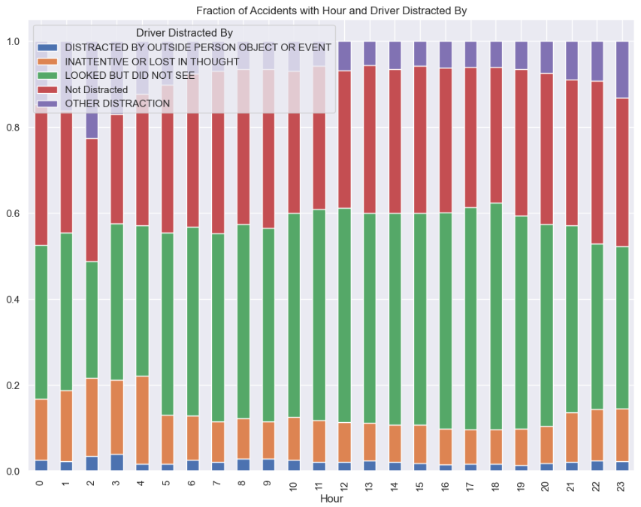
Level of Injury Severity
Accidents by Distracted Drivers By Hour

Slide 7
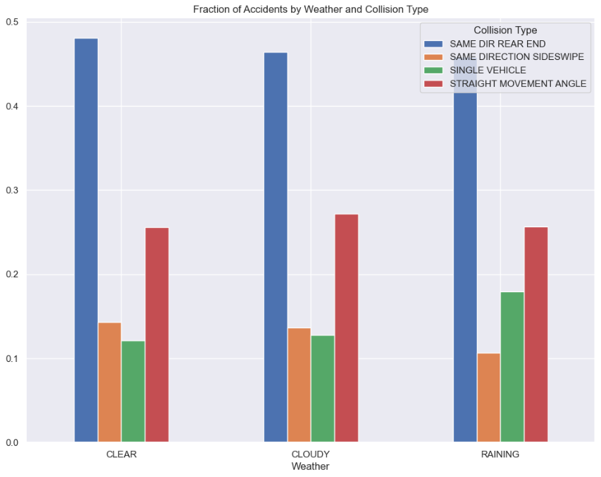
Accidents By Weather

Slide 8
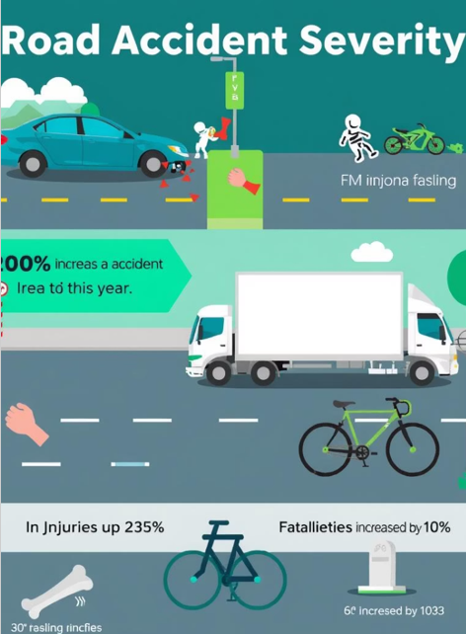
Key Performance Indicators (KPIs): Measuring Success
Crash Reduction
Decrease in crash frequency and severity.
High-Risk Locations
Identification and monitoring of hotspots.
Driver Behavior
Detect patterns influencing crash likelihood.
Emergency Response
Faster response times to incidents.

Slide 9
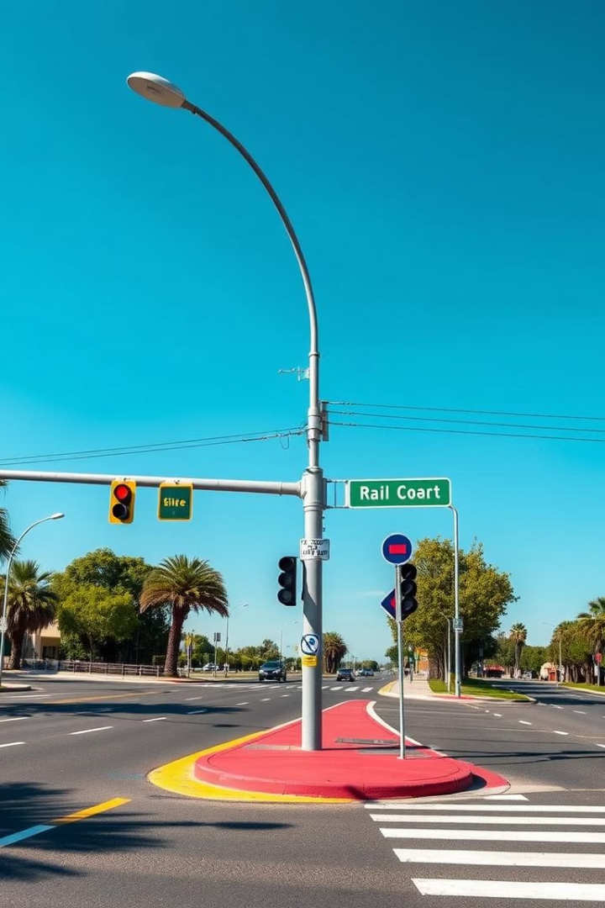
Actionable Insights: Recommendations for Improvement
Infrastructure Upgrades
Improve signage, lighting, and road design.
Education Campaigns
Promote safe driving through targeted programs.
Policy Enforcement
Strengthen speed limits and DUI laws.

Slide 10
Conclusion:
From the analysis of this dataset we now know the peak hours for collision, peak days for collision, peak hours when drivers drive under the influence, more collisions in places with , possibility of a serious injury when driver is under the influence and also what are the different distraction reasons for collisions in different hours.

