Slide 1

Notes:
Introduce the project in one line: I took one GPU kernel, matrix multiplication, and asked whether classical statistics, Design of Experiments and response surface methodology, can find its fastest configuration without trying every option. Everything was measured on an NVIDIA H200, and every claim is checked against an exhaustive search of all 1,396 valid configurations.

Slide 2
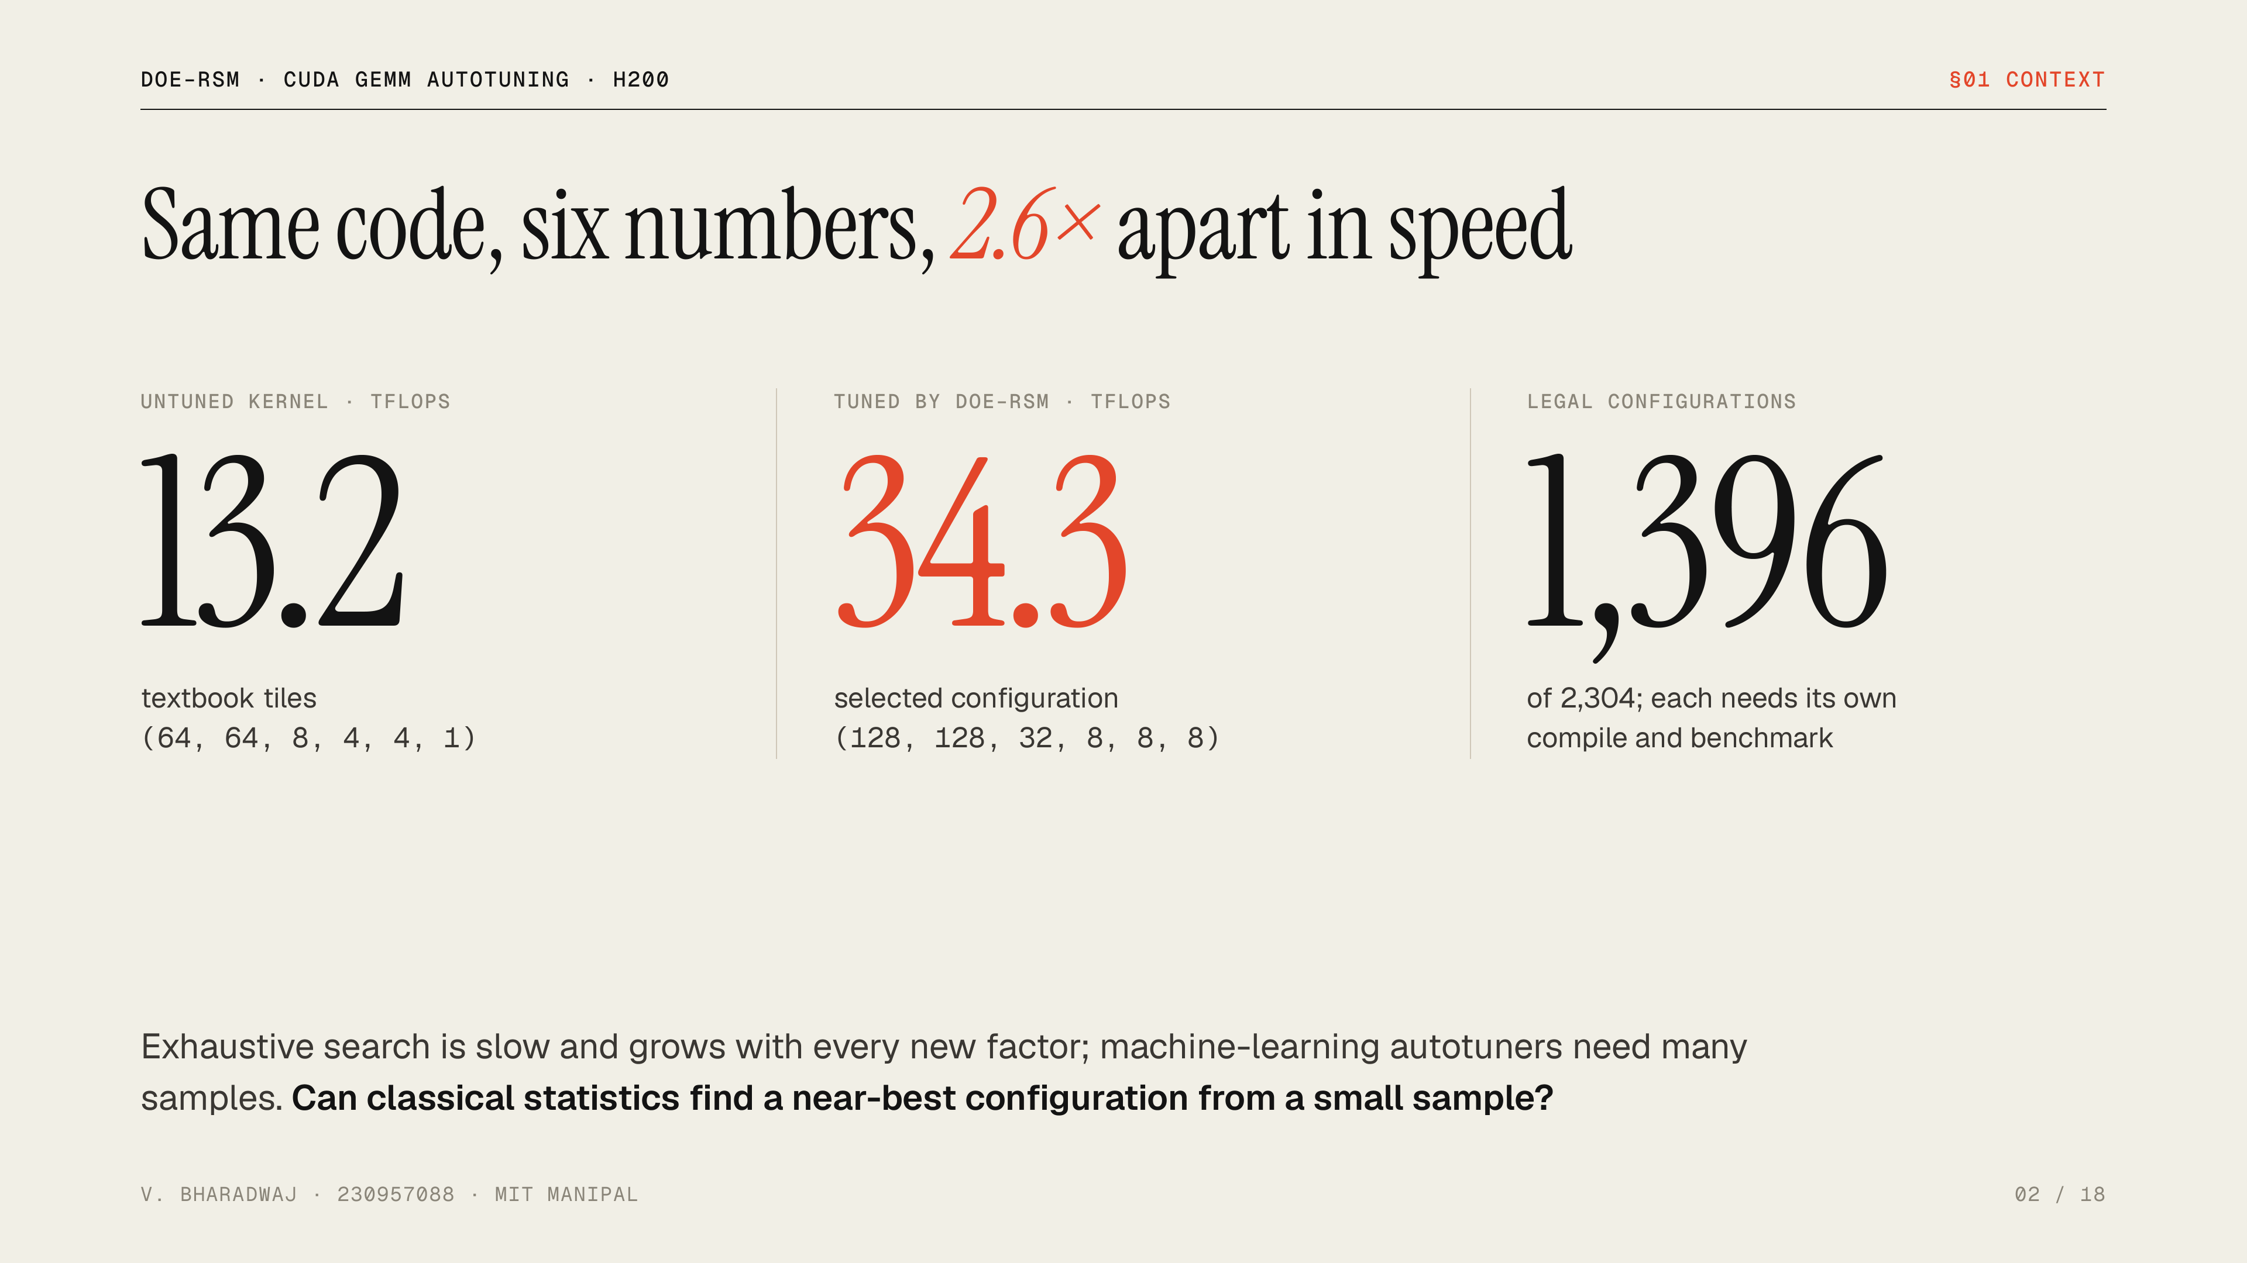
Notes:
A GEMM kernel has tunable compile-time parameters: tile sizes, register tiling and loop unrolling. The same source code runs at 13.2 TFLOPS with textbook settings and 34.3 with tuned ones, a factor of 2.6. Of 2,304 combinations, 1,396 obey the hardware limits, and every one needs its own compile and benchmark. The project asks whether Design of Experiments can find a near-best configuration from a small sample.

Slide 3
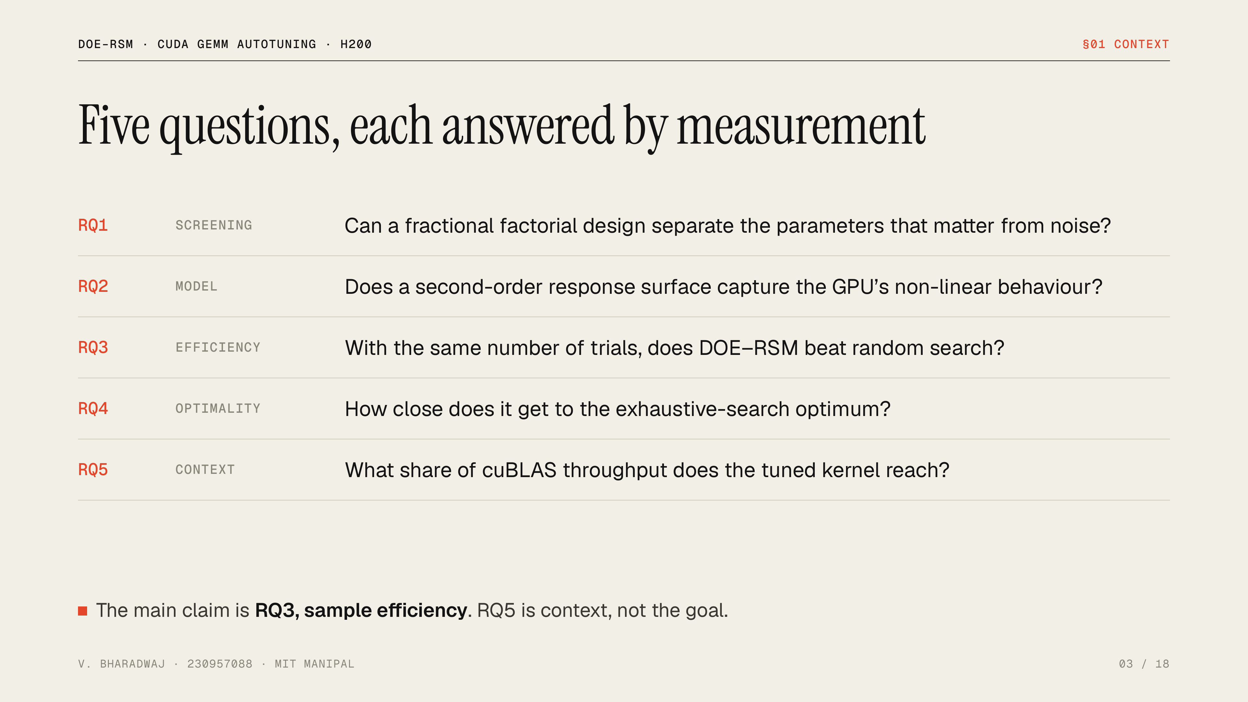
Notes:
The first two questions come straight from the synopsis: does screening work, and does a quadratic surface model the hardware. The third and fourth test whether the method is actually efficient, against random search and against the true optimum. The fifth puts the result in context against NVIDIA’s own library. The main claim of the project is RQ3, not RQ5.

Slide 4
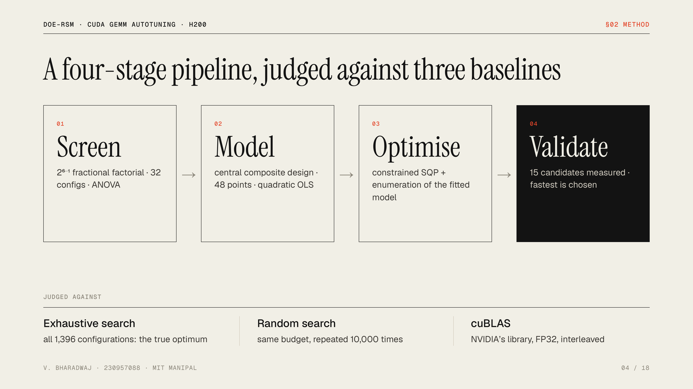
Notes:
The pipeline follows the synopsis objectives. Screening finds which factors matter. A central composite design fits a quadratic response surface. SQP and an exhaustive pass over the model propose the best configurations. Then the proposals are measured and the fastest measured one is chosen. The bottom row is how the method is judged: the true optimum from exhaustive search, random search with the same budget, and cuBLAS as an outside reference.

Slide 5
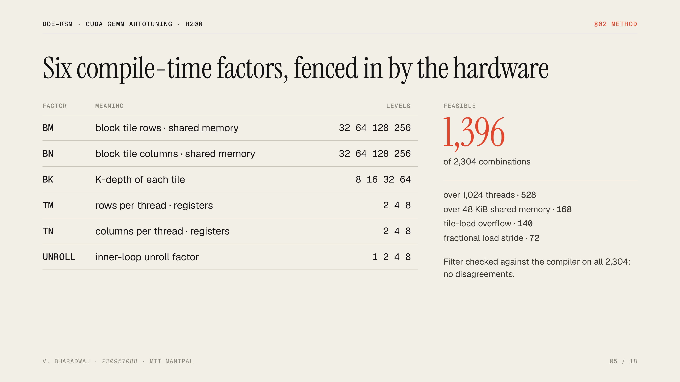
Notes:
The kernel is a standard 2D block-tiled matrix multiply in FP32 on CUDA cores. Six numbers are injected at compile time. Not every combination is legal: the GPU caps threads per block and shared memory, and the tile-loading code needs the thread count to fit the tiles. That constraint set is objective 1 of the synopsis. I checked the Python version of the rules against the real compiler on all 2,304 combinations, and they agree on every one.

Slide 6
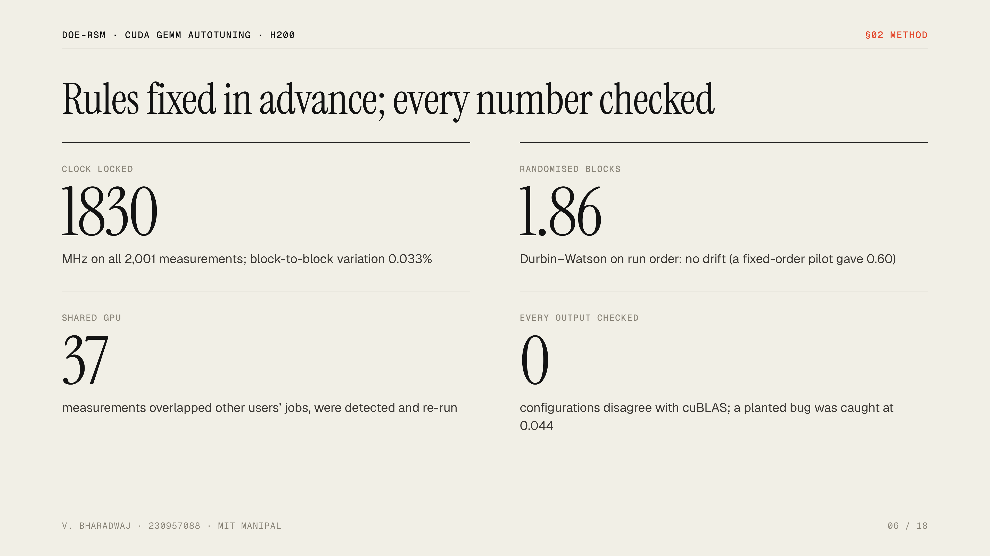
Notes:
Statistics are only as good as the measurements. Before collecting final data I wrote a contract fixing every rule: tolerances, the factor-retention rule, the model adequacy test, the random-search budget. The GPU clock was locked. Runs were randomised, which removed the drift a pilot run had shown. The H200 is shared, so I detected other users’ activity during each measurement and repeated contested runs. And every configuration’s output was checked against cuBLAS, with a deliberately broken kernel proving the check catches errors of the expected size.

Slide 7
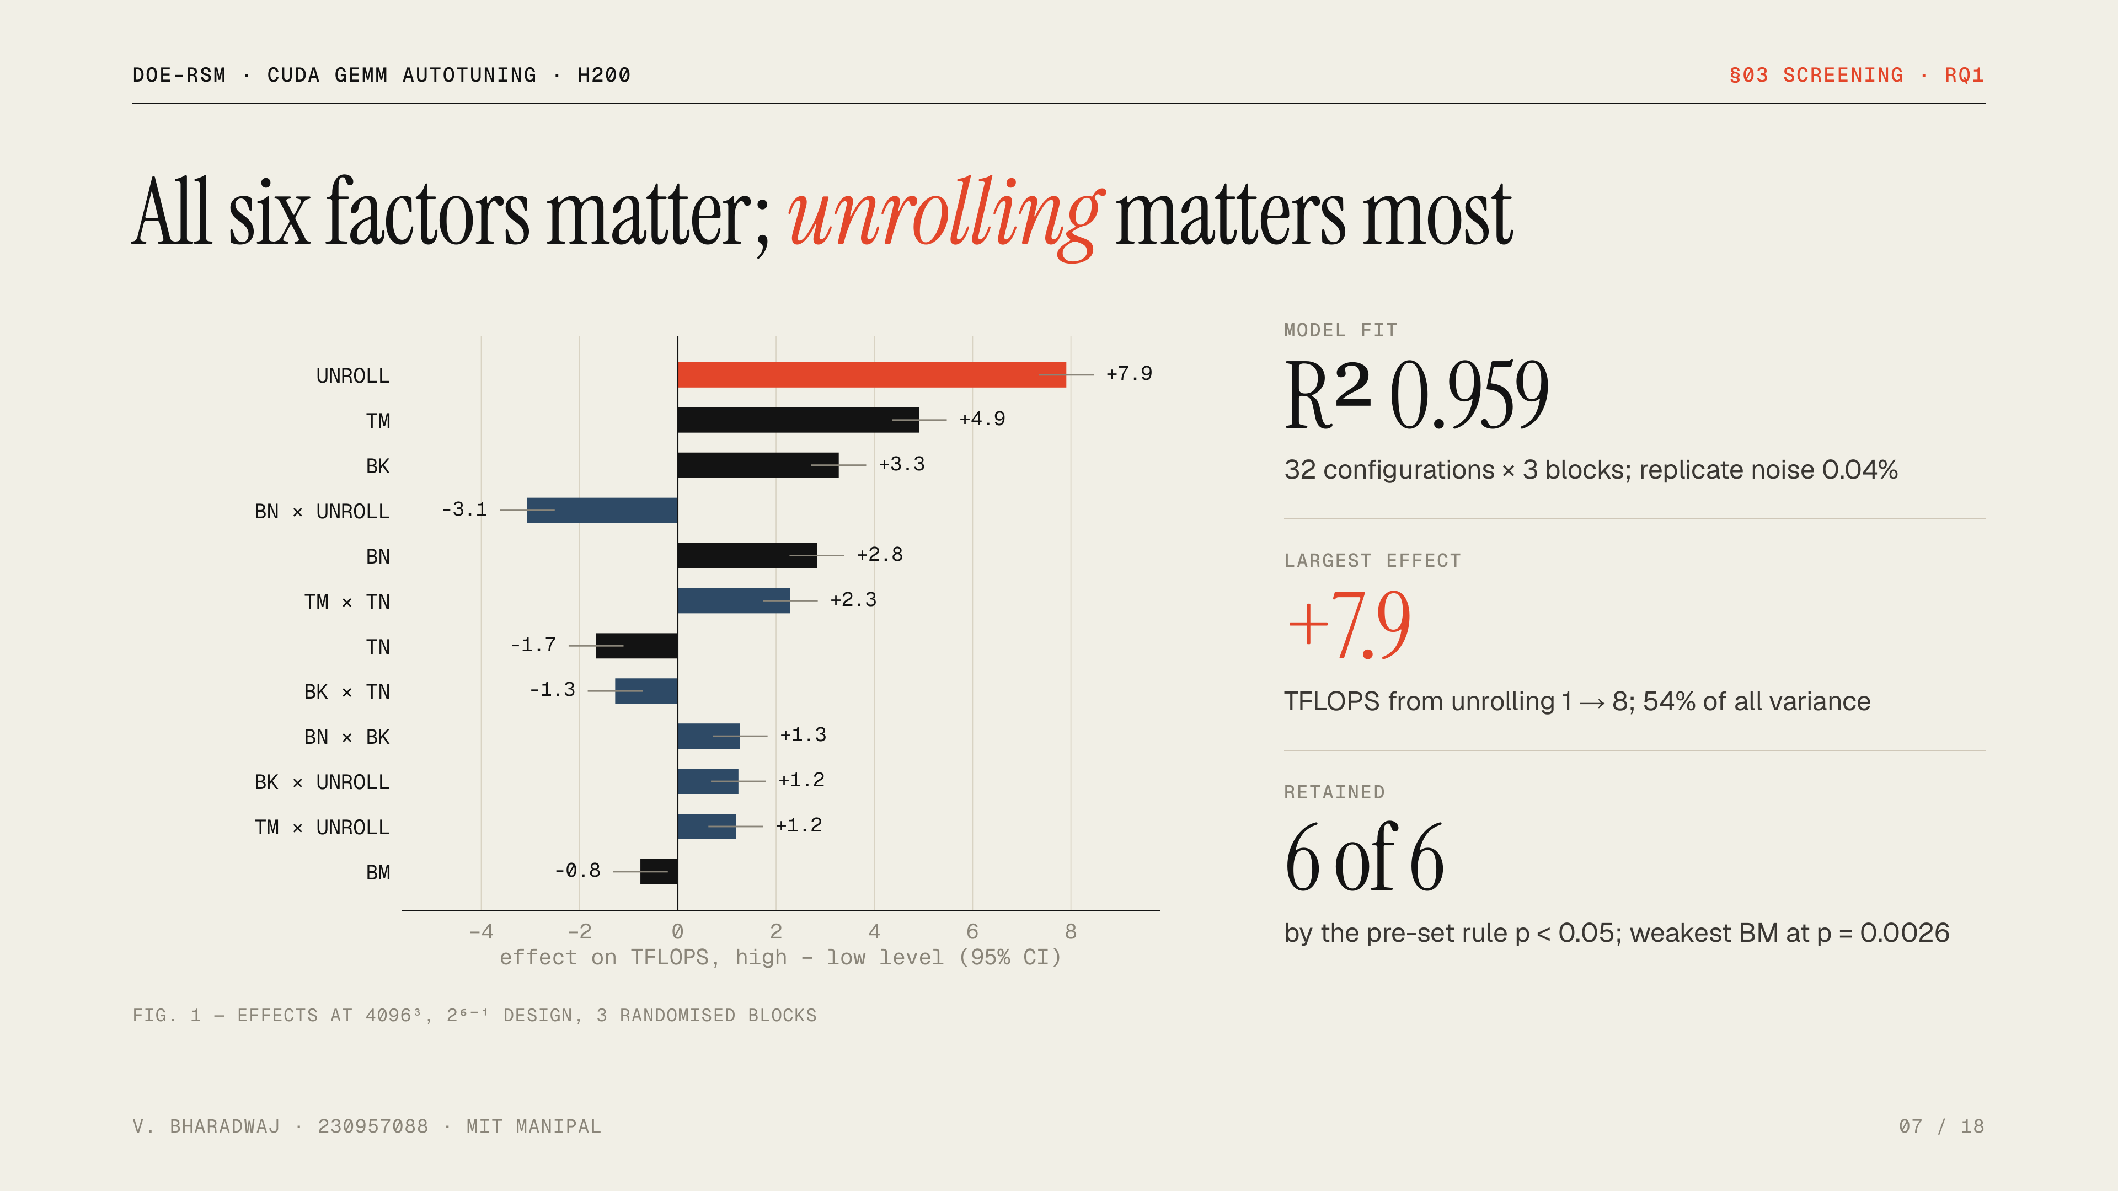
Notes:
The answer to RQ1 is yes. A 32-run half-fraction design, each run replicated three times in random order, separates the factors cleanly: R-squared 0.96 and replicate noise around 0.04 percent. Every factor is significant. Unrolling the inner loop is by far the largest effect, adding 7.9 TFLOPS on average, then register tiling in the M direction. Interactions matter too: the biggest one, BN times UNROLL, is negative. If asked: residual variance is not constant, but refitting on log latency gives the same significant factors.

Slide 8
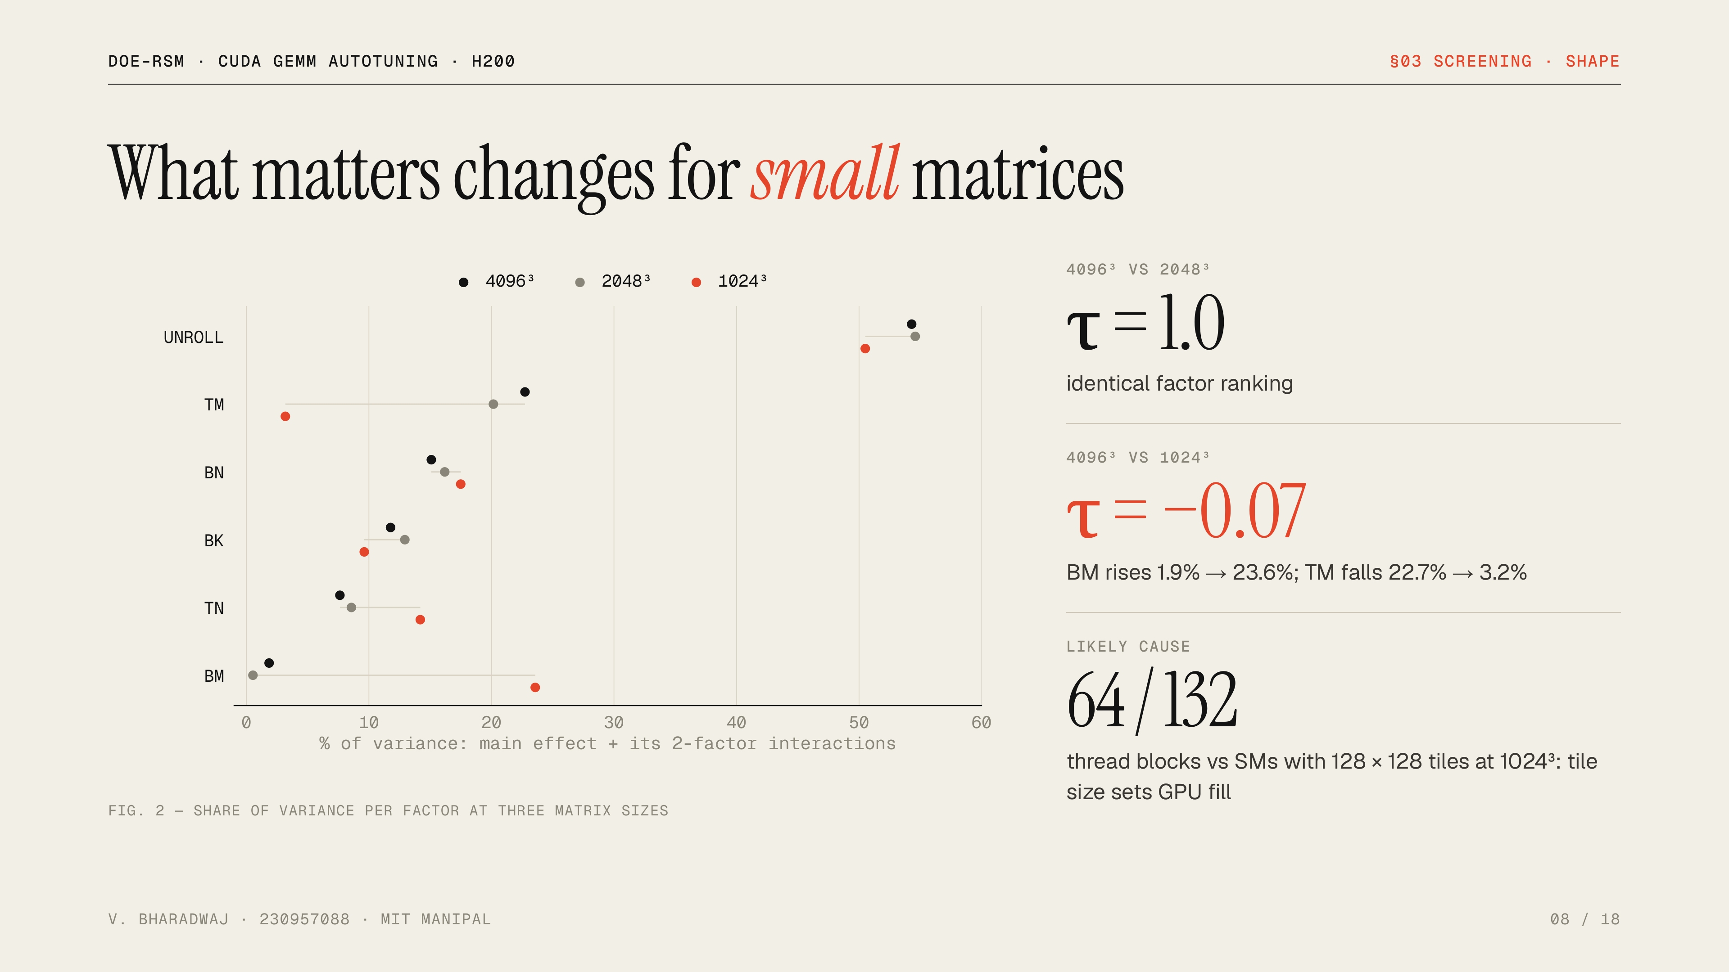
Notes:
I repeated the screening at two smaller sizes. At 2048 cubed the factor ranking is identical to 4096, Kendall tau of 1. At 1024 cubed it is unrelated, tau near zero: the block-tile height BM becomes the second most important factor and the register tile TM drops to last. My explanation, stated as likely rather than proven: with big tiles a 1024 matrix produces only 64 thread blocks, fewer than the H200’s 132 SMs, so tile size decides how much of the GPU is busy. Tuned settings do not transfer to small problems.

Slide 9
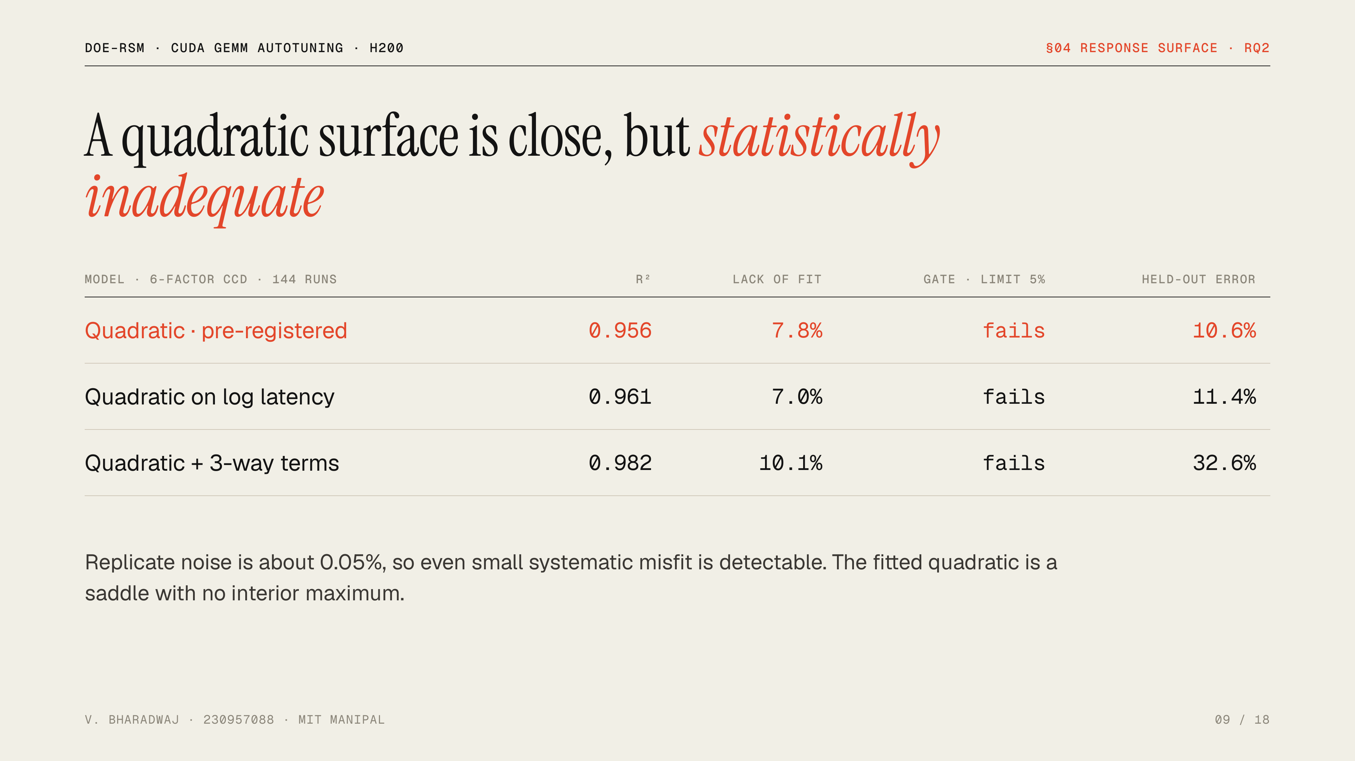
Notes:
This is the honest answer to RQ2. A six-factor central composite design gave a quadratic model with R-squared 0.956, which looks good. But I fixed an adequacy test in advance: lack of fit had to be under 5% of the model mean square. It came in at 7.8%, so it fails, and so does the log-latency fallback. Held-out error is the median error predicting a configuration the model never saw. Because the measurements are so precise, the test sees systematic misfit a noisier experiment would hide. I report this rather than quietly optimising the model anyway.

Slide 10
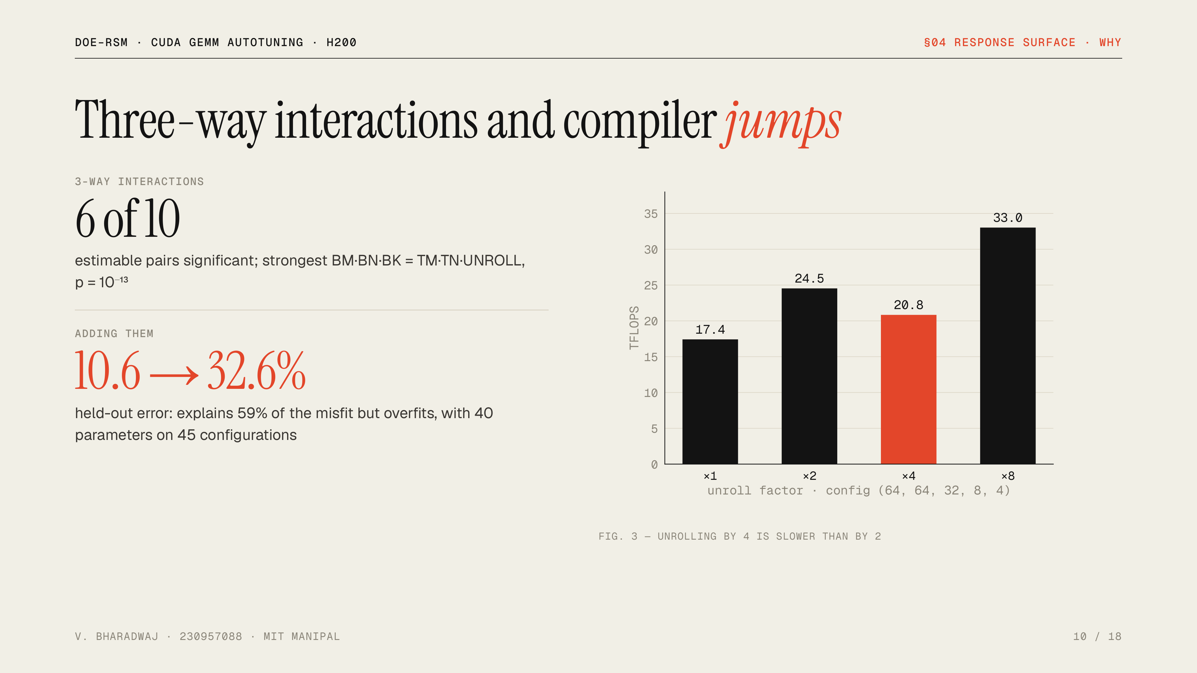
Notes:
Where does the misfit come from? Eighty percent of it is inside the main factorial region, not at the extremes. Two causes. First, three-way interactions: a large register tile, a deep K tile and full unrolling together give a boost no pair of factors explains. Adding those terms, as a follow-up after the gate failed, confirms they are significant, but the model then has 40 parameters for 45 configurations and overfits badly. Second, some behaviour is not smooth at all: here unrolling by 4 is slower than by 2. That is a compiler code-generation effect, and no polynomial can follow it.

Slide 11
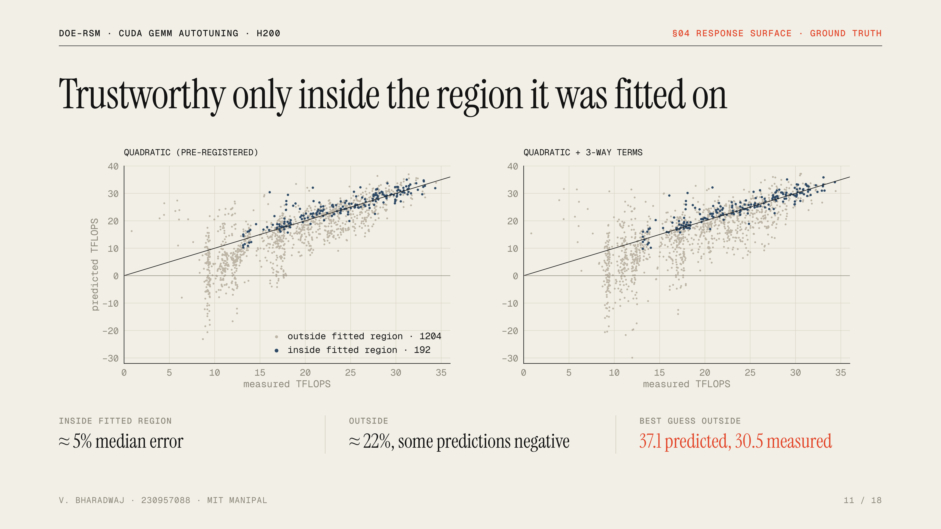
Notes:
Because I measured every configuration, I can check the models everywhere. Blue points are inside the region the design actually tested together; there both models are off by about 5 percent. Grey points are outside; there the error is around 22 percent and the model even predicts negative throughput. Its favourite configuration outside the region was predicted at 37.1 TFLOPS and measured at 30.5. That is why optimisation was restricted to the tested region, a decision fixed before seeing this data.

Slide 12
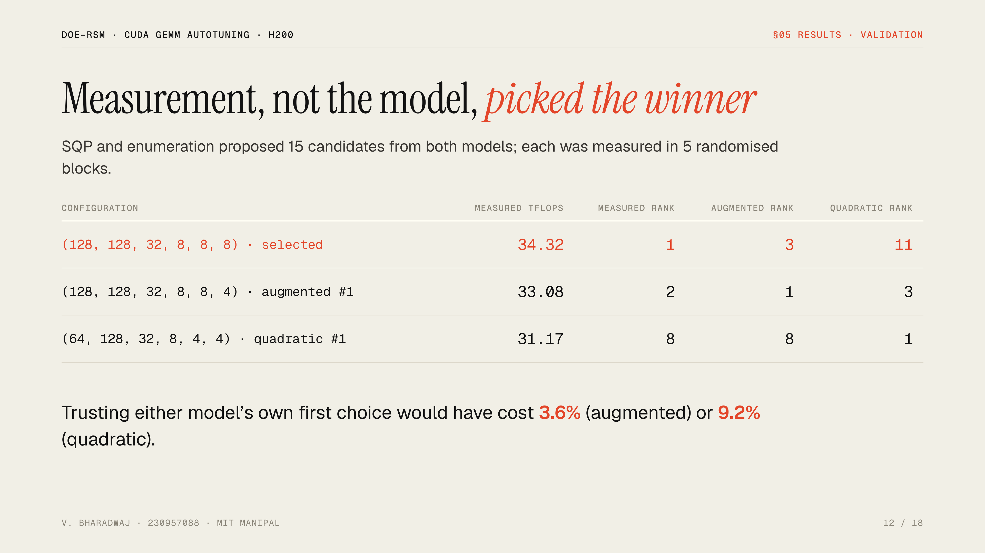
Notes:
After the gate failed, I used the models only to propose candidates: constrained SQP on the continuous surface, plus exhaustive evaluation of the model over the 192 legal configurations in the tested region. Fifteen candidates from both models were then measured five times each. The fastest, 128, 128, 32, 8, 8, 8 at 34.3 TFLOPS, was ranked only third by the augmented model and eleventh by the quadratic. Each model’s own favourite measured 4 to 9 percent slower. In this space a response surface is a good proposal generator, but the decision has to be measured.

Slide 13
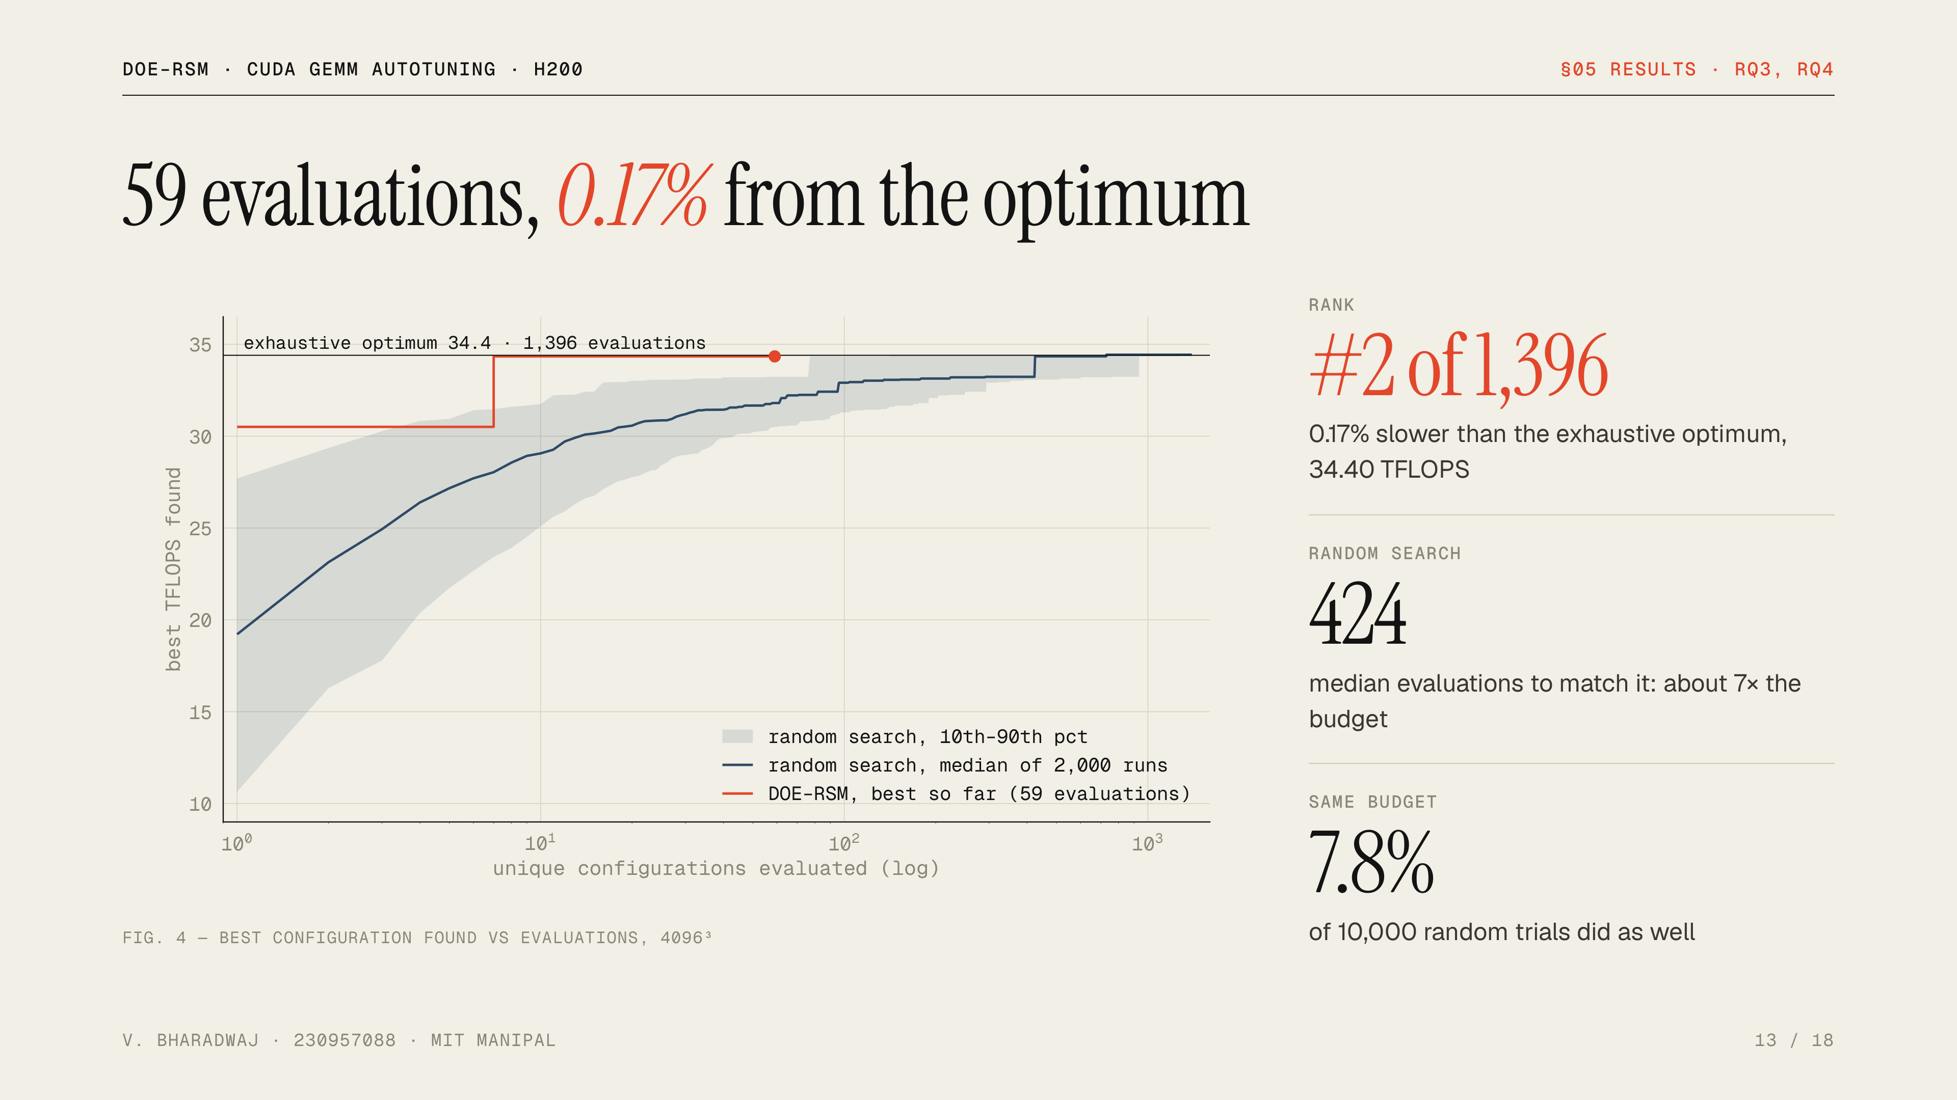
Notes:
This is the main result, RQ3 and RQ4. DOE–RSM used 59 distinct configurations and its choice is the second-best of all 1,396, 0.17 percent behind the true optimum. With exactly the same 59-configuration budget, repeated 10,000 times, random search is 7.3 percent behind at the median and matches DOE–RSM in only 7.8 percent of trials. To match it, random search needs a median of 424 evaluations. One honest note: the winning configuration is a corner of the screening design and was first measured at evaluation 7. The surface and validation confirmed it rather than discovered it, so the credit goes to the design as a whole.

Slide 14
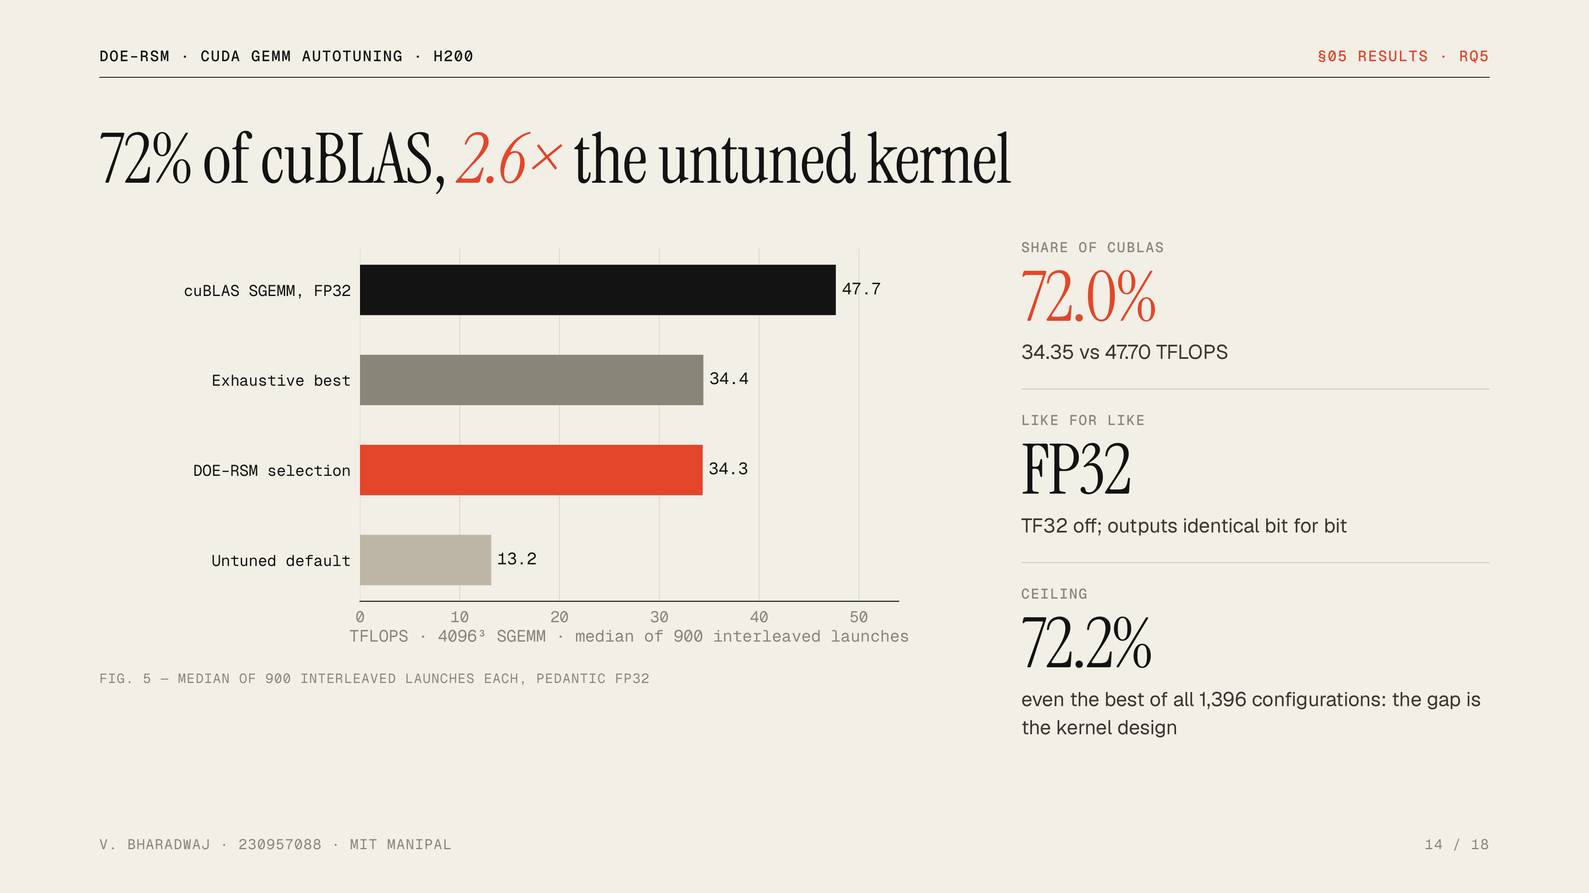
Notes:
RQ5. The tuned kernel reaches 72 percent of cuBLAS and is 2.6 times faster than the untuned default. The comparison is fair: cuBLAS ran in pedantic FP32 mode with TF32 disabled, the outputs are bit-identical, and the timings come from 900 launches of each, interleaved in the same process. The remaining 28 percent is not a tuning failure: even the exhaustive best stops at 72.2 percent. cuBLAS uses techniques this kernel does not have, such as vectorised loads, asynchronous double buffering and warp-level tiling. The project never claims to beat cuBLAS.

Slide 15
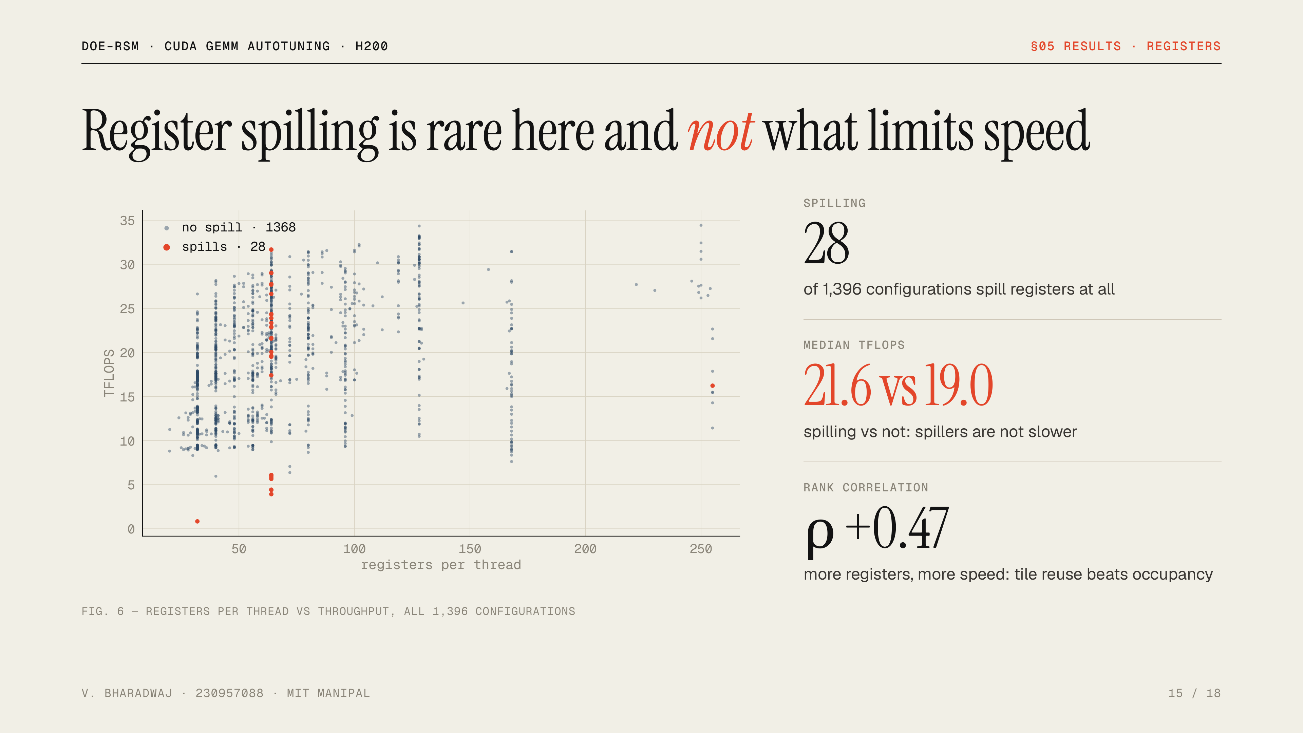
Notes:
The synopsis expected the response surface to capture register spilling. I recorded the compiler’s register and spill report for every configuration. Spilling is rare, 28 of 1,396, and those configurations are not slower than the rest. The real pattern is that more registers per thread mean more speed, a rank correlation of 0.47, because a bigger register tile reuses each loaded value more often, which outweighs running fewer threads.

Slide 16
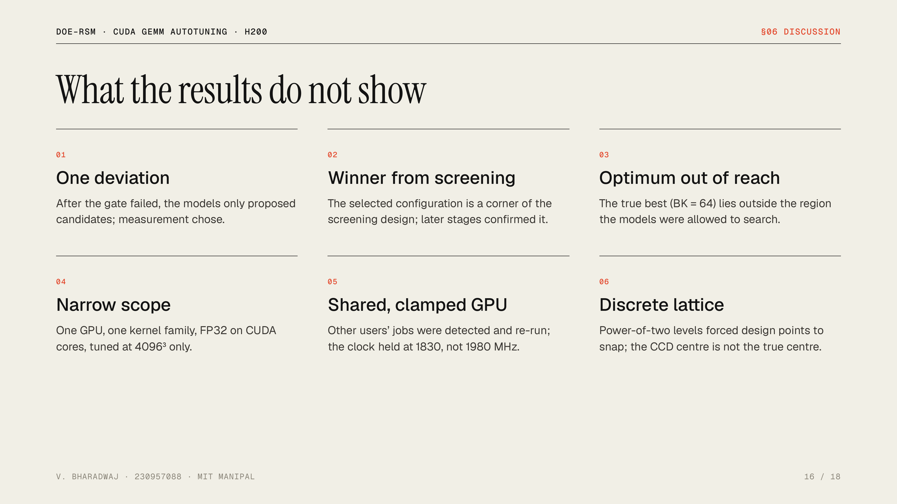
Notes:
Six limits worth stating before anyone asks. One deviation from the pre-registered plan, made after the adequacy test failed and documented. The winning configuration came from the screening design, so the later stages confirmed rather than found it. The true optimum used BK of 64, outside the region the models were allowed to search, a restriction chosen to avoid extrapolation. The scope is one GPU, one kernel and one main matrix size. The GPU was shared, handled by detection and retries. And the power-of-two lattice meant design points had to snap to legal values.

Slide 17
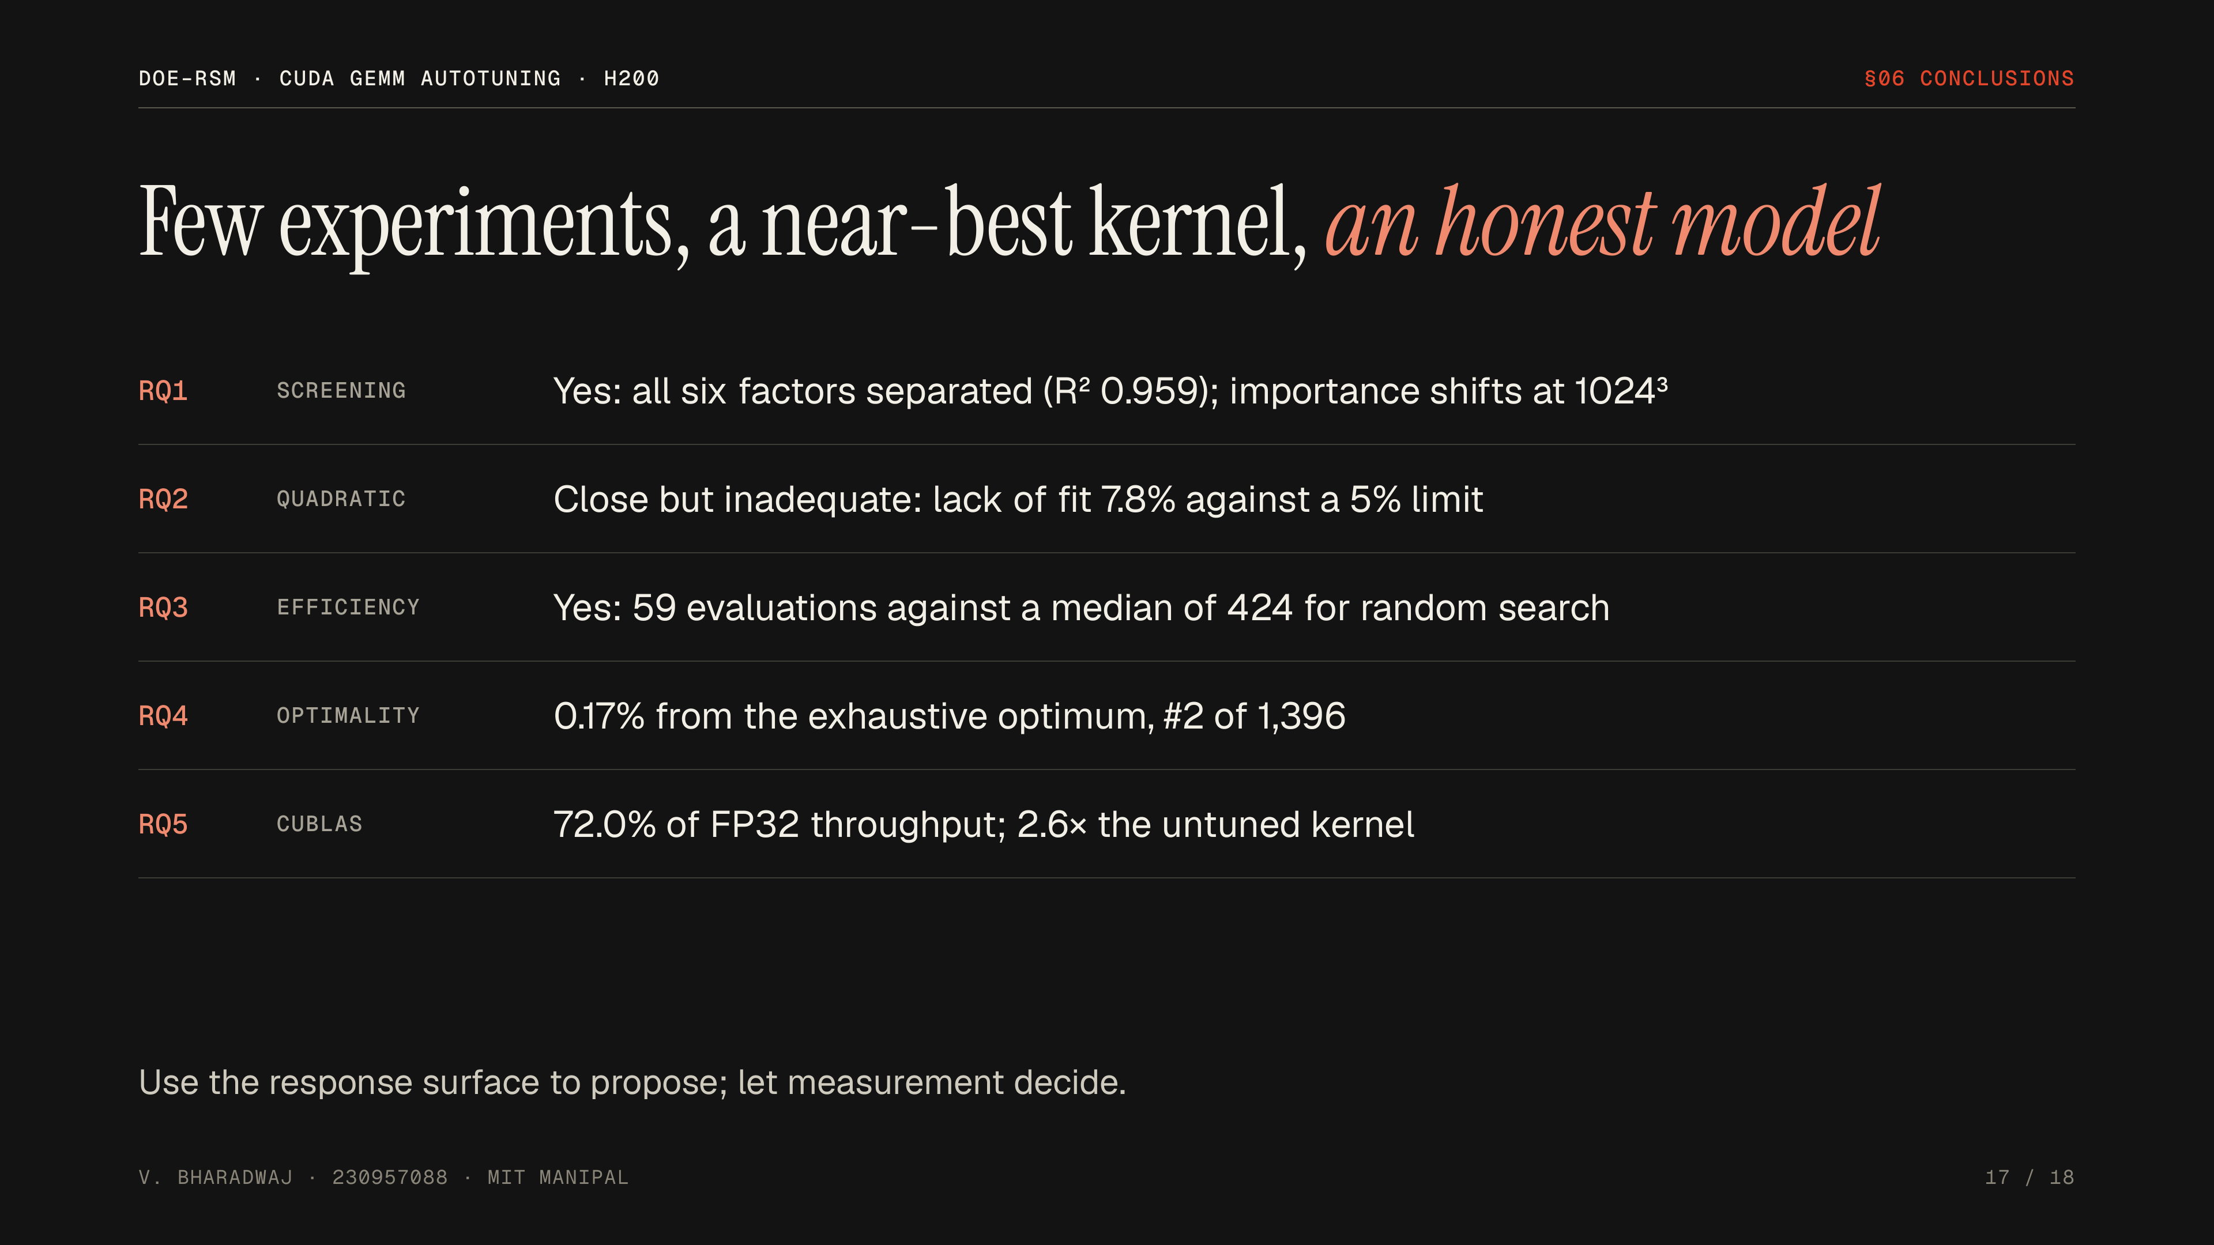
Notes:
One line per question. Screening works and separates all six factors, though their importance shifts for small matrices. A quadratic surface gets close but fails a strict adequacy test, because the GPU has three-way interactions and abrupt compiler effects. The full design is still very sample-efficient: 59 evaluations to land 0.17 percent from the true optimum, where random search needs about 424. And the tuned kernel reaches 72 percent of cuBLAS. The practical message: use the response surface to propose candidates, and let measurement decide.

Slide 18

Notes:
Four natural extensions. A full 2 to the 6 factorial core would let the three-way interactions be estimated without the overfitting we saw. Because factor importance changes for small matrices, tuning should be done per shape. A comparison with Bayesian optimisation, which modern autotuners use, would test the efficiency claim against a stronger baseline than random search. And adding kernel features such as vectorised loads as factors would raise the 72 percent ceiling. Thank you, happy to take questions.

