Slide 1


Budget Sales Analytics Report
Sales Overview & Performance Insights

Slide 2
Executive Summary
• Total Sales: $16.9M
• Total Quantity Sold: 204
• Average Sale: $82.7K
• Bikes contributed 93.95% of total revenue

Slide 3
Sales by Category Overview
Quantity Sold:
Accessories 96
Clothing 72
Bikes 36
Revenue:
Accessories $687,607
Clothing $333,741
Bikes $15,848,226

Slide 4
Monthly Sales Trend
Jan
$850K
Jun
$1.61M
Dec
$1.87M
July–Aug.
Steady growth observed with dips in July–August
December
Sales peaked in December

Slide 5
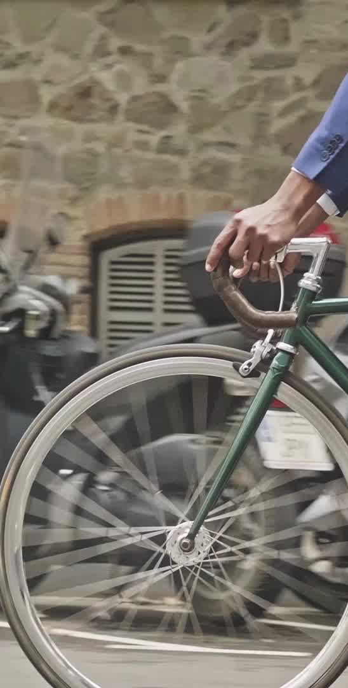
Sales by Sub-Category
Top Sub-Categories:
- Mountain Bikes
- Road Bikes
- Touring Bikes
Bottom Sub-Categories:
- Jerseys
- Helmets

Slide 6

Top Product Performance
Top Products:
- Mountain-100
- Road-150
- Touring-200
These contributed the most to total revenue

Slide 7
Top vs Bottom Sub-Categories
Top Performing (Consistent):
Low Performing:
Caps, Socks, Cleaners
Strategic focus can enhance growth
Mountain, Road, and Touring Bikes

Slide 8

Insights & Recommendations
Invest more in top-performing bike categories
Reevaluate underperforming accessories
Consider bundling strategies to boost Clothing sales
Promotions for low-performing products

Slide 9
Thank You
Questions? Let's discuss your next big move!

