Slide 1
Banking Data Analysis
A. Vyas
M. Dinesh
A.V. Sriram
G.A.N. Murthy

Slide 2
Contents
Abstract
Technologies used
Our Solution
Formulae used

Slide 3
Abstract / Use case Description
This use case is used to predict the safe loan amount that can be sanctioned to a customer
This use case can predict the risk amount of 3 different types by taking input bank statement from the customer
This use case will analyze whether the customer is eligible to take loan or not using his bank statement

Slide 4
Technologies used
Language used: SQL for data analysis
Spark - is a unified analytics engine for big data processing
Databricks Cluster - is a set of computation resources and configurations on which you run data analytics

Slide 5
Solution for use case
When the customer provided the bank statement we take that statement as data set.
We analyze the data set using spark and SQL by running some queries like
‘select sum(deposit)-sum(withdrawal) from “dataset” group by month’
We add all the monthly results extracted from the above query and divide it by the number of months from input
From the above result we get an averaged number of savings amount . That number will be divided by half
for e.g.: if we get 30,000 then half amount is 15,000

Slide 6
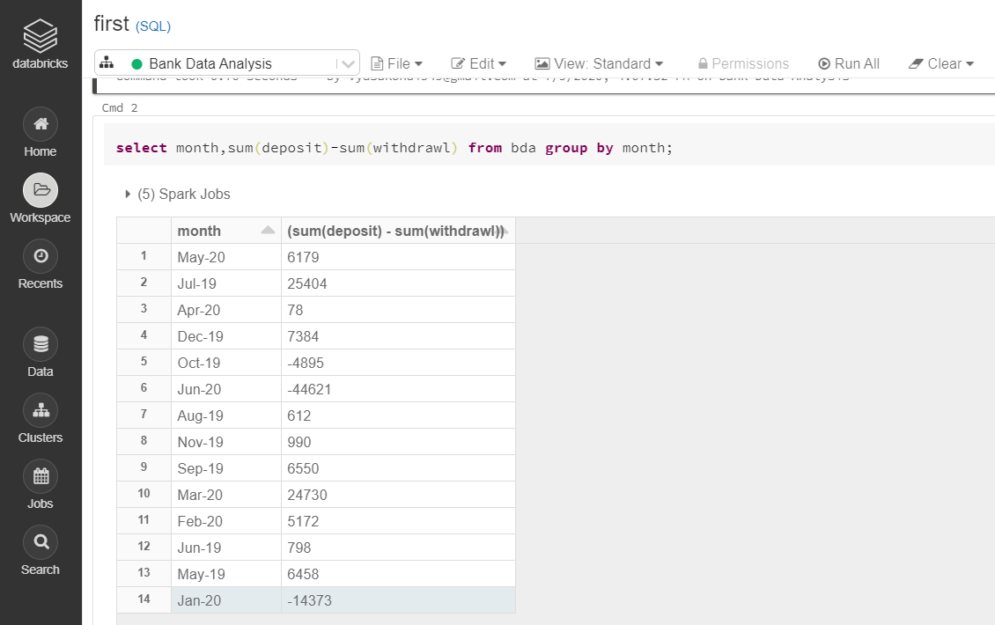
Solution for use case
Screenshot represent the query mentioned in previous slide
and the analysis doesn’t meet requirements

Slide 7
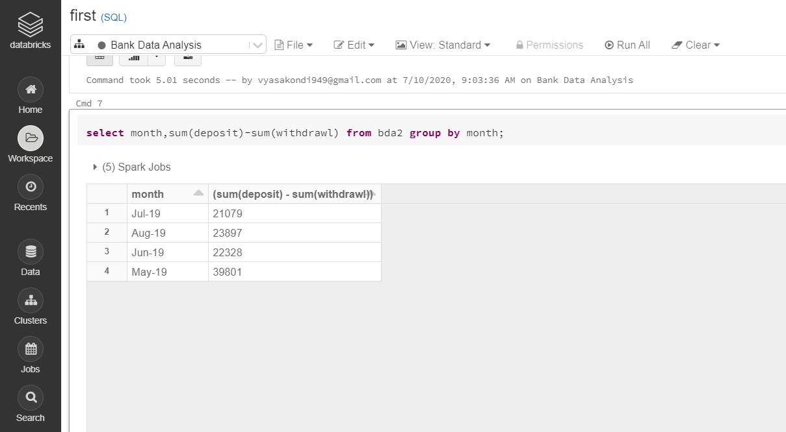
Solution for use case
Loan requirements are satisfied in this screenshot

Slide 8
Solution for use case
While in monthly based analysis if the savings amount doesn’t meet requirements, automatically the loan will be rejected
This analysis provide three solutions for user like at 50% risk, at 70% risk, at 90% risk
e.g. : if averaged amount is 30,000 at 50% risk he can pay 15,000
at 70% risk 21,000, at 90% risk 27,000
The user choose the risk amount accordingly

Slide 9
Formulae used
For average savings amount: (sum of saving amount per month)/ number of months
For risk amount calculation:
50% risk amount: 50 * average savings amount /100
70% risk amount: 70 * average savings amount / 100
90% risk amount: 90 * average savings amount / 100

Slide 10
Thank you
Any Questions ?

