Slide 1
IBM University Engagement Project Submission
“Exploring the power of Agentic AI with IBM Granite and LangFlow”

Slide 2

Project Tile – [Agentic AI for Mental Health& Suicide Prevention]
Domain of Project – [ Healthcare.]
Student Name | Recent Passport Photo | Email ID | Mobile number [WhatsApp]
VYAS VRAJ JAYESHBHAI. |  | vyasvraj1815@gmail.com | 9913003111

Slide 3
Problem Statement -
Agentic AI for Mental Health Awareness & Suicide Prevention
The Challenge
Mental health issues such as depression, anxiety, and suicidal thoughts are growing worldwide. Stigma, lack of awareness, and limited access to timely help prevent many individuals from seeking support. Traditional systems are often reactive, leaving gaps in early detection and preventive care.
The Objective
Build an Agentic AI-powered Mental Health Awareness & Suicide Prevention Agent that is empathetic, proactive, and safe. The solution should:
Promote Awareness & Education – Share accessible resources on mindfulness, coping strategies, and self-care.
Enable Early Detection (RAG) – Use Retrieval-Augmented Generation to identify distress signals in conversations, journaling inputs, or safe online data.
Provide Empathetic Support – Build a conversational agent that listens actively and responds with empathy (with clear disclaimers: not a substitute for professional medical advice).
Predict & Prevent Risks – Forecast stress peaks, suggest preventive strategies, and issue alerts when high-risk signals are detected (with consent).
Connect to Human Support – Link users to helplines, counselors, or community support for timely intervention.
Tech Stack (Mandatory)
IBM Langflow / IBM Orchestrate + IBM Models

Slide 4
Proposed Solution -
Proposed Solution: AI-Powered Mental Health Awareness & Suicide Prevention Agent
The proposed solution is an Agentic AI-powered Mental Health Awareness & Suicide Prevention platform built using IBM LangFlow, IBM Orchestrate, IBM watsonx.ai, Granite Models, and a Retrieval-Augmented Generation (RAG) pipeline to provide empathetic, secure, and proactive mental health support. The platform is designed to promote mental wellness, identify early signs of emotional distress, and connect users with appropriate support while maintaining user privacy and safety.
At its core, the system uses a Retrieval-Augmented Generation (RAG) architecture that retrieves verified mental health information from trusted knowledge sources such as the World Health Organization (WHO), National Institute of Mental Health (NIMH), government mental health guidelines, and evidence-based wellness resources. This knowledge is embedded into a vector database, enabling the AI to generate reliable, context-aware, and empathetic responses using IBM Granite Models.
The platform consists of five intelligent AI agents working together to provide comprehensive mental health assistance:
1. Mental Health Awareness Agent
This agent educates users about mental health by providing easy-to-understand information on topics such as anxiety, depression, stress management, mindfulness, self-care practices, emotional well-being, and healthy lifestyle habits. It recommends verified articles, breathing exercises, meditation techniques, and wellness resources to improve mental health awareness.
2. Early Detection Agent (RAG-Based)
Using Retrieval-Augmented Generation and natural language understanding, this agent analyzes user conversations, journal entries, and mood logs to detect early signs of emotional distress, anxiety, depression, burnout, or suicidal ideation. It identifies behavioral patterns and provides timely recommendations while ensuring ethical AI practices and user consent.
3. Empathetic Support Agent
This conversational AI acts as a compassionate virtual companion that actively listens to users and responds with empathy and encouragement. Powered by IBM Granite Models, it offers emotional support, coping strategies, stress-relief techniques, and mindfulness exercises while clearly informing users that it is not a substitute for professional medical advice or licensed mental health care.

Slide 5
4. Risk Prediction & Prevention Agent
This agent continuously analyzes mood trends, stress levels, sleep patterns, and journal history to forecast potential emotional crises or stress peaks. Based on predictive insights, it generates personalized wellness plans, recommends preventive strategies, schedules self-care reminders, and issues alerts when high-risk patterns are detected, subject to user consent.
5. Crisis Support & Human Assistance Agent
When high-risk or crisis-related signals are identified, this agent immediately provides emergency guidance by displaying suicide prevention helplines, nearby counseling services, mental health professionals, and trusted emergency contacts. With the user's permission, it can notify pre-selected emergency contacts or caregivers to ensure timely human intervention.
The solution includes a modern web dashboard built using React (Vite) and Tailwind CSS v3, offering an intuitive and responsive user experience. Users can interact with the AI chatbot, maintain a personal mood journal, track emotional well-being over time, visualize mood and stress analytics, explore educational resources, and access emergency support services from a single platform.
IBM LangFlow is used to orchestrate the workflows between different AI agents, while IBM Orchestrate manages task automation and agent collaboration. IBM watsonx.ai provides scalable model deployment, embeddings, vector search, and AI governance, and IBM Granite Models power empathetic reasoning, contextual understanding, summarization, personalization, and conversational intelligence.
Overall, the proposed solution delivers a secure, intelligent, and proactive mental health assistant that combines education, early detection, empathetic support, predictive analytics, and human intervention to promote mental well-being and help prevent mental health crises through responsible and trustworthy AI.

Slide 6
Technology Used
Technology Stack Used
Frontend
React.js (Vite)
JavaScript (ES6+)
Tailwind CSS v3
React Router DOM
Framer Motion (Animations)
Axios (API Communication)
Chart.js / Recharts (Mood & Analytics Dashboard)
React Icons / Lucide React
Backend
Node.js
Express.js
RESTful APIs
AI & Machine Learning
IBM watsonx.ai
IBM Granite Models
IBM LangFlow
IBM Orchestrate
Retrieval-Augmented Generation (RAG)
Natural Language Processing (NLP)
Prompt Engineering
AI Agent Architecture

Slide 7
Knowledge Retrieval (RAG)
IBM watsonx Embeddings
Vector Database (FAISS / ChromaDB)
Semantic Search
Document Embeddings
Similarity Search
Database
MongoDB
Mongoose ODM
Authentication & Security
JWT (JSON Web Token)
bcrypt.js
Role-Based Access Control (RBAC)
HTTPS
Environment Variables (.env)
APIs & Integrations
IBM watsonx.ai API
IBM Granite API
IBM LangFlow API
WHO Mental Health Knowledge Base
NIMH Resources
Crisis Helpline APIs (Optional)
Google Maps API (Nearby Counselors - Optional)

Slide 8
Data Visualization
Chart.js
Recharts
Progress Bars
Risk Score Gauge
Mood Trend Charts
Development Tools
Visual Studio Code
Git
GitHub
npm
Postman
Deployment
Vercel (Frontend)
Render / Railway (Backend)
MongoDB Atlas (Cloud Database)
AI Features
Empathetic Conversational AI
Emotion Detection
Sentiment Analysis
Suicide Risk Detection
Stress Prediction
Personalized Wellness Recommendations
Conversation Memory
Mood Tracking
AI-Powered Journaling
Crisis Alert System
Human Support Escalation

Slide 9
UI/UX Technologies
Responsive Design
Dark/Light Mode
Glassmorphism UI
Modern Dashboard
Mobile-First Design
Accessibility (WCAG Guidelines)
External Knowledge Sources (RAG)
World Health Organization (WHO)
National Institute of Mental Health (NIMH)
Evidence-Based Mental Health Resources
Government Mental Health Guidelines
Version Control
Git
GitHub

Slide 10
Langflow component Used -
Chat Input – Receives user messages, journal entries, and mood updates.
Prompt Template – Creates structured prompts for empathetic AI responses.
IBM Granite Model – Generates contextual, empathetic, and personalized responses.
Embeddings Model – Converts documents and user inputs into vector embeddings for semantic search.
Vector Store (FAISS/ChromaDB) – Stores and retrieves embedded mental health knowledge.
Retriever (RAG) – Fetches the most relevant information from the knowledge base before generating responses.
Agent – Coordinates reasoning, decision-making, and execution of tasks between components.
Memory – Maintains conversation history to provide context-aware responses.
Conditional Router – Detects crisis or high-risk conversations and routes them to emergency support workflows.
Output Parser – Formats AI responses before displaying them to the user.
HTTP/API Request – Connects Langflow with the React frontend and external services.
Tool Node – Integrates external resources such as helplines, mental health knowledge bases, and emergency services.

Slide 11
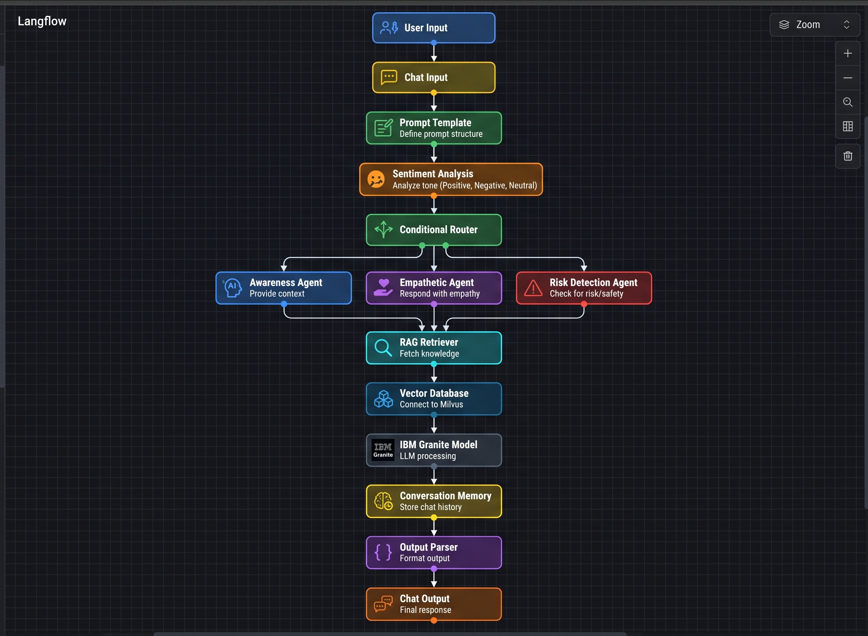
Langflow workflow -

Slide 12
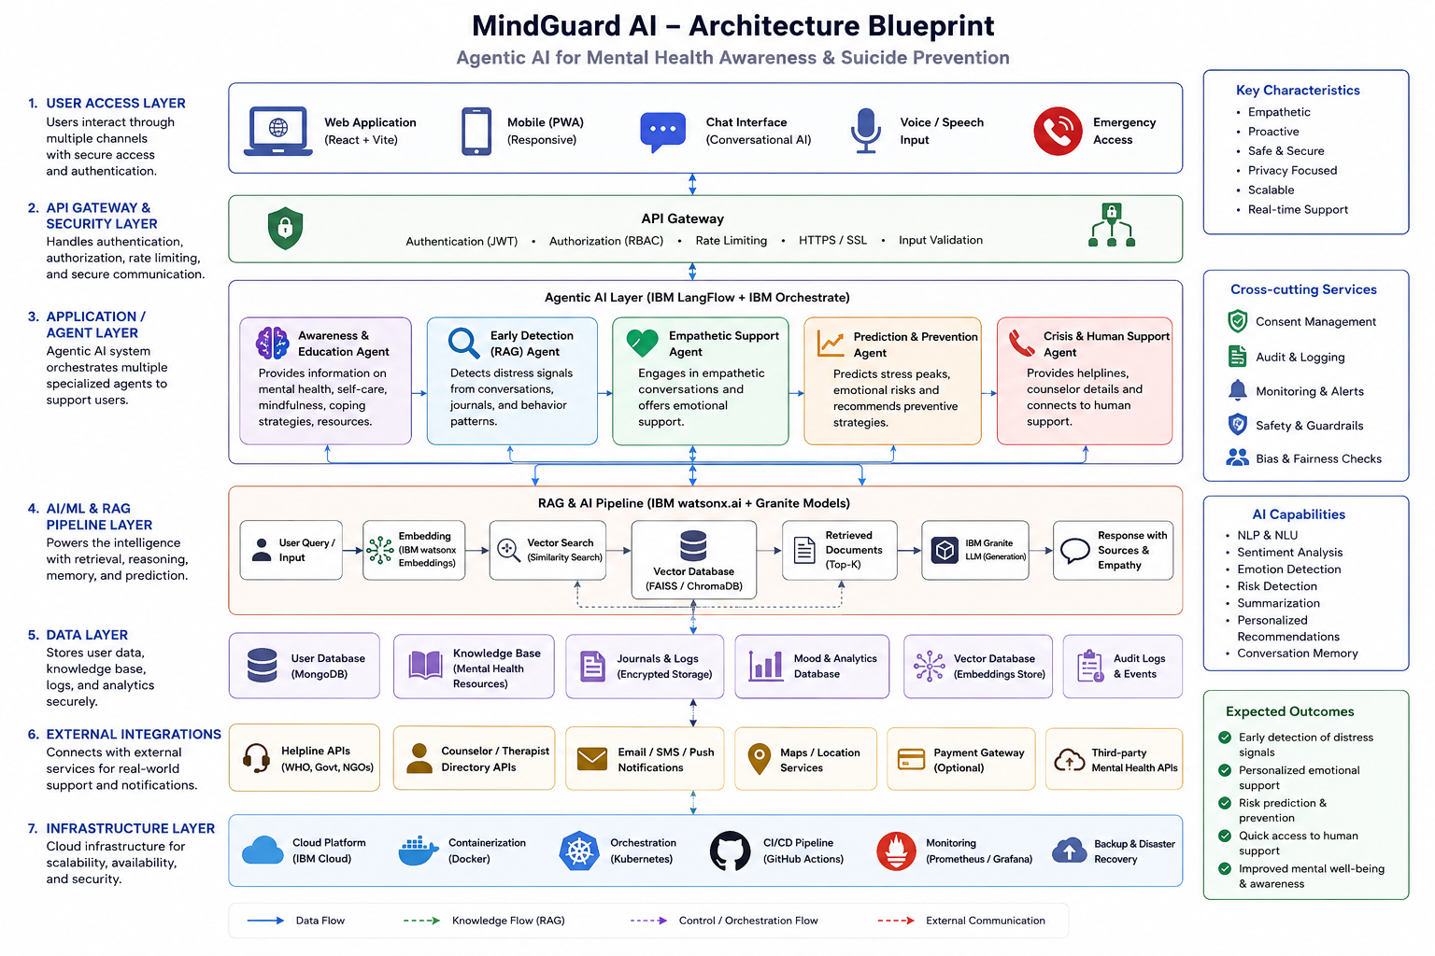
Architecture blueprint

Slide 13

Role of Agentic AI in the solution
Agentic AI serves as the intelligent core of the MindGuard AI – Mental Health Awareness & Suicide Prevention Platform. Unlike a traditional chatbot that only answers questions, Agentic AI is designed to understand user context, reason across multiple tasks, collaborate with specialized AI agents, and take proactive actions while prioritizing user safety, privacy, and well-being.
The platform uses IBM LangFlow, IBM Orchestrate, IBM watsonx.ai, and IBM Granite Models to coordinate multiple AI agents that work together to deliver personalized, empathetic, and timely mental health support.
Roles of Agentic AI
1. Mental Health Awareness & Education
Provides reliable information about mental health, stress, anxiety, depression, mindfulness, and self-care.
Recommends evidence-based articles, meditation techniques, breathing exercises, and wellness resources.
Promotes awareness to reduce stigma surrounding mental health.
2. Early Detection of Emotional Distress
Analyzes conversations, journal entries, and mood logs using Retrieval-Augmented Generation (RAG).
Identifies patterns that may indicate stress, anxiety, burnout, depression, or suicidal thoughts.
Continuously monitors emotional trends while respecting user consent and privacy.
3. Empathetic Conversational Support
Engages users in compassionate, human-like conversations.
Listens actively and responds with empathy, encouragement, and coping strategies.
Clearly informs users that the AI is not a substitute for professional medical advice or licensed mental health care.

Slide 14
4. Intelligent Decision-Making
Coordinates multiple specialized AI agents through IBM LangFlow and IBM Orchestrate.
Selects the most appropriate workflow based on the user's emotional state and needs.
Combines retrieved knowledge with contextual reasoning to provide accurate and personalized responses.
5. Personalized Recommendations
Generates customized wellness plans based on the user's mood history, stress levels, sleep patterns, and personal preferences.
Suggests mindfulness exercises, journaling prompts, relaxation techniques, and healthy lifestyle practices.
6. Risk Prediction & Preventive Care
Forecasts potential stress peaks and emotional deterioration using historical mood and behavioral data.
Recommends preventive actions before a crisis occurs.
Sends wellness reminders and self-care suggestions to encourage healthy habits.
7. Crisis Detection & Human Intervention
Detects high-risk conversations containing signs of self-harm or suicidal ideation.
Immediately provides verified crisis helpline information, nearby counseling services, and emergency resources.
With the user's consent, assists in notifying trusted contacts or mental health professionals for timely intervention.
8. Continuous Learning through RAG
Retrieves the latest evidence-based mental health information from trusted sources such as WHO, NIMH, and government mental health guidelines.
Generates responses grounded in verified knowledge rather than relying solely on the language model's internal knowledge.
Improves response accuracy, transparency, and reliability.
9. Privacy, Ethics & Safety
Protects sensitive user information through secure data handling and consent management.
Follows responsible AI principles by avoiding harmful advice or medical diagnoses.
Ensures every response complies with ethical guidelines and emphasizes professional support when necessary.

Slide 15
Novelty and Uniqueness
The proposed MindGuard AI – Agentic AI for Mental Health Awareness & Suicide Prevention platform introduces a proactive, multi-agent, and human-centered approach to mental healthcare. Unlike conventional chatbots that only respond to user queries, MindGuard AI leverages Agentic AI to understand context, coordinate specialized AI agents, predict emotional risks, and recommend timely interventions while maintaining ethical AI practices and user privacy.
Key Novel Features
1. Multi-Agent AI Architecture
Uses multiple specialized AI agents for awareness, early detection, empathetic conversation, risk prediction, and crisis support.
Each agent performs a dedicated task while collaborating through IBM LangFlow and IBM Orchestrate for intelligent decision-making.
2. Retrieval-Augmented Generation (RAG) for Trusted Responses
Integrates RAG to retrieve verified information from trusted mental health resources such as WHO, NIMH, and evidence-based wellness guidelines.
Ensures responses are accurate, reliable, and grounded in current knowledge rather than relying only on the language model.
3. Proactive Risk Prediction
Goes beyond reactive conversation by analyzing mood history, journal entries, and behavioral patterns to identify early signs of stress, anxiety, depression, or emotional burnout.
Predicts potential mental health risks and recommends preventive actions before a crisis develops.

Slide 16
4. Empathetic and Personalized AI Support
Delivers compassionate, context-aware conversations using IBM Granite Models.
Provides personalized coping strategies, mindfulness exercises, and wellness recommendations based on each user's emotional state and preferences.
5. Intelligent Crisis Escalation
Detects high-risk conversations indicating possible self-harm or suicidal thoughts.
Immediately provides verified crisis helpline information, nearby counseling resources, and emergency guidance.
Supports escalation to trusted contacts or caregivers with the user's consent.
6. Privacy-First and Ethical AI Design
Incorporates consent management, secure data handling, and responsible AI principles.
Avoids medical diagnosis and encourages professional mental health support whenever appropriate.
7. Comprehensive Mental Wellness Platform
Combines AI chat, mood tracking, journaling, educational resources, predictive analytics, and emergency support into a single integrated platform.
Enables users to monitor their emotional well-being through an intuitive and interactive dashboard.
8. IBM AI Ecosystem Integration
Fully utilizes IBM LangFlow, IBM Orchestrate, IBM watsonx.ai, and IBM Granite Models to build an intelligent, scalable, and enterprise-ready Agentic AI solution.
Demonstrates seamless orchestration of AI workflows, RAG pipelines, and specialized agents within a unified architecture.

Slide 17
GitHub Link : VyasVraj/IBM_Project: Config files for my GitHub profile.
·
·
·

Slide 18
Future Scope
The MindGuard AI – Agentic AI for Mental Health Awareness & Suicide Prevention platform has significant potential for future enhancement by incorporating advanced AI capabilities, broader healthcare integrations, and personalized mental wellness services. The following improvements can further increase its impact and accessibility:
1. Wearable Device Integration
Integrate with smartwatches and fitness bands (e.g., Apple Watch, Fitbit, Samsung Galaxy Watch) to monitor heart rate, sleep quality, physical activity, and stress indicators.
Use real-time physiological data to provide more accurate emotional well-being assessments.
2. Multilingual Support
Expand the platform to support multiple regional and international languages.
Enable users to interact with the AI in their preferred language, making mental health support more accessible to diverse communities.
3. Voice-Based AI Assistance
Introduce voice conversations with speech-to-text and text-to-speech capabilities.
Improve accessibility for users who are uncomfortable with typing or have visual impairments.
4. Advanced Predictive Analytics
Apply advanced AI models to identify long-term mental health trends and detect potential emotional crises earlier.
Deliver personalized preventive recommendations based on behavioral and historical data.
5. Integration with Healthcare Systems
Connect with hospitals, clinics, and licensed mental health professionals for secure referrals and appointment scheduling.
Enable seamless collaboration between AI assistance and professional healthcare services.
6. AI-Powered Personalized Wellness Plans
Generate customized daily wellness routines based on mood patterns, lifestyle, sleep quality, and stress levels.
Include meditation plans, breathing exercises, journaling prompts, physical activity suggestions, and healthy habit tracking.
·
·
·

Slide 19
7. Community Support Platform
Develop a moderated peer-support community where users can share experiences, encourage one another, and participate in guided wellness discussions while maintaining privacy and safety.
8. Mobile Application
Launch Android and iOS applications with offline support, push notifications, and emergency assistance features.
Increase accessibility for users anytime and anywhere.
9. Smart Emergency Response
With explicit user consent, integrate real-time emergency alert systems that can notify trusted contacts, caregivers, or mental health professionals when severe crisis situations are detected.
10. Continuous Learning with IBM AI
Enhance the Agentic AI framework using future IBM Granite Models, IBM watsonx.ai capabilities, and improved LangFlow workflows.
Continuously update the RAG knowledge base with the latest evidence-based mental health research and clinical guidelines.

Slide 20
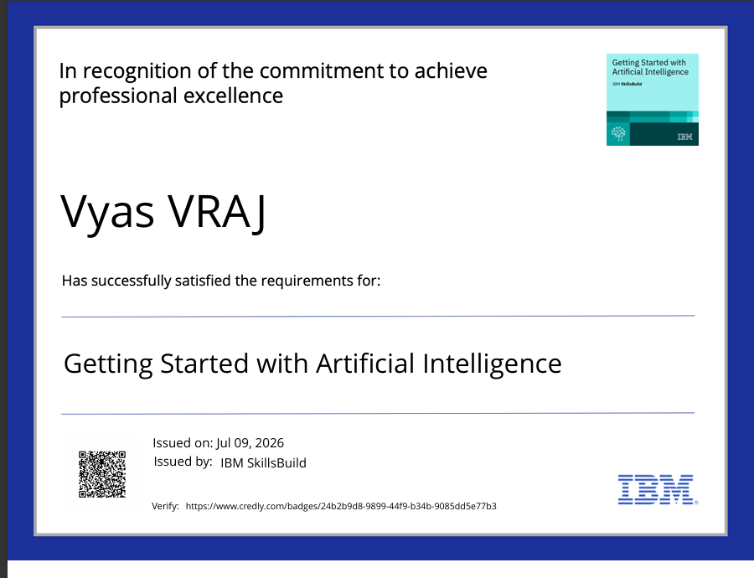
Certificates Earned:

Slide 21
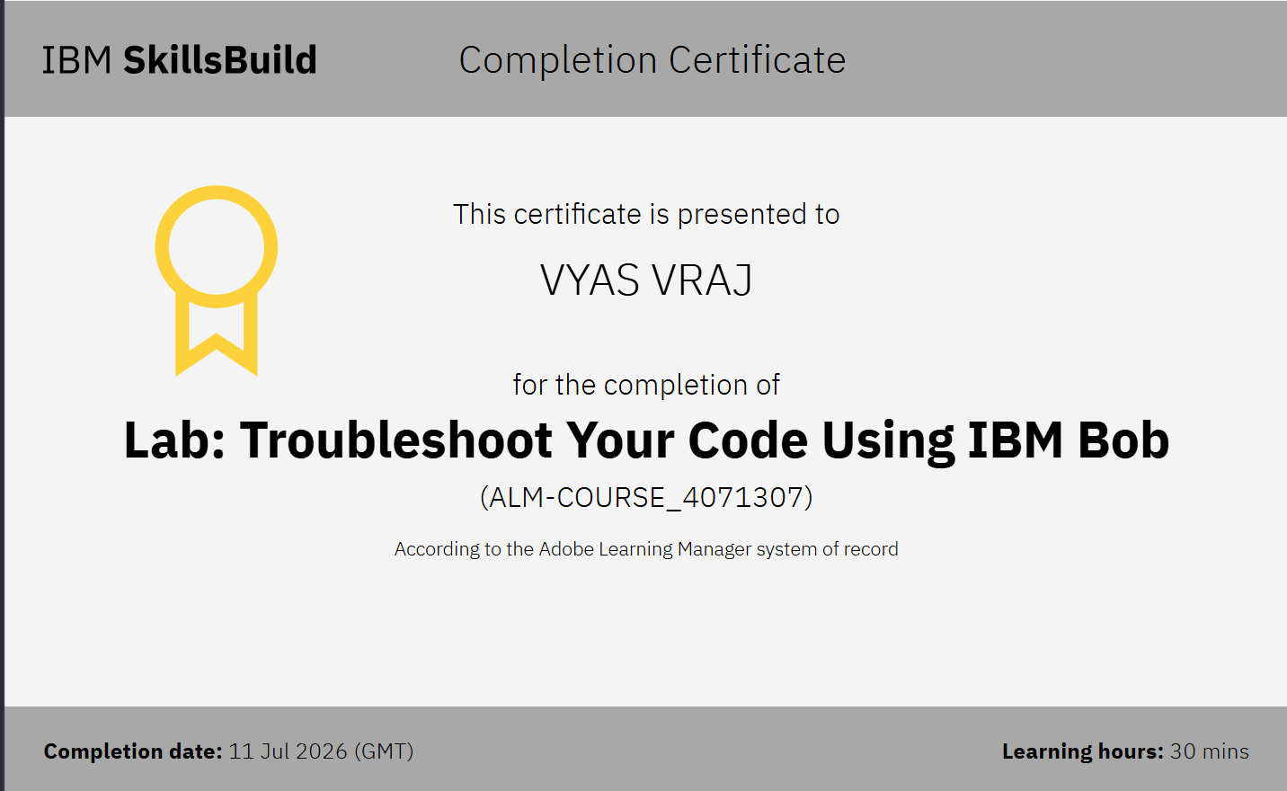

Certificates Earned:​

Slide 22


