Slide 1
Insertion in a Min-Max Heap
Advanced Data Structures
-Vybhavi
22011P0502

Slide 2
Min-Max Heap
A Min-Max Heap is a Complete Binary Tree.
Each node in the heap contains a key.
Levels alternate between Min and Max levels.
The root node is always at a Min level.
Provides efficient access to both minimum and maximum elements.
On Min levels, each node’s key ≤ all its descendants on Max levels.
On Max levels, each node’s key ≥ all its descendants on Min levels.

Slide 3
Insertion Steps
1. Insert x at next free position i.
2. Find parent P = ⌊i/2⌋.
3. Decide level of i (min or max).
• Min level:
- If x > heap[P], swap & bubble-up on max levels.
- Else bubble-up on min levels.
• Max level:
- If x < heap[P], swap & bubble-up on min levels.
- Else bubble-up on max levels.

Slide 4
Bubble-Up Operations
- Bubble-up on min levels:
• Compare with grandparent.
• Swap if smaller.
- Bubble-up on max levels:
• Compare with grandparent.
• Swap if larger.
- Stop when order is satisfied or no grandparent.

Slide 5
Pseudo Code – Insert
Procedure MinMaxHeapInsert(heap, item):
n = n + 1
heap[n] = item
parent = n / 2
if level(parent) == MIN:
if item.key > heap[parent].key:
Swap(heap[n], heap[parent])
BubbleUpMax(parent)
else:
BubbleUpMin(n)
else:
if item.key < heap[parent].key:
Swap(heap[n], heap[parent])
BubbleUpMin(parent)
else:
BubbleUpMax(n)

Slide 6
Pseudo Code – Bubble-Up
Procedure BubbleUpMin(i):
while i has grandparent g:
if heap[i].key < heap[g].key:
Swap(heap[i], heap[g])
i = g
else:
break
Procedure BubbleUpMax(i):
while i has grandparent g:
if heap[i].key > heap[g].key:
Swap(heap[i], heap[g])
i = g
else:
break

Slide 7
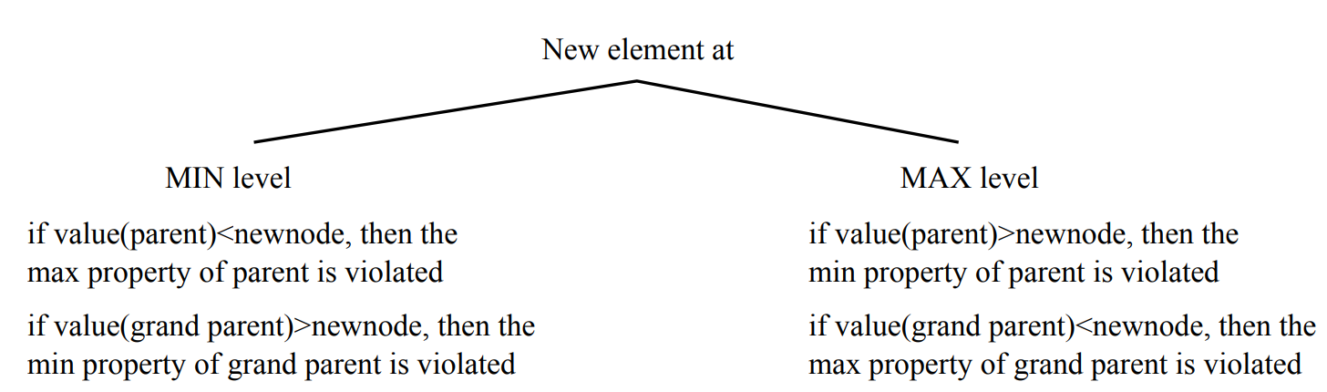

Slide 8
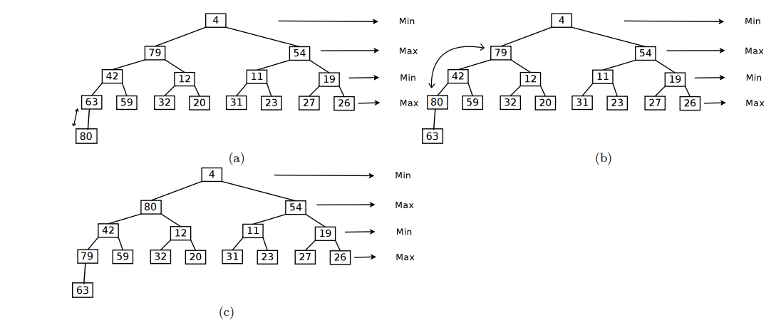
Insert 80 at next position:
Parent = 40 (max level). Since 8 < 40, swap.
The new element 80 is inserted below 63 at a MIN level, but since 63 < 80, the MAX property of the parent is violated, so they are swapped.
After swapping, 80 becomes the child of 42 and grandchild of 4; since 4 < 80, the MAX property of the grandparent is violated, so 80 and 4 are swapped.
The heap is now balanced, and all Min-Max properties are restored.

Slide 9
Complexity Analysis
- Time Complexity: O(log n)
- Bubble-up at most log n levels.
- Space Complexity: O(1)

Slide 10
Summary
- Min-Max Heap supports double-ended priority queue.
- Insertion involves:
1. Insert at next free position.
2. Compare with parent.
3. Bubble-up (min or max).
- Example: insertion of 8.
- Time: O(log n), Space: O(1).

