Slide 1
Ai Travel planner for student
CAPSTONE PROJECT
Presented By : Swati S Mali
College Name - International School of Management Excellence-Bangalore MCA

Slide 2
OUTLINE
Problem Statement
System Development Approach
Algorithm & Deployment
Result
Conclusion
Future Scope
GitHub and deployment link
References

Slide 3
Problem Statement
Design and build an AI-driven Travel Planner for student that:
Creates travel plans tailored to user preferences.
Recommends destinations and generates customized itineraries.
Suggests transportation and lodging options.
Integrates real-time data such as weather, maps, and local events.
Handles bookings and provides timely alerts.
Dynamically adjusts schedules for optimal planning.

Slide 4
System DEVELOPMENT Approach
Frontend | Streamlit app for user interaction (chat UI, input/output display)
Backend | Python logic to handle chat flow, model inference, and session state
Model Engine | LLaMA-based model
Data Handling | Optional logging, feedback collection, and prompt templates

Slide 5
Algorithm & Deployment
1. Privacy & Security
User conversations must be confidential and not stored without consent.
No personally identifiable information (PII) should be collected or exposed.
Secure communication using HTTPS.
2. Availability
The chatbot should be accessible 24/7 to support users during emotional distress.
Minimal downtime during updates or maintenance.
3. Performance
Response time should be under 2 seconds for typical queries.
Efficient memory usage to support low-resource devices (especially if using LLaMA locally).
4. Usability
Clean, intuitive interface with empathetic tone and easy navigation.
Mobile-responsive design for accessibility on phones and tablets.
Use of icons and emotional cues to guide user interaction.
5. Scalability
Should support increasing user load without degradation in performance.
Modular architecture to allow future integration (e.g., journaling, voice input, multilingual support).

Slide 6
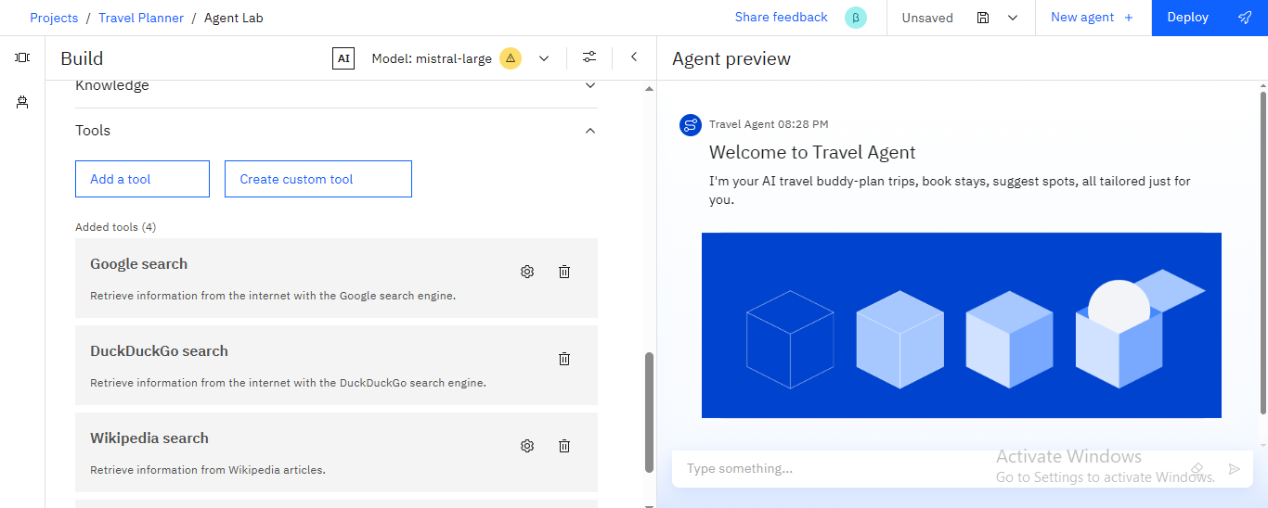
Result

Slide 7
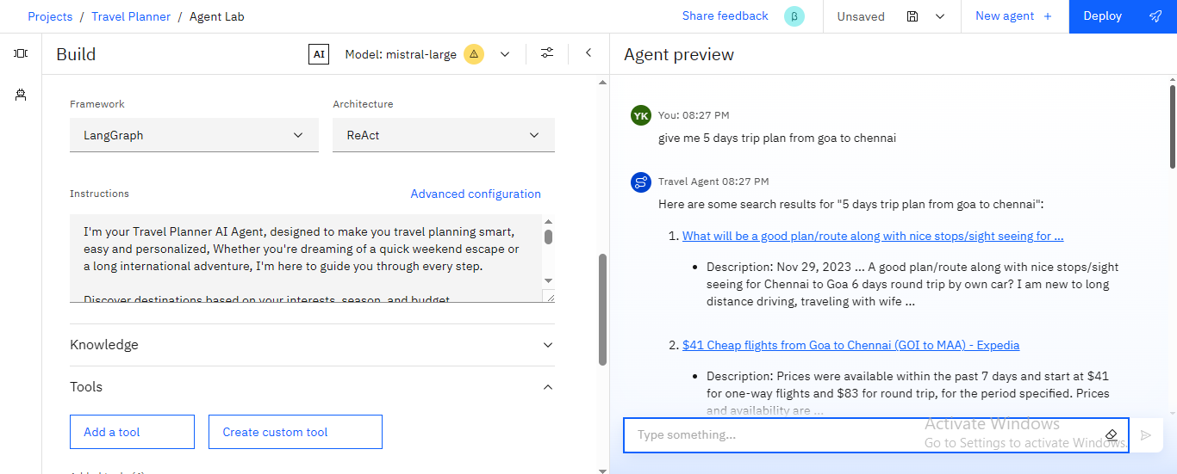
Result

Slide 8
Conclusion
The Travel Planner Agent simplifies the complexities involved in trip planning.
Utilizing IBM Cloud AI services, it provides real-time, personalized, and adaptive travel solutions, enabling users to experience a seamlessly organized journey.
This demonstrates a practical use of AI in addressing real-world logistical challenges while maintaining a user-friendly and efficient experience.

Slide 9
Future scope
AI-based fare prediction to book trips at the cheapest time.
Integration with student discounts, passes, and loyalty programs.
Voice-enabled trip planning and multilingual support.
Group trip coordination with shared itineraries and cost-splitting.
Eco-friendly travel suggestions with carbon footprint tracking.
AR/VR previews of destinations for better decision-making.
Offline mode for itinerary access without internet.

Slide 10
GITHUB AND DEPLOYMENT LINK
Attach your Github Link : coding files GITHUB
https://github.com/swatimali12/Ai-travel-planner-for-students.git
Deployment link: GITHUB/SOME OTHER PLATFORM
https://github.com/swatimali12/Ai-travel-planner-for-students.git

Slide 11
References
List and cite relevant sources, research papers, and articles that were instrumental in developing the proposed solution.
https://github.com/swatimali12/Ai-travel-planner-for-students.git

Slide 12
THANK YOU

