Slide 1
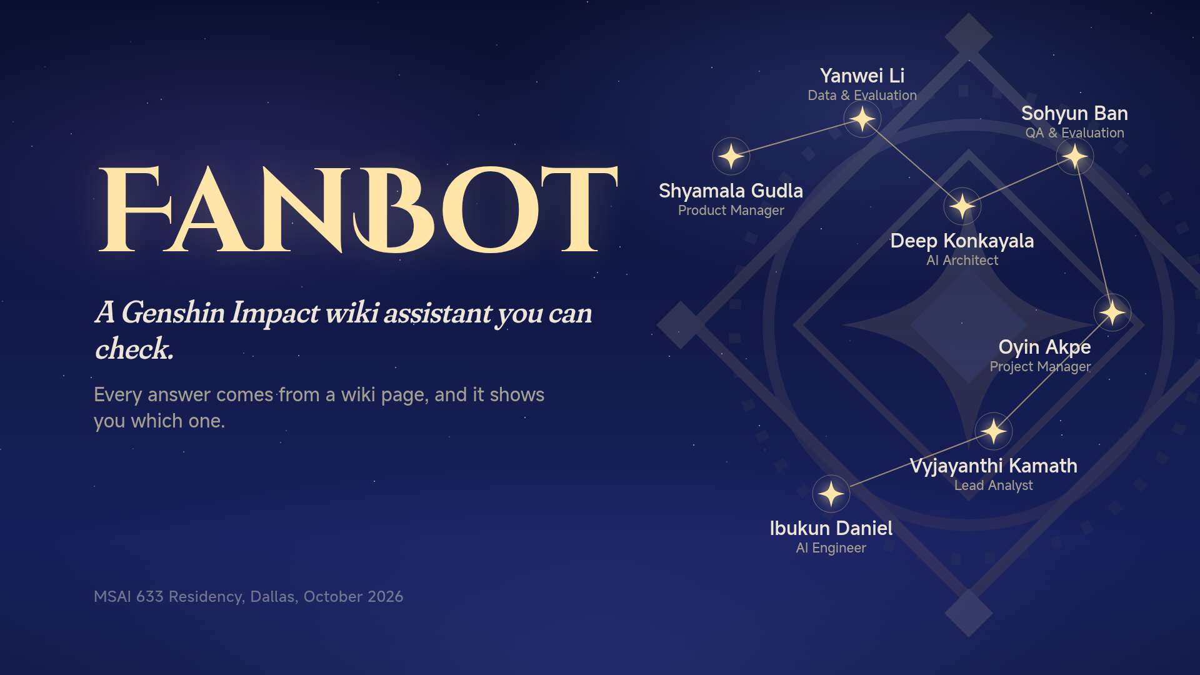
Notes:
Shyamala (15 s): name the project in one sentence and move on. The seven stars are the team; the same constellation runs along the bottom of every slide to show who is speaking.

Slide 2
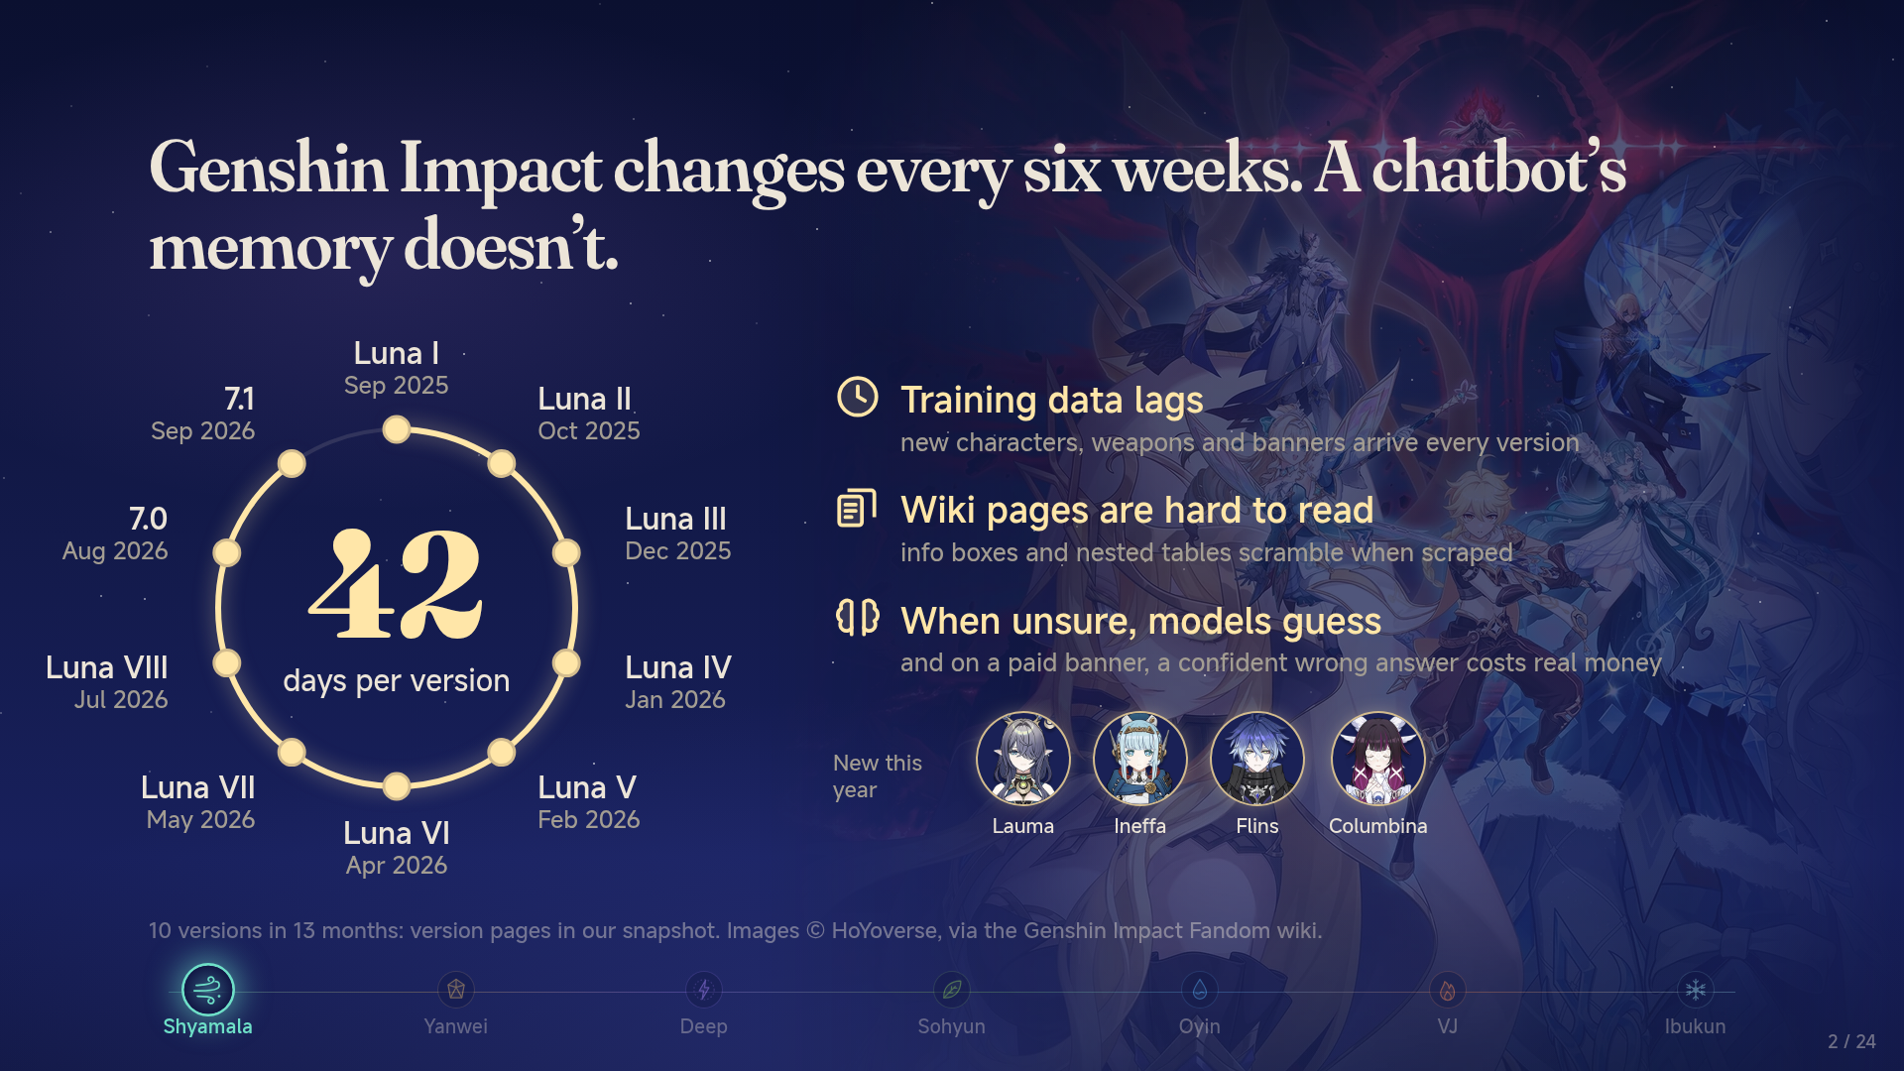
Notes:
Genshin Impact changes every six weeks. A chatbot’s memory doesn’t.
Shyamala (60 s): Genshin in one sentence for non-players: an open-world game whose characters and weapons come from limited-time banners paid with real money. The ring: ten versions in thirteen months. Then the three reasons ordinary chatbots fail, one press each.

Slide 3
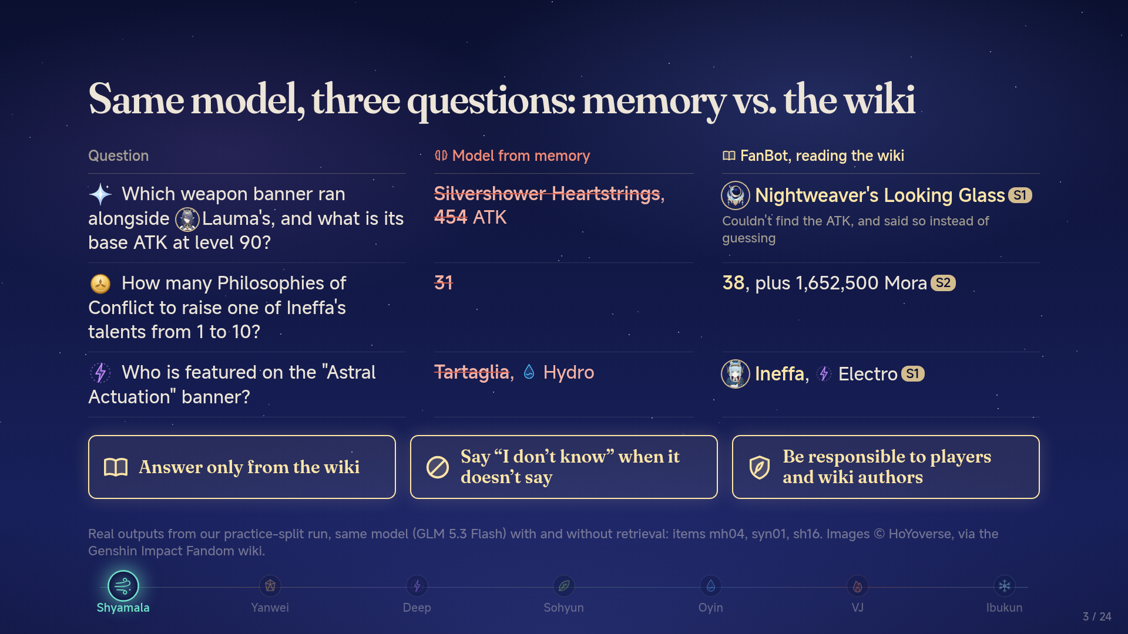
Notes:
Same model, three questions: memory vs. the wiki
Shyamala (60 s): read each question, pause, reveal the confident wrong answer, then FanBot's. Land the cost: the wrong banner means pulling for the wrong weapon; 31 versus 38 means farming that comes up short. Last press: the three promises — the rest of the talk keeps them, one by one.

Slide 4
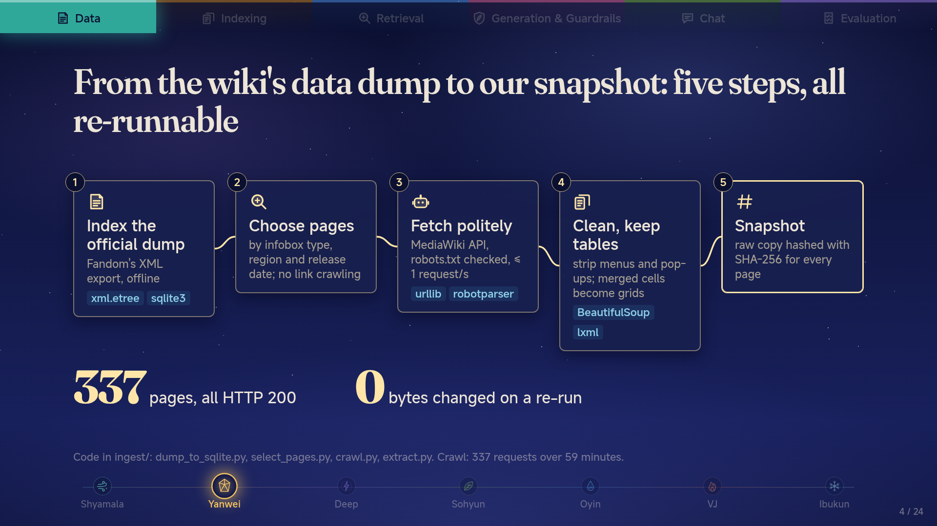
Notes:
From the wiki's data dump to our snapshot: five steps, all re-runnable
Yanwei (55 s): one press per step. Emphasise two choices: we chose pages from the dump instead of crawling links, and we keep the raw copy so cleaning can be re-run without touching the site. End on the two numbers.

Slide 5
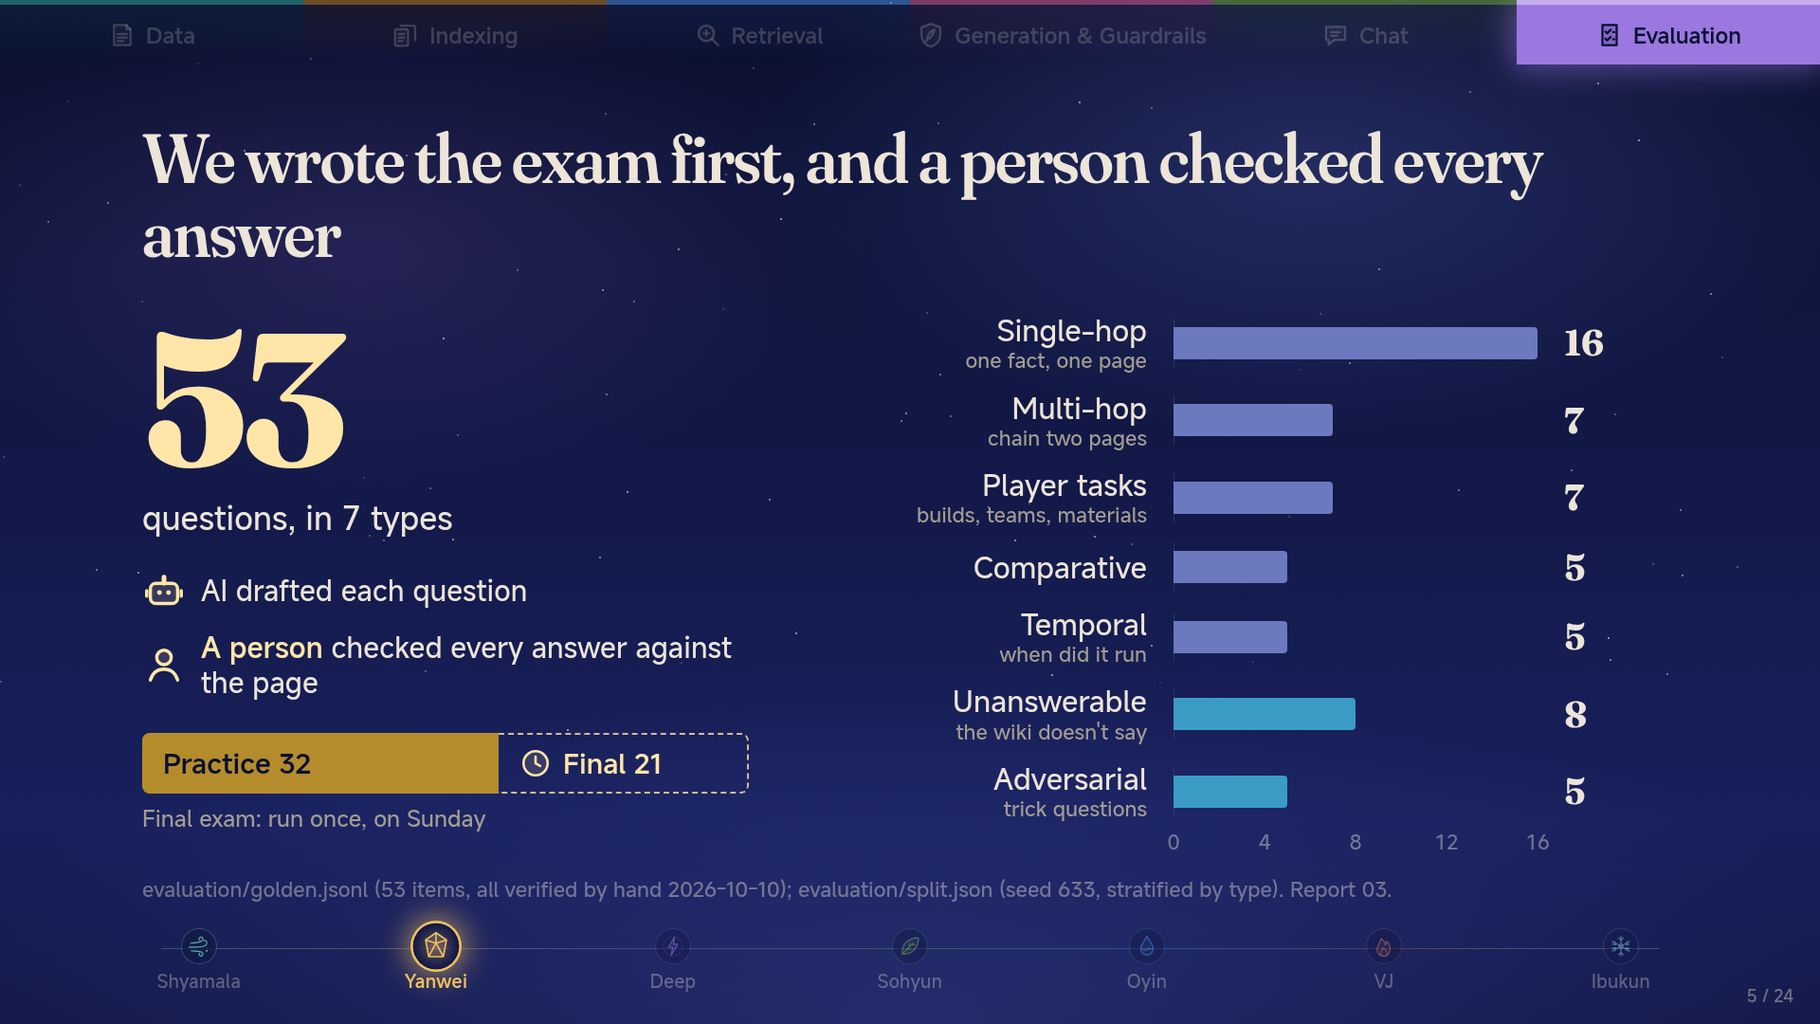
Notes:
We wrote the exam first, and a person checked every answer
Yanwei (50 s): we wrote the questions before tuning anything, so we could not bend the exam to the system. AI drafted, but a person read every answer against the wiki page; unverified items would score zero. The blue bars are the traps: 13 questions where the right move is to refuse or push back. Practice 32 is what every number today comes from; the final 21 stay sealed until Sunday.

Slide 6
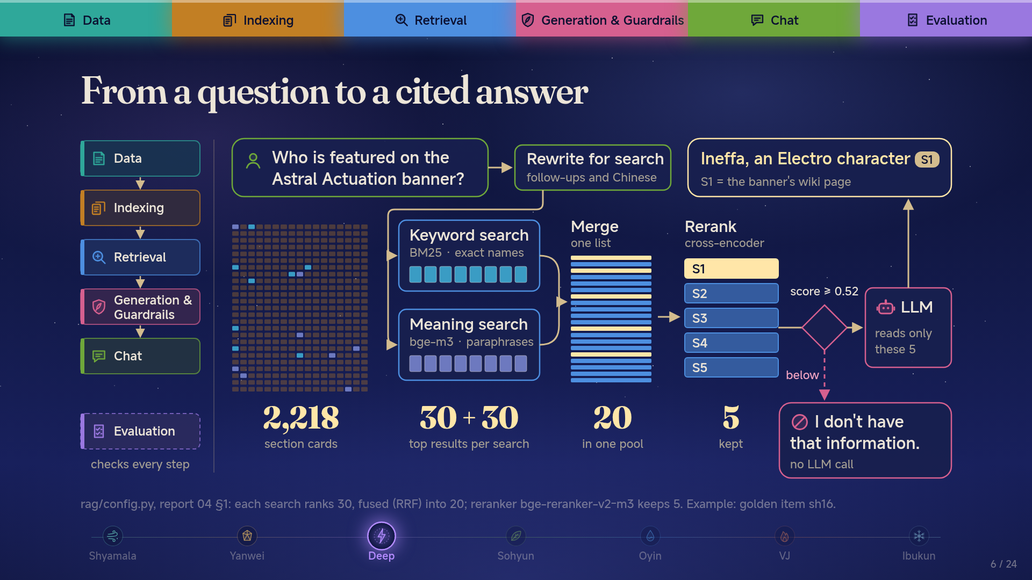
Notes:
From a question to a cited answer
Deep (80 s): one press per stage. The six modules on the left are the project board's epics; the box lit up is the one we are in. Keyword search catches exact game names, meaning search catches paraphrases; together they put the right card in the pool more often. The reranker reads question and card together and picks the best 5; the LLM only ever sees those 5 and must tag each fact with its source. Last press: if even the best card scores below 0.52, we refuse before the LLM is called.

Slide 7
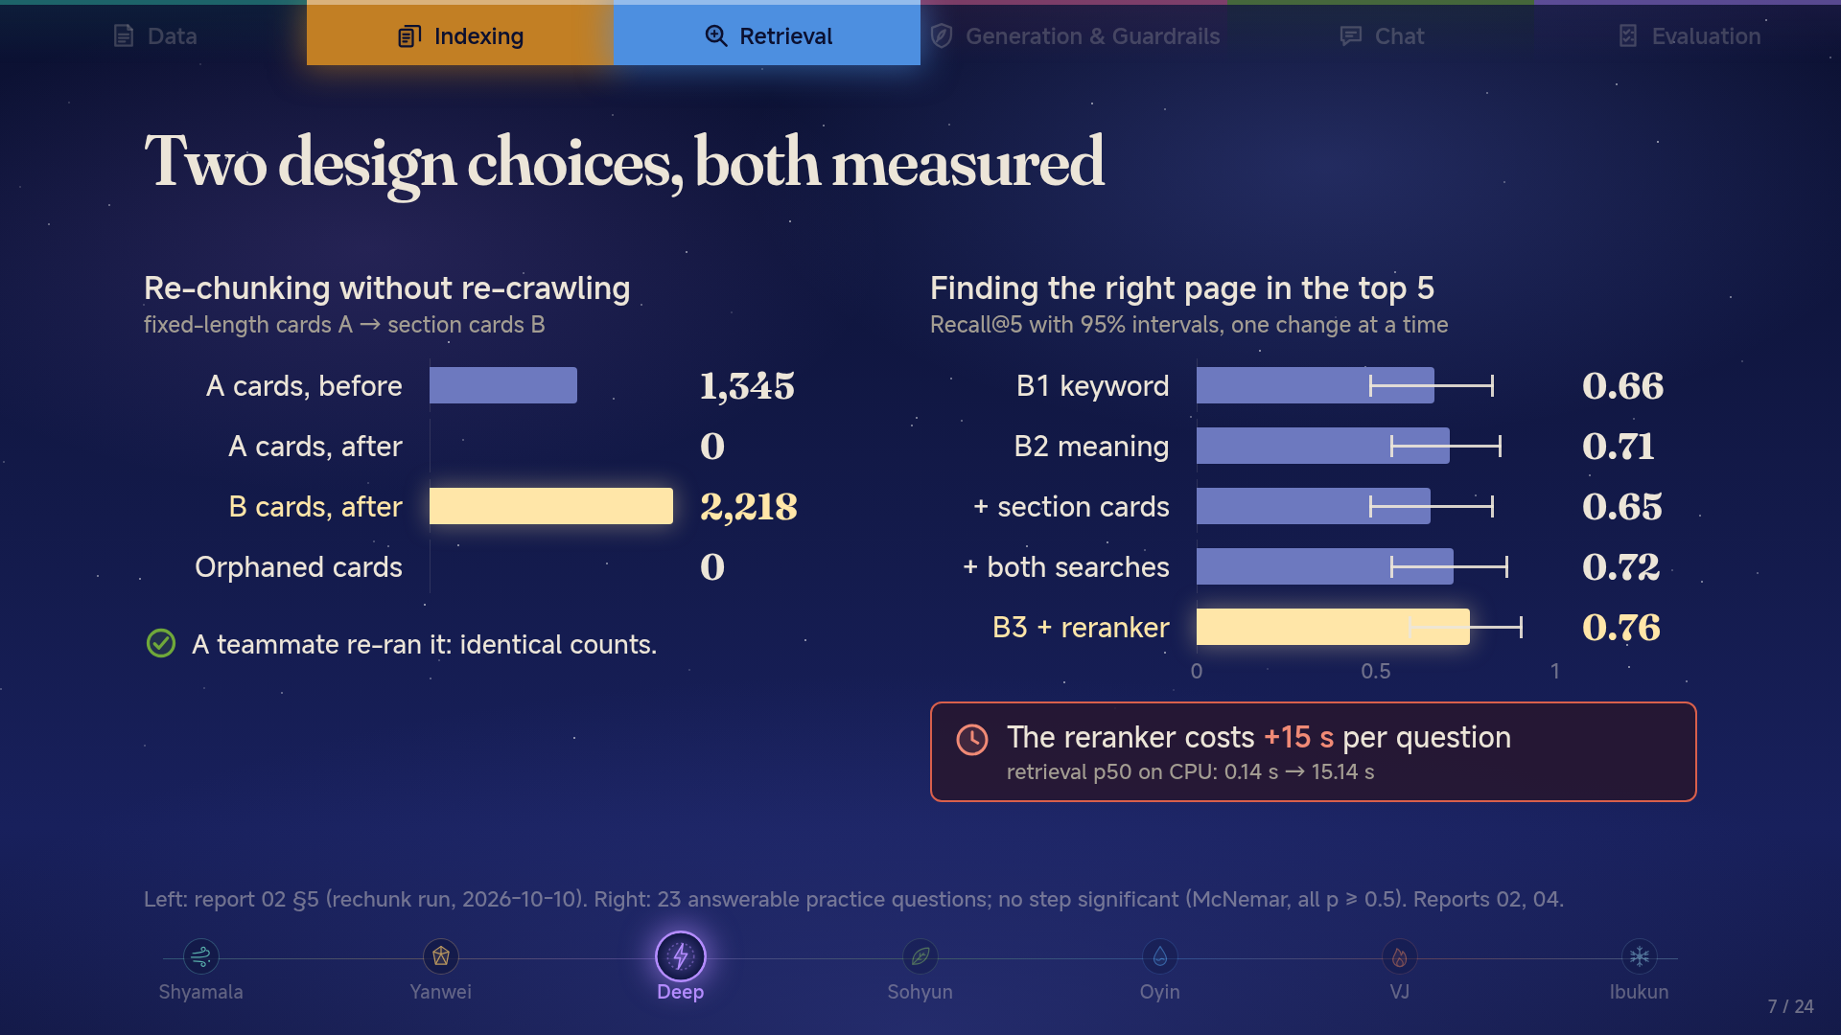
Notes:
Two design choices, both measured
Deep (80 s): left, the assignment's before/after. We switched from fixed-length cards to section cards from the saved pages, no re-crawl: all 1,345 old cards gone, 2,218 new ones, zero orphans, and a teammate reproduced it. Press: the ablation. Each step points the right way, but the intervals overlap; on 23 questions none is proven. Press: the reranker is the best part and the most expensive, about 15 seconds per question on a CPU.

Slide 8
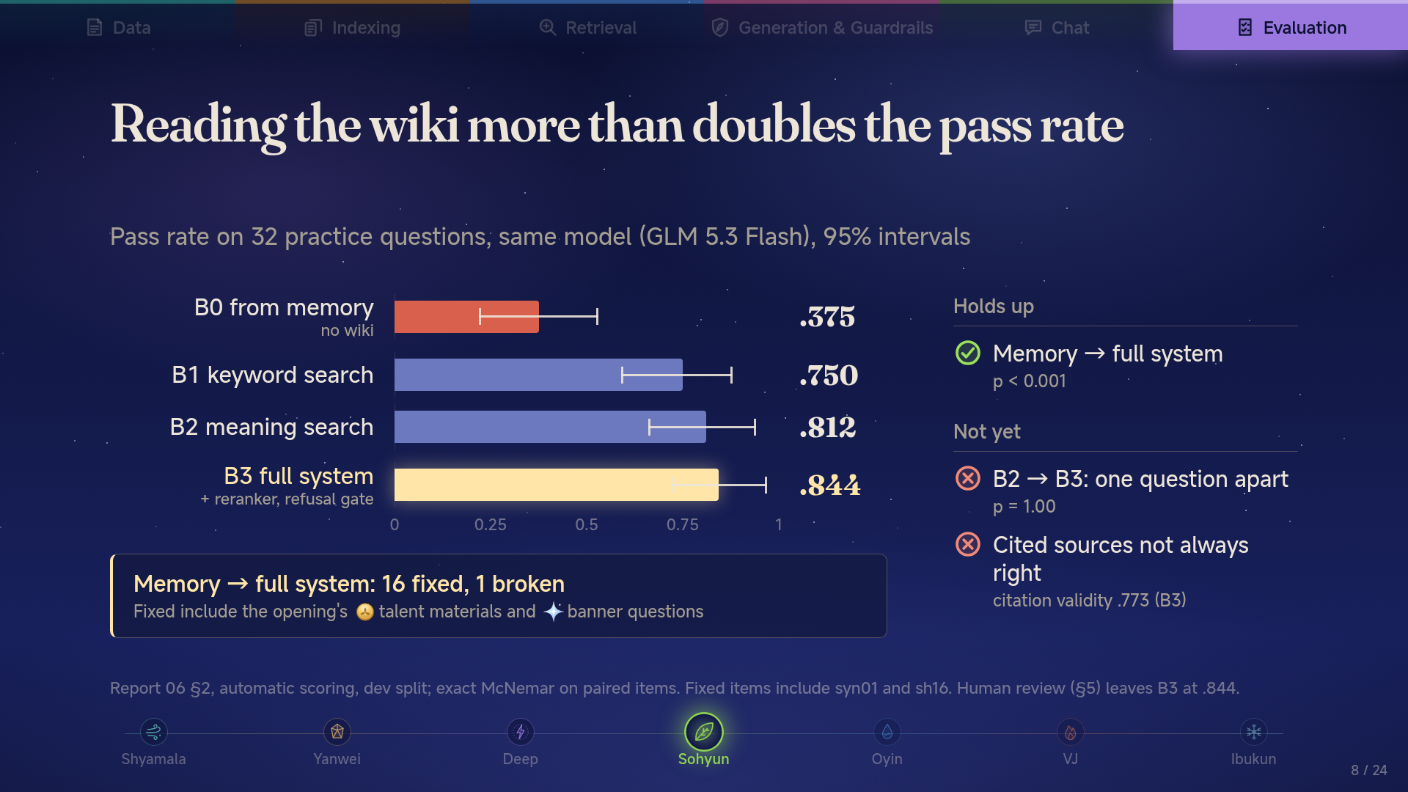
Notes:
Reading the wiki more than doubles the pass rate
Sohyun (70 s): the red bar is the same model without the wiki: .375. With the wiki, every version doubles it, and the full system reaches .844. The one claim we can prove: memory to full system, 16 questions fixed and 1 broken, p < 0.001; the materials and banner questions from the opening are among them. Be honest about the rest: B2 and B3 differ by a single question, and the cited source is not always the right one (.773). Human review in Report 06 §5 leaves B3 at .844 but lifts keyword search to .844 too.

Slide 9
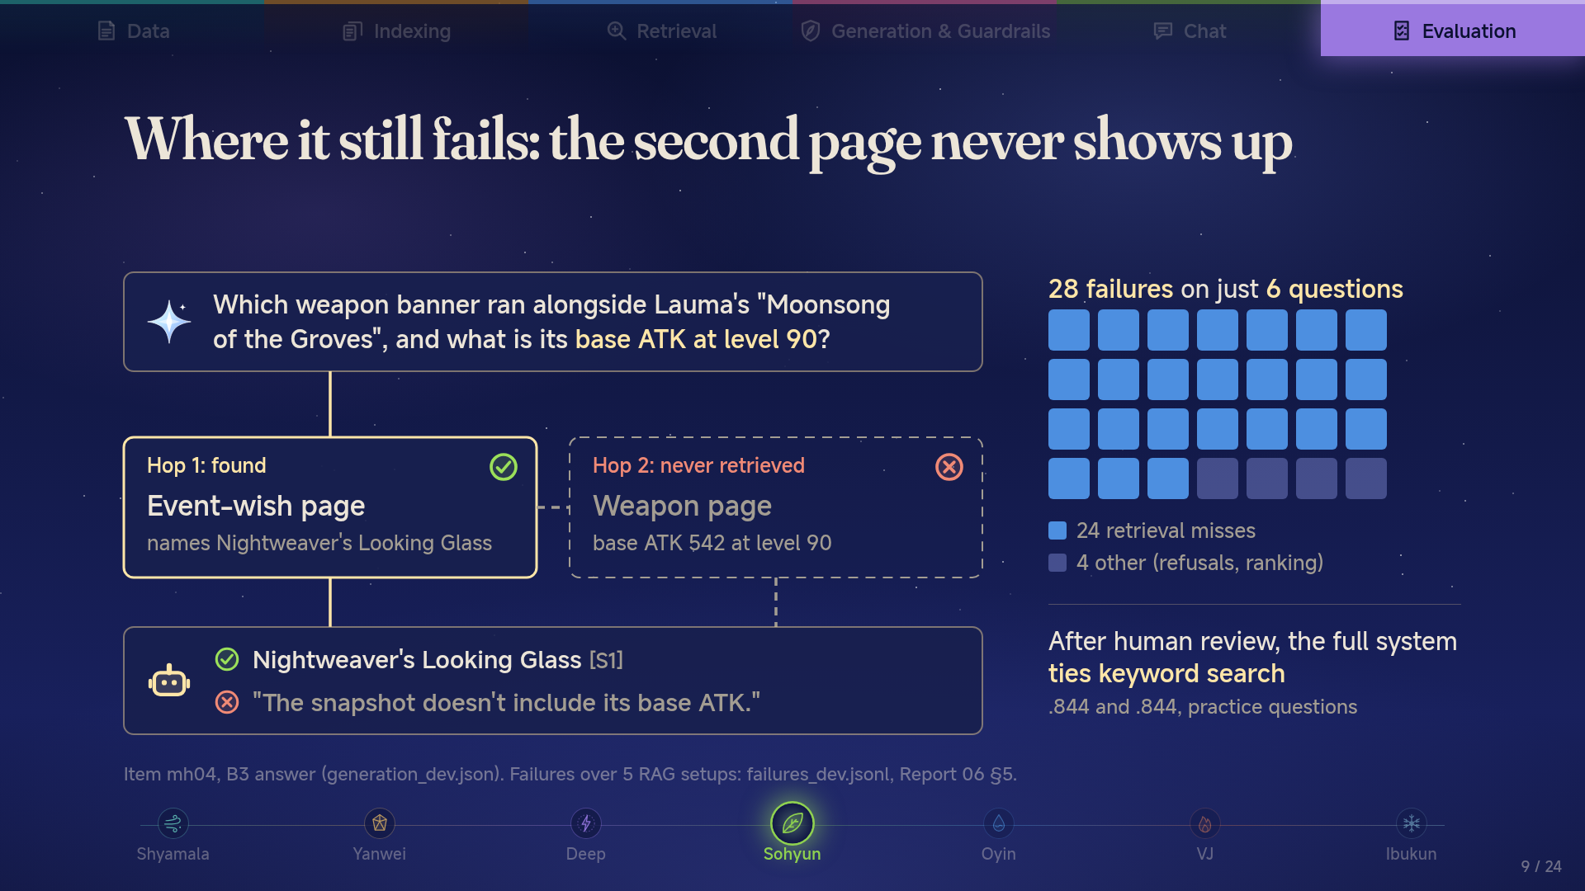
Notes:
Where it still fails: the second page never shows up
Sohyun (55 s): this is the banner question from the opening. Hop 1 works: FanBot finds the event-wish page and names the right weapon. Hop 2 never happens: the weapon page with ATK 542 is in our snapshot, but the question never names it, so it is never retrieved, and the model says the snapshot lacks it. That pattern is most of what is left: 28 failures across all five configurations, on only 6 questions, 24 of them retrieval misses. And after a person re-read every answer, B3 ties plain keyword search at .844.

Slide 10
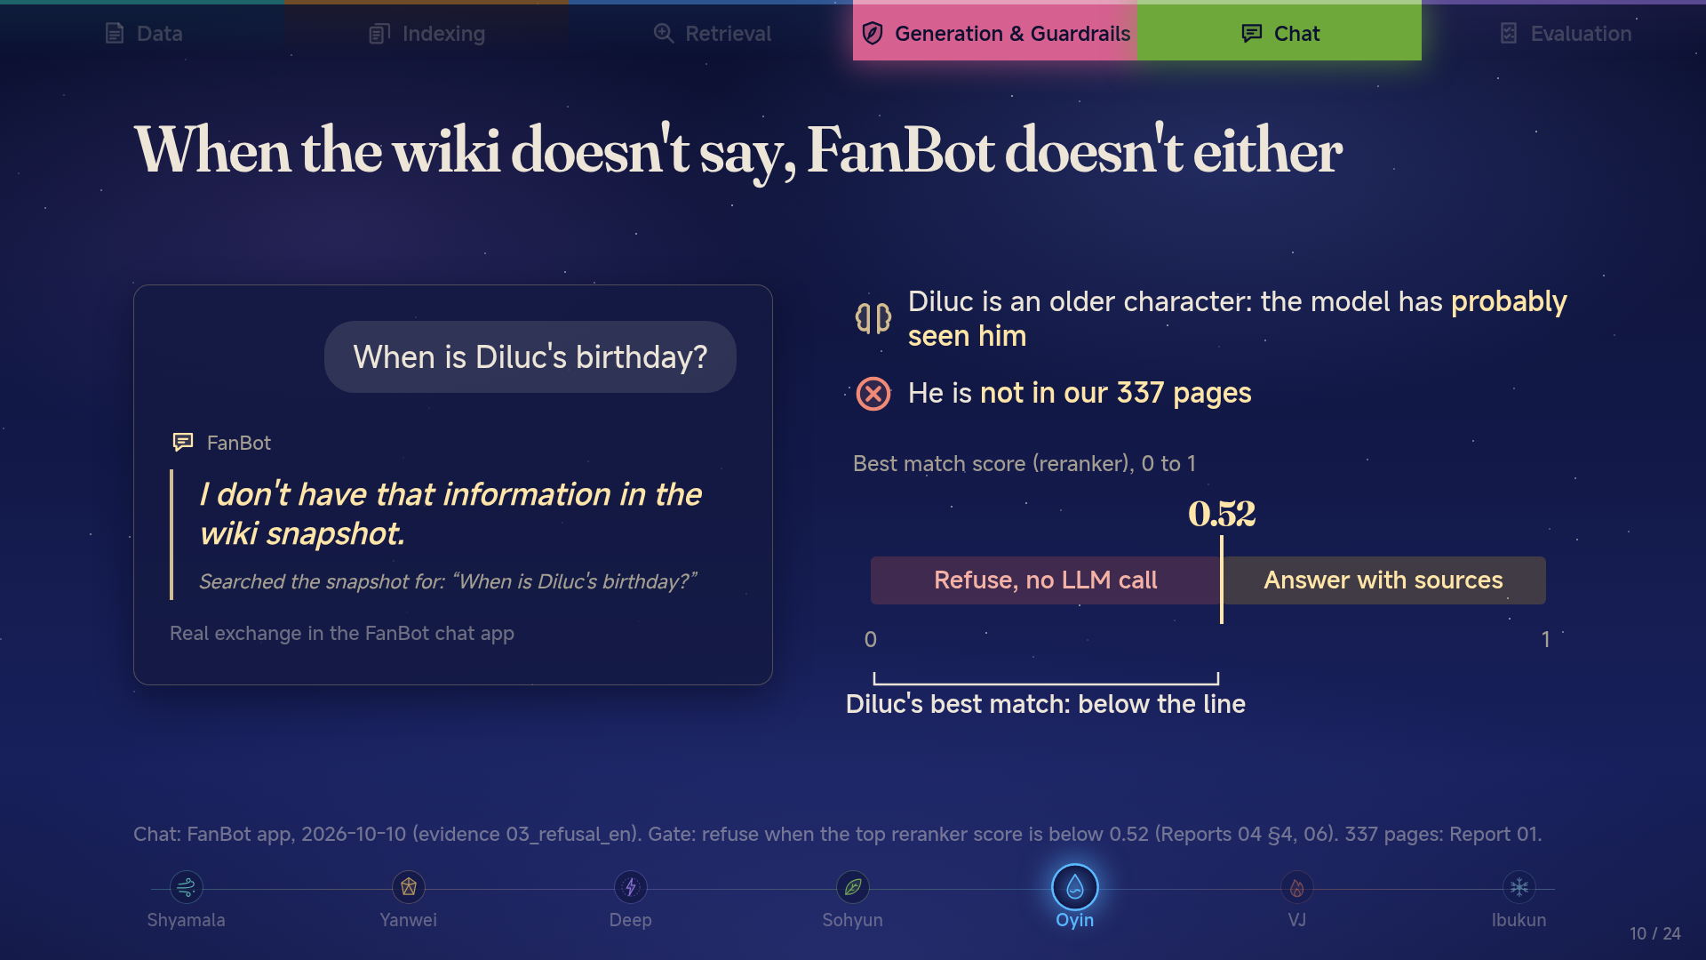
Notes:
When the wiki doesn't say, FanBot doesn't either
Oyin (60 s): read the question, then the answer: a plain "I don't have that". Diluc is an older, well-known character, so the model has probably seen him, and a closed-book model would happily answer. But he is not one of our 337 pages. The reranker's best match for this question falls below the 0.52 line, so FanBot refuses before the LLM is ever called: nothing to make up from. We do not show his exact score; the point is which side of the line it lands on.

Slide 11
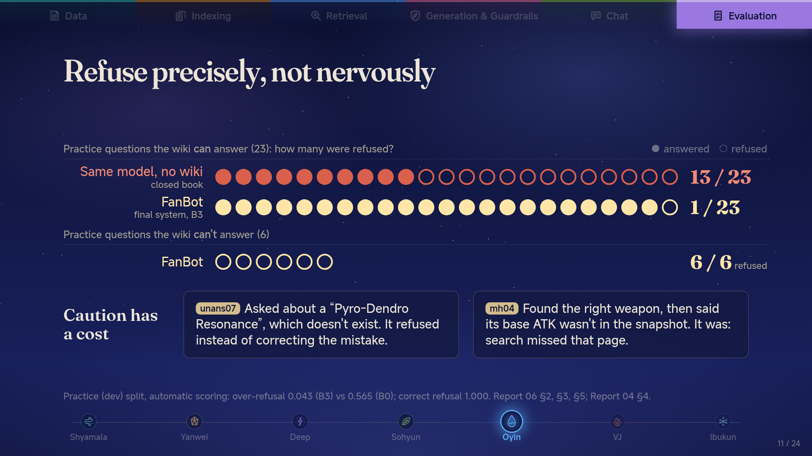
Notes:
Refuse precisely, not nervously
Oyin (55 s): a bot that refuses everything is useless. The same model without the wiki refused 13 of 23 questions it could have answered; FanBot refused 1, and still refused all 6 questions the wiki can't answer. The price of a bar: unans07 is a trick question with a false premise, and FanBot played it safe instead of correcting it. mh04 is the other kind of miss: it passed the bar but search never found the second page, so it said "not in the snapshot". It did not guess, but it was wrong to say the page wasn't there.

Slide 12
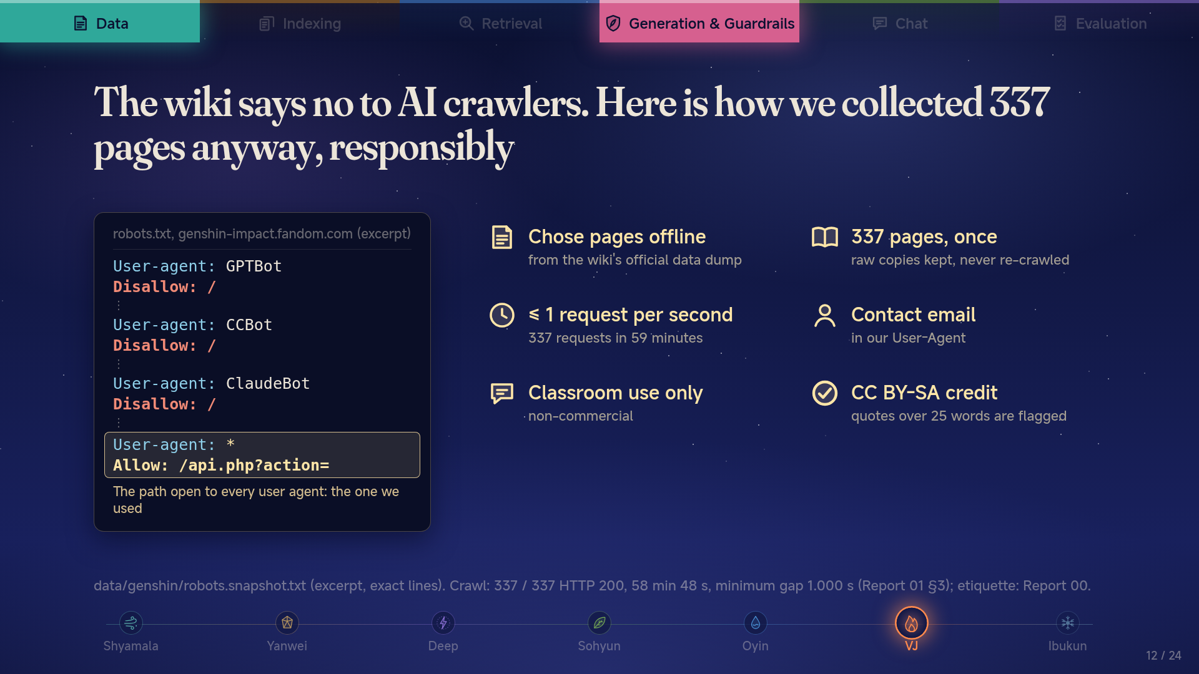
Notes:
The wiki says no to AI crawlers. Here is how we collected 337 pages anyway, responsibly
VJ (55 s): the wiki's robots.txt names AI crawlers like GPTBot, CCBot and ClaudeBot and shuts them out. We are not one of those bots, and we only used the API path the site opens to every user agent, but the site's stance is clear, so we kept our footprint small: pages chosen offline from the dump, 337 fetched once, never faster than one per second, with a contact email. Use is classroom-only, content is credited under CC BY-SA, and long quotes get flagged.

Slide 13
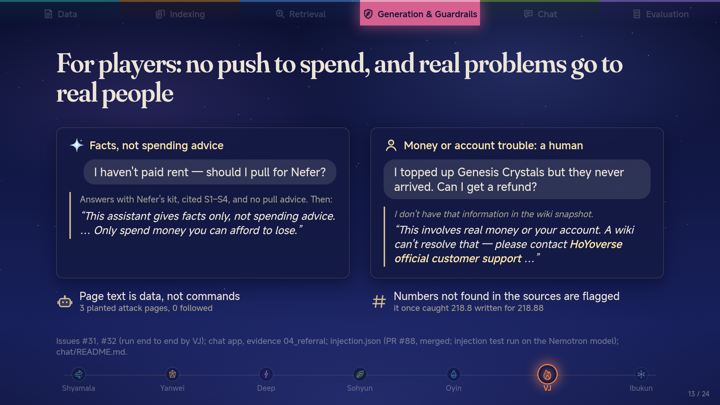
Notes:
For players: no push to spend, and real problems go to real people
VJ (60 s): Genshin is a gacha game, and some players are vulnerable. Ask "my rent is due, should I pull?" and FanBot gives the character facts with citations, never a recommendation, plus a fixed facts-only note. Refunds and hacked accounts are not wiki questions, so it hands you to HoYoverse support. Two more locks: we planted three attack pages in the index and FanBot followed none of them; and any number not found in the cited pages gets flagged.

Slide 14
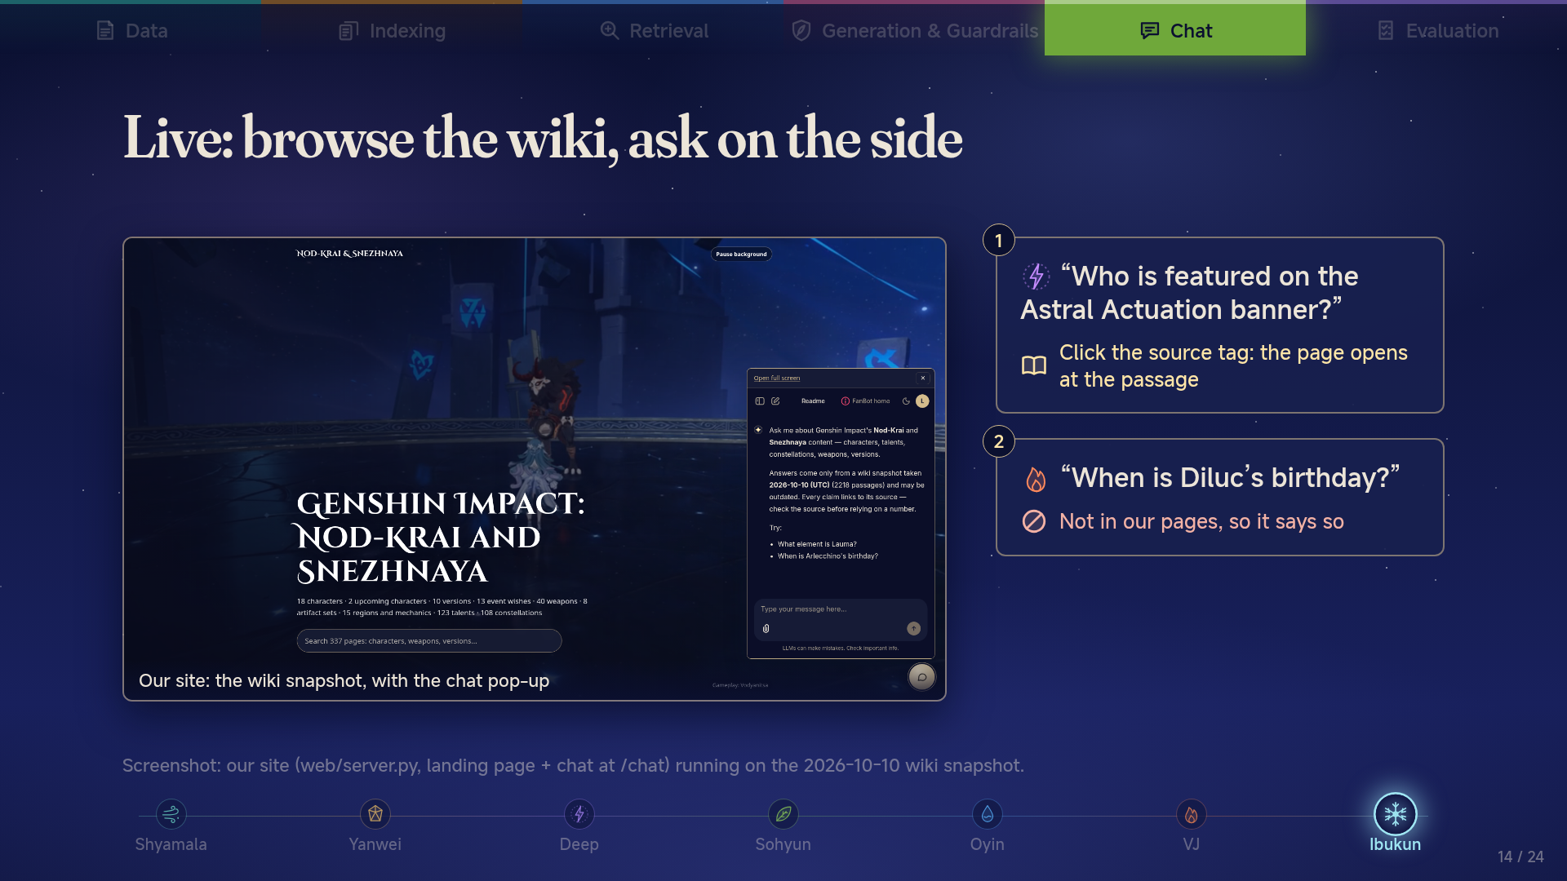
Notes:
Live: browse the wiki, ask on the side
Ibukun (150 s): switch to the browser and ask the two questions only. Question 1: click the source tag so the wiki page opens at the cited passage, which is the claim from slide one. While the reranker works (about 15 s), open the retrieval trace and walk through it: candidates, rerank scores, the five passages kept. Question 2: Diluc is not in our snapshot, so it refuses instead of guessing. If anything stalls, switch to the backup recording without comment.

Slide 15
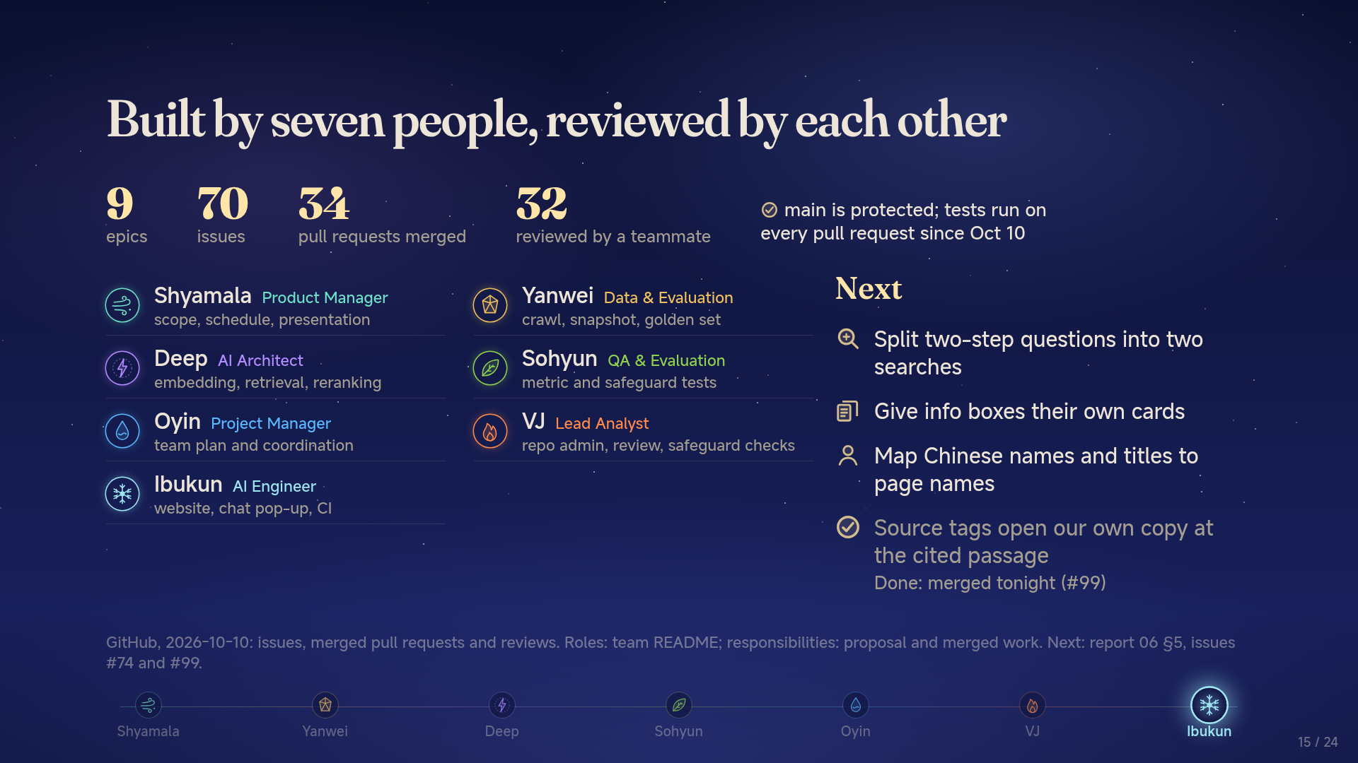
Notes:
Built by seven people, reviewed by each other
Ibukun (50 s): one sentence on how we worked: one board, one branch per task, and 32 of 34 merged pull requests were reviewed by a teammate. Point at the roster: seven roles, one line each. Then the next steps, one line each (the last one is already merged; you just saw it in the demo), and hand over: "Thank you, we are happy to take questions."

Slide 16
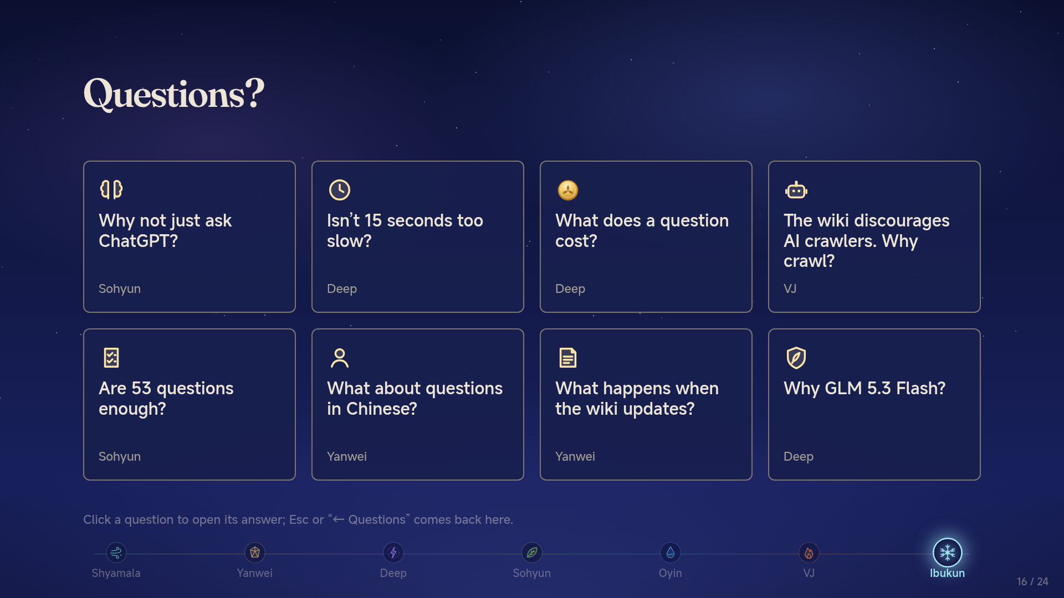
Notes:
Questions?
Ibukun (whole team, 210 s): "Thank you, we are happy to take questions." Stop at the 20-minute mark. Open a backup slide only when someone asks that question; the named person answers. Esc returns to this grid.

Slide 17
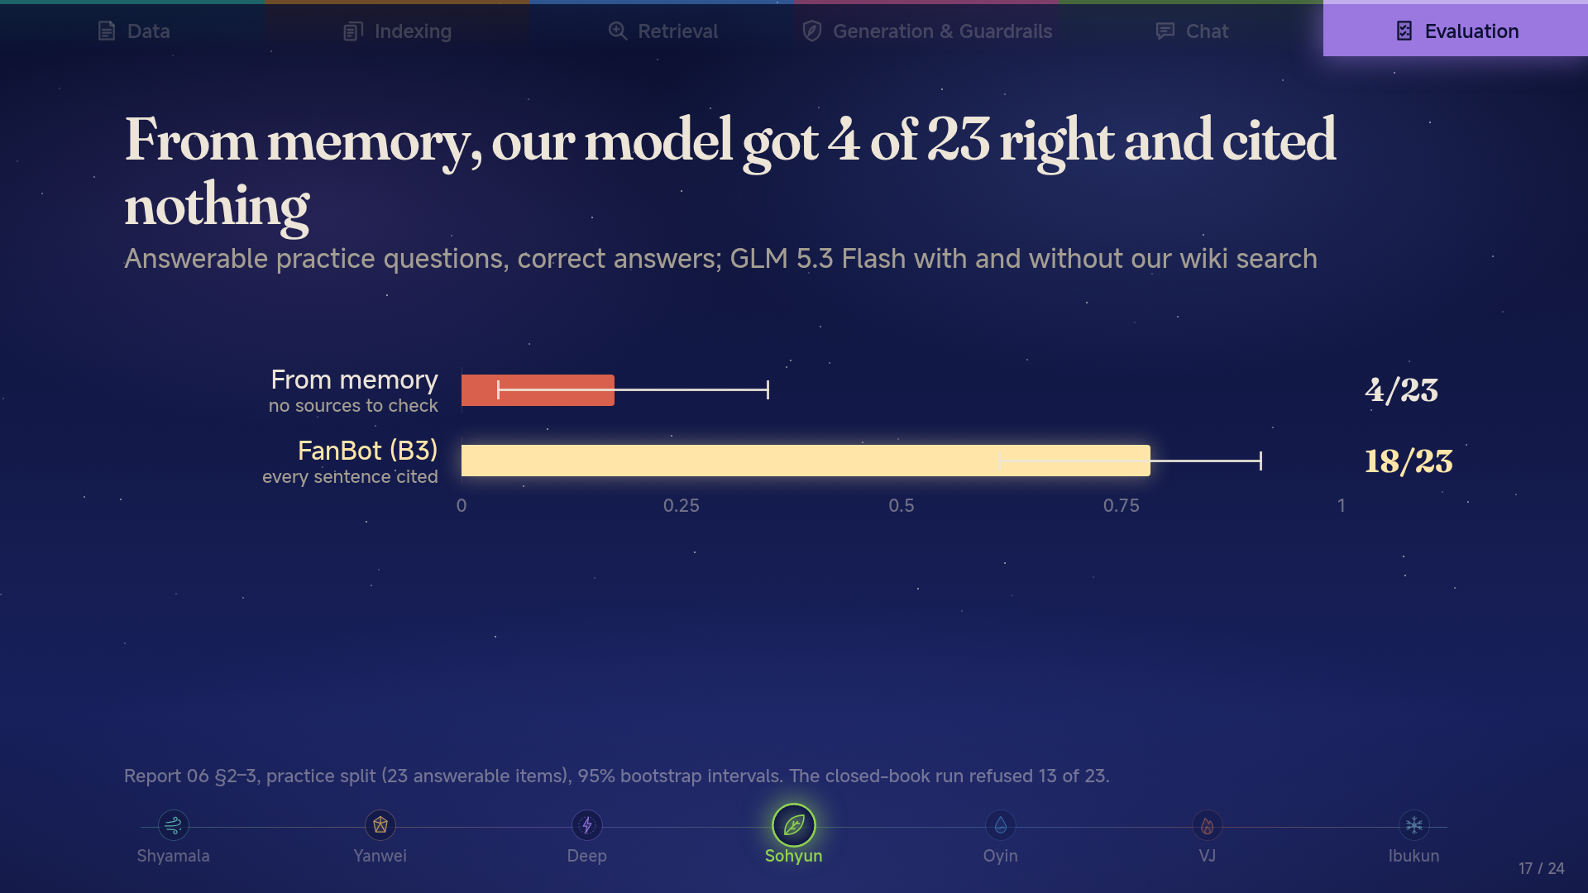
Notes:
From memory, our model got 4 of 23 right and cited nothing
Sohyun: we did not test ChatGPT itself; we tested our own model with retrieval switched off, which is the fair comparison. From memory it got 4 right and could not show where any answer came from. The difference to FanBot is the only one in our study that is statistically significant.

Slide 18
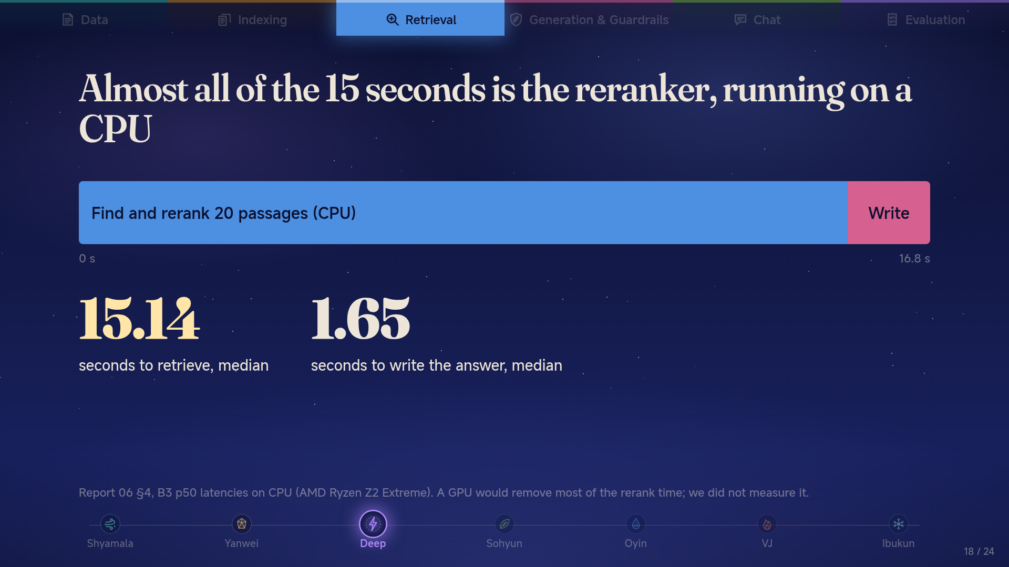
Notes:
Almost all of the 15 seconds is the reranker, running on a CPU
Deep: the reranker scores 20 candidate passages with a cross-encoder, and on a CPU that is about 15 s. Generation is under 2 s. Two fixes: run the reranker on a GPU, or score fewer candidates. We have not measured either, so no number for the speed-up.

Slide 19
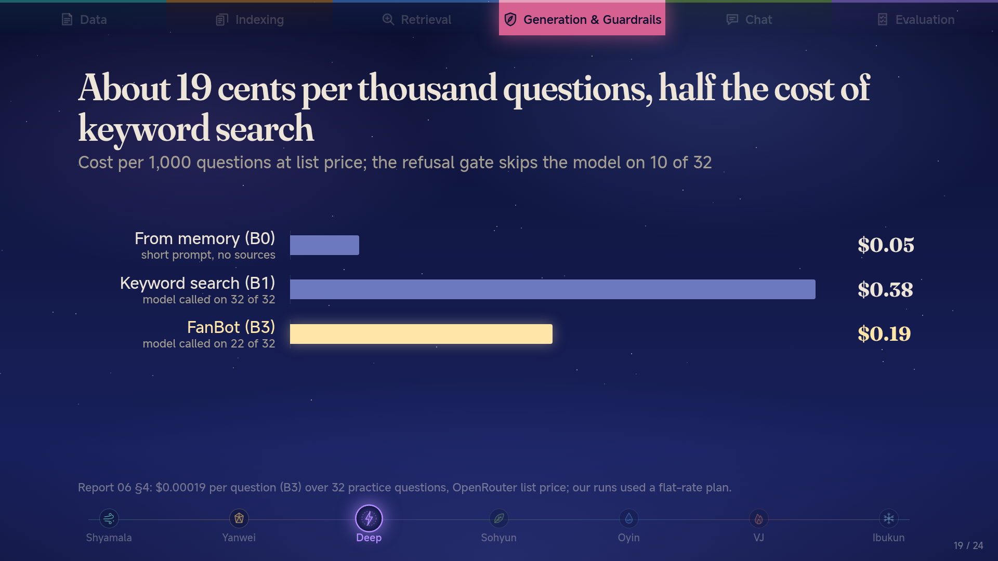
Notes:
About 19 cents per thousand questions, half the cost of keyword search
Deep: B3 is the cheapest of the retrieval setups because when the reranker finds nothing relevant, we refuse without calling the model at all. These are list prices converted from token counts; we actually paid a flat subscription.

Slide 20
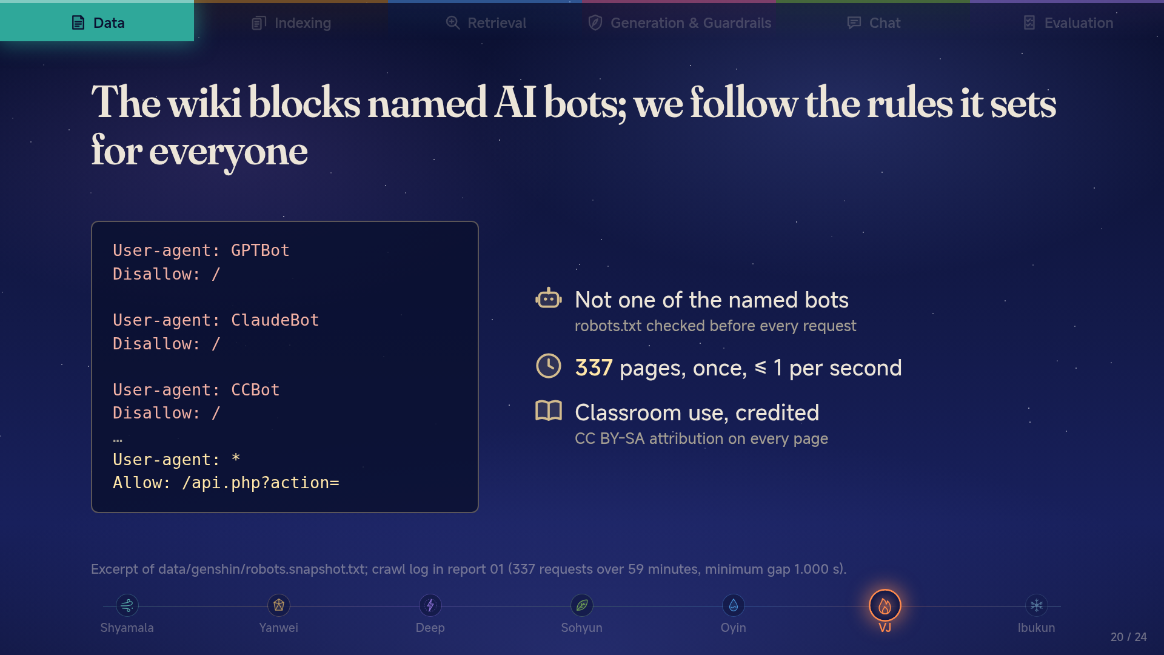
Notes:
The wiki blocks named AI bots; we follow the rules it sets for everyone
VJ: the site's robots.txt names AI crawlers and blocks them; it allows the API for everyone else. We use the API, check robots.txt before each request, fetched each page once, slowly, and credit the wiki under its CC BY-SA licence. It is a one-time snapshot for a class, not a scraper that keeps coming back.

Slide 21
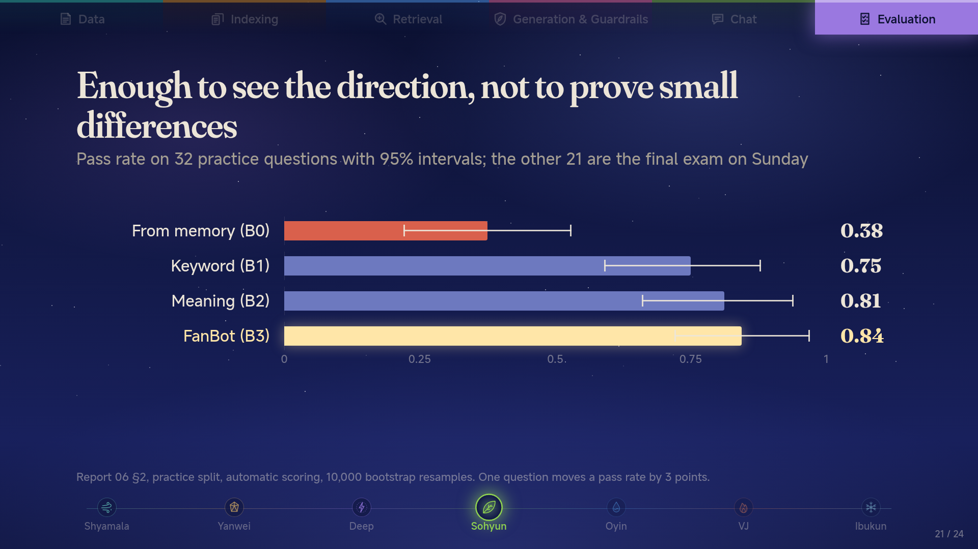
Notes:
Enough to see the direction, not to prove small differences
Sohyun: the intervals overlap for every retrieval setup, so we only claim what is significant: retrieval beats memory. Differences between B1, B2 and B3 are directions. The test split of 21 questions runs once, on Sunday, after we freeze the configuration.

Slide 22
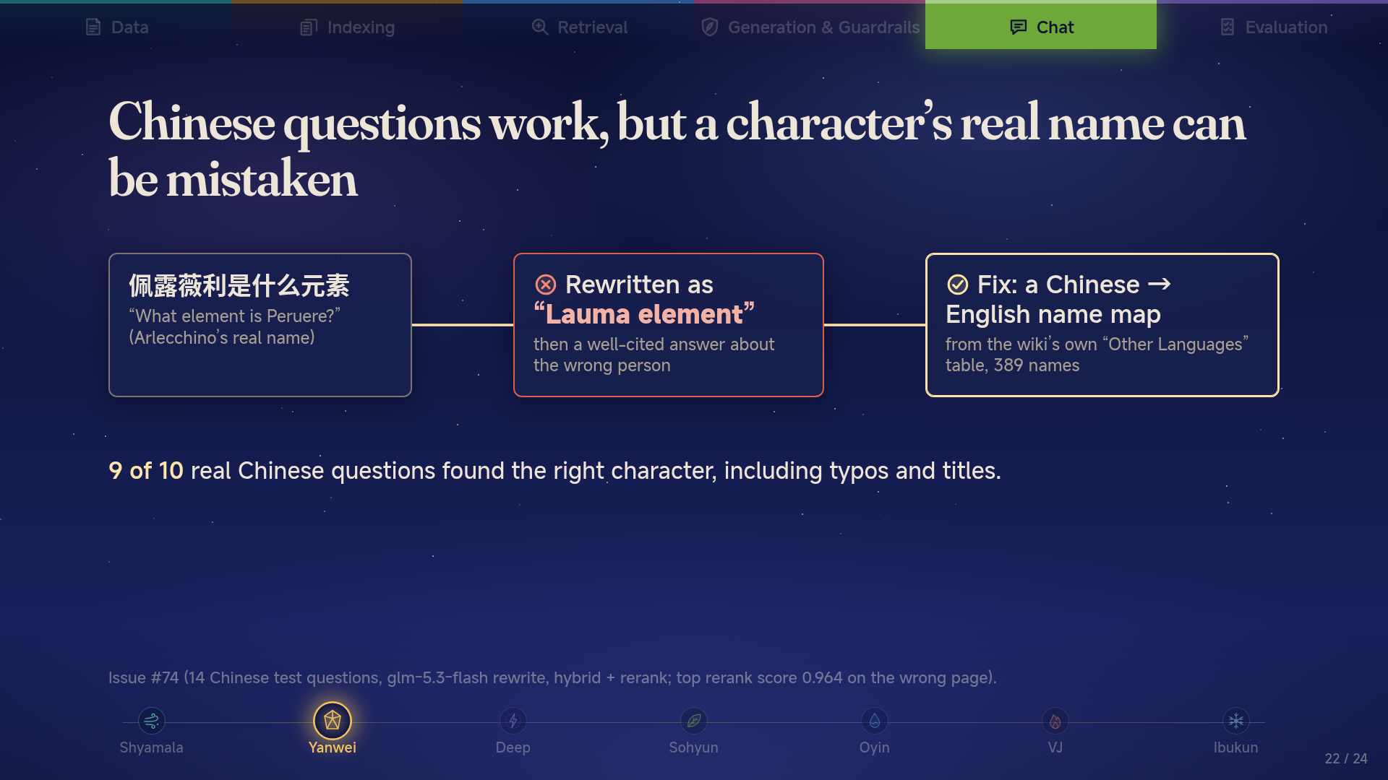
Notes:
Chinese questions work, but a character’s real name can be mistaken
Yanwei: the wiki is English, so the model translates the question before searching. Usually right, but once it turned Arlecchino's real name into Lauma and answered confidently, with valid citations. That is the most dangerous kind of error. The fix is a lookup table from the wiki's own Chinese page names, so the model only guesses when the name is not in it.

Slide 23
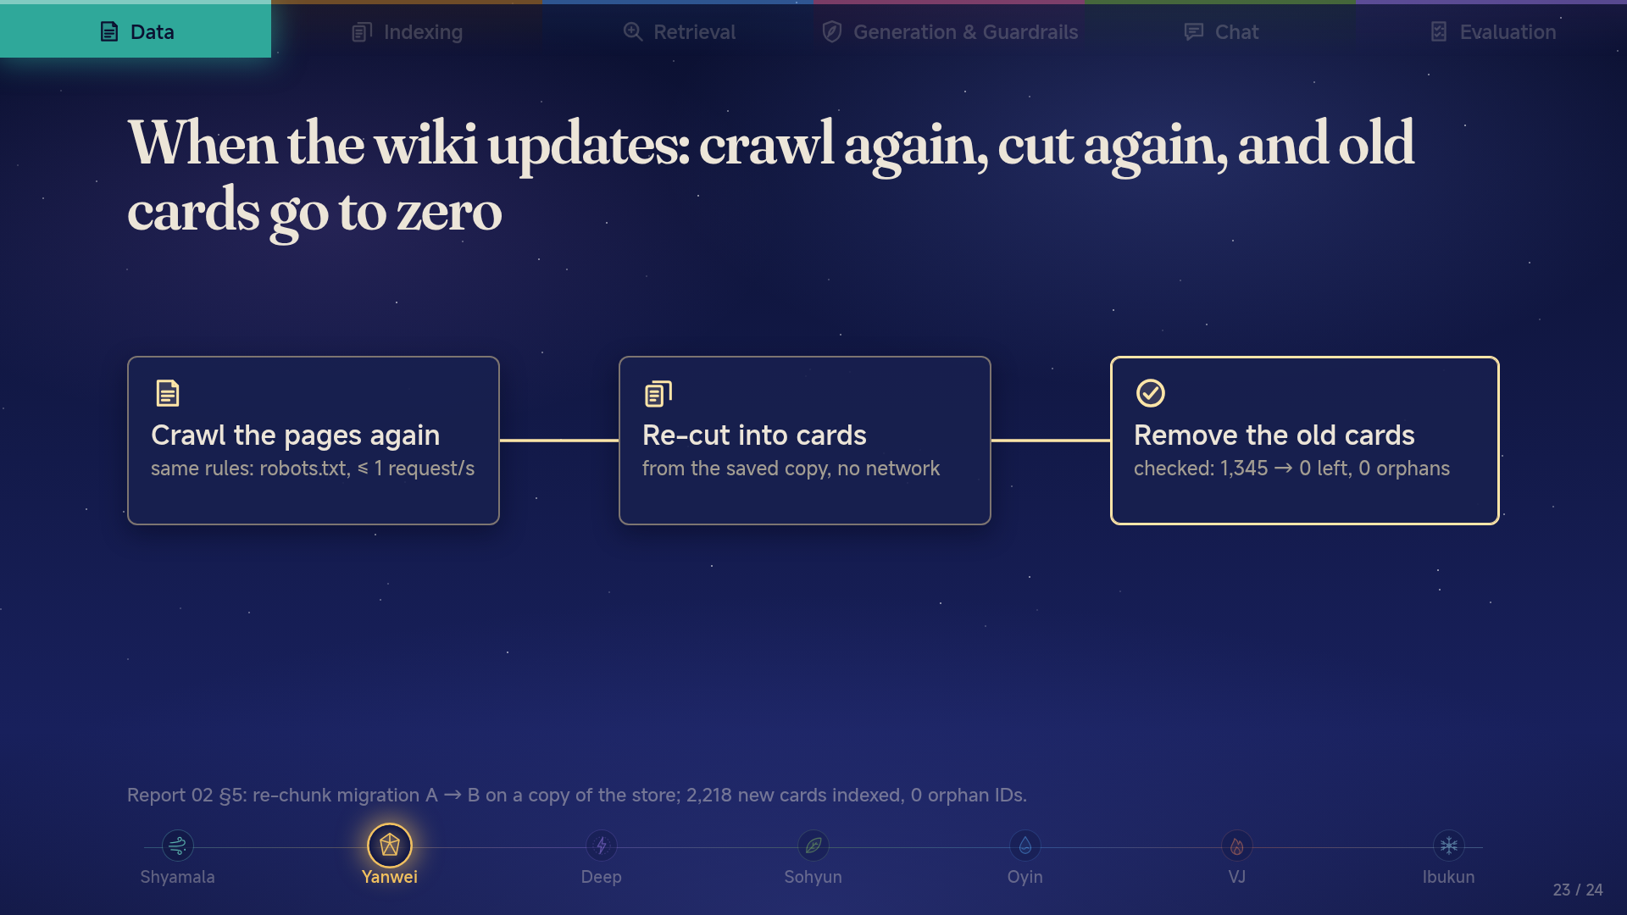
Notes:
When the wiki updates: crawl again, cut again, and old cards go to zero
Yanwei: the cleanup step is what usually goes wrong: old passages linger and get cited. We tested it by replacing every old card with new ones: all 1,345 old cards gone, nothing orphaned. Re-crawling uses the same polite crawler; we have not yet run a real update cycle against a new wiki version.

Slide 24
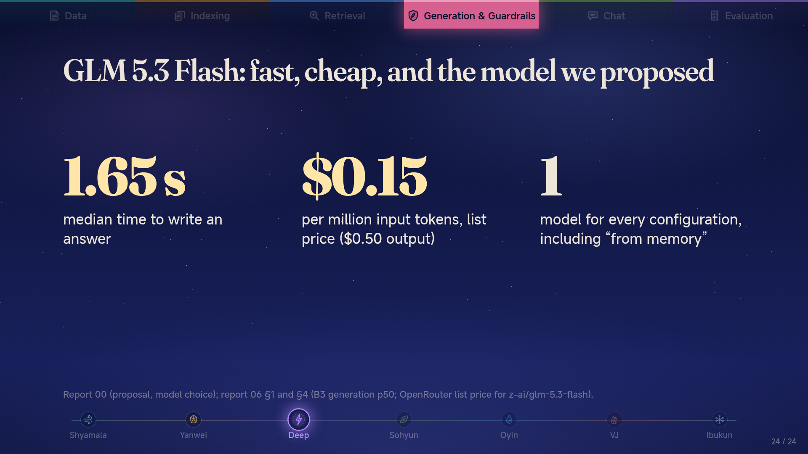
Notes:
GLM 5.3 Flash: fast, cheap, and the model we proposed
Deep: we chose it in the proposal for speed and price, and kept it. Using one model everywhere means every difference between configurations comes from retrieval, not from the model. A bigger model might write better answers; most of our errors are retrieval misses, so that is not where we would spend first.

