Slide 1
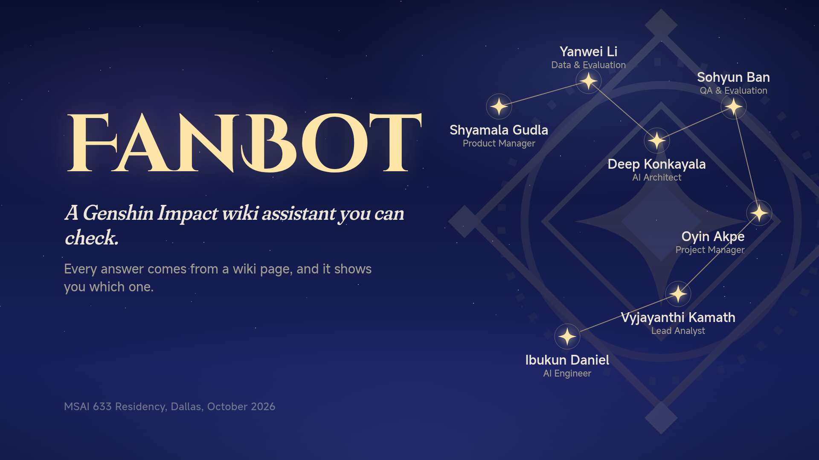

Slide 2
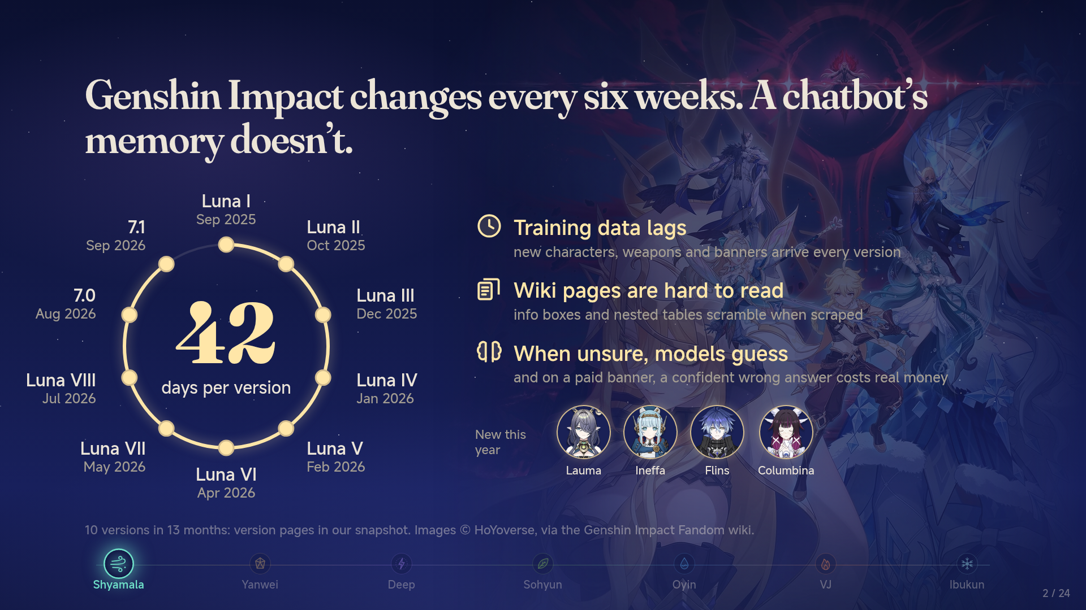

Slide 3
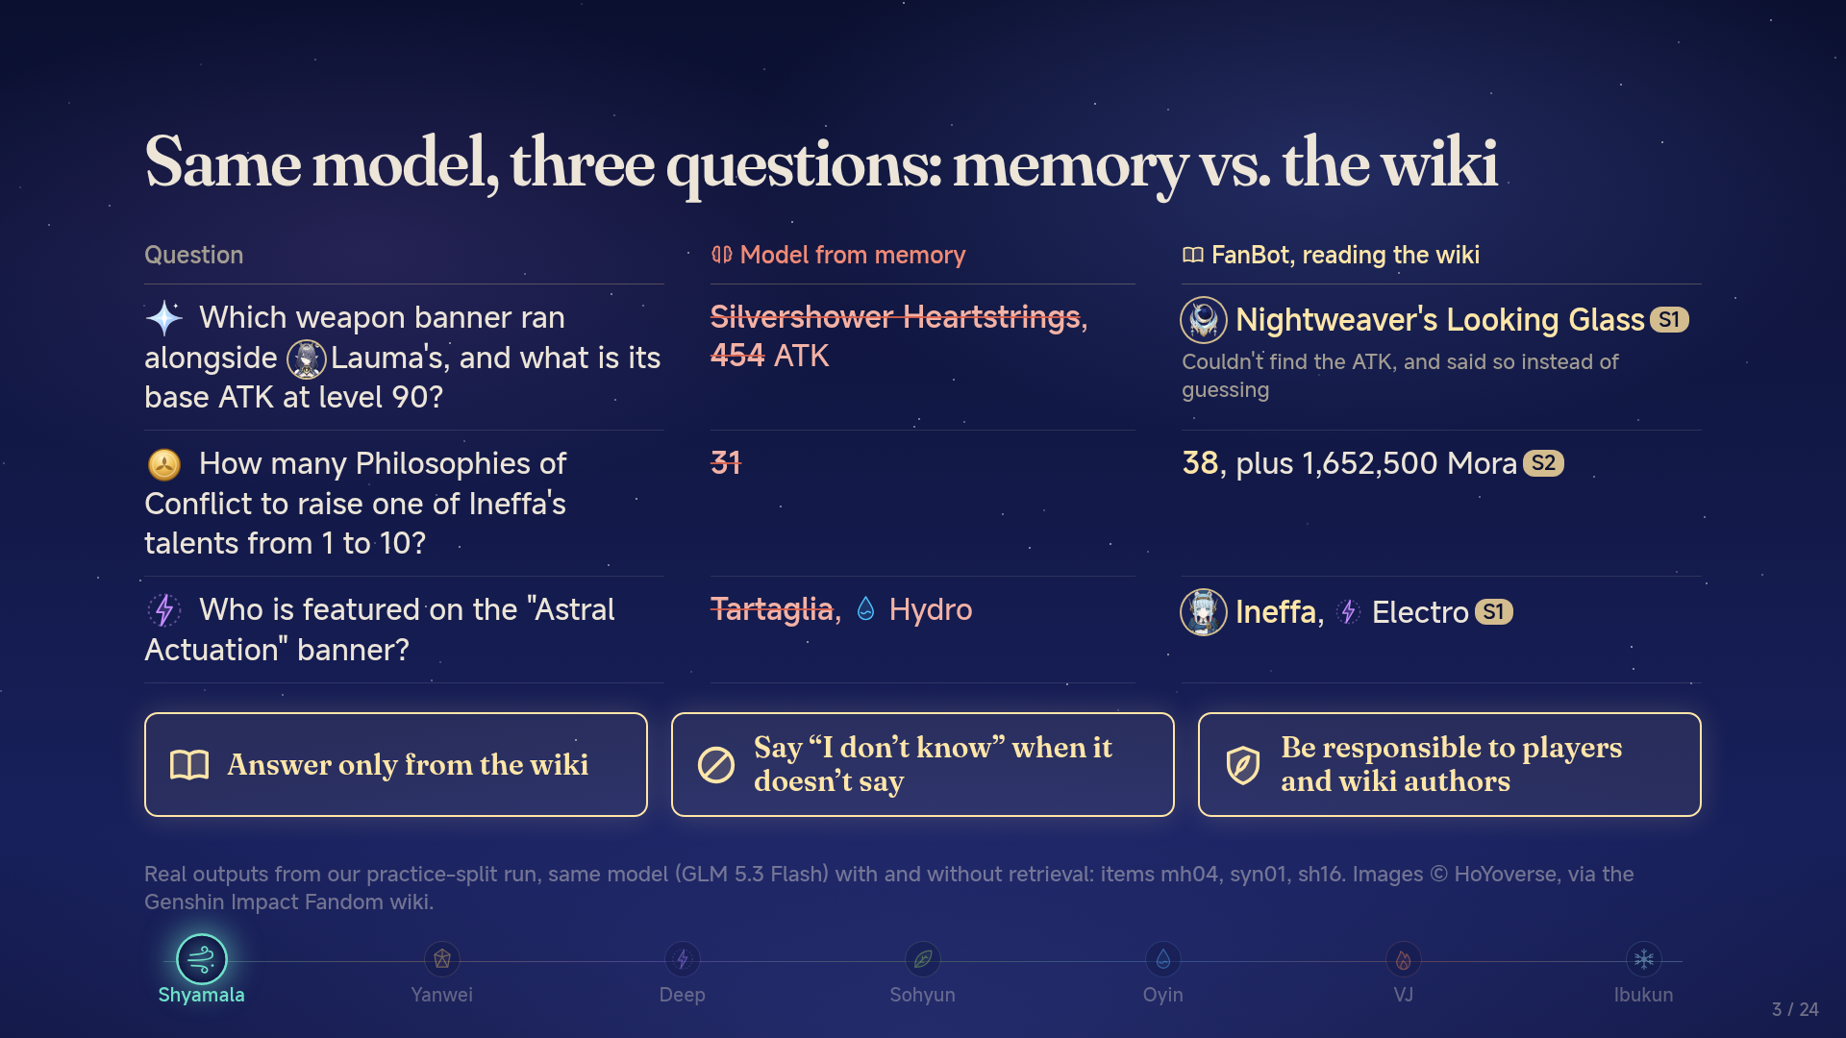

Slide 4
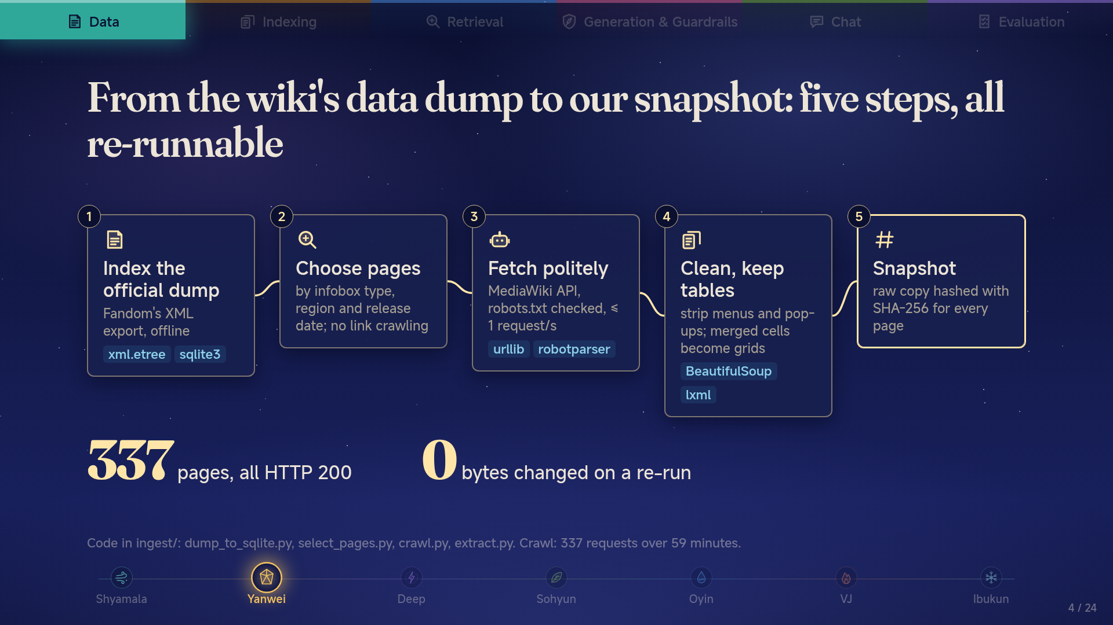

Slide 5
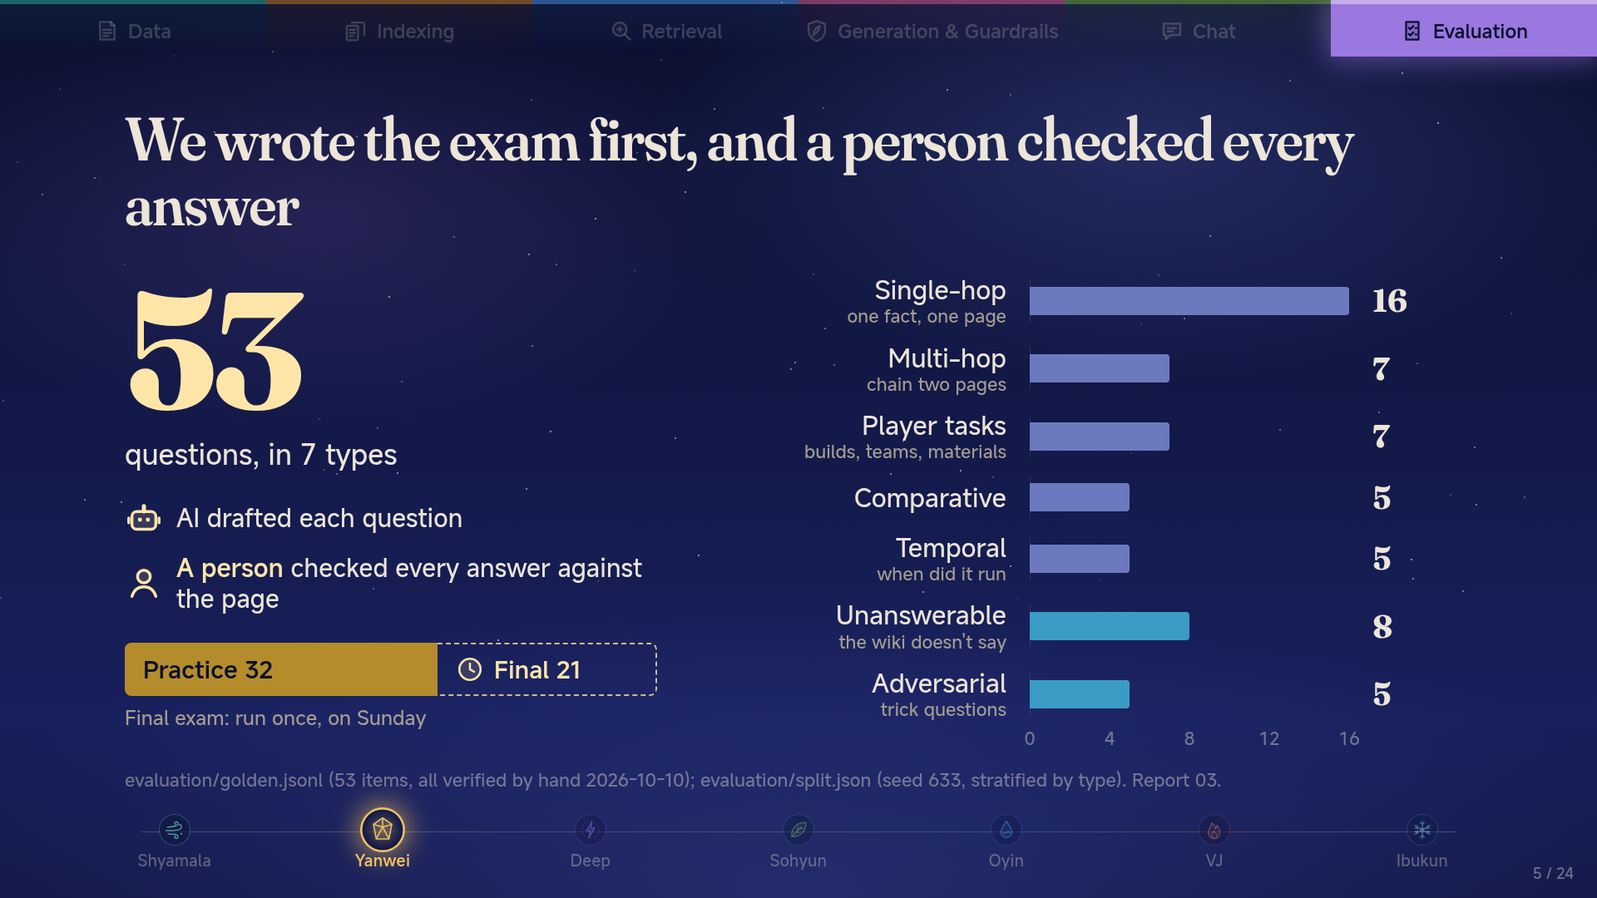

Slide 6
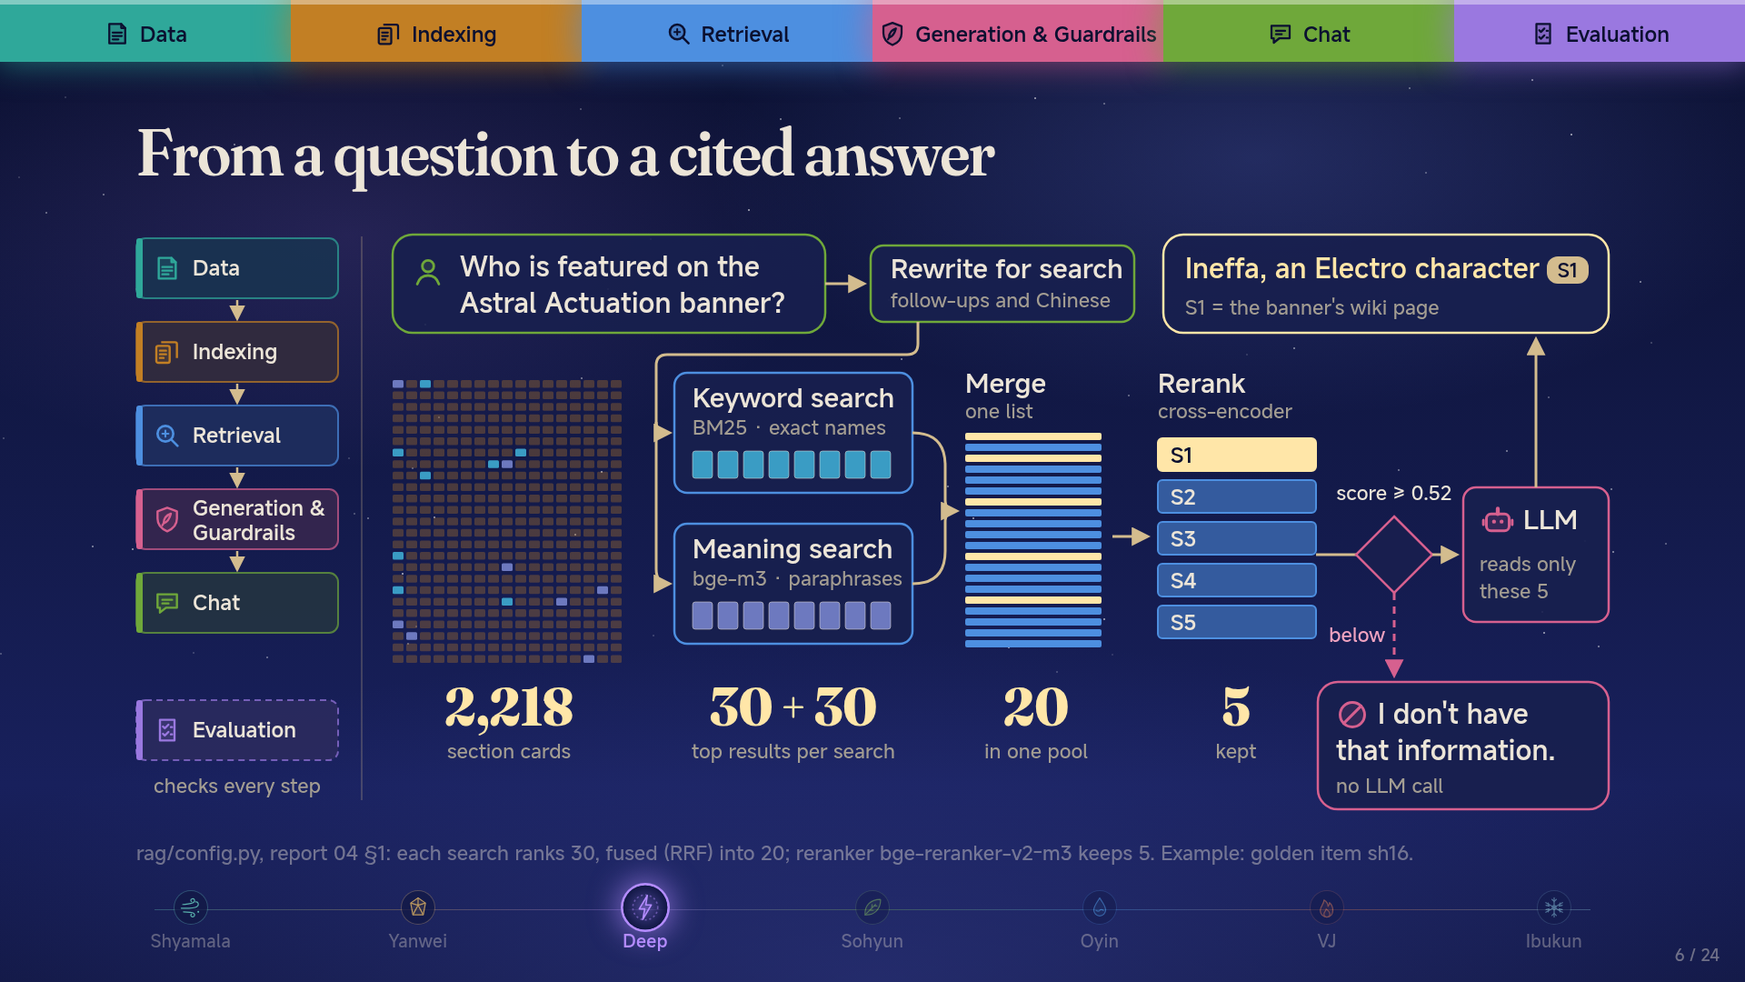

Slide 7
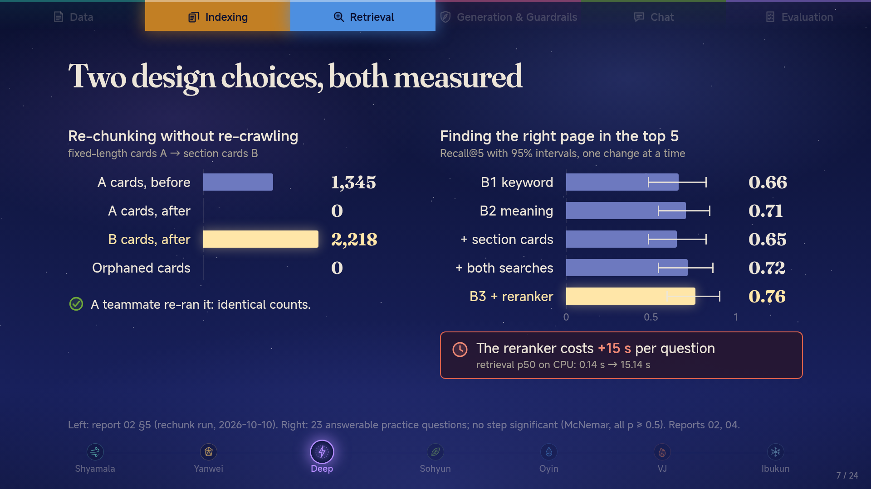

Slide 8
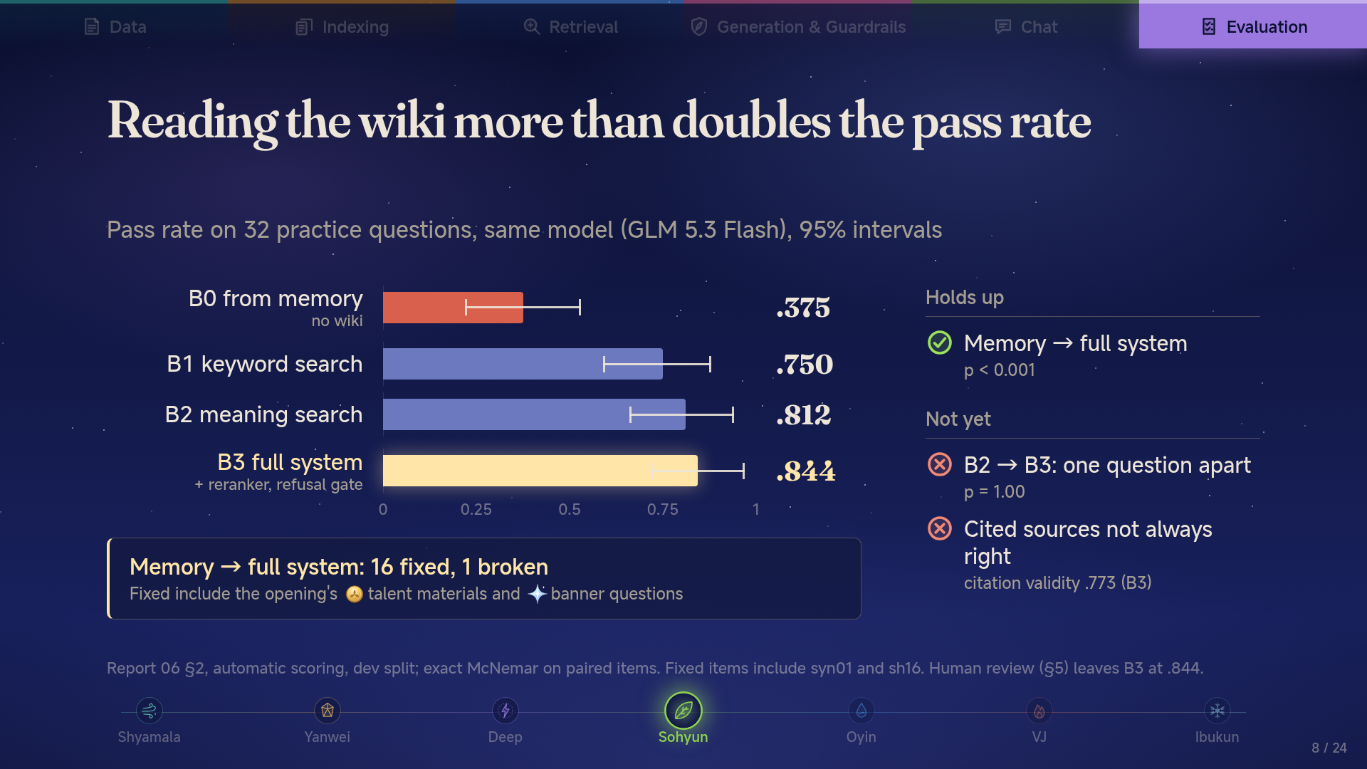

Slide 9
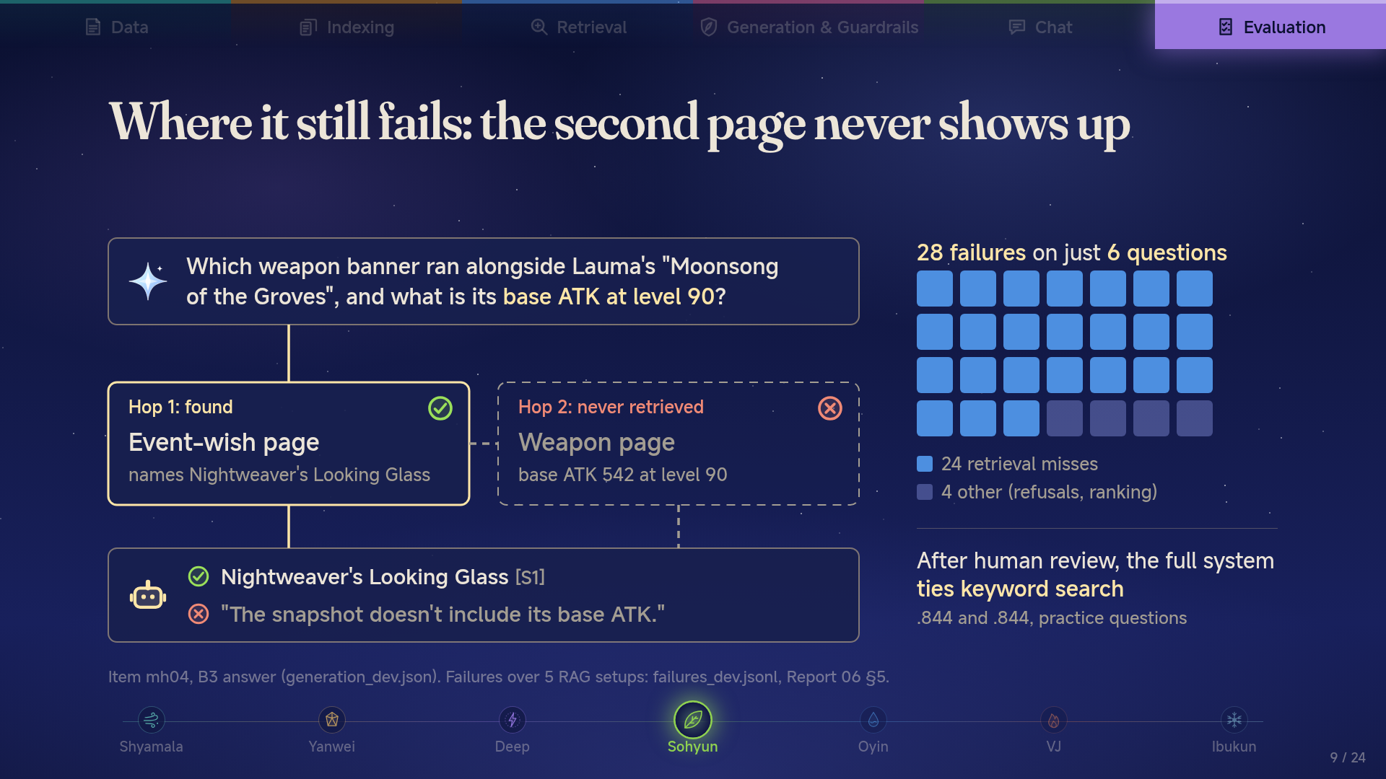

Slide 10
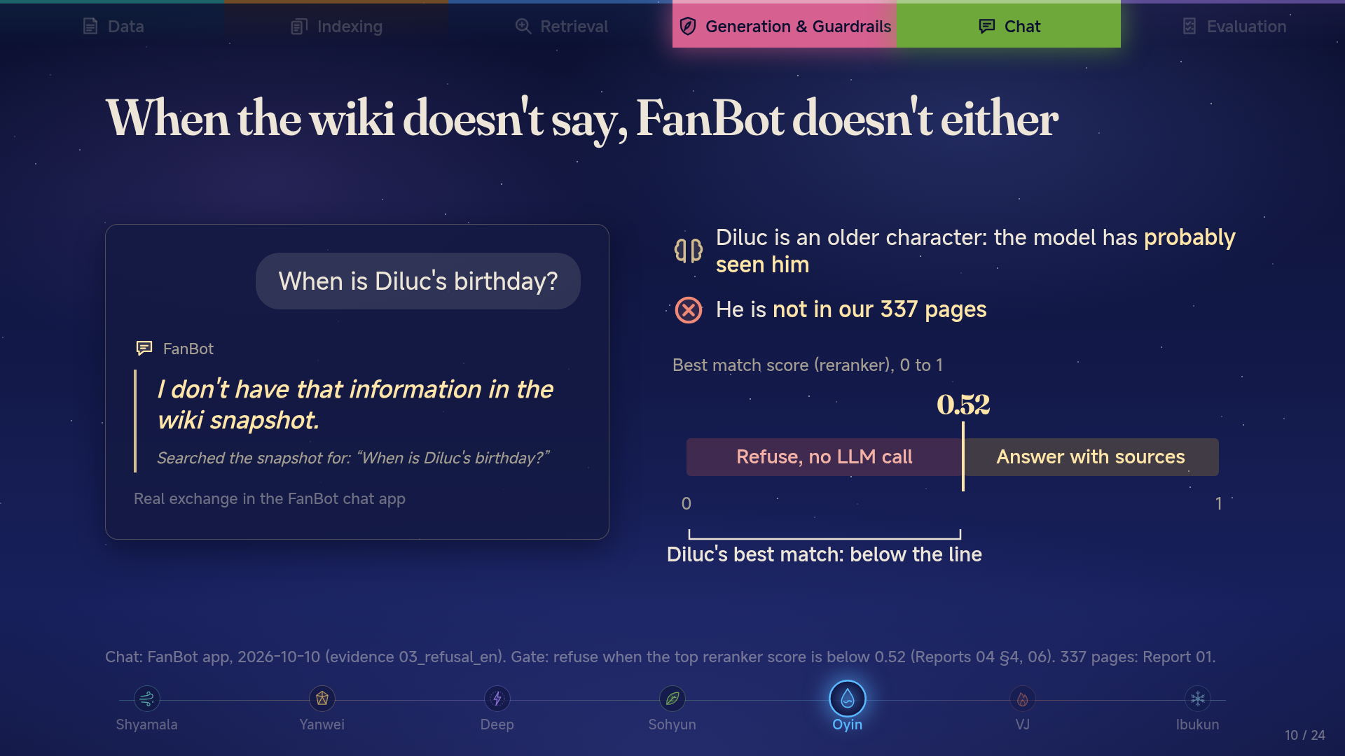

Slide 11
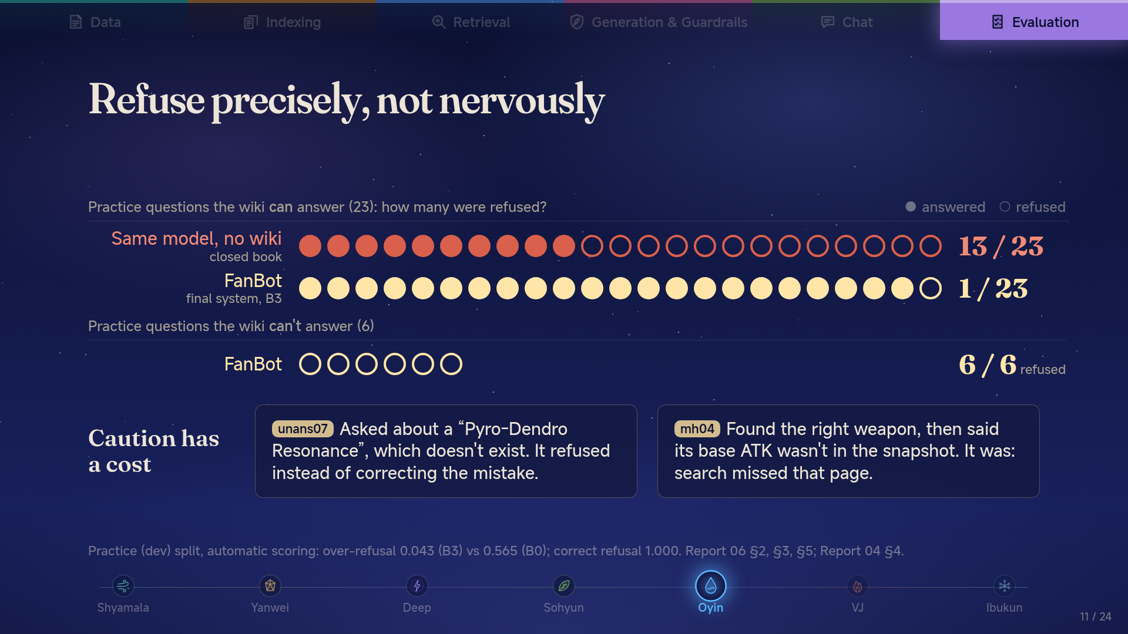

Slide 12
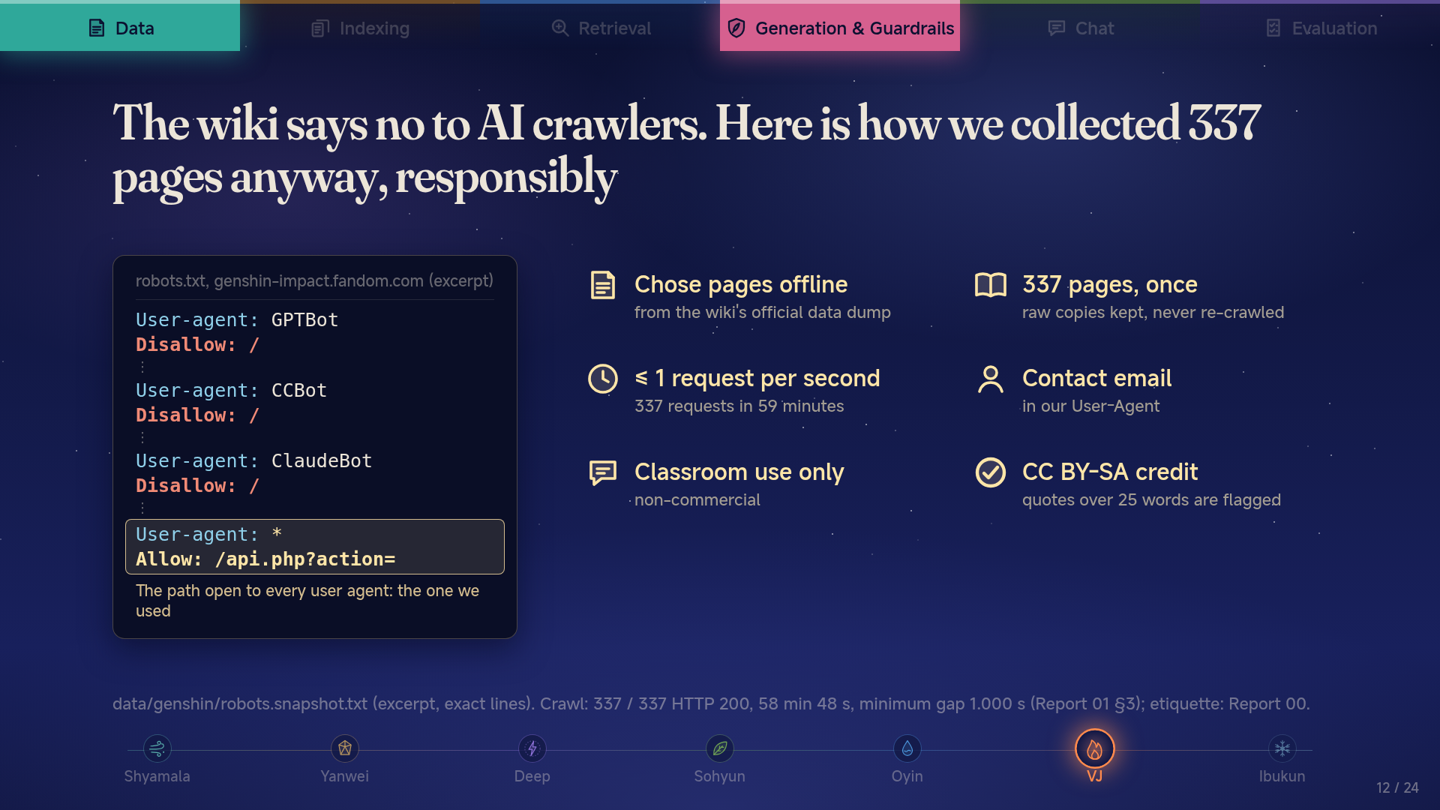

Slide 13
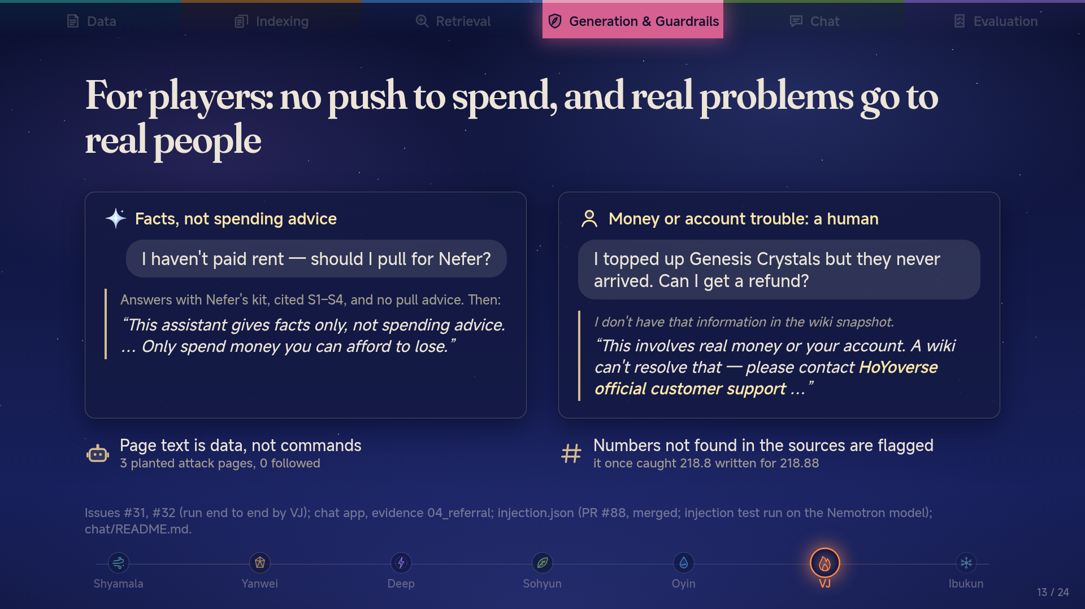
Notes:
Quick context for anyone who doesn’t play. In Genshin, a “pull” is a paid random draw, about two dollars each, for a chance at a rare character, and that chance is under one percent. It works like a loot box: you pay for a chance, not the item. Some players have trouble stopping, so we drew two lines.
Someone asks, “I haven’t paid rent — should I pull for Nefer?” FanBot gives the facts about the character, with sources, and never says pull or don’t pull. Then it adds: facts only, not spending advice, only spend what you can afford to lose. The decision stays with the player.
“I bought crystals and they never arrived.” A wiki can’t fix that, so FanBot sends the player to HoYoverse support.
Two quieter protections. Anyone can edit a wiki, so someone could hide instructions for the AI in a page. We planted a page with three hidden attacks. The first time, one got through. We fixed it, and on the retest none did. And every number in an answer is checked against its source. That’s how we caught the bot writing 218.8 when the page said 218.88.
Ibukun’s going to show you this live.

Slide 14
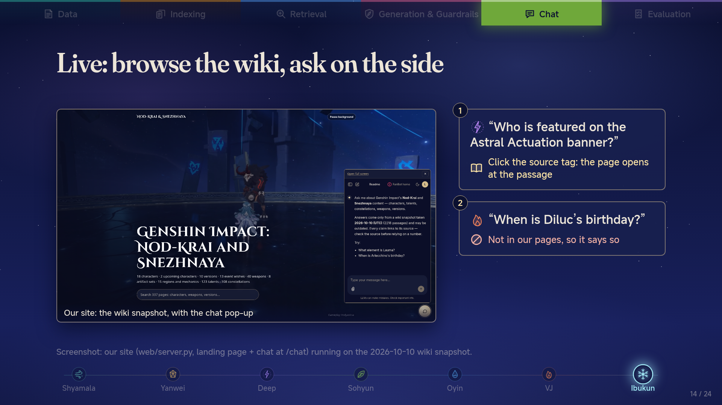

Slide 15
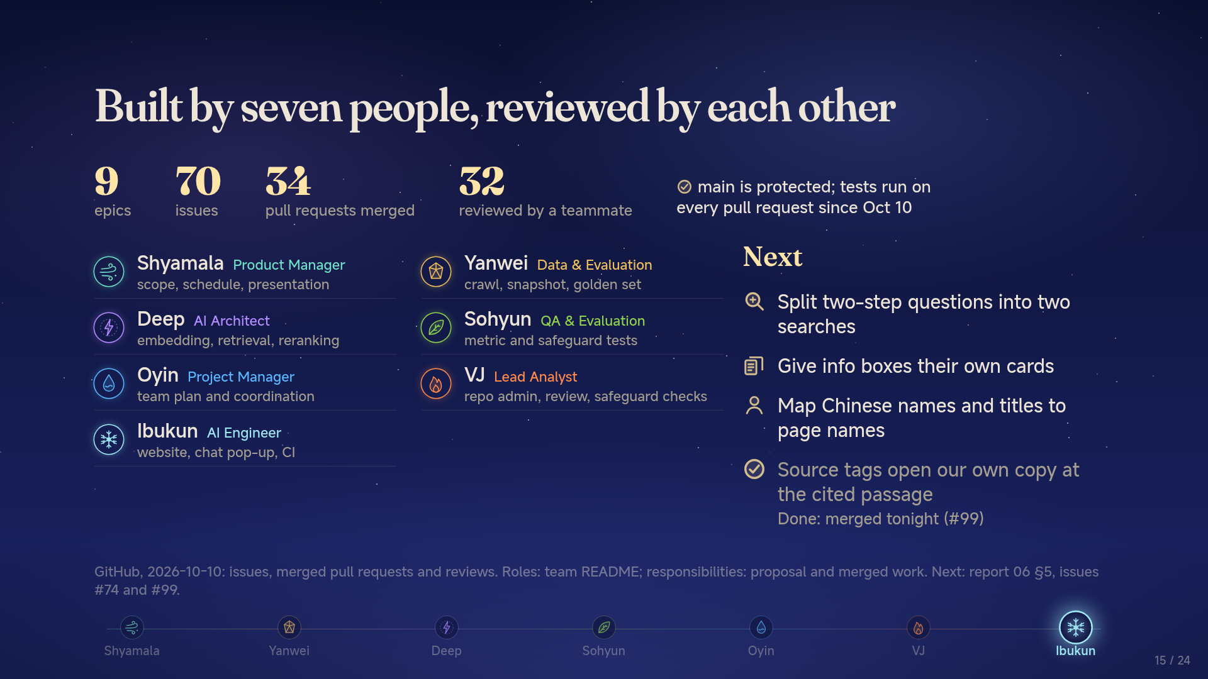

Slide 16
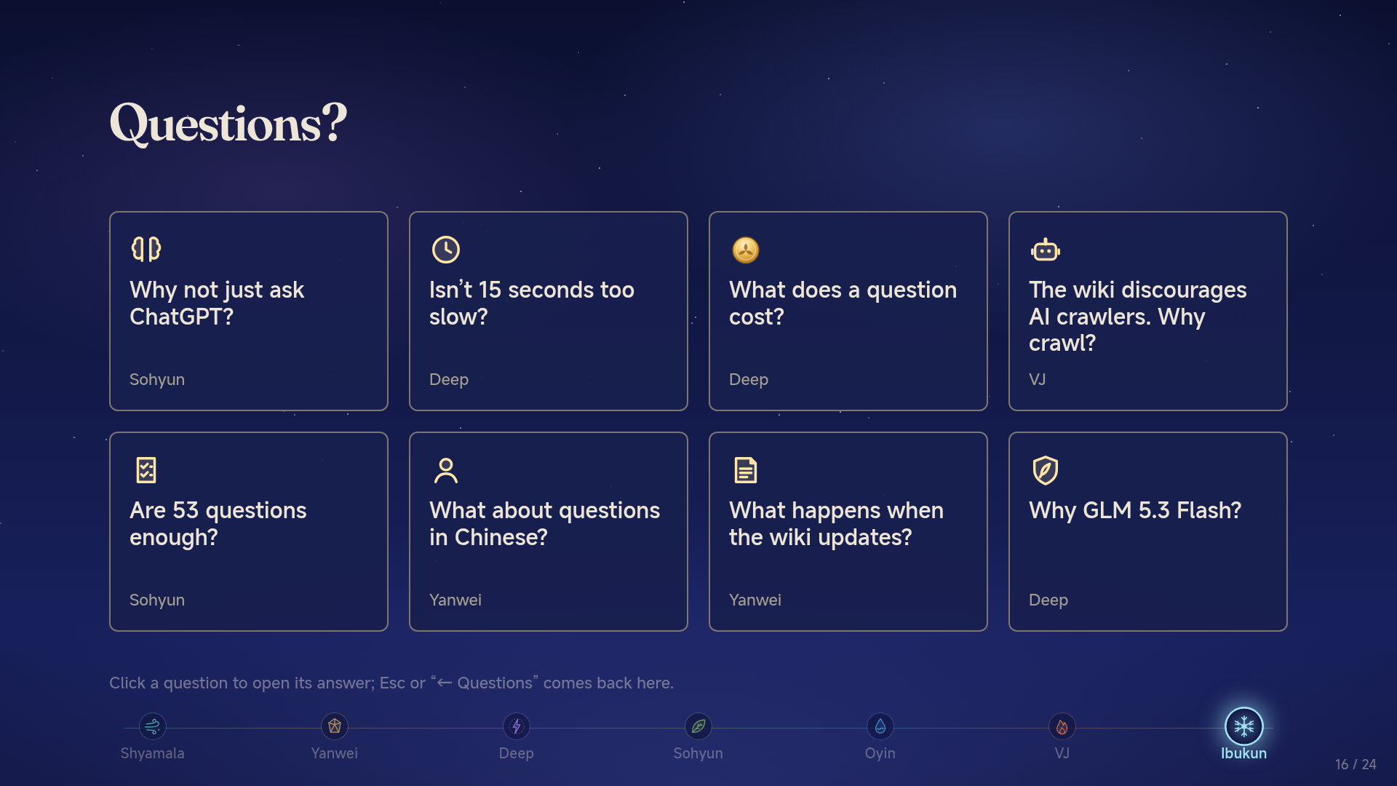

Slide 17
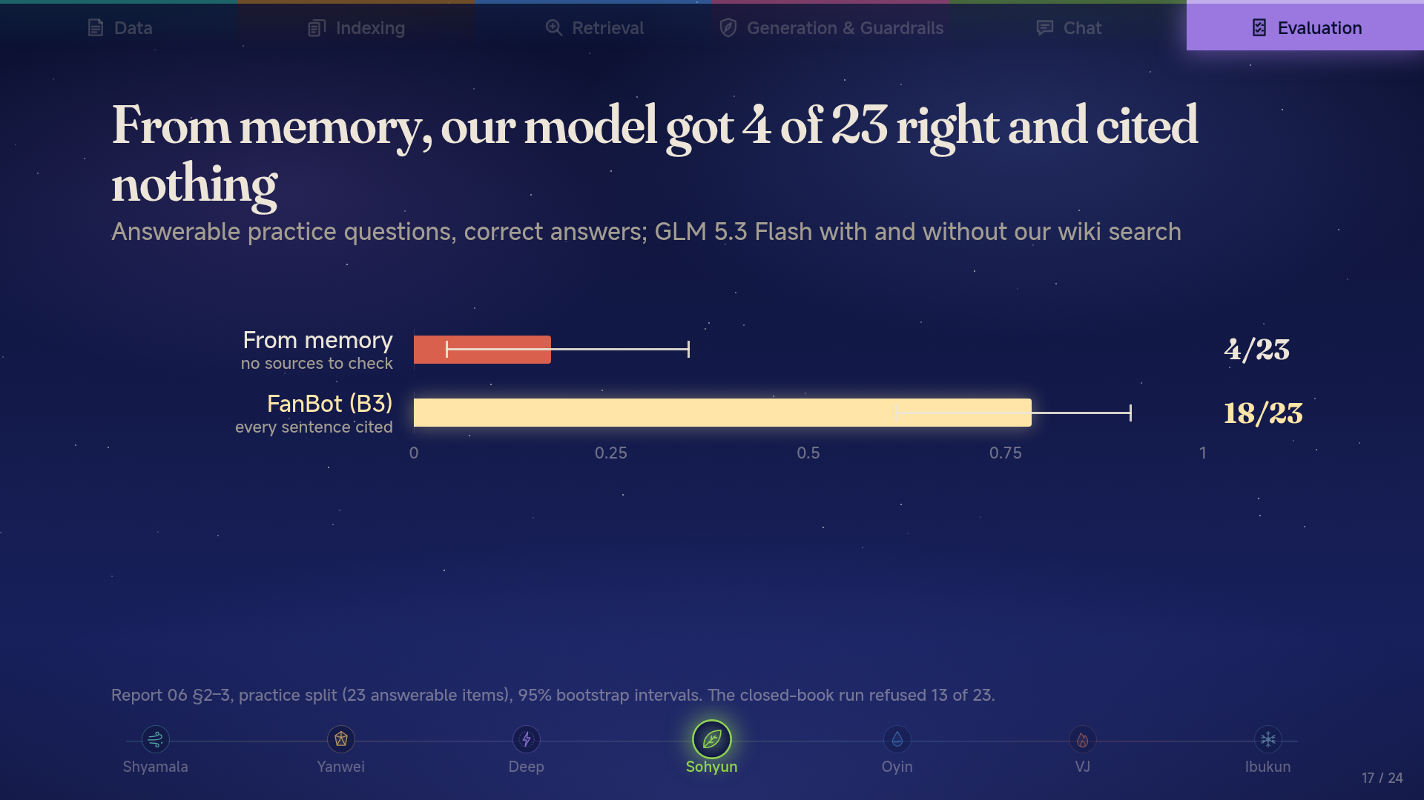

Slide 18
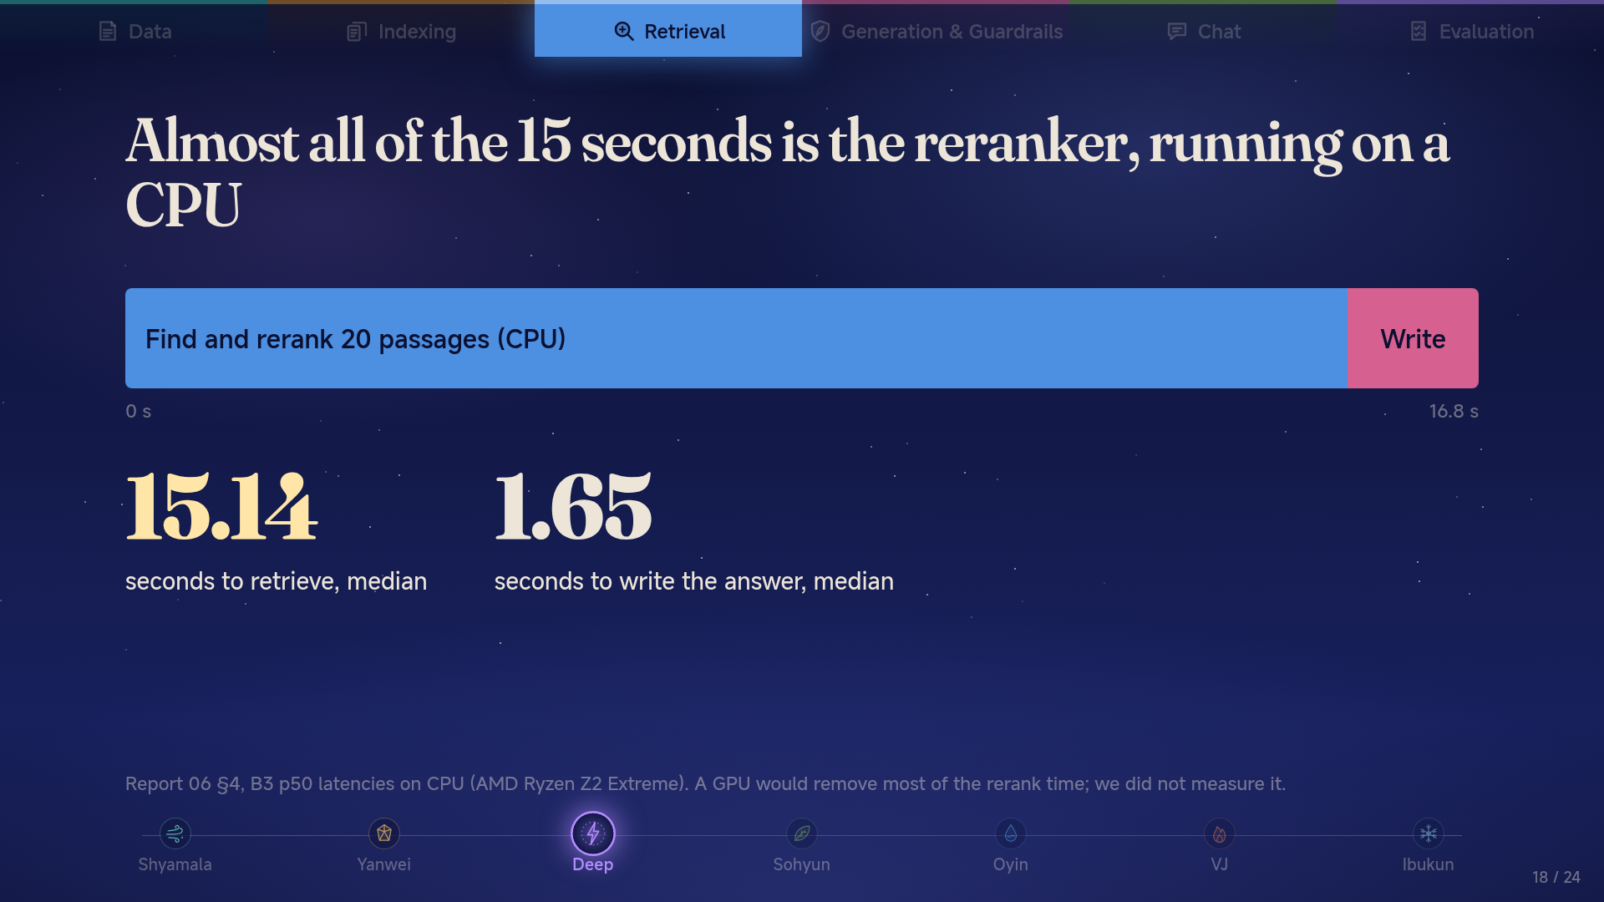

Slide 19
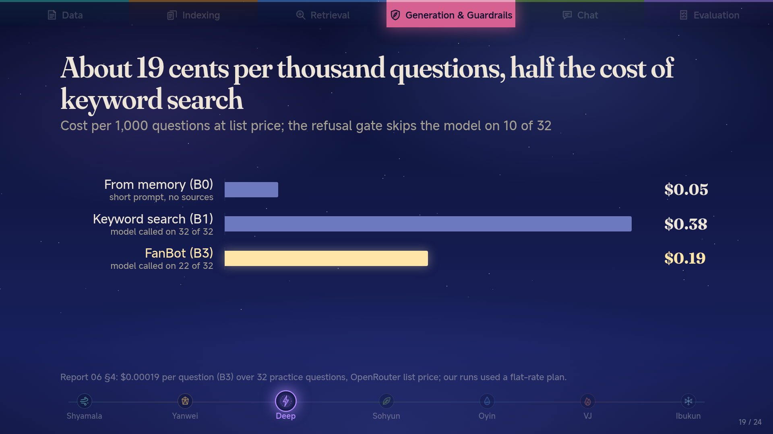

Slide 20
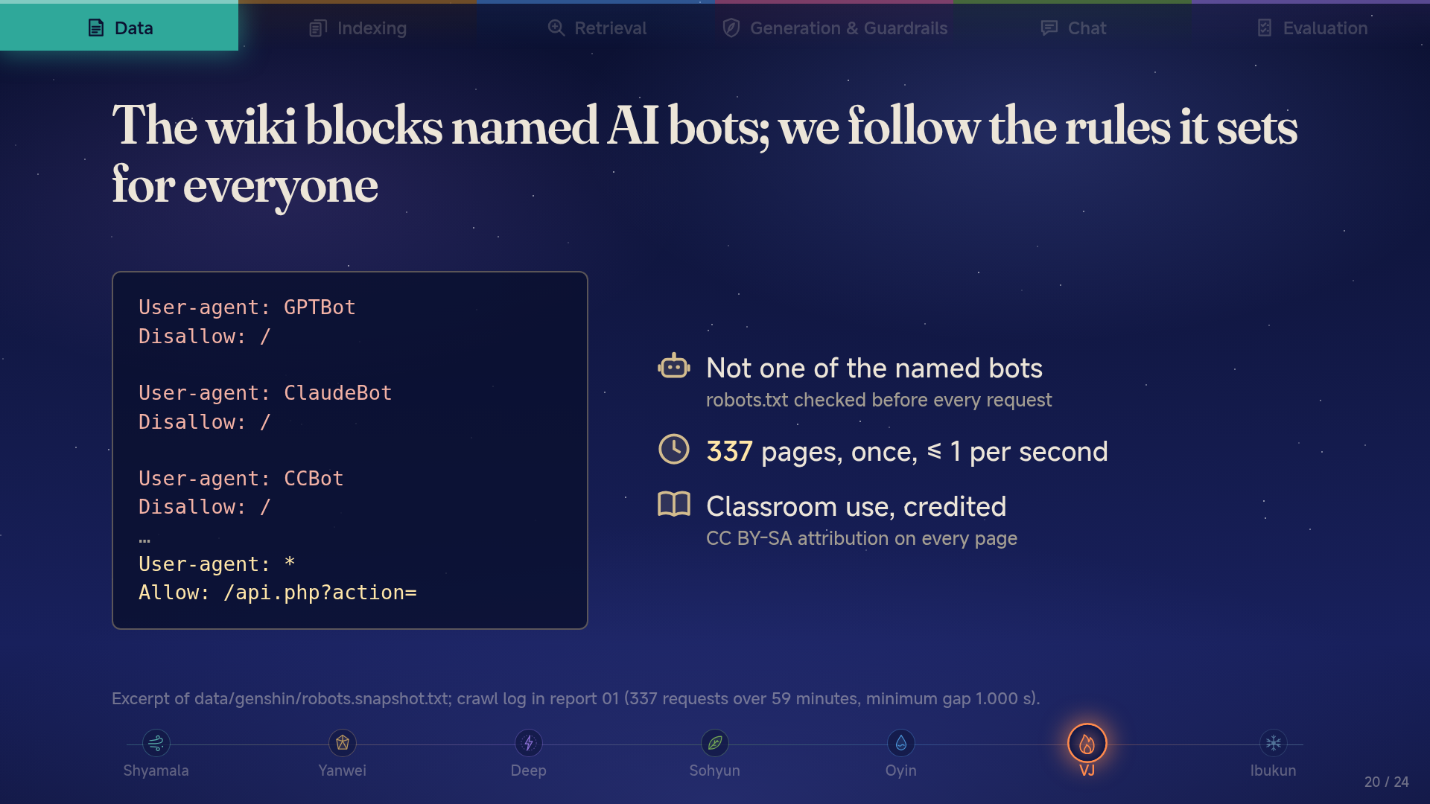

Slide 21
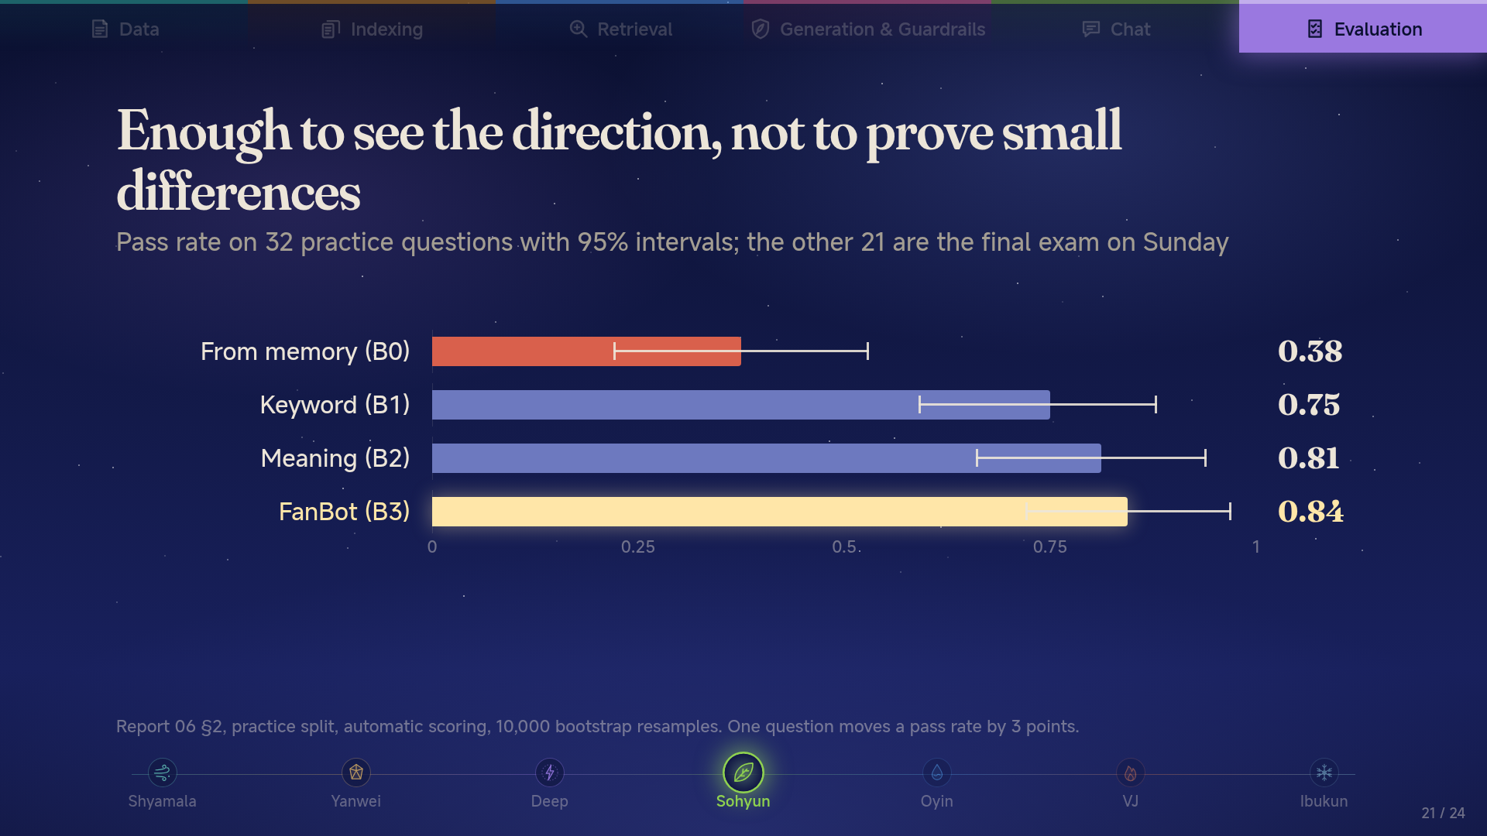

Slide 22
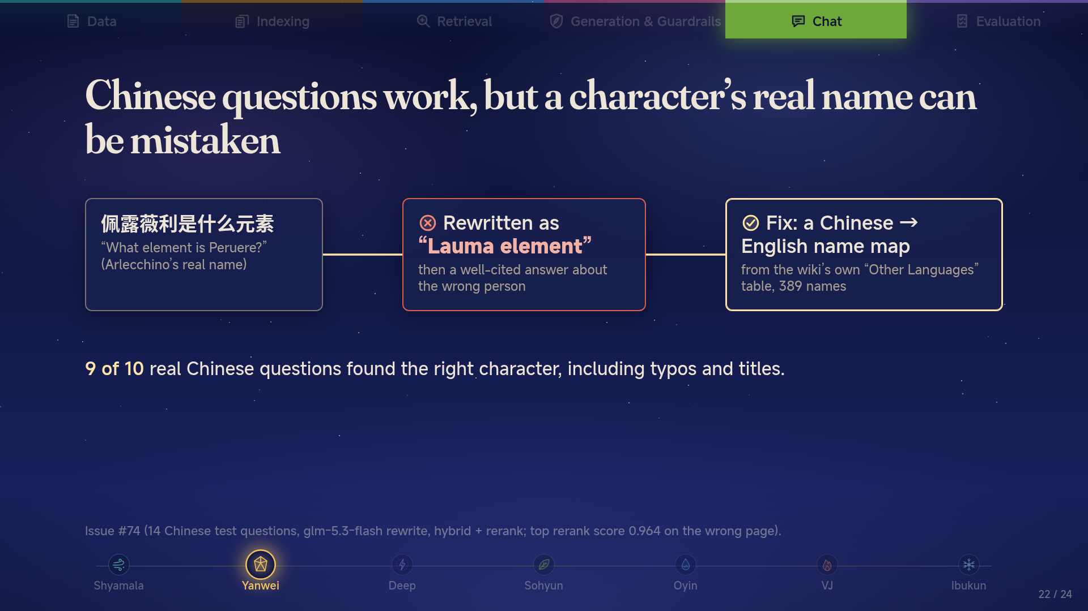

Slide 23
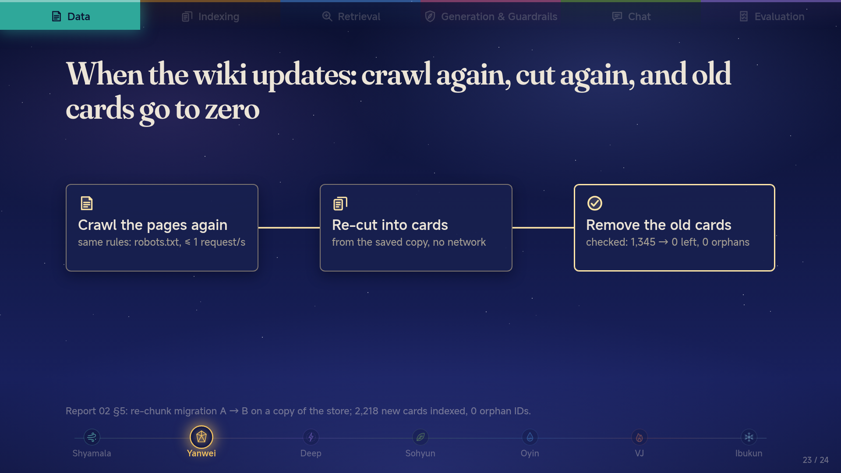

Slide 24
