Slide 1




The Best of Both Worlds: On Exploiting Bit-Alterable NAND Flash for Lifetime and Read Performance Optimization
Shuo-Han Chen, Ming-Chang Yang, and Yuan-Hao Chang
The Chinese University of Hong Kong, Hong Kong & Academia Sinica, Taiwan
Presented By Shuo-Han Chen, DAC 2019, 2018.06.06
Notes:
Good afternoon Ladies and Gentlemen. I am Shuo-Han Chen, a postdoctoral research fellow from Academia Sinica at Taiwan. I am really glad to be here today to present our work on bit-alterable NAND flash
The topic of today’s presentation is “The Best of Both Worlds: On Exploiting Bit-Alterable NAND Flash for Lifetime and Read Performance Optimization”

Slide 2
Outline
Overview
Background
Bit-Alterable NAND Flash
How Bit Errors Affect the Read Performance
Motivation
Bit-Level Error Removal Scheme
Performance Evaluation
Conclusion
Notes:
This is my outline for todays presentation.
First, I will have a brief overview of our topic today. Followed by the background of bit-alterable NAND flash and how bit errors affect the read performance on flash devices.
Next, it’s our motivation and the proposed bit-level error removal scheme
Finally, I will report the performance evaluation result and conclude todays presentation with a few remarks

Slide 3
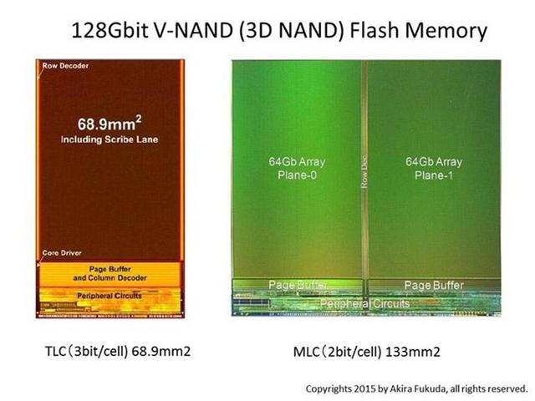

Overview
Conventional flash rewrites need to be conducted in a unit of page
Lead to high overhead when rewriting a page for removing bit errors
Bit-alterable NAND flash has become a reality
Bit-level rewrite operation can refresh error bits without page-based rewrites
Removing bit errors brings the following possibility at low lifetime expense
Reducing the error correction latency
Improving the read performance
However, bit-level rewrites has the similar latency as page-based rewrites
Leads to low rewrite throughput
Such observation motivates us to bit-level error removal (BER) scheme
For both lifetime and read performance optimization
Improving read performance by up to 25.22%
Notes:
Conventionally, removing bit errors on NAND flash devices need to be conducted in the unit of a page, which is the smallest read/write unit on today’s NAND flash devices. Refreshing a flash page for removing bit errors induce high lifetime expenses.
Recently, with the emergency of bit-alterable NAND, removing bit errors via bit-level rewrites brings the possibilities of reducing the error correction latency and read latency at low lifetime expense
However, the main constraint is that bit-level rewrites has the similar latency as page-based rewrites. Such observation motivates us to bit-level error removal scheme. And the evaluation results show that the read performance can be improved by an average of 25%

Slide 4
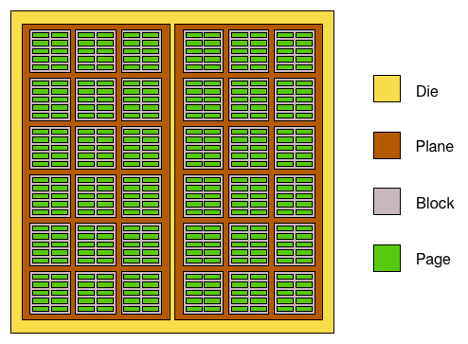
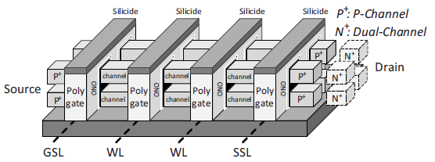
Background - Bit-Alterable NAND Flash
Few operation constraints are exists for NAND flash
Erase-before-write property
Limit program/erase cycle
Asymmetric program/erase unit
To break the program/erase unit constraint
Bit-alterable NAND flash has been realized
P-channel or Dual-channel 3D flash NAND structure
Low latency FN program/erase can be realized
One major issue of bit-level operations
Erase unit
Read/write unit
Bit-level program/erase have similar latency and wear as page-based program and block-based erase
Notes:
Traditionally, there are some operation constraints on NAND flash devices. There constraints are the erase-before-write propriety, limited program/erase cycle, and asymmetric program/erase unit.
With the asymmetric program/erase unit constraint, reading and writing to a flash page are conducted in the unit of a page. And erase are conducted in a unit of block. Each block consists of multiple pages.
To break the program/erase unit constraint, bit-alterable NAND flash has been realized through P-channel or Dual-channel 3D flash NAND structure and the Low latency FN program/erase can be realized.
However, one major issue of bit-level operations is that bit-level program/erase have similar latency and wear as page-based program and block-based erase
Therefore, the enforcement timing of bit-level operations should be carefully planned to avoid excessive lifetime expense

Slide 5
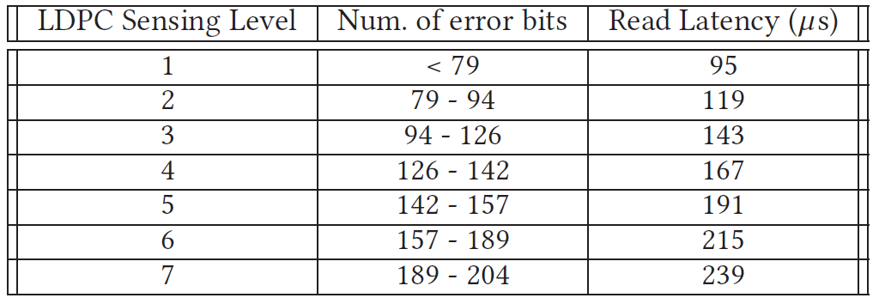
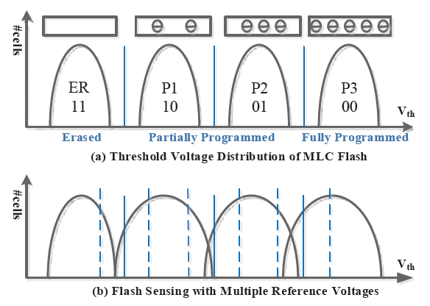
Background - Bit Errors Affect the Read Performance
To ensure reliability on NAND flash storages, Low-density parity-check (LDPC) code has been widely used
Hard-decision and multiple soft-decision sensing
Down-scaling (from 70 nm to 1X-nm) or multi-level cell (MLC, TLC) results in higher bit error rate
Higher bit error rate results in higher LDPC sensing overhead during read path
Multiple read-retry steps for reading erroneous data induces high sensing latency
In the end, the read performance is degraded due to this growing trend of bit error rate
Hard-decision
Soft-decision
Notes:
Now, let’s talk about how bit errors affect the read performance
On NAND flash devices, bit-error are Inevitable and in order to correct those errors and return correct data to the user. Error correction code, such as the Low-density parity-check (LDPC) code has been widely used.
LDPC code usually utilizes one hard-decision and multiple soft-decision sensing to sense the storage voltage in a flash cell. And different number of soft-decision sensing results in different decoding latency. The decoding latency directly affects the read latency of the flash device.
As the down-scaling or multi-level cell NAND flash become widely used, the bit error rate increases. Thus requiring multiple soft sensing to get the correct stored data. In the end, the read performance is degraded due to this growing trend of bit error rate

Slide 6
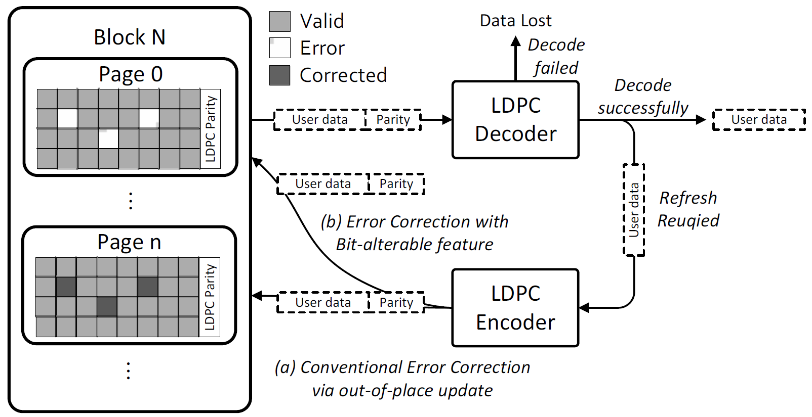
Motivation
Based on page-based erase, previous works either
Increase the complexity of LDPC strategy
Cause additional wear to flash devices
In addition, conventional page-based rewrite leads to serious lifetime expenses and wear
With these observation in mind, we aim to correct error bits with bit-alterable feature
Greatly shorten the sensing overhead
Hugely reduce the lifetime capacity expenses
Notes:
To correct bit errors for avoiding data loss and reduce the ldpc sensing latency, page-based rewrites are utilized to read the page with errors and pass through the decoder to get the correct data. Then, the corrected data are re-encoded through LDPC encoder and written to a free page.
Since only a few bits are corrected during rewriting the whole page, the page-based rewrites lead to serious lifetime expenses and wear
With these observation in mind, we aim to correct error bits with bit-alterable operations to shorten the sensing overhead and reduce the lifetime capacity expenses

Slide 7
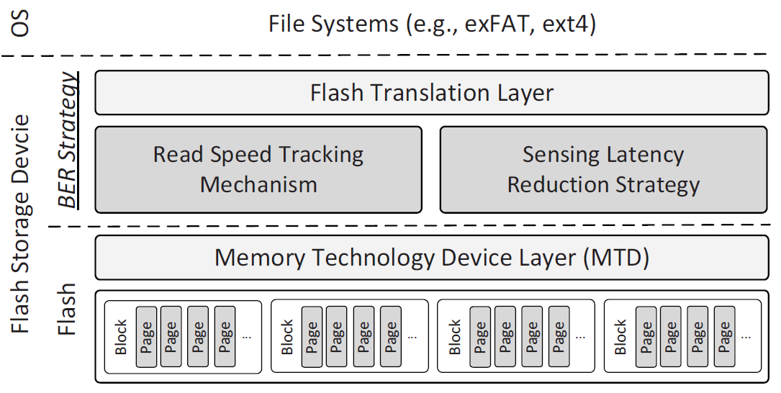
Bit-level Error Removal (BER) Scheme
Goal : Maximize the read performance with minimal lifetime degradation
Technical difficulties
How to utilize the bit-alterable feature for boosting the read performance ?
How to identify different bit error type and avoid unnecessary correction ?
How to compensate the uneven wear induced by bit-alter operations ?
Strategy
Identify different type of bit errors
Avoid unnecessary refresh
Components :
Read Speed Tracking Mechanism
Sensing Latency Reduction Strategy
Notes:
To utilize bit-alterable operations for bit error correction, this study proposed the Bit-level Error Removal (BER) Scheme with the goal of maximizing the read performance with minimal lifetime degradation
The strategy of the proposed BER scheme is to Identify different type of bit errors and avoid unnecessary refresh
Components of the proposed BER scheme includes the Read Speed Tracking Mechanism and the Sensing Latency Reduction Strategy

Slide 8
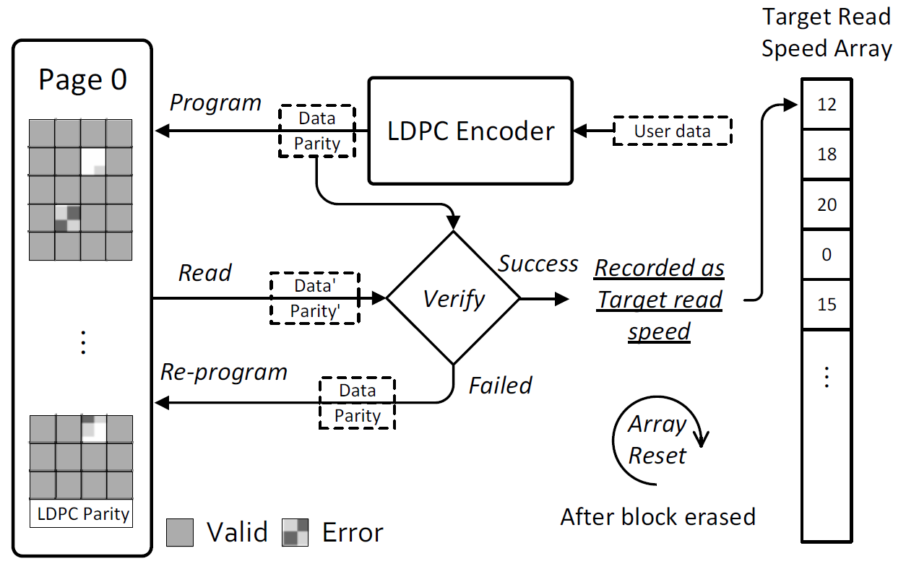
Read Speed Tracking Mechanism
When data are written to a page in the first place, the read latency for the program and verify procedure is recorded as the target access speed
Maintained in an array for each block, reset after block erased
Then, after the soft-decision LDPC is completed, the read latency is compared with the target access speed
Notes:
In the Read Speed Tracking Mechanism, the read speed of a newly written flash page is recorded as the target access speed after the flash page is newly written
As the figure shows here, the user data get encoded through the encoder and get written to the flash page. Then, we apply an additional read to record the read speed in the target read speed array.
Then, whenever the block is erased the target read speed array is reset because the erase operation change the wear level of each page in the block. Thus, the read speed of pages may change.

Slide 9
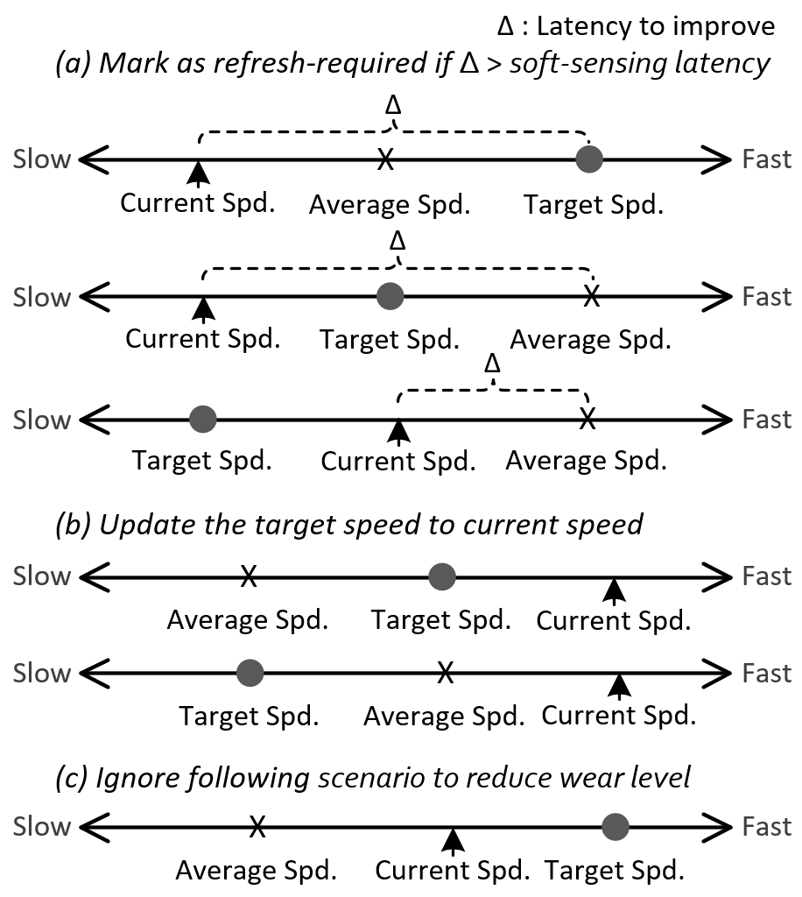
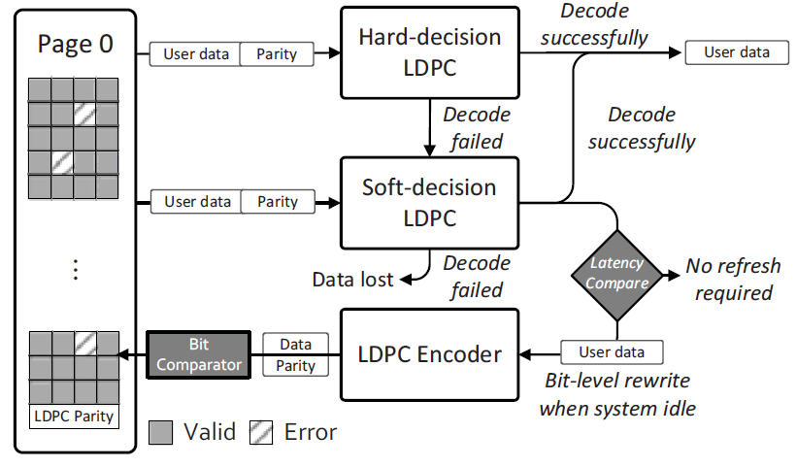
Sensing Latency Reduction Strategy
Enforced by observing the read speed
The goal is to differentiate the sources of soft-sending
Recently-written pages with high sensing latency
-> Possible program errors, aka write error
Early-written pages with high sensing latency
-> Possible due to retention error, aka transient error
Determine whether bit-level refresh is required
Current read speed, Target read speed, Average read speed
Notes:
Then, in the sensing latency reduction strategy, the recorded read speed is utilized as a indicator for deciding whether the bit-level refresh operation is required or not.
After the initial target read speed is recorded, the read latency of successive read operations are compared with the Target read speed and another Average read speed. The average read speed refers to the overall read speed of all the flash pages in the flash system.
And different cases are investigated to determine whether the refresh is required or not. Also, how many bit error should be removed to achieve the better performance is also decided. However, due to the time limitation, I will not go into the details of these

Slide 10
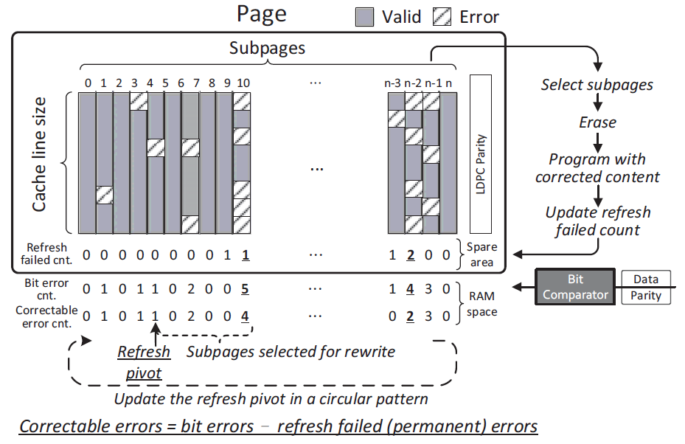
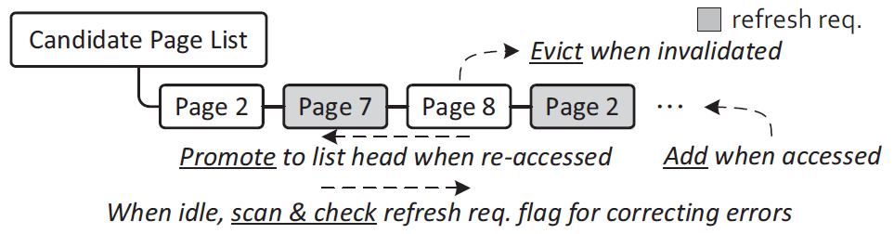
Bit-level Enabled Circular Refresh Pattern
We assume the smallest unit of conducting bit-level rewrite is the size of a cache line
The timing of enforcing error correction becomes striking a balance between
Read speed gain after conducting correction -> Number of reduced soft sensing levels
Overall performance benefits -> Data Read hotness
For each subpage, we record
Refresh failed count : Spare area
Bit error count : RAM space
Correctable count = Bit error - Refresh failed
Avoid unnecessary refresh
Skip refresh if refresh fail count = bit error count
Notes:
On the other hand, for the bit correction, we firstly assume the smallest unit of conducting bit-level rewrites is the size of a cache line to better manage the in-page uneven wear due to bit-level rewrites
Then, the core issue is to strike a balance between Read speed gain after conducting correction and Overall performance benefits
To achieve the balance, a candidate page list is maintained to keep track of those read page in a LRU fashion. And the system is idle, correction are made to there pages from the beginning.
Within each page, the circular refresh pattern is utilized to make sure each subpage has similar of wear. Then, we first derive the bit errors of the current stored data in the page a bit comparator. Also, the number of Refresh fail count from previous run are recorded in the spare area of the page.
Then, the correctable bit error of this page can be calculated by minimizing Refresh fail count from the bit error count. So that we can estimate the potential number of bit errors we can remove after refreshing the subpage. Finally, we will push the refesh pivot forward based on the targeted read speed we want to achieve via the cases we investigated in previous slide.

Slide 11
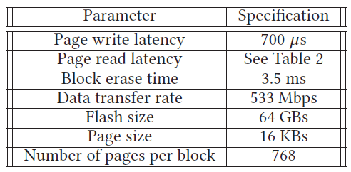
Performance Evaluation Setup
The experiments are conducted on a flash simulator
Flash specs. from Samsung 3D V-NDAD
Evaluated by
Microsoft Research Cambridge (MSR) trace
TPC benchmark
An one-month I/O trace
Notes:
The evaluation is done via simulation with the flash specs. from Samsung 3D V-NDAD and the table here summarizes the decoding latency of each LDPC sensing level
The real-world traces are utilized to evaluate the proposed strategy,

Slide 12
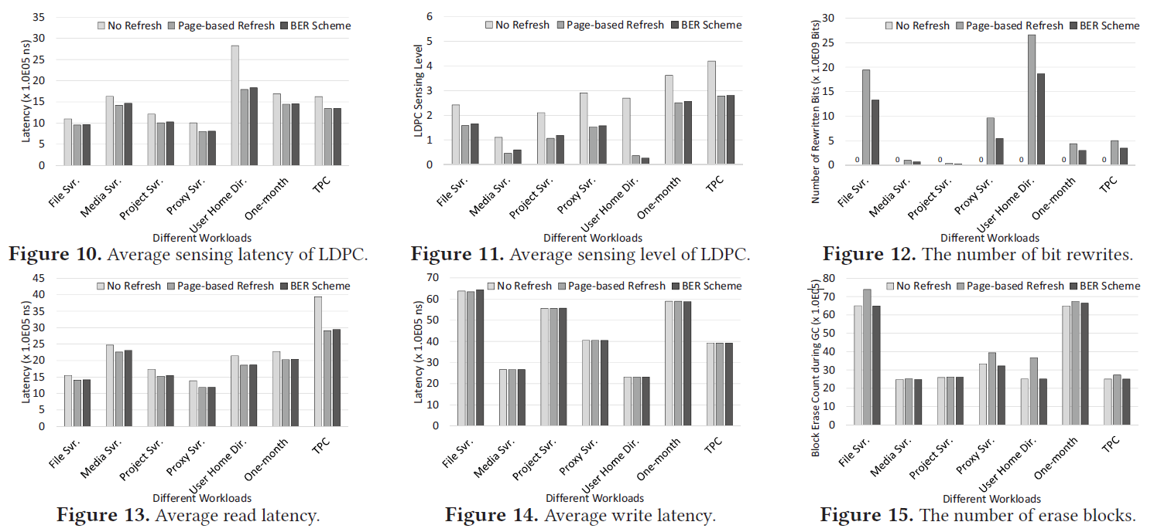
Performance Evaluation
Notes:
When compared with conventional approach with no refresh scheme, the read performance can be improved by up to 25.22%
On the other hand, when compared with page-based refresh, the number of rewritten bits can be reduced by 40.39% on average via the proposed scheme to conserve the lifetime capacity expense

Slide 13
Conclusion
This study utilize the bit-level operations for lifetime and read performance optimization
Remove error bits via the bit-level operations
Present the Bit-level error removal (BER) scheme
BER scheme introduces
Read speed tracking mechanism
-> Record the initial read speed of each page
Sensing latency reduction strategy
-> Latency comparator & Circular refresh pattern
-> Remove bit-errors with bit-level operations & Avoid excessive rewrites
In the end,
The read performance is improved by 25.22% on average
The lifetime capacity expense is reduced by 40.39% on average
Notes:
Now, I would like to conclude my presentation with a few remarks.

Slide 14
Thank you for your listening.
Notes:
Thank you for listening.

