Slide 1

Embedded System Lecture 14: I2C
Department of Computer Science and Information Engineering
Shuo-Han Chen (陳碩漢), shchen@csie.ntut.edu.tw
Hong-Yue Technology Research Building 334
R 09:10 - 12:00

Slide 2
Course Schedule Update
Full Online Course: To practice taking online course, Required by the School (due to Covid-19)
W | Date | Lecture | Notes | Homework
1 | Sept. 17 | Lec01: Introduction |  | HW00
2 | Sept. 24 | Lec02: The Big Picture
3 | Oct. 1 | Moon Festival | No Class
4 | Oct. 8 | Lec04: Linux and Real time
5 | Oct. 15 | Lec05: The Linux Kernel
6 | Oct. 22 | Lec06: Kernel Arch for Device Drivers & Kernel Initialization
7 | Oct. 29 | Lec07: Driver Allocation, Input Subsystem & Memory
8 | Nov. 5 | Lec08: Direct Memory Access & misc & File System | Full Online Course
9 | Nov. 12 | School Midterm Week | No Class
10 | Nov. 19 | Lec10: Flash Memory | Full Online Course
11 | Nov. 26 | Midterm on Nov. 26 | 3 Hour Paper-and-pencil Test (Slides & Notes Allowed)
12 | Dec. 3 | Lec10: Flash Memory
13 | Dec. 10 | Lec13: USB Device
14 | Dec. 17 | Lec14: I2C
15 | Dec. 24 | Lec15: TBD
16 | Dec. 31 | Lec16: Pre-Presentation Discussion
17 | Jan. 7 | Final Presentation | Full Online Course
18 | Jan. 14 | Final Presentation | Full Online Course
2

Slide 3

Final Presentation
Pre-presentation Discussion
12/31
Same Classroom
Come during your time slot
No show or late -> Lose 3 points on final grade
Final Presentation
1/7 and 1/14
Online & need to attend for the whole class
Login into the meeting room at least 10 minutes before first presentation -> Lose 3 points if late or no show
3

Slide 4
Final Presentation
Group | Student ID | Student ID | Pre-Presentation | Presentation Date | Paper
I | 109598076 | 109598090 | 11:40-12:00 | 01/14 10:45-11:15 | Security Challenges in Embedded Systems (10 pages)
H | 108aea008 | 107aea002 | 11:20-11:40 | 01/14 10:15-10:45 | Built-in Security Computer Deploying (13 pages)
G | 108AEA001 | 108AEA002 | 11:00-11:20 | 01/14 09:45-10:15 | Improving SSD Read Latency via Coding (14 pages)
F | 109999401 |  | 10:50-11:00 | 01/14 09:30-09:45 | Embedded Device Forensics and Security (5 pages)
E | 106820005 | 106820011 | 10:30-10:50 | 01/07 11:30-12:00 | Power System Security With Cyber-Physical (13 pages)
D | 109598074 | 109598088 | 10:10-10:30 | 01/07 11:00-11:30 | Object-Level Memory Allocation and Migration (13 pages)
C | 109598061 | 109598085 | 09:50-10:10 | 01/07 10:30-11:00 | CIMAT A Compute-In-Memory Architecture (11 pages)
B | 107598064 | 108598061 | 09:30-09:50 | 01/07 10:00-10:30 | A Neural Network-Based On-Device Learning (18 pages)
A | 108598066 | 108599001 | 09:10-09:30 | 01/07 09:30-10:00 | Algorithmics of Cost-Driven Computation (14 pages)
4

Slide 5
Overview
Introduction to I2C
Basics
I2C/SMBus Protocol
Linux I2C
Linux I2C Subsystem
I2C Bus Driver
I2C Adapter Driver
I2C-Dev Driver
I2C Client Driver
5

Slide 6
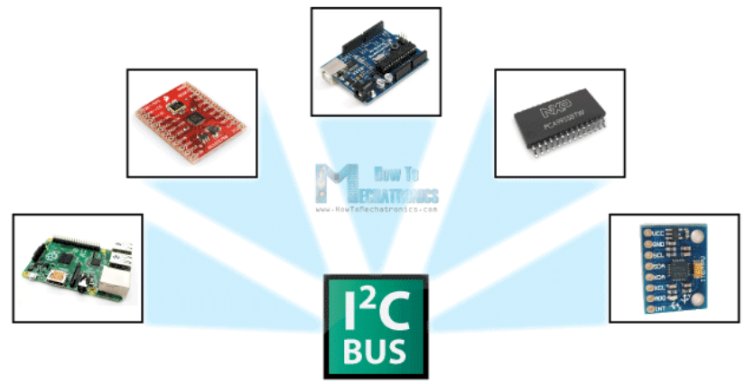
Introduction to I2C ─ Basics
Very popular on embedded system
6

Slide 7
Introduction to I2C ─ Basics
I2C(Inter-Intergradted Circuit Bus):published by Philip with licensed trademark and patent (not any more)
Inter-chip communication
Two wires
SCL(Serial Clock Line)
SDA(Serial Data Line)
With pull-up resistors
Master/slave hierarchy
Bus speed
100KHz/ 400KHz/ 1MHz/ 3.4MHz/ 5MHz
7

Slide 8
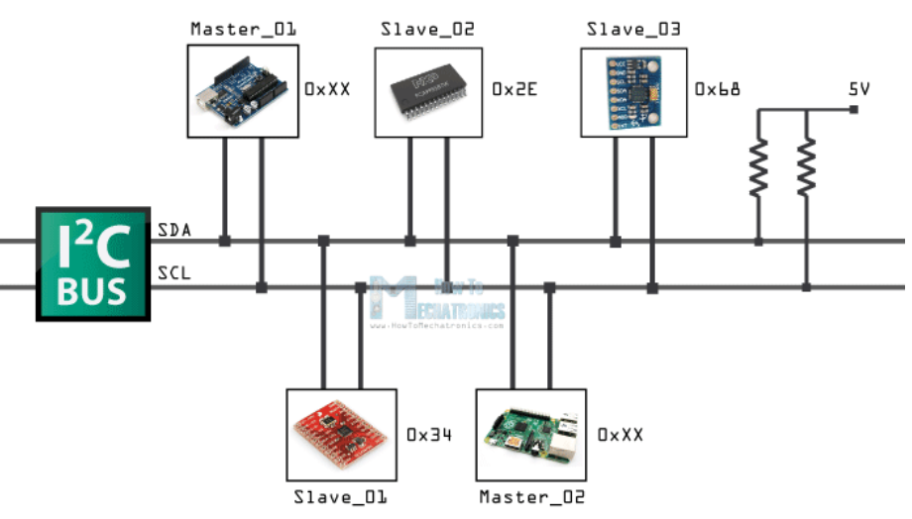
How it’s connect?
With only two address line
8

Slide 9
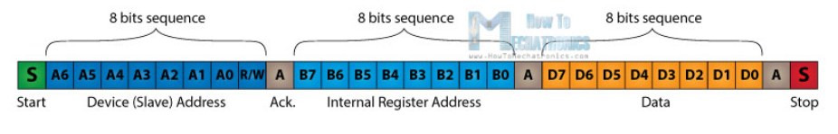
The Data Line Signal
Transferred in sequences of 8 bits
Address of the slave
It’s actually composed of 7 bits
8th bit is used for indicating whether the master will write to the slave (logic low) or read from it (logic high).
Internal registers of the slave device
Data sequences
Bit AKC/ NACK is used by the slave device to indicate whether it has successfully received the previous sequence of bits.
9

Slide 10
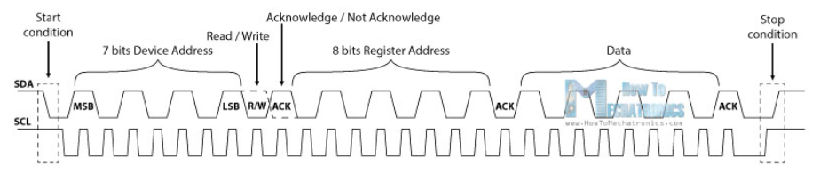
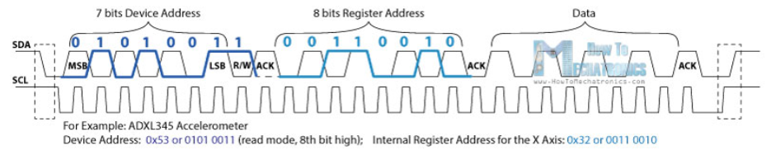
The Data Line Signal
ACK : If the slave device has successfully received the previous sequence it will pull the SDA line down to the condition called Acknowledge.
10

Slide 11
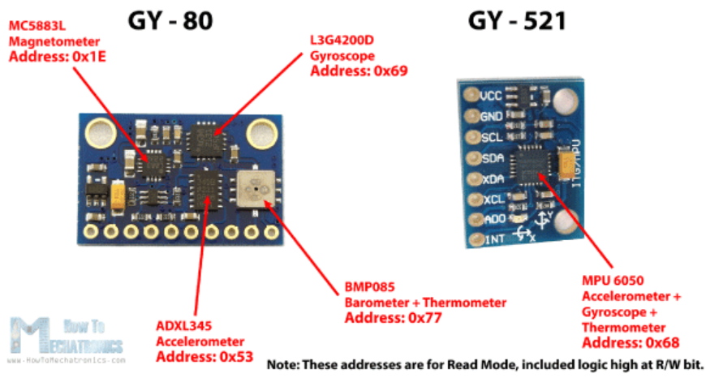
Example
11

Slide 12
Variation of I2C
TWI(Two-Wire Interface)：introduced by Atmel to avoid conflicts with trademark issues related to I²C
SMBus(System Management Bus)：defined by Intel
with tighter constraints (100KHz, timeout, format)
I2C adapters can support most SMBus protocol, but not the other way around
SCCB(Serial Camera Control Bus)：developed by OmniVision
three kind of transaction
3 Phase write
2 Phase read
2 Phase write
Don’t care bit
12

Slide 13
Introduction to I2C ─ I2C/SMBus Protocol
I2C protocol
S (1 bit) : Start bit
Sr (1 bit) : Repeated start bit
Addr (7 bits): I2C 7 bit address
Rd/Wr (1 bit) : Read/Write bit
A, NA (1 bit) : ACK/NACK bit
Data (8 bits)
P (1 bit) : Stop bit
13

Slide 14
Introduction to I2C ─ I2C/SMBus Protocol
Simple send transaction
S Addr Wr [A] Data [A] Data [A] … [A] Data [A] P
Simple receive transaction
S Addr Rd [A] [Data] A [Data] A … A [Data] NA P
Combined transactions
S Addr Wr [A] Data [A] Sr Addr Rd [A] [Data] NA P
...
14

Slide 15
Introduction to I2C ─ I2C/SMBus Protocol
SMBus protocol
S (1 bit) : Start bit
Sr (1 bit) : Repeated start bit
Addr (7 bits): I2C 7 bit address
Rd/Wr (1 bit) : Read/Write bit.
A, NA (1 bit) : ACK/NACK bit
Comm (8 bits): Command byte, a data byte which often selects a register on the device.
Data (8 bits): A plain data byte
Count (8 bits): A data byte containing the length of a block operation.
P (1 bit) : Stop bit
15

Slide 16
Introduction to I2C ─ I2C/SMBus Protocol
SMBus Quick Command
S Addr Rd/Wr [A] P
SMBus Receive Byte
S Addr Rd [A] [Data] NA P
SMBus Send Byte
S Addr Wr [A] Data [A] P
SMBus Read Byte
S Addr Wr [A] Comm [A] Sr Addr Rd [A] [Data] NA P
SMBus Read Word
S Addr Wr [A] Comm [A] Sr Addr Rd [A] [DataLow] A [DataHigh] NA P
SMBus Write Byte
S Addr Wr [A] Comm [A] Data [A] P
SMBus Write Word
S Addr Wr [A] Comm [A] DataLow [A] DataHigh [A] P
16

Slide 17
Introduction to I2C ─ I2C/SMBus Protocol
SMBus Process Call
S Addr Wr [A] Comm [A] DataLow [A] DataHigh [A] Sr Addr Rd [A] [DataLow] A [DataHigh] NA P
SMBus Block Read
S Addr Wr [A] Comm [A] Sr Addr Rd [A] [Count] A [Data] A [Data] A … A [Data] NA P
reads a block of up to 32 bytes from a device
SMBus Block Write
S Addr Wr [A] Comm [A] Count [A] Data [A] Data [A] … [A] Data A P
SMBus Block Write - Block Read Process Call
S Addr Wr [A] Comm [A] Count [A] Data [A] ... Sr Addr Rd [A] [Count] A [Data] ... A P
Send then read 31 bytes
I2C Block Read
S Addr Wr [A] Comm [A] Sr Addr Rd [A] [Data] A [Data] A … A [Data] NA P
I2C Block Write
S Addr Wr [A] Comm [A] Data [A] Data [A] … [A] Data [A] P
17

Slide 18
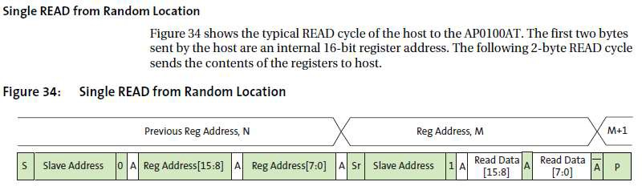
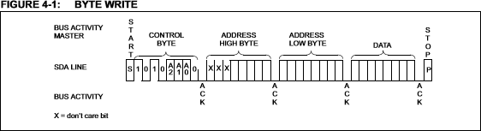
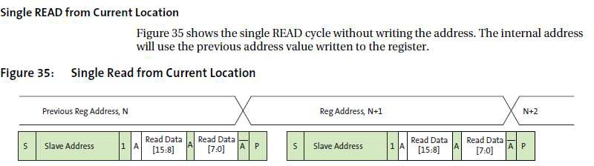
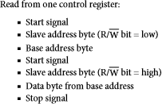
Introduction to I2C ─ I2C/SMBus Protocol
Check the datasheet of the slave device for its protocol
18

Slide 19
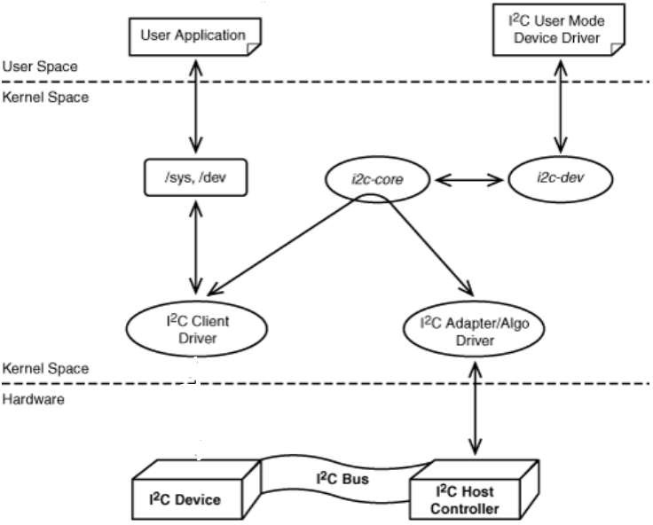
Linux I2C ─ Linux I2C Subsystem
From hardware prospective
I2C Adapter (Core)
I2C Device
From Linux prospective
I2C Core
I2C Adapter
Algorithm
I2C Client
I2C client driver
I2C-dev
19

Slide 20
Linux I2C ─ I2C Bus Driver
The bus driver：i2c-core (i2c-core-*.c)、i2c.h
Creates and registers the bus_type structure -> i2c_bus_type
Provides API to
register and implement I2C adapter drivers
register and implement I2C device drivers
matches the device drivers against the devieces detected by the adapter driver
Define driver and device specific structures
struct i2c_adapter
struct i2c_algorithm
struct i2c_client
struct i2c_driver
…
20

Slide 21
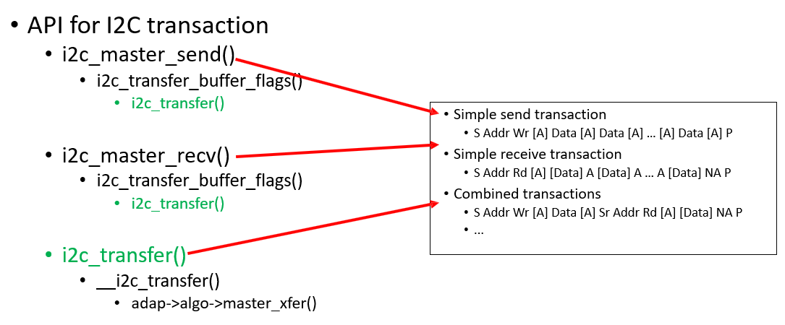
Linux I2C ─ I2C Bus Driver
21

Slide 22
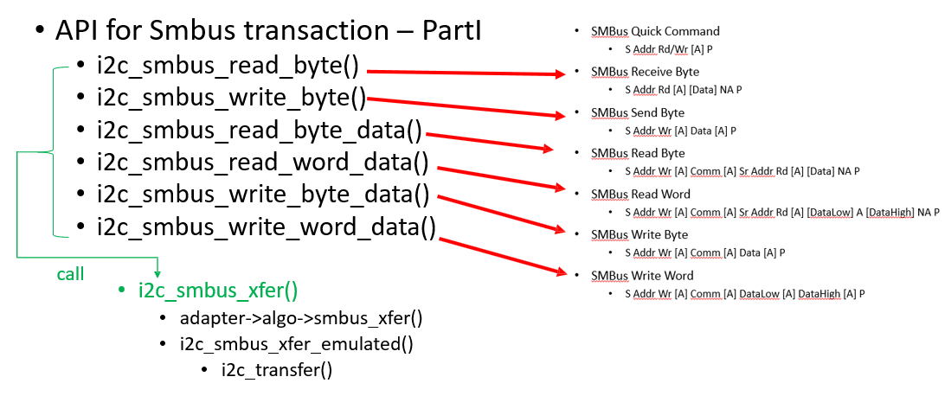
Linux I2C ─ I2C Bus Driver
22

Slide 23
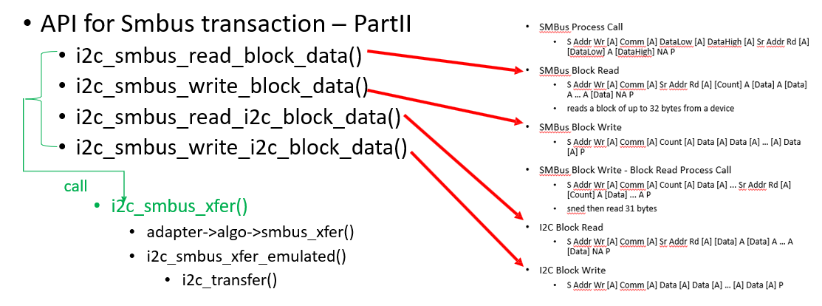
Linux I2C ─ I2C Bus Driver
23

Slide 24
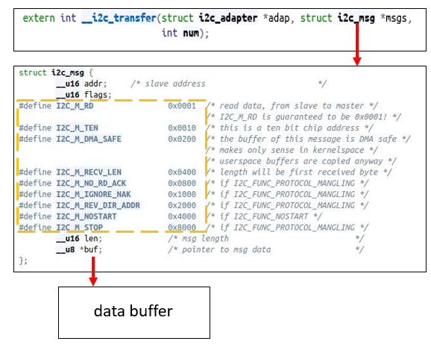
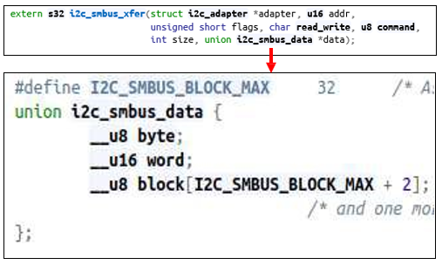
Linux I2C ─ I2C Bus Driver
Structures for I2C and SMBus transaction messages
24

Slide 25
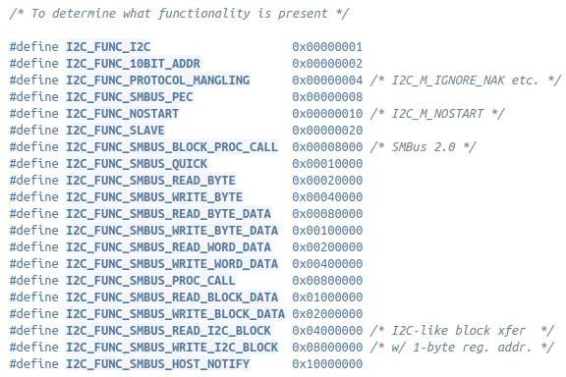
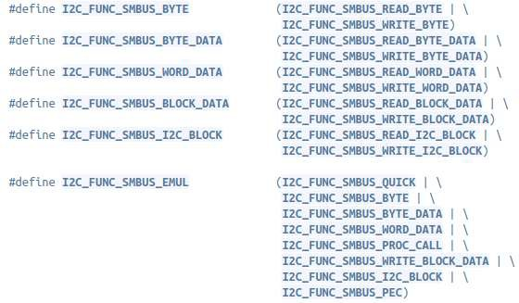
Linux I2C ─ I2C Bus Driver
Functionalities
25

Slide 26
Linux I2C ─ I2C Bus Driver
Device Model data structures
Adapter
Bus：struct bus_type platform_bus_type
Driver：struct platform_driver
Device：struct i2c_adapter
Struct i2c_algorithm
Client
Bus：struct bus_type i2c_bus_type
Driver：Struct i2c_driver
Device：Struct i2c_client
※ Adapter could belong to other device driver
module_usb_driver(/drivers/i2c/busses/i2c-robotfuzz- osif.c)
module_acpi_driver(/drivers/i2c/busses/i2c-scmi.c)
module_serio_driver(/i2c/busses/i2c-taos-evm.c)
isa_driver(/drivers/i2c/busses/i2c-elektor.c)
26

Slide 27
Linux I2C ─ I2C Adapter Driver
Adapter driver(/drivers/i2c/busses/i2c-cadence.c)
struct cdns_i2c
struct i2c_algorithm cdns_i2c_algo
cdns_i2c_probe()
cdns_i2c_remove()
struct platform_driver cdns_i2c_drv
module_platform_driver(cdns_i2c_drv)
27

Slide 28
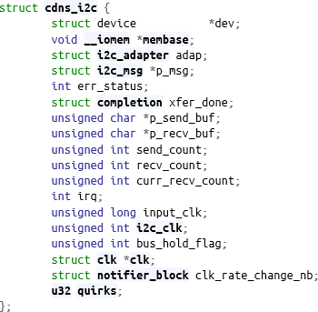
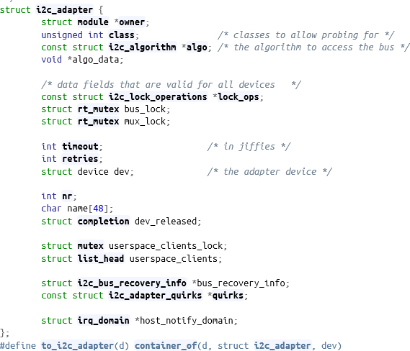
Linux I2C ─ I2C Adapter Driver
i2c_adapter structure
28

Slide 29
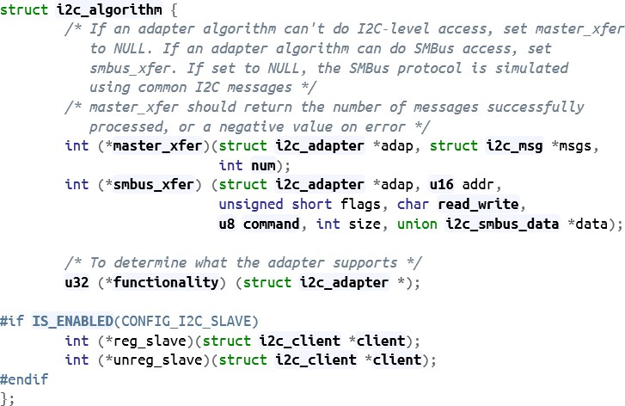
Linux I2C ─ I2C Adapter Driver
i2c_algorithm structure
master_xfer
i2c access
can emulate Smbus protocol
smbus_xfer
smbus access
29

Slide 30

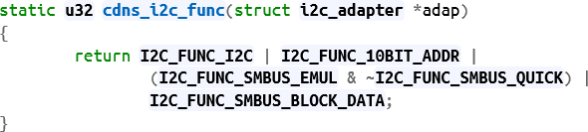
Linux I2C ─ I2C Adapter Driver
Algorithm
30

Slide 31
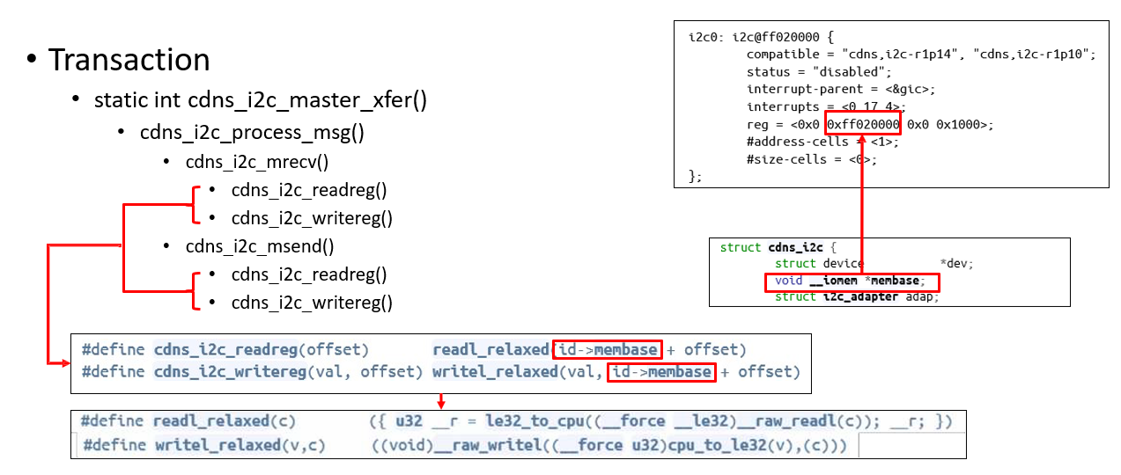
Linux I2C ─ I2C Adapter Driver
31

Slide 32
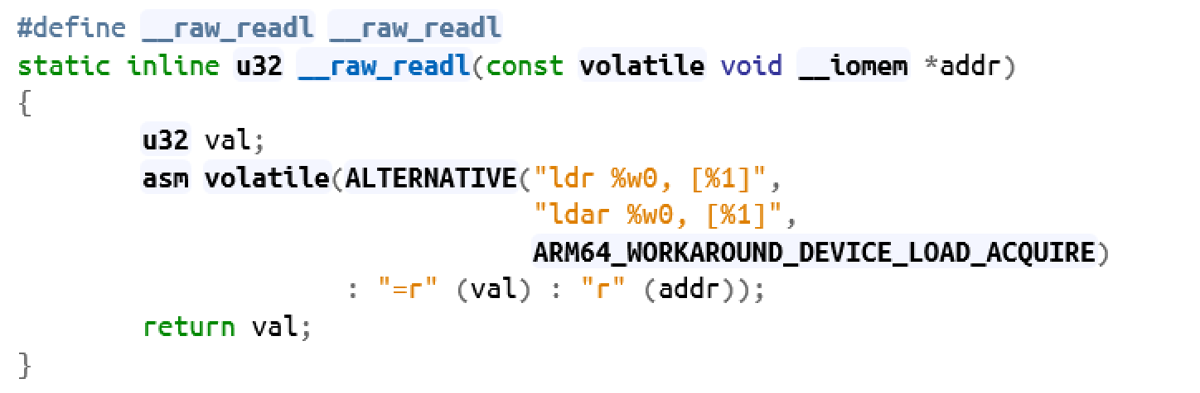
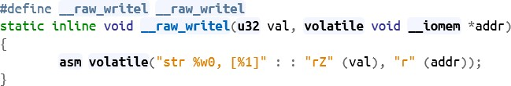
Linux I2C ─ I2C Adapter Driver
Memory-mapped I/O access
32

Slide 33
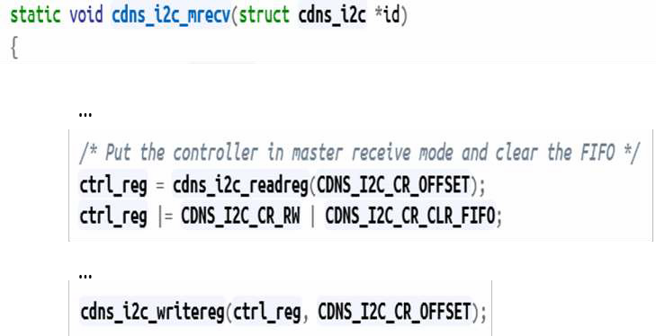
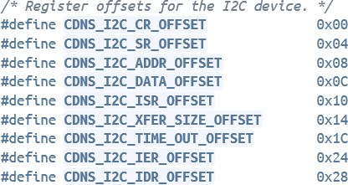
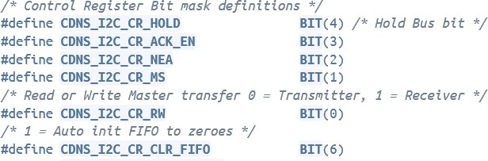
Linux I2C ─ I2C Adapter Driver
Register offsets and bit mask definitions
33

Slide 34
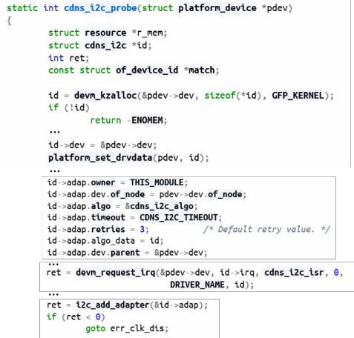
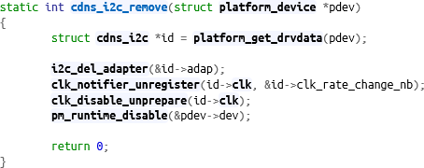
Linux I2C ─ I2C Adapter Driver
Probe / remove
34

Slide 35
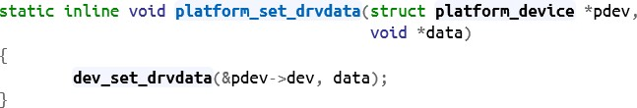

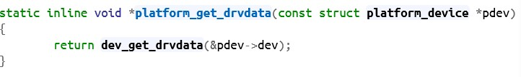

Linux I2C ─ I2C Adapter Driver
Get/set driver data
35

Slide 36
Linux I2C ─ I2C Adapter Driver
i2c_add_adapter() / i2c_del_adapter()
i2c_add_adapter()
i2c_register_adapter()
device_register(&adap->dev)
device_add()
of_i2c_register_devices()
of_i2c_register_device()
i2c_new_device()
device_register(&client->dev)
device_add()
i2c_del_adapter()
i2c_unregister_device(client)
device_unregister(&client->dev)
device_del()
device_unregister(&adap->dev)
device_del()
36

Slide 37

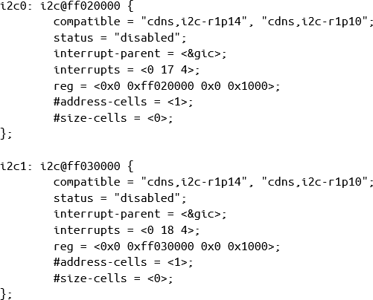
Linux I2C ─ I2C Adapter Driver
Matching
/arch/arm64/boot/dts/xilinx/zynqmp.dtsi
37

Slide 38
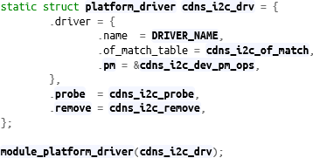
Linux I2C ─ I2C Adapter Driver
Device driver structure
38

Slide 39

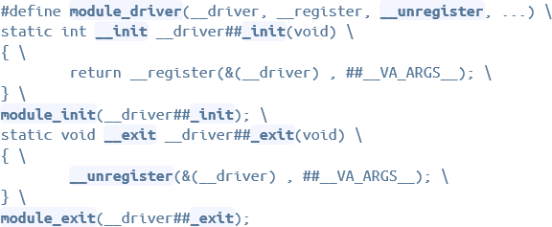
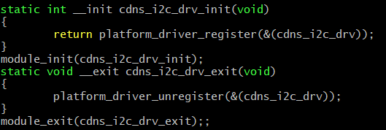
Linux I2C ─ I2C Adapter Driver
Driver registration/unregistration
39

Slide 40

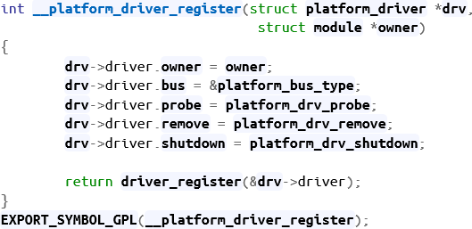
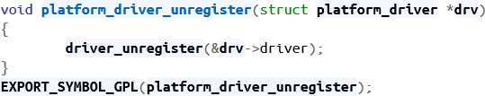
Linux I2C ─ I2C Adapter Driver
platform_driver_register() / platrom_driver_unregister()
40

Slide 41
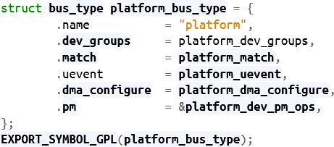
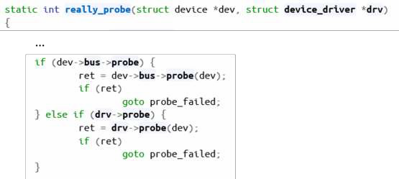
Linux I2C ─ I2C Adapter Driver
driver_register()
bus_add_driver()
driver_attach()
driver_attach()
driver_probe_device()
really_probe()
probe not assigned in Platform_bus_type so drv->probe will be called
41

Slide 42
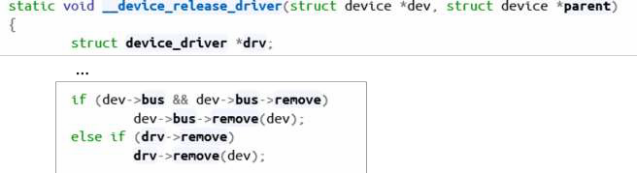
Linux I2C ─ I2C Adapter Driver
driver_unregister()
bus_remove_driver()
driver_detach()
device_release_driver_internal()
device_release_driver()
remove not assigned in platform_bus_type so drv->remove will be called
42

Slide 43
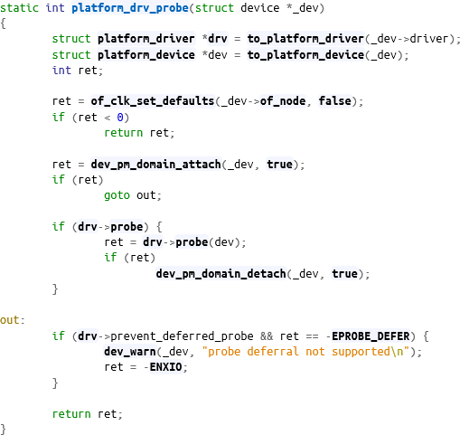
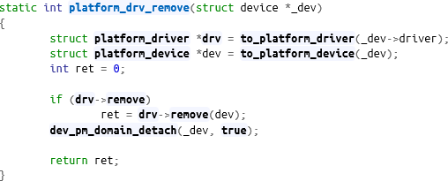
Linux I2C ─ I2C Adapter Driver
platform_drv_probe() / platform_drv_remove()
43

Slide 44
Linux I2C ─ I2C-Dev Driver
I2c-dev.c
i2cdev_read()
i2cdev_write()
i2cdev_ioctl()
i2cdev_open()
i2cdev_release()
struct file_operations i2cdev_fops
i2c_dev_init()
i2c_dev_exit()
44

Slide 45
Linux I2C ─ I2C Client Driver
Client driver (/drivers/mfd/tps65086.c)
tps65086_probe()
tps65086_remove()
struct i2c_driver tps65086_driver
module_i2c_driver(tps65086_driver)
45

Slide 46

That’s all for today.
Notes:
Thank you for listening. Now, I would like to end today’s talk by the Q & A time.

