Slide 1

Embedded System Lecture 00: Course Information
Department of Computer Science and Information Engineering
Shuo-Han Chen (陳碩漢), shchen@csie.ntut.edu.tw
Hong-Yue Technology Research Building 334
R 09:10 - 12:00

Slide 2
Course Information
Embedded System
Full English
Designed for students in graduate school
Course Time and Place
Lecture (3 Hours)
Thursday 09:10 - 12:00
Hong-Yue Technology Research Building 334e
Course Website
2

Slide 3





Course Instructor & Teaching Assistant
Course Instructor
Prof. Shuo-Han Chen (陳碩漢)
Office: 宏裕科技大樓 1532
Office Hours: Monday 11:00 - 15:00
Email: shchen@csie.ntut.edu.tw
Teaching Assistant
吳承岳
Office: 宏裕科技大樓 438
Office Hours: Tuesday 09:00 – 12:00
Email: t109598085@ntut.edu.tw
3

Slide 4
Prerequisites
Addend & Interact
Comfortable with C
Already taken the Operating System Course
Not afraid of English
And, of course, willing to learn more about Embedded System
4

Slide 5
Course Assessment
Assignment: 40 %
Weekly or Biweekly
Upload to following gitlab:
You’re requested to register and do the exercise before Next Thursday !
Midterm Exam: 40 %
Survey Paper Presentation: 20 %
Two people a group & each group will be requested to read a 12-page papers
Form a 30 minutes English presentation (15 minutes for each member)
You are required to meet with me in advance to practice
Your points is determined on how much efforts you put into this presentation
Not how fluently you can speak in English
5

Slide 6
Course Schedule
W | Date | Lecture | Suggest Readings | Homework
1 | Sept. 17 | Lec01: Introduction |  | HW00
2 | Sept. 24 | Lec02: The Big Picture
3 | Oct. 1 | Moon Festival | No Class
4 | Oct. 8 | Lec04: Linux and Real time
5 | Oct. 15 | Lec05: The Linux Kernel
6 | Oct. 22 | Lec06: Kernel Initialization
7 | Oct. 29 | Lec07: User Space Initialization
8 | Nov. 5 | Lec08: Bootloaders
9 | Nov. 12 | Lec09: Bootloaders
10 | Nov. 19 | Lec10: File System and Flash storage
11 | Nov. 26 | Midterm on Nov. 5 | No Class
12 | Dec. 3 | Lec11: MTD System
13 | Dec. 10 | Lec12: Busy box
14 | Dec. 17 | Lec13: Device Driver Basics
15 | Dec. 24 | Lec14: USB
16 | Dec. 31 | Lec15: udev
17 | Jan. 7 | Final Presentation | Online Course
18 | Jan. 14 | Final Presentation | Online Course
Due to national holiday, there will be no class on Oct. 1.
6

Slide 7
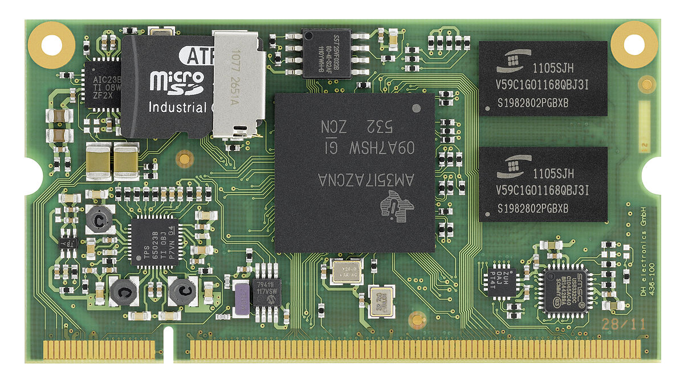
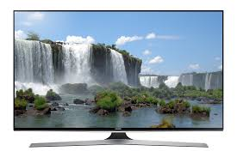
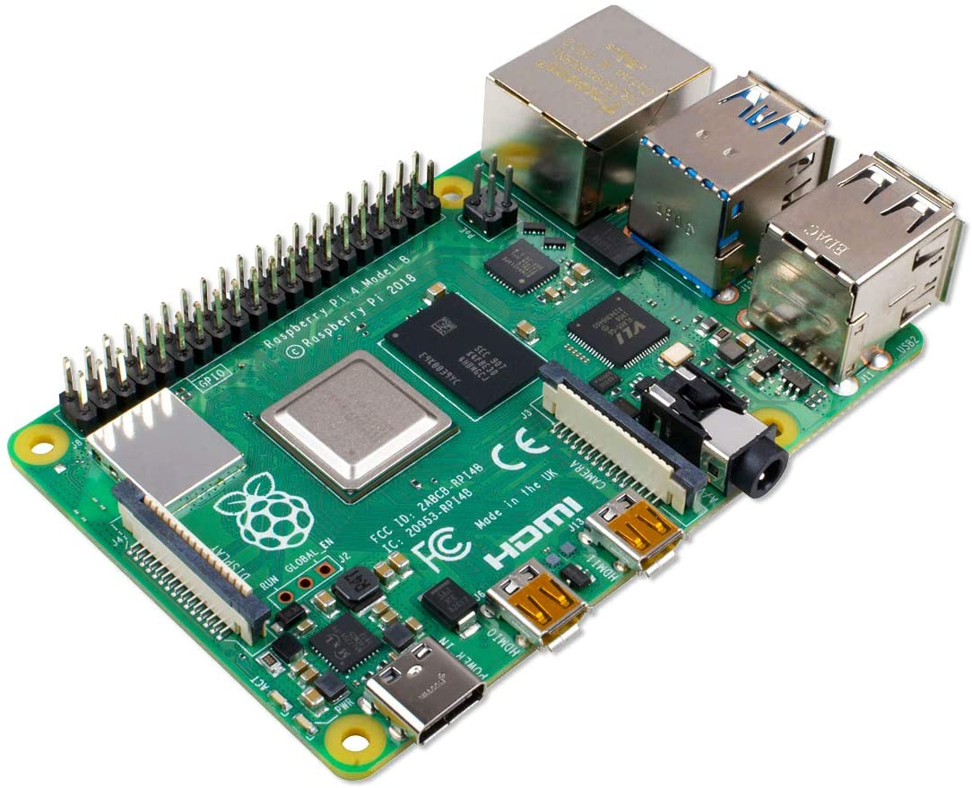
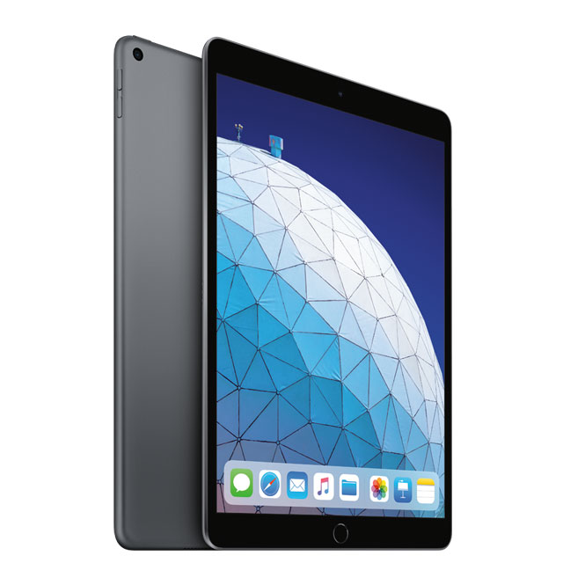
Big Question : What is Embedded System ?
Should be mobile ?
Should be small ?
Should have battery ?
Should be less powerful than desktop ?
Should be inexpensive ?
Actually, these are not deciding factors of embedded system
7

Slide 8
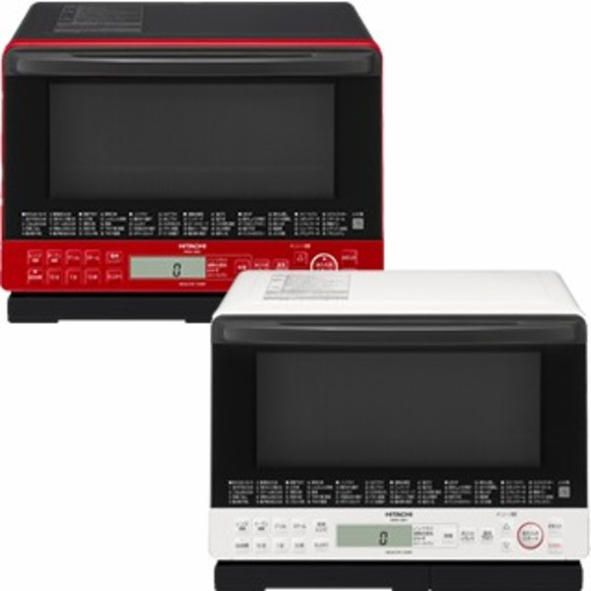

Big Question : What is embedded system ?
A Combination of computer hardware, software, and input/output peripheral devices
Hardware = Motherboard, Processor, RAM, Storage
Designed to perform a specific function.
Very few people realize that a processor and software are involved in the preparation of their lunch or dinner !!!
General-purpose computer is not designed to perform a specific function.
Induction Heater
Healsio
8

Slide 9
Big Question : What is embedded system ?
Usually Installed in a larger system
The existence of processor & software should be completely unnoticed by a device user
For example, cars and trucks contain many embedded systems
Anti-lock brake controller
Vehicle emission monitor and controller
Dashboard information display
Tesla has embedded system with AI chips for auto drive
9

Slide 10
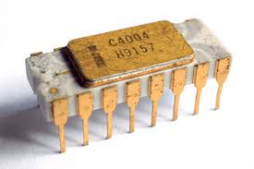
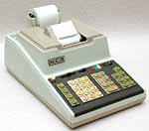
Interesting Facts
When did embedded systems first appear?
Not before 1974, because that’s when world’s first microprocessor
Intel 4004, for use in Busicom 141-PF calculator of a Japan Company
The microprocessor was an overnight success !
Increased use in the server future decade
10

Slide 11
Generic Embedded System
Embedded systems will continue to increase
Memory
Input
Processor
Output
11

Slide 12





We are going to focus on Embedded Linux System
First of all, what is Linux ?
Just like Windows, iOS, and Mac OS, Linux is an operating system
It’s a software that manages all of the hardware resources
Contains of
Bootloader
Kernel
Init system
Daemons
Graphical server
Desktop environment
Applications
Very Popular and has many different Linux distribution
12

Slide 13
What’s Embedded Linux ?
Umbrella term:
Ad-hoc recipes for building Linux-based embedded systems
Very wide range of systems:
Very tiny (mmuless)
Smartphones (i.e. Android)
Cellular base stations
etc.
An Embedded Linux system doesn't have any specific:
Kernel
User-space filesystem content
API
etc.
13

Slide 14
Why Linux ?
Linux has been adopted for embedded products
Linux supports a vast variety of hardware devices, probably more than any other OS.
Linux supports a huge variety of applications and networking protocols.
Linux is scalable, from small consumer-oriented devices to large, heavy-iron, carrier-class switches and routers.
Linux can be deployed without the royalties required by traditional proprietary embedded operating systems.
Linux has attracted a huge number of active developers, enabling rapid support of new hardware architectures, platforms, and devices.
An increasing number of hardware and software vendors support Linux.
14

Slide 15
Why Linux and What are We Going to Learn ?
It’s open source and under GNU GPL (General Public License)
GPL states that “When we speak of free software, we are referring to freedom, not price.”
Goals of this course
Linux and Real time
Architecture of Linux Kernel
Kernel & User Space Initialization
File System and Flash storage
MTD / Driver / USB
15

Slide 16

Q & A
Thank you for your attention.
Find your team member and report to TA before next class !
Notes:
Thank you for listening. Now, I would like to end today’s talk by the Q & A time.

