Slide 1

Embedded System Lecture 04: Linux and Real time
Department of Computer Science and Information Engineering
Shuo-Han Chen (陳碩漢), shchen@csie.ntut.edu.tw
Hong-Yue Technology Research Building 334
R 09:10 - 12:00

Slide 2
What is Real Time System ?
Ask five people what “real time System” means
Chances are, you will get five different answers.
Possible answers that are incorrect
Return results in a few second ?
Return results with unnoticeable latency ?
Return results with very high speed ?
In the world of computer, real time means that the correctness of the system depends
Not only on the logical result of computation
But also on the time at which the results are produced
2

Slide 3
Different Types of Real Time Requirement
Based on how tolerable the real time system is
Hard real-time systems -> Usually Life critical
(e.g., Avionics, Command & Control Systems)
Firm real-time systems -> Usually Money related
(e.g., Banking, Online transaction processing)
Soft real-time systems -> Not so big deal
(e.g., Video streaming)
3

Slide 4
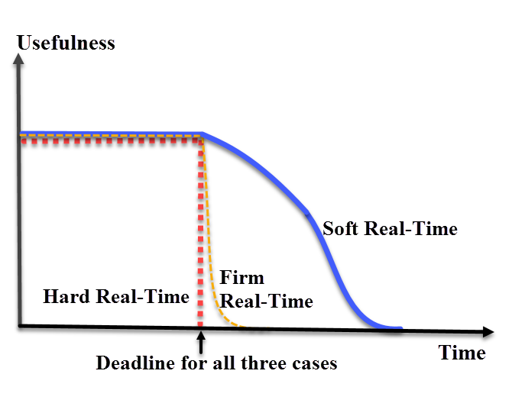
Penalty of Real Time Requirement
Hard deadline:
Penalty due to missing deadline is a higher order of magnitude than the reward in meeting the deadline
Firm deadline:
Penalty and reward are in the same order of magnitude
Soft deadline:
Penalty often lesser magnitude than reward
4

Slide 5
These Two are Usually Discussed Together
Hard real time
Tasks have to be performed on time
Failure to meet deadlines is fatal
Soft real time
Tasks are performed as fast as possible
Late completion of jobs is undesirable but not fatal.
System performance degrades as more & more jobs miss deadlines
5

Slide 6
Common Misconceptions
Real-time computing is equivalent to fast computing.
Real-time programming is assembly coding, priority interrupt programming, and writing device drivers.
Real-time systems operate in a static environment.
The problems in real-time system design have all been solved in other areas of computer science.
6

Slide 7
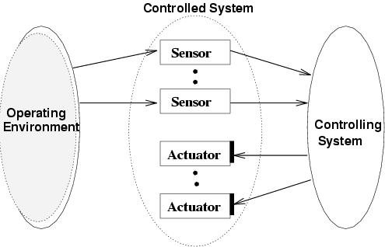
A Typical Real Time System
7

Slide 8
Most Real-Time Systems are embedded
An embedded system is a computer built into a system but not seen by users as being a computer
Examples
FAX machines
Copiers
Printers
Scanners
Routers
Robots
8

Slide 9
Role of an OS in Real Time Systems
Standalone Applications
Often no OS involved
Micro controller based Embedded Systems
Some Real Time Applications are huge & complex
Multiple threads
Complicated Synchronization Requirements
File system / Network / Windowing support
OS primitives reduce the software design time
9

Slide 10
Foreground/Background Systems
Small systems of low complexity
These systems are also called “super-loops”
A scheduling algorithm that is used to control an execution of multiple processes on a single processor
Two waiting lists
Interrupt service routines (ISRs) handle asynchronous events (foreground)
An application consists of an infinite loop of desired operations (background)
10

Slide 11
Foreground/Background Systems (cont.)
Critical operations must be performed by the ISRs to ensure the timing correctness
Thus, ISRs tend to take longer than they should
Task-Level Response
Information for a background module is not processed until the module gets its turn
11

Slide 12
Foreground/Background Systems
The execution time of typical code is not constant
If a code is modified, the timing of the loop is affected
Most high-volume microcontroller-based applications are F/B systems
Microwave ovens
Telephones
Toys
12

Slide 13
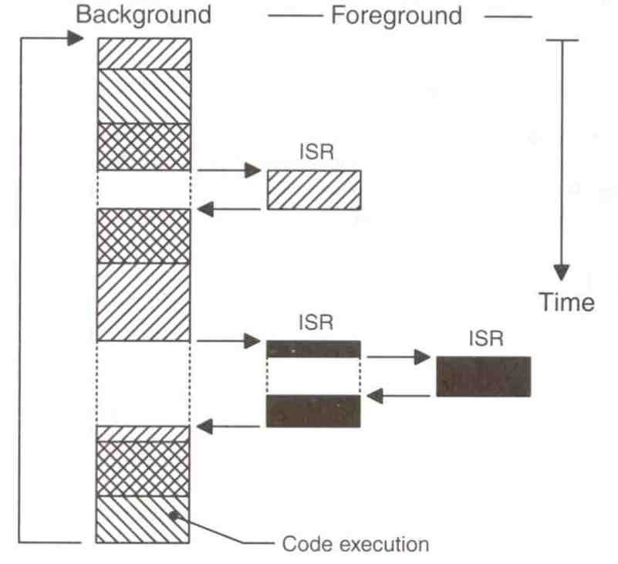
Foreground/Background Systems (cont.)
From a power consumption point of view, it might be better to halt and perform all processing in ISRs
13

Slide 14
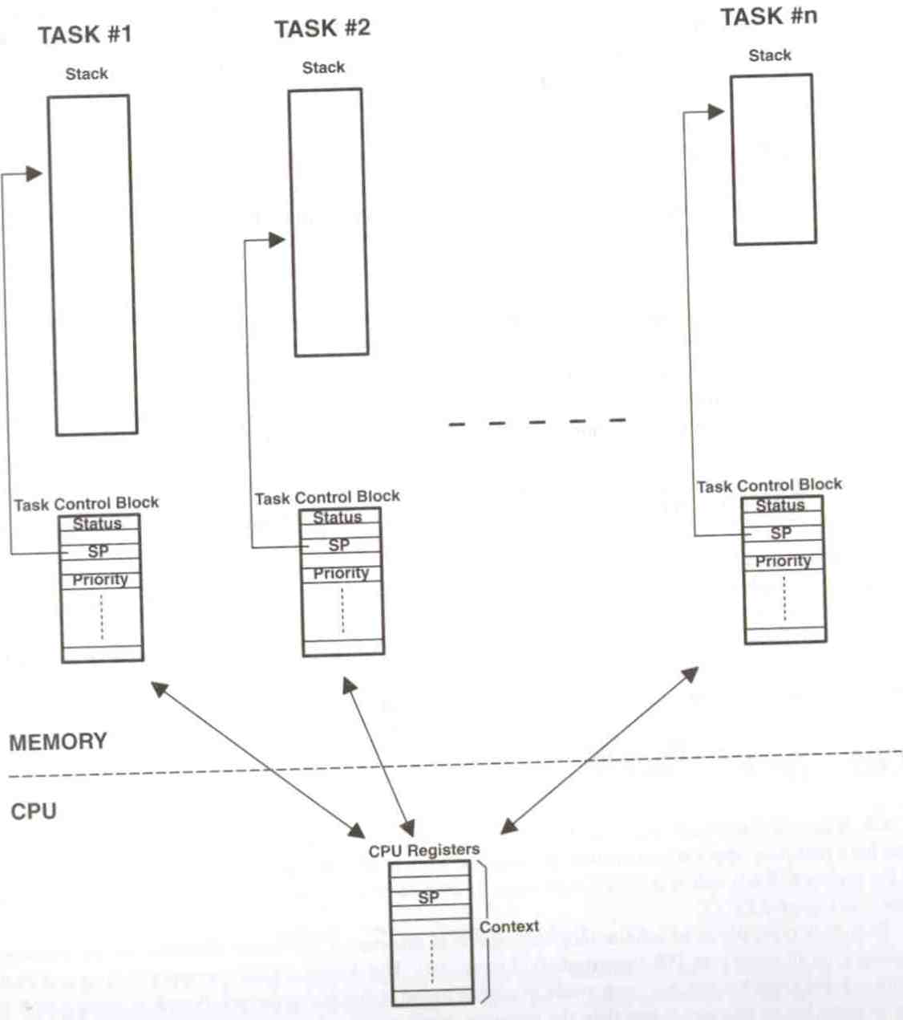
Multitasking Systems
Like F/B systems with multiple backgrounds
Allow programmers to manage complexity inherent in real-time applications
14

Slide 15
Scheduling in RTOS
More information about the tasks are known
Number of tasks
Resource Requirements
Execution time
Deadlines
Being a more deterministic system better scheduling algorithms can be devised.
15

Slide 16
Scheduling Algorithms in RTOS
Clock Driven Scheduling
Weighted Round Robin Scheduling
Priority Scheduling
16

Slide 17
Scheduling Algorithms in RTOS (cont.)
Clock Driven
All parameters about jobs (execution time/deadline) known in advance.
Schedule can be computed offline or at some regular time instances.
Minimal runtime overhead.
Not suitable for many applications.
17

Slide 18
Scheduling Algorithms in RTOS (cont.)
Weighted Round Robin
Jobs scheduled in FIFO manner
Time quantum given to jobs is proportional to it’s weight
Example use : High speed switching network
QOS guarantee.
Not suitable for precedence constrained jobs.
Job A can run only after Job B. No point in giving time quantum to Job B before Job A.
18

Slide 19
Scheduling Algorithms in RTOS (cont.)
Priority Scheduling
Processor never left idle when there are ready tasks
Processor allocated to processes according to priorities
Priorities
Static - at design time
Dynamic - at runtime
19

Slide 20
Priority Scheduling
Earliest Deadline First (EDF)
Process with earliest deadline given highest priority
Least Slack Time First (LSF)
slack = relative deadline – execution left
Rate Monotonic Scheduling (RMS)
For periodic tasks
Tasks priority inversely proportional to it’s period
20

Slide 21
Schedulers
Also called “dispatchers”
Schedulers are parts of the kernel responsible for determining which task runs next
Most real-time kernels use priority-based scheduling
Each task is assigned a priority based on its importance
The priority is application-specific
21

Slide 22
Priority-Based Kernels
There are two types
Non-preemptive
Preemptive
22

Slide 23
Non-Preemptive Kernels
Perform “cooperative multitasking”
Each task must explicitly give up control of the CPU
This must be done frequently to maintain the illusion of concurrency
Asynchronous events are still handled by ISRs
ISRs can make a higher-priority task ready to run
But ISRs always return to the interrupted tasks
23

Slide 24
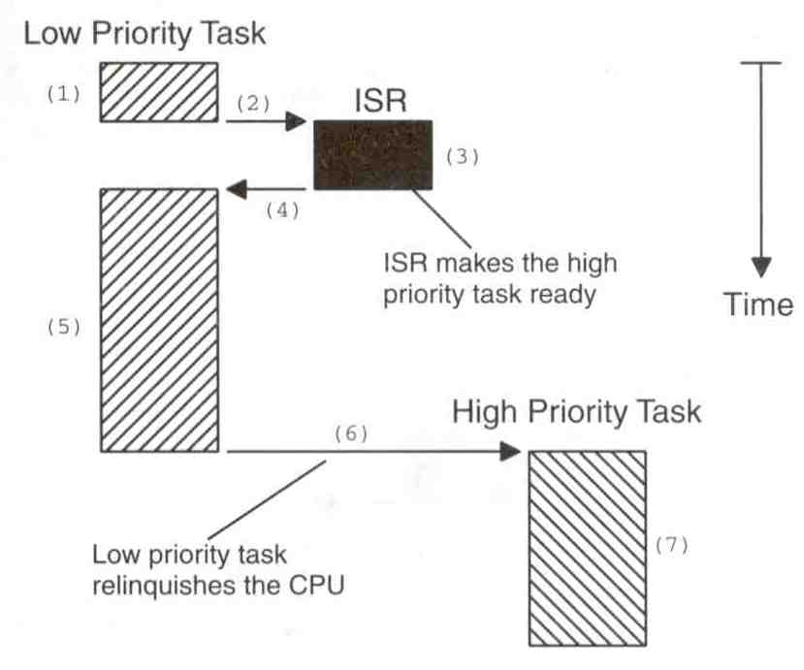
Non-Preemptive Kernels (cont.)
24

Slide 25
Advantages of Non-Preemptive Kernels
Interrupt latency is typically low
Can use non-reentrant functions without fear of corruption by another task
Because each task can run to completion before it relinquishes the CPU
However, non-reentrant functions should not be allowed to give up control of the CPU
Task-response is now given by the time of the longest task
much lower than with F/B systems
25

Slide 26
Advantages of Non-Preemptive Kernels (cont.)
Less need to guard shared data through the use of semaphores
However, this rule is not absolute
Shared I/O devices can still require the use of mutual exclusion semaphores
A task might still need exclusive access to a printer
26

Slide 27
Disadvantages of Non-Preemptive Kernels
Responsiveness
A higher priority task might have to wait for a long time
Response time is nondeterministic
Very few commercial kernels are non-preemptive
27

Slide 28
Preemptive Kernels
The highest-priority task ready to run is always given control of the CPU
If an ISR makes a higher-priority task ready, the higher-priority task is resumed (instead of the interrupted task)
Most commercial real-time kernels are preemptive
28

Slide 29
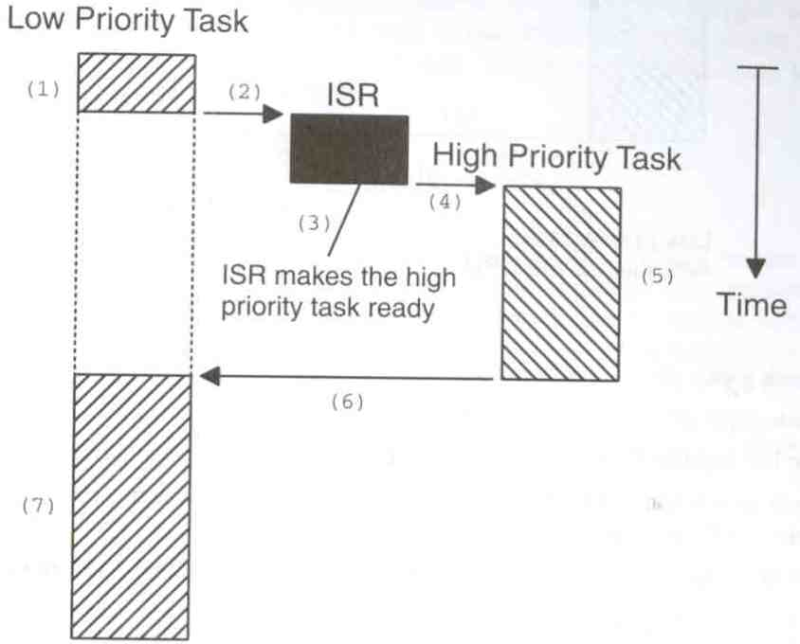
Preemptive Kernels (cont.)
29

Slide 30
Preemptive Kernels (cont.)
Advantages
Execution of the highest-priority task is deterministic
Task-level response time is minimized
Disadvantages
Should not use non-reentrant functions unless exclusive access to these functions is ensured
30

Slide 31
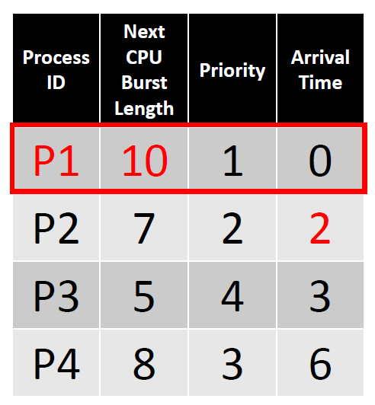
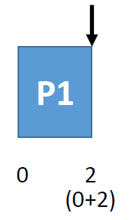
Preemptive Shortest Job First (SJF)
Also known as Shortest-remaining-time-first
Starvation will happen -> Resolved by using priority aging
Current Process：P1
P2 Arrive
31

Slide 32
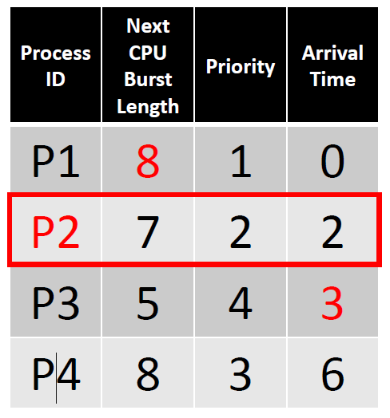
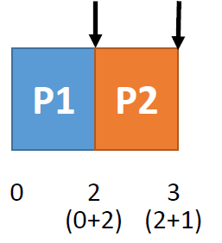
Preemptive Shortest Job First (SJF) (cont.)
Also known as Shortest-remaining-time-first
Starvation will happen -> Resolved by using priority aging
Current Process： P1、P2
P1 burst time：10 - 2 = 8
P1：８ > P2：7 → P2
P3 Arrive
P2 Arrive
32

Slide 33
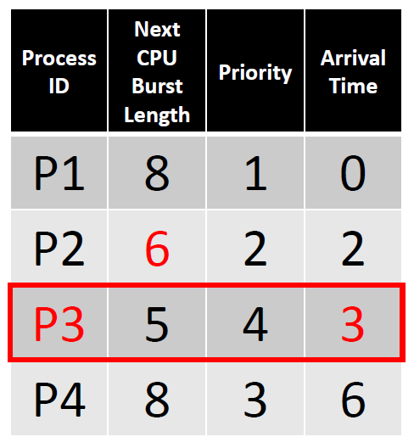
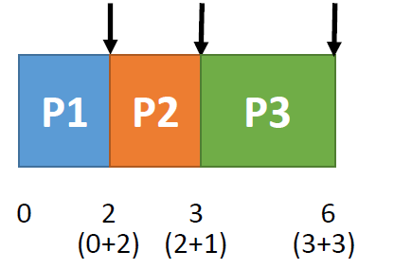
Preemptive Shortest Job First (SJF) (cont.)
Also known as Shortest-remaining-time-first
Starvation will happen -> Resolved by using priority aging
Current Process： P1、P2、P3
P2 burst time：7-1=6
P1：８>P2：6>P3：５→ P3
P3 Arrive
P2 Arrive
P4 Arrive
33

Slide 34
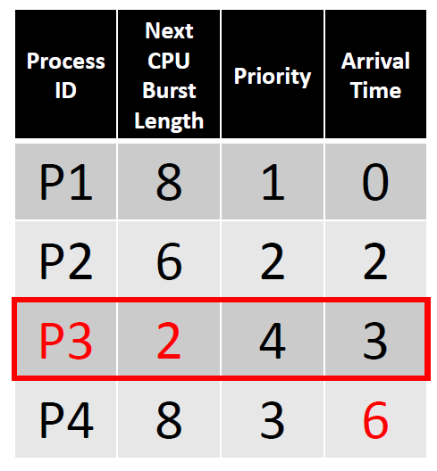
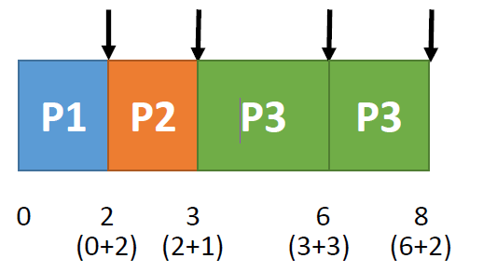
Preemptive Shortest Job First (SJF) (cont.)
Also known as Shortest-remaining-time-first
Starvation will happen -> Resolved by using priority aging
Current Process： P1、P2、P3、P4
P3 burst time：5-3=2
1：８= P4：８>P2：6>P3：２→P3
P3 Arrive
P3 end
P2 Arrive
P4 Arrive
34

Slide 35
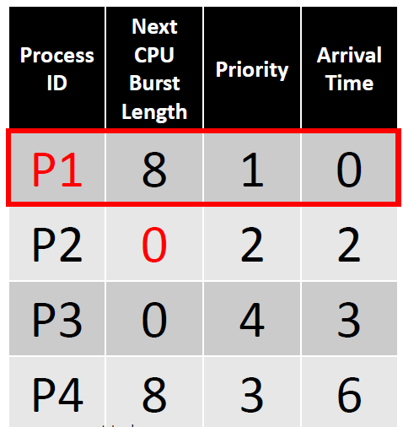
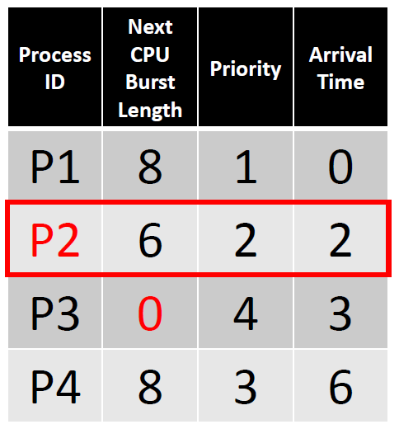
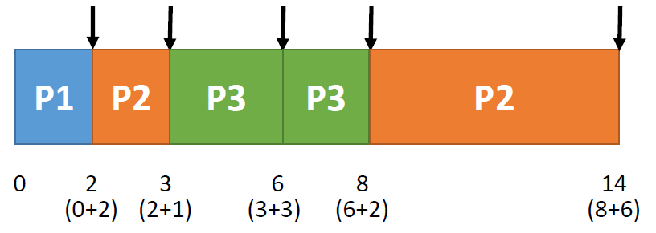
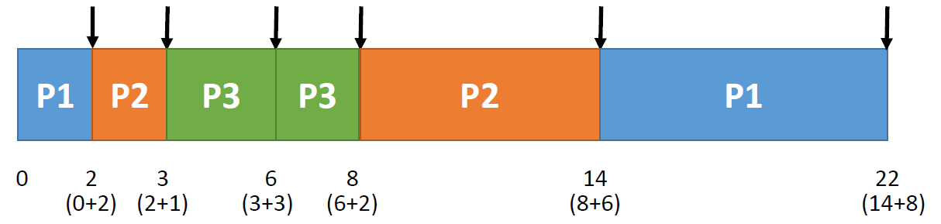
Preemptive Shortest Job First (SJF) (cont.)
Also known as Shortest-remaining-time-first
Starvation will happen -> Resolved by using priority aging
Current Process： P1、P4
P2 burst time：6-6=0
P1：８= P4：８→ P1
P3 Arrive
P3 end
P2 Arrive
P4 Arrive
P2 end
P1 end
35

Slide 36
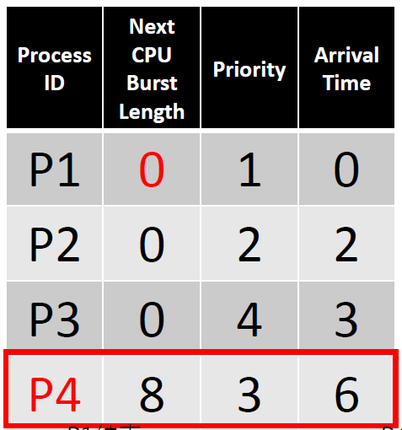
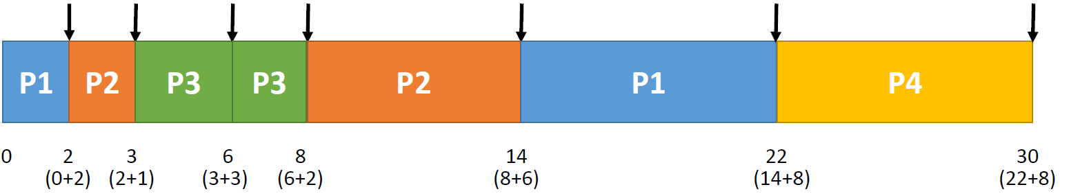
Preemptive Shortest Job First (SJF) (cont.)
Also known as Shortest-remaining-time-first
Starvation will happen -> Resolved by using priority aging
Current Process： P4
P1 burst time：8-8=0
P3 Arrive
P3 end
P2 Arrive
P4 Arrive
P2 end
P1 end
P4 end
36

Slide 37
Reentrant Functions
A reentrant function can be used by more than one task without fear of data corruption
It can be interrupted and resumed at any time without loss of data
It uses local variables (CPU registers or variables on the stack)
Protect data when global variables are used
37

Slide 38
Non-Reentrant Function Example
int Temp;
void swap(int *x, int *y)
{
Temp = *x;
*x = *y;
*y = Temp;
}
38

Slide 39
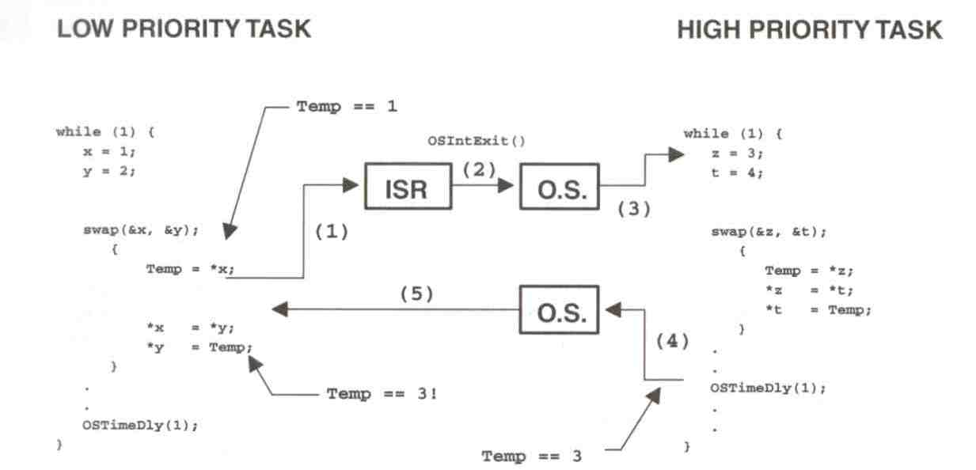
Non-Reentrant Function Example (cont.)
39

Slide 40
Resource Allocation in RTOS
Resource Allocation
The issues with scheduling applicable here.
Resources can be allocated in
Weighted Round Robin
Priority Based
Some resources are non preemptible
Example: semaphores
Priority inversion problem may occur if priority scheduling is used
40

Slide 41
Priority Inversion Problem
Common in real-time kernels
Suppose task 1 has a higher priority than task 2
Also, task 2 has a higher priority than task 3
If mutual exclusion is used in accessing a shared resource, priority inversion may occur
41

Slide 42
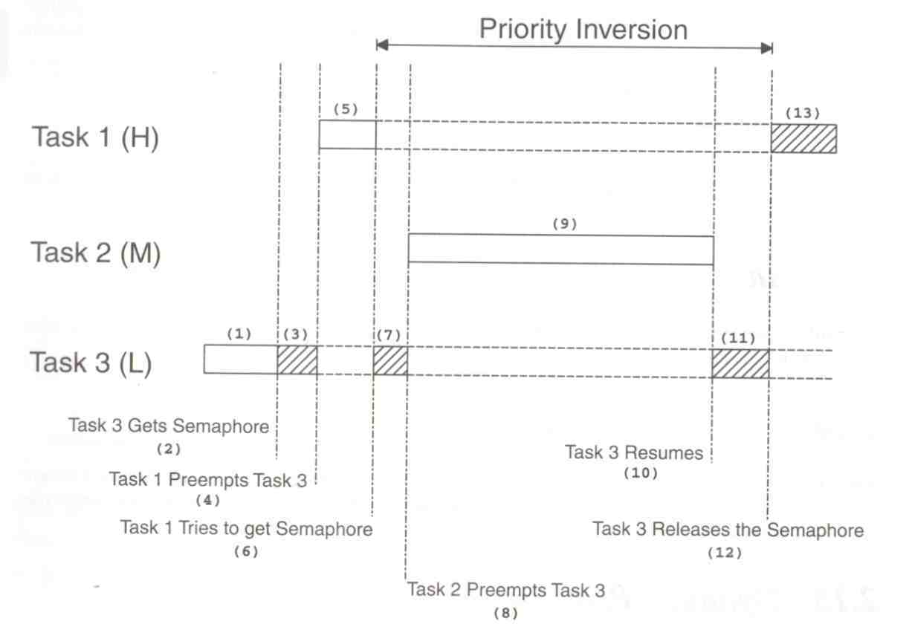
Priority Inversion Problem
42

Slide 43
A Solution to Priority Inversion Problem
We can correct the problem by raising the priority of task 3
Just for the time it accesses the shared resource
After that, return to the original priority
What if task 3 finishes the access before being preempted by task 1?
incur overhead for nothing
43

Slide 44
A Better Solution to the Problem
Priority Inheritance
Automatically change the task priority when needed
The task that holds the resource will inherit the priority of the task that waits for that resource until it releases the resource
44

Slide 45
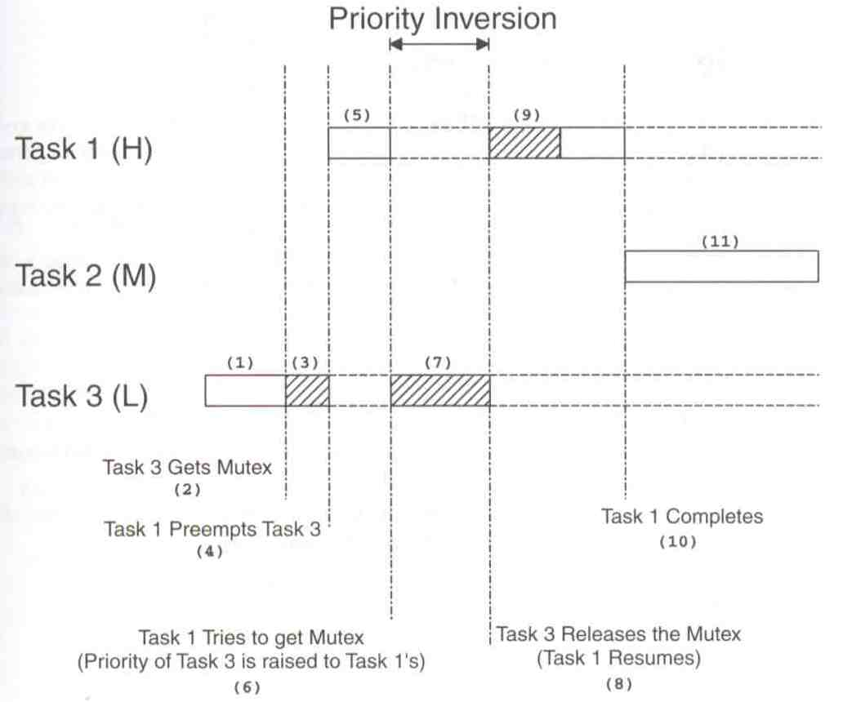
Priority Inheritance Example
45

Slide 46
Assigning Task Priorities
Not trivial
In most systems, not all tasks are critical
Non-critical tasks are obviously low-priorities
Most real-time systems have a combination of soft and hard requirements
46

Slide 47
A Technique for Assigning Task Priorities
Rate Monotonic Scheduling (RMS)
Priorities are based on how often tasks execute
Assumption in RMS
All tasks are periodic with regular intervals
Tasks do not synchronize with one another, share data, or exchange data
Preemptive scheduling
47

Slide 48
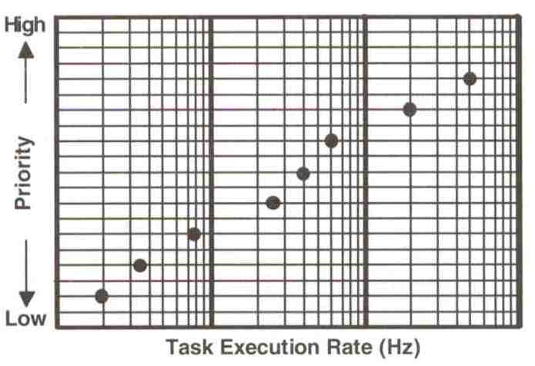
RMS Example
48

Slide 49
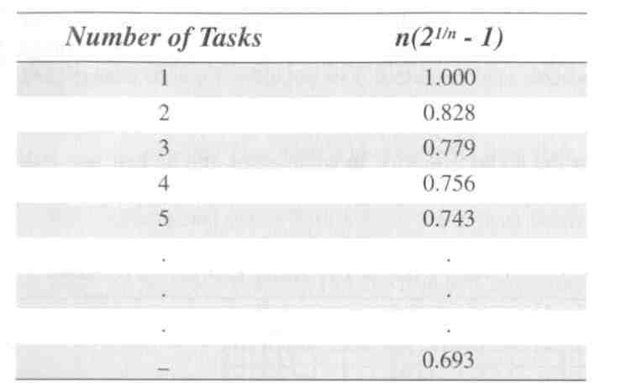
RMS: CPU Time and Number of Tasks
49

Slide 50
RMS: CPU Time and Number of Tasks (cont.)
The upper bound for an infinite number of tasks is 0.6973
To meet all hard real-time deadlines based on RMS, CPU use of all time-critical tasks should be less than 70%
Note that you can still have non-time-critical tasks in a system
So, 100% of CPU time is used
But not desirable because it does not allow code changes or added features later
50

Slide 51
RMS: CPU Time and Number of Tasks (cont.)
Note that, in some cases, the highest-rate task might not be the most important task
Eventually, application dictates the priorities
However, RMS is a starting point
51

Slide 52
Other RTOS issues
Interrupt Latency should be very small
Kernel has to respond to real time events
Interrupts should be disabled for minimum possible time
For embedded applications Kernel Size should be small
Should fit in ROM
Sophisticated features can be removed
No Virtual Memory
No Protection
52

Slide 53
Mutual Exclusion
The easiest way for tasks to communicate is through shared data structures
Global variables, pointers, buffers, linked lists, and ring buffers
Must ensure that each task has exclusive access to the data to avoid data corruption
53

Slide 54
Mutual Exclusion (cont.)
The most common methods are:
Disabling interrupts
Performing test-and-set operations
Disabling scheduling
Using semaphores
54

Slide 55
Disabling and Enabling Interrupts
The easiest and fastest way to gain exclusive access
Example:
Disable interrupts;
Access the resource;
Enable interrupts;
55

Slide 56
Disabling and Enabling Interrupts (cont.)
This is the only way that a task can share variables with an ISR
However, do not disable interrupts for too long
Because it adversely impacts the “interrupt latency”!
Good kernel vendors should provide the information about how long their kernels will disable interrupts
56

Slide 57
Test-and-Set (TAS) Operations
Two functions could agree to access a resource based on a global variable value
If the variable is 0, the function has the access
To prevent the other from accessing the resource, the function sets the variable to 1
TAS operations must be performed indivisibly by the CPU (e.g., 68000 family)
Otherwise, you must disable the interrupts when doing TAS on the variable
57

Slide 58
TAS Example
Disable interrupts;
if (variable is 0) {
Set variable to 1;
Enable interrupts;
Access the resource;
Disable interrupts;
Set variable to 0;
Enable interrupts;
} else {
Enable interrupts;
}
58

Slide 59
Disabling and Enabling the Scheduler
Viable for sharing variables among tasks but not with an ISR
Scheduler is locked but interrupts are still enabled
Thus, ISR returns to the interrupted task
Similar to a non-preemptive kernel (at least, while the scheduler is locked)
59

Slide 60
Disabling and Enabling the Scheduler (cont.)
Example:
Lock scheduler;
Access shared data;
Unlock scheduler;
Even though this works well, you should avoid it because it defeats the purpose of having a kernel
60

Slide 61
Semaphores
Invented by Edgser Dijkstra in the mid-1960s
Offered by most multitasking kernels
Used for:
Mutual exclusion
Signaling the occurrence of an event
Synchronizing activities among tasks
61

Slide 62
Semaphores (cont.)
A semaphore is a key that your code acquires in order to continue execution
If the key is already in use, the requesting task is suspended until the key is released
There are two types
Binary semaphores
0 or 1
Counting semaphores
>= 0
62

Slide 63
Semaphore Operations
Initialize (or create)
Value must be provided
Waiting list is initially empty
Wait (or pend)
Used for acquiring the semaphore
If the semaphore is available (the semaphore value is positive), the value is decremented, and the task is not blocked
Otherwise, the task is blocked and placed in the waiting list
Most kernels allow you to specify a timeout
If the timeout occurs, the task will be unblocked and an error code will be returned to the task
63

Slide 64
Semaphore Operations
Initialize (or create)
Value must be provided
Waiting list is initially empty
64

Slide 65
Semaphore Operations (cont.)
Wait (or pend)
Used for acquiring the semaphore
If the semaphore is available (the semaphore value is positive), the value is decremented, and the task is not blocked
Otherwise, the task is blocked and placed in the waiting list
Most kernels allow you to specify a timeout
If the timeout occurs, the task will be unblocked and an error code will be returned to the task
65

Slide 66
Semaphore Operations (cont.)
Signal (or post)
Used for releasing the semaphore
If no task is waiting, the semaphore value is incremented
Otherwise, make one of the waiting tasks ready to run but the value is not incremented
Which waiting task to receive the key?
Highest-priority waiting task
First waiting task
66

Slide 67
Semaphore Example
Semaphore *s;
Time timeout;
INT8U error_code;
timeout = 0;
Wait(s, timeout, &error_code);
Access shared data;
Signal(s);
67

Slide 68
Applications of Binary Semaphores
Suppose task 1 prints “I am Task 1!”
Task 2 prints “I am Task 2!”
If they were allowed to print at the same time, it could result in:
I Ia amm T Tasask k1!2!
Solution:
Binary semaphore
68

Slide 69
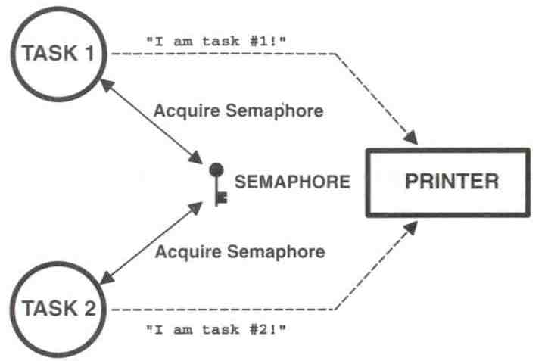
Sharing I/O Devices
69

Slide 70
Sharing I/O Device (cont.)
In the example, each task must know about the semaphore in order to access the device
A better solution:
Encapsulate the semaphore
70

Slide 71
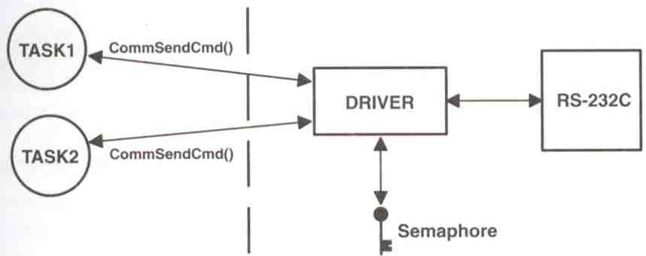
Encapsulating a Semaphore
71

Slide 72
Encapsulating a Semaphore (cont.)
INT8U CommSendCmd(char *cmd, char *response, INT16U timeout)
{
Acquire semaphore;
Send command to device;
Wait for response with timeout;
if (timed out) {
Release semaphore;
return error code;
} else {
Release semaphore;
return no error;
}
}
72

Slide 73
Applications of Counting Semaphores
A counting semaphore is used when a resource can be used by more than one task at the same time
Example:
Managing a buffer pool of 10 buffers
73

Slide 74
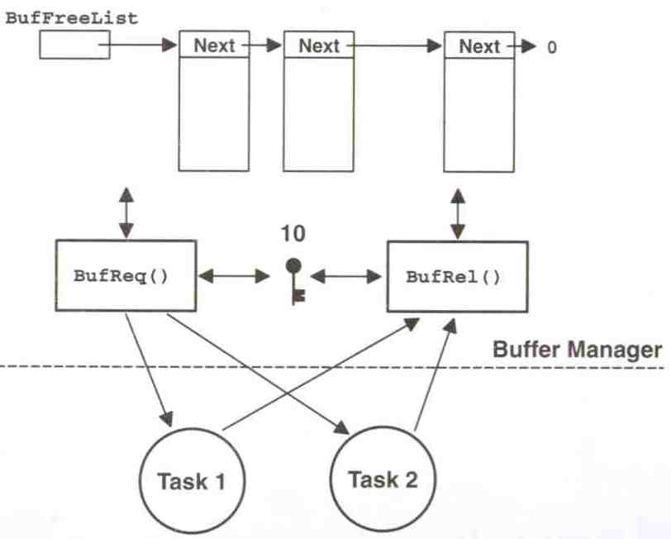
Buffer Management
74

Slide 75
Buffer Management (cont.)
BUF *BufReq(void)
{
BUF *ptr;
Acquire a semaphore;
Disable interrupts;
ptr = BufFreeList;
BufFreeList = ptr->BufNext;
Enable interrupts;
return (ptr);
}
75

Slide 76
Buffer Management (cont.)
void BufRel(BUF *ptr)
{
Disable interrupts;
ptr->BufNext = BufFreeList;
BufFreeList = ptr;
Enable interrupts;
Release semaphore;
}
76

Slide 77
Buffer Management (cont.)
Semaphores are often overused
The use of semaphore to access simple shared variable is overkill in most situations
For this simple access, disabling interrupts are more cost-effective
However, if the variable is floating-point and CPU does not support floating-point in hardware, disabling interrupts should be avoided
77

Slide 78
Linux for Real Time Applications
Scheduling
Priority Driven Approach
Optimize average case response time
Interactive Processes Given Highest Priority
Aim to reduce response times of processes
Real Time Processes
Processes with high priority
There was no notion of deadlines
78

Slide 79
Linux for Real Time Applications (cont.)
Resource Allocation
There was no support for handling priority inversion
Since version 2.6.18, priority inheritance available in both kernel and user space mutexes for preventing priority inversion
79

Slide 80
Interrupt Handling in Linux
Interrupts were disabled in ISR/critical sections of the kernel
There was no worst case bound on interrupt latency avaliable
eg: Disk Drivers might disable interrupt for few hundred milliseconds
80

Slide 81
Interrupt Handling in Linux (cont.)
Linux was not suitable for Real Time Applications
Interrupts may be missed
Since 2.6.18, Hard IRQs executed in kernel thread context
(where differing priority levels can be assigned)
allows developers to better insulate systems from external events
81

Slide 82
Other Problems with Linux
Processes were not preemtible in Kernel Mode
System calls like fork take a lot of time
High priority thread might wait for a low priority thread to complete it’s system call
Processes are heavy weight
Context switch takes several hundred microseconds
Linux 2.6.18 adds preemption points in kernel, with the goal of achieving microsecond-level latency;
all but "kernel-critical" portions of kernel code become preemptible involuntarily at any time
82

Slide 83
Why Linux ?
Coexistence of Real Time Applications with non Real Time Ones
Example http server
Device Driver Base
Stability
83

Slide 84
Why Linux? (cont.)
Several real-time features are now integrated into the main distribution of Linux
Improved POSIX compliancy
including Linux's first implementation of message queues and of priority inheritance,
as well as an improved implementation of signals less apt to disregard multiple inputs
Hard IRQs executed in thread context
84

Slide 85
Why Linux? (cont.)
Three levels of real-time preemptibility in kernel, configurable at compile time (throughput or real-time predictability):
Voluntary preemption
Preemptible kernel (ms level)
Full real-time preemption (microsecond level)
Priority inheritance available in both kernel and user space mutexes
85

Slide 86
Why Linux? (cont.)
High-resolution timers
Added in 2.6.21, this allows the kernel to actually use the high-resolution timers built into most processors, enabling,
For example, POSIX timers and nano_sleep calls to be "as accurate as hardware allows,"
The kernel's entire time management gets to the level of microseconds
86

Slide 87
Why Linux? (cont.)
Various kernel config options for monitoring real-time behavior of kernel:
CONFIG_LATENCY_TRACE
Track the full trace of maximum latency
CONFIG_WAKEUP_TIMING
Tracking of the maximum recorded time between
waking up for a high-priority task, and
executing on the CPU, shown in microseconds
87

Slide 88

Q & A
Thank you for your attention.
HW01 is due today
Notes:
Thank you for listening. Now, I would like to end today’s talk by the Q & A time.

