Slide 1

Embedded System Lecture 05: The Linux Kernel
Department of Computer Science and Information Engineering
Shuo-Han Chen (陳碩漢), shchen@csie.ntut.edu.tw
Hong-Yue Technology Research Building 334
R 09:10 - 12:00

Slide 2
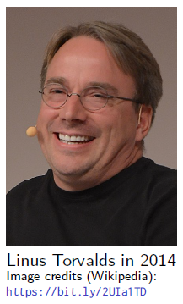
History
The Linux kernel is one component of a system, which also requires libraries and applications to provide features to end users.
The Linux kernel was created as a hobby in 1991 by a Finnish student, Linus Torvalds.
Linux quickly started to be used as the kernel for free software operating systems
Linus Torvalds has been able to create a large and dynamic developer and user community around Linux.
Nowadays, more than one thousand people contribute to each kernel release, individuals or companies big and small.
2

Slide 3
Linux Kernel Key Features
Portability and hardware support. Runs on most architectures.
Scalability. Can run on super computers as well as on tiny devices (4 MB of RAM is enough).
Compliance to standards and interoperability
Exhaustive networking support.
Security. It can’t hide its flaws. Its code is reviewed by many experts.
Stability and reliability.
Modularity. Can include only what a system needs even at run time.
Easy to program. You can learn from existing code. Many useful resources on the net.
3

Slide 4
Supported Hardware Architectures
See the arch/ directory in the kernel sources
Minimum: 32 bit processors, with or without MMU, and gcc support
32 bit architectures (arch/ subdirectories)
Examples: arm, arc, c6x, m68k, microblaze...
64 bit architectures:
Examples: alpha, arm64, ia64...
32/64 bit architectures
Examples: mips, powerpc, riscv, sh, sparc, x86...
Note that unmaintained architectures can also be removed when they have compiling issues and nobody fixes them.
Find details in kernel sources: arch/<arch>/Kconfig, arch/<arch>/README, or Documentation/<arch>/
4

Slide 5
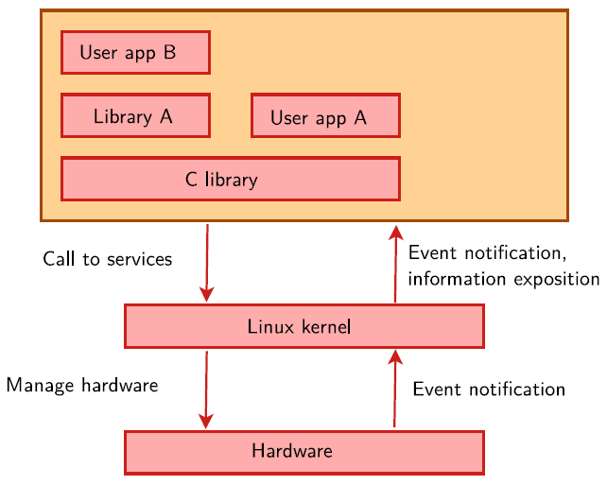
Linux Kernel in the System
5

Slide 6
Linux Kernel Main Roles
Manage all the hardware resources: CPU, memory, I/O.
Provide a set of portable, architecture and hardware independent APIs to allow user space applications and libraries to use the hardware resources.
Handle concurrent accesses and usage of hardware resources from different applications.
Example: a single network interface is used by multiple user space applications through various network connections. The kernel is responsible to “multiplex” the hardware resource.
6

Slide 7
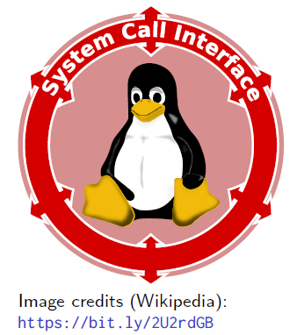
System Calls
The main interface between the kernel and user space is the set of system calls
About 400 system calls that provide the main kernel Services
File and device operations, networking operations, inter-process communication, process management, memory mapping, timers, threads, synchronization primitives, etc.
This interface is stable over time: only new system calls can be added by the kernel developers
This system call interface is wrapped by the C library, and user space applications usually never make a system call directly but rather use the corresponding C library function
7

Slide 8
Pseudo Filesystems
Linux makes system and kernel information available in user space through pseudo filesystems, sometimes also called virtual filesystems
Pseudo filesystems allow applications to see directories and files that do not exist on any real storage: they are created and updated on the fly by the kernel
The two most important pseudo filesystems are
proc, usually mounted on /proc: Operating system related information (processes, memory management parameters...)
sysfs, usually mounted on /sys: Representation of the system as a set of devices and buses. Information about these devices.
8

Slide 9
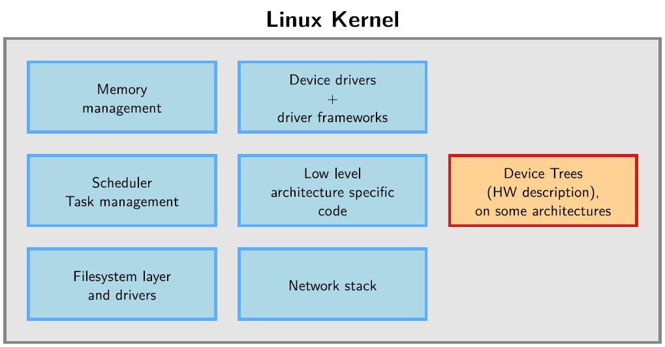
Inside the Linux Kernel
9

Slide 10
Programming Language
Implemented in C like all UNIX systems. (C was created to implement the first UNIX systems)
A little Assembly is used too:
CPU and machine initialization, exceptions
Critical library routines.
No C++ used, see http://vger.kernel.org/lkml/#s15-3
All the code compiled with gcc
Many gcc specific extensions used in the kernel code, any ANSI C compiler will not compile the kernel
See https://gcc.gnu.org/onlinedocs/gcc-6.2.0/gcc/C-Extensions.html
Ongoing work to compile the kernel with the LLVM C compiler too.
10

Slide 11
No C library
The kernel has to be standalone and can’t use user space code.
Architectural reason: user space is implemented on top of kernel services, not the opposite.
Technical reason: the kernel is on its own during the boot up phase, before it has accessed a root filesystem.
Hence, kernel code has to supply its own library implementations (string utilities, cryptography, uncompression...)
So, you can’t use standard C library functions in kernel code. (printf(), memset(), malloc(),...).
Fortunately, the kernel provides similar C functions for your convenience, like printk(), memset(), kmalloc(), ...
11

Slide 12
Portability
The Linux kernel code is designed to be portable
All code outside arch/ should be portable
To this aim, the kernel provides macros and functions to abstract the architecture specific details
Endianness
cpu_to_be32()
cpu_to_le32()
be32_to_cpu()
le32_to_cpu()
I/O memory access
Memory barriers to provide ordering guarantees if needed
DMA API to flush and invalidate caches if needed
Never use floating point numbers in kernel code. Your code may need to run on a low-end processor without a floating point unit.
12

Slide 13
Kernel Memory Constraints
No memory protection
The kernel doesn’t try to recover from attempts to access illegal memory locations. It just dumps oops messages on the system console.
Fixed size stack (8 or 4 KB). Unlike in user space, no mechanism was implemented to make it grow.
Swapping is not implemented for kernel memory either.
13

Slide 14
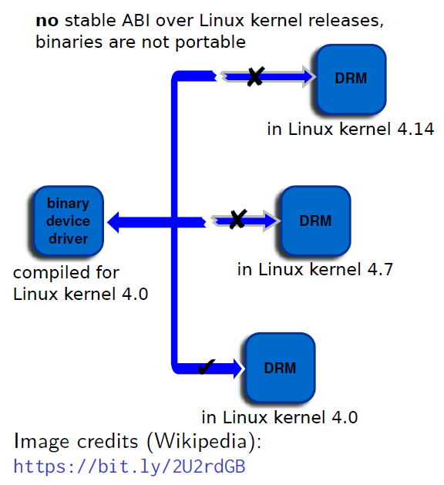
No Stable Linux Internal API
The internal kernel API to implement kernel code can undergo changes between two releases.
In-tree drivers are updated by the developer proposing the API change: works great for mainline code.
An out-of-tree driver compiled for a given version may no longer compile or work on a more recent one.
See process/stable-api-nonsense in kernel sources for reasons why.
Of course, the kernel to user space API does not change (system calls, /proc, /sys), as it would break existing programs.
application binary interface (ABI)
14

Slide 15
Benefit of Writing Driver in Linux Kernel
What is in-tree? There is also another term out-of-tree
All modules start out as "out-of-tree" developments, that can be compiled using the context of a source-tree.
Once a module gets accepted to be included, it becomes an in-tree module.
Once your sources are accepted in the mainline tree...
There are many more people reviewing your code, allowing to get cost-free security fixes and improvements.
You can also get changes from people modifying internal kernel APIs.
Accessing your code is easier for users.
You can get contributions from your own customers.
This will for sure reduce your maintenance and support work
15

Slide 16
User Space Device Drivers
In some cases, it is possible to implement device drivers in user space !
Can be used when
The kernel provides a mechanism that allows user space applications to directly access the hardware.
There is no need to leverage an existing kernel subsystem such as the networking stack or filesystems.
There is no need for the kernel to act as a “multiplexer” for the device: only one application accesses the device.
Possibilities for user space device drivers
USB with libusb, https://libusb.info/
SPI with spidev, Documentation/spi/spidev
I2C with i2cdev, Documentation/i2c/dev-interface
Memory-mapped devices with UIO, including interrupt handling, driver-api/uio-howto
16

Slide 17
User Space Device Drivers
Certain classes of devices (printers, scanners, 2D/3D graphics acceleration) are typically handled partly in kernel space, partly in user space.
Drawbacks
Less straightforward to handle interrupts.
Increased interrupt latency vs. kernel code.
Advantages
No need for kernel coding skills. Easier to reuse code between devices.
Drivers can be written in any language and can be kept proprietary.
Driver code can be killed and debugged. Cannot crash the kernel.
Can be swapped out (kernel code cannot be).
Can use floating-point computation.
Less in-kernel complexity.
Potentially higher performance, especially for memory-mapped devices, thanks to the avoidance of system calls.
17

Slide 18
Time to Look at the Source Strcutrue
arch/<ARCH>
Architecture specific code
arch/<ARCH>/mach-<machine>, SoC family specific code
arch/<ARCH>/include/asm, architecture-specific headers
arch/<ARCH>/boot/dts, Device Tree source files, for some architectures
block/
Block layer core
certs/
Management of certificates for key signing
COPYING
Linux copying conditions (GNU GPL)
CREDITS
Linux main contributors
18

Slide 19
Time to Look at the Source Strcutrue
crypto/
Cryptographic libraries
Documentation/
Kernel documentation sources. Also available on https://kernel.org/doc/ (includes functions prototypes and comments extracted from source code).
drivers/
All device drivers except sound ones (usb, pci...)
fs/
Filesystems (fs/ext4/, etc.)
include/
Kernel headers
include/linux/
Linux kernel core headers
19

Slide 20
Time to Look at the Source Strcutrue
include/uapi/
User space API headers
init/
Linux initialization (including init/main.c)
ipc/
Code used for process communication
Kbuild
Part of the kernel build system
Kconfig
Top level description file for configuration parameters
kernel/
Linux kernel core (very small!)
lib/
Misc library routines (zlib, crc32...)
20

Slide 21
Time to Look at the Source Strcutrue
MAINTAINERS
Maintainers of each kernel part. Very useful!
Makefile
Top Linux Makefile (sets version information)
mm/
Memory management code (small too!)
net/
Network support code (not drivers)
README
Overview and building instructions
samples/
Sample code (markers, kprobes, kobjects, bpf...)
21

Slide 22
Time to Look at the Source Strcutrue
scripts/
Executables for internal or external use
security/
Security model implementations (SELinux...)
sound/
Sound support code and drivers
tools/
Code for various user space tools (mostly C, example: perf)
usr/
Code to generate an initramfs cpio archive
virt/
Virtualization support (KVM)
22

Slide 23
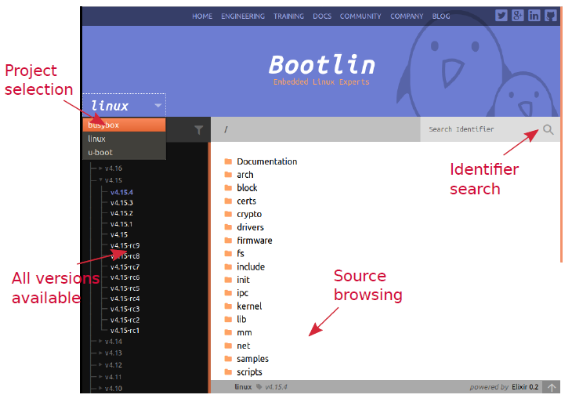
http://elixir.bootlin.com/
23

Slide 24
Let’s see the Booting of Linux Kernel
Device Tree need to be provided
Many embedded architectures have a lot of non-discoverable hardware (serial,Ethernet, I2C, Nand flash, USB controllers...)
Depending on the architecture, such hardware is either described in BIOS ACPItables (x86), using C code directly within the kernel, or using a special hardware description language in a Device Tree.
A Device Tree Source, written by kernel developers, is compiled into a binary Device Tree Blob, and needs to be passed to the kernel at boot time.
There is one different Device Tree for each board/platform supported by the kernel, available in arch/arm/boot/dts/<board>.dtb.
See arch/arm/boot/dts/at91-sama5d3_xplained.dts for example.
The bootloader must load both the kernel image and the Device Tree Blob in memory before starting the kernel.
24

Slide 25
Booting with U-Boot
The Universal Boot Loader
Can boot the zImage binary.
zImage is the outcome after you compiled Linux Kernel Srouce
Older versions require a special kernel image format: uImage
uImage is generated from zImage using the mkimage tool. It is done automatically by the kernel make uImage target.
On some ARM platforms, make uImage requires passing a LOADADDR environment variable, which indicates at which physical memory address the kernel will be executed.
In addition to the kernel image, U-Boot can also pass a Device Tree Blob to the kernel.
The typical boot process is therefore:
Load zImage or uImage at address X in memory
Load <board>.dtb at address Y in memory
Start the kernel with bootz X - Y (zImage case), or bootm X - Y (uImage case) The - in the middle indicates no initramfs
25

Slide 26
Kernel Command Line
In addition to the compile time configuration, the kernel behavior can be adjusted with no recompilation using the kernel command line
The kernel command line is a string that defines various arguments to the kernel
It is very important for system configuration
root= for the root filesystem (covered later)
console= for the destination of kernel messages
Example: console=ttyS0 root=/dev/mmcblk0p2 rootwait
Many more exist. The most important ones are documented in admin-guide/kernel-parameters in kernel documentation.
This kernel command line can be, in order of priority (highest to lowest):
Passed by the bootloader. In U-Boot, the contents of the bootargs environment variable is automatically passed to the kernel.
Specified in the Device Tree (for architectures which use it)
Built into the kernel, using the CONFIG_CMDLINE option.
26

Slide 27
Kernel Modules
Modules make it easy to develop drivers without rebooting: load, test, unload, rebuild, load...
Useful to keep the kernel image size to the minimum (essential in GNU/Linux distributions for PCs).
Also useful to reduce boot time: you don’t spend time initializing devices and kernel features that you only need later.
Caution: once loaded, have full control and privileges in the system. No particular protection. That’s why only the root user can load and unload modules.
To increase security, possibility to allow only signed modules, or to disable module support entirely.
27

Slide 28
Module Dependencies
Some kernel modules can depend on other modules, which need to be loaded first.
Example: the ubifs module depends on the ubi and mtd modules.
Dependencies are described both in
/lib/modules/<kernel-version>/modules.dep and in
/lib/modules/<kernel-version>/modules.dep.bin (binary hashed format)
These files are generated when you run make modules_install.
28

Slide 29
Kernel Log
When a new module is loaded, related information is available in the kernel log.
The kernel keeps its messages in a circular buffer (so that it doesn’t consume more memory with many messages)
Kernel log messages are available through the dmesg command (diagnostic message)
Kernel log messages are also displayed in the system console (console messages can be filtered by level using the loglevel kernel command line parameter, or completely disabled with the quiet parameter). Example:
console=ttyS0 root=/dev/mmcblk0p2 loglevel=5
Note that you can write to the kernel log from user space too:
echo "<n>Debug info" > /dev/kmsg
29

Slide 30
Module Utilities
<module_name>: name of the module file without the trailing .ko
modinfo <module_name> (for modules in /lib/modules)
modinfo <module_path>.ko
Gets information about a module without loading it: parameters, license, description and dependencies.
sudo insmod <module_path>.ko
Tries to load the given module. The full path to the module object file must be given.
30

Slide 31
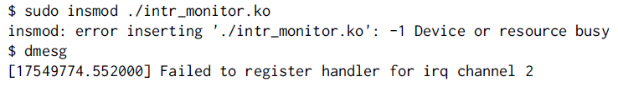
Understanding module loading issues
When loading a module fails, insmod often doesn’t give you enough details!
Details are often available in the kernel log.
Example:
31

Slide 32
Module Utilities
sudo modprobe <module_name>
Most common usage of modprobe: tries to load all the modules the given module depends on, and then this module.
Lots of other options are available. modprobe automatically looks in /lib/modules/<version>/ for the object file corresponding to the given module name.
lsmod
Displays the list of loaded modules
Compare its output with the contents of /proc/modules!
32

Slide 33
Let’s see the Booting of Linux Kernel
sudo rmmod <module_name>
Tries to remove the given module.
Will only be allowed if the module is no longer in use (for example, no more processes opening a device file)
sudo modprobe -r <module_name>
Tries to remove the given module and all dependent modules (which are no longer needed after removing the module)
33

Slide 34
Passing Parameters to Modules
Find available parameters:
modinfo usb-storage
Through insmod:
sudo insmod ./usb-storage.ko delay_use=0
Through modprobe:
Set parameters in /etc/modprobe.conf or in any file in /etc/modprobe.d/: options usb-storage delay_use=0
34

Slide 35
Passing Parameters to Modules
Through the kernel command line, when the driver is built statically into the
kernel:
usb-storage.delay_use=0
usb-storage is the driver name
delay_use is the driver parameter name. It specifies a delay before accessing a USB storage device (useful for rotating devices).
0 is the driver parameter value
35

Slide 36
Check Module Parameter Values
How to find/edit the current values for the parameters of a loaded module?
Check /sys/module/<name>/parameters.
There is one file per parameter, containing the parameter value.
Also possible to change parameter values if these files have write permissions (depends on the module code).
Example:
echo 0 > /sys/module/usb_storage/parameters/delay_use
36

Slide 37
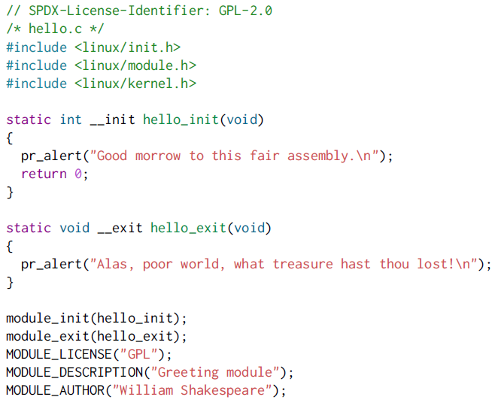
Hello Module
37

Slide 38
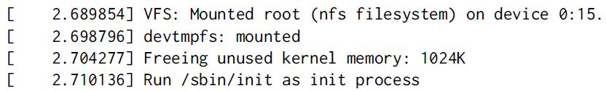
Hello Module
Code marked as __init:
Removed after initialization (static kernel or module.)
See how init memory is reclaimed when the kernel finishes booting:
Code marked as __exit:
Discarded when module compiled statically into the kernel, or when module unloading support is not enabled.
Code of this example module available on https://frama.link/Q3CNXnom
38

Slide 39
Hello Module Explanations
Headers specific to the Linux kernel: linux/xxx.h
No access to the usual C library, we’re doing kernel programming
An initialization function
Called when the module is loaded, returns an error code (0 on success, negative value on failure)
Declared by the module_init() macro: the name of the function doesn’t matter, even though <modulename>_init() is a convention.
A cleanup function
Called when the module is unloaded
declared by the module_exit() macro.
Metadata information declared using MODULE_LICENSE(), MODULE_DESCRIPTION() and MODULE_AUTHOR()
39

Slide 40
Symbols Exported to Modules
From a kernel module, only a limited number of kernel functions can be called
Functions and variables have to be explicitly exported by the kernel to be visible to a kernel module
Two macros are used in the kernel to export functions and variables:
EXPORT_SYMBOL(symbolname), which exports a function or variable to all modules
EXPORT_SYMBOL_GPL(symbolname), which exports a function or variable only to GPL modules
Linux 5.3: contains the same number of symbols with EXPORT_SYMBOL() and symbols with EXPORT_SYMBOL_GPL()
A normal driver should not need any non-exported function.
40

Slide 41
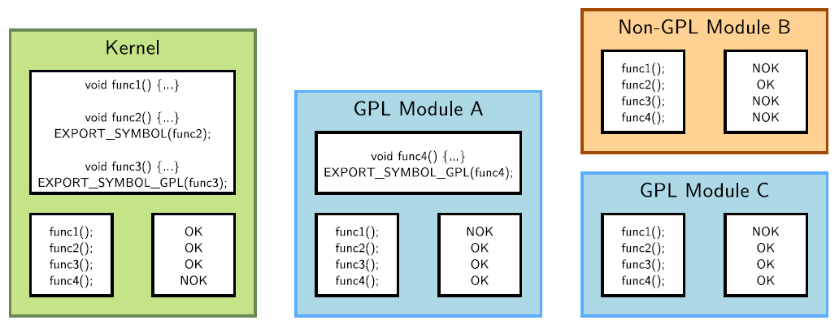
Symbols Exported to Modules
41

Slide 42
Compiling a Module
Two solutions
Out of tree
When the code is outside of the kernel source tree, in a different directory
Advantage: Might be easier to handle than modifications to the kernel itself
Drawbacks: Not integrated to the kernel configuration/compilation process, needs to be built separately, the driver cannot be built statically
Inside the kernel tree
Well integrated into the kernel configuration/compilation process
Driver can be built statically if needed
42

Slide 43
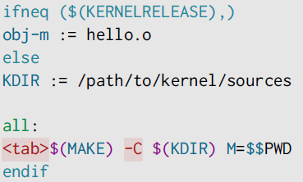
Compiling an out-of-tree Module
The below Makefile should be reusable for any single-file out-of-tree Linux module
The source file is hello.c
Just run make to build the hello.ko file
KDIR: kernel source or headers directory (see next slides)
43

Slide 44
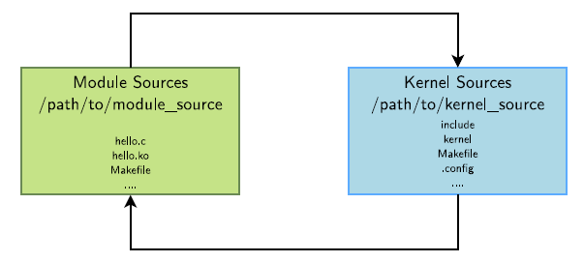
Compiling an out-of-tree Module
The module Makefile is interpreted with KERNELRELEASE undefined, so it calls the kernel Makefile, passing the module directory in the M variable
The kernel Makefile knows how to compile a module, and thanks to the M variable, knows where the Makefile for our module is. This module Makefile is then interpreted with KERNELRELEASE defined, so the kernel sees the obj-m definition.
44

Slide 45
Sources of Concurrency Issues
In terms of concurrency, the kernel has the same constraint as a multi-threaded program: its state is global and visible in all executions contexts
Concurrency arises because of
Interrupts, which interrupts the current thread to execute an interrupt handler. They may be using shared resources (memory addresses, hardware registers...)
Kernel preemption, if enabled, causes the kernel to switch from the execution of one system call to another. They may be using shared resources.
Multiprocessing, in which case code is really executed in parallel on different processors, and they may be using shared resources as well.
The solution is to keep as much local state as possible and for the shared resources that can’t be made local (such as hardware ones), use locking.
45

Slide 46
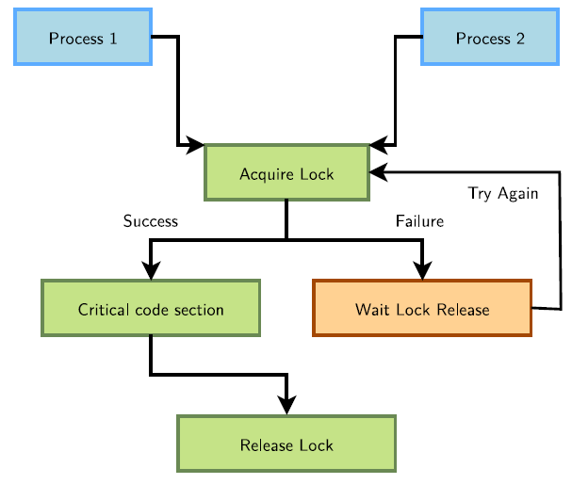
Concurrency Protection with Locks
46

Slide 47
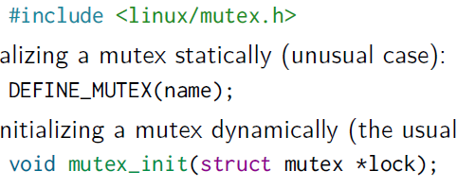
Linux mutexes
mutex = mutual exclusion
The kernel’s main locking primitive. It’s a binary lock. Note that counting locks (semaphores) are also available, but used 30x less frequently.
The process requesting the lock blocks when the lock is already held. Mutexescan therefore only be used in contexts where sleeping is allowed.
Mutex definition:
Initializing a mutex statically (unusual case):
Or initializing a mutex dynamically (the usual case, on a per-device basis):
47

Slide 48
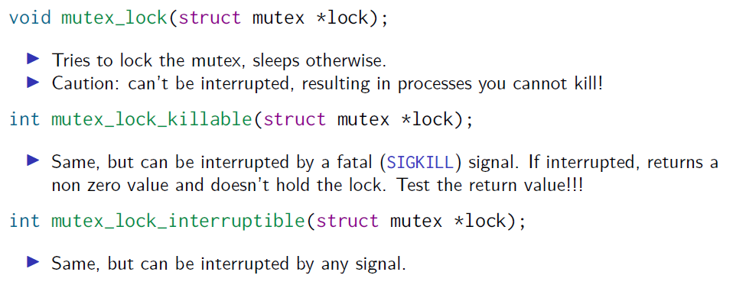
Locking and Unlocking Mutexes
Tries to lock the mutex, sleeps otherwise.
Caution: can’t be interrupted, resulting in processes you cannot kill!
Same, but can be interrupted by a fatal (SIGKILL) signal. If interrupted, returns a non zero value and doesn’t hold the lock. Test the return value!!!
Same, but can be interrupted by any signal.
48

Slide 49
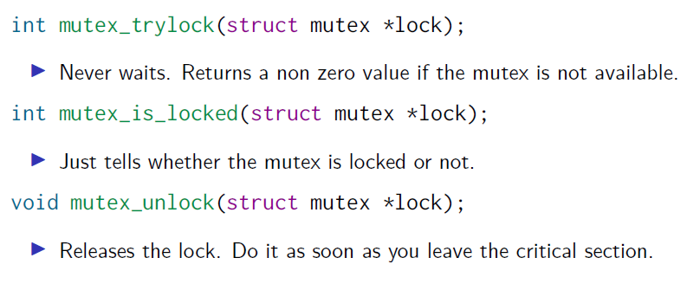
Locking and Unlocking Mutexes
Never waits. Returns a non zero value if the mutex is not available.
Just tells whether the mutex is locked or not.
Releases the lock. Do it as soon as you leave the critical section.
49

Slide 50
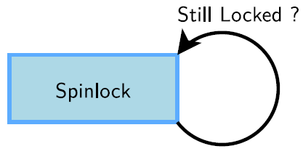
Spinlocks
Locks to be used for code that is not allowed to sleep (interrupt handlers), or that doesn’t want to sleep (critical sections).
Be very careful not to call functions which can sleep!
Originally intended for multiprocessor systems
Spinlocks never sleep and keep spinning in a loop until the lock is available.
Spinlocks cause kernel preemption to be disabled on the CPU executing them.
The critical section protected by a spinlock is not allowed to sleep.
50

Slide 51
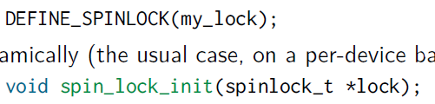
Initializing Spinlocks
Statically (unusual)
Dynamically (the usual case, on a per-device basis)
51

Slide 52
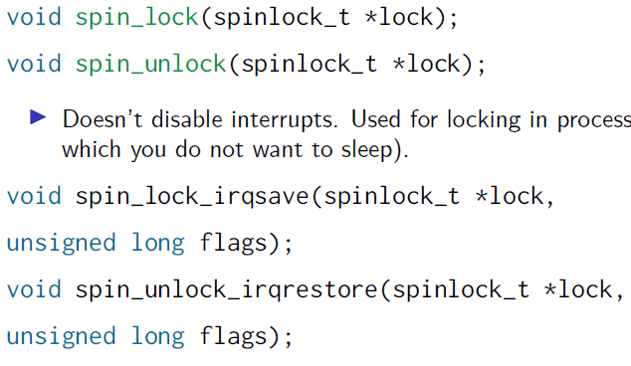
Using Spinlocks
Several variants, depending on where the spinlock is called:
Doesn’t disable interrupts. Used for locking in process context (critical sections in which you do not want to sleep).
Disables / restores IRQs on the local CPU.
Typically used when the lock can be accessed in both process and interrupt context, to prevent preemption by interrupts
52

Slide 53

Using Spinlocks
Disables software interrupts, but not hardware ones.
Useful to protect shared data accessed in process context and in a soft interrupt (bottom half).
No need to disable hardware interrupts in this case.
Note that reader / writer spinlocks also exist, allowing for multiple simultaneous readers.
53

Slide 54
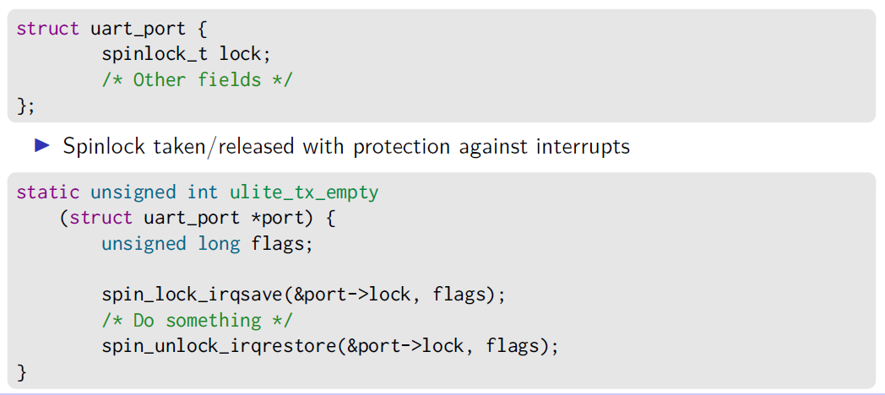
Spinlock example
From drivers /tty/serial/uartlite.c
Spinlock structure embedded into struct uart_port
Spinlock taken/released with protection against interrupts
54

Slide 55
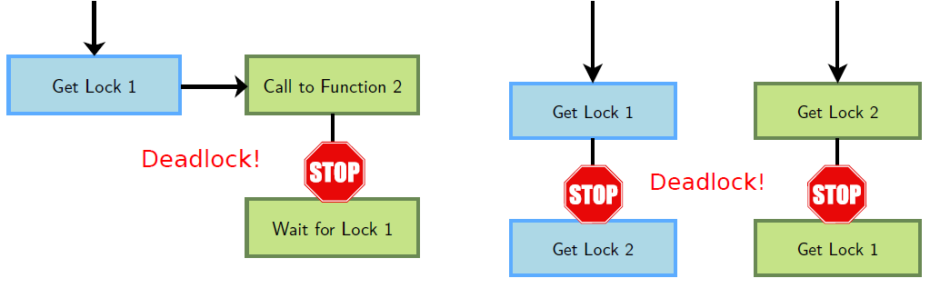
Deadlock Situations
They can lock up your system. Make sure they never happen!
Rule 1: don’t call a function that can try to get access to the same lock
Rule 2: if you need multiple locks, always acquire them in the same order!
55

Slide 56
Alternatives to Locking
Locking can have a strong negative impact on system performance. In some situations, you could do without it.
By using lock-free algorithms like Read Copy Update (RCU).
RCU API available in the kernel (See https://en.wikipedia.org/wiki/RCU).
When available, use atomic operations.
56

Slide 57
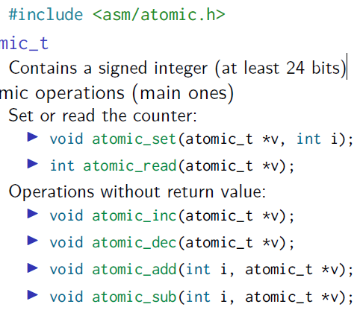
Atomic Variables
Useful when the shared resource is an integer value
Even an instruction like n++ is not guaranteed to be atomic on all processors!
Atomic operations definitions
atomic_t
Contains a signed integer (at least 24 bits)
Atomic operations (main ones)
Set or read the counter:
Operations without return value:
57

Slide 58
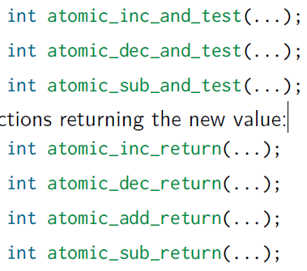
Atomic Variables
Similar functions testing the result:
Functions returning the new value:
58

Slide 59
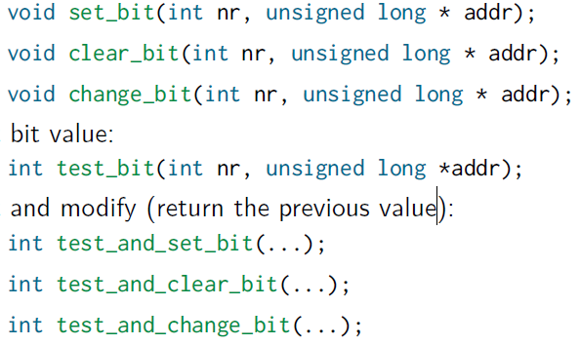
Atomic Bit Operations
Supply very fast, atomic operations
On most platforms, apply to an unsigned long * type.
Apply to a void * type on a few others.
Set, clear, toggle a given bit:
Test bit value
Test and modify (return the previous value)
59

Slide 60
Kernel Locking: Summary and References
Use mutexes in code that is allowed to sleep
Use spinlocks in code that is not allowed to sleep (interrupts) or for which sleeping would be too costly (critical sections)
Use atomic operations to protect integers or addresses
See kernel-hacking/locking in kernel documentation for many details about kernel locking mechanisms.
60

Slide 61

That’s all for today.
Notes:
Thank you for listening. Now, I would like to end today’s talk by the Q & A time.

