Slide 1

Embedded System Lecture 05: Kernel Arch for Device Drivers & Kernel Initialization
Department of Computer Science and Information Engineering
Shuo-Han Chen (陳碩漢), shchen@csie.ntut.edu.tw
Hong-Yue Technology Research Building 334
R 09:10 - 12:00

Slide 2
Kernel Arch for Device Drivers
Userspace sees three main types of devices:
Character devices
The most common type of devices.
Initially for devices implementing streams of bytes, it is now used for a wide range of devices: serial ports, framebuffers, video capture devices, sound devices, input devices, I2C and SPI gateways, etc.
Block devices
for storage devices like hard disks, CD-ROM drives, USB keys, SD/MMC cards, etc.
Network devices
for wired or wireless interfaces, network connections and others
2

Slide 3
Accessing the devices
Network devices are accessed through network-specic APIs and tools (socket API of the standard C library, tools such as ifconfig, route, etc.)
Block and character devices are represented for userspace applications as files than can be manipulated using the traditional file API (open(), read(), write(), close(), etc.)
Special file types for block and character devices, associating a name with a couple (major, minor)
The kernel only cares about the (type, major, minor), which is the unique identifier of the device
Special files traditionally located in /dev, created by mknod, either manually or automatically by udev
3

Slide 4
Inside the Kernel
Device drivers must register themselves to the core kernel and implement a set of operations specific to their type:
Character drivers must instantiate and register a cdev structure and implement file_ operations
Block drivers must instantiate and register a gendisk structure and implement block_device_operations and a special make_request function
Network drivers must instantiate and register a net_device structure and implement net_device_ops
For the following, we will first focus on character devices as an example of device drivers.
4

Slide 5
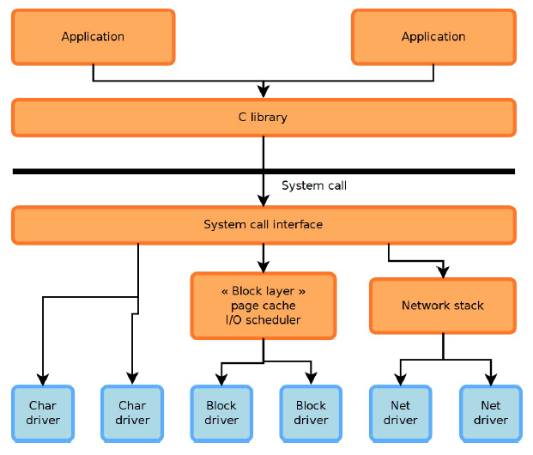
General architecture
5

Slide 6
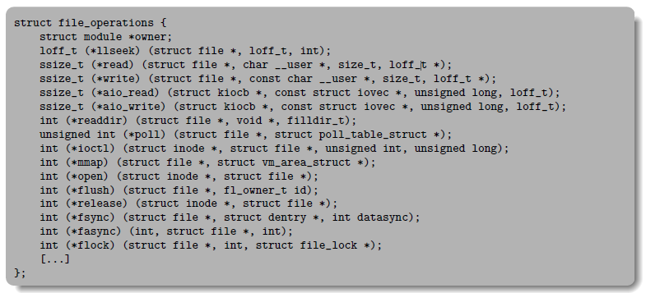
File operations
The file operations are generic to all types of files: regular files, directories, character devices, block devices, etc.
6

Slide 7
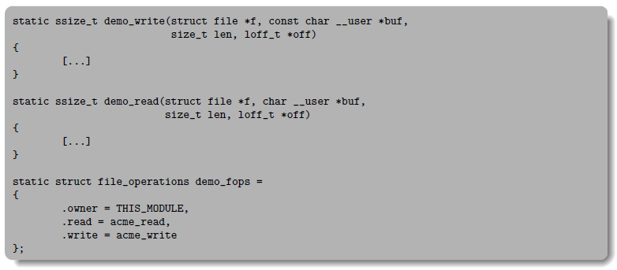
Character Driver Skeleton
Implement the read() and write() operations, and instantiate the file_operations structure.
7

Slide 8
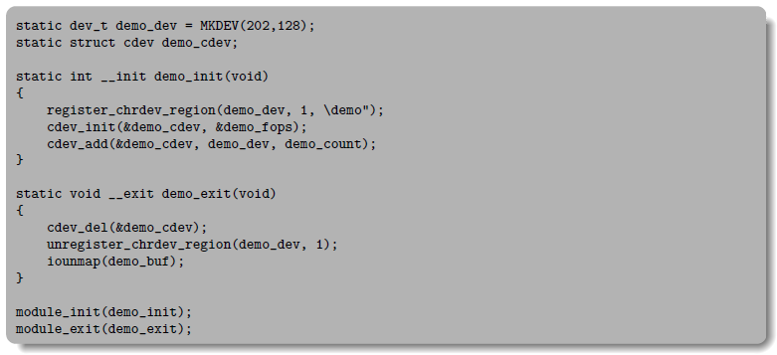
Character Driver Skeleton
Register and unregister the driver to the kernel using
register_chrdev_region & unregister_chrdev_region
cdev_add & cdev_del
8

Slide 9
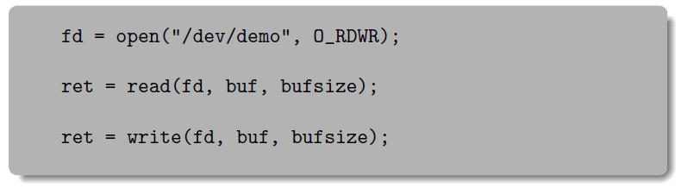
Driver Usage in Userspace
Making it accessible to userspace application by creating a device node:
mknod /dev/demo c 202 128
Using normal the normal file API :
9

Slide 10
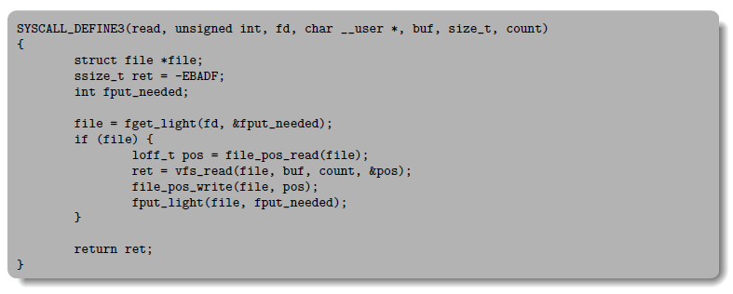
From the Syscall to Your Driver
In fs/read write.c
10

Slide 11
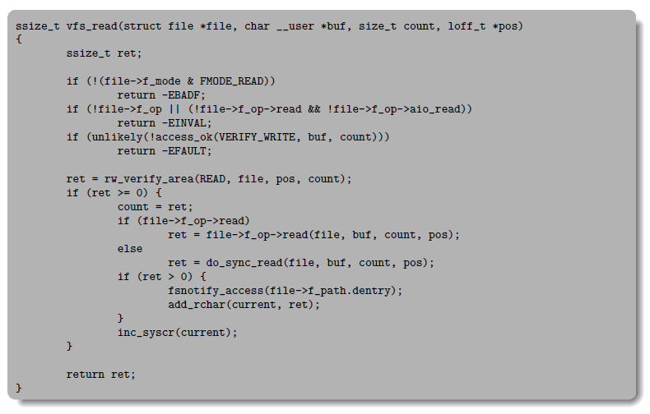
From the Syscall to Your Driver
In fs/read write.c
11

Slide 12
ioctl mechanism
The file operations set of operations, while being sufficient for regular files, isn't sufficient as an API to the wide range of character and block devices
Device-specific operations such as changing the speed of a serial port, setting the volume on a soundcard, configuring video-related parameters on a framebuffer are not handled by the file operations
One of the operations, ioctl() allows to extend the capabilities of a driver with driver-specific operations
In user space: int ioctl(int d, int request, ...);
d, the file descriptor
request, a driver-specific integer identifying the operation
..., zero or one argument.
In kernel space: int (*ioctl) (struct inode *, struct file *, unsigned int, unsigned long);
12

Slide 13
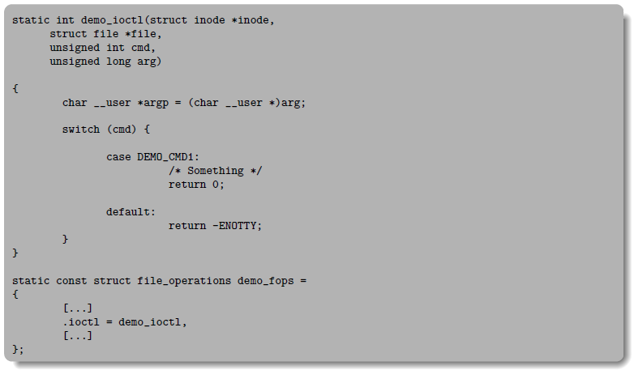
Kernel
Implement the demo ioctl() operation and reference it in the file_operations structure:
13

Slide 14
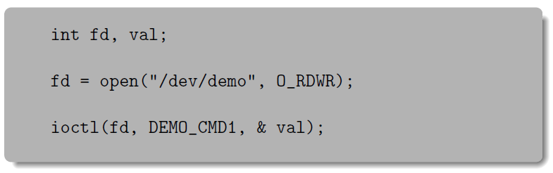
ioctl example, userspace side
Use the ioctl() system call.
14

Slide 15
Kernel Framework
Most device drivers are not directly implemented as character devices or block devices
They are implemented under a framework, specific to a device type (framebuffer, V4L, serial, etc.)
The framework allows to factorize the common parts of drivers for the same type of devices
From user space, they are still seen as normal character devices
The framework allows to provide a coherent user space interface (ioctl numbering and semantic, etc.) for every type of device, regardless of the driver
15

Slide 16
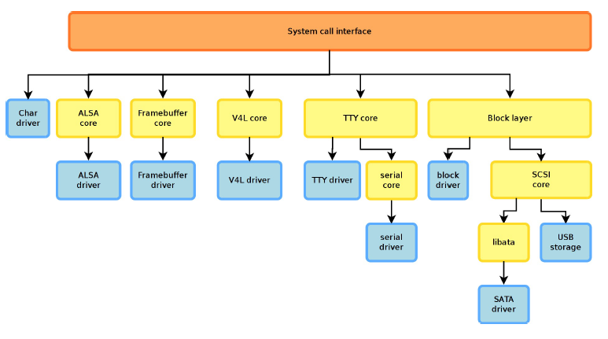
Example of frameworks
16

Slide 17
Example of the framebuffer framework
Kernel option CONFIG_FB
Implemented in drivers/video/
fb.c, fbmem.c, fbmon.c, fbcmap.c, fbsysfs.c, modedb.c, fbcvt.c
Implements a single character driver (through file operations), registers the major number and allocates minors, allocates and implements the user/kernel API
First part of include/linux/fb.h
Defines the set of operations a framebuffer driver must implement and helper functions for the drivers
struct fb_ops
Second part of include/linux/fb.h
17

Slide 18
The framebuffer Driver
Must implement some or all operations defined in struct fb_ops. Those operations are framebuffer-specfic.
xxx_open(), xxx _ read(), xxx_write(), xxx_release(), xxx_checkvar(), xxx_setpar(), xxx_setcolreg(), xxx_blank(), xxx_pan_display(), xxx_fillrect(), xxx_copyarea(), xxx_imageblit(), xxx_cursor(), xxx_rotate(), xxx_sync(), xxx get_caps(), etc.
Must allocate a fb_info structure with framebuffer_alloc(), set the ->fbops field to the operation structure, and register the framebuer device with register framebuffer()
18

Slide 19
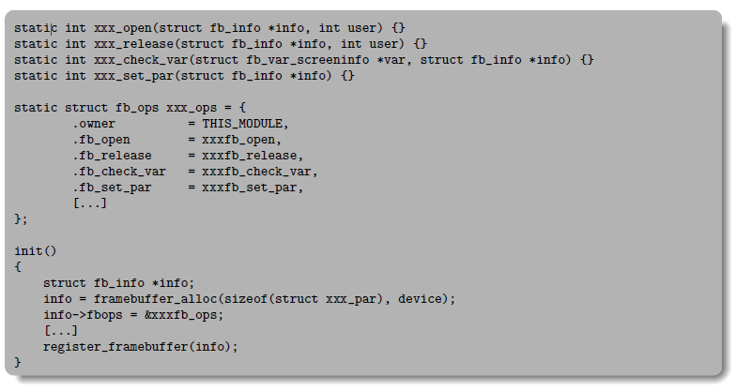
Skeleton example
19

Slide 20
Other example of framework: serial driver
1. The driver registers a single uart_driver structure, that contains a few informations such as major, starting minor, number of supported serial ports, etc.
Functions uart register driver() and uart unregister driver()
2. For each serial port detected, the driver registers a uart_port structure, which points to a uart_ops structure and contains other informations about the serial port
Functions uart_add_one_port() and uart_remove_one_port()
3. The driver implements some or all of the methods in the uart ops structure
tx empty(), set mctrl(), get mctrl(), stop tx(), start tx(), send xchar(), stop rx(), enable ms(), break ctl(), startup(), shutdown(), flush buffer(), set termios(), etc.
All these methods receive as argument at least a uart port structure, the device on which the method applies. It is similar to the this pointer in object-oriented languages
20

Slide 21
Device and Driver model
One of the features that came with the 2.6 kernel is a unified device and driver model
Instead of different ad-hoc mechanisms in each subsystem, the device model unfies the vision of the devices, drivers, their organization and relationships
Allows to minimize code duplication, provide common facilities, more coherency in the code organization
Defines base structure types: struct device, struct driver, struct bus type
Is visible in userspace through the sysfs filesystem, traditionally mounted under /sys
21

Slide 22
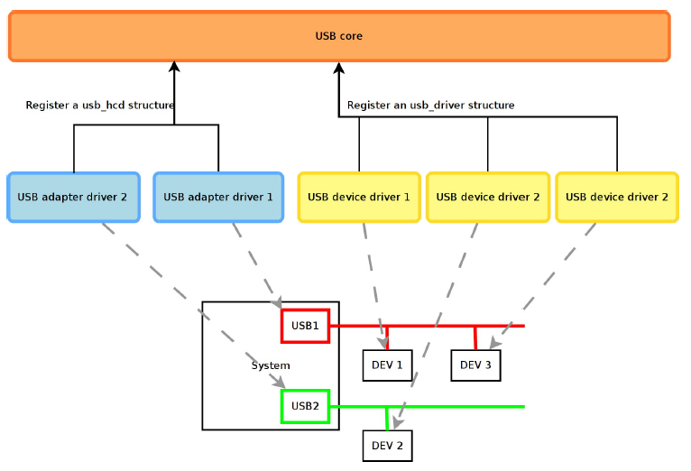
Adapter, Bus and Device Drivers
22

Slide 23
Example of Device Driver
To illustrate how drivers are implemented to work with the device model, we will use an USB network adapter driver. We will therefore limit ourselves to device drivers and won't cover adapter drivers.
23

Slide 24
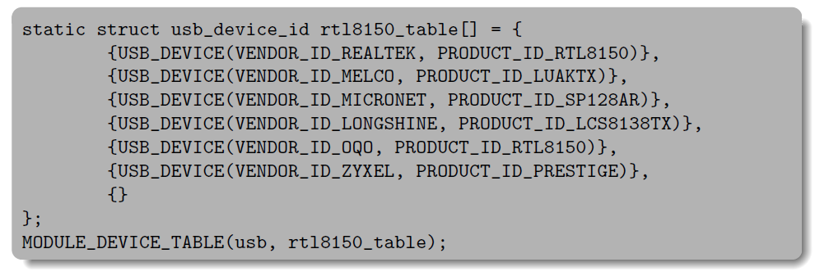
Device Identifiers
Defines the set of devices that this driver can manage, so that the USB core knows which devices this driver can handle.
The MODULE_DEVICE_TABLE macro allows depmod to extract at compile the relation between device identifiers and drivers, so that drivers can be loaded automatically by udev.
See /lib/modules/$(uname -r)/modules. {falias,usbmapg}
24

Slide 25
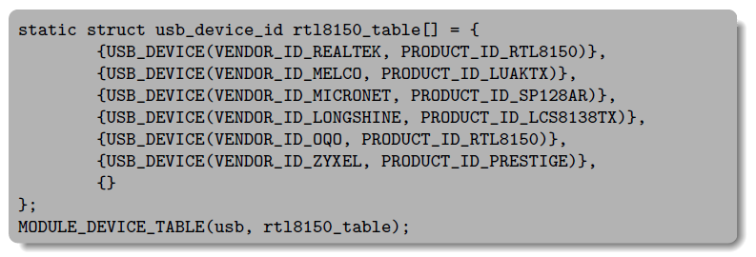
Device identifiers
Instantiates the usb_driver structure. This structure is a specialization of struct_driver dened by the driver model. We have an example of inheritance here.
25

Slide 26
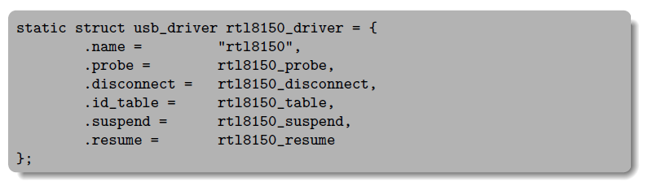
Instantation of usb_driver
Instantiates the usb_driver structure. This structure is a specialization of struct driver defined by the driver model. We have an example of inheritance here.
26

Slide 27
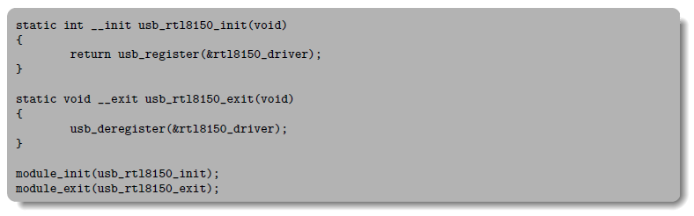
Registration of the Driver
When the driver is loaded and unloaded, it simply registers and unregisters itself as an USB device driver.
27

Slide 28
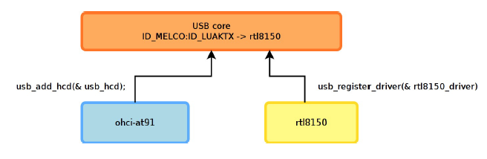
Probe Call Sequence (1/3)
At boot time, the USB device driver registers itself to the generic BUS infrastructure
28

Slide 29
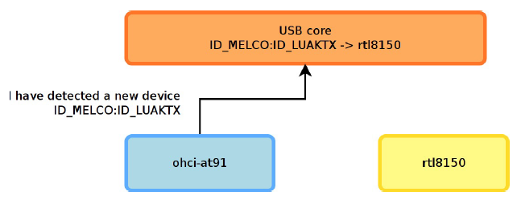
Probe Call Sequence (2/3)
When a bus adapter driver detects a device, it notifies the generic USB bus infrastructure
29

Slide 30
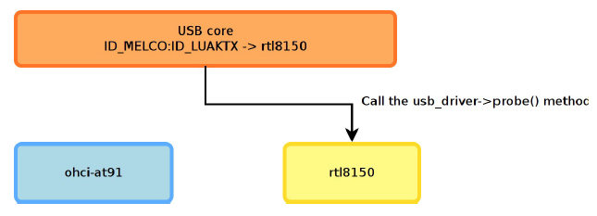
Probe Call Sequence (3/3)
The generic USB bus infrastructure knows which driver is capable of handling the detected device. It calls the probe() method of that driver
30

Slide 31
Probe Method
The probe() method receives as argument a structure describing the device, usually specialized by the bus infrastructure (pci_dev, usb_interface, etc.)
This function is responsible for
Initializing the device, mapping I/O memory, registering the interrupt handlers. The bus infrastructure provides methods to get the addresses, interrupts numbers and other device-specific information.
Registering the device to the proper kernel framework, for example the network infrastructure.
31

Slide 32
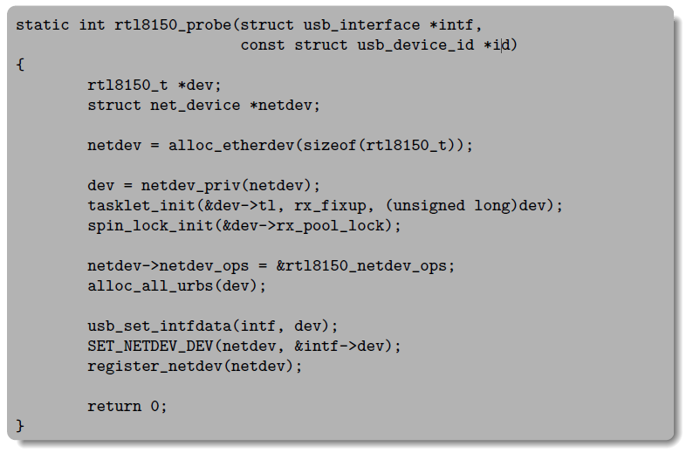
rtl8150 probe
32

Slide 33
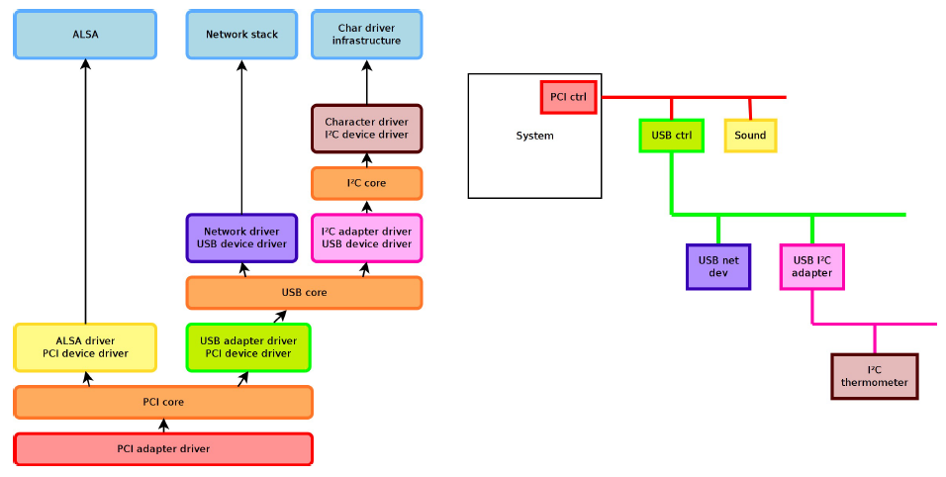
Device Model is Recursive
Drivers can be connected to another driver
33

Slide 34
Platform Drivers
On embedded systems, devices are often not connected through a bus allowing enumeration, hotplugging, and providing unique identifiers for devices.
However, we still want the devices to be part of the device model.
The solution to this is the platform driver / platform device infrastructure.
The platform devices are the devices that are directly connected to the CPU, without any kind of bus.
34

Slide 35
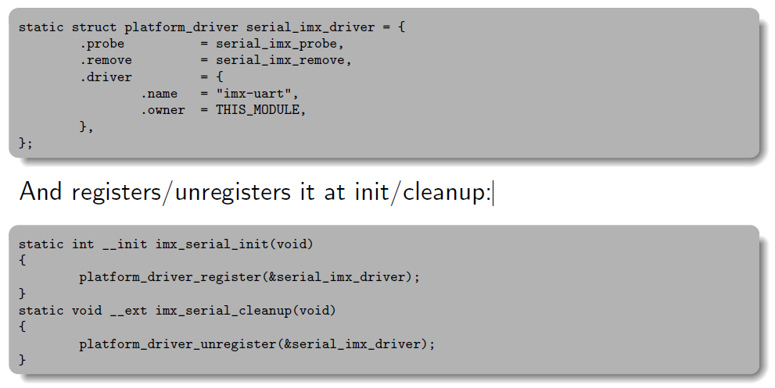
Initialization of a Platform Driver
Example of the iMX serial port driver, in drivers/serial/imx.c. The driver instantiates a platform driver structure:
And registers/unregisters it at init/cleanup:
35

Slide 36
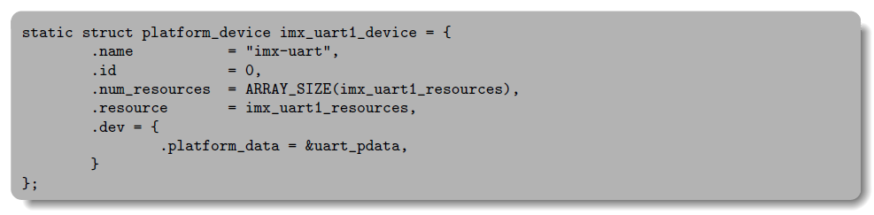
Initialization of a Platform Device
As platform devices cannot be detected dynamically, they are statically defined:
by direct instantiation of platform_device structures, as done on ARM
by using a device tree, as done on PowerPC
Example on ARM, where the instantiation is done in the board specific code (arch/arm/mach-imx/mx1ads.c)
The matching between a device and the driver is simply done using the name.
36

Slide 37
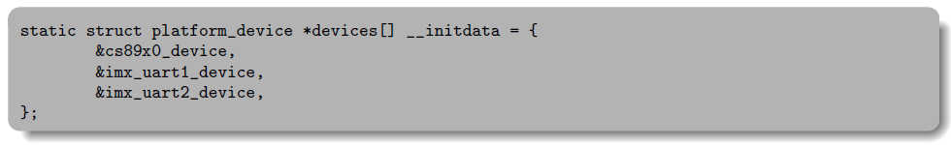
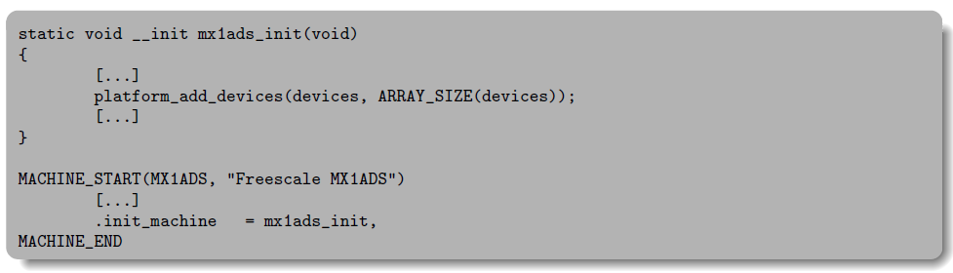
Registration of Platform Devices
The device is part of a list:
And the list of devices is added to the system during the board initialization
37

Slide 38
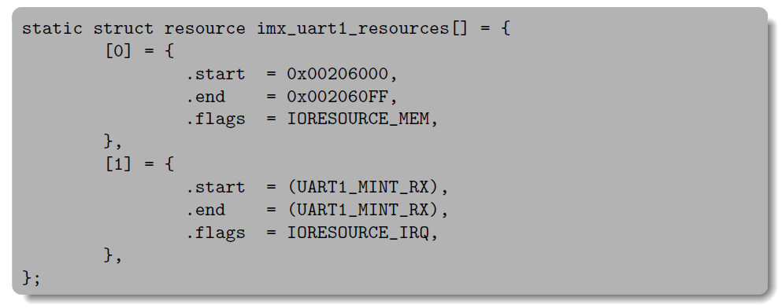
The resource mechanism
Each device managed by a particular driver typically uses different hardware resources: different addresses for the I/O registers, different DMA channel, different IRQ line, etc.
These information can be represented using the kernel struct resource, and an array of resources is associated to a platform device definition.
38

Slide 39
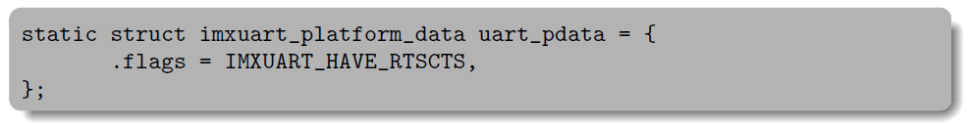
The platform_data mechanism
In addition to the well-defined resources, some driver require driver-specific configuration for each platform device
These can be specified using the platform_data field of the struct device
As it is a void * pointer, it can be used to pass any type of data to the driver
In the case of the iMX driver, the platform data is a struct imxuart_platform_data structure, referenced from the platform_device structure
39

Slide 40
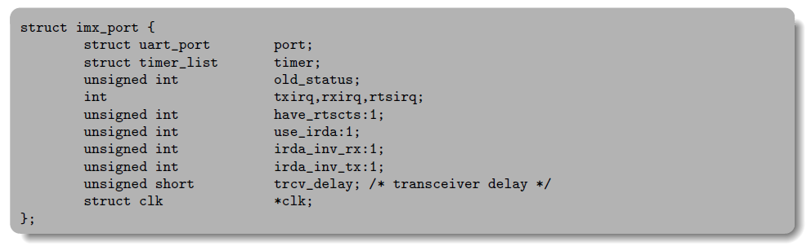
Driver-specific data structure
Typically, device drivers subclass the type-specific data structure that they must instantiate to register their device to the upper layer framework
For example, serial drivers subclass uart_port, network drivers subclass netdev, framebuffer drivers subclass fb_info
This inheritance is done by aggregation or by reference
40

Slide 41
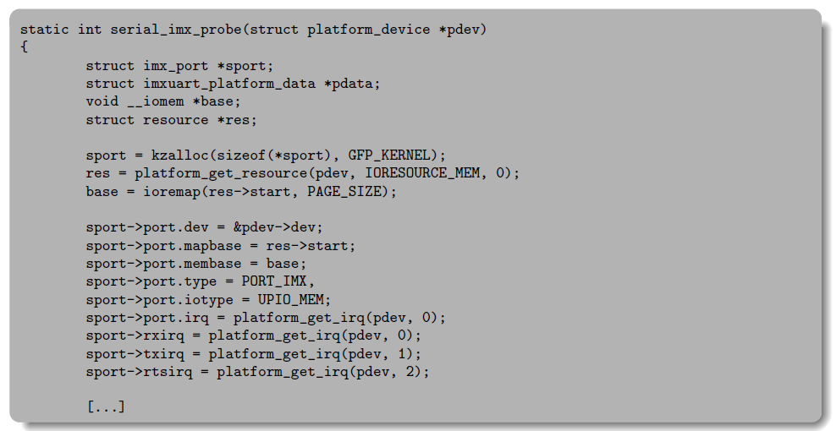
probe() method for Platform Devices
Just like the usual probe() methods, it receives the platform_device pointer, uses different utility functions to find the corresponding resources, and registers the device to the corresponding upper layer.
41

Slide 42
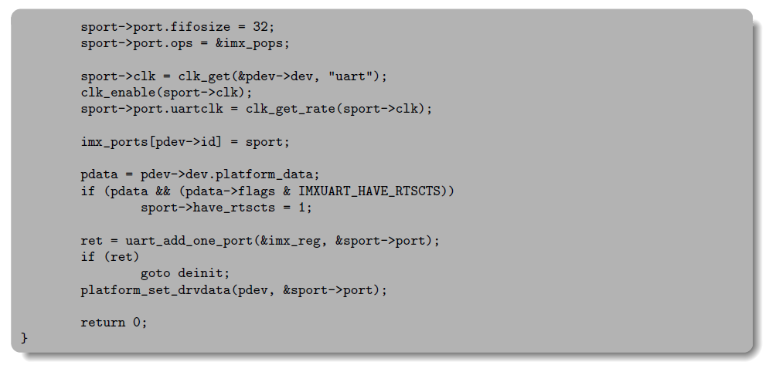
probe() method for Platform Devices
42

Slide 43
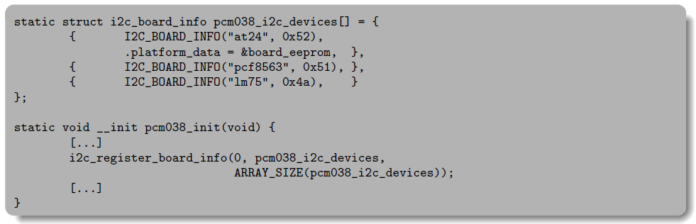
Other Non-Dynamic
In addition to the special platform bus, there are some other busses that do not support dynamic enumeration and identification of devices. For example: I2C and SPI.
For these busses, a list of devices connected to the bus is hardcoded into the board-specific information and is registered using i2c_register_board_info() or spi_register_board_info(). The binding between the device is also done using a string identifier.
43

Slide 44
Typical Organization of a Driver
A driver typically
Defines a driver-specific data structure to keep track of per-device state, this structure often subclass the type-specific structure for this type of device
Implements a set of helper functions, interrupt handlers, etc.
Implements some or all of the operations, as specified by the framework in which the device will be subscribed
Instantiate the operation table
Defines a probe() method that allocates the "state" structure, initializes the device and registers it to the upper layer framework. Similarly defines a corresponding remove() method
Instantiate a SOMEBUS_driver structure that references the probe() and remove() methods and give the bus infrastructure some way of binding a device to this driver (by name, by identifier, etc.)
In the driver initialization function, register as a device driver to the bus-specific infrastructure. In the driver cleanup function, unregister from the bus-specific infrastructure
44

Slide 45
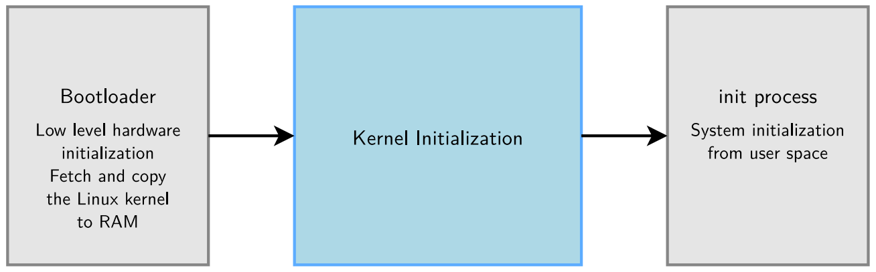
Kernel Initialization : From Bootloader to User Space
Upon power-on, the bootloader in an embedded system is the first software to get processor control for low-level hardware initialization.
Then, the control is passed to the Linux kernel
45

Slide 46
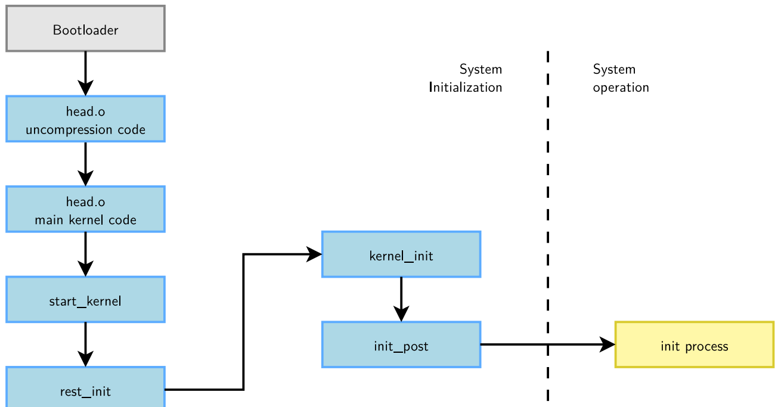
Kernel Initialization Graph
46

Slide 47
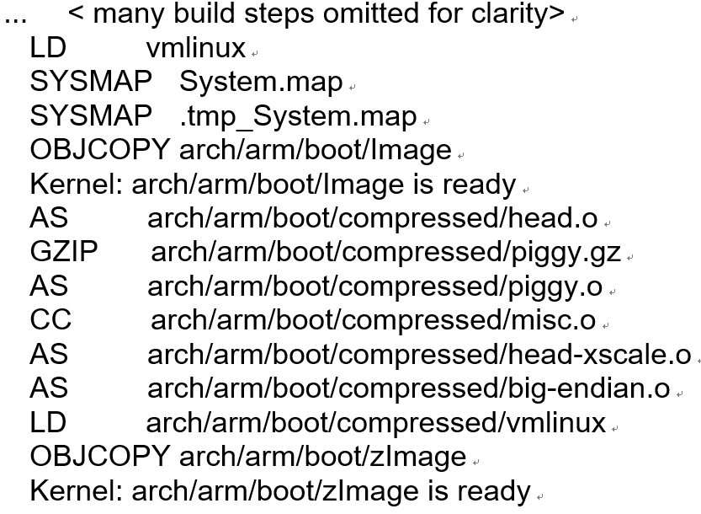
Kernel Bootstrap
How the kernel bootstraps itself appears in kernel building. Example on ARM (pxa cpu) in Linux 2.6.36:
make ARCH=arm CROSS_COMPILE=xscale_be- zImage
47

Slide 48
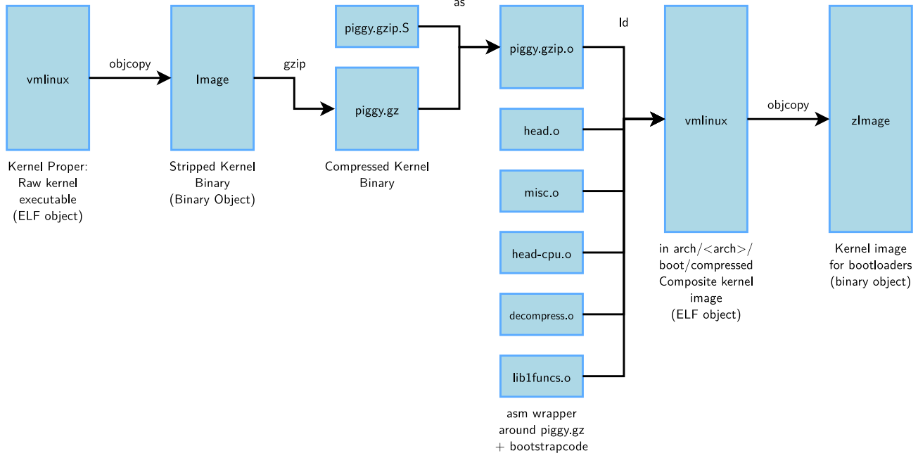
Kernel Bootstrap
How the kernel bootstraps itself appears in kernel building. Example on ARM (pxa cpu) in Linux 2.6.36:
48

Slide 49
Bootstrap Code for Compressed Kernels
Located in arch/<arch>/boot/compressed
head.o
Architecture specific initialization code.
This is what is executed by the bootloader
head-cpu.o (here head-xscale.o)
CPU specific initialization code
decompress.o, misc.o
Decompression code
piggy.o
The kernel itself
Responsible for uncompressing the kernel itself and jumping to its entry point.
49

Slide 50
Architecture-specific Initialization Code
The uncompression code jumps into the main kernel entry point, typically located in arch/<arch>/kernel/head.S, whose job is to:
Check the architecture, processor and machine type.
Configure the MMU, create page table entries and enable virtual memory.
Calls the start_kernel function in init/main.c.
Same code for all architectures.
Anybody interested in kernel startup should study this file!
50

Slide 51
start_kernel Main Actions
Calls setup_arch(&command_line)
Function defined in arch/<arch>/kernel/setup.c
Copying the command line from where the bootloader left it.
On arm, this function calls setup_processor (in which CPU information is displayed) and setup_machine(locating the machine in the list of supported machines).
Initializes the console as early as possible (to get error messages)
Initializes many subsystems (see the code)
Eventually calls rest_init.
51

Slide 52
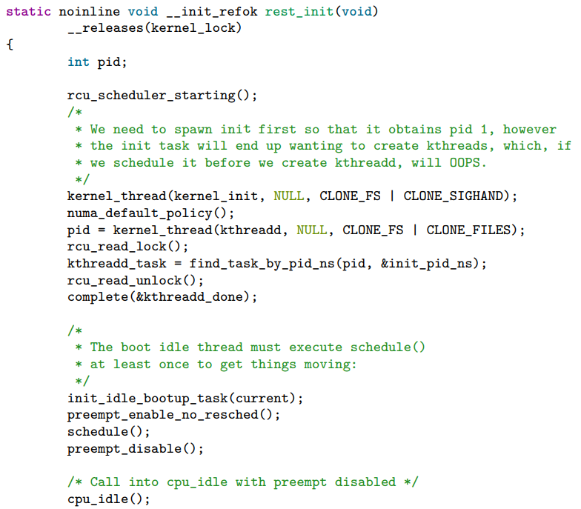
rest_init: Starting the Init Process
52

Slide 53
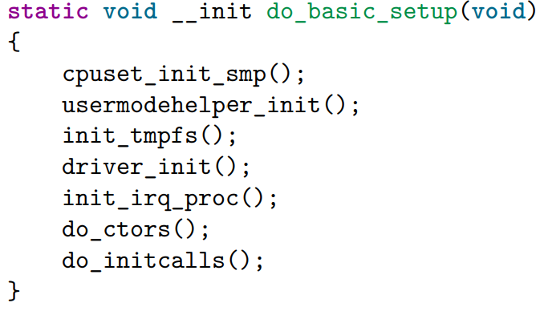
kernel_init
kernel_init does two main things:
Call do_basic_setup
Once kernel services are ready, start device initialization (Linux 2.6.36 code excerpt):
Call init_post
53

Slide 54
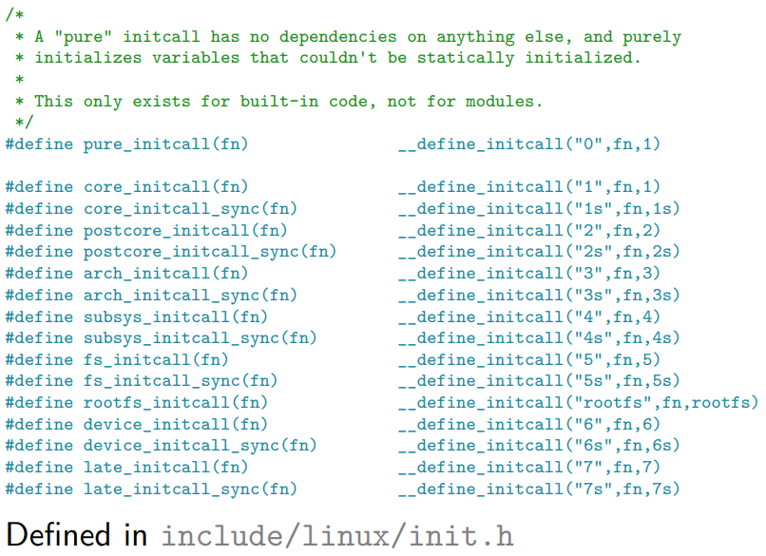
do_initcalls
Calls pluggable hooks registered with the macros below. Advantage: the generic code doesn’t have to know about them
54

Slide 55
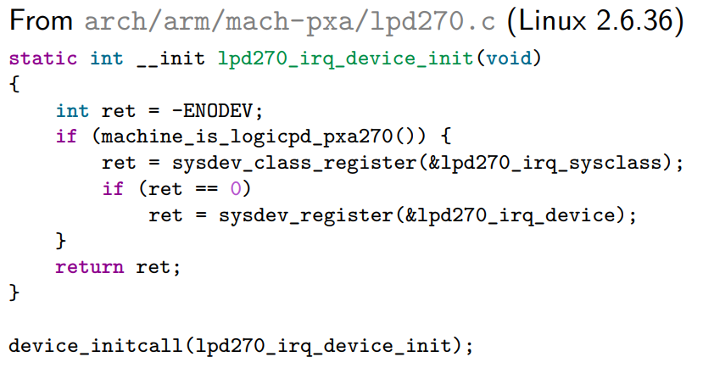
initcall example
55

Slide 56
init_post
The last step of Linux booting
First tries to open a console
Then tries to run the init process, effectively turning the current kernel thread into the user space init process
56

Slide 57
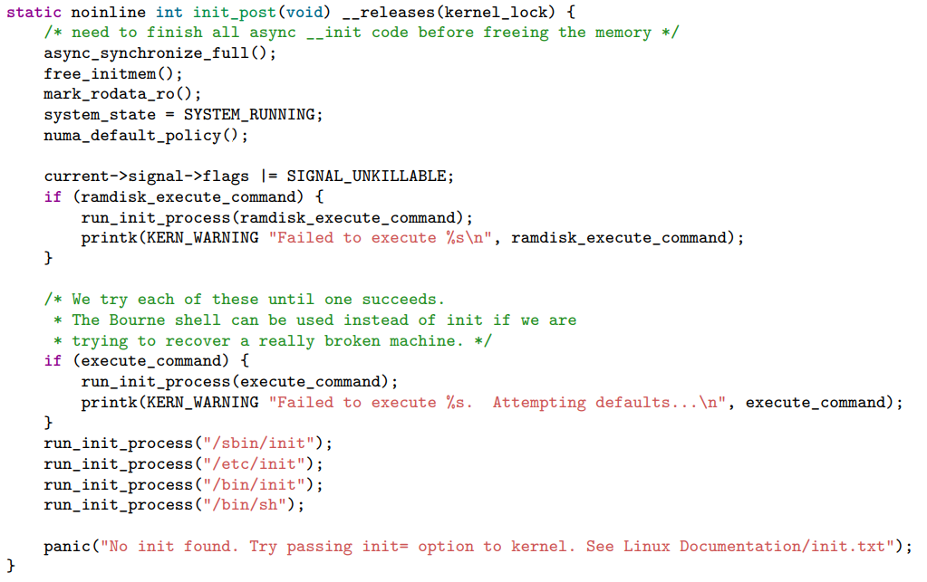
init_post Code: init/main.c
57

Slide 58
Kernel Initialization - Summary
The bootloader executes bootstrap code.
Bootstrap code initializes the processor and board, and uncompresses the kernel code to RAM, and calls the kernel’s start_kernel function.
Copies the command line from the bootloader.
Identifies the processor and machine.
Initializes the console.
Initializes kernel services (memory allocation, scheduling, file cache...)
Creates a new kernel thread (future init process) and continues in the idle loop.
Initializes devices and execute initcalls
58

Slide 59

That’s all for today.
Notes:
Thank you for listening. Now, I would like to end today’s talk by the Q & A time.

