Slide 1

Embedded System Lecture 07: Driver Allocation, Input Subsystem & Memory
Department of Computer Science and Information Engineering
Shuo-Han Chen (陳碩漢), shchen@csie.ntut.edu.tw
Hong-Yue Technology Research Building 334
R 09:10 - 12:00

Slide 2
Course Schedule Updaye
Full Online Course: To practice taking online course, Required by the School (due to Covid-19)
W | Date | Lecture | Notes | Homework
1 | Sept. 17 | Lec01: Introduction |  | HW00
2 | Sept. 24 | Lec02: The Big Picture
3 | Oct. 1 | Moon Festival | No Class
4 | Oct. 8 | Lec04: Linux and Real time
5 | Oct. 15 | Lec05: The Linux Kernel
6 | Oct. 22 | Lec06: Kernel Arch for Device Drivers & Kernel Initialization
7 | Oct. 29 | Lec07: Driver Allocation, Input Subsystem & Memory
8 | Nov. 5 | Lec08: File System and Flash storage | Full Online Course
9 | Nov. 12 | Lec09: Bootloaders
10 | Nov. 19 | Lec10: Bootloaders | Full Online Course
11 | Nov. 26 | Midterm on Nov. 26 | 3 Hour Paper-and-pencil Test (Slides & Notes Allowed)
12 | Dec. 3 | Lec11: MTD System
13 | Dec. 10 | Lec12: Busy box
14 | Dec. 17 | Lec13: Device Driver Basics
15 | Dec. 24 | Lec14: USB
16 | Dec. 31 | Lec15: udev
17 | Jan. 7 | Final Presentation | Full Online Course
18 | Jan. 14 | Final Presentation | Full Online Course
2

Slide 3
Device Managed Allocations
The probe() function is typically responsible for allocating a significant number of resources: memory, mapping I/O registers, registering interrupt handlers, etc.
These resource allocations have to be properly freed:
In the probe() function, in case of failure
In the remove() function
This required a lot of failure handling code that was rarely tested
To solve this problem, device managed allocations have been introduced.
The idea is to associate resource allocation with the struct device, and automatically release those resources
When the device disappears
When the device is unbound from the driver
Functions prefixed by devm_
See Documentation/driver-model/devres.txt for details
3

Slide 4
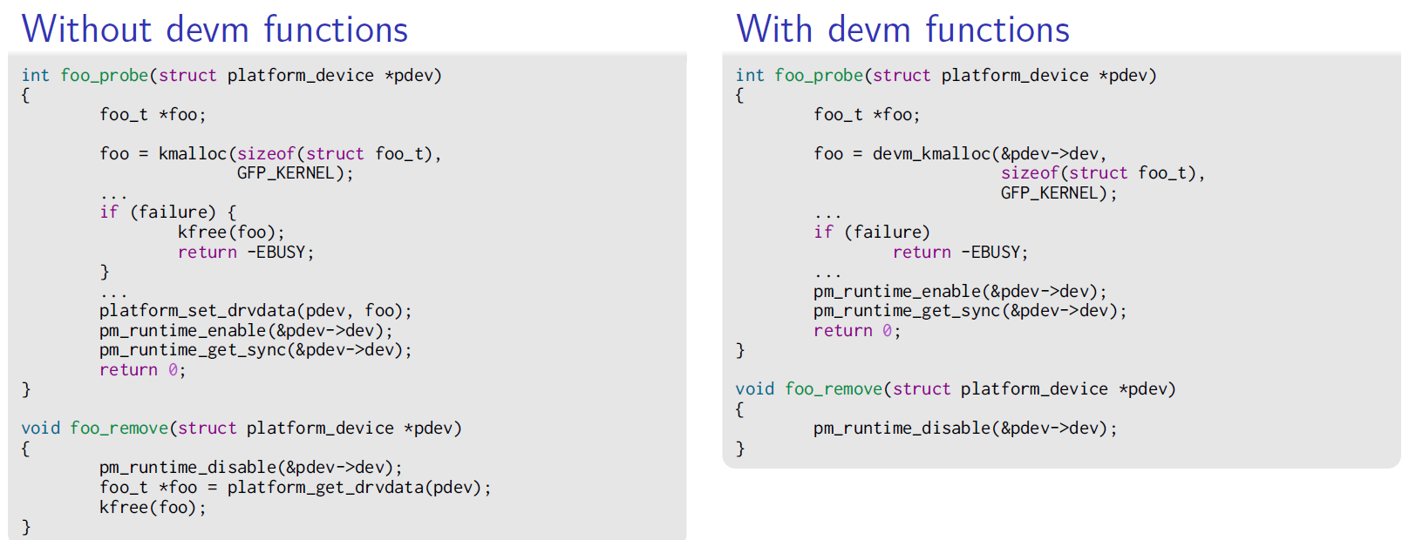
Device Managed Allocations
Memory allocation example
Normally done with kmalloc(size_t, gfp_t), released with kfree(void *)
Device managed with devm_kmalloc(struct device *, size_t, gfp_t)
4

Slide 5
Driver Data Structures and Links
Each framework defines a structure that a device driver must register to be recognized as a device in this framework
struct uart_port for serial ports, struct net_device for network devices, struct fb_info for framebuffers, etc.
In addition to this structure, the driver usually needs to store additional information about each device
This is typically done
By subclassing the appropriate framework structure
By storing a reference to the appropriate framework structure
Or by including your information in the framework structure
5

Slide 6
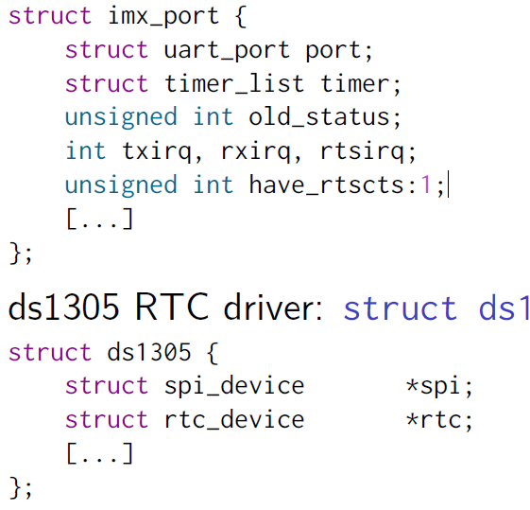
Driver-Specific Data Structure Examples
i.MX serial driver: struct imx_port is a subclass of struct uart_port
ds1305 RTC driver: struct ds1305 has a reference to struct rtc_device
6

Slide 7
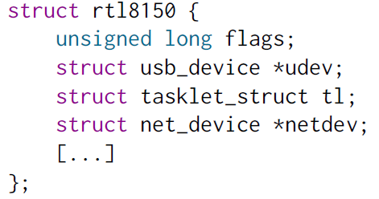
Driver-Specific Data Structure Examples
rtl8150 network driver: struct rtl8150 has a reference to struct net_device and is allocated within that framework structure.
7

Slide 8
Links between Structures
The framework structure typically contains a struct device * pointer that the driver must point to the corresponding struct device
It’s the relation between the logical device (for example a network interface) and the physical device (for example the USB network adapter)
The device structure also contains a void * pointer that the driver can freely use.
It’s often used to link back the device to the higher-level structure from the framework.
It allows, for example, from the struct platform_device structure, to find the structure describing the logical device
8

Slide 9
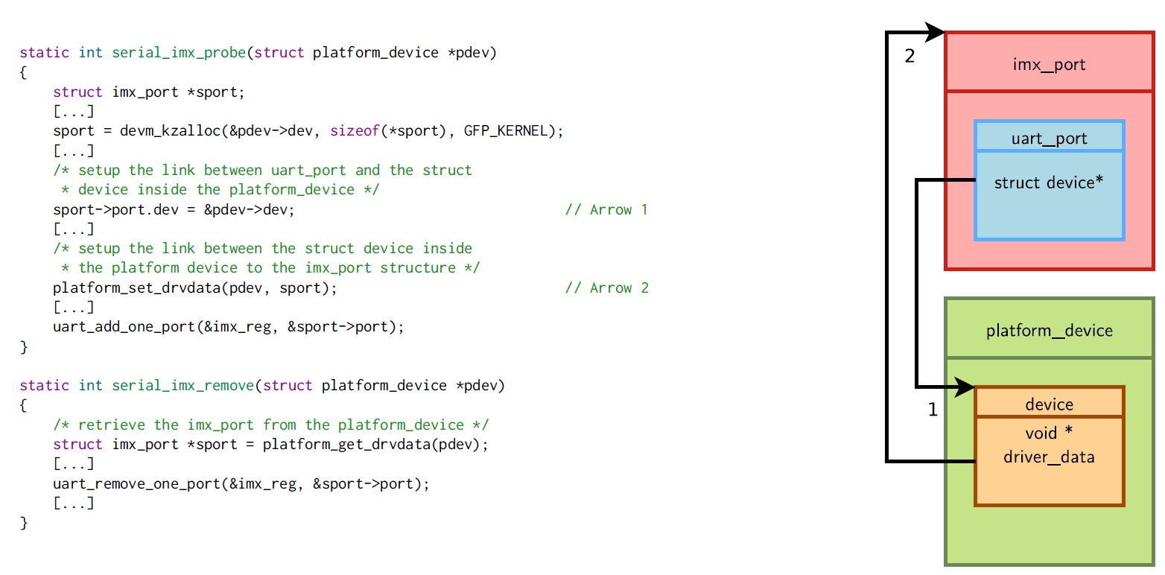
Links between Structures
9

Slide 10
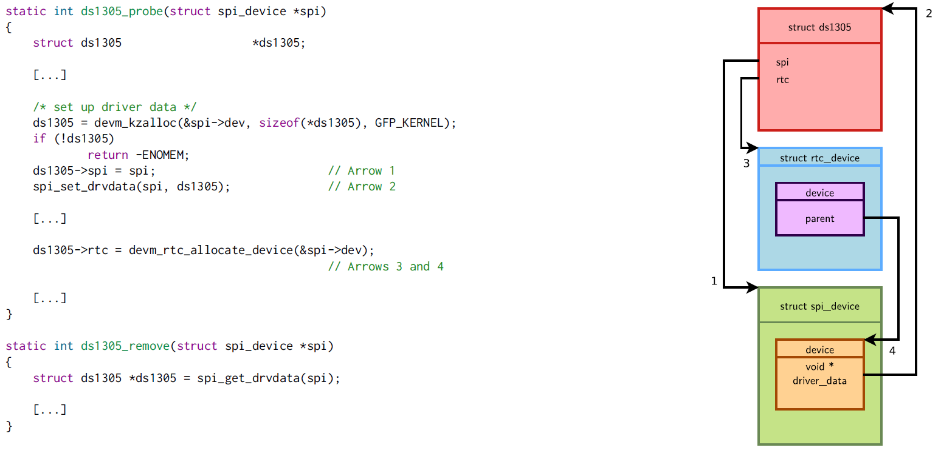
Links between Structures
10

Slide 11
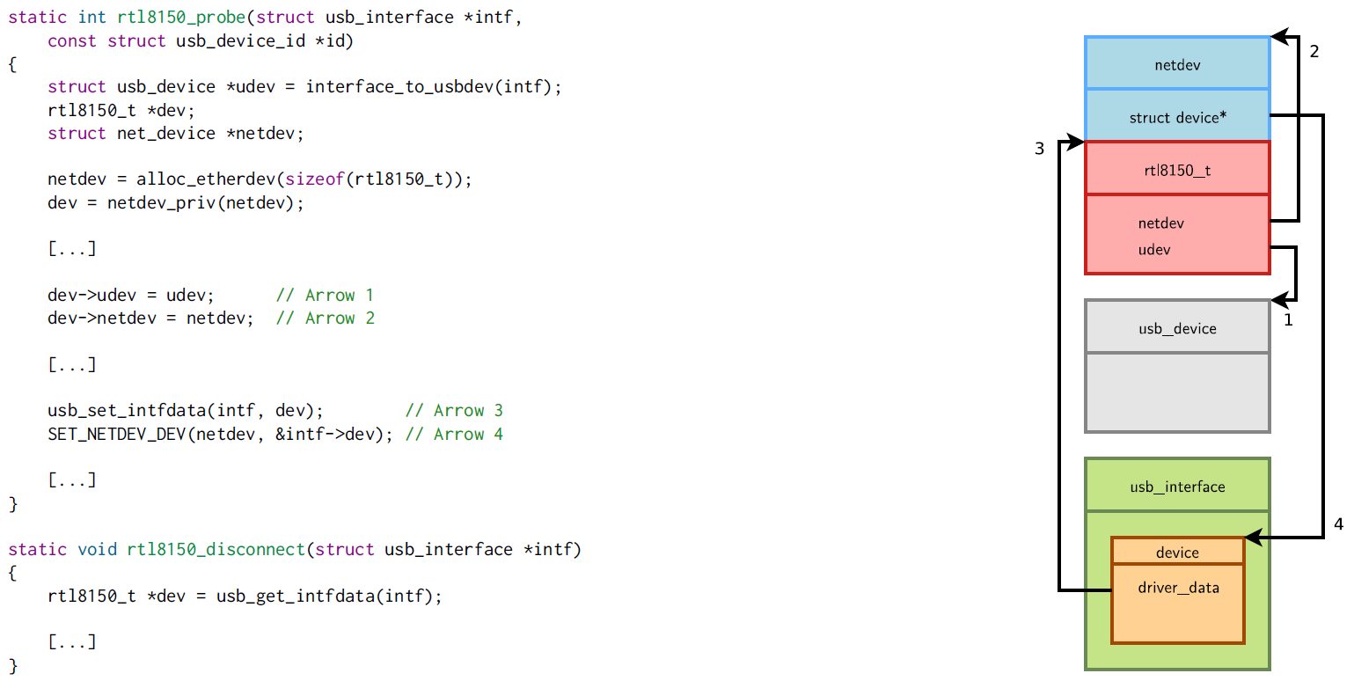
Links between Structures
11

Slide 12
What is the Input Subsystem?
The input subsystem takes care of all the input events coming from the human user.
Initially written to support the USB HID (Human Interface Device) devices, it quickly grew up to handle all kind of inputs (using USB or not): keyboards, mice, joysticks, touchscreens, etc.
The input subsystem is split in two parts:
Device drivers: they talk to the hardware (for example via USB), and provide events (keystrokes, mouse movements, touchscreen coordinates) to the input core
Event handlers: they get events from drivers and pass them where needed via various interfaces (most of the time through evdev)
In user space it is usually used by the graphic stack such as X.Org, Wayland or Android’s InputManager.
12

Slide 13
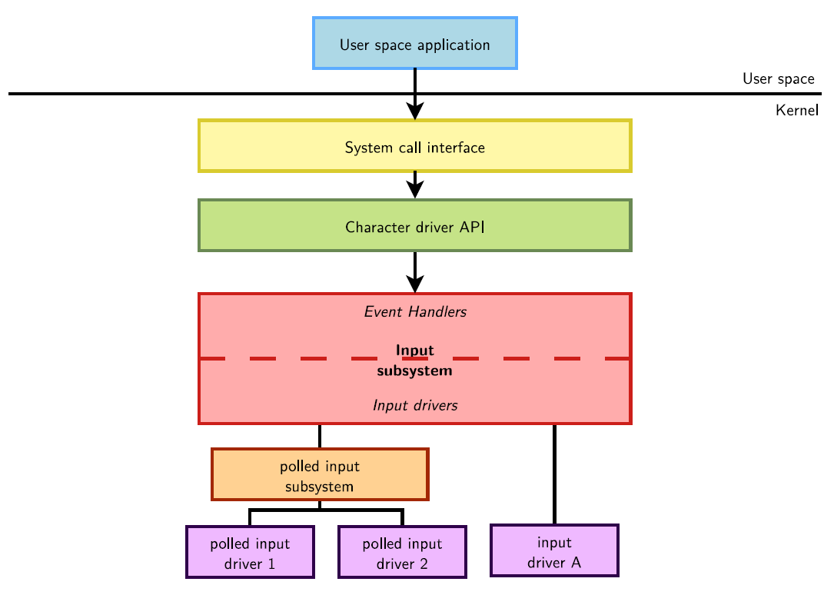
Input Subsystem Diagram
13

Slide 14
Input Subsystem API
Kernel option CONFIG_INPUT
menuconfig INPUT
tristate "Generic input layer (needed for keyboard, mouse, ...)"
Implemented in drivers/input/
input.c, input-polldev.c, evbug.c
Implements a single character driver and defines the user/kernel API
include/uapi/linux/input.h
Defines the set of operations a input driver must implement and helper functions for the drivers
struct input_dev for the device driver part
struct input_handler for the event handler part
include/linux/input.h
14

Slide 15
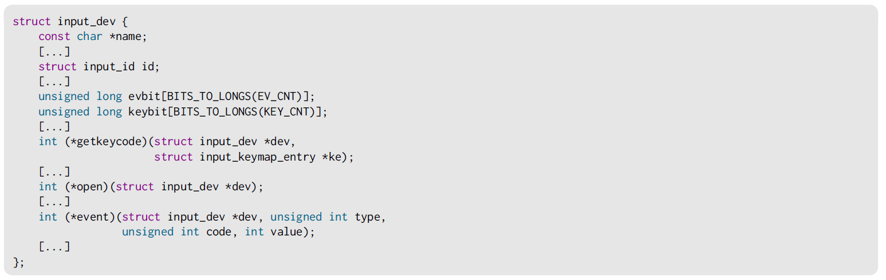
Input Subsystem API
An input device is described by a very long struct input_dev structure, an excerpt is:
Before being used it, this structure must be allocated and initialized, typically with:
struct input_dev *devm_input_allocate_device(struct device *dev);
15

Slide 16
Input Subsystem API
Depending on the type of events that will be generated, the input bit fields evbit and keybit must be configured:
For example, for a button we only generate EV_KEY type events, and from these only BTN_0 events code:
set_bit() is an atomic operation allowing to set a particular bit to 1
Once the input device is allocated and filled, the function to register it is:
int input_register_device(struct input_dev *);
16

Slide 17
Input Subsystem API
Event types are groupings of codes under a logical input construct. Each type has a set of applicable codes to be used in generating events. See the Codes section for details on valid codes for each type.
EV_SYN - Used as markers to separate events. Events may be separated in time or in space, such as with the multitouch protocol.
EV_KEY - Used to describe state changes of keyboards, buttons, or other key-like devices.
EV_REL - Used to describe relative axis value changes, e.g. moving the mouse 5 units to the left.
EV_ABS - Used to describe absolute axis value changes, e.g. describing the coordinates of a touch on a touchscreen.
EV_MSC - Used to describe miscellaneous input data that do not fit into other types.
…
17

Slide 18
Input Subsystem API
The events are sent by the driver to the event handler using input_event(struct
input_dev *dev, unsigned int type, unsigned int code, int value);
The event types are documented in Documentation/input/event-codes.txt
An event is composed by one or several input data changes (packet of input data changes) such as the button state, the relative or absolute position along an axis, etc..
After submitting potentially multiple events, the input core must be notified by calling: void input_sync(struct input_dev *dev):
The input subsystem provides other wrappers such as input_report_key(), input_report_abs(), ...
18

Slide 19
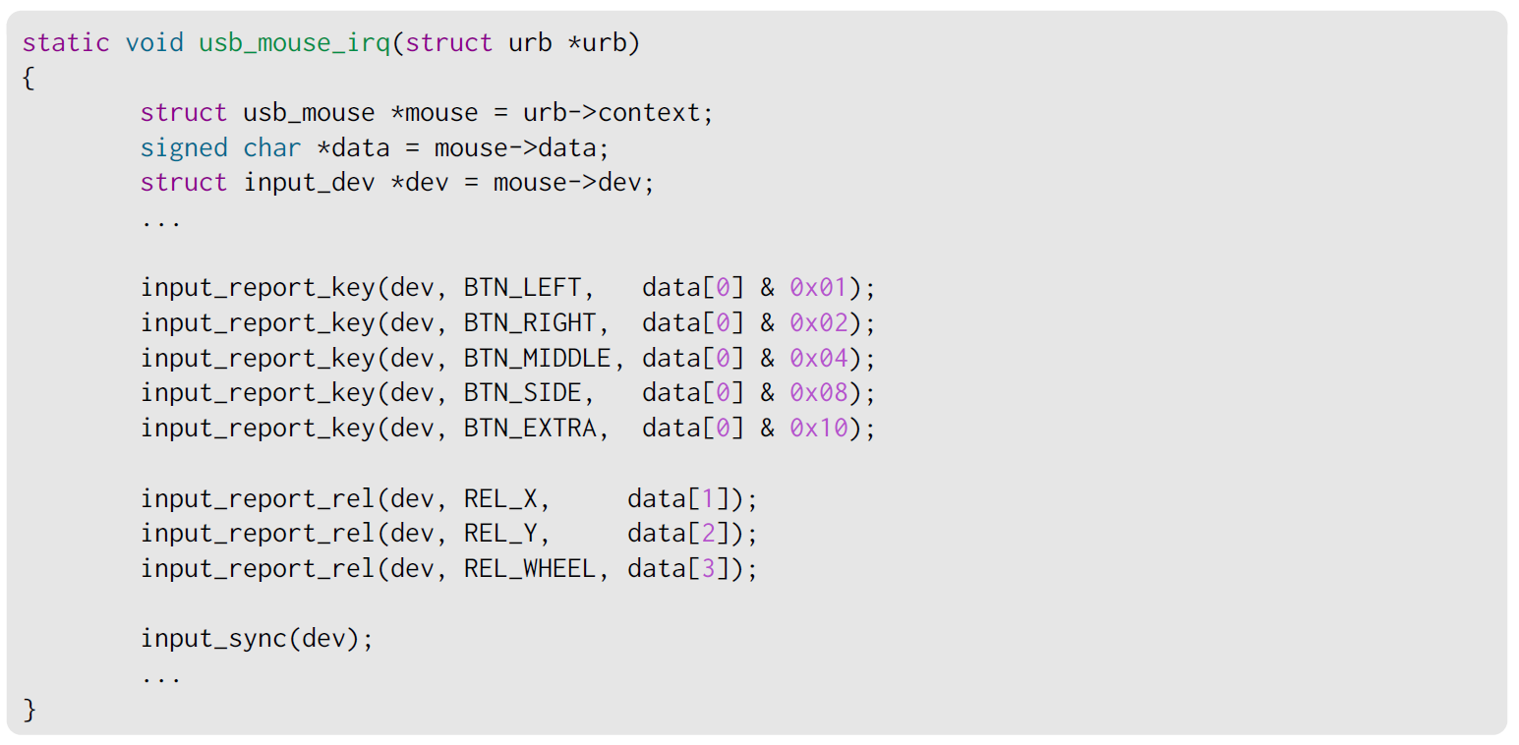
Example from drivers/hid/usbhid/usbmouse.c
19

Slide 20
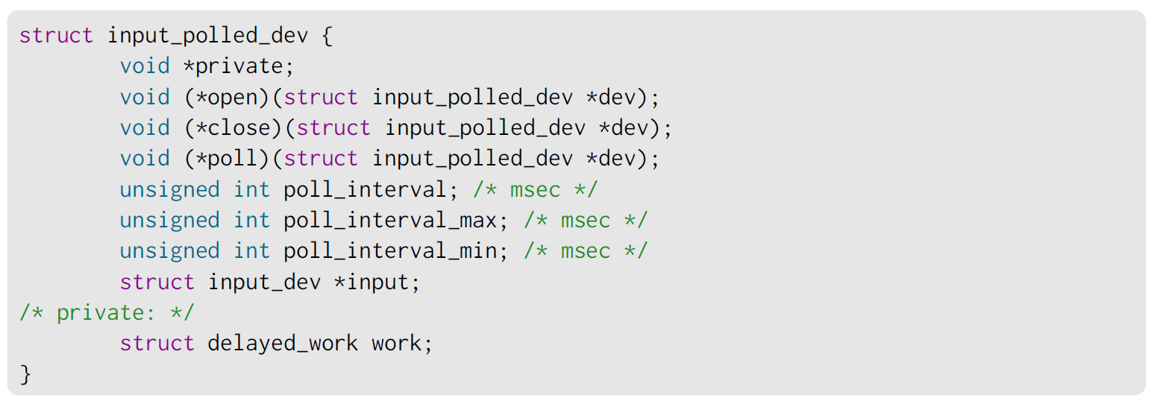
Polled Input Subclass
The input subsystem provides a subclass supporting simple input devices that do not raise interrupts but have to be periodically scanned or polled to detect changes in their state.
A polled input device is described by a struct input_polled_dev structure:
20

Slide 21
Polled Input Subsystem API
Allocating the struct input_polled_dev structure is done using devm_input_allocate_polled_device()
Among the handlers of the struct input_polled_dev only the poll() method is mandatory, this function polls the device and posts input events.
The fields id, name, evbit and keybit of the struct input structure must be initialized too.
If none of the poll_interval fields are filled then the default poll interval is 500ms.
The device registration/unregistration is done with:
input_register_polled_device(struct input_polled_dev *dev).
Unregistration is automatic after using devm_input_allocate_polled_device()
21

Slide 22
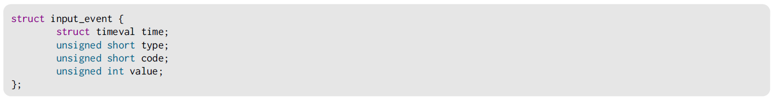
evdev User Space Interface
The main user space interface to input devices is the event interface
Each input device is represented as a /dev/input/event<X> character device
A user space application can use blocking and non-blocking reads, but also select() (to get notified of events) after opening this device.
Each read will return struct input_event structures of the following format:
A very useful application for input device testing is evtest, from https://cgit.freedesktop.org/evtest/
22

Slide 23
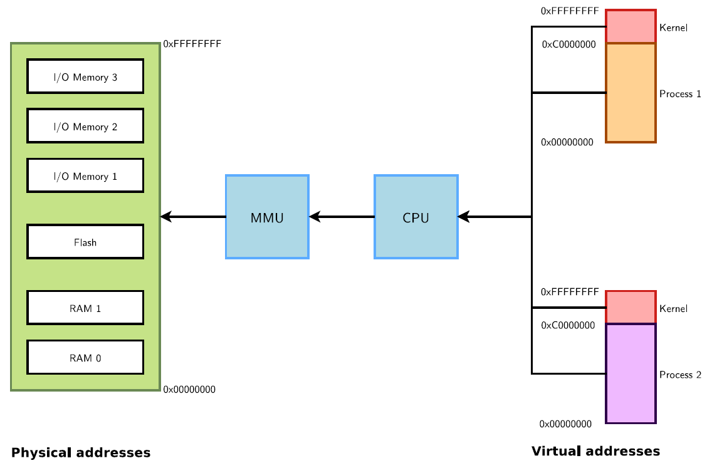
Memory Management
Physical and Virtual Memory
23

Slide 24
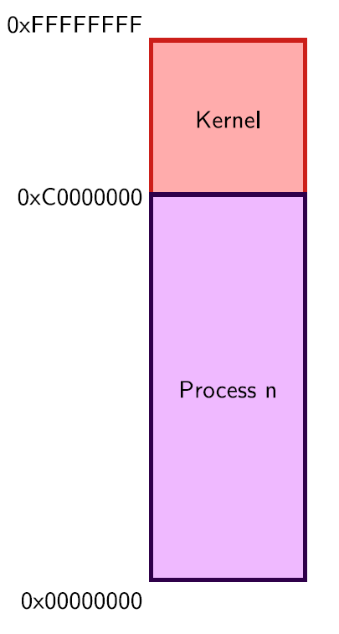
Virtual Memory Organization
1GB reserved for kernel-space
Contains kernel code and core data structures, identical in all address spaces
Most memory can be a direct mapping of physical memory at a fixed offset
Complete 3GB exclusive mapping available for each user space process
Process code and data (program, stack, ...)
Memory-mapped files
Not necessarily mapped to physical memory (demand fault paging used for dynamic mapping to physical memory pages)
Differs from one address space to another
24

Slide 25
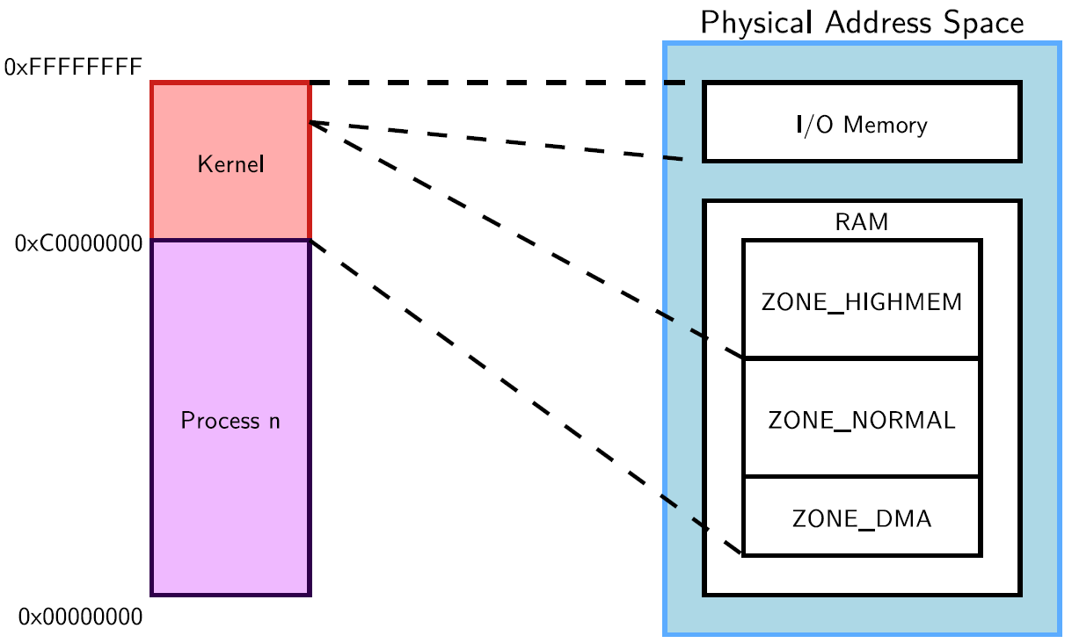
Physical / Virtual Memory Mapping
25

Slide 26
Accessing More Physical Memory
Only less than 1GB memory addressable directly through kernel virtual address space
If more physical memory is present on the platform, part of the memory will not be accessible by kernel space, but can be used by user space
To allow the kernel to access more physical memory:
Change the 3GB/1GB memory split to 2GB/2GB or 1GB/3GB (CONFIG_VMSPLIT_2G or CONFIG_VMSPLIT_1G) -> reduce total user memory available for each process
Change for a 64 bit architecture ;-) See Documentation/x86/x86_64/mm.txt for an example.
Activate highmem support if available for your architecture:
Allows kernel to map parts of its non-directly accessible memory
Mapping must be requested explicitly
Limited addresses ranges reserved for this usage
See https://lwn.net/Articles/75174/ for useful explanations
26

Slide 27
Notes on User Space Memory
New user space memory is allocated either from the already allocated process memory, or using the mmap system call
Note that memory allocated may not be physically allocated:
Kernel uses demand fault paging to allocate the physical page (the physical page is allocated when access to the virtual address generates a page fault)
... or may have been swapped out, which also induces a page fault
User space memory allocation is allowed to over-commit memory (more than available physical memory) -> can lead to out of memory
OOM killer kicks in and selects a process to kill to retrieve some memory. That’s better than letting the system freeze.
27

Slide 28
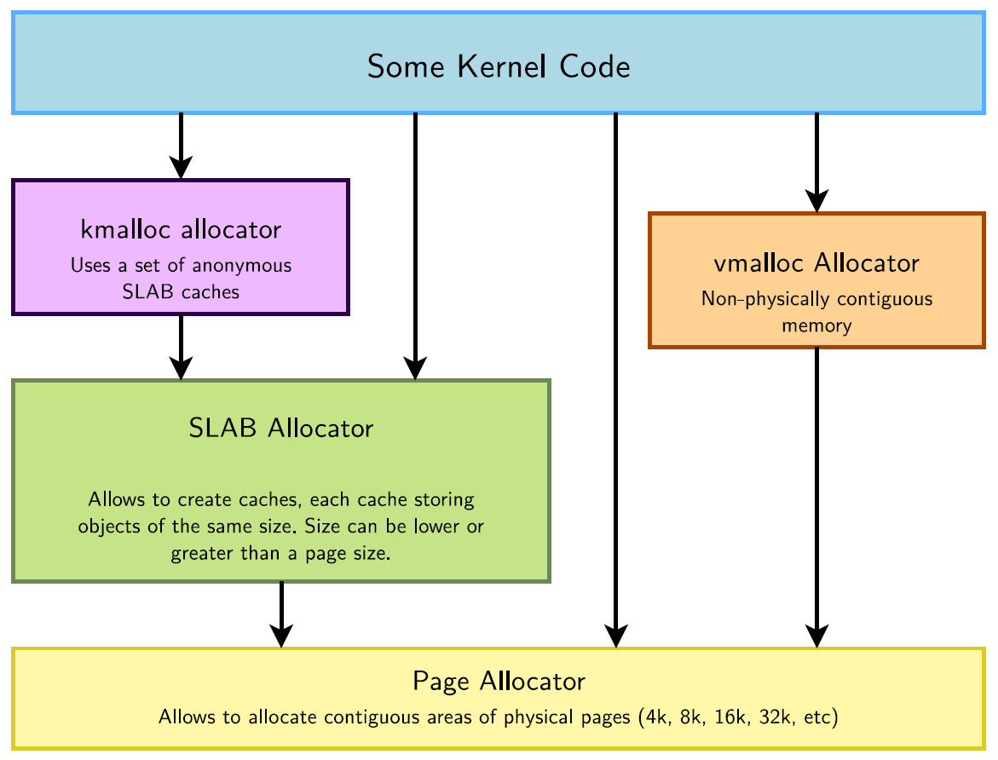
Allocators in the Kernel
28

Slide 29
Page Allocator
Appropriate for medium-size allocations
A page is usually 4K, but can be made greater in some architectures (sh, mips: 4, 8, 16 or 64 KB, but not configurable in x86 or arm).
Buddy allocator strategy, so only allocations of power of two number of pages are possible: 1 page, 2 pages, 4 pages, 8 pages, 16 pages, etc.
Typical maximum size is 8192 KB, but it might depend on the kernel configuration.
The allocated area is virtually contiguous (of course), but also physically contiguous. It is allocated in the identity-mapped part of the kernel memory space.
This means that large areas may not be available or hard to retrieve due to physical memory fragmentation.
29

Slide 30
Page Allocator API: Get free pages
unsigned long get_zeroed_page(int flags)
Returns the virtual address of a free page, initialized to zero
flags: see the next pages for details.
unsigned long __get_free_page(int flags)
Same, but doesn’t initialize the contents
unsigned long __get_free_pages(int flags, unsigned int order)
Returns the starting virtual address of an area of several contiguous pages in physical RAM, with order being log2(number_of_pages).Can be computed from the size with the get_order() function.
30

Slide 31
Page Allocator API: Free Pages
void free_page(unsigned long addr)
Frees one page.
void free_pages(unsigned long addr, unsigned int order)
Frees multiple pages. Need to use the same order as in allocation.
31

Slide 32
Page Allocator Flags
The most common ones are:
GFP_KERNEL
Standard kernel memory allocation. The allocation may block in order to find enough available memory. Fine for most needs, except in interrupt handler context.
GFP_ATOMIC
RAM allocated from code which is not allowed to block (interrupt handlers or critical sections). Never blocks, allows to access emergency pools, but can fail if no free memory is readily available.
GFP_DMA
Allocates memory in an area of the physical memory usable for DMA transfers. See our DMA chapter.
Others are defined in include/linux/gfp.h
32

Slide 33
SLAB Allocator
The SLAB allocator allows to create caches, which contain a set of objects of the same size
The object size can be smaller or greater than the page size
The SLAB allocator takes care of growing or reducing the size of the cache as needed, depending on the number of allocated objects. It uses the page allocator to allocate and free pages.
SLAB caches are used for data structures that are present in many many instances in the kernel: directory entries, file objects, network packet descriptors, process descriptors, etc.
See /proc/slabinfo
They are rarely used for individual drivers.
See include/linux/slab.h for the API
33

Slide 34
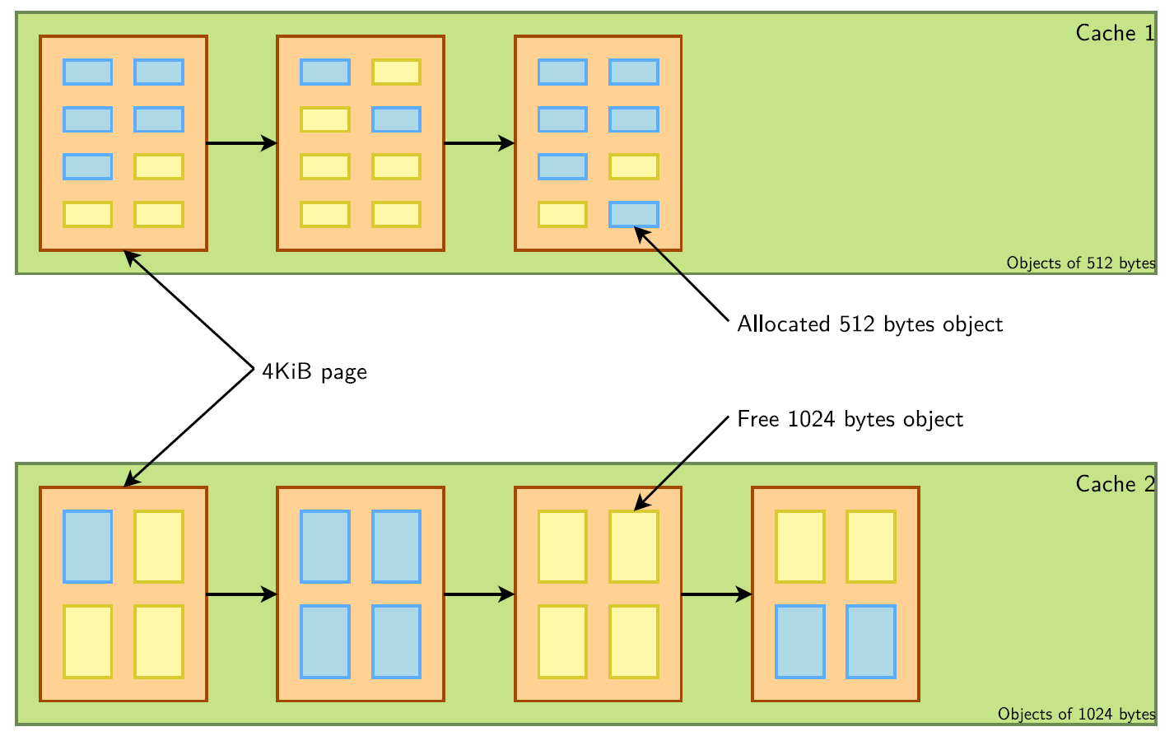
SLAB Allocator
34

Slide 35
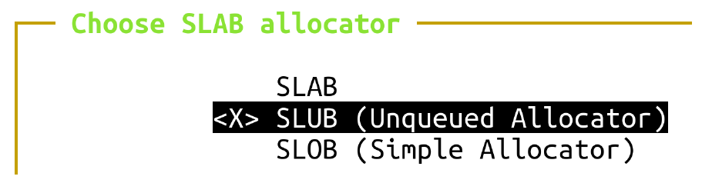
Different SLAB Allocators
There are three different, but API compatible, implementations of a SLAB allocator in the Linux kernel. A particular implementation is chosen at configuration time.
SLAB: legacy, well proven allocator.
Linux 4.20 on ARM: used in 48 defconfig files
SLOB: much simpler. More space efficient but doesn’t scale well. Can save space in small systems (depends on CONFIG_EXPERT).
Linux 4.20 on ARM: used in 7 defconfig files
SLUB: more recent and simpler than SLAB, scaling much better (in particular for huge systems) and creating less fragmentation.
Linux 4.20 on ARM: used in 0 defconfig files
35

Slide 36
kmalloc Allocator
The kmalloc allocator is the general purpose memory allocator in the Linux kernel
For small sizes, it relies on generic SLAB caches, named kmalloc-XXX in /proc/slabinfo
For larger sizes, it relies on the page allocator
The allocated area is guaranteed to be physically contiguous
The allocated area size is rounded up to the size of the smallest SLAB cache in which it can fit (while using the SLAB allocator directly allows to have more flexibility)
It uses the same flags as the page allocator (GFP_KERNEL, GFP_ATOMIC, GFP_DMA,
etc.) with the same semantics.
Maximum sizes, on x86 and arm (see https://j.mp/YIGq6W):
- Per allocation: 4 MB
- Total allocations: 128 MB
Should be used as the primary allocator unless there is a strong reason to use another
36

Slide 37
kmalloc API
#include <linux/slab.h>
void *kmalloc(size_t size, int flags);
Allocate size bytes, and return a pointer to the area (virtual address)
size: number of bytes to allocate
flags: same flags as the page allocator
void kfree(const void *objp);
Free an allocated area
Example: (drivers/infiniband/core/cache.c)
struct ib_update_work *work;
work = kmalloc(sizeof *work, GFP_ATOMIC);
...
kfree(work);
37

Slide 38
kmalloc API
void *kzalloc(size_t size, gfp_t flags);
Allocates a zero-initialized buffer
void *kcalloc(size_t n, size_t size, gfp_t flags);
Allocates memory for an array of n elements of size size, and zeroes its contents.
void *krealloc(const void *p, size_t new_size, gfp_t flags);
Changes the size of the buffer pointed by p to new_size, by reallocating a new buffer and copying the data, unless new_size fits within the alignment of the existing buffer.
38

Slide 39
devm_ kmalloc Functions
Allocations with automatic freeing when the corresponding device or module is unprobed.
void *devm_kmalloc(struct device *dev, size_t size, int flags);
void *devm_kzalloc(struct device *dev, size_t size, int flags);
void *devm_kcalloc(struct device *dev, size_t n, size_t size, gfp_t flags);
void *devm_kfree(struct device *dev, void *p);
Useful to immediately free an allocated buffer
For use in probe() functions.
39

Slide 40
vmalloc Allocator
The vmalloc() allocator can be used to obtain virtually contiguous memory zones, but not physically contiguous. The requested memory size is rounded up to the next page.
The allocated area is in the kernel space part of the address space, but outside of the identically-mapped area
Allocations of fairly large areas is possible (almost as big as total available memory), since physical memory fragmentation is not an issue, but areas cannot be used for DMA, as DMA usually requires physically contiguous buffers.
Example use: to allocate kernel buffers to load module code.
API in include/linux/vmalloc.h
void *vmalloc(unsigned long size);
Returns a virtual address
void vfree(void *addr);
40

Slide 41
Kernel Memory Debugging
KASAN (Kernel Address Sanitizer)
Dynamic memory error detector, to find use-after-free and out-of-bounds bugs.
Only available on x86_64, arm64, s390 and xtensa so far (Linux 4.20 status), but will help to improve architecture independent code anyway.
See dev-tools/kasan for details.
Kmemleak
Dynamic checker for memory leaks
This feature is available for all architectures.
See dev-tools/kmemleak for details.
Both have a significant overhead. Only use them in development!
-
41

Slide 42
I/O Memory and Port I/O
MMIO
Same address bus to address memory and I/O devices
Access to the I/O devices using regular instructions
Most widely used I/O method across the different architectures supported by Linux
PIO
Different address spaces for memory and I/O devices
Uses a special class of CPU instructions to access I/O devices
Example on x86: IN and OUT instructions
42

Slide 43
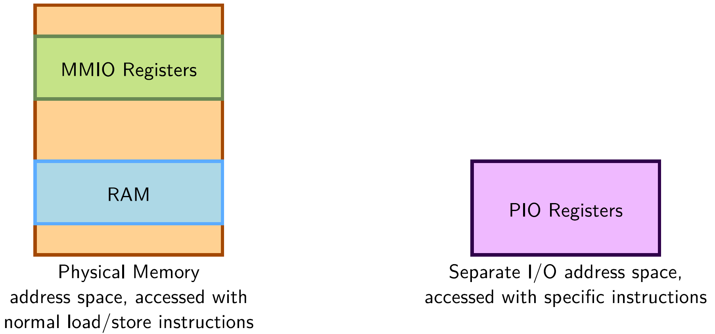
MMIO vs PIO
43

Slide 44
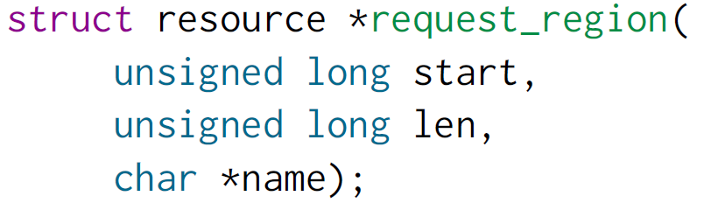
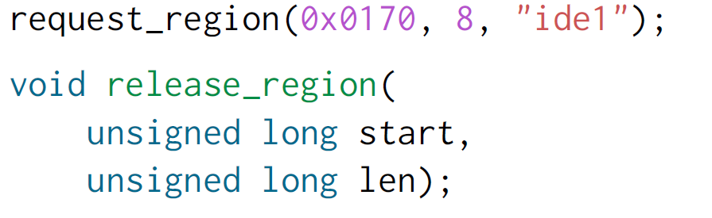
Requesting I/O ports
Tells the kernel which driver is using which I/O ports
Allows to prevent other drivers from using the same I/O ports, but is purely voluntary.
Tries to reserve the given region and returns NULL if unsuccessful.
44

Slide 45
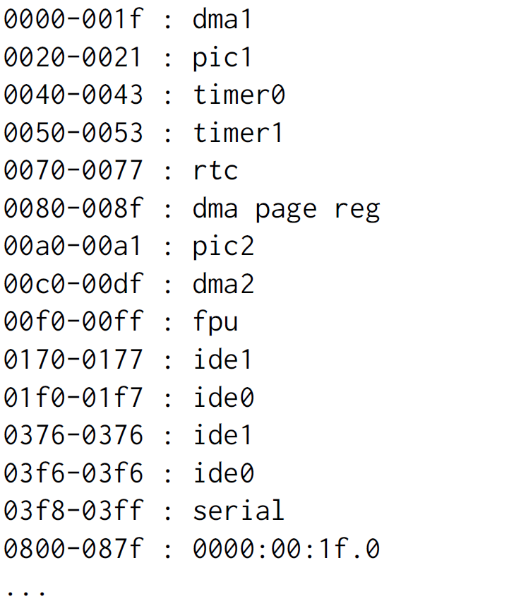
/proc/ioports example (x86)
45

Slide 46
Accessing I/O ports
Functions to read/write bytes (b), word (w) and longs (l) to I/O ports:
unsigned in[bwl](unsigned long port)
void out[bwl](value, unsigned long port)
And the strings variants: often more efficient than the corresponding C loop, if the processor supports such operations!
void ins[bwl](unsigned port, void *addr, unsigned long count)
void outs[bwl](unsigned port, void *addr, unsigned long count)
Examples
read 8 bits
oldlcr = inb(baseio + UART_LCR)
write 8 bits
outb(MOXA_MUST_ENTER_ENCHANCE, baseio + UART_LCR)
46

Slide 47
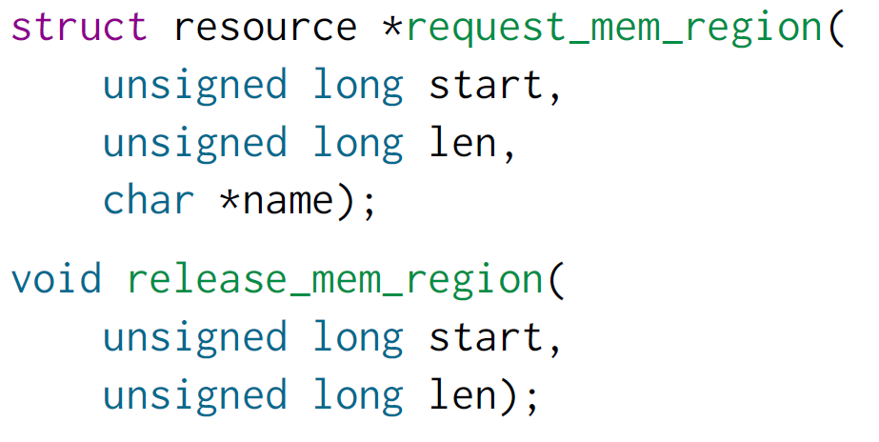
Requesting I/O memory
Functions equivalent to request_region() and release_region(), but for I/O memory.
47

Slide 48
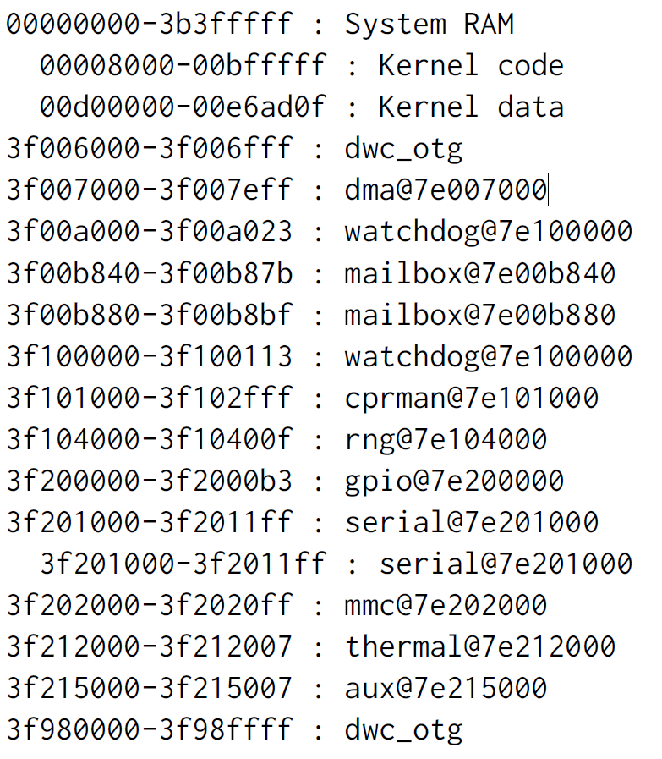
/proc/iomem example - ARM (Raspberry Pi, Linux 4.19)
48

Slide 49
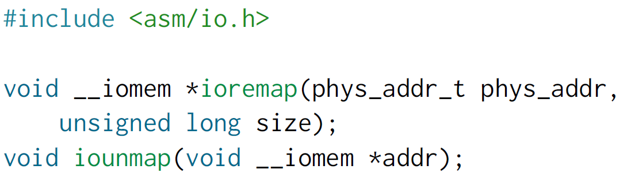
Mapping I/O Memory in Virtual Memory
Load/store instructions work with virtual addresses
To access I/O memory, drivers need to have a virtual address that the processor can handle, because I/O memory is not mapped by default in virtual memory
The ioremap function satisfies this need:
Caution: check that ioremap() doesn’t return a NULL address!
49

Slide 50
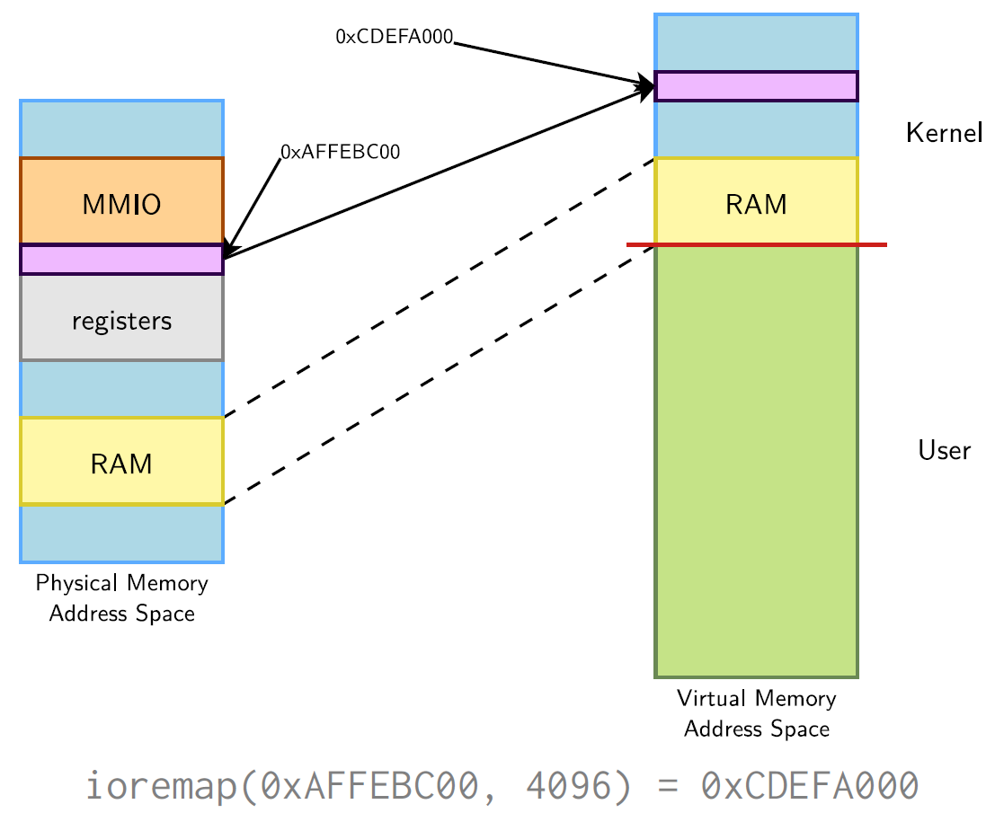
ioremap()
50

Slide 51
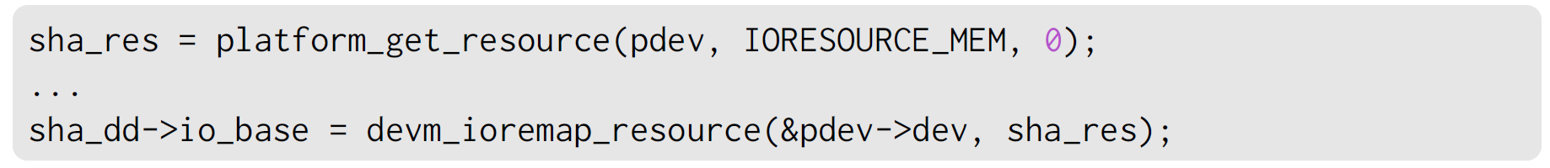
Managed API
Using request_mem_region() and ioremap() in device drivers is now deprecated. You should use the below ”managed” functions instead, which simplify driver coding and error handling:
devm_ioremap()
devm_iounmap()
devm_ioremap_resource()
Takes care of both the request and remapping operations
Example (drivers/crypto/atmel-sha.c):
devm_platform_ioremap_resource()
51

Slide 52
Accessing MMIO devices
Directly reading from or writing to addresses returned by ioremap() (pointer dereferencing) may not work on some architectures.
To do PCI-style, little-endian accesses, conversion being done automatically
unsigned read[bwl](void *addr);
void write[bwl](unsigned val, void *addr);
To do raw access, without endianness conversion
unsigned __raw_read[bwl](void *addr);
void __raw_write[bwl](unsigned val, void *addr);
Example
32 bits write
__raw_writel(1 << KS8695_IRQ_UART_TX, membase + KS8695_INTST);
52

Slide 53
Avoiding I/O Access Issues
Caching on I/O ports or memory already disabled
Use the writel()/readl() macros, they do the right thing for your architecture
The compiler and/or CPU can reorder memory accesses, which might cause troubles for your devices is they expect one register to be read/written before another one.
Memory barriers are available to prevent this reordering
rmb() is a read memory barrier, prevents reads to cross the barrier
wmb() is a write memory barrier
mb() is a read-write memory barrier
Starts to be a problem with CPUs that reorder instructions and SMP.
See Documentation/memory-barriers.txt for details
53

Slide 54
/dev/mem
Used to provide user space applications with direct access to physical addresses.
Usage: open /dev/mem and read or write at given offset. What you read or write is the value at the corresponding physical address.
Used by applications such as the X server to write directly to device memory.
On x86, arm, arm64, powerpc, s390 and unicore32: CONFIG_STRICT_DEVMEM option to restrict /dev/mem to non-RAM addresses, for security reasons (Linux 4.20 status).
54

Slide 55
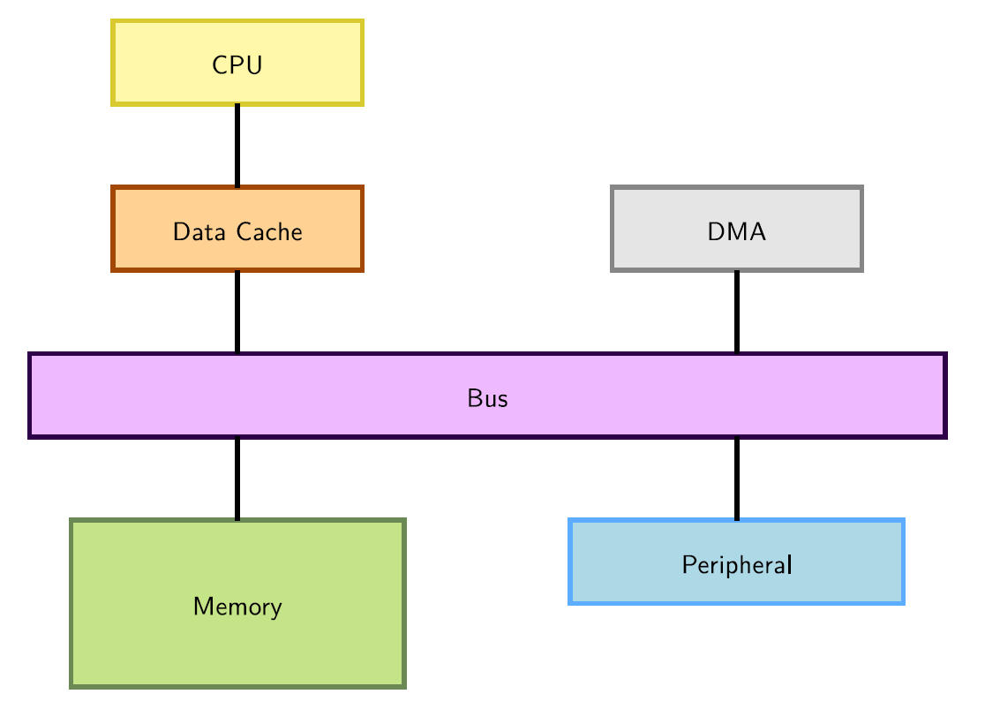
DMA Integration
DMA (Direct Memory Access) is used to copy data directly between devices and RAM, without going through the CPU.
55

Slide 56
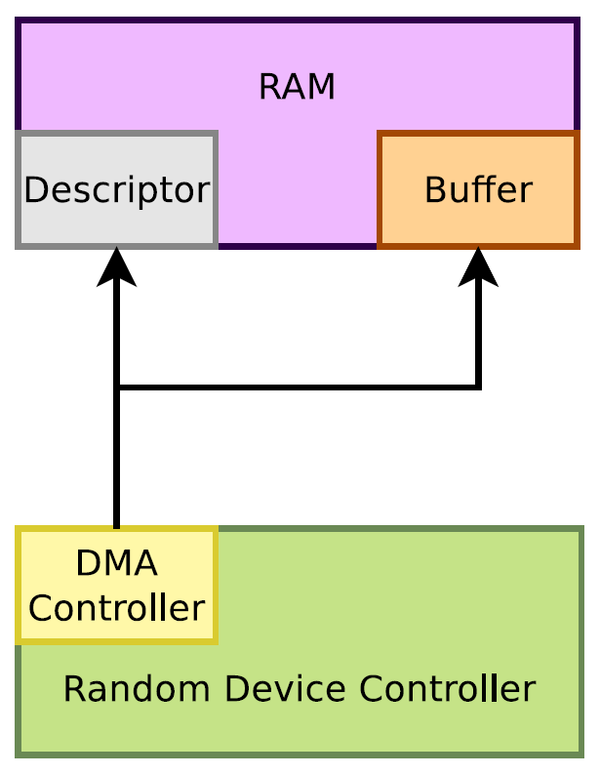
Peripheral DMA
Some device controllers embedded their own DMA controller and therefore can do DMA on their own.
56

Slide 57
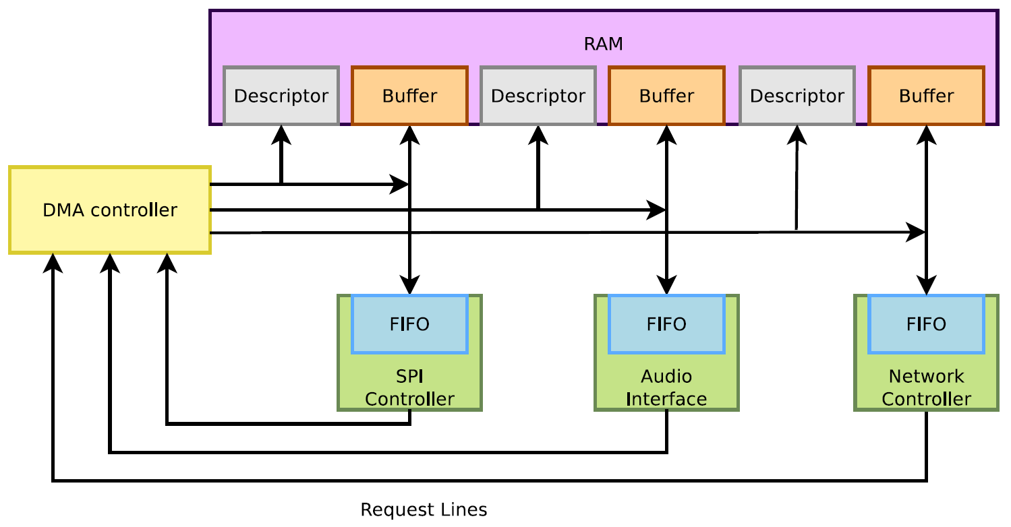
DMA Controllers
Other device controllers rely on an external DMA controller (on the SoC). Their drivers need to submit DMA descriptors to this controller.
57

Slide 58
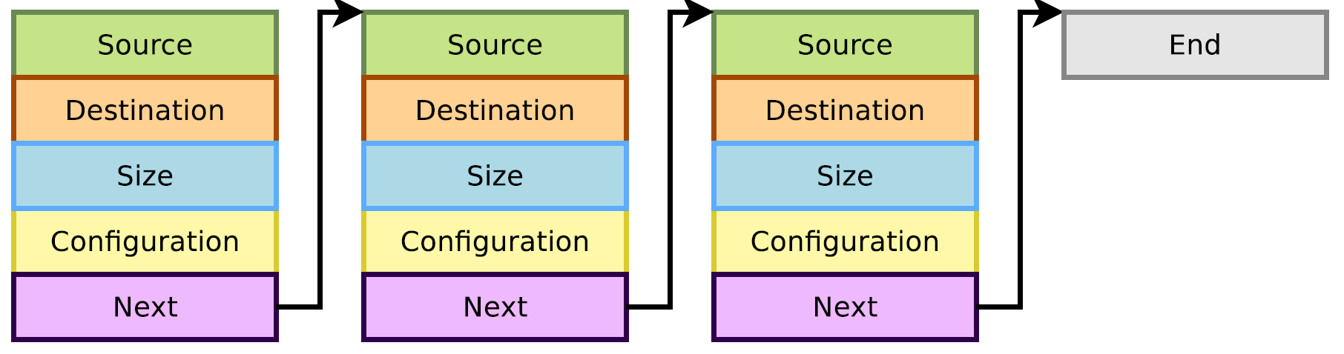
DMA Descriptors
DMA descriptors describe the various attributes of a DMA transfer, and are chained.
58

Slide 59
Constraints with a DMA
A DMA deals with physical addresses, so:
Programming a DMA requires retrieving a physical address at some point (virtual addresses are usually used)
The memory accessed by the DMA shall be physically contiguous
The CPU can access memory through a data cache
Using the cache can be more efficient (faster accesses to the cache than the bus)
But the DMA does not access the CPU cache, so one needs to take care of cache coherency (cache content vs. memory content)
Either clean (write to memory) or invalidate the cache lines corresponding to the buffer accessed by DMA and processor at the right times
59

Slide 60
DMA Memory Constraints
Need to use contiguous memory in physical space.
Can use any memory allocated by kmalloc() (up to 128 KB) or __get_free_pages() (up to 8MB).
Can use block I/O and networking buffers, designed to support DMA.
Can not use vmalloc() memory (would have to setup DMA on each individual physical page).
60

Slide 61
Memory synchronization issues
Memory caching could interfere with DMA
Before DMA to device
Need to make sure that all writes to the DMA buffer are done (corresponding cache lines cleaned)
After DMA from device
Before drivers read from a DMA buffer, need to make sure that the corresponding cache lines are invalidated.
Bidirectional DMA
Need to do both of the above operations
61

Slide 62
Linux DMA API
The kernel DMA utilities can take care of:
Either allocating a buffer in a cache coherent area,
Or making sure caches are handled when required,
Managing the DMA mappings and IOMMU (if any).
See Documentation/DMA-API.txt for details about the Linux DMA generic API.
Most subsystems (such as PCI or USB) supply their own DMA API, derived from the generic one. May be sufficient for most needs.
62

Slide 63
Coherent or Streaming DMA Mappings
Coherent mappings
The kernel allocates a suitable buffer and sets the mapping for the driver.
Can simultaneously be accessed by the CPU and device.
So, has to be in a cache coherent memory area.
Usually allocated for the whole time the module is loaded.
Can be expensive to setup and use on some platforms.
Streaming mappings
The kernel just sets the mapping for a buffer provided by the driver.
Use a buffer already allocated by the driver.
Mapping set up for each transfer. Keeps DMA registers free on the hardware.
The recommended solution.
63

Slide 64
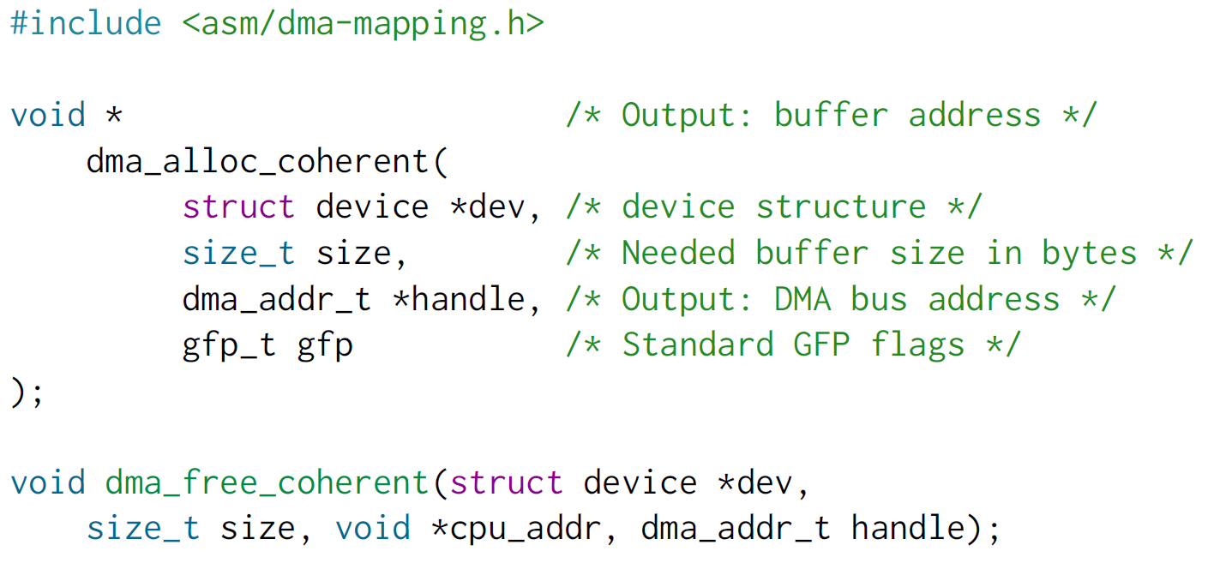
Allocating Coherent Mappings
The kernel takes care of both buffer allocation and mapping
64

Slide 65
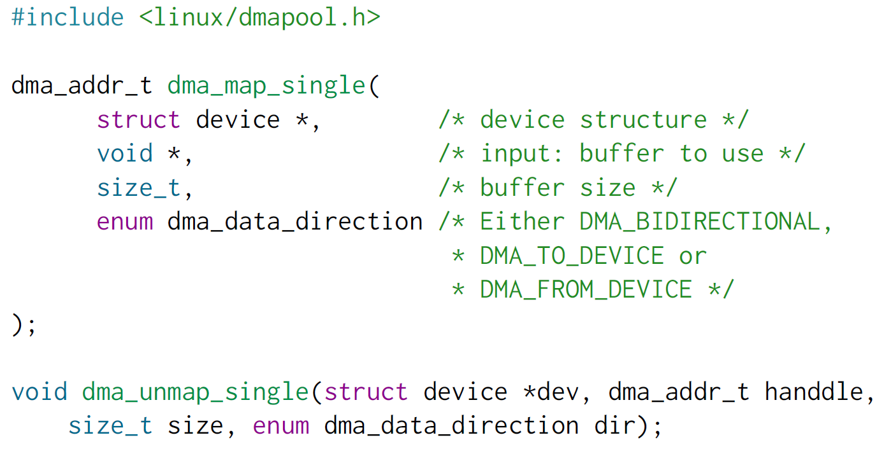
Setting up Streaming Mappings
Works on buffers already allocated by the driver
65

Slide 66
DMA Streaming Mapping Notes
When the mapping is active: only the device should access the buffer (potential
cache issues otherwise).
The CPU can access the buffer only after unmapping!
Another reason: if required, this API can create an intermediate bounce buffer (used if the given buffer is not usable for DMA).
The Linux API also supports scatter / gather DMA streaming mappings.
66

Slide 67
Why a misc subsystem?
The kernel offers a large number of frameworks covering a wide range of device
types: input, network, video, audio, etc.
These frameworks allow to factorize common functionality between drivers and offer a consistent API to user space applications.
However, there are some devices that really do not fit in any of the existing frameworks.
Highly customized devices implemented in a FPGA, or other weird devices for which implementing a complete framework is not useful.
The drivers for such devices could be implemented directly as raw character drivers (with cdev_init() and cdev_add()).
But there is a subsystem that makes this work a little bit easier: the misc subsystem.
It is really only a thin layer above the character driver API.
Another advantage is that devices are integrated in the Device Model (device files appearing in devtmpfs, which you don’t have with raw character devices).
67

Slide 68
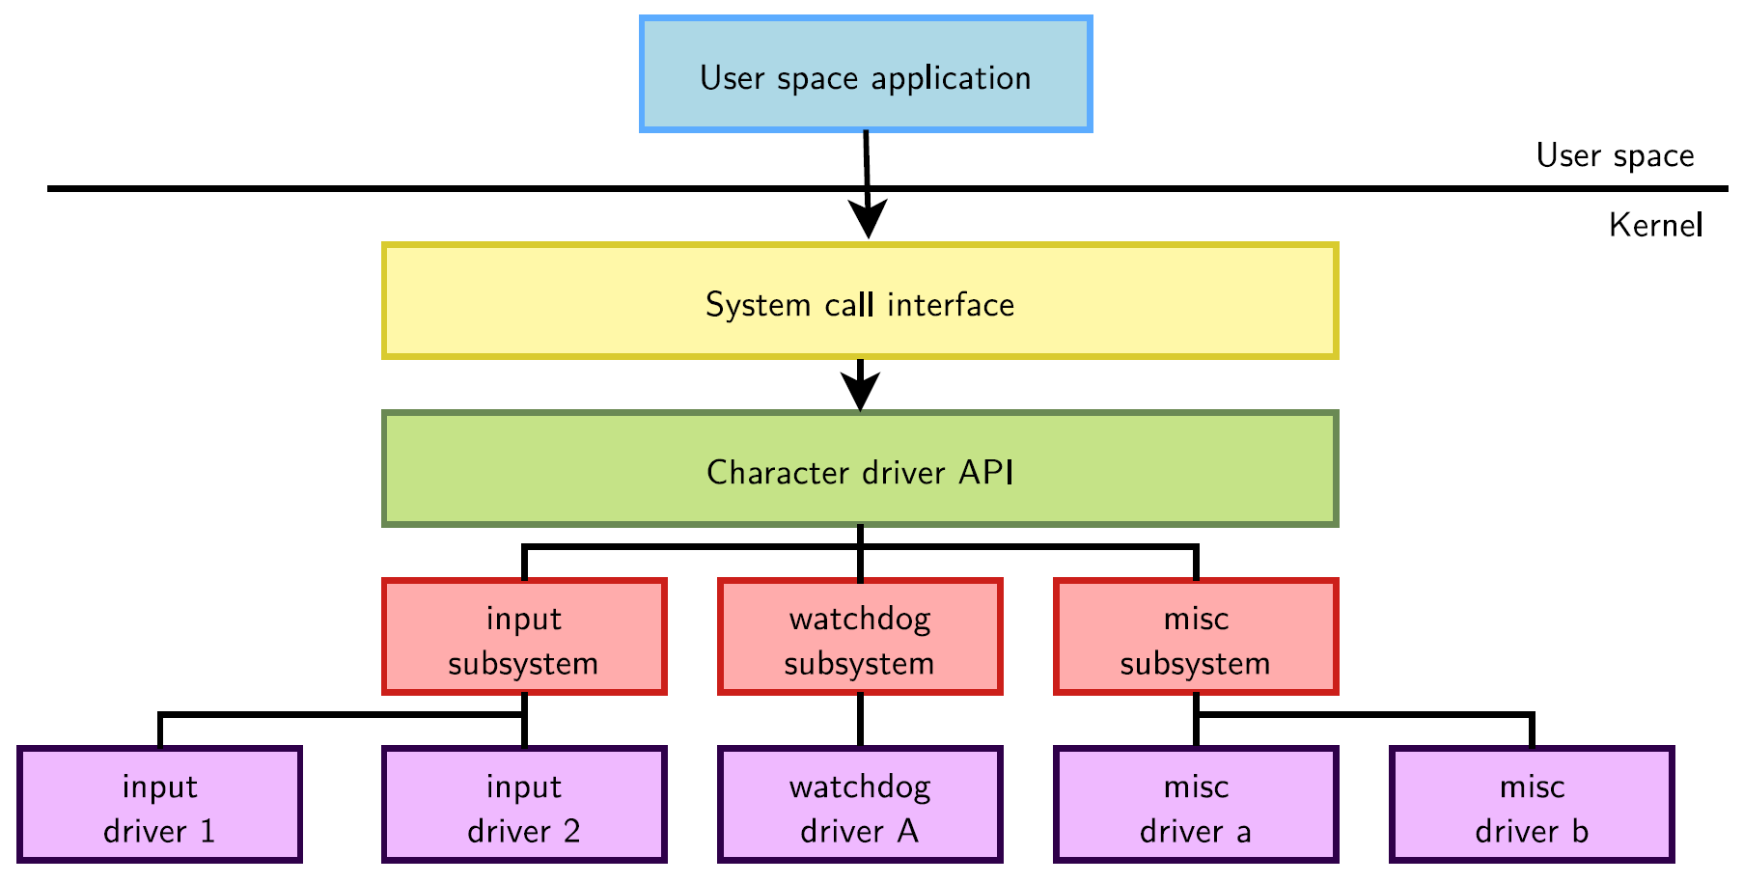
misc Subsystem Diagram
68

Slide 69
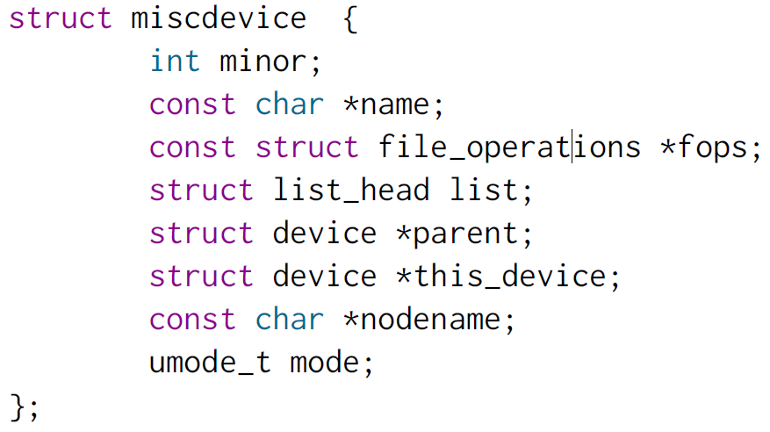
Misc Subsystem API
The misc subsystem API mainly provides two functions, to register and unregister a single misc device:
int misc_register(struct miscdevice * misc);
void misc_deregister(struct miscdevice *misc);
A misc device is described by a struct miscdevice structure:
69

Slide 70
Misc Subsystem API
The main fields to be filled in struct miscdevice are:
minor, the minor number for the device, or MISC_DYNAMIC_MINOR to get a minor number automatically assigned.
name, name of the device, which will be used to create the device node if devtmpfs is used.
fops, pointer to the same struct file_operations structure that is used for raw character drivers, describing which functions implement the read, write, ioctl, etc. operations.
parent, pointer to the struct device of the underlying “physical” device (platform device, I2C device, etc.).
70

Slide 71
User Space API for misc Devices
misc devices are regular character devices
The operations they support in user space depends on the operations the kernel driver implements:
The open() and close() system calls to open/close the device.
The read() and write() system calls to read/write to/from the device.
The ioctl() system call to call some driver-specific operations.
71

Slide 72

That’s all for today.
Notes:
Thank you for listening. Now, I would like to end today’s talk by the Q & A time.

