Slide 1

Embedded System Lecture 08: Direct Memory Access & misc & File System
Department of Computer Science and Information Engineering
Shuo-Han Chen (陳碩漢), shchen@csie.ntut.edu.tw
Hong-Yue Technology Research Building 334
R 09:10 - 12:00

Slide 2
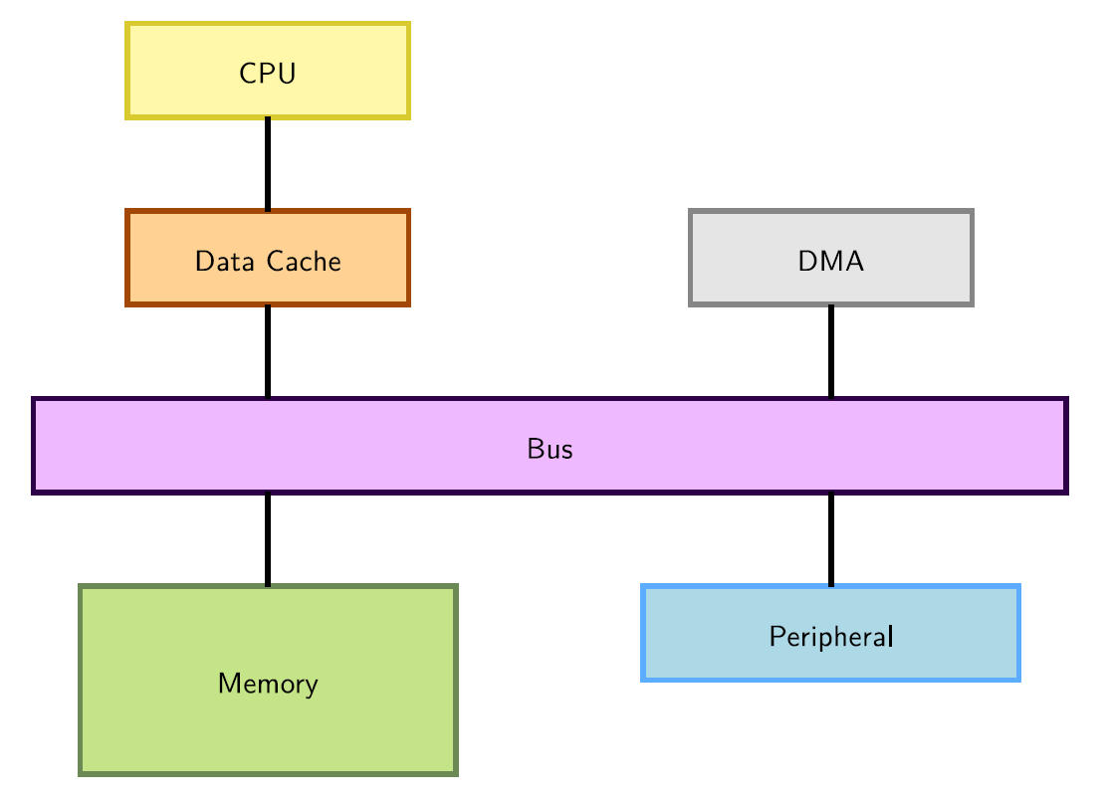
DMA Integration
DMA (Direct Memory Access) is used to copy data directly between devices and RAM, without going through the CPU.
2

Slide 3
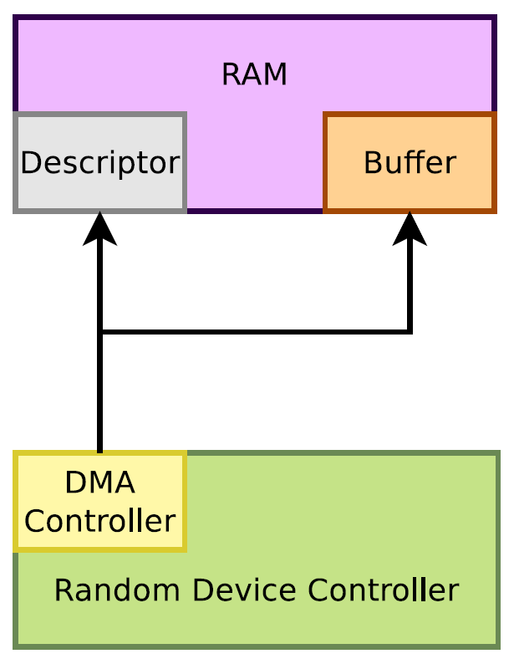
Peripheral DMA
Some device controllers embedded their own DMA controller and therefore can do DMA on their own.
3

Slide 4
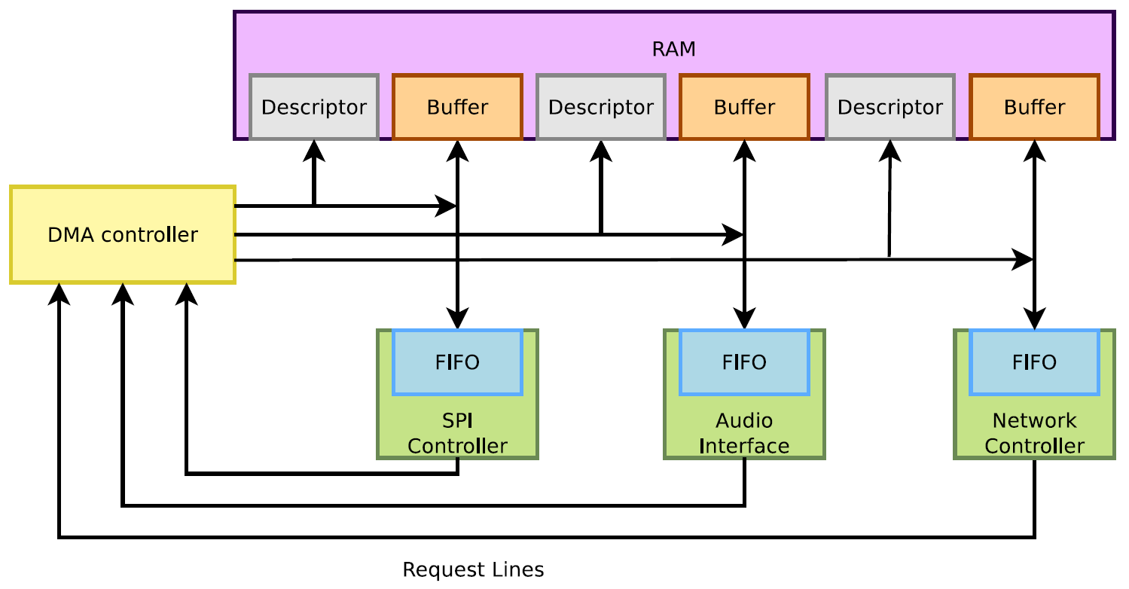
DMA Controllers
Other device controllers rely on an external DMA controller (on the SoC). Their drivers need to submit DMA descriptors to this controller.
4

Slide 5
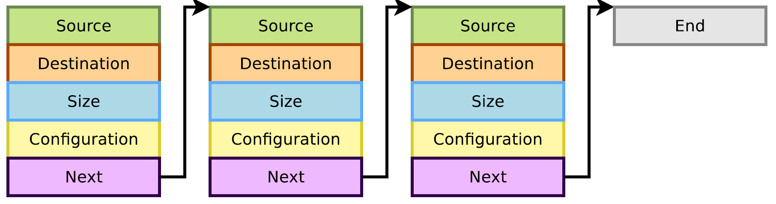
DMA Descriptors
DMA descriptors describe the various attributes of a DMA transfer, and are chained.
5

Slide 6
Constraints with a DMA
A DMA deals with physical addresses, so:
Programming a DMA requires retrieving a physical address at some point (virtual addresses are usually used)
The memory accessed by the DMA shall be physically contiguous
The CPU can access memory through a data cache
Using the cache can be more efficient (faster accesses to the cache than the bus)
But the DMA does not access the CPU cache, so one needs to take care of cache coherency (cache content vs. memory content)
Either clean (write to memory) or invalidate the cache lines corresponding to the buffer accessed by DMA and processor at the right times
6

Slide 7
DMA Memory Constraints
Need to use contiguous memory in physical space.
Can use any memory allocated by kmalloc() (up to 128 KB) or __get_free_pages() (up to 8MB).
Can use block I/O and networking buffers, designed to support DMA.
Can not use vmalloc() memory (would have to setup DMA on each individual physical page).
7

Slide 8
Memory synchronization issues
Memory caching could interfere with DMA
Before DMA to device
Need to make sure that all writes to the DMA buffer are done (corresponding cache lines cleaned)
After DMA from device
Before drivers read from a DMA buffer, need to make sure that the corresponding cache lines are invalidated.
Bidirectional DMA
Need to do both of the above operations
8

Slide 9
Linux DMA API
The kernel DMA utilities can take care of:
Either allocating a buffer in a cache coherent area,
Or making sure caches are handled when required,
Managing the DMA mappings and IOMMU (if any).
See Documentation/DMA-API.txt for details about the Linux DMA generic API.
Most subsystems (such as PCI or USB) supply their own DMA API, derived from the generic one. May be sufficient for most needs.
9

Slide 10
Coherent or Streaming DMA Mappings
Coherent mappings
The kernel allocates a suitable buffer and sets the mapping for the driver.
Can simultaneously be accessed by the CPU and device.
So, has to be in a cache coherent memory area.
Usually allocated for the whole time the module is loaded.
Can be expensive to setup and use on some platforms.
Streaming mappings
The kernel just sets the mapping for a buffer provided by the driver.
Use a buffer already allocated by the driver.
Mapping set up for each transfer. Keeps DMA registers free on the hardware.
The recommended solution.
10

Slide 11
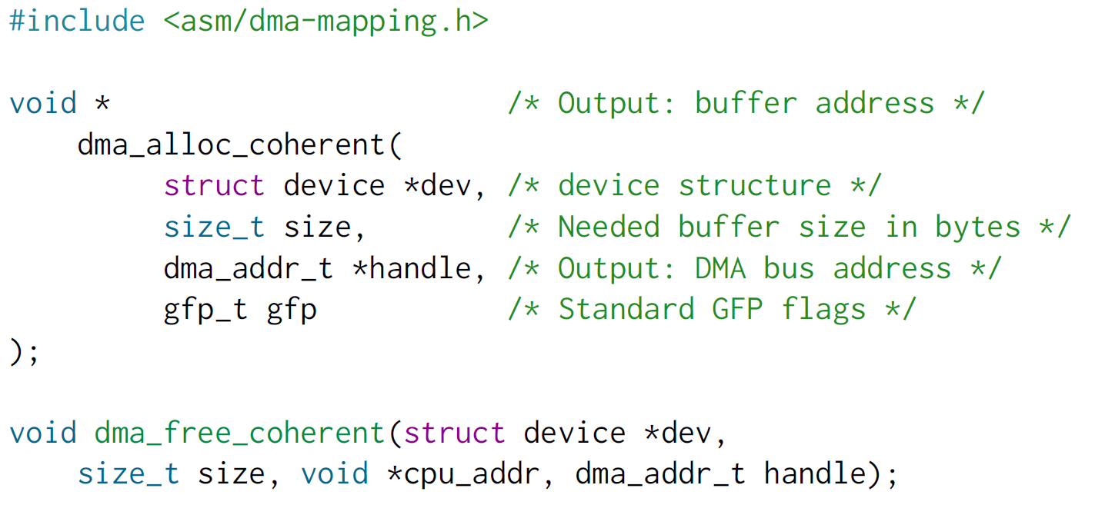
Allocating Coherent Mappings
The kernel takes care of both buffer allocation and mapping
11

Slide 12
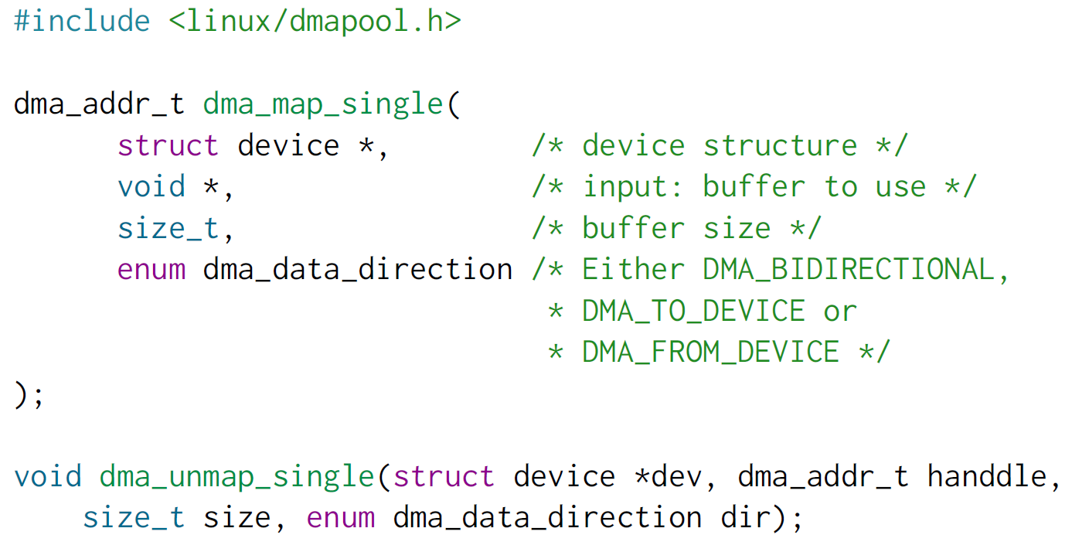
Setting up Streaming Mappings
Works on buffers already allocated by the driver
12

Slide 13
DMA Streaming Mapping Notes
When the mapping is active: only the device should access the buffer (potential
cache issues otherwise).
The CPU can access the buffer only after unmapping!
Another reason: if required, this API can create an intermediate bounce buffer (used if the given buffer is not usable for DMA).
The Linux API also supports scatter / gather DMA streaming mappings.
13

Slide 14
Why a misc subsystem?
The kernel offers a large number of frameworks covering a wide range of device
types: input, network, video, audio, etc.
These frameworks allow to factorize common functionality between drivers and offer a consistent API to user space applications.
However, there are some devices that really do not fit in any of the existing frameworks.
Highly customized devices implemented in a FPGA, or other weird devices for which implementing a complete framework is not useful.
The drivers for such devices could be implemented directly as raw character drivers (with cdev_init() and cdev_add()).
But there is a subsystem that makes this work a little bit easier: the misc subsystem.
It is really only a thin layer above the character driver API.
Another advantage is that devices are integrated in the Device Model (device files appearing in devtmpfs, which you don’t have with raw character devices).
14

Slide 15
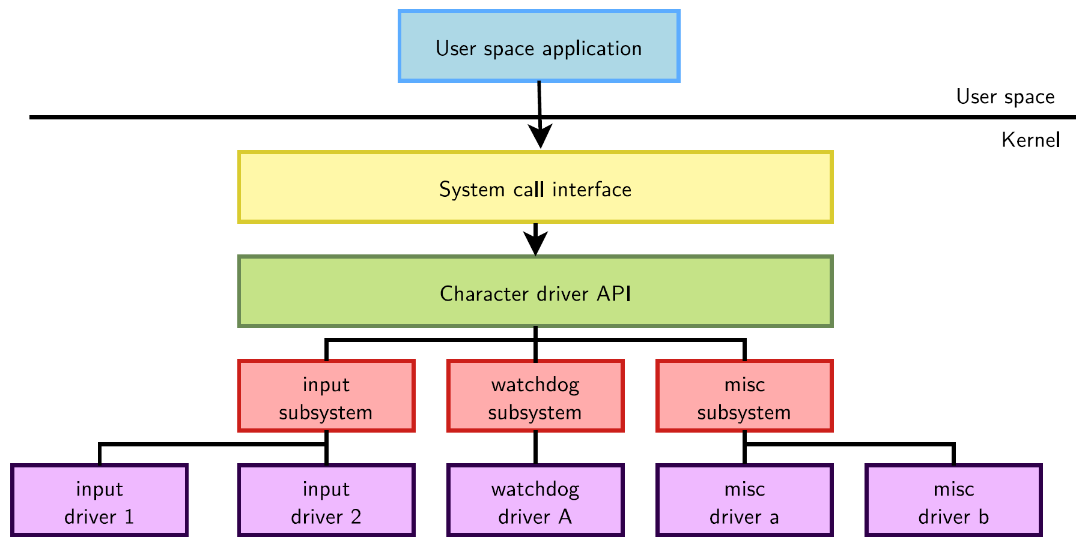
misc Subsystem Diagram
15

Slide 16
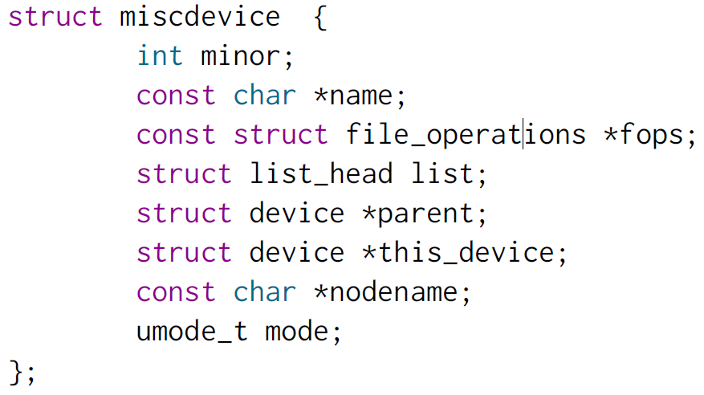
Misc Subsystem API
The misc subsystem API mainly provides two functions, to register and unregister a single misc device:
int misc_register(struct miscdevice * misc);
void misc_deregister(struct miscdevice *misc);
A misc device is described by a struct miscdevice structure:
16

Slide 17
Misc Subsystem API
The main fields to be filled in struct miscdevice are:
minor, the minor number for the device, or MISC_DYNAMIC_MINOR to get a minor number automatically assigned.
name, name of the device, which will be used to create the device node if devtmpfs is used.
fops, pointer to the same struct file_operations structure that is used for raw character drivers, describing which functions implement the read, write, ioctl, etc. operations.
parent, pointer to the struct device of the underlying “physical” device (platform device, I2C device, etc.).
17

Slide 18
User Space API for misc Devices
misc devices are regular character devices
The operations they support in user space depends on the operations the kernel driver implements:
The open() and close() system calls to open/close the device.
The read() and write() system calls to read/write to/from the device.
The ioctl() system call to call some driver-specific operations.
18

Slide 19
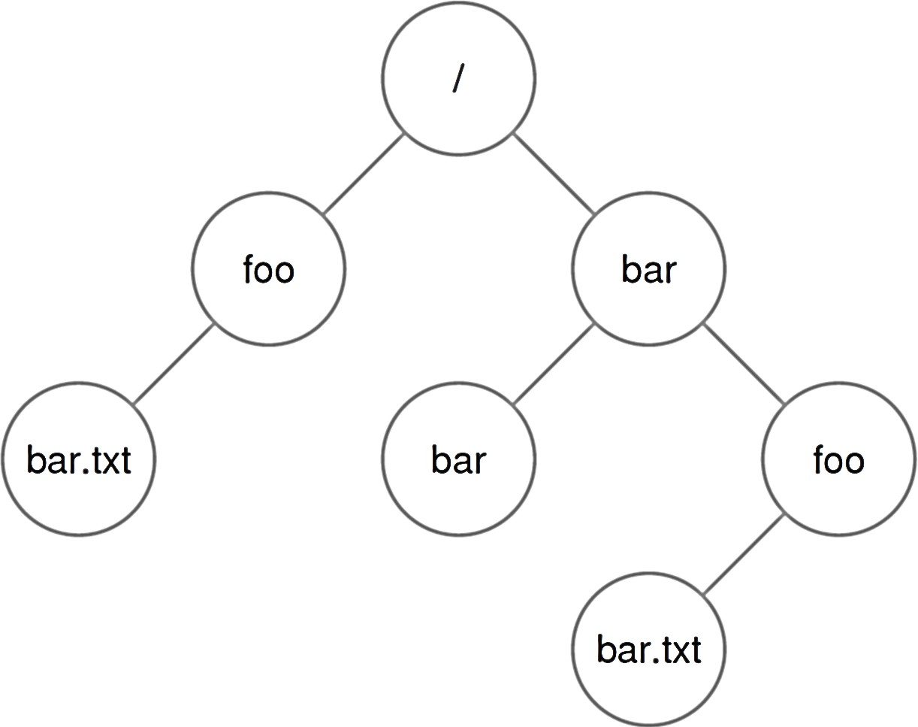
File Systems Basics
File: a linear array of bytes that can be read/written
Each file has a low-level name (or inode number) that uniquely identifies itself in the file system.
Often, the user is not aware of this name.
Directory: a list of entries
A directory has an inode number as well.
A directory is just a special type of file with specific content.
Each entry is a pair of (user-readable name, inode number).
Each entry refers to either files or other directories.
A directory tree is formed
Leaf node: file
Non-leaf node: directory
19

Slide 20
Directory Tree
/bar/foo/bar.txt
/ is the root directory.
/ is also used as a “separator” to name subsequent sub- directories and files.
A file/directory is referred by the absolute pathname.
Directories and files can have the same name.
If they are in different locations/directories (e.g., /bar/foo/bar.txt).
The file extension is to indicate the type of a file (e.g., .txt).
20

Slide 21
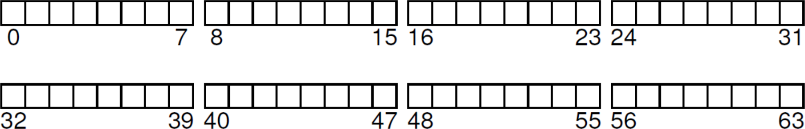
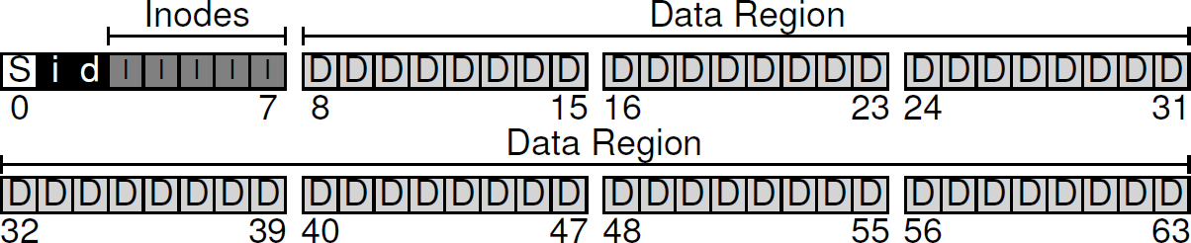
Overall Organization
On-Disk Organization
– A series of blocks (e.g., 4 KB) is addressed from 0 to N −1.
File System Organization
Metadata Region: tracks data and file system information.
Data Region: stores user data and occupies most space.
21

Slide 22
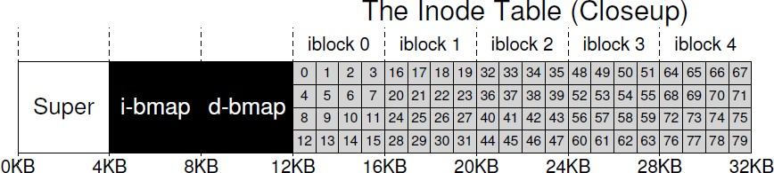
File System Metadata
Inode (I): tracks “everything” about a file / directory.
Each inode is referenced by an i-number (low-level name).
Given an i-numbers, the inode can be located.
An inode keeps which data block(s) are used for a file / dir.
Inode Table: the collection of all inodes.
i-bmap: tracks which inode is allocated.
d-bitmap: tracks which data block is allocated.
Superblock (S): tracks a file system.
22

Slide 23
File Organization: Inode (1/3)
The most important design of the inode:
How it refers to where data blocks are.
One simple approach would be to have one or more
direct pointers (each refers to one data block).
Challenge: Hard to support files of big sizes.
Multi-Level Index
Direct Pointer: points to a data block explicitly.
Indirect Pointer: points to an indirect block that holds (multiple) pointers to data blocks.
Double Indirect Pointer: points to pointers to indirect blocks.
Triple Indirect Pointer: points to pointers to pointers to indirect blocks.
23

Slide 24
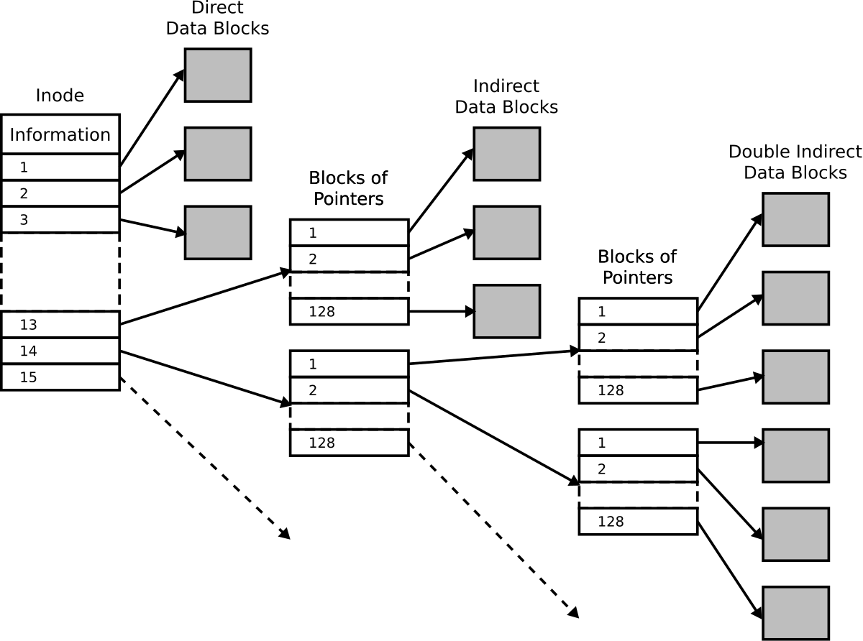
File Organization: Inode (2/3)
Each ext2 inode
15 disk pointers:
Indirect Blocks
12 direct pointers;
1 indirect pointer;
1 double indirect pointer;
1 triple indirect pointer
24

Slide 25
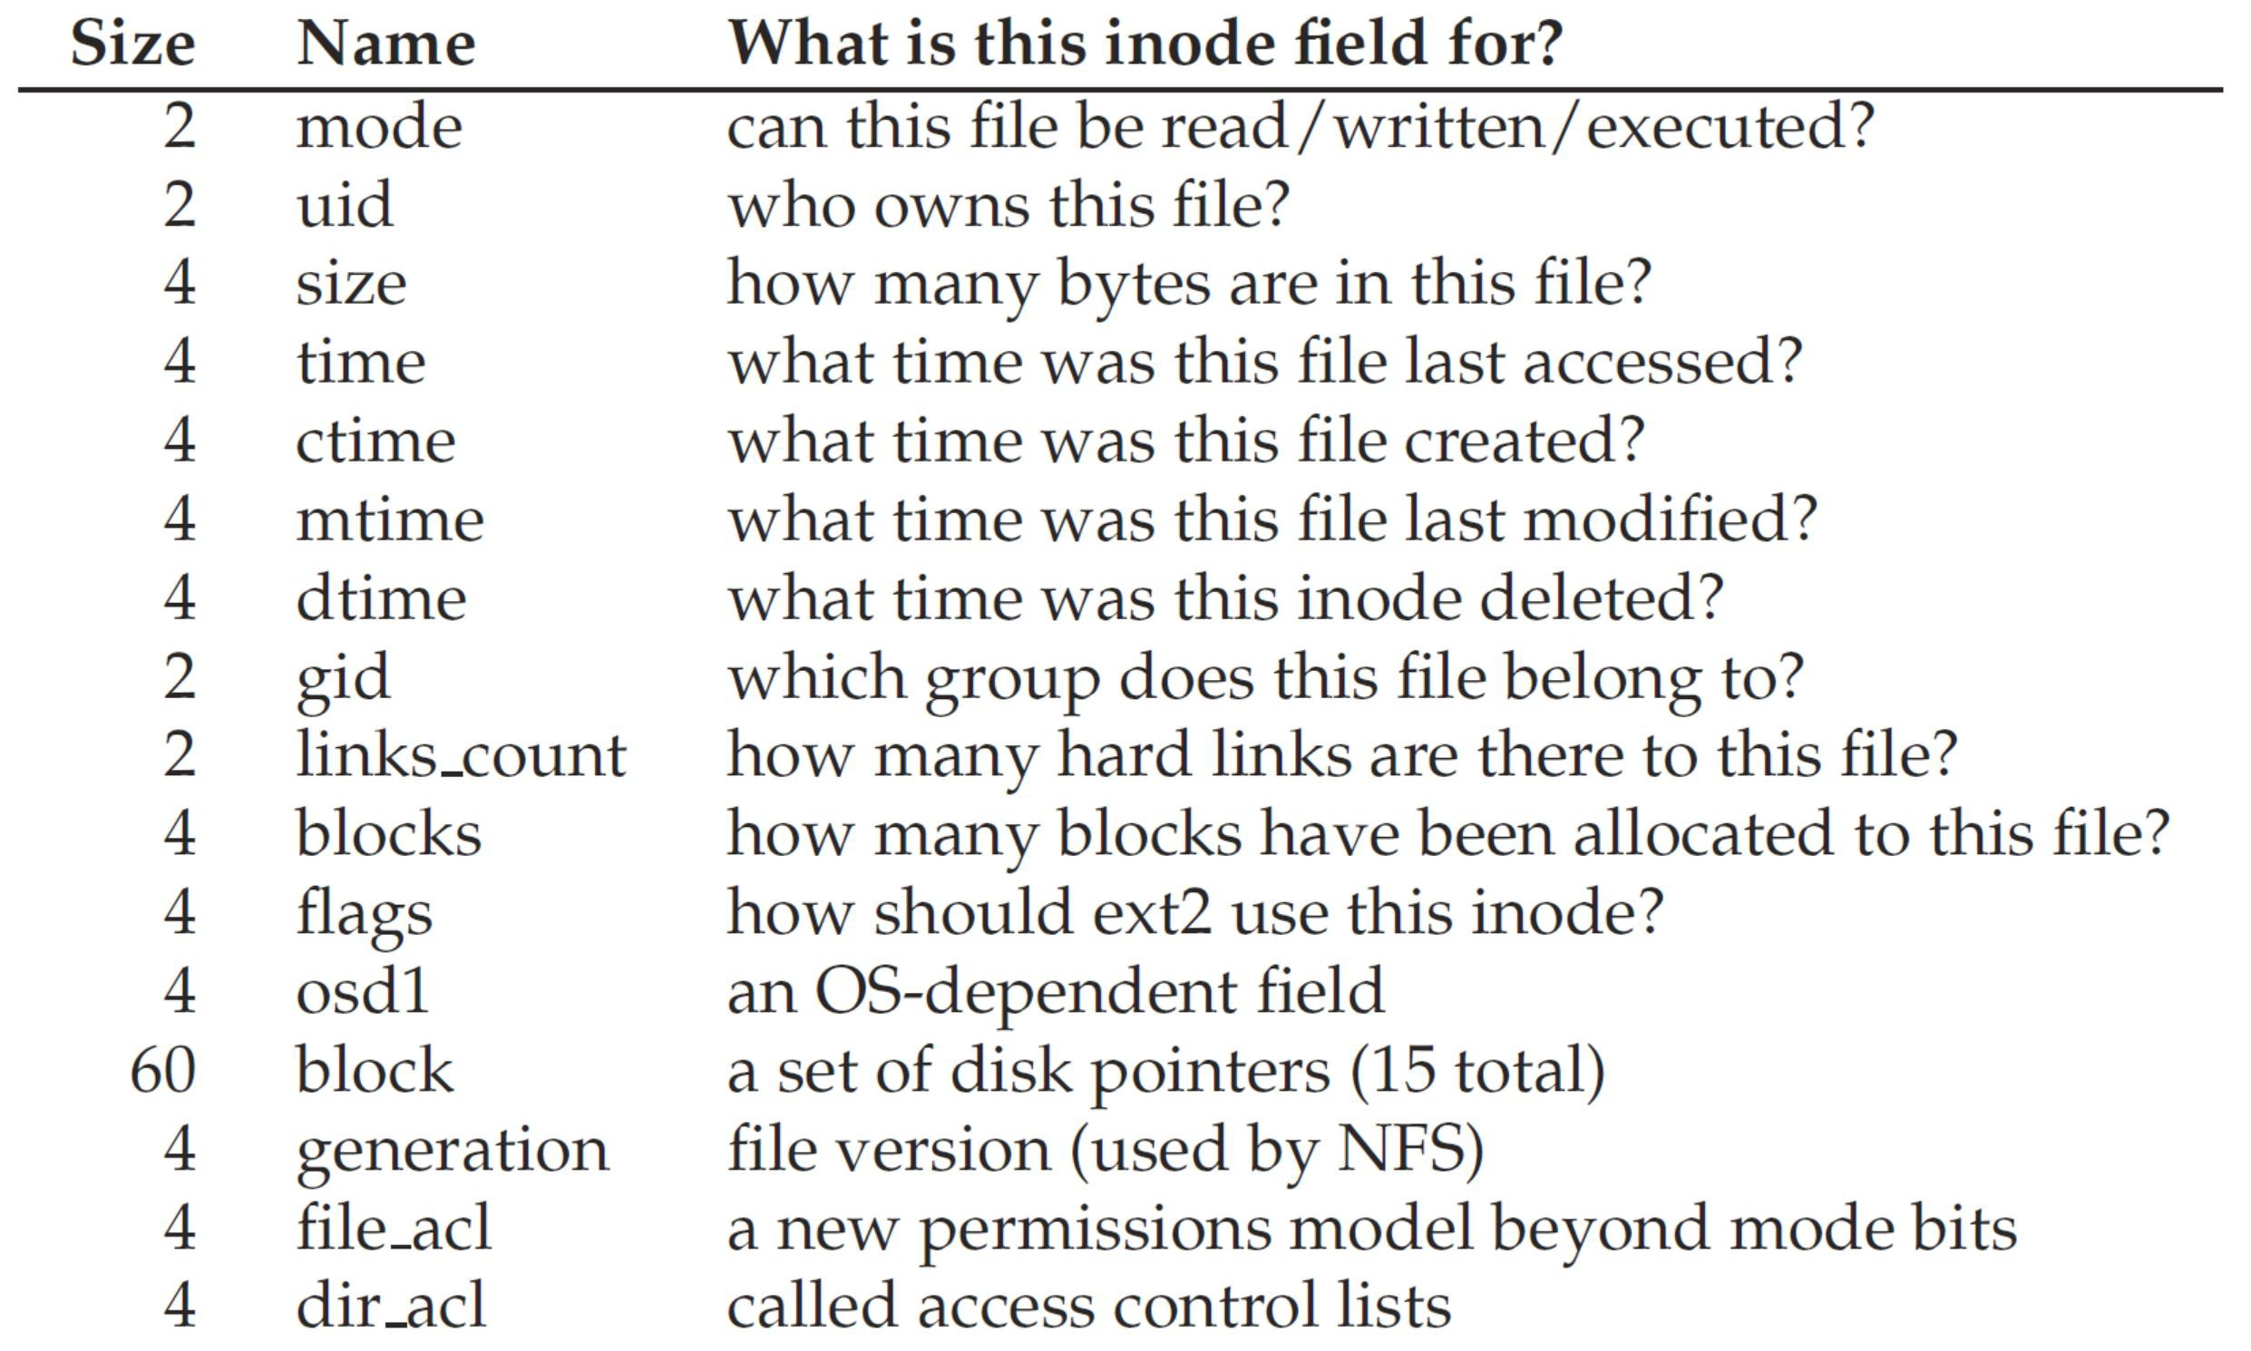
File Organization: Inode (3/3)
An inode tracks everything except “file name” (why?).
25

Slide 26
Directory Organization
A directory is a special type of file.
Each directory is also associated with an inode number.
A directory contains a list of (file name, inode number) pairs in its corresponding data block(s).
inum | | | reclen | | strlen | | name
5 |  | 12 | 2 | .
2 |  | 12 | 3 | ..
12 |  | 12 | 4 | foo
13 |  | 12 | 4 | bar
24 |  | 36 | 28 | foobar_is_a_pretty_lon
. = current directory
.. = parent directory
strlen = length of the file name (including ‘\0’)
reclen = actual space for an entry (used when deletion)
26

Slide 27
Free Space Management
A file system must track which inodes and data blocks are allocated or not:
Bitmap is one way for free space management.
0: free; 1: used
Other structures, e.g., free list and B-tree, are feasible.
There is always a trade-off between time and space.
Pre-allocation may also be used.
Strategy: Always looking for a sequence of free blocks (say 8).
– A portion of the file will be contiguous on the disk (better performance).
27

Slide 28
Exercise
Question: Can you locate the data block(s) for a file?
The root inode number must be “well known” (e.g., inode #2).
/foo/bar.txt
28

Slide 29
File System Interface
File system interface includes:
Creating files;
Reading/writing files;
Renaming files;
Getting information about files;
Removing files;
Managing directories;
Linking files/directories;
Mounting/unmounting a file system.
The file system interface uses (or wraps) the OS system calls for file/directory management.
We focus on UNIX.
29

Slide 30
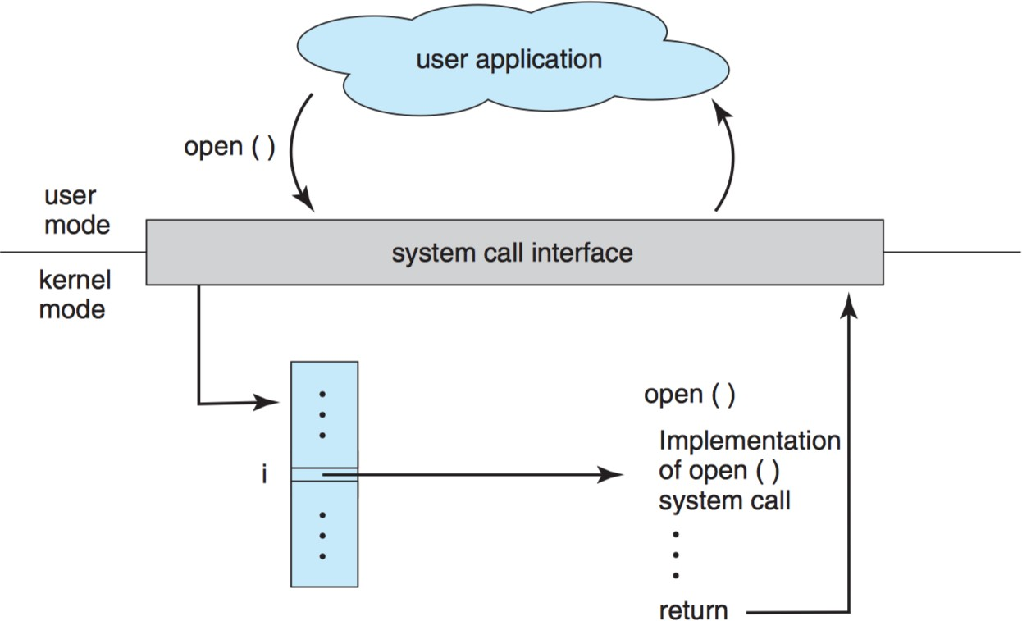
System Calls
System Call Handler
function pointer(s)
30

Slide 31
Creating Files (1/2)
The system call open() is to create or open a file:
1st argument: file name (absolute or relative pathname)
2nd argument:
O_CREAT: creates a file;
O_WRONLY: only write is allowed;
O_TRUNC: truncate to zero size if a file exists.
3rd argument: specifies permissions (readable or writable).
On success, a file descriptor is returned
A pointer for subsequent accesses (function calls) to a file.
In UNIX, it’s just an integer.
int fd = open( "foo", O_CREAT | O_WRONLY | O_TRUNC,
S_IRUSR|S_IWUSR);
31

Slide 32
Creating Files (2/2)
File descriptors are managed on a per-process basis by the operating system .
For example, the UNIX systems (xv6 kernel) must keep some kind of structure in the struct proc:
A simple array (with a maximum of NOFILE open files) tracks which files are opened on a per-process basis.
Each entry of the array is just a pointer to a struct file, which tracks the information of the “open file” being used.
struct proc {
...
struct file *ofile[NOFILE]; // Open files
...
};
32

Slide 33
Management of Open Files (1/2)
The struct file represents an open file:
The struct file (an open file) is referenced by a process.
The readable/writable specifies read/write permissions.
The off keeps the “current” offset, where the next read/write should take place, for this open file.
The actual file is referenced by the struct inode.
All open files are kept in an open file table by OS.
struct proc {
...
struct file *ofile[N];
// open files
...
};
struct file {
struct inode *ip; char readable; char writable; uint off;
int ref; };
33

Slide 34
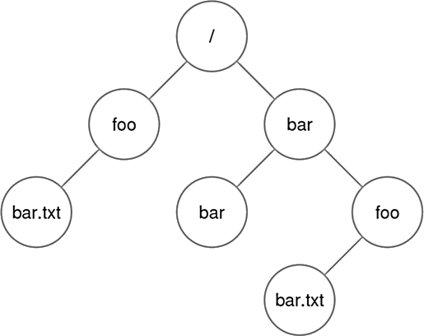
Management of Open Files (2/2)
File System Organization
Process A
Open File Table
struct proc
(struct file) inode *ip off: 100 ref: 1
inode *ip off: 0 ref: 1
inode *ip off: 0 ref: 1
3
Process B
struct proc
3
inode #1000
File A
Process C
struct proc
3
inode #2000
File B
34

Slide 35
Reading and Writing Files (1/4)
How does a process actually read or write a file?
Exercise: Let’s use the strace tool to trace every system call made by reading (cat) the file foo:
prompt> strace cat foo ...
open("foo", O_RDONLY|O_LARGEFILE) | = | 3
read(3, "hello\n", 4096) | = | 6
write(1, "hello\n", 6) | = | 6
hello
read(3, "", 4096) | = | 0
close(3) | = | 0
...
35

Slide 36
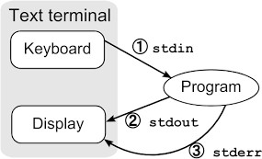
Reading and Writing Files (2/4)
open("foo", O_RDONLY|O_LARGEFILE) = 3
First, the open() system call opens a file for reading:
O_RDONLY: read only (writing is not allowed)
O_LARGEFILE: 64-bit offset is used.
open() returns a file descriptor of 3.
Each running process already has three “open files”:
Standard Input: 0
Standard Output: 1
Standard Error: 2
36

Slide 37
Reading and Writing Files (3/4)
read(3, | "hello\n", | 4096) | = | 6
write(1, | "hello\n", | 6) | = | 6
hello
read(3, | "", 4096) |  | = | 0
close(3) |  |  | = | 0
read() are called for many times to read the file:
1st argument: file descriptor
2nd argument: buffer where the results are stored
3rd argument: size of the buffer
write() is called to display output on screen (fd=1).
close() is called when reaching the EOF.
Writing a file? open() → write() → close()
37

Slide 38
Reading and Writing Files (4/4)
lseek() is to read or write to a specific offset within a file (rather than from the beginning to the end).
1st argument: file descriptor
2nd argument: positions the offset to a particular location within a file (for subsequent reads/writes).
lseek() has nothing to do with a disk seek!
3rd argument: specifies how lseek() is performed.
SEEK_SET: set to offset bytes from the beginning
SEEK_CUR: set to current location plus offset bytes
SEEK_END: set to offset bytes from the end
off_t lseek(int fd, off_t offset, int whence);
38

Slide 39
Shared File Table Entries
In many cases, the mapping of file descriptor to an entry in the open file table is a one-to-one mapping.
An entry in the open file table can be shared when
A parent process creates a child process with fork();
A process creates a few file descriptors that refers to the same file with dup() or its cousins dup2() and dup3().
Open File Table Open File Table
Parent Proc
(struct file) inode *ip off: 100 ref: 2
(struct file) inode *ip off: 100 ref: 2
3
3
6
Child
3
39

Slide 40
Forcing Writes
For performance, the file system buffers writes in memory (e.g., for 5 sec or 30 sec).
The fsync() system call forces all dirty (i.e., not yet written) data to the disk.
int fd = open("foo", O_CREAT|O_WRONLY|O_TRUNC,
S_IRUSR|S_IWUSR);
assert(fd > -1);
int rc = write(fd, buffer, size); assert(rc == size);
rc = fsync(fd);
assert(rc == 0);
40

Slide 41
Information of Files
The file system keeps a fair amount of information about each file it is storing.
– stat() or fstat() calls can be used to see the metadata.
struct stat {
dev_t st_dev; /* ID of device containing file */ ino_t st_ino; /* inode number */
mode_t st_mode; /* protection */
nlink_t st_nlink; /* number of hard links */
uid_t st_uid; /* user ID of owner */ gid_t st_gid; /* group ID of owner */
dev_t st_rdev; /* device ID (if special file) */ off_t st_size; /* total size, in bytes */
blksize_t st_blksize; /* blocksize for filesystem I/O */ blkcnt_t st_blocks; /* number of blocks allocated */ time_t st_atime; /* time of last access */
time_t st_mtime; /* time of last modification */
time_t st_ctime; /* time of last status change */ };
41

Slide 42
Summary of File System Operations
File System Operations | System Calls
Creating a file | open()
Reading a file | read()
Writing a file | write(), fsync()
Seeking to an offset | lseek()
Renaming a file | rename() (often an atomic call)
Getting file information | stat() or fstat()
Removing a file | unlink()
Making a directory | mkdir()
Reading a directory | opendir(), readdir(), closedir()
Removing a directing | rmdir() (must be empty)
42

Slide 43
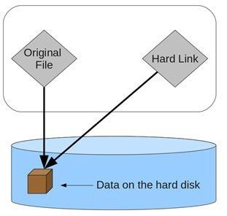
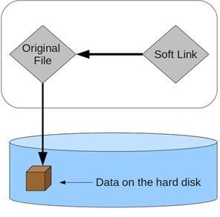
Links
File systems allow links to create multiple names (aliases) for the same file
Hard Link: holds the inode number of a file.
Symbolic/Soft Link: holds the pathname to a file.
43

Slide 44
Recall: Directory Organization
A directory is a special type of file.
Each directory is also associated with an inode number.
A directory contains a list of (file name, inode number)
pairs in its corresponding data block(s).
inum | | | reclen | | strlen | | name
5 |  | 12 | 2 | .
2 |  | 12 | 3 | ..
12 |  | 12 | 4 | foo
13 |  | 12 | 4 | bar
24 |  | 36 | 28 | foobar_is_a_pretty_lon
. = current directory
.. = parent directory
strlen = length of the file name (including ‘\0’)
reclen = actual space for an entry (used when deletion)
44

Slide 45
Hard Link
Hard link (ln) creates a new entry in the directory to refer to the same inode number of the original file.
Create a Hard Link Show inode Numbers Remove a File
The inode has a reference count that keeps track of how many hard links refer to it.
Only when the reference count is zero, the file system frees the inode and related data blocks.
This explains why unlink() is called when removing a file.
prompt> echo hello > file prompt> cat file
hello
prompt> ln file hard_link prompt> cat hard_link hello
prompt>
ls -i file hard_link 67158084 file
67158084 hard_link
prompt> rm file removed ‘file’ prompt> cat hard_link hello
45

Slide 46
Recall: File Organization: Inode
An inode tracks everything except “file name” (why?).
46

Slide 47
Symbolic/Soft Link
Hard links are limited:
Cannot link to a directory (to avoid creating a cycle).
Cannot link to a different partition (only within a file system).
Symbolic Link (ln -s)
It is a special file with its own inode number.
It holds a pointer to link but may cause dangling reference.
prompt> echo hello > file prompt> cat file
hello
prompt> ln file soft_link
prompt> cat soft_link hello
prompt> rm file prompt> cat soft_link
cat: soft_link: No such file or directory
-s
47

Slide 48
Hard Link vs. Soft Link
File systems allow links to create multiple names (aliases) for the same file
Hard Link: holds the inode number of a file
By only creating a new directory entry.
Symbolic/Soft Link: holds the pathname to a file
By creating a new file of special type.
Three types of file: 1) Data File; 2) Directory File; 3) Soft Link File.
Directory
12
12
file hard_link
Directory
12
13
file soft_link
ino #12
ino #12
ino #13
path “file”
file
Disk
ref count: 2
file
Disk
ref count: 1
48

Slide 49
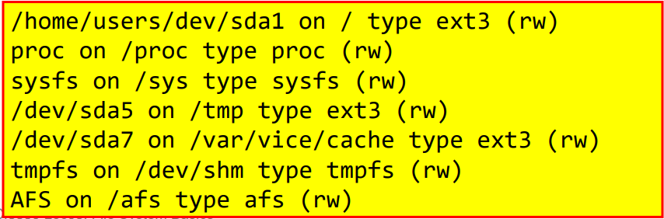
Mounting a File System
Final Step: Set up a file system to make it run.
Mounting (mount) a file system:
You can have multiple file systems on the same machine, and mounts all file systems into one tree!
– Create a mount point
your I/O device (SCSI)
– Paste a file system onto the directory tree at that point
prompt> mount -t ext3 /dev/sda1 /home/users
49

Slide 50
UNIX File System
The organization we have learnt is a simplified version of a typical UNIX file system:
Metadata Region: tracks data and file system information.
Data Region: stores user data and occupies most space.
50
CSCI5550 Lec03: File System Basics 43

Slide 51
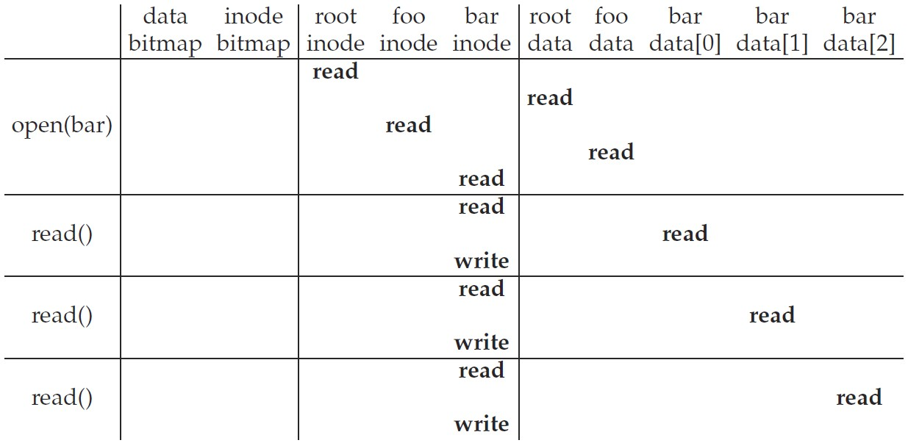
Access Path: Read (1/2)
Example: Read a file /foo/bar
Traverse the pathname to locate the requested inode:
root → foo → bar
1. Read root inode (must be known) to locate root data
2. Read root data to find foo inode
3. Read foo inode to locate foo data
4. Read foo data to find bar inode
5. Read bar inode into memory*
Read bar inode to locate data
Read data block of bar
Update timestamp of bar inode
51

Slide 52
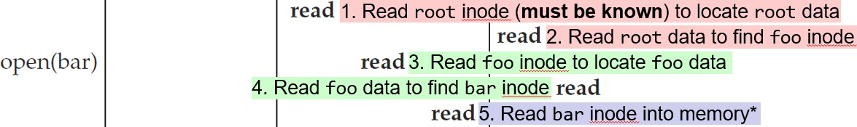
Access Path: Read (2/2)
Note 1: The amount of I/O generated by the open() is proportional to the length of the pathname.
Large directories would make this worse. (Why? Step 4)
Note 2: The following work is also needed but not listed:
Step 5 also needs to check permissions; allocate a file descriptor for this process; create an entry in the open-file table; return the file descriptor to the user.
Read bar inode to locate data
Note 3: The read will further update the in-memory open file table to maintain the file offset for this file descriptor.
Such that the next read will read the subsequent file block.
52

Slide 53
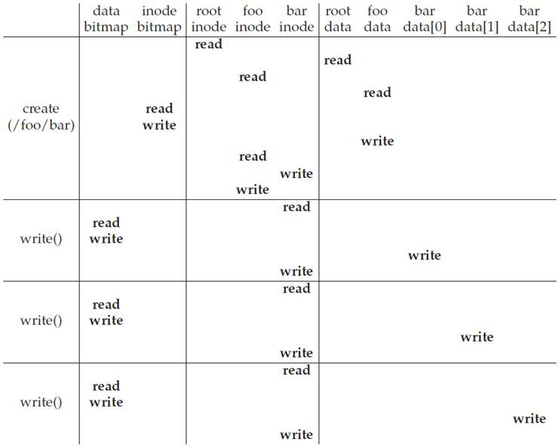

Access Path: Write (1/2)
Example: Create (write) a new file /foo/bar
1. The file must be opened as well
10
I/Os
(find a free inode) (mark it allocated)
2. FS must not only allocate an inode, but also allocate space within the directory for the file
(link the file name and the inode in dir)
(update)
(initialize)
5
I/Os
(find a free data block)
(update data bitmap)
(update with the new data block location)
(write the actual data block)
5
I/Os
5
I/Os
53

Slide 54
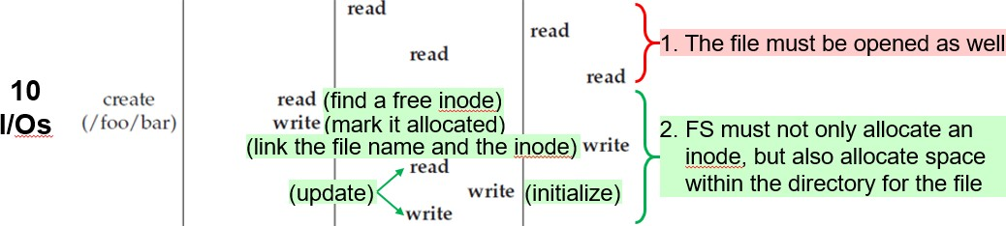
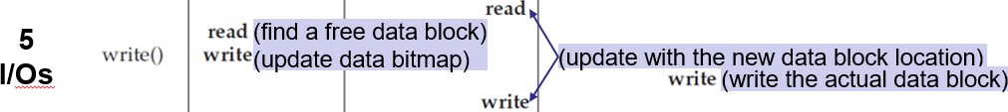
Access Path: Write (2/2)
10 I/Os are needed to walk the pathname and create file.
If the directory needs to grow, additional I/Os are needed.
– i.e., to the data bitmap, and the new directory block.
Each data block write logically generates 5 I/Os.
If write() involves indirect pointers, more I/Os are needed as well.
54

Slide 55
Caching and Buffering
Like in UNIX file system, reading and writing files can be expensive, incurring many I/Os to the (slow) disk.
Most file systems leverage the system memory to:
Cache some important or popular blocks
To avoid repeated reads to the same blocks
To avoid performing hundreds of reads to open a file with long pathname (e.g., /1/2/3/…/100/file.txt).
Buffer a number of writes (for 5~30 seconds)
To allow writes to the same location (in memory)
To batch updates into a smaller set of I/Os
To allow rescheduling of I/Os
Cache/buffer trades reliability for performance!
But not everyone likes it; some applications (e.g., databases) require frequent fsync() to avoid losing data kept in the write buffer.
55

Slide 56

Revisit File System Organization (1/2)
“Old UNIX File System” by Ken Thompson:
The super block (S) contained the file system information:
How big the volume is, how many inodes there are, a pointer to the head of a free list of blocks, and so forth.
The inode region contained all inodes for the file system.
Most of the disk space was taken up by data blocks.
Problem 1: Poor Performance
The file system was delivering only 2% of disk bandwidth, because of expensive disk positioning costs.
The data blocks of a file were often very far away from its inode.
– An expensive seek was induced whenever one first read the inode, and then read the file system block.
56

Slide 57


Revisit File System Organization (2/2)
“Old UNIX File System” by Ken Thompson:
Problem 2: Fragmentation
External Fragmentation
Free block space is not contiguous.
A large file may have blocks scattered across disk.
Disk defragmentation tools may help by reorganization.
Internal Fragmentation
Reads/writes are in units of
blocks.
If a small file cannot cover a block, block space is wasted.
Smaller blocks may have more positioning overhead.
After writing file E of four blocks
F
After writing file F of 1/2 block
57

Slide 58
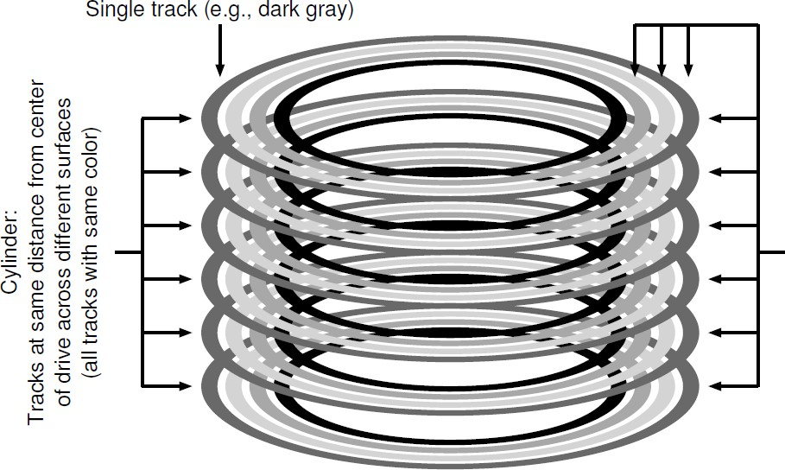
Fast File System (FFS) by Berkeley
Goal: Make the file system structures and allocation policies to be “disk-aware” to improve performance.
– By keeping the same file system interface (i.e., system calls) but changing the internal implementation.
Key: FFS divides disk into cylinder groups.
Cylinder: Tracks at same distance from center across different surfaces (same color)
Cylinder Group: A set of 𝑁 consecutive cylinders (different color)
58

Slide 59

Fast File System (FFS) (2/3)
FFS aggregates 𝑁 consecutive cylinders into a group, and the disk is of a collection of cylinder groups.
…
Modern disks do not export cylinder information for the file system to explore.
Modern FSs instead organize disk into block groups.
– Each block group is of the consecutive block addresses (rather than consecutive cylinders).
59

Slide 60

Fast File System (FFS) (3/3)
FFS maintains similar structures for each group:
A copy of superblock (S)
Per-group inode bitmap (ib) and data bitmap (db)
Per-group inode and data block regions.
FFS further explores the data locality to place files, directories, and associated metadata on disk:
keep related stuff together, keep unrelated stuff far apart
① Allocate data blocks of a file in the same group as its inode
② Place files of the same directory in the same group
③ Balance directories across groups
60

Slide 61

That’s all for today.
Notes:
Thank you for listening. Now, I would like to end today’s talk by the Q & A time.

