Slide 1

Embedded System Lecture 09: Flash Memory
Department of Computer Science and Information Engineering
Shuo-Han Chen (陳碩漢), shchen@csie.ntut.edu.tw
Hong-Yue Technology Research Building 334
R 09:10 - 12:00

Slide 2
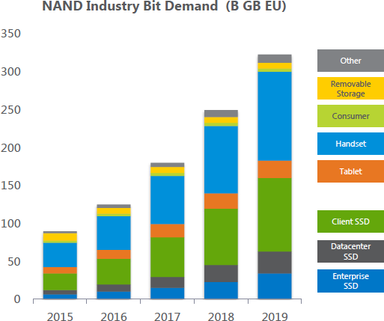
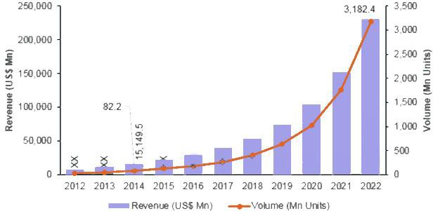
Why Flash Memory
Flash memory is a widely used memory/storage technology in today’s products.
It is a type of non-volatile memory.
Data can be persisted under power loss.
Revenue Growth: 40% every year!
Volume Price: ~40% annual reduction!
Sources : Micron, Intel And 3D NAND Post [link]
Sources : Global SSD Market to Post CAGR of 41% Until 2022, OriginStorage
2

Slide 3
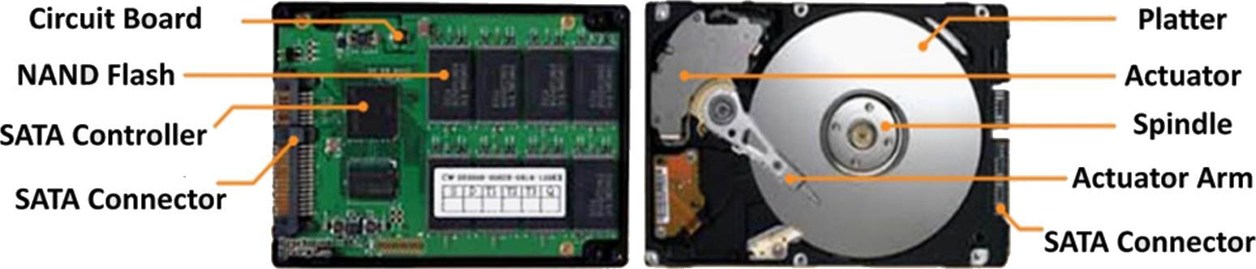
Solid-State Drive vs. Hard Disk Drive
Solid-State Drive (SSD)
Hard Disk Drive (HDD)
Faster performance
No vibrations or noise
Shock resistance
More energy efficient
Lighter and smaller
Cheaper per GB
Reliability
3

Slide 4

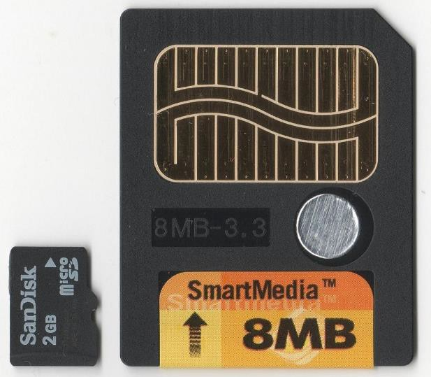
The Greatest Invention in 1990s
Invented by Dr. Fujio Masuoka (舛岡 富士雄) born in 1943, while working for Toshiba around 1980.
First presented in IEEE International Electron Devices Meeting, 1984.
First NAND flash first introduced as
SmartMedia storage in 1995.
First NOR flash commercialized by Intel in 1998 to replace the read-only memory (ROM) to store BIOS
4

Slide 5
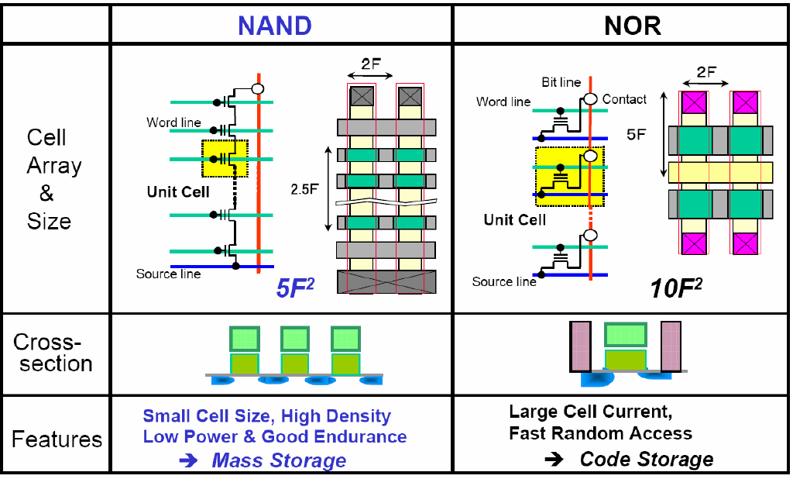
NAND Flash vs. NOR Flash
5

Slide 6
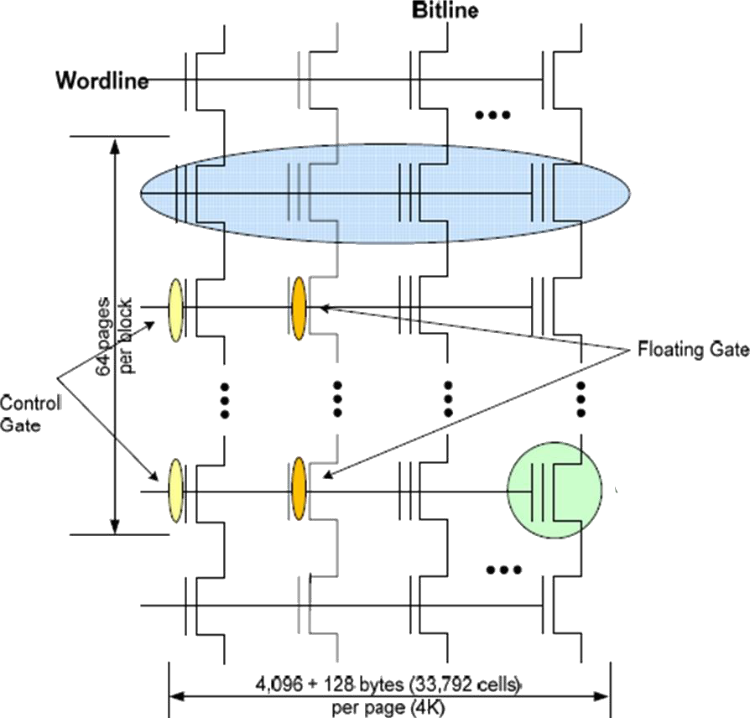

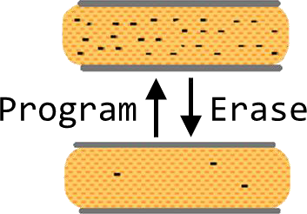
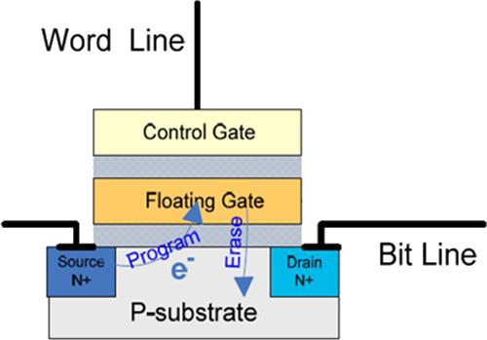
NAND Flash Technology
NAND Flash Array
NAND Flash Cell
Floating-Gate Transistor
Program: Inject electrons into FG to raise voltage
Flash
Flash Block (Erase)
Erase: Remove electrons from FG to lower voltage
Read: Sense voltage of FG
Page (R/W)
Cell
Dielectric
Oxide
Flash Management – Why and How? A detailed overview of flash management techniques, SMART Modular Technologies
Based on MOSFET Metal Oxide Semiconductor Field Effect Transistor
6

Slide 7
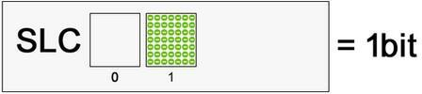
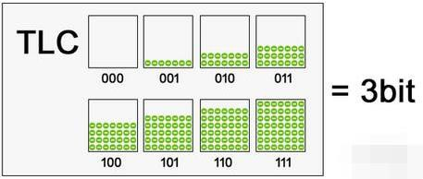
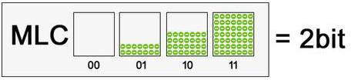
Single-Level Cell & Multi-Level Cell (1/2)
Single-Level Cell (SLC): one bit per cell
SLC provides faster read/write speed, lower error rate and longer endurance with higher cost.
Multi-Level Cell (MLC): multiple bits per cell
MLC allows each memory cell to store multiple bits of information with degraded performance and reliability.
Multi-Level Cell (MLC_{x2}): 2 bits per cell
Triple-Level Cell (TLC): 3 bits per cell
Quad-Level Cell (QLC): 4 bits per cell
7

Slide 8
Single-Level Cell & Multi-Level Cell (2/2)
# of Cells
Cell Distribution
PV: Program Verify Voltage V_{pass}: A Pass-gate Voltage Vt: Threshold Voltage
_{V} Vt
pass
# of Cells
1
0
Vt
V
pass
# of Cells
11 10 00 01
PV1 PV2 PV3
Vt
^{V}pass
Low efficiency in programming/verifying low bit(s)
High bit error rate in low bit(s)
8

Slide 9
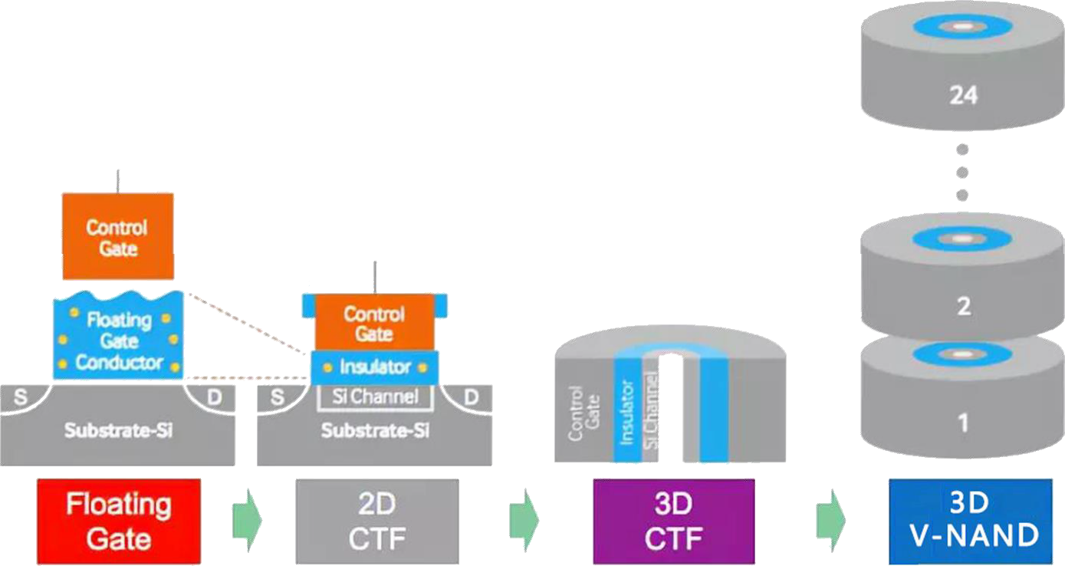


Evolution of NAND Flash
Scaling down floating-gate cell is challenging.
The oxide thickness must be more than 6-nm.
Charge trap flash (CTF) becomes popular.
It uses a silicon nitride film to suck electrons.
3D flash further scales down the feature size and increase areal density by building tall.
Silicon nitride
Oxide
Scale ⬇
9

Slide 10
Inherent Challenges
Common challenges of NAND flash:
① Asymmetric operation units between read/write and erase
② Erase before writing (a.k.a., write-once property)
③ Limited endurance
④ Data errors caused by write and read disturb
⑤ Data retention errors
Sophisticated management techniques are needed to make flash become better.
10

Slide 11
1. Asymmetric Operation Units
Flash cells are organized into pages, and hundreds of pages are grouped into a block.
A page is further divided into data area and spare area.
The spare area keeps redundancy for error correction or metadata.
Asymmetric Operation Units: Flash cells can only be read or written in the unit of a page; while all pages of a block need to be erased at a time.
Block: Basic erase operation unit
Page (Data Area): Basic W/R operation unit
Page (Spare Area): Housekeeping info.
Block 0 Block 1 Block N-1
4KB 64B
4KB | 64B
4KB | 64B
4KB | 64B
4KB | 64B
4KB | 64B
4KB | 64B
4KB 64B
4KB 64B
…
…
…
…
4KB 64B
4KB
64B
4KB
64B
11

Slide 12
2. Erase before Write (Write-once)
Erase before Write: Once written to “0”, the only way to reset a flash cell to “1” is by erasing.
– The erase operation sets all bits in a block to “1”s at a time.
Write-once Property: A flash page cannot be overwritten until the residing block is erased first.
12

Slide 13
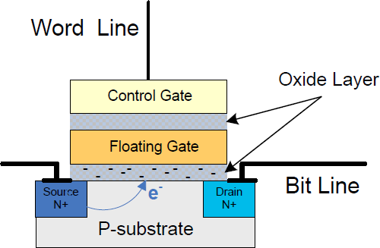
3. Limited Endurance
Limited Endurance: A flash block can only endure a limited number of program/erase (P/E) cycles.
SLC: 60𝐾 ~ 100𝐾 P/E cycles
MLC: 1𝐾 ~ 10𝐾 P/E cycles
TLC: < 1𝐾 P/E cycles
Reason: The oxide layer may be “worn out”.
13

Slide 14
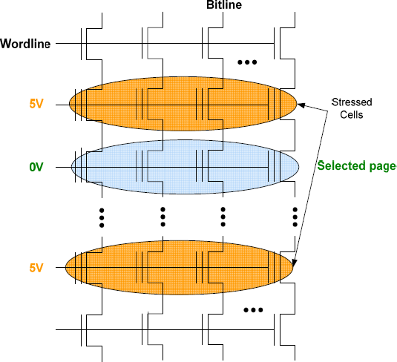
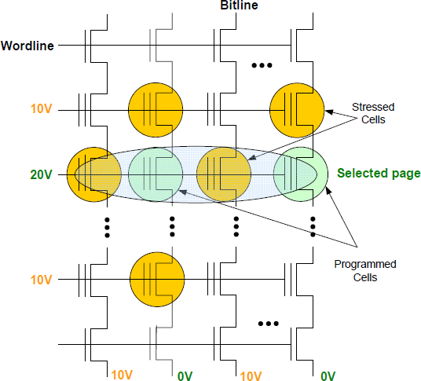
4. Read/Write Disturb
Read/Write Disturb: Reading or writing a page may result in the “weak programming” on its neighbors.
– Solution to Write Disturb: Programming pages of a block “in a sequential order” (a.k.a., sequential write constraint).
Read Disturb Write Disturb
14

Slide 15


5. Data Retention Errors
Data retention time defines how long the written data remains valid within a flash cell.
It is inversely related to the number of P/E cycles.
Electrons leak over time and result in retention errors.
Solution: “Correct-and-refresh pages” from time to time.
This solution can also reset the read/write disturb.
Electrons leakage
1 1
Flash cell
Flash correct-and-refresh: Retention-aware error management for increased flash memory lifetime (ICCD’12)
0
Retention error
15

Slide 16

System Architecture
There are two typical ways to address the inherent challenges of flash memory:
Implementing a Flash Translation Layer in the device.
Designing a Flash-aware File System in the host.
Application
Virtual File System
Legacy File System (e.g., Ext2, FAT, LFS)
Flash-aware File System (e.g., JFFS, YAFFS, F2FS)
Flash Translation Layer
Device
NAND Flash Memory
NAND Flash Memory
16

Slide 17
Flash Translation Layer
Flash Translation Layer (FTL) is a firmware inside the flash device to make the NAND flash memory “appear as” a block device to the host.
– It consists of three major components: ① address translator, ② garbage collector, and ③ wear leveler.
Flash Translation Layer (firmware)
Address Translator
Garbage Collector
Wear Leveler
Flash Device
NAND Flash Memory (hardware)
…
Block Page Page
Block Page Page
Block Page Page
Block Page Page
…
…
…
…
Page
Page
Page
Page
17

Slide 18
1. Address Translator
Due to the write-once property, the out-place update is adopted to write the updated data to free pages.
Address translator maps logical block addresses (LBAs) from the host to physical page addresses (PPAs) in flash.
The mapping table is kept in the memory space of the flash device.
LBA
Flash Translation Layer
Address Translator
LBA PBA
Garbage Collector
Wear Leveler
Flash Device
NAND Flash Memory
Block A
A’
Block
Block
Block
…
…
…
…
…
A’’
18

Slide 19







Page-Level, Block-Level, and Hybrid
Page-Level (PL)
1-1 Page-Level
Block-level (BL)
1-1 Block-Level
Big in table size!
Slow in write!
Mapping Table
LBA PPA
Mapping Table
Block X Block Y
LBA | PBA
0~3 | X → Y
4~7 | …
8~11 | …
… | …
Block X Block Y
0
(X, 0)→(Y, 0)
D₀
D₁
D₂
D₃
w
D₀’
D₀
w
D₀’
1
(X, 1)
D₁
D₁
2
(X, 2)
D₂
D₂
…
...
D₃
D₃
Block-Level (BAST)
Hybrid (FAST)
Good R/W?
1-2 Block-Level Mapping Table
(Like BL)
Primary
(Logging)
Secondary
1-1
BL Map
LBA | PBA
0~3 | X
PL
Map
LBA PPA
0
(Z, 2)
LBA
PBA
Block X
Block Y
Block X
Block Y
Block Z
0~3
(X, Y)
D₀
w
D₀’
D₀
D₁
D₂
D₃
D₄
D₅
D₆
D₇
w
D₀’
4~7
…
D₁
w
D₂’
w
D₅’
8~11
…
D₂
w
D₀”
w
D₀”
…
…
D₃
Slow in read (must check spare area)!
Data Block(s) share Log Block(s)
19

Slide 20
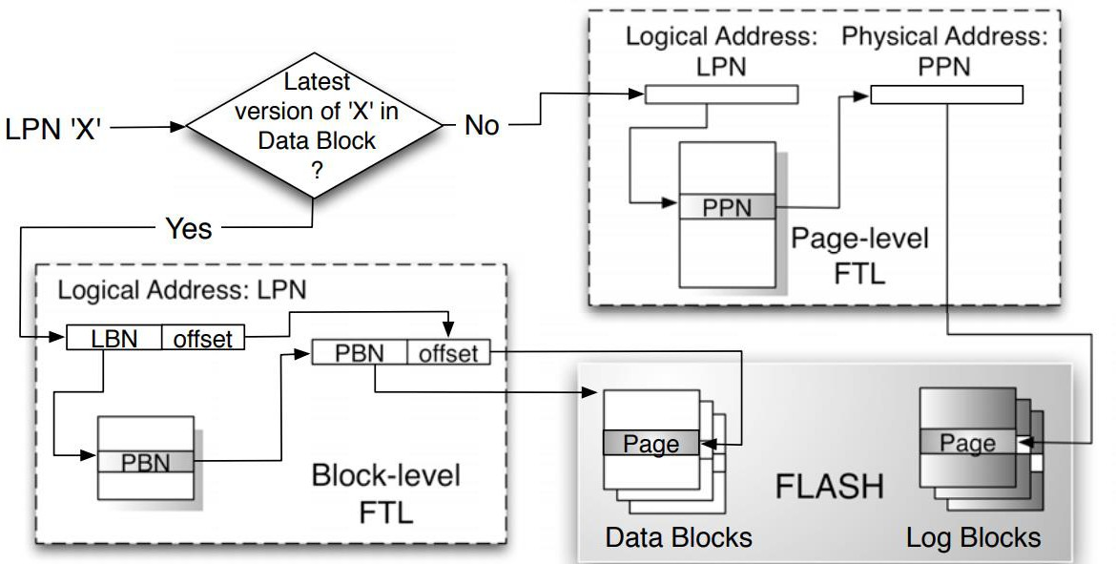
Hybrid FTL
Hybrid FTLs logically partition blocks into two groups:
Data Blocks are mapped via the block-level mapping.
Log/Update Blocks are mapped via a page-level mapping.
Any update on data blocks are performed by writes to the log blocks.
Few log blocks are shared by all data blocks.
20

Slide 21
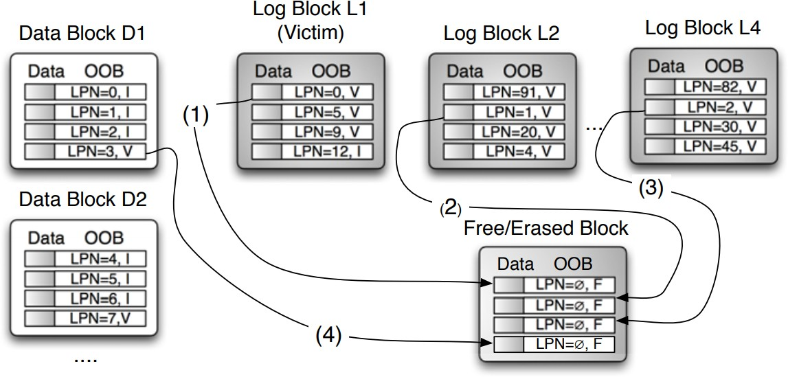
Expensive Merge of Hybrid FTL
Hybrid FTLs induce costly garbage collection.
21

Slide 22



















Demand-based Address Translation
Keeping all mapping tables in RAM is ineffective.
Page-level translation for all data with limited RAM.
Map of data pages are stored in translation pages on flash.
Translation pages are cached in RAM on demand.
Map of translation pages (i.e., global translation table) are kept in RAM for efficient lookup.
Translation
blocks
Data blocks
Flash space
Flash Device
. . .
. . .
RAM
space
Cached Translation pages
Data pages
Global Translation Table
22

Slide 23
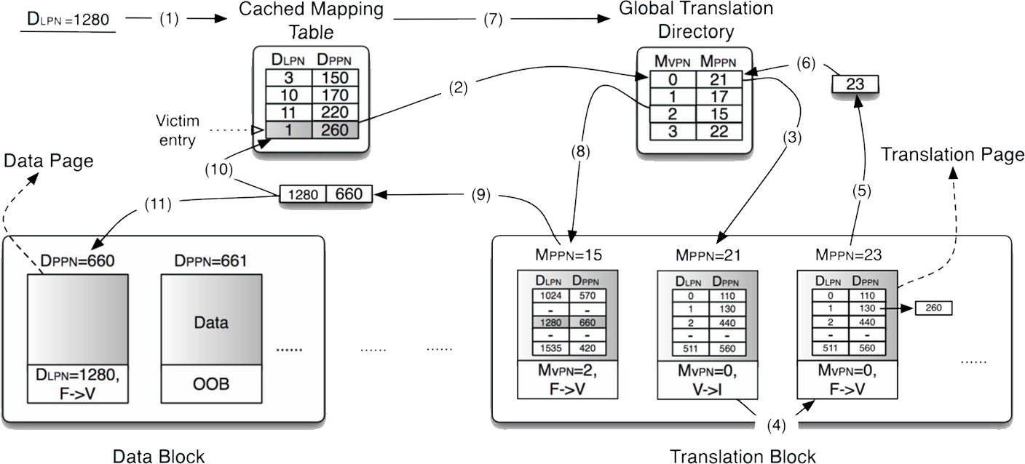
DFTL: An Working Example
(1) Request to DLP N 1280 incurs a miss in Cached Mapping Table (CMT), (2) Victim entry DLP N 1 is selected, its corresponding translation page MPPN 21 is located using Global Translation Directory (GTD), (3)-(4) MPPN 21 is read, updated (DPPN 130 → DPPN 260) and written to a free translation page (MPPN 23), (5)-(6) GTD is updated (MPPN 21 → MPPN 23) and DLP N 1 entry is erased from CMT. (7)-(11) The original request’s (DLP N 1280) translation page is located on flash (MPPN 15). The mapping entry is loaded into CMT and the request is serviced.
Note that each GTD entry maps 512 logically consecutive mappings.
23

Slide 24
2. Garbage Collector
Since the out-place update leaves multiple versions of data, the garbage collector is to reclaim pages occupied by stale data by erasing its residing blocks.
– The live-page copying is needed to migrate pages of the latest versions of data before the erase operation.
Flash Translation Layer
Address Translator
Garbage Collector
Wear Leveler
Flash Device
erase
Block A
A’
NAND Flash Memory
Block A”
…
Block B
C
Block E
F
…
…
…
…
A’’
D
F’
24

Slide 25



Typical GC Procedure
Victim Block Selection: Pick one (or more) block that is “most worthy” to be reclaimed
Live-Page Copying: Migrate all live pages out
Victim Block Erasing: Reclaim the space occupied by dead pages
Flash Translation Layer
Address Translator
③
Garbage Collector
Wear Leveler
Flash Device
erase
Block A
A’
NAND Flash Memory
Block A”
…
①
Block B
C
Block E
F
②
…
…
…
…
A’’
D
F’
25

Slide 26
Typical Victim Block Selection Policies
Random selects the victim block in a uniformly- random manner to yield a long-term average use.
FIFO (or RR) cleans blocks in a round-robin manner for minimized P/E cycle difference.
Greedy cleans the block with the largest number of dead pages for minimized live-page copying.
Cost-Benefit (CB) (and its variants) cleans the block with the largest benefit-cost for wear leveling:
𝑏𝑒𝑛𝑒𝑓𝑖𝑡 𝑎𝑔𝑒 × (1 − 𝑢)
=
𝑐𝑜𝑠𝑡 2𝑢
age: invalidated time period = current time – the time when a page of the block was lastly invalidated
u: percentage of live pages of the block
26

Slide 27
Page Liveness
Keep the LBA into the spare area.
Check both the spare area of pages and the mapping table during GC.
Live: LBA matches the mapping.
Dead: LBA mismatches the mapping.
LBA | PPA
0 | (O, 3)
1 | (Q, 0)
2 | (Q, 1)
3 | (Q, 3)
… | …
Flash Translation Layer
Address Translator
Garbage Collector
Wear Leveler
Flash Device
erase
NAND Flash Memory
Block P Block Q
Block O
Block R
A
A”
B | 1
C | 2
E | 4
F | 5
0
A’ 0
0
…
…
…
…
…
A’’ 0
D
3
F’ 5
27

Slide 28
3. Wear Leveler
Since each block can only endure a limited number of P/E cycles, the wear leveler is to prolong the overall lifetime by evenly distributing erases.
– The main objective is to prevent any flash block from being worn out “prematurely” than others.
Flash Translation Layer
Address Translator
Garbage Collector
Wear Leveler
Flash Device
erase
Block A
A’
erase
Block A”
erase
Block B
C
NAND
Flash Memory
…
erase
Block E
F
…
…
…
…
A’’ D
F’
28

Slide 29
Dynamic vs. Static Wear Leveling
Wear leveling is classified into static or dynamic based on the type of blocks involved in WL:
Dynamic Wear Leveling
Let free blocks have closer erase counts
How? Simply use free block with lower erase count (i.e., young block) to service writes
Static Wear Leveling
Let all blocks (free + used)
have closer erase counts
① Actively move cold data in young block to elder block
② Then use this (previously- used) young block to service writes
write
write
young old
blk blk
old old young
blk blk blk
young old old old young
blk blk blk
C
free
used
free
used
29

Slide 30
Dynamic Wear Leveling (DWL)
DWL achieves wear leveling only for hot blocks.
Hot Block: a block mainly containing hot data
Cold Block: a block mainly containing cold data
Hot blocks will be worn out earlier than cold blocks.
P/E cycles
Maximal
5000
P/E Cycle
0
Blocks
Hot blocks
Cold blocks
30

Slide 31

Static Wear Leveling (SWL)
SWL achieves wear leveling for all blocks by pro- actively moving cold data to young blocks.
Extra data migrations are introduced.
Performance is traded for lifetime/endurance.
P/E cycles
Maximal
5000
P/E Cycle
0
Blocks
Hot blocks
Improving Flash Wear-Leveling by Proactively Moving Static Data (TC’10)
Rejuvenator: A static wear leveling algorithm for NAND flash memory with minimized overhead (MSST’11)
Cold blocks
31

Slide 32





Progressive Wear Leveling (PWL)
When, and how often WL should be performed?
WL should be performed in a progressive way:
Prevent WL in the early stages for better performance.
Progressively trigger WL to prolong lifetime.
More and more WLs are performed over time.
250000
The number of triggered WL
WL Count Expected WL Count
200000
150000
100000
50000
0
0.9
1.8
2.7 3.6 4.5 5.4 6.3 7.2
The amount of written data (Unit: TB)
8.1
9
9.9
32

Slide 33
Error-Rate-Aware Wear Leveling
Key Observations: Flash is not perfect!
P/E cycles might inaccurately reflect the reliability of flash.
Blocks might have different bit-error rates (BERs) when enduring the same P/E cycles due to process variation.
Idea: BER could be a better metric to WL designs.
The error correction hardware can report BER to FTL.
Premature worn out
BER ₁₀-3
Maximal
BER
₁₀-7
Blocks
New ERA: New Efficient Reliability-Aware Wear Leveling for Endurance Enhancement of Flash Storage Devices (DAC’13)
33

Slide 34














Multilevel I/O Parallelism (1/2)
The internal of flash devices is highly hierarchical:
– Channel → Chip → Die → Plane → Block → Page
Multiple I/O operations can be performed concurrently.
R/W
Flash Device
μ-Controller
Flash Translation Layer (FTL)
Operations: Read, Write, Erase
Register
Register
Read/Write
Hardware Abstraction Layer (HAL)
(a.k.a. Memory Technology Device (MTD))
Operation Unit
Block 0
Block 1
Block 0
Page 0
Page 1
Block 1
…
…
…
…
Channel 0
Channel 1
Channel N
Block N_{B}
Block N_{B}
Page N_{P}
Ch
Plane 0
Plane 1
Erase
Flash Chip 0
Flash Chip 0
Flash Chip 0
Operation Unit
…
Interface
Die
1
Die
2
… Die
N_{D}
Basic
Flash Chip 1
Flash Chip 1
Flash Chip 1
Operation Unit
34
Exploring and Exploiting the Multilevel Parallelism Inside SSDs for Improved Performance and Endurance (TC’13)

Slide 35
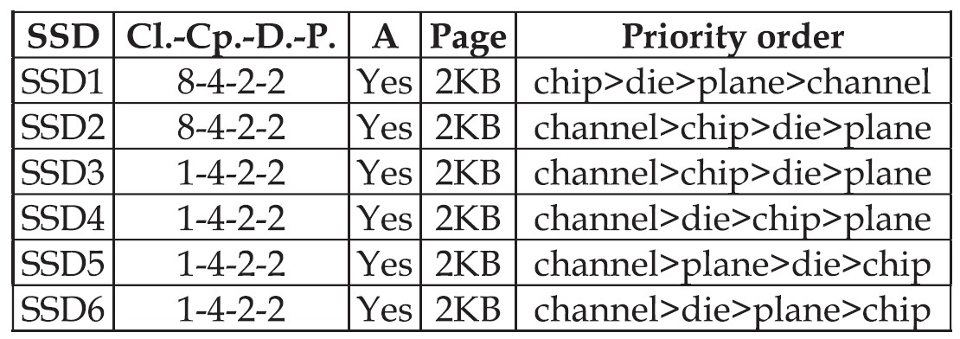
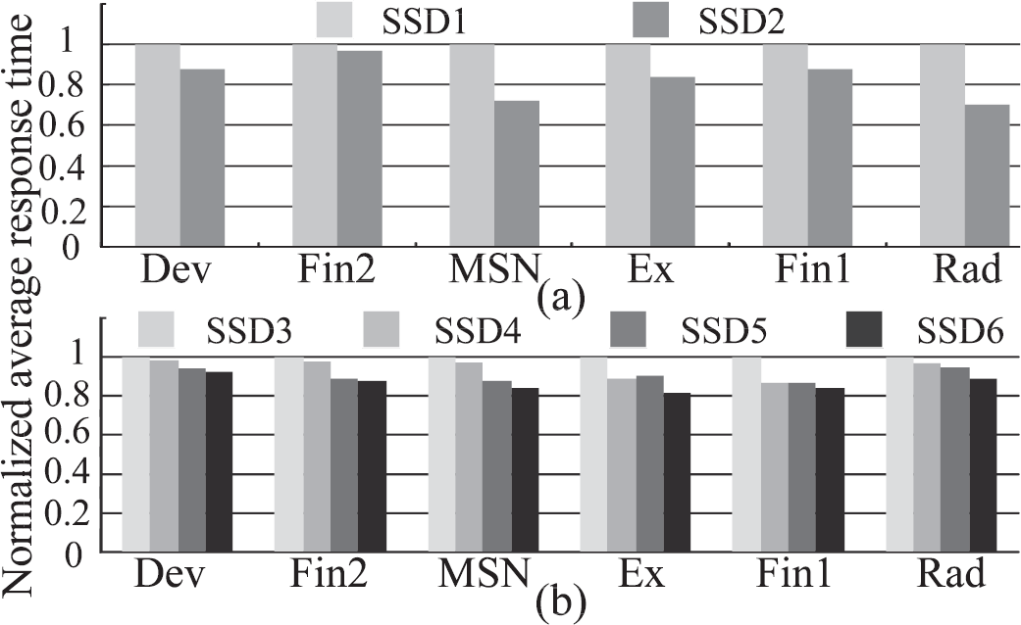
Multilevel I/O Parallelism (2/2)
The optimal priority order of parallelism should be:
① Channel-level
② Die-level
③ Plane-level
④ Chip-level
35

Slide 36
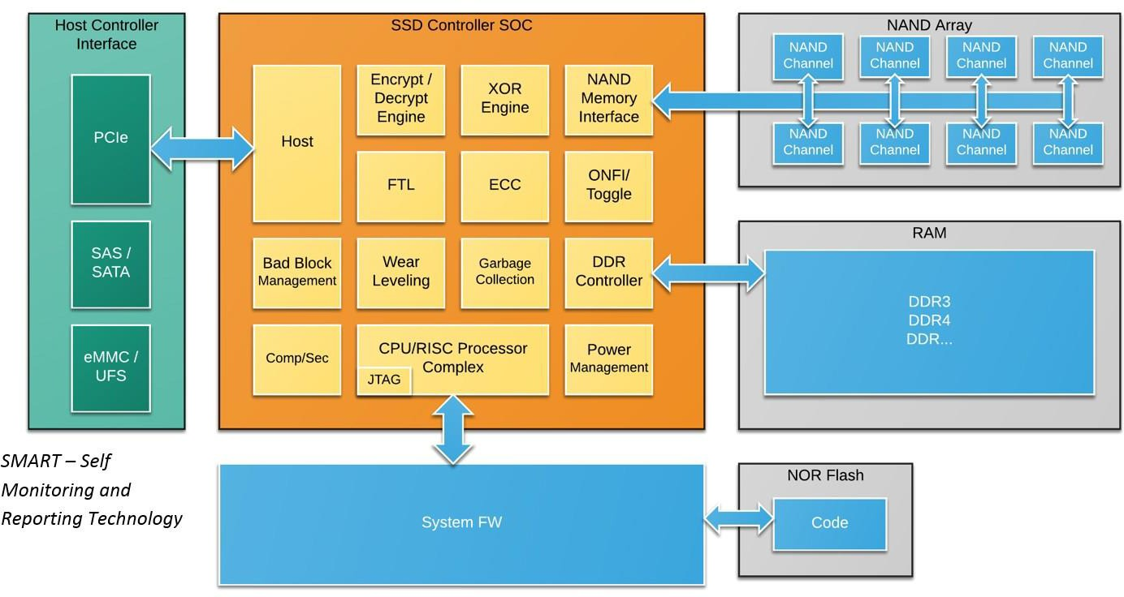
Flash Management is Complex
The controller of flash memory device is complex.
– It must perform a myriad of tasks to receive, monitor and deliver data efficiently and reliably.
36

Slide 37

Recall: System Architecture
There are two typical ways to address the inherent challenges of flash memory:
① Implementing a Flash Translation Layer in the device.
② Designing a Flash-aware File System in the host.
Application
Virtual File System
Legacy File System (e.g., Ext2, FAT, LFS)
Flash-aware File System (e.g., JFFS, YAFFS, F2FS)
Flash Translation Layer
Device
NAND Flash Memory
NAND Flash Memory
37

Slide 38
Flash-aware File System
Random writes are bad to flash devices.
Free space fragmentation
Degraded performance (due to GC)
Reduced lifetime (due to GC)
Writes must be reshaped into sequential writes.
Same as Log-structured file system (LFS) for HDD!
Most flash-aware file systems are derived from LFS:
Journaling Flash File System (JFFS)
Yet Another Flash File System (YAFFS)
Flash-Friendly File System (F2FS)
Publicly available, included in Linux mainline kernel since Linux 3.8.
38

Slide 39
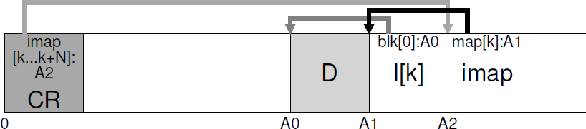
Log-structured File System
LFS first buffers all writes in an in-memory segment
and commits the segment to disk sequentially.
The Inode Map (imap)
Maps from an inode-number to the disk-address of the most recent version of the inode (i.e., one more mapping!).
Updated whenever an inode is written to disk.
Placed right next to where data block (D) and inode (I[k]) reside.
The Checkpoint Region (CR):
Records disk pointers to all latest pieces of imap.
Flushed to disk periodically (e.g., every 30 seconds).
39

Slide 40
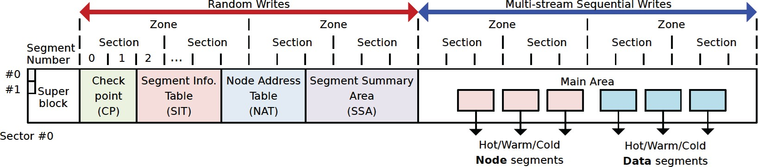
Flash-friendly On-Disk Layout
Key: There is no re-position delay in flash memory!
Flash Awareness
All the FS metadata are located together for locality.
Start address of main area is aligned to the zone size.
block=4KB; segment=2MB; section=n segments; zone=m sections.
File system cleaning (i.e., GC) is done in a unit of section.
Cleaning Cost Reduction
Multi-head logging for hot/cold data separation.
40

Slide 41
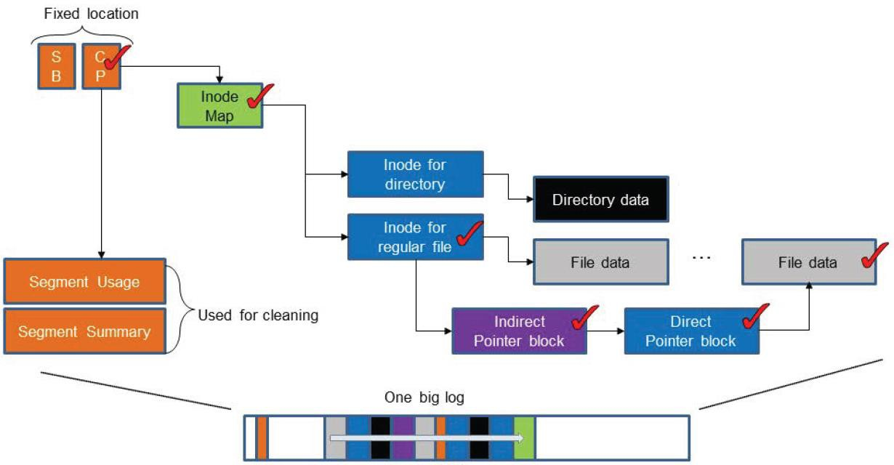
LFS Index Structure
LFS manages the disk space as one big log.
LFS has the update propagation problem.
If a leaf data block is updated its direct index block should be updated, too. Once the direct index block is written, again its indirect index block should be updated.
41

Slide 42
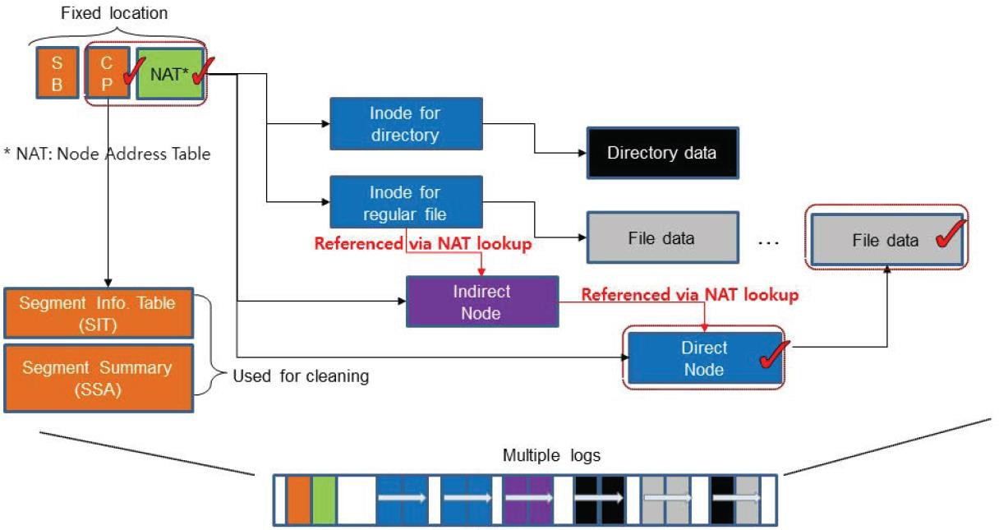
F2FS Index Structure
Restrained update propagation by node address table.
F2FS manages the flash space as multi-head log.
42

Slide 43
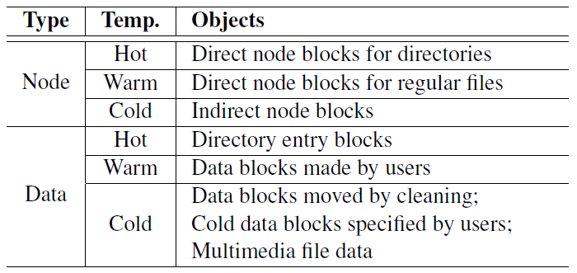
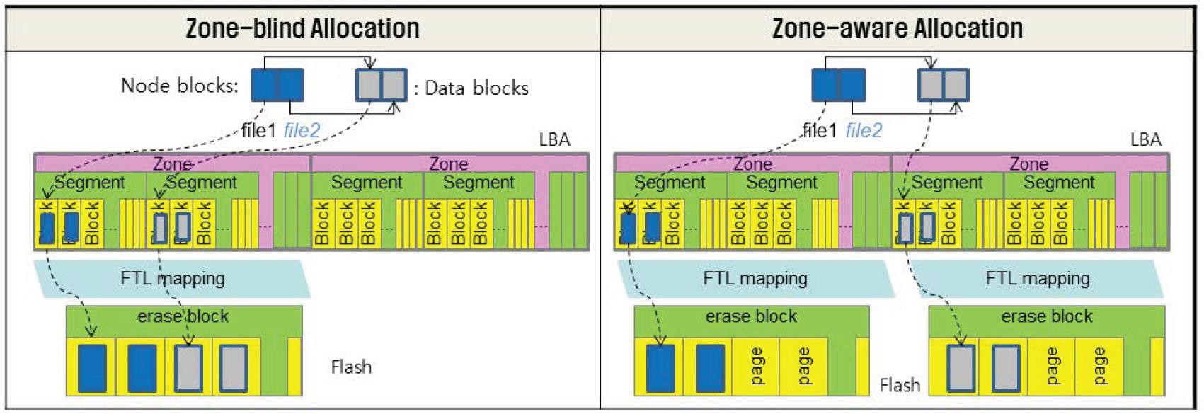
Multi-head Logging
Data temperature:
Node > Data
Direct Node > Indirect Node
Directory > User File
Separation of multi-head logs in NAND flash
Hot/cold separation reduces the cleaning (GC) overhead.
43

Slide 44

That’s all for today.
Notes:
Thank you for listening. Now, I would like to end today’s talk by the Q & A time.

