Slide 1

Embedded System HW 00: Environmental Setup
Department of Computer Science and Information Engineering
Shuo-Han Chen (陳碩漢), shchen@csie.ntut.edu.tw
Hong-Yue Technology Research Building 334
R 09:10 - 12:00
Notes:
Good Afternoon everyone
I am Shuo-Han Chen, a postdoctoral research fellow at Academia Sinica
It is a great honor to be invited by the department for being here today

Slide 2
Purpose for this Homework
Following steps are required to do your homework
Install WMware
Download Ubuntu’s iso
Install it on VMware’s virtual machine
Screen the installation result and submit your report
Complete following steps and form a PDF report
Follow the template
Submit your report on 北科 i 學園 PLUS
Deadline is schedule on 24:00 of next Thursday 9/24 (9/24 晚上12點)
2
Notes:
Here is more detail about me. I started working as a postdoctoral research fellow at the Institute of Information Science, Academia Sinica since March 2018
During my fellowship, I have been to the Purdue University USA and the Chinese University of Hong Kong for visiting
Before my fellowship, I spent two and half years for my phd degree at the CS Department of National Tsing Hua University
My research interests mainly lies in
the next generation memory/storage architecture designs
Emerging non-volatile memory and storage technologies
Low power system designs for artificial neural networks
In the past few years, I have revived few awards and a best paper nomination at DAC conference, which is a top rated conference in the EDA field

Slide 3
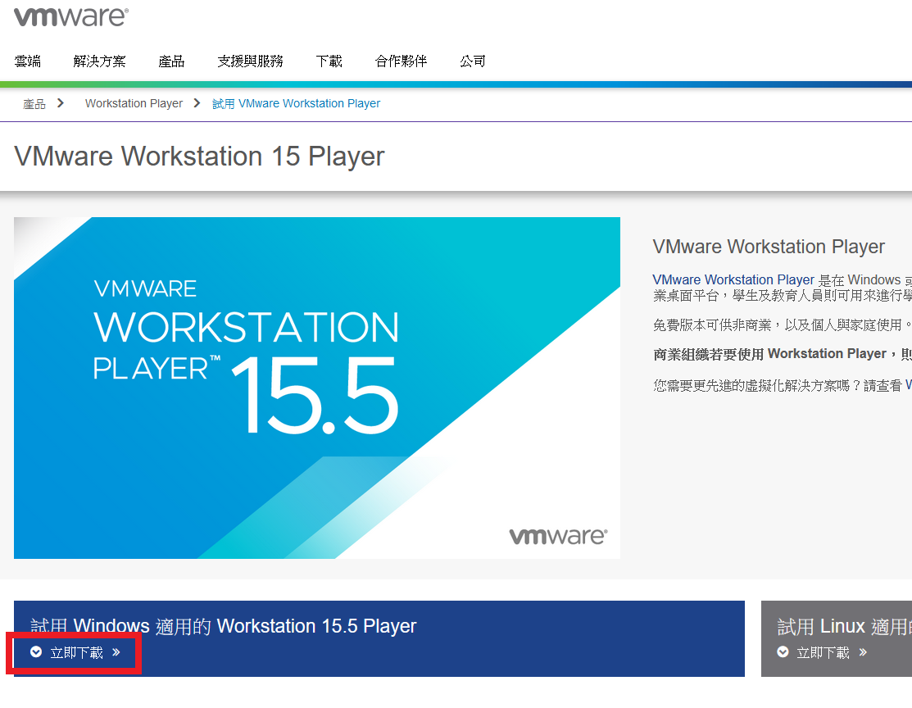
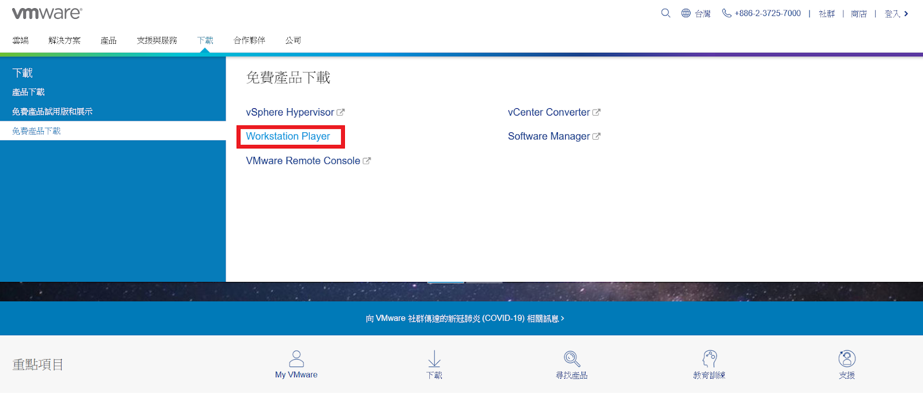
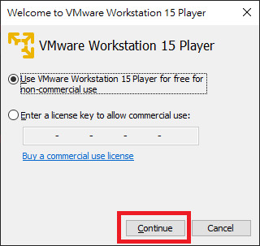
Install VMware
Go to https://www.vmware.com/tw.html
Download the VMware setup file
Execute it and keep clicking “Next” to install it
3
Notes:
Here is more detail about me. I started working as a postdoctoral research fellow at the Institute of Information Science, Academia Sinica since March 2018
During my fellowship, I have been to the Purdue University USA and the Chinese University of Hong Kong for visiting
Before my fellowship, I spent two and half years for my phd degree at the CS Department of National Tsing Hua University
My research interests mainly lies in
the next generation memory/storage architecture designs
Emerging non-volatile memory and storage technologies
Low power system designs for artificial neural networks
In the past few years, I have revived few awards and a best paper nomination at DAC conference, which is a top rated conference in the EDA field

Slide 4
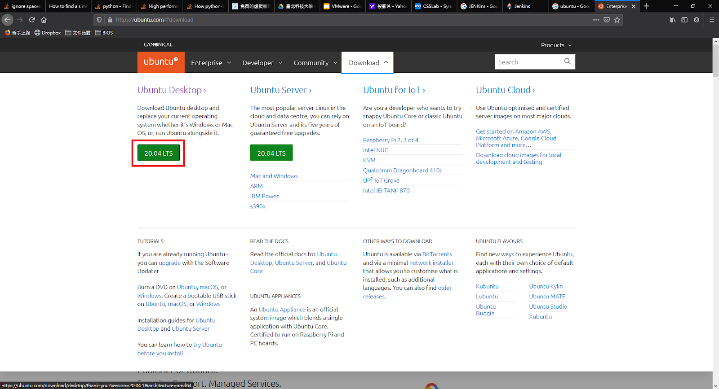
Download Ubuntu’s iso
Go to https://ubuntu.com/
4
Notes:
Here is more detail about me. I started working as a postdoctoral research fellow at the Institute of Information Science, Academia Sinica since March 2018
During my fellowship, I have been to the Purdue University USA and the Chinese University of Hong Kong for visiting
Before my fellowship, I spent two and half years for my phd degree at the CS Department of National Tsing Hua University
My research interests mainly lies in
the next generation memory/storage architecture designs
Emerging non-volatile memory and storage technologies
Low power system designs for artificial neural networks
In the past few years, I have revived few awards and a best paper nomination at DAC conference, which is a top rated conference in the EDA field

Slide 5
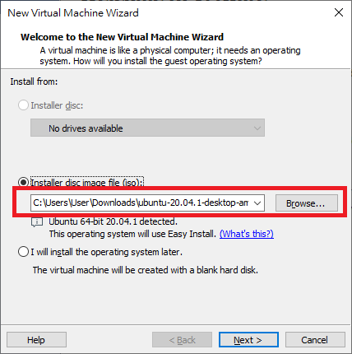
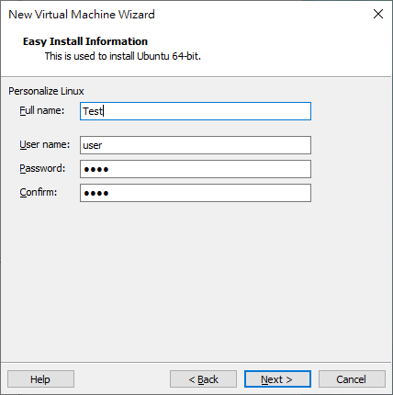
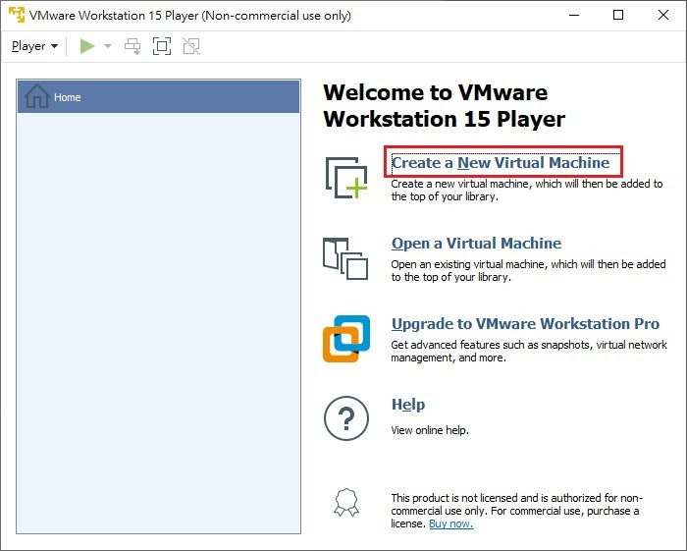
Install Ubuntu on Virtual Machine
Click “Create a New Virtual Machine”
Choose the iso file you just downloaded
Type the user name and password you like
5
Notes:
Here is more detail about me. I started working as a postdoctoral research fellow at the Institute of Information Science, Academia Sinica since March 2018
During my fellowship, I have been to the Purdue University USA and the Chinese University of Hong Kong for visiting
Before my fellowship, I spent two and half years for my phd degree at the CS Department of National Tsing Hua University
My research interests mainly lies in
the next generation memory/storage architecture designs
Emerging non-volatile memory and storage technologies
Low power system designs for artificial neural networks
In the past few years, I have revived few awards and a best paper nomination at DAC conference, which is a top rated conference in the EDA field

Slide 6
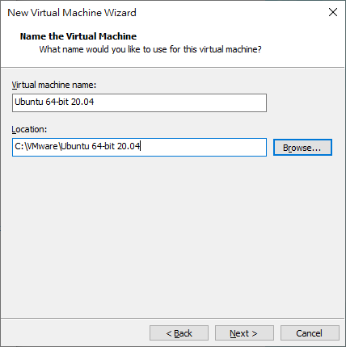
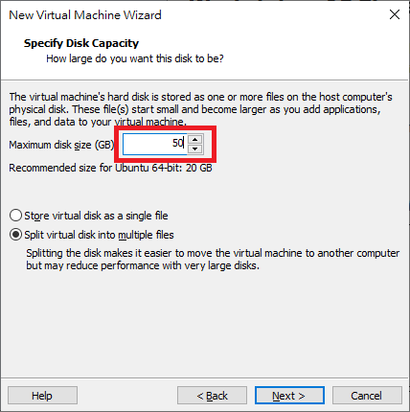
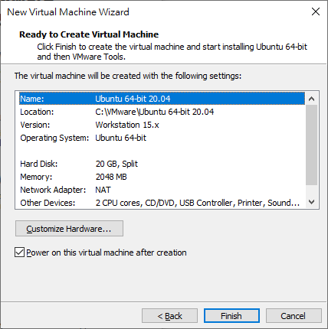
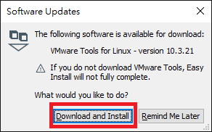
Click “Next”.(or you may change the location of your virtual machine here)
Set the disk size to at least 50GB
Click “Next”
Click “Download and Install”
Wait the virtual machine for Installing Ubuntu
6
Notes:
Here is more detail about me. I started working as a postdoctoral research fellow at the Institute of Information Science, Academia Sinica since March 2018
During my fellowship, I have been to the Purdue University USA and the Chinese University of Hong Kong for visiting
Before my fellowship, I spent two and half years for my phd degree at the CS Department of National Tsing Hua University
My research interests mainly lies in
the next generation memory/storage architecture designs
Emerging non-volatile memory and storage technologies
Low power system designs for artificial neural networks
In the past few years, I have revived few awards and a best paper nomination at DAC conference, which is a top rated conference in the EDA field

Slide 7
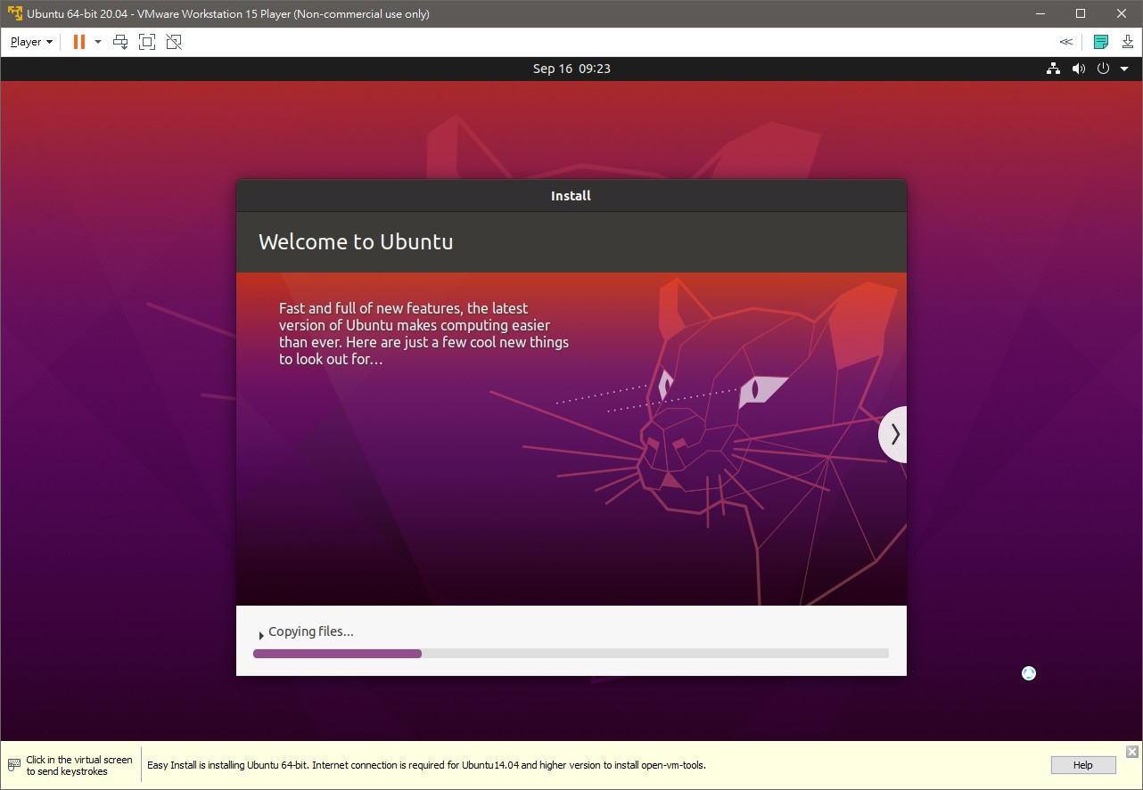
Screen desktop of your virtual machine
Login into your virtual machaine
Screen shot the desktop and put it into report
7
Notes:
Here is more detail about me. I started working as a postdoctoral research fellow at the Institute of Information Science, Academia Sinica since March 2018
During my fellowship, I have been to the Purdue University USA and the Chinese University of Hong Kong for visiting
Before my fellowship, I spent two and half years for my phd degree at the CS Department of National Tsing Hua University
My research interests mainly lies in
the next generation memory/storage architecture designs
Emerging non-volatile memory and storage technologies
Low power system designs for artificial neural networks
In the past few years, I have revived few awards and a best paper nomination at DAC conference, which is a top rated conference in the EDA field

Slide 8

Q & A
Remember to submit your report.
Deadline is set to 9/24 24:00 !
Late submission will be not accepted !
Notes:
Thank you for listening. Now, I would like to end today’s talk by the Q & A time.

