Slide 1

LIBRARY MANAGEMENT
Team Members:
- Shajith Ahamed s
Vinoth P
Nishanth M K
Parani kumar
Nisha A
Nijishri M

Slide 2

PROJECT OVERVIEW
OBJECTIVE : To find the location of the book in the library
KEY FEATURES :
INPUT : Book(eg.c,python)
OUTPUT : eg.book placed in 2nd row
CONCEPT USED :
Conditions Statement
String

Slide 3

STEPS IN THE PROGRAM
Input the required book :
Accept the language and type the book from the user.
Simple Formula :
Using a pre-defined logic to find the book from library.
Output of the book :
It displays the accurate place of the book.

Slide 4

C CODE SNIPPET
#include <stdio.h>
#include<string.h>
int main()
{
int a=0,b=0;
char booktype[50];
char category[50];
char str11[20]={"program_language"};
char str12[10]={"c_lang"};
char str13[7]={"python"};
char str14[5]={"c++"};
char str15[5]={"java"};
char str21[10]={"english"};
char str22[10]={"friction"};
char str23[10]={"grammar"};
char str24[10]={"history"};
char str25[10]={"story"};
printf("\t\t\t 'WELCOME TO LIBARRY OF RATHINAM TECH CAMPUS' \n \n");
printf(" THE LIBRARY HAS 1:program_language \n ");
printf("\t\t 2:english");
printf( "\n ENETR THE TYPE OF BOOK WHICH YOU WANT:");
scanf("%s",&booktype);

Slide 5
if(strcmp(booktype,str11)==0)
{
printf(" THERE ARE: c_language \n");
printf("\t :python\n");
printf("\t :c++\n");
printf("\t :java\n");
printf("WHICH LANGUAGE BOOK YOU NEED :");
scanf("\n%s",category);
if(strcmp(category,str12)==0)
{
printf("THE BOOK IS IN 1ST ROW 1ST COLUMN RIGHT SIDE ");
a++;
}
if(strcmp(category,str13)==0)
{
printf("THE BOOK IS IN 1ST ROW 2ND COLUMN RIGHT SIDE ");
a++;
}
if(strcmp(category,str14)==0)
{
printf("THE BOOK IS IN 1ST ROW 1ST COLUMN LEFT SIDE ");
a++;
}
if(strcmp(category,str15)==0)
{

Slide 6

printf("THE BOOK IS IN 1ST ROW 2ND COLUMN LEFT SIDE ");
a++;
b++;
}
if(a==0)
{
printf("THIS PROGRAM LANGUAGE IS NOT IN THE LIBRARY");
} }
if(strcmp(booktype,str21)==0)
{
printf(" THERE ARE:1fiction \n");
printf("\t 2:grammer\n");
printf("\t 3:history\n");
printf("\t 4:story\n");
printf("WHICH TYPE OF ENGLISH BOOK YOU NEED :");
scanf("\n%s",category);
if(strcmp(category,str22)==0)
{
printf("THE BOOK IS IN 2ND ROW 1ST COLUMN RIGHT SIDE ");
a++;
}
if(strcmp(category,str23)==0)
{

Slide 7
printf("THE BOOK IS IN 2ND ROW 2ND COLUMN RIGHT SIDE ");
a++;
}
if(strcmp(category,str24)==0)
{
printf("THE BOOK IS IN 2ND ROW 1ST COLUMN LEFT SIDE "); a++; } if(strcmp(category,str25)==0) {
printf("THE BOOK IS IN 2ND ROW 2ND COLUMN LEFT SIDE ");
a++;
b++;
}
if(a==0){
printf("THIS TYPE OF ENGLISH BOOK ARE NOT IN OUR LIBRARY "); } }
if(b==0){
printf("THIS TYPE OF BOOK IS NOT IN THE LIBRARY");
}
return 0;
}

Slide 8
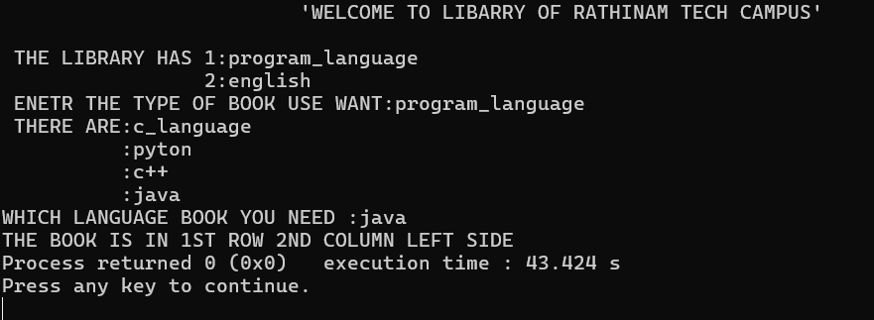
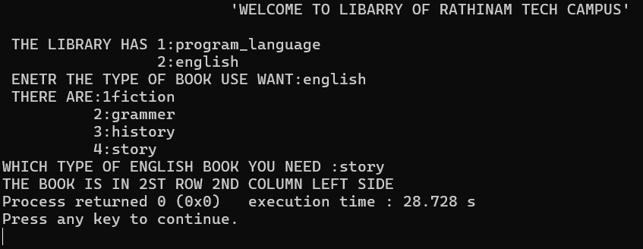
RUNNING PROCESS
INPUT : PROGRAM_LANGUAGE
JAVA
OUTPUT : THE BOOK IS IN 1ST ROW 2ND COLUMN LEFT SIDE
INPUT : ENGLISH
STORY
OUTPUT : THE BOOK IS IN 2ND ROW 2ND COLUMN LEFT SIDE

Slide 9
ADVANTAGES
Efficient Classification: Library management systems (LMS) allow for categorizing and organizing books, journals, and other resources for easy retrieval.
Reduced Human Error: Automation minimizes manual errors in cataloging and record-keeping.
Real-time Availability: Users can check the availability of resources in real-time, avoiding wasted trips to the library.
Reservation Features: Users can reserve books or resources ahead of time, ensuring availability.
Easy Registration: User registration and management are simplified, allowing for quick access to library services.

Slide 10


