Slide 1

Detailed sketches for GravityJump
Maximilian Armuß, Julian Kunert, Robin Mayer, Kerstin Pfaffinger, Michael Vynogradov
Technische Universität München
TUM Department of Informatics
22. Mai 2022

Slide 2
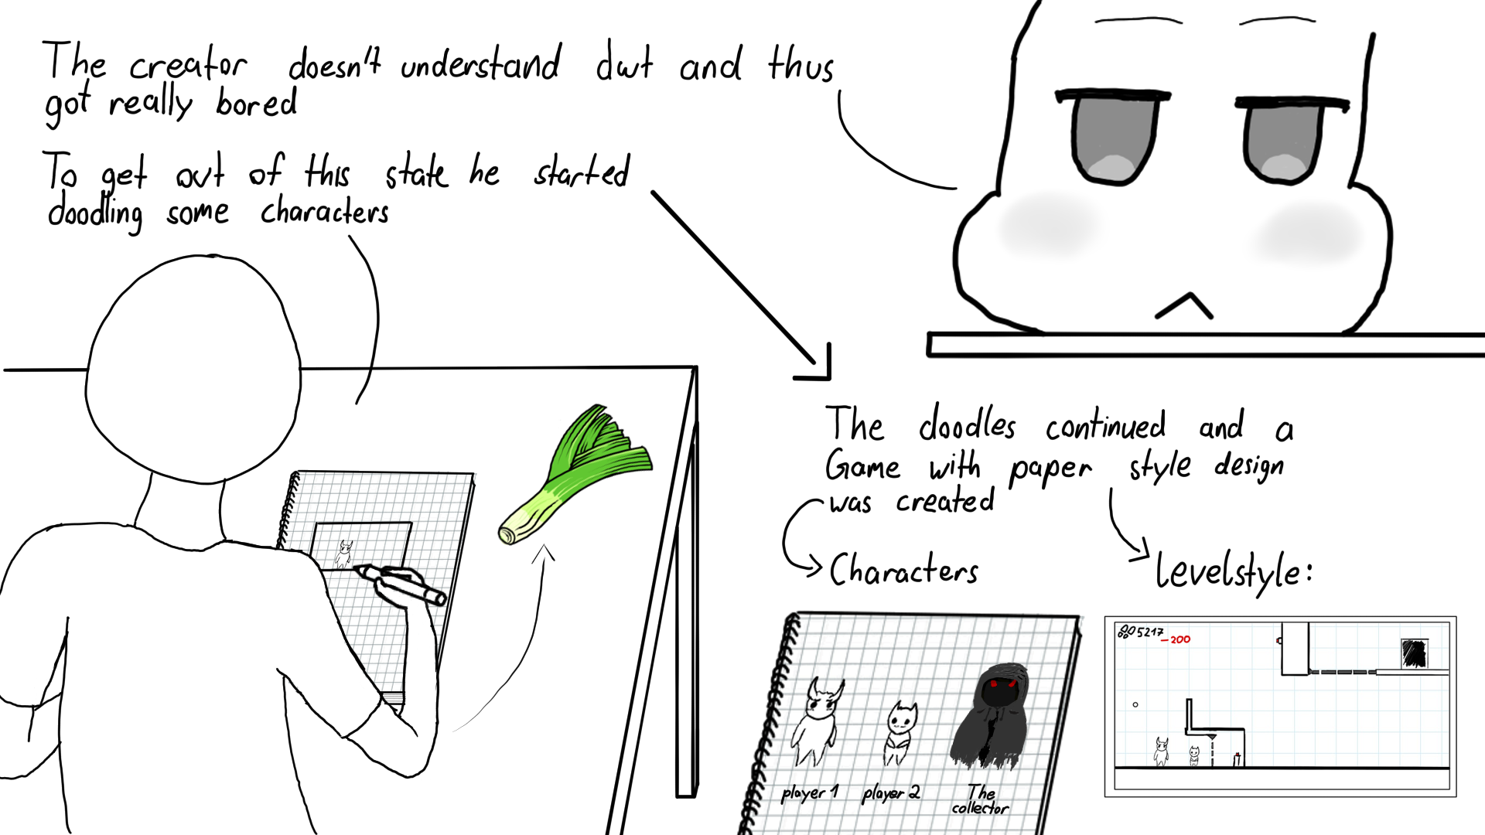
Backstory

Slide 3
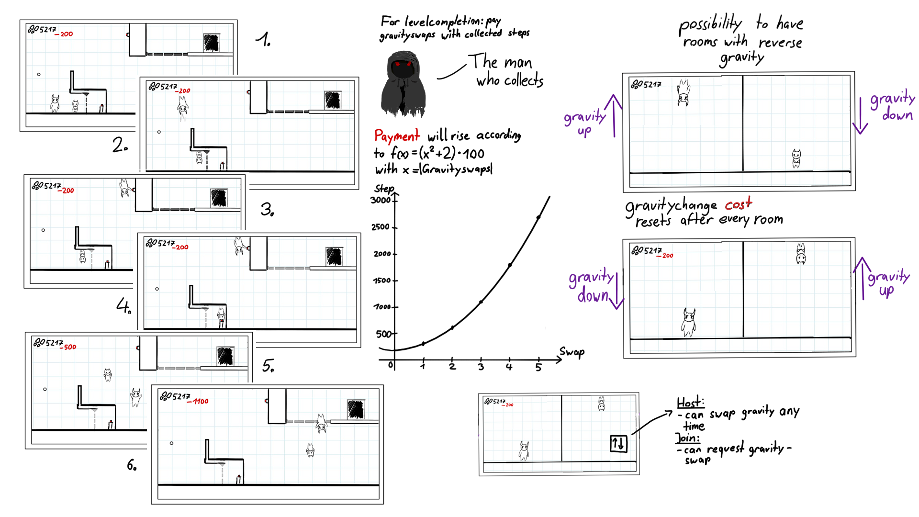
Gravityswap

Slide 4
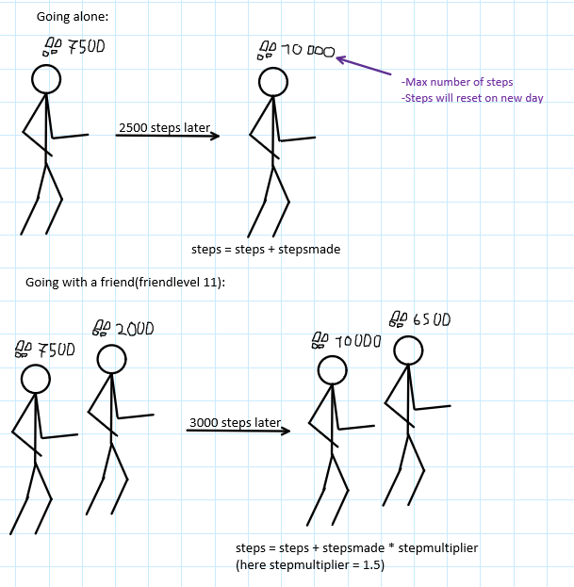
Step-System
-Collect steps in real life and use them as payment

Slide 5
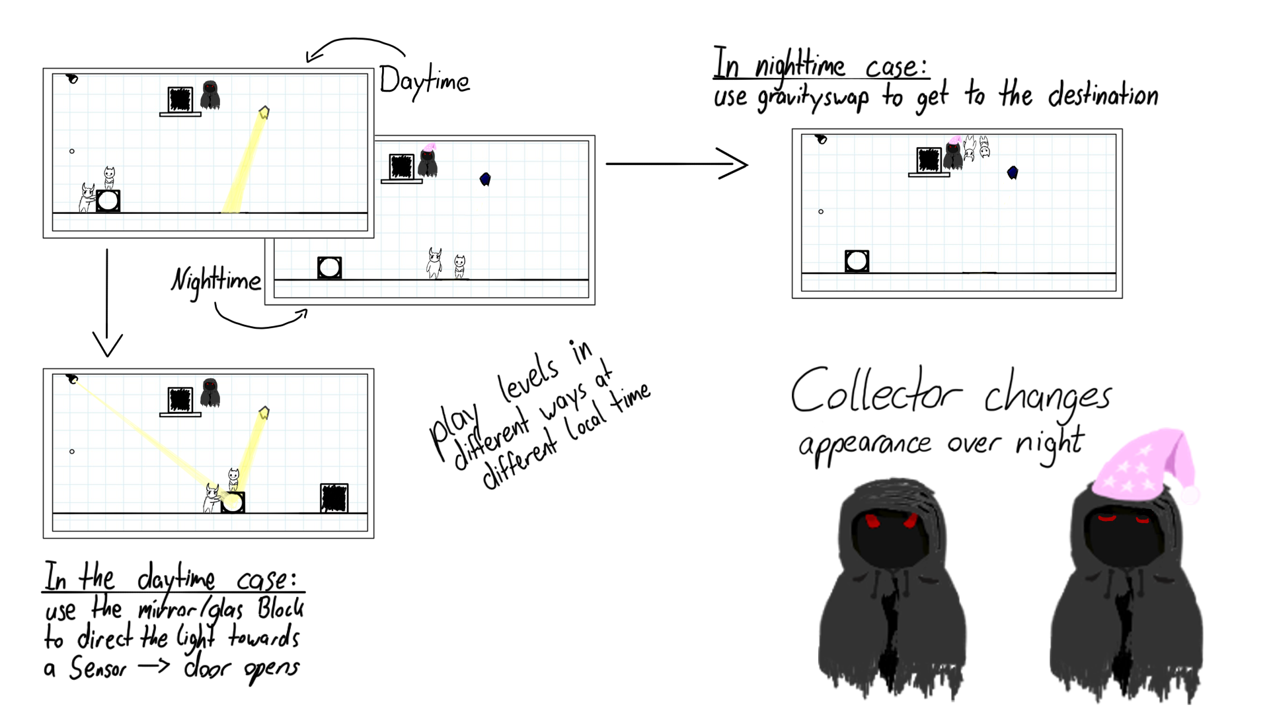
Day and night levels

Slide 6
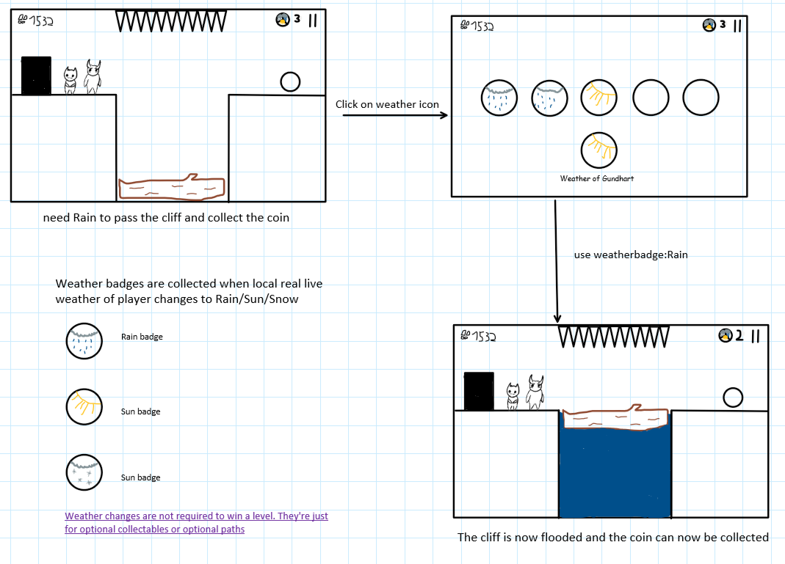
Weather based Design

Slide 7
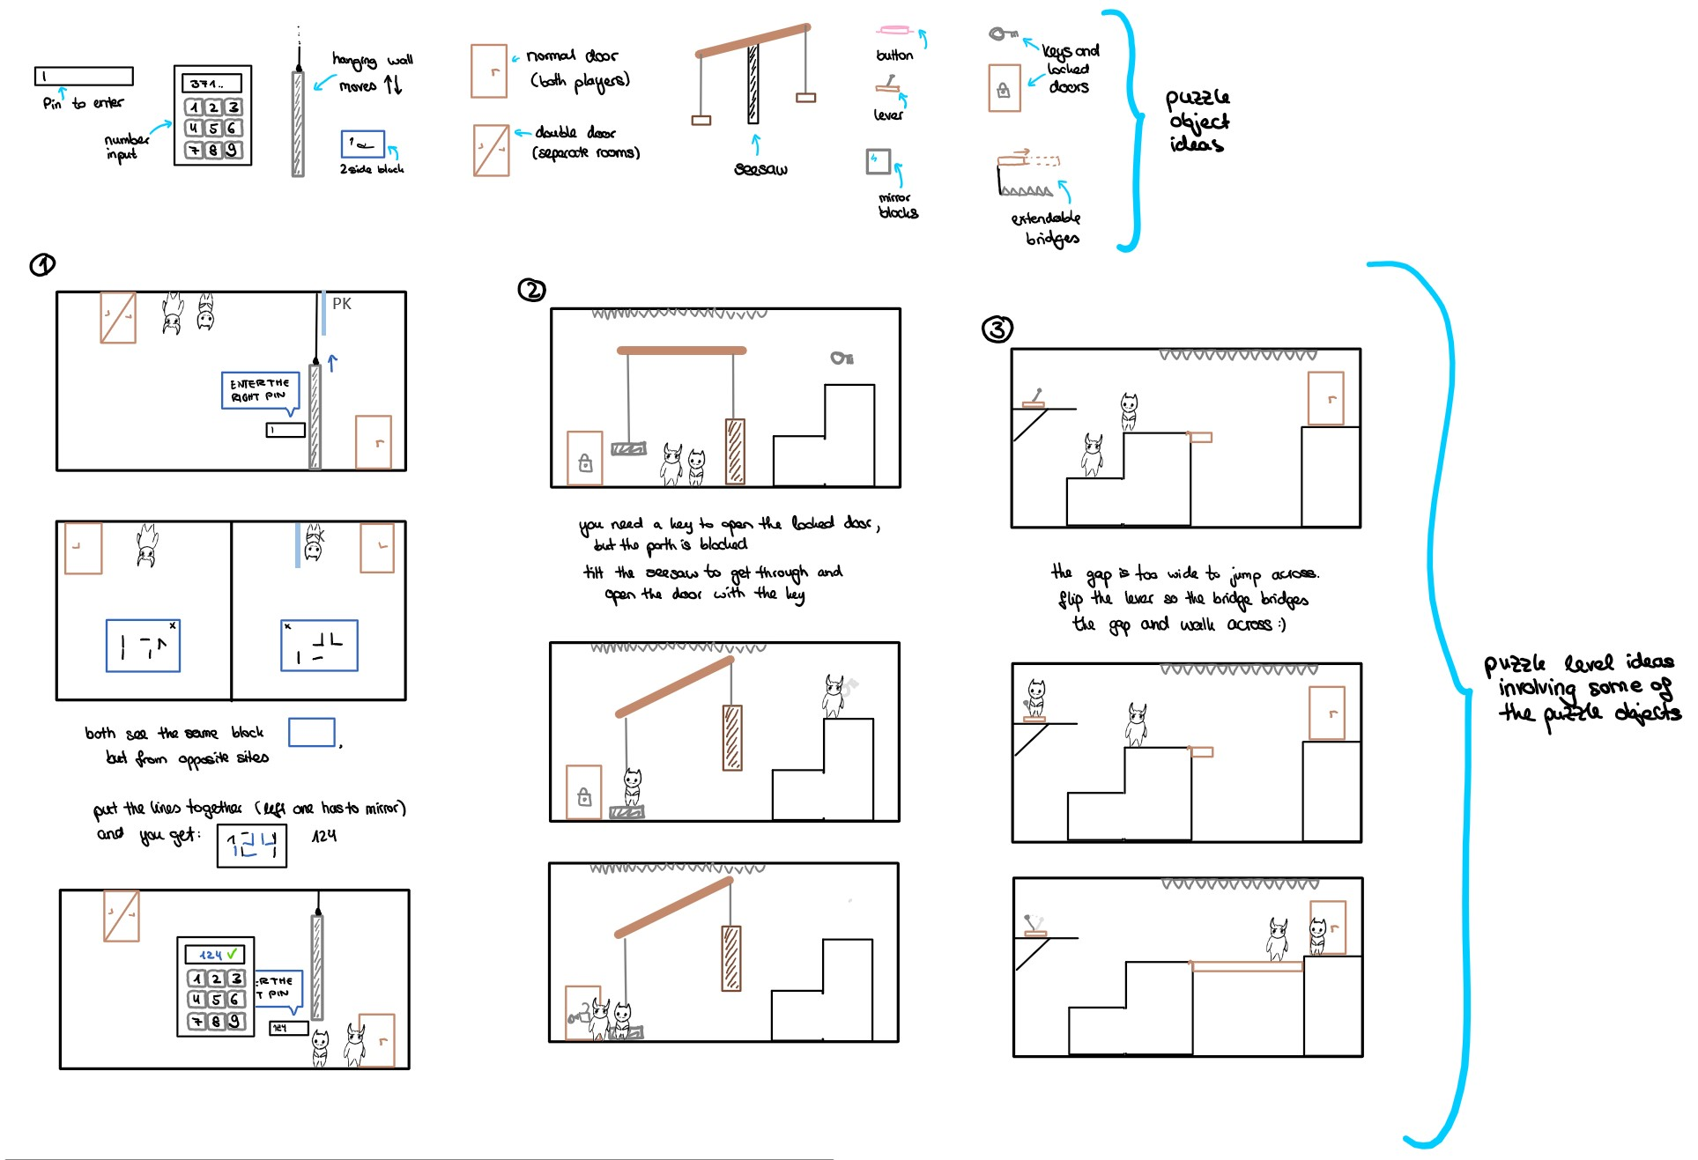
Puzzle examples

Slide 8
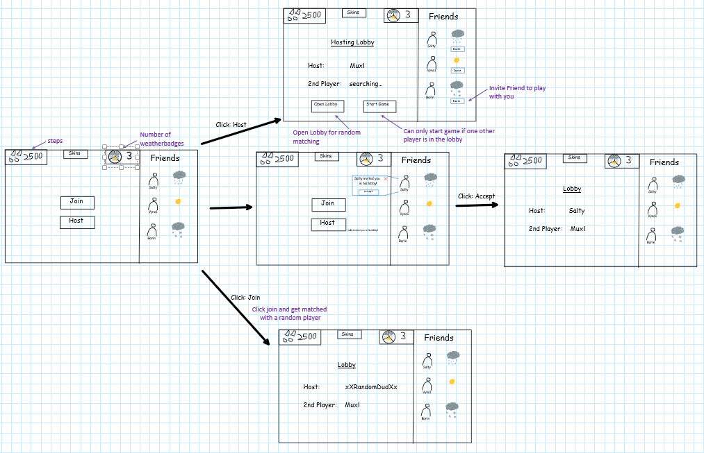
Join/Host

Slide 9
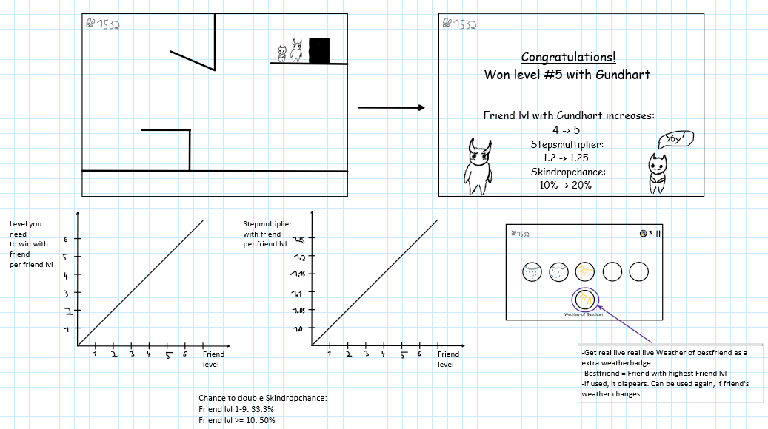
Friend Bonus

Slide 10
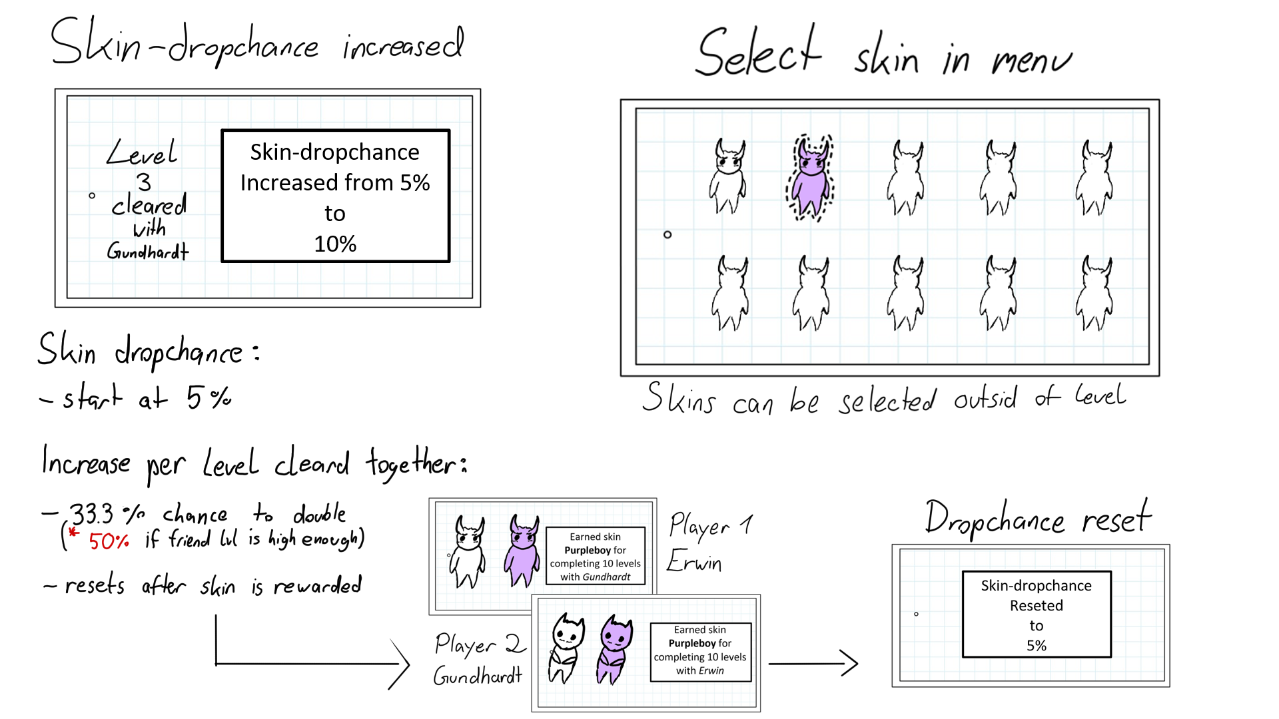
Skin-System

Slide 11
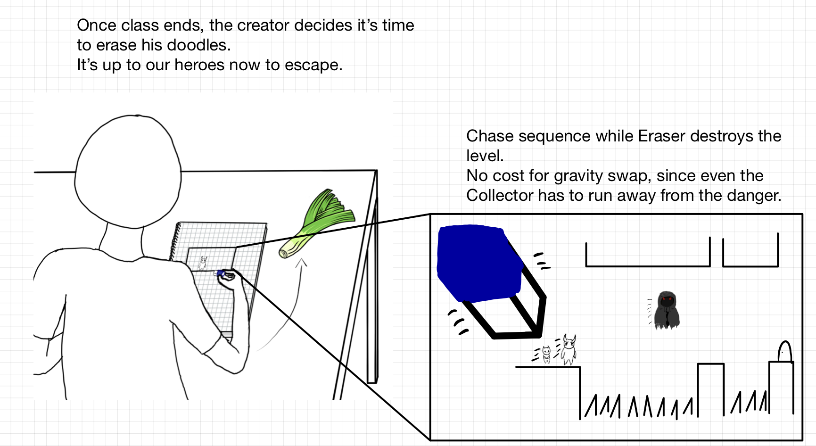
Rubber-Run

