Slide 1

Basic Details of the Team and Problem Statement
Ministry/Organization Name/Student Innovation: National Technical Research Organisation,(NTRO)
PS Code: SIH-1446 Problem Statement Title : Developing a GUI based hardening script for Ubuntu operating system with flexibility to cater for organizational security policies Team Name: ShuLin Team Leader Name: Shivam Shandilya Institute Code (AISHE): ASET Institute Name: Amity School of Engineering and Technology
Theme Name: GUI Based Hardening Script for Ubuntu

Slide 2
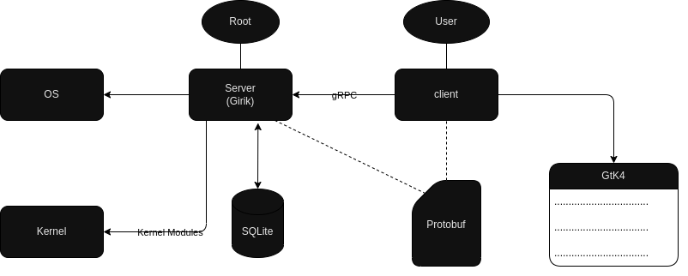
Idea/Approach Details
Add process flowchart or simulated image of prototype
Describe your Idea/Solution/Prototype here
Revolutionizing Ubuntu Security!
✨ Ditch the Complex Commands, Embrace Visual Simplicity:
ShuLin's sleek GUI redefines Ubuntu hardening. No more mind-boggling command lines or cryptic configs. With ShuLin, security is at your fingertips.
✨ User-Centric Design, No Tech Jargon:
ShuLin is all about you, the end user. Our intuitive interface is crystal clear, sparing you the tech mumbo-jumbo. We put the "easy" in security.
✨ Step-by-Step Guidance, No Tech Experts Needed:
We've got your back every step of the way. ShuLin's instructions are as clear as daylight, no need for fancy training or tech manuals.
Describe your Technology Stack here
Elevating Ubuntu Security with our Cutting-Edge Tech Stack!
Frontend Magic:
✨ Python (GTK4) for Sleek, Intuitive Interfaces
✨ Libadwaita for a Modern, Pixel-Perfect Look
✨ Cambalache for Smooth User Experience
Backend Brilliance:
🛡️ Rust for Rock-Solid Security
🛡️ gRPC for Lightning-Fast Communication
🛡️ Tonic for Ultra-Responsive Performance
Experience the Future of Ubuntu Security Today and fortify your system with style.

Slide 3
Idea/Approach Details
Describe your use cases here
Describe your Dependencies / Show stopper here
Tailored Solutions for NTRO & Beyond!
DevOps Dynamite: - Turbocharge your DevOps workflows with seamless, visual security enhancements.
Admins' Dream: - System administrators rejoice! ShuLin brings simplicity to Ubuntu hardening.
IT Gurus Unite: - IT consultants, meet your new secret weapon for fortified Ubuntu environments.
SME Supercharge: - Small to Medium-sized Enterprises, gear up for enterprise-level security without the complexity.
EdTech Excellence: - Educational Institutions, prepare for a new era of secure, streamlined Ubuntu systems.
Philanthropy Fortified: - Non-Profit Organizations, safeguard your mission with ShuLin's intuitive security solutions.
Regulatory Ready: - Achieve compliance effortlessly with ShuLin's adherence to industry standards.
Remote Warriors: - Embrace secure remote work environments with ShuLin's user-friendly approach.
Data Fortress: - Defend your server farms and data centres with ShuLin's robust security protocols.
Unmatched Efficiency, Zero Hassle!
Lean, Mean & Dependable: - Minimal external dependencies for a seamless security boost.
All-in-One Powerhouse: - ShuLin is a self-contained package, ensuring a hassle-free experience.
Harmony in Coexistence: - No conflicts, no worries! ShuLin plays well with your existing software.
Resource Whisperer: - Optimize resource use while fortifying your Ubuntu environment.
Plug & Protect: - Designed for standard Ubuntu installations, ensuring effortless compatibility.
Time-Tested Resilience: - Cross-version compatibility guarantees security across Ubuntu releases.
Guidance at Every Step: - Clear documentation and robust support for a worry-free security journey.

Slide 4
Team Member Details
Team Leader Name: Shivam Shandilya
Branch: Btech Stream: CSE Year : III
Team Member 1 Name: Priyanshu Verma
Branch: Btech Stream: CSE Year : III
Team Member 2 Name: Manav Kumar Dubey
Branch: Btech Stream: CSE Year : III
Team Member 3 Name: Jigyasa Kumari
Branch: Btech Stream: CSE Year : III
Team Member 4 Name: Tanishq Pathak
Branch: Btech Stream: CSE Year : III
Team Member 5 Name: Shambhavi Mishra
Branch: Btech Stream: CSE Year : III
Team Mentor 1 Name: Dr Nitish Kumar
Category: Academic

