Slide 1
Solution of Printed Circuit Board Assembly
Group 6
Vyom Khanna 28965736
Zeyan Kang 34061835
Jiankun Li 35182911
Deran Kong 34704507
Zheng Ju 34887946
Jun Jin 33718628

Slide 2
CONTENTS
01
02
PROBLEM STATEMENT
APPROACHES
03
04
SELECTED SOLUTION
CONCLUSION

Slide 3
01
PROBLEM STATEMENT

Slide 4
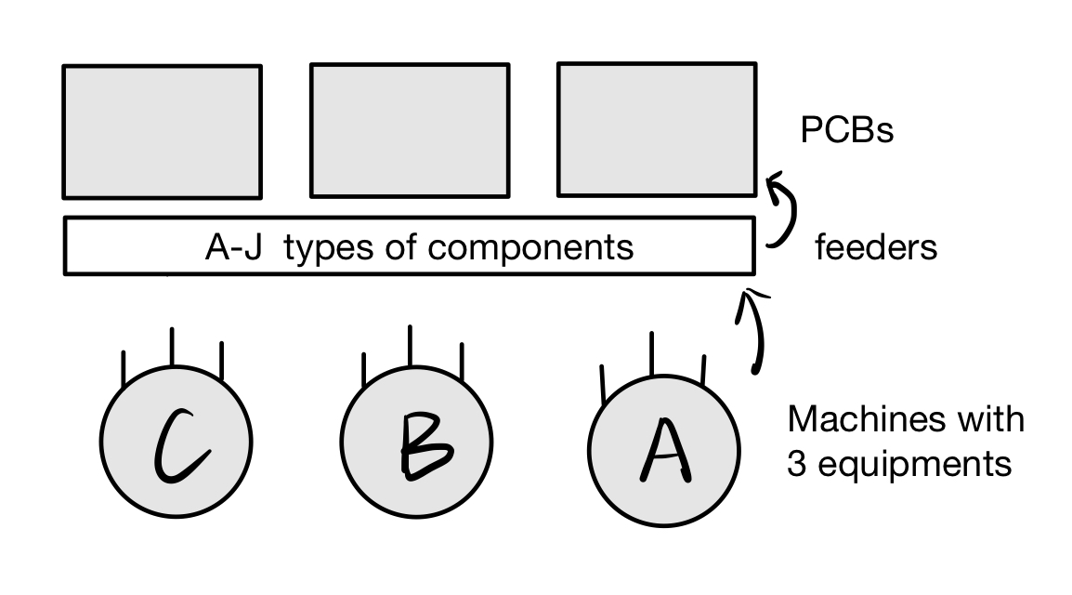
1. PROBLEM STATEMENT
Our main goal is to maximize the throughput of the assembly line by minimizing the total traveled distance of machine arms, which need to pick up the components from feeders and place them on PCBs under specific constraints.

Slide 5
02
APPROACHES
1. Allocate equipment
2. Find Routes
3. Allocate Components
4. Optimize Routes

Slide 6
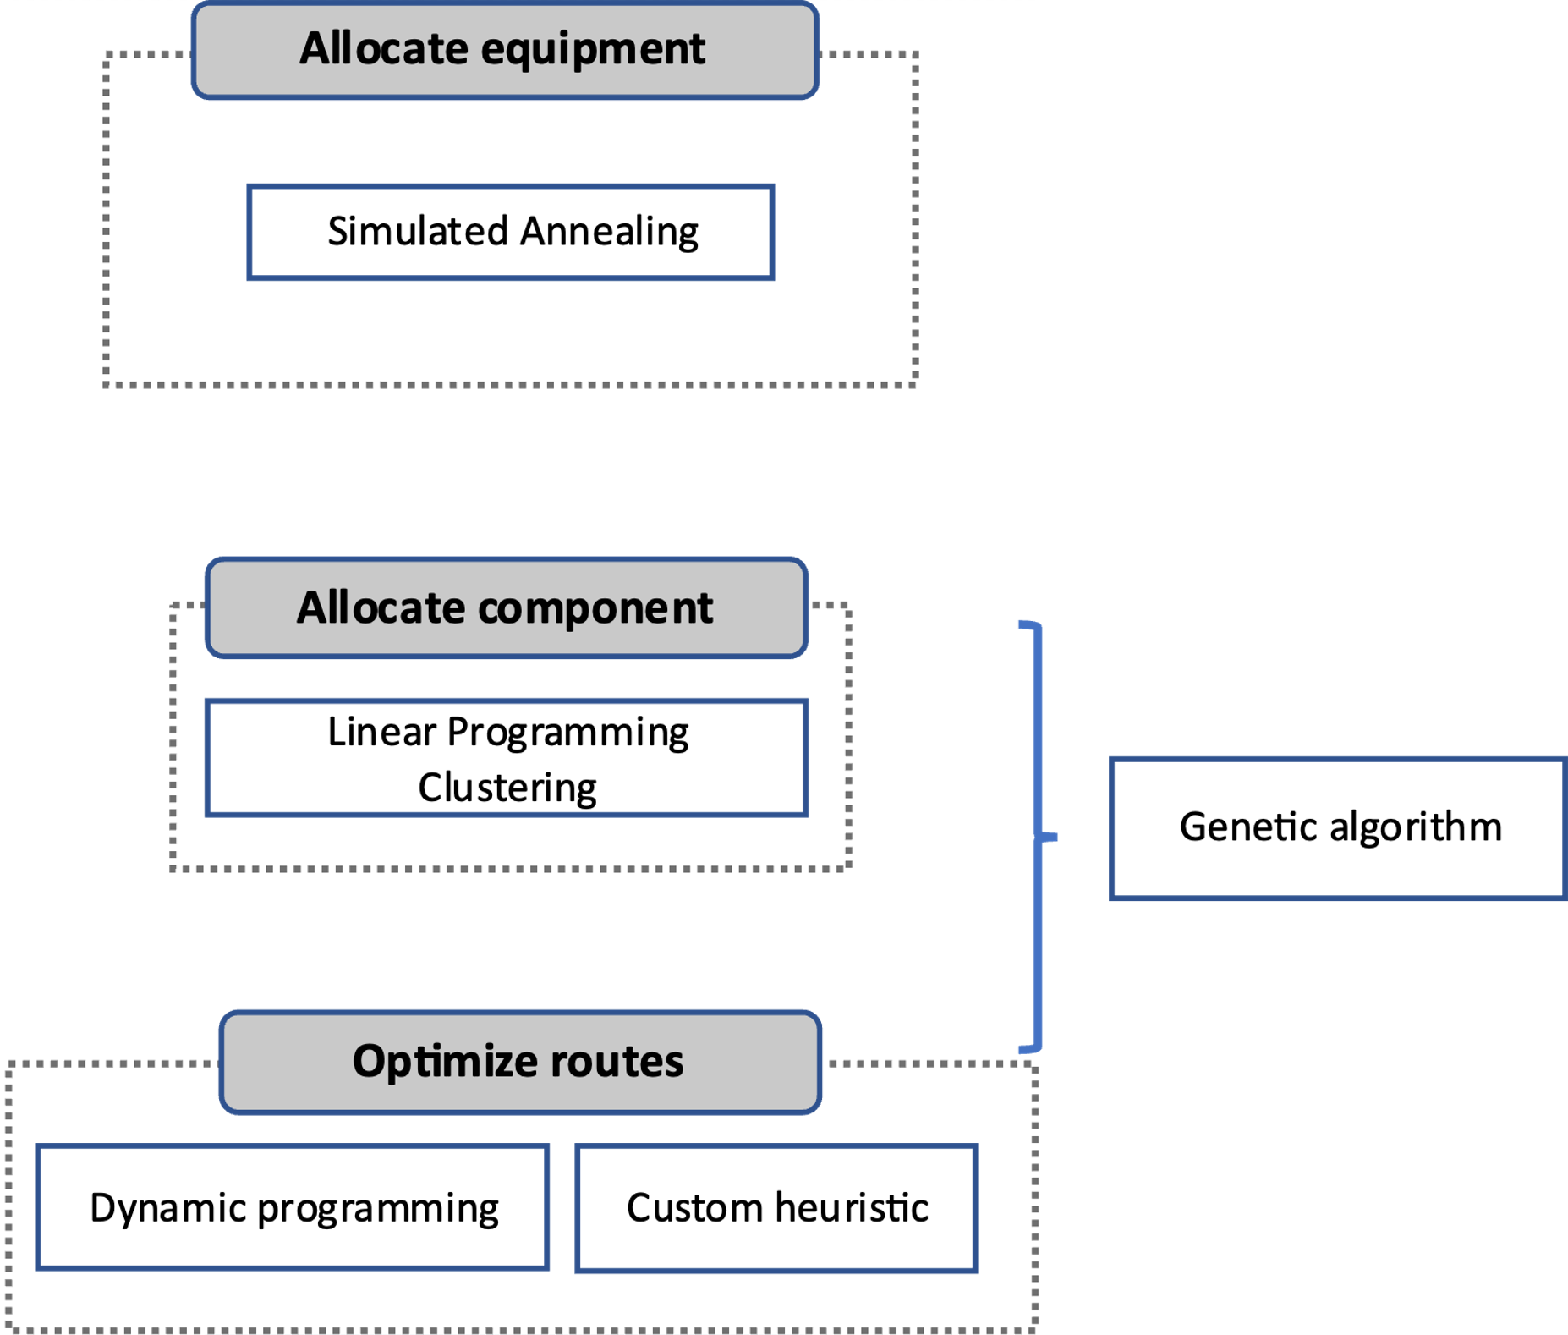
2. APPROACH
To ensure the reliability and stability of our model, we have simplified the problem into three distinct stages
Determine the equipment for the heads of each machine.
Allocate tasks to each machine.
Minimize the operational distance for the machines
For each of these stages, we have explored various methodologies, including the annealing algorithm, genetic algorithm, and dynamic programming.

Slide 7
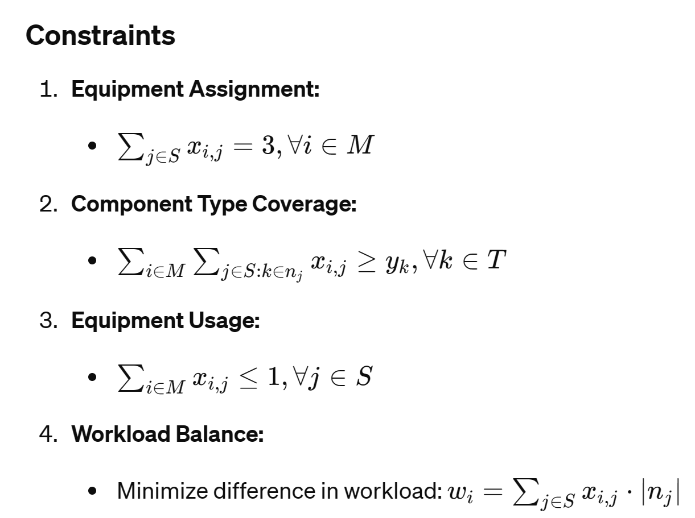
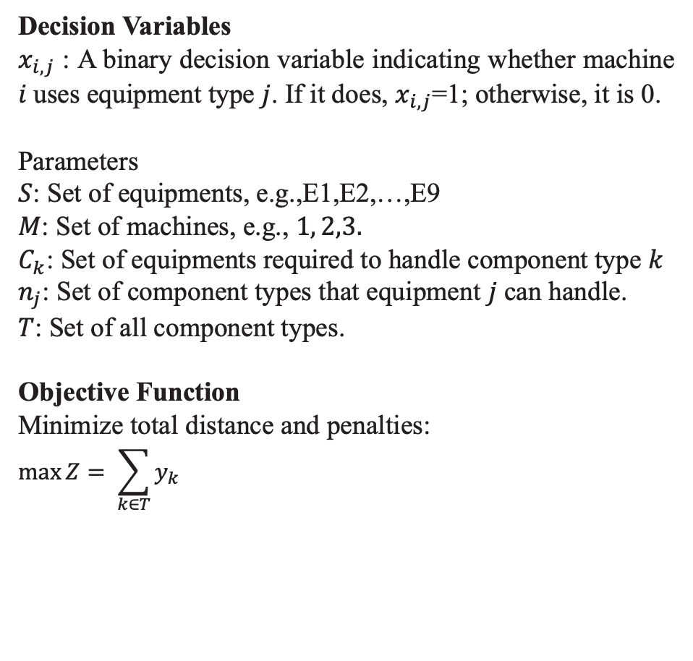
2.1 Allocate equipment: Model Structure
To allocate the equipment, the objective function was be set by maximizing the total number of covered component types for each machine to guarantee the potential capability of our system.
Decision Variables
​$x_{i,j}$ : A binary decision variable indicating whether machine 𝑖 uses equipment type 𝑗. If it does, $x_{i,j}$=1; otherwise, it is 0.
Parameters
$S$: Set of equipments, e.g.,E1,E2,…,E9
$M$: Set of machines, e.g., $1, 2,3.$
$C_{k}$: Set of equipments required to handle component type $k$
$n_{j}$: Set of component types that equipment 𝑗 can handle.
$T$: Set of all component types.
Objective Function
Minimize total distance and penalties:
$$\max{Z= \sum_{k∈T}{y_{k}}}$$

Slide 8
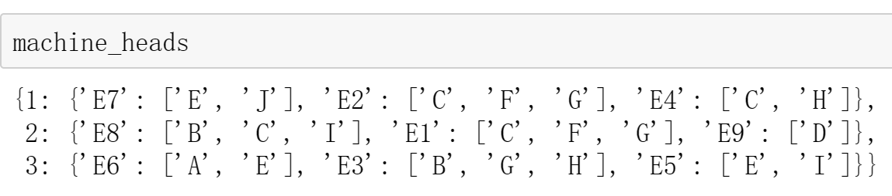
2.1 Allocate equipment: Simulated Annealing Algorithm
We applied Simulated Annealing Algorithm , which randomly generates the initial configurations and measures the performance as 'temperature’. With its decreasing, the system gradually accepts only superior configurations, leading towards an optimal solution output.
The process is structured into several key phases including
Initialization
Temperature Control
Configuration Acceptance
Convergence and Output.
The output includes the optimized equipment assignment for each machine with simulated annealing consistently maintained a fitness level of 5, ensuring maximum coverage of component types and workload balance.

Slide 9
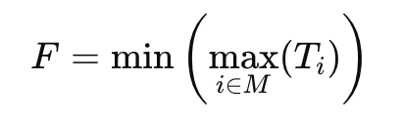
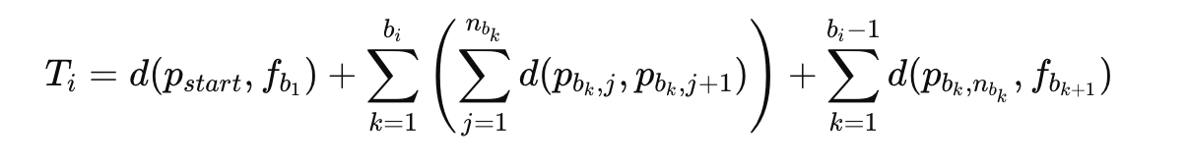
2.2 Find Routes：Genetic Algorithm
Genetic algorithms efficiently achieve minimization of target values by rapidly converging on highly optimal solutions within complex solution spaces.
By setting the objective to minimize the maximum time taken by any machine to complete the task, taking into account of constraints such as machine capability, the process encompasses initializing a solution, generating boarder solutions by crossover and mutation, and then efficient computing and outputting the best route throughout iterations.
Objective：
However, the initial result is not ideal, probably because of unsuitable parameter settings, lack of diversity maintenance within the population, ect.
, where

Slide 10
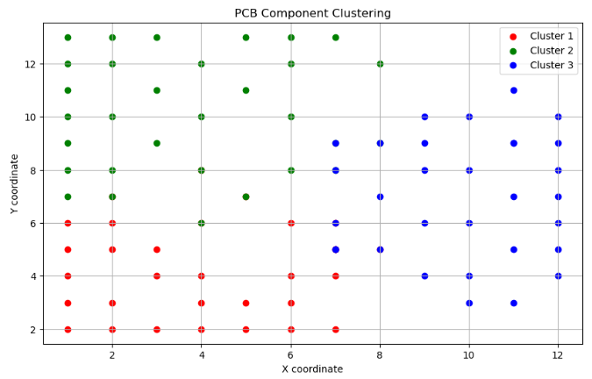
2.3 Allocate Components1: Clustering
Firstly, we utilized the clustering method KNN, which assigns data points to clusters based on the nearest center point measured by the distance between target points on the PCBs.
However, the clustering method only considers the distribution position of the components on the PCB board without considering the distance from the feeders, so it can only ensure that the relative positions between the components are closest, but cannot ensure that the finishing and moving distance is close.

Slide 11
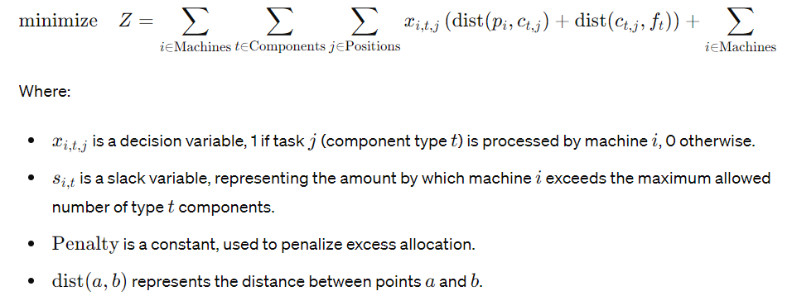
2.3 Allocate Components2: Linear Programming(LP)
We consider this problem into a basic linear problem to minimize the working distance with a penalty measured by excess tasks compared within machines.
With the main constraints of tasks limitation (exactly equal 1), machine capability, We obtain the task list for each machine.

Slide 12
2.4 Optimize Routes
Two approaches are considered here:
Dynamic Programming : Breaks down complex problems into simpler subproblems, constructing the optimal solution from these individual solutions.
Although DP can explore all possibilities and identify globally optimal solutions effectively, its computational efficiency decreases significantly with an increase in input variables. Thus, despite its theoretical feasibility, DP is not practical for this problem due to the excessive computational overhead.
Customized heuristic model :
Instead, by combining the wide solution space based on heuristic algorithm and using rules-based logic to reduce it, we designed a function in the same objective function which minimized the maximum distance to solve problems faster.

Slide 13
03
SELECTED SOLUTION
Distribution of equipment
Distribution of component
Optimize route

Slide 14
3 SELECTED SOLUTION 3.1 Distribution of equipment
In the first step of this problem we used a simulated annealing algorithm to find the optimal distribution of equipment across three machines.
By requiring the final distribution to cover as many different types of components as possible and try to balance the workload between machines.
Penalize component types that require multiple machines to process together.
Machine A
Machine B
Machine C
E1
E7
E9
E4
E6
E8
E2
E3
E5

Slide 15
3.2 Distribution of component
In the second step we use “plup” for linear programming modeling to minimize the total distance of task assignments while satisfying a series of constraints.
The outcome is:
Machine A is responsible for the installation of 36 components
Machine B is responsible for 31 components
Machine C is responsible for the last 35 components

Slide 16
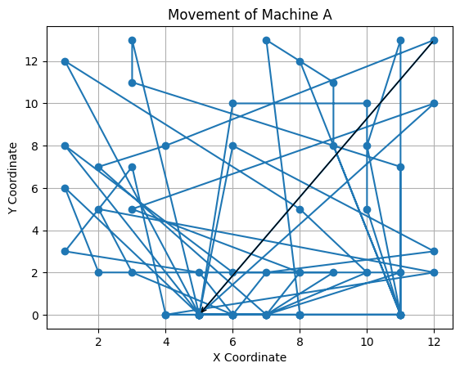
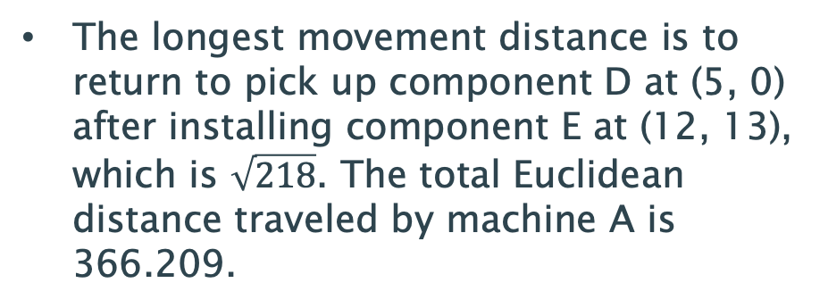
3.3 Optimize route
In the third step, we use a customized heuristic algorithm to find the optimal installation route to achieve the shortest robot arm movement distance.
The longest movement distance is to return to pick up component D at (5, 0) after installing component E at (12, 13), which is $\sqrt{218}$. The total Euclidean distance traveled by machine A is 366.209.

Slide 17
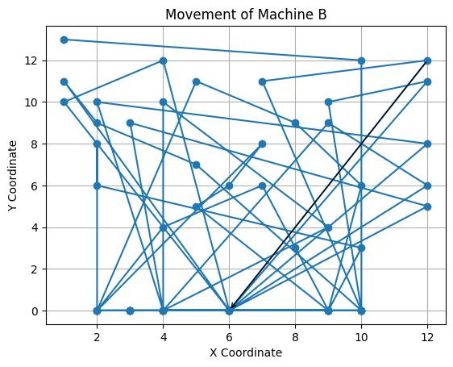
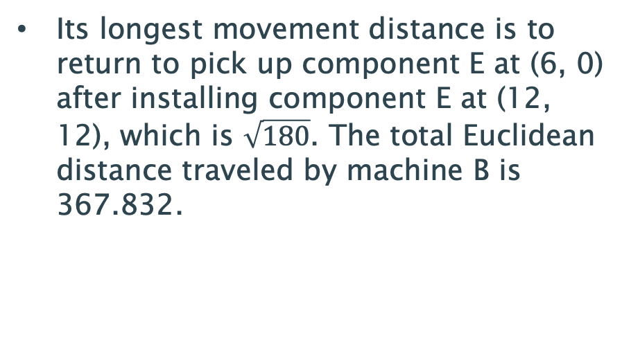
3.3 Optimize route
Performing the same algorithm on machine B, we can get its installation trajectory.
Its longest movement distance is to return to pick up component E at (6, 0) after installing component E at (12, 12), which is $\sqrt{180}$. The total Euclidean distance traveled by machine B is 367.832.

Slide 18
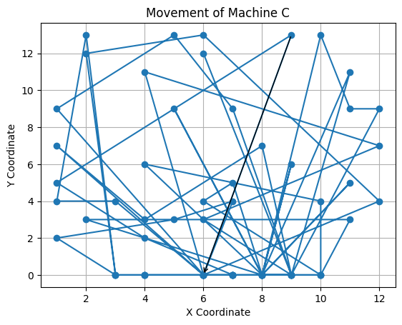
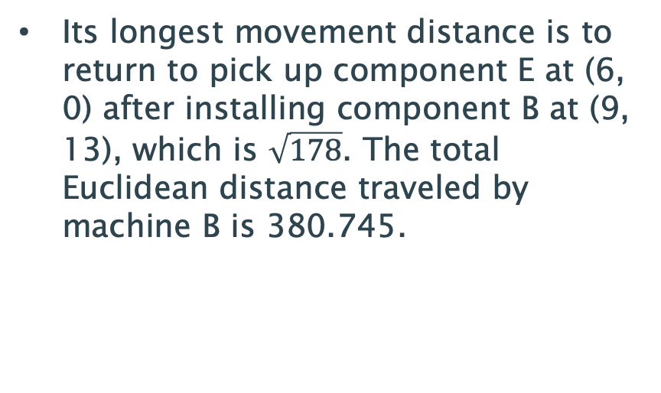
3.3 Optimize route
Machine C is the part with the largest workload in our installation plan.
Its longest movement distance is to return to pick up component E at (6, 0) after installing component B at (9, 13), which is $\sqrt{178}$. The total Euclidean distance traveled by machine B is 380.745.

Slide 19
04
CONCLUSION

Slide 20
4 CONCLUSION
in the first step, the annealing algorithm to find the optimal equipment allocation for each machine.
require the final distribution to cover as many different types of components as possible and try to balance the workload between machines.
penalize component types that require multiple machines to process together.
In the second step, linear programming to find the optimal division of labor for each machine.
objective function is to calculate the sum of the moving distance of each machine by picking up and installing one component each time
The global optimal solution may not be found.
In the third step we use a greedy algorithm to find the shortest moving distance for each machine to complete the assigned installation task.

Slide 22
