Slide 1
oodle
Car Finance Data Analysis
Marketing Investment Insights
Dataset: 10,000 Loan Applications | Audience: Technical Leadership
Presented by: Vyom Khanna | Data Analyst

Slide 2
Executive Summary
10,000
64.7%
47.4%
3,069
Total Applications
Approval Rate
Conversion Rate
Total Funded
fabricated records
6,470 approved
of approved → funded
30.7% of all apps
Key Findings
Urban customers approve 13% more & convert 12% more than rural
Ages 51-65 have the highest approval rate (87.5%) — key demographic
Convertibles drive the highest funded rate (34%) and largest avg loan (£17,179)
APR has negligible impact on conversion — pricing elasticity is low
Urban 51-65 customers fund at 50%+ — the clear marketing sweet spot

Slide 3
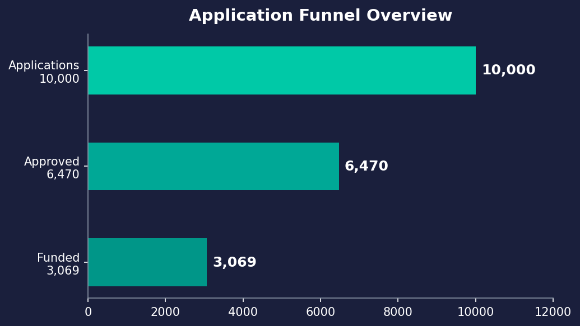
The Application Funnel
Funnel Insight
35.3%
of applicants are declined — significant volume to recover
47.4%
of approved customers don't proceed — a major conversion gap
30.7%
overall funded rate means 2 in 3 applicants never convert

Slide 4
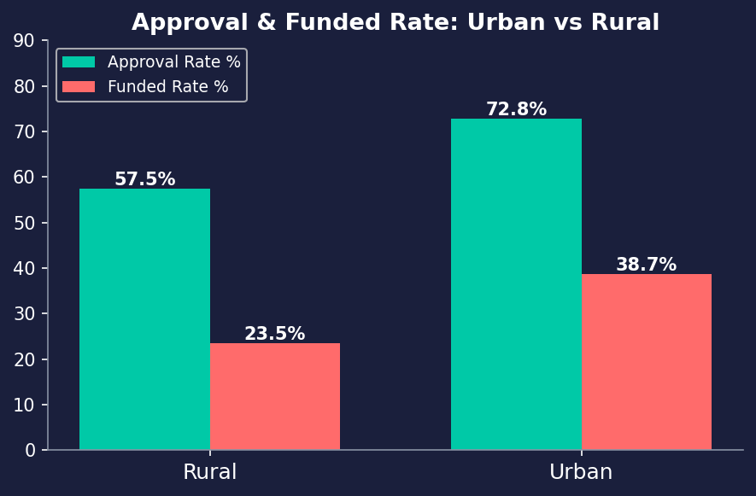
Urban vs Rural: A Clear Gap
Urban
Approval: 72.8% Funded: 38.7%
4,710 applicants
Rural
Approval: 57.5% Funded: 23.5%
5,290 applicants
▶ Recommendation: Prioritise urban marketing channels
Urban customers are 65% more likely to fund than rural.

Slide 5
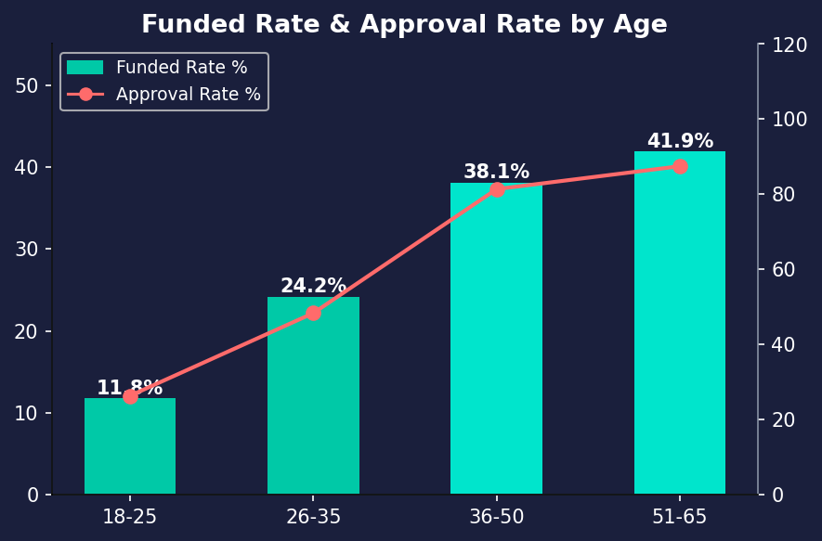
Age: Where Approvals & Funding Are Won
Age Band | Approval | Funded Rate
18-25 | 26.4% | 11.8%
26-35 | 48.4% | 24.2%
36-50 | 81.4% | 38.1%
51-65 | 87.5% | 41.9%
▶ 36-65 age group represents 78% of all funded loans.
Young applicants (18-25) face a 73.6% decline rate — lowest ROI segment.

Slide 6
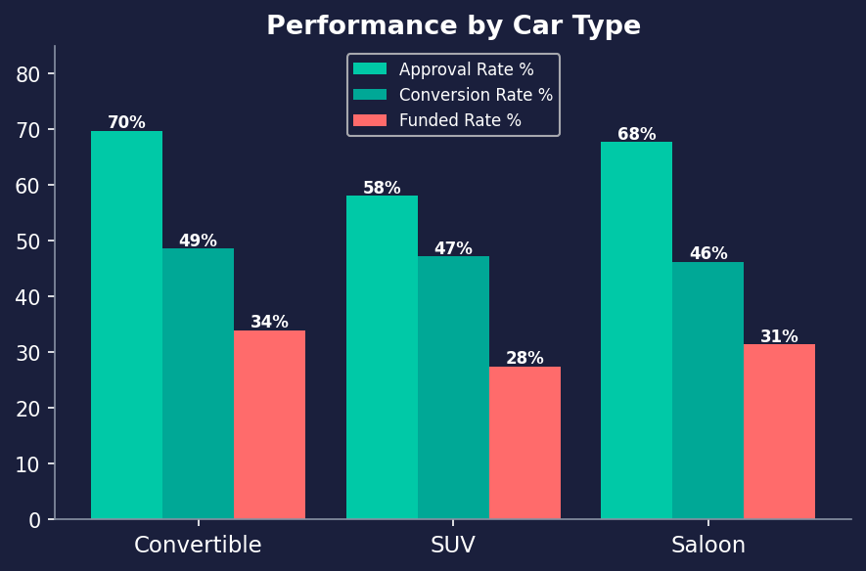
Car Type: Convertibles Lead on Revenue
Convertible
Funded: 34.0% | Avg Loan: £17,179
Saloon
Funded: 31.4% | Avg Loan: £8,271
SUV
Funded: 27.5% | Avg Loan: £10,744
▶ Convertible buyers have the highest funded rate AND 2× the avg loan vs Saloon.
SUVs have the most applicants (38%) but the lowest funded rate.

Slide 7
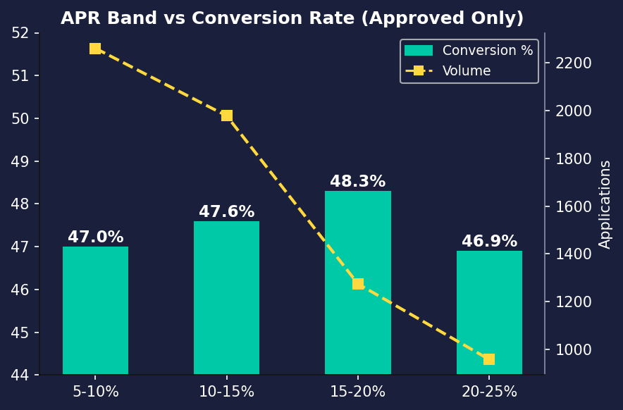
APR vs Conversion: Surprisingly Flat
What this means
Conversion is flat across all APR bands (46.9% – 48.3%)
Customers are NOT price-sensitive once approved
5-10% APR band has the most volume (2,259 applicants)
Higher APR does NOT chase away customers
Marketing should focus on volume drivers, not APR competitiveness

Slide 8
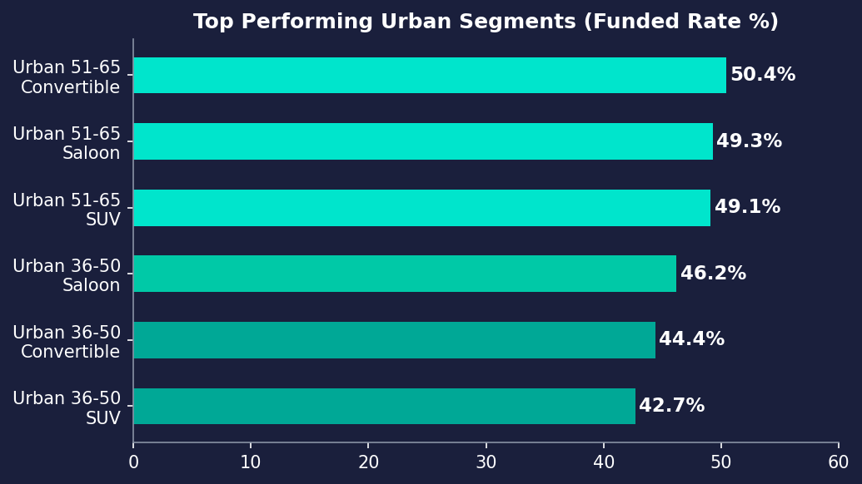
The Sweet Spot: Best Marketing Segments
Segment Profile
Location:
Urban
Age:
51–65 (primary)
Car Type:
Convertible
Funded Rate:
50.4%
vs. Overall:
+19.7 ppts
▶ Focus spend on Urban 51-65 Convertible buyers.
Secondary: Urban 36-50 Saloon/Convertible segments.

Slide 9
Recommendations for Marketing
01
Double down on urban channels
Urban customers have 65% higher funded rate. Digital, OOH and geo-targeted spend should prioritise urban postcodes.
02
Target 36-65 age demographics
This group has 81-88% approval rates. Align creatives, messaging and media mix to resonate with this cohort.
03
Lead with Convertible & Saloon offerings
Convertibles yield highest revenue per customer (avg £17,179 loan). Saloon offers balance of volume and conversion.
04
Investigate the 35% decline rate
Over 1 in 3 applicants are declined. Improving targeting to higher-creditworthy segments reduces wasted spend.
05
Address post-approval drop-off
47% of approved customers don't fund. Test re-engagement campaigns, faster decisioning, and nudge strategies.

Slide 10
oodle
Thank you
Key Takeaway
Urban customers aged 51-65 applying for Convertibles represent the highest-value, highest-converting segment. Focusing marketing investment here — combined with addressing post-approval drop-off — offers the greatest ROI improvement.
Analysis by Vyom Khanna | 10,000 Application Records | All workings in accompanying Python script

