Slide 1
Property & Repairs
Data Analysis
GreenSquareAccord | BI Engineer Interview
Vyom Khanna
550
1,200
£382K
5
Properties
Repairs
Total Spend
Visuals

Slide 2
Agenda
What we will cover in this presentation
01
Analysis Approach
How I explored and structured the data before building anything
02
The 5 Visuals
What I built, what each one shows, and why I chose it
03
Key Insights
What a business leader needs to know from this data
04
Additional Visuals
What else could be built with more time or scope
05
Recommendations
Actionable next steps I would propose to the business

Slide 3
Analysis Approach
How I approached the dataset before building anything
Step 01
Data Profiling
Step 02
Data Modelling
Reviewed both datasets: 550 properties, 1,200 repairs. Checked for nulls, duplicates and outliers. The dataset was clean with zero missing values and no duplicate records.
Built a star schema in Power BI: Repairs as fact table, Properties and DateTable as dimensions. Connected via PropertyID and ReportedDate. DateTable spans Jan 2024 to Mar 2025 to enable time intelligence.
Step 03
Property Analysis
Step 04
Repairs Analysis
Explored portfolio by type, build year, EPC rating and heating type. Identified sustainability risk, ageing stock and geographic patterns using a PostcodeDistrict field extracted from PostcodeSector.
Analysed volume, cost and duration by category, priority and contractor. Identified cost drivers, efficiency gaps and seasonal demand patterns across the 15-month dataset.

Slide 4
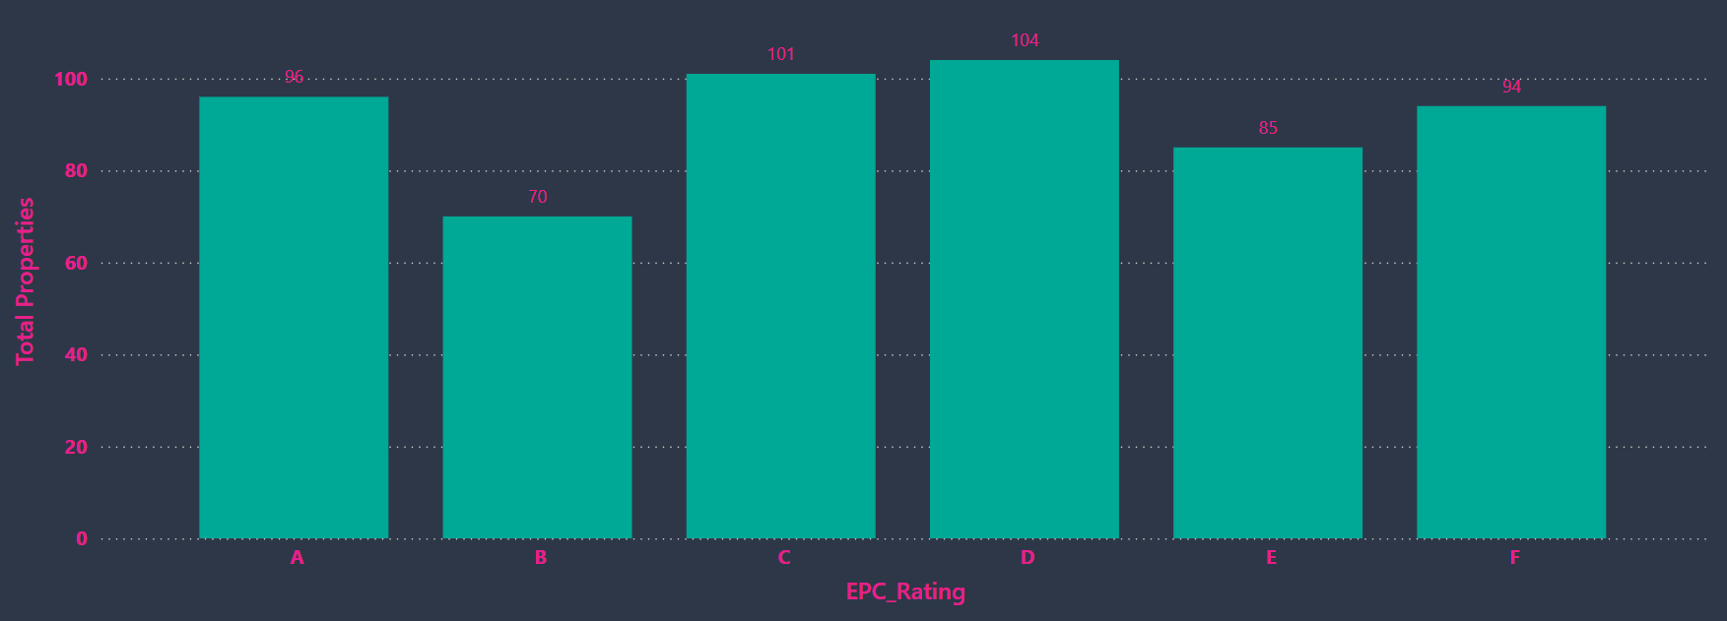
V1 | EPC Rating Distribution
Energy efficiency risk across the portfolio
Key Insight: 51% of properties are rated D or below. With Decent Homes 2 and net zero targets approaching, this is the biggest compliance and financial risk in the portfolio.

Slide 5
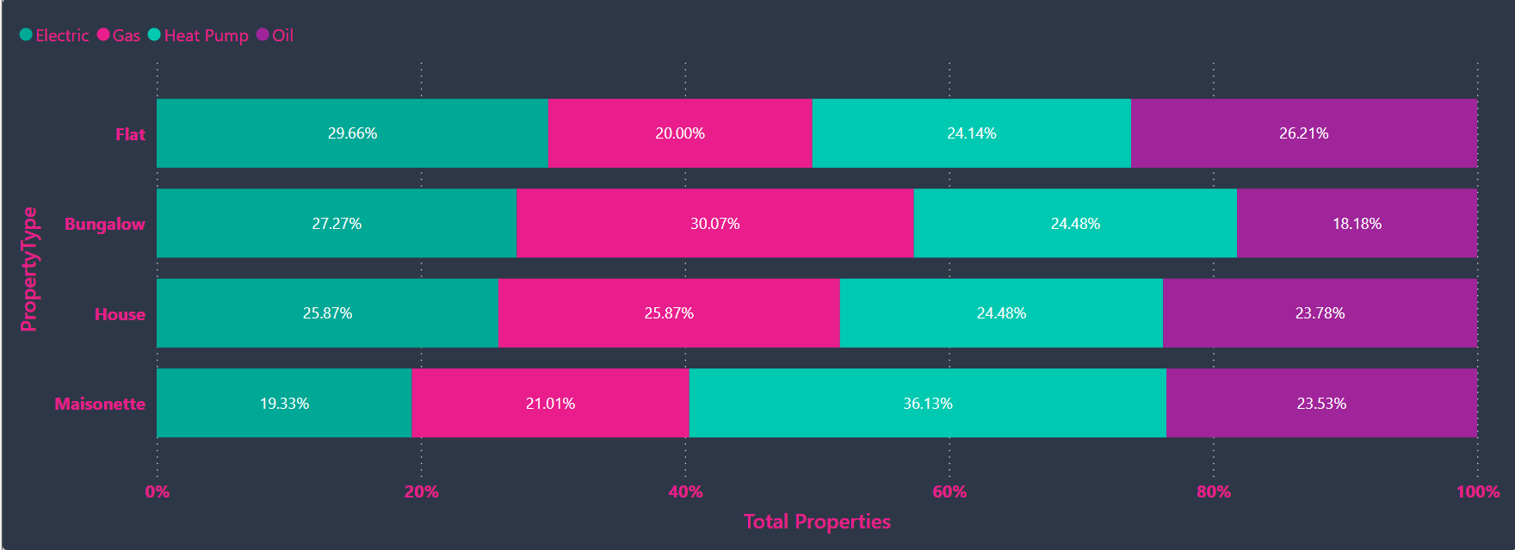
V2 | Property Type by Heating Type
Asset profile and sustainability risk
Key Insight: Maisonettes have the highest heat pump usage at 36%, making them most sustainable. Bungalows rely most on gas at 30%, representing the highest carbon risk.

Slide 6
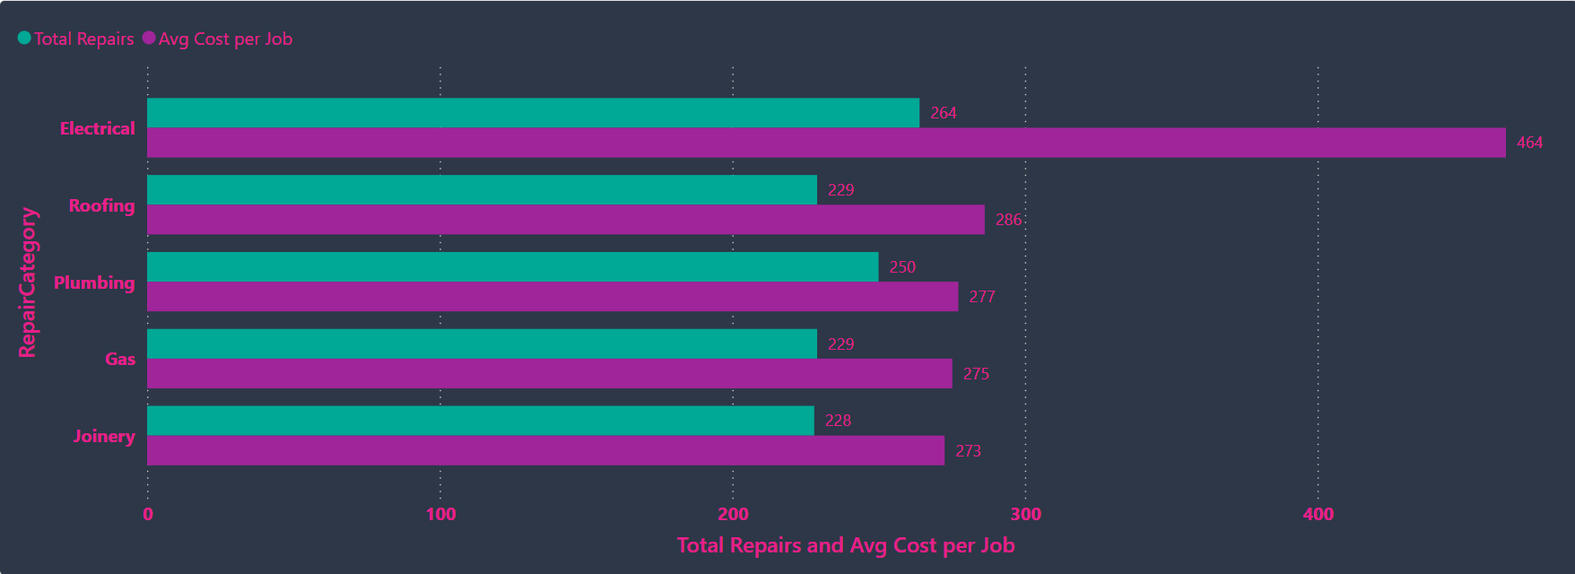
V3 | Repairs Volume and Avg Cost by Category
Where the most repairs happen and where the money goes
Key Insight: Electrical is highest on both volume (264 jobs) and cost (£464 avg). That double impact makes it the most important category for a preventative program.

Slide 7
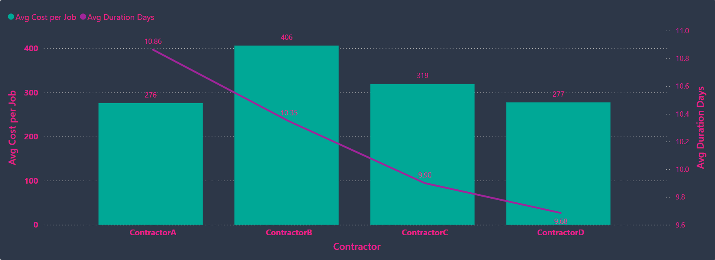
V4 | Contractor Performance: Cost vs Time
Benchmarking contractors on value for money
Key Insight: ContractorB charges £406 per job, 47% more than A and D at £276-277, with virtually identical completion times of 9 to 11 days.

Slide 8
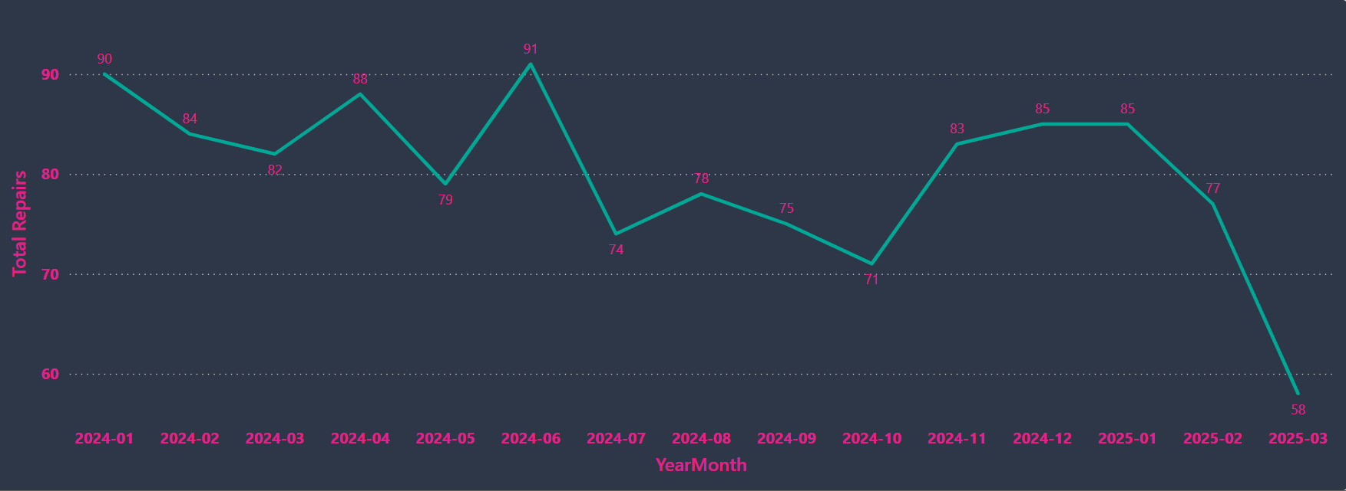
V5 | Monthly Repair Volume Trend
Seasonal patterns Jan 2024 to Mar 2025
Key Insight: Peaks in Jan (90) and Jun (91) suggest seasonal patterns. Oct is lowest (71). March 2025 shows only 58 as the data is incomplete for that month.

Slide 9
Key Insights for Business Leaders
What the data is telling us and why it matters
EPC Risk: 51% Rated D or Below
ContractorB is 47% More Expensive
283 properties at D, E or F. Decent Homes 2 and net zero targets make this the biggest compliance and financial risk. A retrofit programme is urgently needed.
£406 vs £276-277 with identical completion times. This premium costs tens of thousands annually and should be renegotiated or retendered.
Electrical Drives Volume and Cost
Seasonal Peaks in January and June
264 jobs at £464 average. Busiest and most expensive category. A proactive inspection programme would reduce reactive demand and lower annual spend.
Predictable demand spikes. Pre-booking contractor capacity for these months would reduce response times and emergency call-out costs.

Slide 10
Additional Visuals I Could Have Built
Given more time or a larger scope, these would add further value
Postcode District Hotspot
Properties
Extracted PostcodeDistrict (e.g. B23, B1) to show areas with worst EPC or highest repairs. Enables geographic investment prioritisation.
Properties Over 50 Years by Type
Properties
BuildYear <= 1976 flags oldest stock. By PropertyType shows which asset class carries most age-related structural risk.
Volume and Cost by Priority
Repairs
Emergency vs Urgent vs Routine on cost and duration. Emergency jobs take only 0.6 days less than Routine, raising SLA compliance questions.
Repeat Repairs by Property
Repairs
Properties with 3+ repairs flagged for structural review. Reactive maintenance on failing stock costs more than planned intervention.
Cost by Property Type and Build Era
Combined
Joining both datasets to show which combination of type and age drives most spend, informing planned maintenance investment priorities.

Slide 11
Recommendations and Next Steps
Actionable proposals based on the analysis
1
Launch an EPC Retrofit Programme
Prioritise 283 D/E/F properties by worst rating and oldest build year. Reduces compliance risk and long-term maintenance costs.
2
Retender or Renegotiate ContractorB
47% cost premium with no speed advantage. Competitive retendering or negotiation could save tens of thousands annually.
3
Introduce an Electrical Inspection Programme
264 jobs at £464 average. Proactive inspections reduce reactive demand, improve safety and lower annual spend.
4
Plan Resources Around Seasonal Peaks
January and June spikes are predictable. Pre-booking contractor capacity reduces response times and call-out costs.
5
Develop a Problem Property Register
Properties with 3+ repairs should be flagged for structural review rather than continued reactive maintenance.

Slide 12
DAX Measures I created
Measure | DAX Formula | Purpose
Total Repairs | COUNTROWS(repairs_dataset) | Count of all repair jobs
Total Spend | SUM(repairs_dataset[Cost]) | Total cost of all repairs
Avg Cost per Job | AVERAGE(repairs_dataset[Cost]) | Average cost per repair job
Avg Duration Days | AVERAGE(repairs_dataset[JobDurationDays]) | Average days to complete a job
Total Properties | COUNTROWS(property_dataset) | Count of all properties
Repairs per Property | DIVIDE([Total Repairs],[Total Properties],0) | Average repairs per property
% Emergency Jobs | DIVIDE(CALCULATE(COUNTROWS(repairs_dataset), repairs_dataset[Priority]="Emergency"),[Total Repairs],0) | % of jobs flagged as Emergency
% EPC D or Below | DIVIDE(CALCULATE(COUNTROWS(property_dataset), property_dataset[EPC_Rating] IN {"D","E","F"}),[Total Properties],0) | % of properties rated D, E or F
High Cost Repairs | CALCULATE(COUNTROWS(repairs_dataset), repairs_dataset[Cost]>1000) | Count of jobs costing over £1,000
Properties Over 50 Yrs | CALCULATE(COUNTROWS(property_dataset), property_dataset[BuildYear]<=1976) | Properties older than 50 years

Slide 13
Thank You
Happy to answer any questions on my approach, design choices or the insights I found.
550
1,200
£382K
5
Properties
Repairs
Total Spend
Visuals Built
Vyom Khanna | GreenSquareAccord BI Engineer Interview

