Slide 1

INTRODUCTION TO COMPOSITION

Slide 2
Topics to be Covered:
S NO. | NAME OF TOPIC | DAY
1. | Rule Of Thirds | Day 1
2. | Symmetry | Day 1
3. | Depth | Day 1
4. | Sizing | Day 2
5. | Framing | Day 2

Slide 3
Below are detailed techniques that must be followed to ensure the best possible outcome while taking pictures from your phone.
Try these various methods and tricks with objects at home, on your terrace or garden and have as much fun as you can.
At the end of the slides, there will be an assignment that must be done in order to track your progress. The assignment must be completed before Friday so that you can mail it to us and we can check their assignments firsthand.
These assignments will then further be reviewed with you, during the Friday evening session with everyone, and a discussion will take place.

Slide 4
1) Rule Of Thirds
Upon enabling the grid which comprises of 3 lines horizontal and 3 lines vertical, which form 4 intersecting lines that help to focus your objects while shooting either one or more objects in the frame, and placing them in these 4 intersecting points.
Preferable to use this method of technique when there is a background available and an object is placed to bring more to the image and not concentrate on just the object you need to shoot.

Slide 5
When using the Rule of Thirds, remember to use the Grid, and place the object on any of the 4 intersecting points which must be highlighted.
Use objects like a flower pot, water bottle or even use someone at home to try it on to see the effectiveness of the grid
Try to pan the camera in such a way to experiment with all the 4 points of intersection to get the best picture according to you, its all about experimenting!

Slide 6
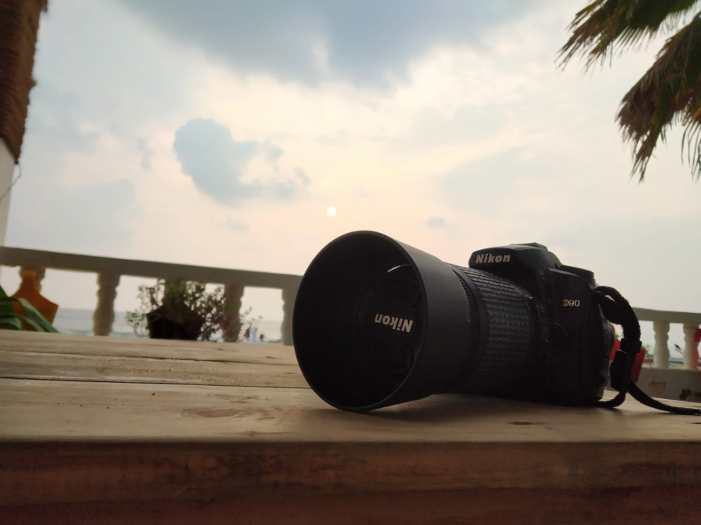
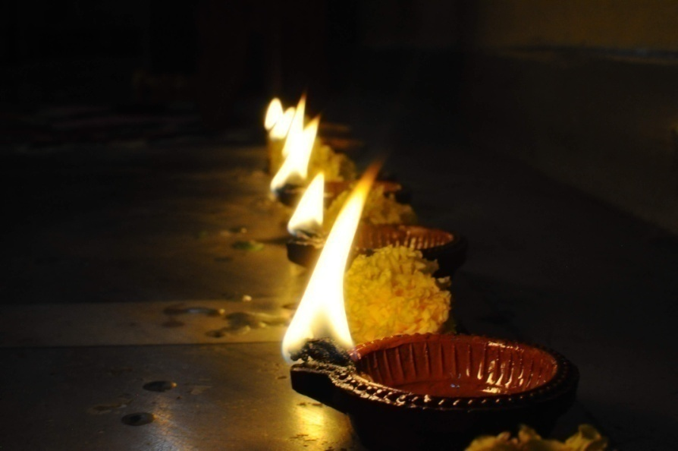
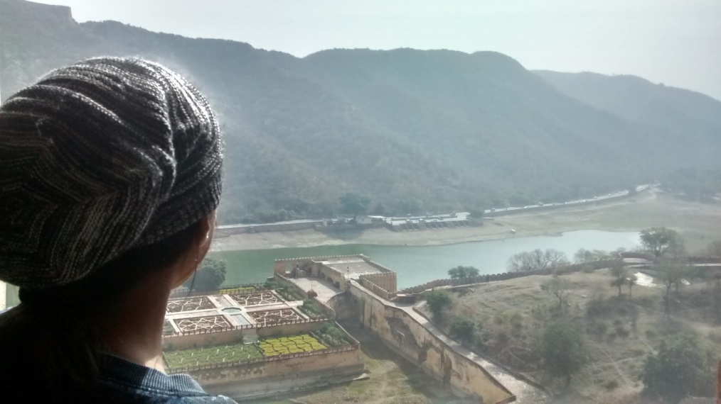
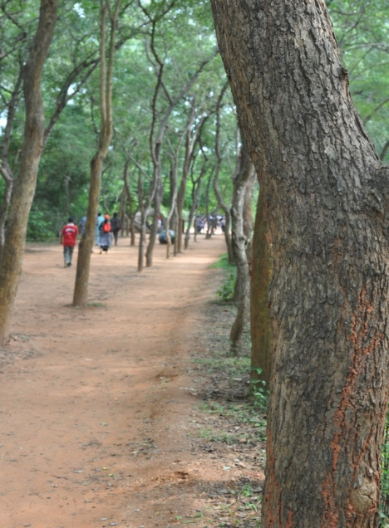
EXAMPLES of Rule Of Thirds

Slide 7
2) Symmetry
Using the grid again, if you choose to place the object in the centre, we may not realize at first, but if we place the object right at the dead centre of the frame it gives a more appealing look to it.
This can be done by various clues within the frame or any spaces visible within the frame, like the number of lines in the background or tiles, etc., which will assist you in placing the object in the centre.
This is best applicable when shooting one object or if you want to divide your photograph into two equal parts.

Slide 8
Its best to click pictures of a standing object right at the centre to make it look better.
Try placing the objects right at the centre of the frame and ensure the spacing on either sides are also same using the Grid and standing in the middle to make it look as symmetric as possible.

Slide 9
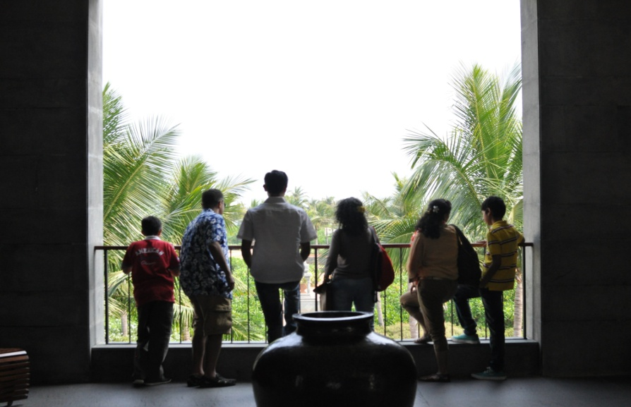
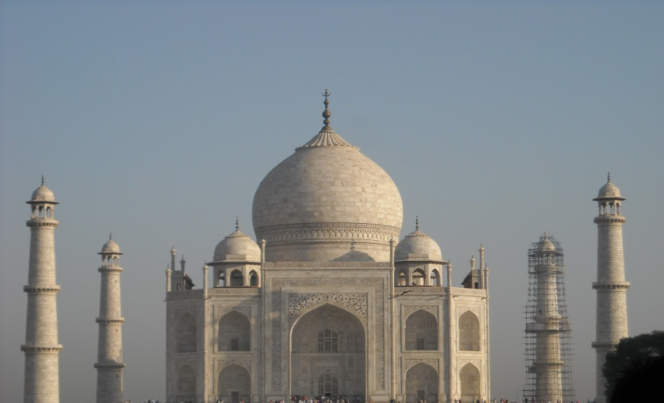
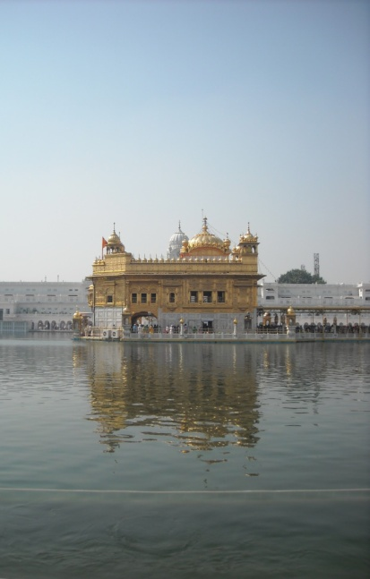
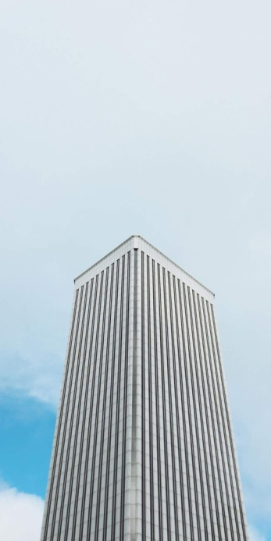
EXAMPLES of Symmetry

Slide 10
3) Depth
Depth is the technique to toggle between the object and background, by shifting the focus onto which ever is required.
It is best utilized when there are two objects placed one behind the other or you can use one object and a background.
Try to place the objects at least 3 feet apart from each other to create the depth effect and get the best results.

Slide 11
You must remember that to get the best depth effect, there must be some distance apart to provide focus on the object that is required.
Close up on the object that is nearer to you and tap the focus on it which blurs the background, which gives a depth effect.
Only try to click pictures from the front facing angle and not from the top.

Slide 12
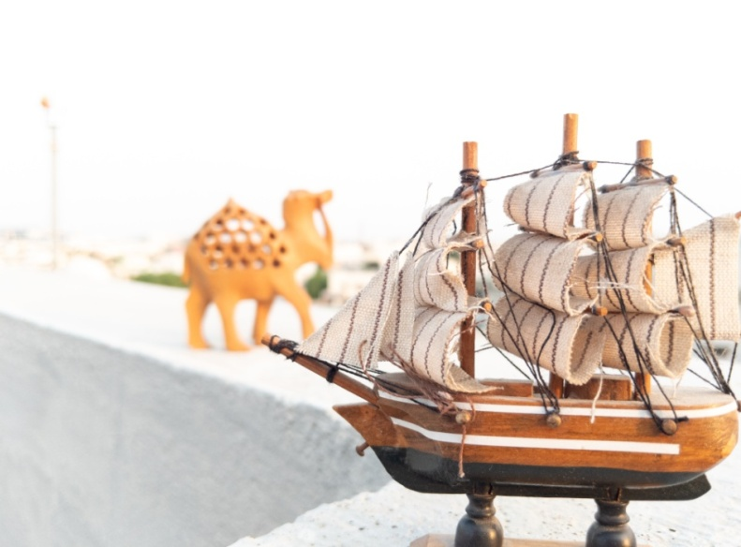
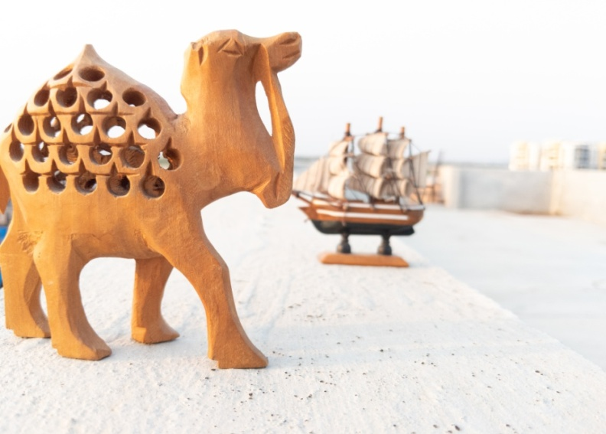
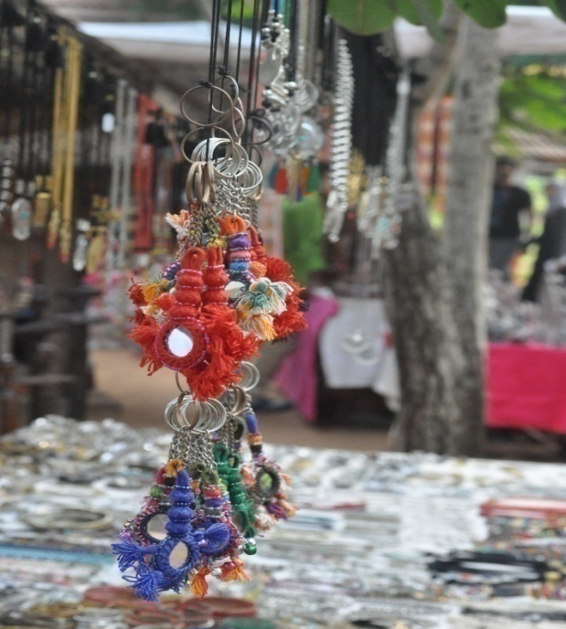
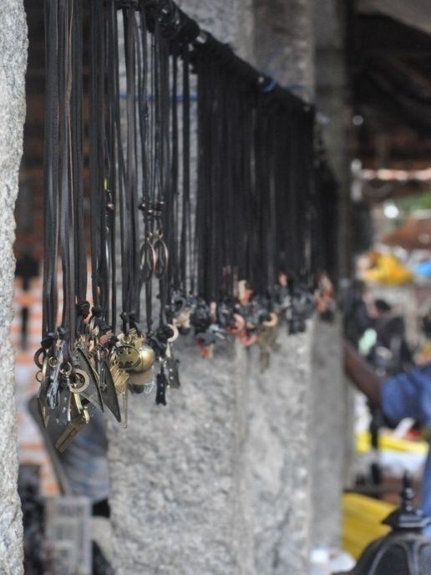
EXAMPLES of Depth

Slide 13
4) Sizing
A very basic way of giving the desired object a definite size by moving yourself back and forth or your object back and forth, whichever seems convenient.
This technique can be applied when differentiating between two objects to show the relevance and importance by using different angles to make the object either small or big.
If you want your object to have more importance over another, try to place it on top of the other object and vice-versa.

Slide 14
Try to move around the objects and angle them in such a way that one is on top of the other.
To achieve the “Forced Perspective”, there must be a great distance between the two objects.
Forced Perspective is fun to try with your parents or siblings and other objects at home, by instructing them to stand in such a way that they look bigger or smaller.

Slide 15
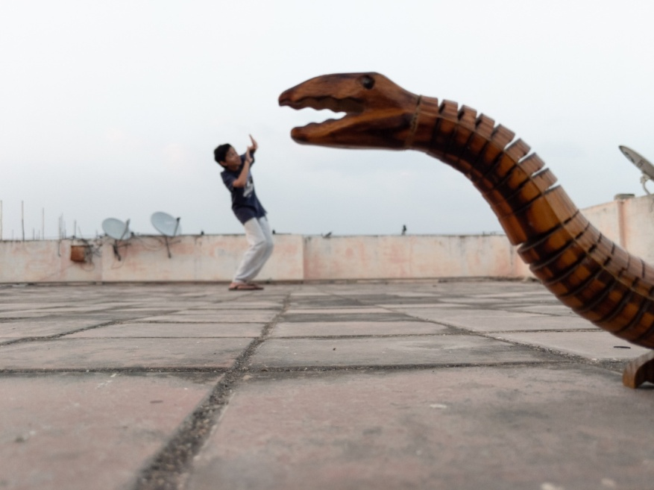
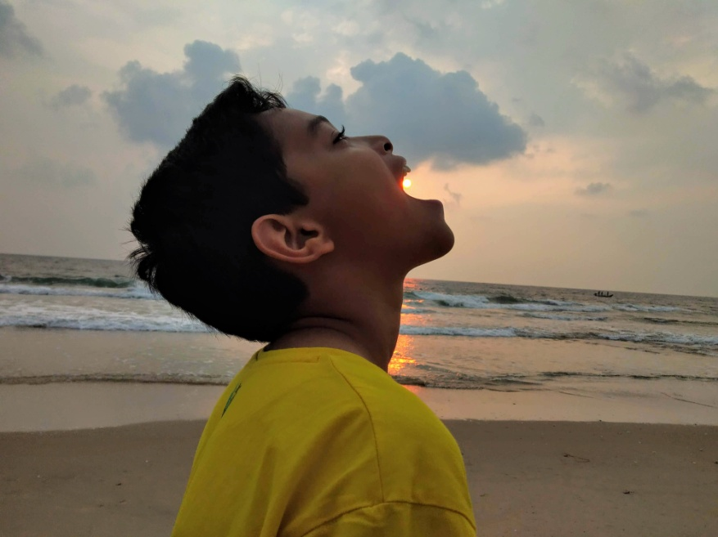
EXAMPLES of Sizing

Slide 16
5) Framing
To conclude all the techniques and get the best shot of all, it is very important to frame all the required elements in the frame to show the importance of the object.
A good way to frame is by clearing any excess clutter from the frame and include only those objects in the frame that are required, hence making the photograph simpler and beautiful.

Slide 17
The only way to achieve the “perfectly well framed” shot is by taking pictures again and again, until you reach your own level of satisfaction.
The best frame is considered as the one where there are only a few selected elements which are perfectly chosen and shot.
So try to keep thing as simple as possible and have fun!

Slide 18
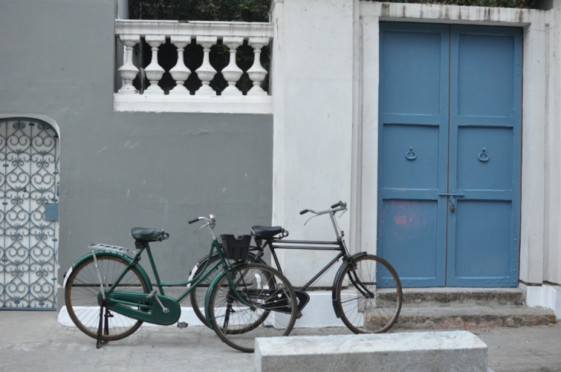
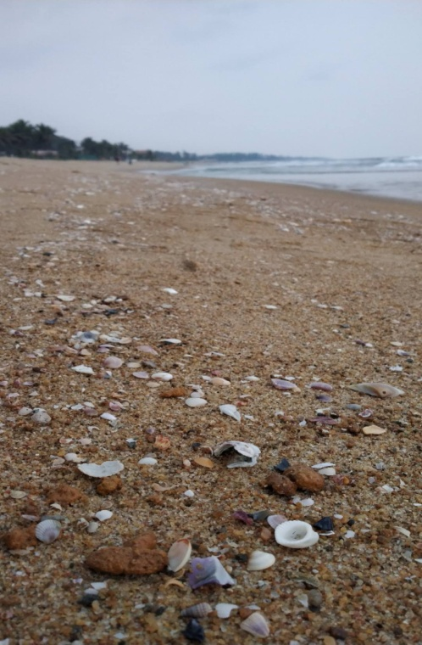
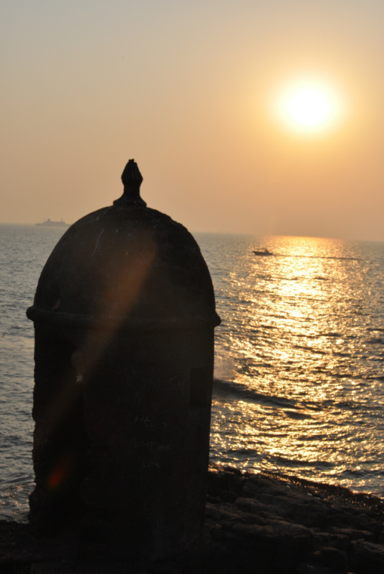
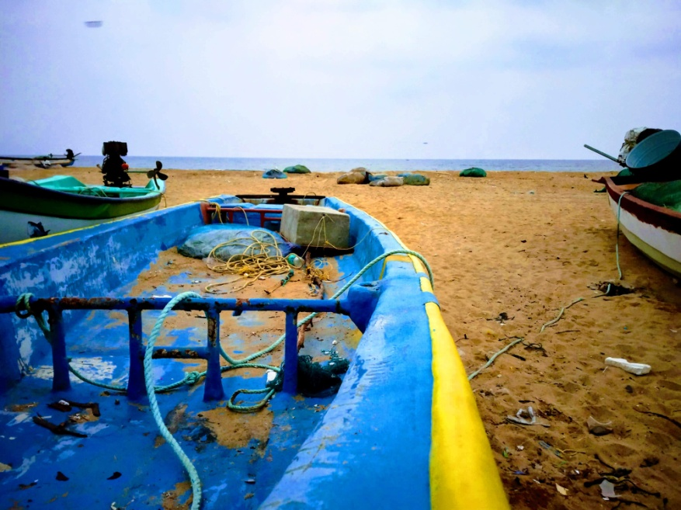
EXAMPLES of Framing

Slide 19
ASSIGNMENTS TO BE DONE
As demonstrated in the video clips and using the PPT’s as reference, click a minimum of 1 picture using “Forced Perspective” method, by using objects available at home and parents if required.
Go through the video clip again and click a minimum of 1 photo using “Rule Of Thirds” method, by using objects available at home and parents if required.
THESE ASSIGNMENTS MUST BE COMPLETED BEFORE FRIDAY (29TH MAY) SO THE REVIEW CAN BE DONE WITH CHILDREN IN THE LIVE SESSION ON ZOOM.

