Slide 1
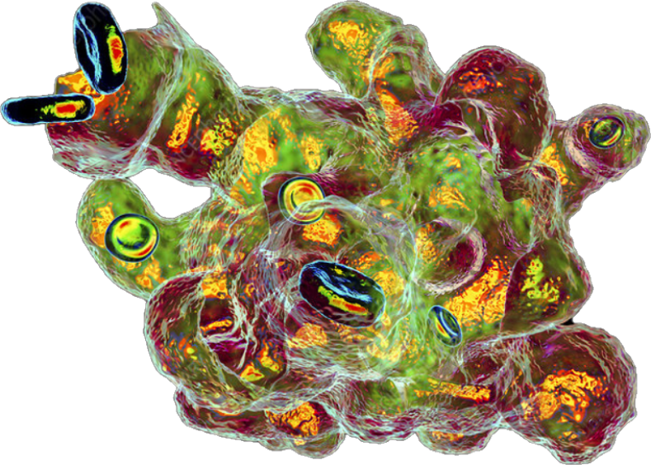
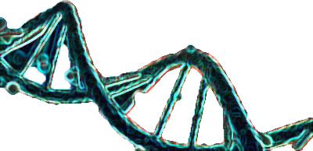
Vote for Vyom
A well defined structure with flexibility, that is all that you need
Vote for Amoeba

Slide 2


