Slide 1


Computer Hardware Shopping via Databases
By:
Michael Azzinaro
Michael Calabrese
Matthew Eder

Slide 2

Goal
Incorporate database systems and design into a real world system.

Slide 3
Outline
Detailed description
Stumbling blocks
Data Collection/diagrams
Sample of findings
Future Extensions
Acknowledgements
Demo

Slide 4
Description
The main usage of this database will be the backend to an online shop. Users will not directly query the data however they will submit requests for items which would be converted into SQL queries on the database. Manufacturers and sellers would make direct queries on the data in order to add and remove new products.

Slide 5
Stumbling Blocks
ER Design
ER Refinement
Table Normalization
Table Representation to SQL transition
VM/PHP/mySQL setup

Slide 6
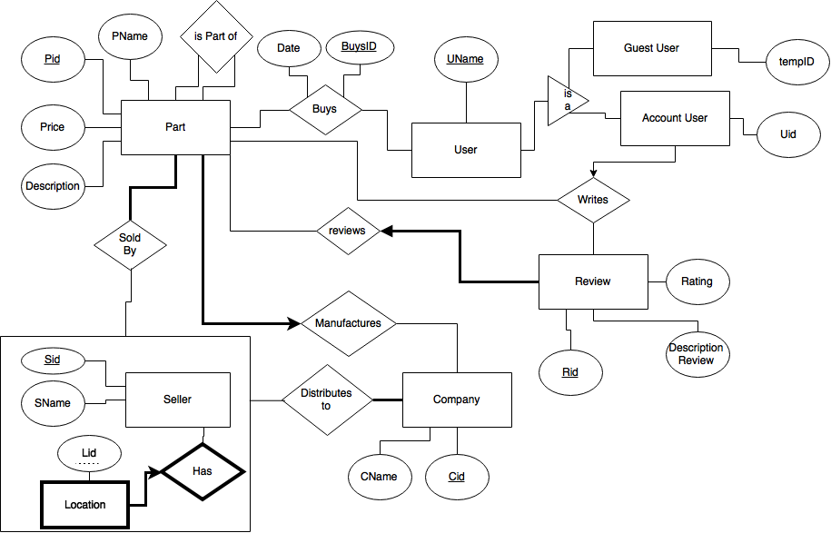
Conceptual Diagram

Slide 7
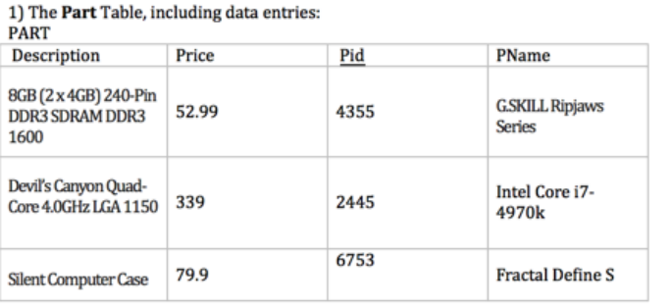
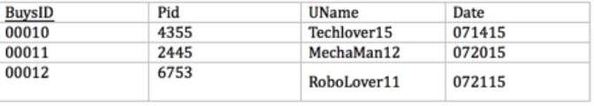
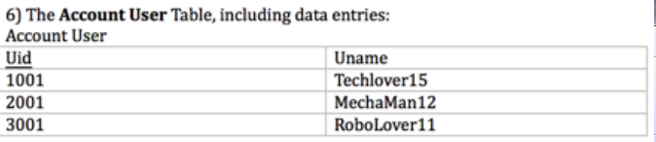
Sample Data

Slide 8

Integrity Constraints
Almost everything within the database cannot be NULL.
Location Weak Entity
Writes relation
Exceptions: Review’s Descriptions
Buys Table
ISA User Constraints
Is Part Of
Manufacturers
Distributes to

Slide 9
Findings
Users of the database will find meaningful information regarding computer hardware.
Where to purchase the computer parts.
Companies/Sellers will find use in marketing their products through use of the database (thanks to the Buys, SoldBy and Distributes to entities).

Slide 10
Future Extensions
Extendable via web
Implement a similar service to Newegg
Collect data for tables via online queries
Implement user interface
More search options for refined queries

Slide 11
Acknowledgements
Thanks to:
Professor James Abello
Riham Elsaadany

Slide 12

References & Resources
Database Management 3rd Edition
LAMP
MyPHPAdmin
MySQL
VirtualBox
Apache
StackOverflow

Slide 13
Demo

