Slide 1
KERALAMMATCH
Complete End-to-End Software Architecture & Master System Presentation
Customer Panel · Admin Panel · 24h Ephemeral Reveal · Security · Razorpay · Production Roadmap

Slide 2
KERALAMMATCH PLATFORM ARCHITECTURE
Executive Overview & Core Architectural Pillars
The Legacy Problem vs KeralamMatch
The Privacy Crisis: Legacy portals publicly expose candidate phone numbers, photos, and personal details to anonymous crawlers.
Harassment & Spam: Unsolicited calls, stalking, and unvetted profiles plague conventional matchmaking websites.
The KeralamMatch Solution: Kerala's premier privacy-first matrimonial platform designed specifically for the global Malayali community.
Clean Architecture: Strict domain separation, typed repositories, and secure server actions across 53 compiled routes.
4 Core Architectural Pillars
Consent-Based Ephemeral Reveal: Encrypted phone & email credentials unlocked for exactly 24 hours upon mutual consent, then auto-locked.
Multi-Layer Verification Queue: Mobile SMS OTP, selfie facial liveness checks, and optional Aadhaar/Govt ID verification badges.
AI Attribute & Horoscope Matcher: Algorithmic compatibility percentage calculated across 12 candidate lifestyle, career, and astro criteria.
Admin Privacy Shield: Architectural barrier preventing administrators from accessing un-redacted user messages without audit flags.

Slide 3
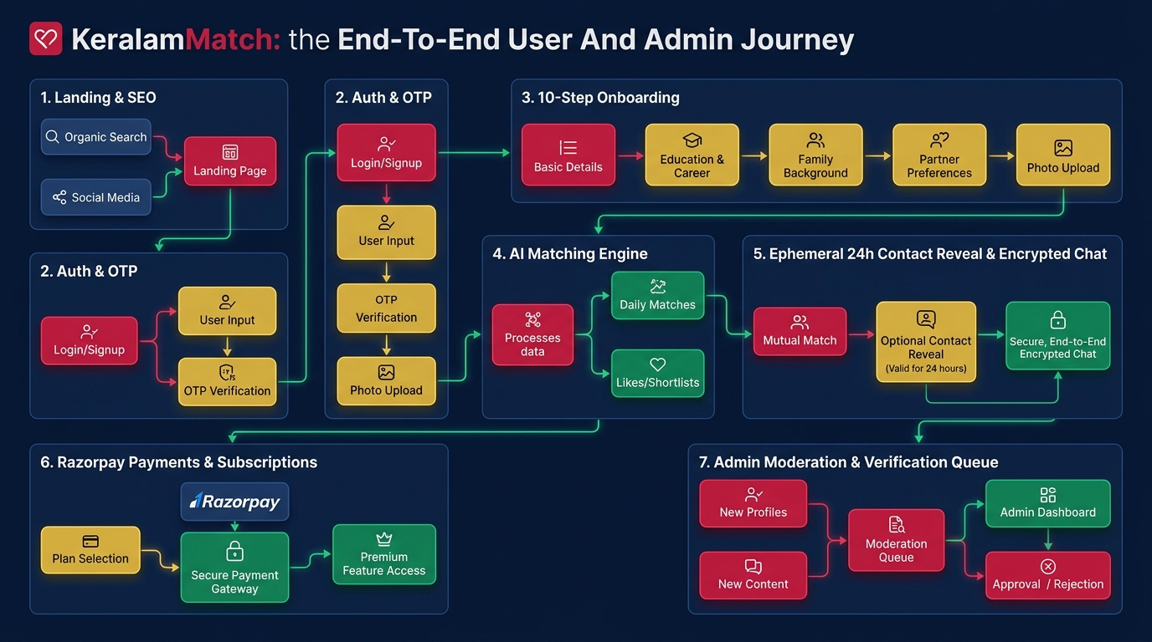
KERALAMMATCH PLATFORM ARCHITECTURE
End-to-End System Journey Flowchart

Slide 4
KERALAMMATCH PLATFORM ARCHITECTURE
Platforms & Technology Stack (Used Now)
Frontend & UI Layer
Next.js 16 App Router: Server Components + Turbopack
React 19 & TypeScript: Strict type-safe interfaces
Tailwind CSS v4: Curated HSL design tokens
Lucide React Icons: Crisp vector icons suite
PWA Infrastructure: Manifest, service worker, caching
Backend & Data Layer
Neon PostgreSQL: Serverless PostgreSQL with SSL
Prisma ORM v6: Model migrations & schema relations
AES-256 Encryption: Field-level encryption at rest
Upstash Redis: Sliding-window API rate limiter
Clean Architecture: Controllers, Services, Repos
Third-Party Integrations
Firebase Auth: SMS Phone OTP + Google OAuth
Cloudinary CDN: AVIF/WebP image optimization
Razorpay Gateway: UPI, Netbanking, Card checkout
Resend Email API: Branded transactional templates
Google Analytics 4: Traffic metrics & event tracking

Slide 5
KERALAMMATCH PLATFORM ARCHITECTURE
Customer Panel: Landing, Public SEO & Authentication
Landing & SEO Discovery
High-Converting Hero: Serif headline, authentic Kerala couple imagery, and prominent CTA buttons.
Dark Maroon Stat Bar: 50,000+ Happy Members, 100+ Communities, 98% Verified, 24/7 Support.
District SEO Pages: 13 dedicated landing pages for Trivandrum, Ernakulam, Kozhikode, etc.
Community Matrimony: Dedicated hubs for Nair, Ezhava, Christian, Latin Catholic, and Muslim.
Blog Magazine: 7 rich articles on safety tips, traditions, and success stories.
Split-Screen Authentication (/auth)
Branded Left Panel: Deep Maroon (#5C0A1E) background with traditional Nilavilakku lamp graphic motif.
Mobile Phone OTP: Indian (+91) phone number entry with automated 6-digit SMS OTP verification.
Google OAuth 2.0: One-click authentication for fast account access.
Encrypted Session Cookie: HTTP-only 'km_session' token with secure server-side validation.
Developer Sandbox OTP: Built-in sandbox OTP (123456) fallback for offline/test environments.

Slide 6
KERALAMMATCH PLATFORM ARCHITECTURE
Customer Panel: 10-Step Intelligent Onboarding Wizard (/join)
Steps 1 to 5: Personal & Career Profile
Step 1: Basic Information: Full name, DOB, gender, profile owner (Self/Parent/Sibling).
Step 2: Physical Attributes: Height in cm, complexion, body type, physical status.
Step 3: Religion & Community: Religion, caste, sub-caste, mother tongue, horoscope details.
Step 4: Education & Profession: Degree qualification, university, job title, annual income range.
Step 5: Location Details: State, district, current living city, native place.
Steps 6 to 10: Preferences & Verification
Step 6: Family Details: Family type (Joint/Nuclear), values, status, parental details.
Step 7: Lifestyle Habits: Dietary preference (Veg/Non-Veg), smoking, drinking habits.
Step 8: Partner Preferences: Desired age range, height, religion, caste, district filter.
Step 9: Cloudinary Media: Gallery photo upload dropzone with watermarking & voice intro.
Step 10: Verification Queue: Selfie liveness check & Aadhaar ID upload for queue review.

Slide 7
KERALAMMATCH PLATFORM ARCHITECTURE
Customer Panel: Dashboard, Discovery & Matching Engine
Member Dashboard (/dashboard)
Welcome Greeting: Personalized greeting 'Welcome back, [Name] 👋'.
Profile Completion Ring: Interactive circular progress indicator with 'Update Now' CTA.
Profile Views Analytics: Tracks real-time profile visits with weekly growth delta badges.
Recommendations Grid: Curated candidate cards based on user's partner preferences.
Left Navigation Sidebar: Quick access to Dashboard, Matches, Messages, Requests, Settings.
Find Matches & Smart Search (/find)
Quick Filter Selectors: Dropdowns for Religion, Caste, District, Age Range, Education.
AI Smart Search Bar: Natural language query box (e.g. 'Software engineer from Ernakulam preferring vegetarian diet').
12-Attribute Match Score: Calculates compatibility % based on career, lifestyle, and horoscope alignment.
Candidate Profile View: Rich profile detail view (/profile/[id]) with verified checkmarks.

Slide 8
KERALAMMATCH PLATFORM ARCHITECTURE
The Breakthrough Feature: 24-Hour Ephemeral Contact Reveal
1. Request Initiation
Action Choice: Candidate A clicks 'Send Contact Request' on Candidate B's profile.
Wallet Check: Checks user subscription tier or decrements 1 reveal credit token.
Alert Trigger: Candidate B receives in-app notification and transactional email notice.
Masked Data: Credentials remain completely encrypted and invisible.
2. Mutual Consent Approval
Consent Screen: Candidate B inspects Candidate A's verified profile.
Accept / Decline: Candidate B clicks 'Accept' to give explicit disclosure permission.
Timer Activation: Backend sets expiresAt = now + 24 hours.
Real-Time Notification: Candidate A receives instant acceptance alert.
3. 24h Window & Expiry
Credential Decryption: AES-256 decrypted phone number & email are revealed on profile page.
Live Countdown: Real-time visual timer counts down 24:00:00 remaining hours.
Auto-Locking: At t > 24 hours, credentials automatically re-lock and disappear.
Privacy Protected: Zero permanent phone number leaks on the public web.

Slide 9
KERALAMMATCH PLATFORM ARCHITECTURE
Customer Panel: In-App Encrypted Chat & Notification Hub
In-App Encrypted Chat (/chat)
Split-Pane Messaging: Left thread list with avatars, timestamps, and unread badges; Right active chat window.
Encryption Indicator: Banner confirming 'Messages are encrypted and private'.
Branded Bubbles: Sender bubbles in Crimson (#C81D45), receiver bubbles in Warm Ivory (#FCFBF7) with double checkmarks.
Instant Safety Controls: One-click 'Block User' and 'Report Profile' triggers.
Rate Limiting Guard: Upstash Redis throttles message spam (30 messages/min limit).
Central Notification Hub (/notifications)
Categorized Alerts: Distinct icon badges for Requests (Heart), Messages (Chat), Verifications (Shield), Payments (Coins).
Real-Time In-App Alerts: Instant red indicator badge on header navigation.
Email Synchronization: Resend API sends transactional emails for high-priority actions.
Batch Actions: 'Mark all as read' button clears unread counters instantly.

Slide 10
KERALAMMATCH PLATFORM ARCHITECTURE
Monetization: Membership Plans & Razorpay Gateway
Membership Subscriptions & Wallet
Tiered Plans: Free, Silver (₹999/mo), Gold (₹1,999/3mo - Most Popular), Platinum (₹3,499/yr).
Feature Unlocks: Unlimited chat messages, 5 to 25 verified reveals, Astro matching, priority support.
Pay-Per-Reveal Credit Packs: Flexible wallet recharge packs (₹99 for 1 reveal, ₹499 for 5 reveals).
100% Secure Guarantee: SSL encryption, instant receipt downloads, and transparent pricing.
Razorpay Payment Processing Flow
Order Creation: Next.js Server Action initializes secure order with Razorpay Order API.
Modal Checkout: Native Razorpay Checkout supporting UPI (GPay, PhonePe), Netbanking, and Cards.
Webhook Verification: Asynchronous signature verification (/api/payments/razorpay/webhook).
Instant Provisioning: Upgrades user account tier and credits wallet immediately upon success.

Slide 11
KERALAMMATCH PLATFORM ARCHITECTURE
Admin Portal: App Shell & Analytical Dashboard (/admin)
Admin App Shell Architecture
Dark Navy Sidebar: Professional Deep Navy (#0A1F44) sidebar with KeralamMatch logo emblem.
Active Crimson Indicator: Highlighted current menu item styled in vibrant crimson red (#C81D45).
Top Search Header: Universal search bar ('Search candidates, reports, payments...'), notifications, avatar.
Role-Based Middleware: Strict session guard checking km_session and admin permissions.
Admin Dashboard KPIs & Charts
4 Top KPI Overview Cards: Total Users (25,430), New Registrations (1,234), Verified Profiles (18,765), Active Premium (2,456).
Registrations Chart Bar: Visual graph tracking daily candidate registration trajectory.
Verification Queue Box: Pending (324), In Review (76), Completed (1,842).
Reports Summary Box: Total Reports (156), Resolved (120).

Slide 12
KERALAMMATCH PLATFORM ARCHITECTURE
Admin Portal: User Management, Verification & Moderation
User Management (/admin/users)
Tabbed Filters: All Users, Active, Inactive, Blocked, Premium.
Universal Search: Search by candidate name, phone, or email.
Action Controls: View profile, manual verification, password reset, account ban/unban.
Verification Queue (/admin/verification)
Document Inspection: Inspect candidate selfie liveness & Aadhaar ID uploads.
Approval Workflow: One-click 'Approve' (issues green verified badge) or 'Reject' with reason.
Status Tabs: Pending, In Review, Completed.
Reports & Moderation (/admin/reports)
Flagged Profiles: Inspect reports for harassment, fake profiles, spam.
Investigation Panel: Reporter details, timestamp, reported activity.
Enforcement Actions: Issue warning, dismiss report, or instantly suspend/ban candidate.

Slide 13
KERALAMMATCH PLATFORM ARCHITECTURE
Admin Portal: Payments, Content CMS & Audit Logs
Payments & Revenue (/admin/payments)
Financial Metrics: Total Revenue (₹18.76L), This Month (₹2.45L), Refunds, Pending Payouts.
Transaction Ledger: User, plan name, amount, payment ID, status, and date.
Refund Controls: Process authorized refunds directly.
Content CMS (/admin/blog, /faq)
Blog CMS: Create, edit, publish, draft articles with SEO title/description tags.
FAQ Manager: Add/edit customer questions and answers inline.
Category Manager: Manage article topics & guides.
Audit Logs & Settings (/admin/audit)
Immutable Audit Trail: Records every admin action: Admin name, module, action, timestamp, IP.
System Settings: Configure site name, support email, maintenance mode, reveal durations.
Backup Management: Database snapshots & export.

Slide 14
KERALAMMATCH PLATFORM ARCHITECTURE
Security, Privacy Shield & Compliance Architecture
Data Protection & Privacy Architecture
Field-Level AES-256-GCM Encryption: Candidate phone numbers & emails are encrypted at rest in PostgreSQL.
Admin Privacy Shield: Administrators cannot view un-redacted candidate messages without explicit audit authorization.
Consent-Based Ephemeral Locking: Credentials automatically expire and vanish from memory after 24 hours.
Zero Public Scraping: Phone numbers and sensitive attributes are never rendered to unauthenticated guests.
Infrastructure & Network Hardening
Content Security Policy (CSP): Strict CSP blocking unauthorized scripts, object injection, and framing.
Security Headers: Strict-Transport-Security (HSTS), X-Frame-Options: SAMEORIGIN, nosniff.
Upstash Redis Rate Limiting: Throttles Auth OTP (10 req/min), Contact Requests (5 req/min), Chat (30/min).
Automated SSL/TLS: All network traffic encrypted end-to-end with TLS 1.3.

Slide 15
KERALAMMATCH PLATFORM ARCHITECTURE
Future Technology Roadmap & Strategic Expansion
Mobile & Identity Innovations
Native iOS & Android Apps: React Native / Expo apps with FaceID/Fingerprint biometrics and native camera verification.
DigiLocker Govt ID API: SurePass / Cashfree API for 5-second automated Aadhaar, Passport, and PAN verification.
WhatsApp Business API Alerts: Meta WhatsApp notifications for contact requests, acceptances, and 24h timer warnings.
AI & Virtual Matchmaking
AI Vector Matchmaker: OpenAI Embeddings + Pinecone vector database for semantic matching and Porutham astro scoring.
In-App Virtual Video Dates: Agora.io WebRTC SDK for encrypted 1-on-1 video dating without sharing phone numbers.
Firebase Cloud Push (FCM): Web push and mobile push notifications for instant user engagement.

Slide 16
KERALAMMATCH PLATFORM ARCHITECTURE
Launch Readiness: 100% Production Ready
Verification & Compilation Scorecard
TypeScript Strict Check: npx tsc --noEmit — 0 errors
ESLint Audit: npm run lint — 0 errors
Unit Test Suite: 24/24 Unit Tests Passed (100% Success Rate)
Next.js 16 Production Build: 53/53 Routes Compiled & Statically Optimized
Pre-Production QA Suite: Complete 25-Section QA Checklist Verified
Ready for Market Deployment
Target Market: Global Malayali Community in Kerala, GCC (UAE, Saudi, Qatar), USA, UK, Singapore.
Primary USP: The most trusted, privacy-first, verified matrimonial experience in Kerala.
Immediate Next Step: Deploy to Vercel (sin1 Edge) + Neon PostgreSQL and execute controlled soft launch!
Status: 🟢 100% READY FOR LAUNCH

