Slide 1

INTERNATIONAL CONFERENCE ON GLOBAL ENVIRONMENTAL CHANGES AND SUSTAINABLE DEVELOPMENT – ICGECSD’19
Ref No :
Size effect studies on Geopolymer Concrete
Author : P Vyshali , Post graduate scholar
Affiliation : Department of Civil Engineering, JNTU, Anantapur.
Co Author(1) : Prabhat Ranjan Prem, Scientist
Affiliation : CSIR-Structural Engineering Research Centre, Taramani, Chennai.
Co Author(2) : P.S.Ambily, Scientist
Affiliation : CSIR-Structural Engineering Research Centre, Taramani, Chennai
Co Author(3) : B.Ajitha, Assistant Professor
Affiliation : Assistant Professor, Department of Civil Engineering, JNTUA, Anantapur.

Slide 2
Contents
Introduction
Research Gap – Based on Critical literature review
Objective
Current Studies ( Till April 2019)
Further study

Slide 3
Introduction
The tremendous growth in civil infrastructure has led to two global problems
Lack of knowledge to effectively utilize industrial by products
Global warming
Apart from this it is well known that cement production in India is approximately ∼550 million tonnes with a shortfall of ∼230 million tonnes (∼58%)
However, it is alarming to know that, 7% of the global CO2 emissions are due to the cement production, as manufacture of each ton of cement produces about 650–920 kg of CO2.
One alternative for aforementioned problem – Geopolymer (GPC)

Slide 4
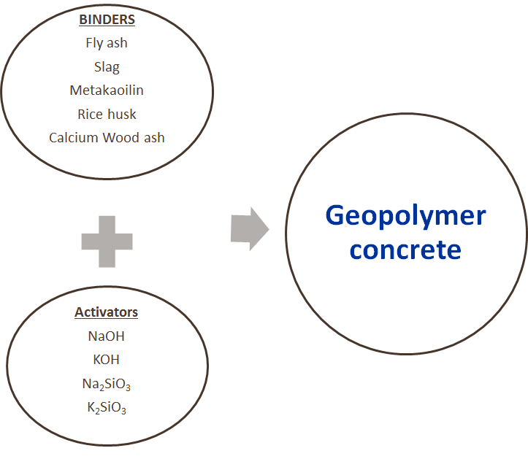
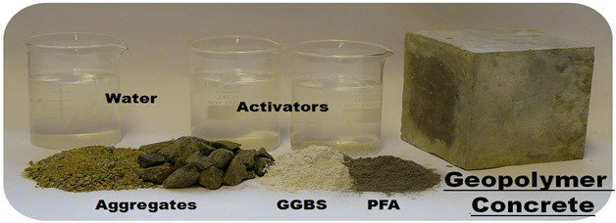
Introduction - Geopolymer Concrete
GC has attracted considerable attention among these binders because of its
Early compressive strength,
Low permeability,
Good chemical resistance and
Excellent fire resistance behavior.

Slide 5
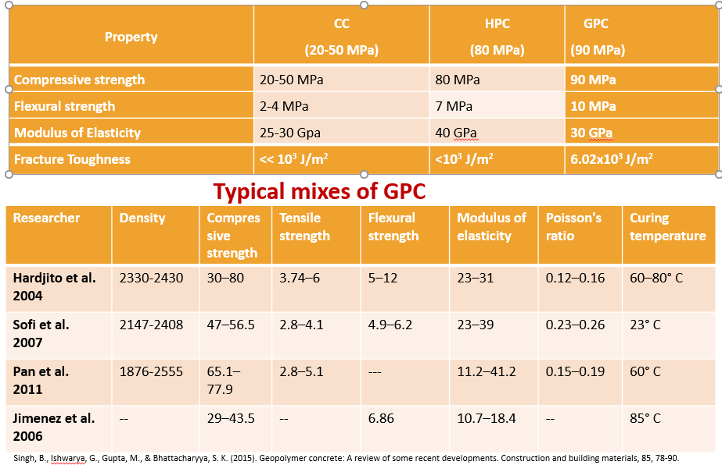
Comparison of Different Types of Concretes with GPC

Slide 6
Research Gap on GPC ………..?
Material standards (including terminology; definition of GPC and constituents and composition; material properties (statistically significant for design; tolerances, batching, packaging, marking, and storage)
Laboratory and Field Testing Standards (including test methods; specimen details and preparation; procedure, precision, reporting, etc.; and lab qualification)
Structural design codes (stress-strain behavior, including minimum ductility requirement; bending with or without axial force, shear, torsion, punching, creep and shrinkages; impact strength and fire resistance/parameters for fire design; phi factors for flexure and shear; dosage of fibers; and dispersion of fibers)
Construction procedures and practices (mixing, placement, consolidation, curing)
Operation and maintenance guidelines
Durability studies

Slide 7
Objectives
Material characterization of ingredients for GPC
Size effect studies on plain GPC under compression
Development of theoretical size effect model for GPC
Parametric studies and Validation

Slide 8
Experimental study
Several trials are conducted in the laboratory to arrive at a GPC mix with good repeatability and reproducibility. The results of the optimized mix are presented here.
Type | MIX 1 (kg) | MIX 2 (kg) | MIX 3 (kg)
Fly ash | 25 | 35 | 12.5
GGBS | 25 | 15 | 37.5
River sand | 88.5 | 88.5 | 88.5
Coarse aggregate | 138.5 | 138.5 | 138.5
AAS solution | 31.5 | 31.5 | 31.5
Properties of Ingredients
Source | River sand | Crushed aggregate | Fly ash | GGBS
Specific gravity | 2.47 | 2.54 | 2.21 | 2.91
Water absorption (%) | 2.85 | 7.21 | - | -
Fineness modulus | 1.41 | 2.27 | 310 | 425
Bulk density | - | - | 995 | 1360

Slide 9
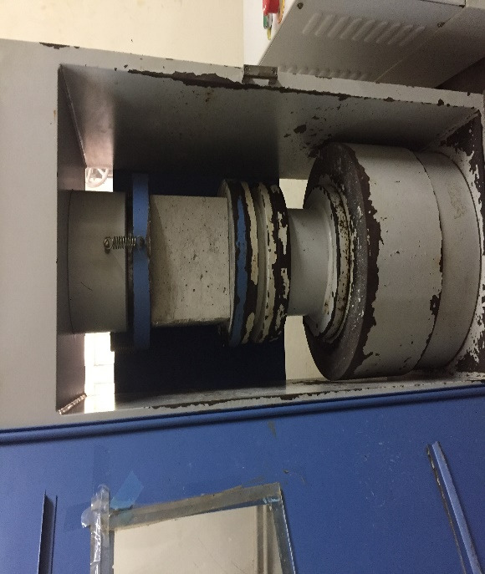
Results
The compressive strength and the workability of the samples is presented in the following table
Specimen type |  | MIX 1 (N/mm²) | MIX 2 ( N/mm²) | MIX 3 (N/mm²)
Cubes (100x100x100) | 1 | 52.6 | 44.51 | 71.31
 | 2 | 56.46 | 41.67 | 6.51
 | 3 | 54.52 | 42.82 | 67.65
Average Strength |  | 54.52 | 43 | 69.49
(150x150x150) | 1 | 55.23 | 46.15 | 68.61
 | 2 | 52.82 | 45.38 | 66.07
 | 3 | 51.32 | 46.56 | 68.88
Average Strength |  | 53.12 | 46.03 | 67.85
Slump (mm) |  | 55 | 25 | 65
Fresh concrete density(kg/m³) |  | 2331.4 | 2308.81 | 2361.2

Slide 10
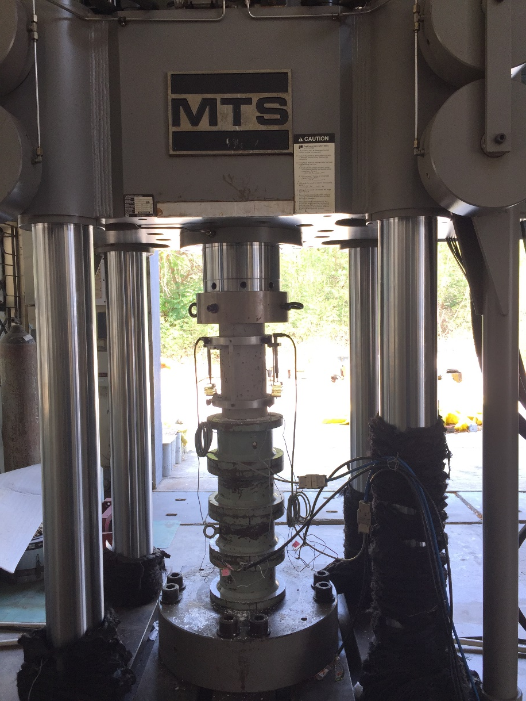
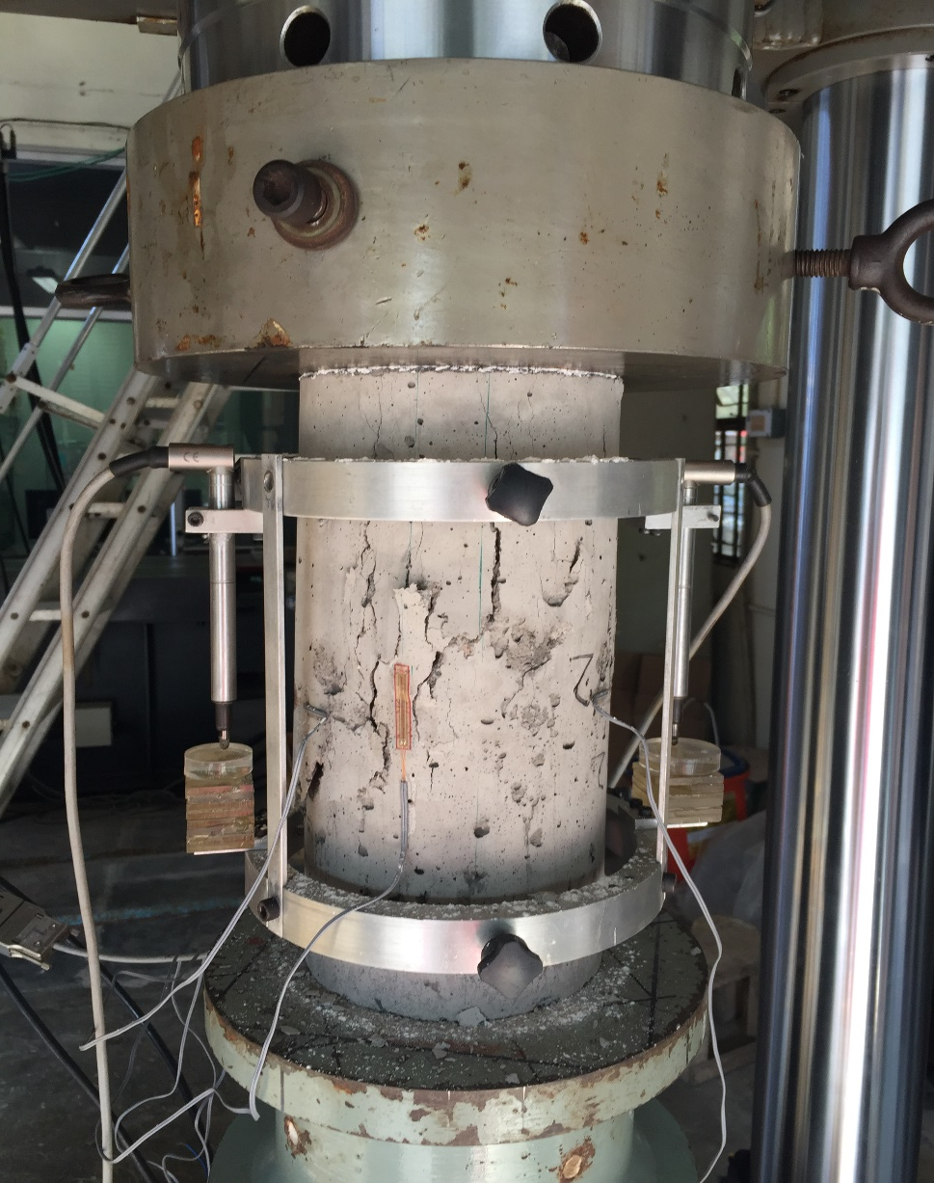
Stress-strain response

Slide 11
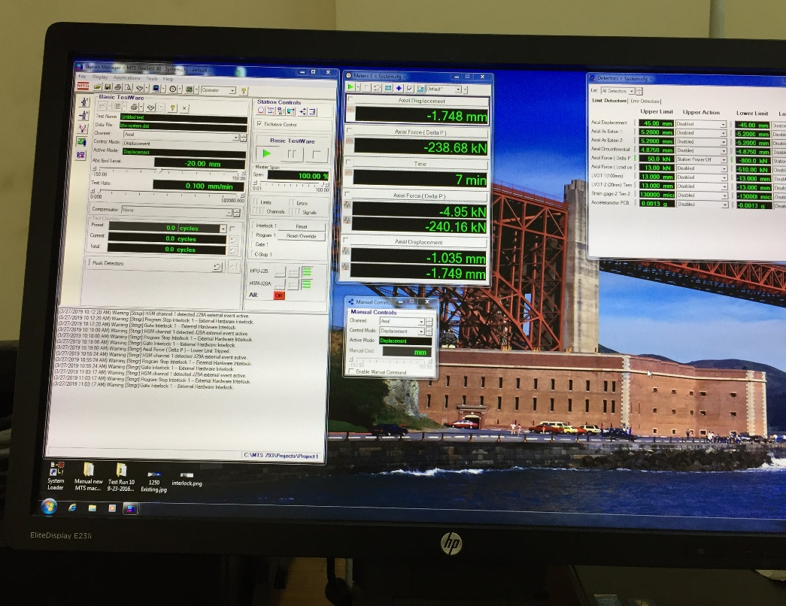
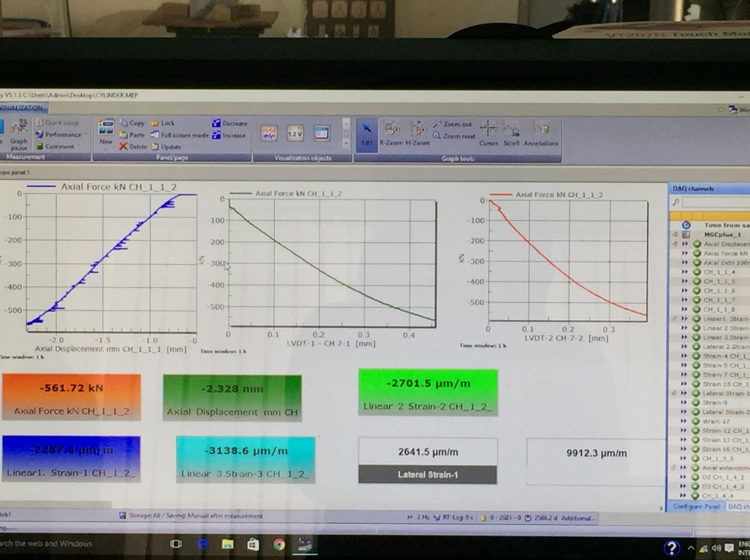
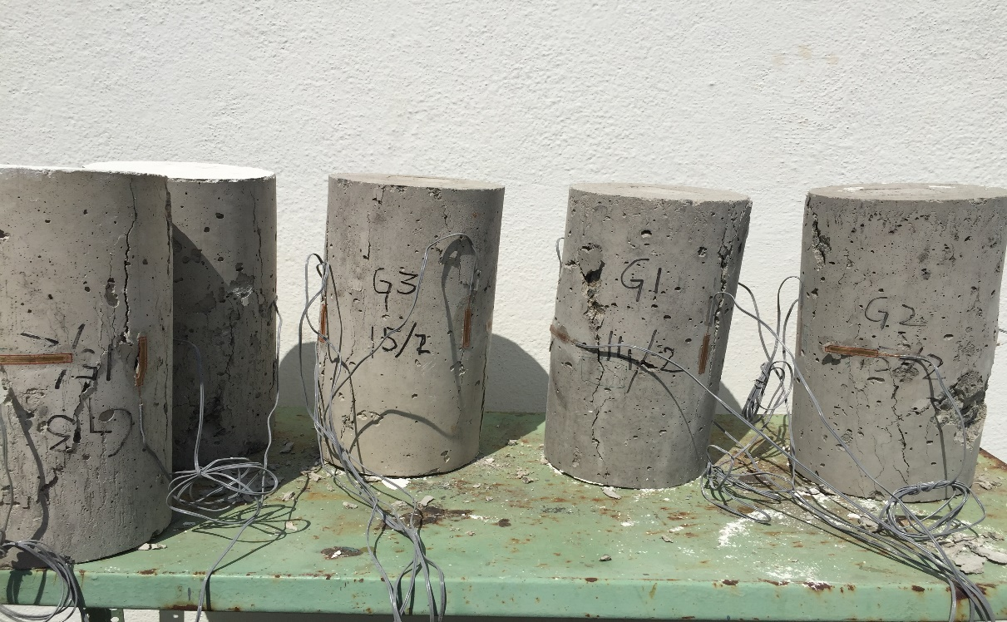
Different grades of cylinder specimens subjected to stress-strain response

Slide 12
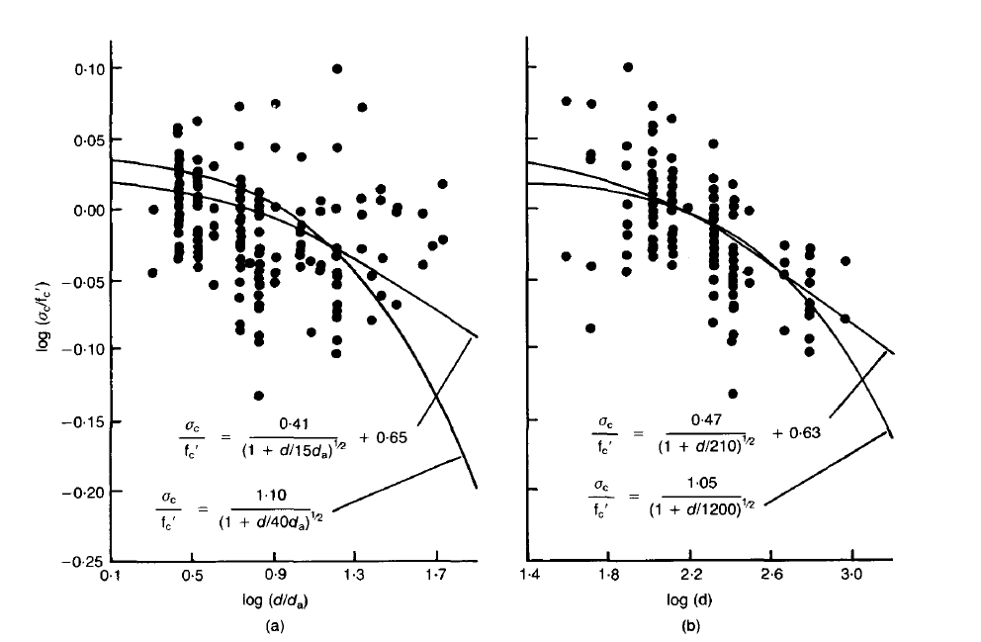
Size effect of uniaxial compressive strength

Slide 13
Stress-strain behaviour of concrete
The compressive strength of the cylinder samples is presented in the following table
Mix | Compressive strength | Maximum Stress | Maximum strain
G-1 | 32.79 | 32.67 | 0.00375
G-2 | 25.16 | 24.79 | 0.00164
G-3 | 32.35 | 29.39 | 0.00329

Slide 14
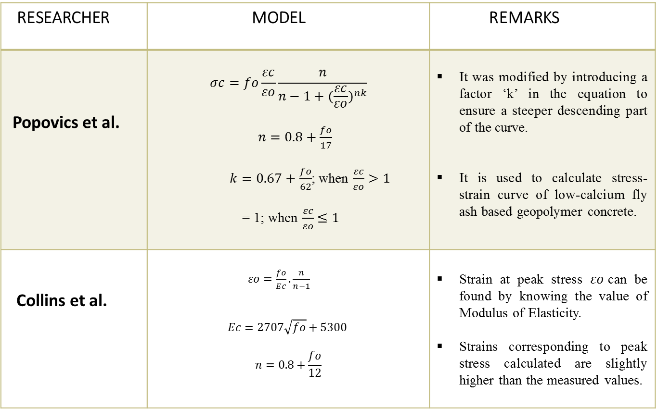
Literature review – Geopolymer concrete
RESEARCHER | MODEL | REMARKS
Popovics et al. | $$σc=fo\frac{εc}{εo}\frac{n}{n−1+{(\frac{εc}{εo})}^{nk}}$$ $n=0.8+\frac{fo}{17}$ $k=0.67+\frac{fo}{62}$; when $\frac{εc}{εo}>1$ = 1; when $\frac{εc}{εo}≤1$ | It was modified by introducing a factor ‘k’ in the equation to ensure a steeper descending part of the curve. It is used to calculate stress-strain curve of low-calcium fly ash based geopolymer concrete.
Collins et al. | $εo=\frac{fo}{Ec}.\frac{n}{n−1}$ $$Ec=2707\sqrt{fo}+5300$$ $$n=0.8+\frac{fo}{12}$$ | Strain at peak stress $εo$can be found by knowing the value of Modulus of Elasticity. Strains corresponding to peak stress calculated are slightly higher than the measured values.

Slide 15
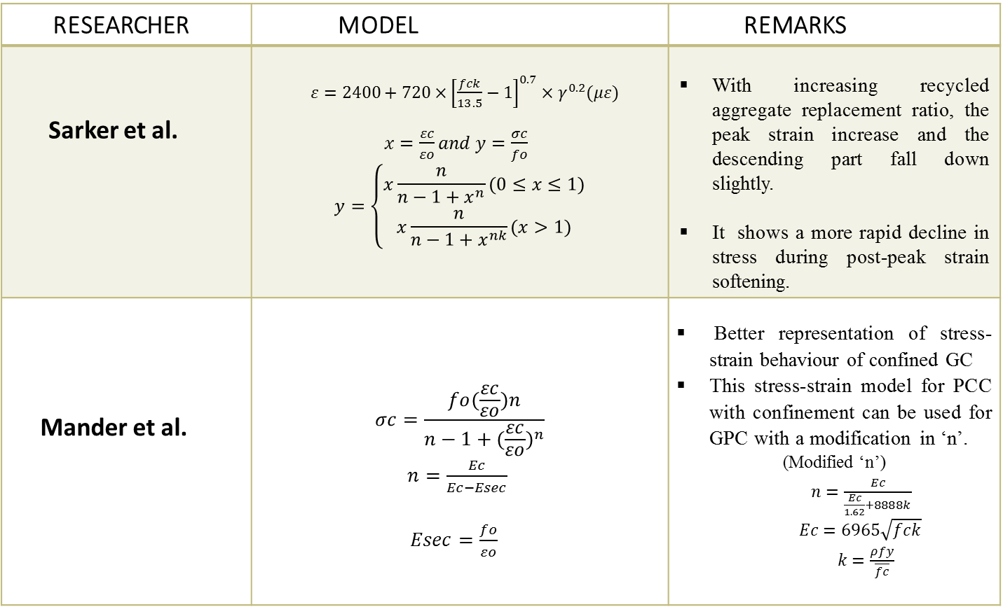
Literature review – Geopolymer concrete
RESEARCHER | MODEL | REMARKS
Sarker et al. | $ε=2400+720×{\left[\frac{fck}{13.5}−1\right]}^{0.7}×γ^{0.2}(με)$ $x=\frac{εc}{εo}and y=\frac{σc}{fo}$ $$y=\left\{\begin{aligned}x\frac{n}{n−1+x^{n}}(0≤x≤1) \\ x\frac{n}{n−1+x^{nk}}(x>1)\end{aligned}\right.$$ | With increasing recycled aggregate replacement ratio, the peak strain increase and the descending part fall down slightly. It shows a more rapid decline in stress during post-peak strain softening.
Mander et al. | $$σc=\frac{fo(\frac{εc}{εo})n}{n−1+{(\frac{εc}{εo})}^{n}}$$ $n=\frac{Ec}{Ec−Esec}$ $Esec=\frac{fo}{εo}$ | Better representation of stress-strain behaviour of confined GC This stress-strain model for PCC with confinement can be used for GPC with a modification in ‘n’. (Modified ‘n’) $n=\frac{Ec}{\frac{Ec}{1.62}+8888k}$ $Ec=6965\sqrt{fck}$ $k=\frac{ρfy}{\overline{fc}}$

Slide 16
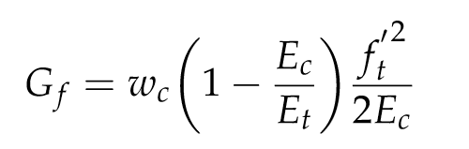
Size effect model for GPC
Review of existing models
Bazant et al. (1984)
Bazant demonstrated the size effect on concrete strength through some theoretical approaches based on non-linear fracture mechanics.
To derive the size effect law, he assumed the potential energy release rate at the fracture to be dependent on the length and width of the crack band zone.
The width of crack band is proportional to da.
Based on the energy balance approach, the fracture energy required for crack propagation in concrete, is expressed as
The width of crack is w_{c} = nd_{a} , where ‘d_{a}’ is the maximum size of aggregate and ‘n’is empirical constant. E_{c} and E_{t} are elastic modulus and strain-softening modulus, while f_{t}´ is direct tensile strength of concrete.

Slide 17
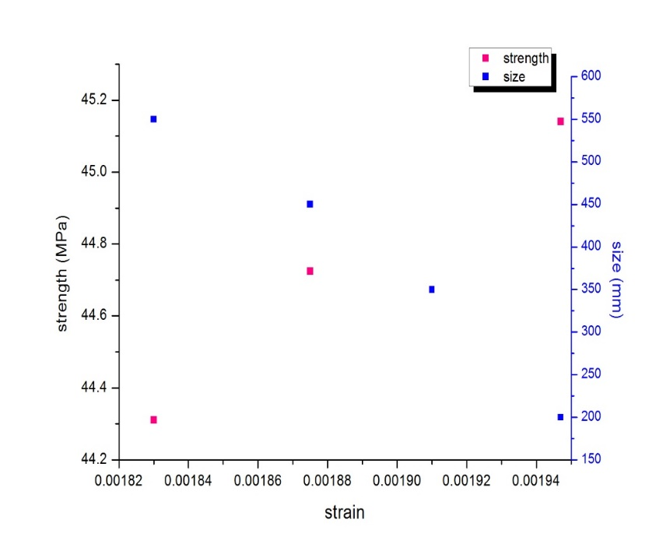

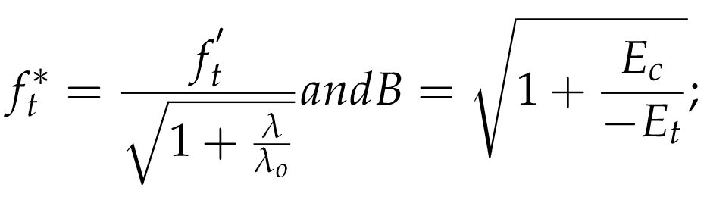
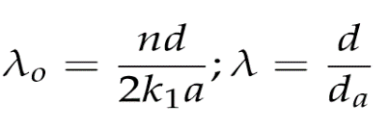
Size effect model for GPC-contd…
The nominal strength is expressed as size dependent parameter and given by
where f_{t}* called as size reduced-strength, k₁ is slope and a be the length , f_{t} is the compressive strength of concrete, λ and λ_{o} are the constants, when geometrically similar specimens are considered.

Slide 18
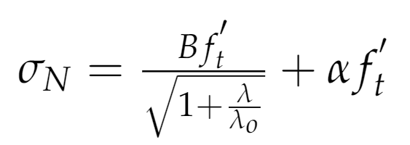
2. Kim and Eo (1990)
Kim and Eo proposed the trend of the size effect for specimens with dissimilar initial cracks and modified the basic formula derived by Bazant where including the parameter called Size independent strength (αf _{t}).
The nominal strength is further expressed as the sum of size dependent and size independent strength.

Slide 19
Results and Conclusions
Comparing the experimental and proposed model values are as follows
Specimen type | Experimental (N/mm²) | Proposed (N/mm²)
Cube (100 mm) | 54.52 | 54.60
 | 43.00 | 43.06
 | 69.49 | 69.59
Cube (150 mm) | 53.12 | 53.19
 | 46.03 | 46.09
 | 67.85 | 67.95
From the experimental studies the size effect of GPC is evident.
The proposed model is able to satisfactorily predict the experimental compressive strength of concrete.

Slide 20
References
Bažant, Z. P. (1984). Size effect in blunt fracture: concrete, rock, metal. Journal of engineering mechanics, 110(4), 518-535
Bažant, Z. P., & Oh, B. H. (1983). Crack band theory for fracture of concrete. Matériaux et construction, 16(3), 155-177.
Dehestani, M., Nikbin, I. M., & Asadollahi, S. (2014). Effects of specimen shape and size on the compressive strength of self- consolidating concrete (SCC). Construction and building materials, 66, 685-691.
Gonnerman, H. F. (1925). Effect of size and shape of test specimen on compressive strength of concrete. In Proceedings of ASTM (Vol. 25, pp. 237-250).
Hamad, A. J. (2017). Size and shape effect of specimen on the compressive strength of HPLWFC reinforced with glass fibres. Journal of King Saud University-Engineering Sciences, 29(4), 373-380.
Kim, J. K. (1990). Size effect in concrete specimens with dissimilar initial cracks. Magazine of Concrete Research, 42(153), 233-238.
Sim, J. I., Yang, K. H., Kim, H. Y., & Choi, B. J. (2013). Size and shape effects on compressive strength of lightweight concrete. Construction and building Materials, 38, 854-864.
Singh, B., Ishwarya, G., Gupta, M., & Bhattacharyya, S. K. (2015). Geopolymer concrete: A review of some recent developments. Construction and building materials, 85, 78-90.
Prem, P. R., Murthy, A. R., & Verma, M. (2018). Theoretical modelling and acoustic emission monitoring of RC beams strengthened with UHPC. Construction and Building Materials, 158, 670-682.
Prem, P. R., Verma, M., & Ambily, P. S. (2018). Sustainable cleaner production of concrete with high volume copper slag. Journal of cleaner production, 193, 43-58.

