Slide 1

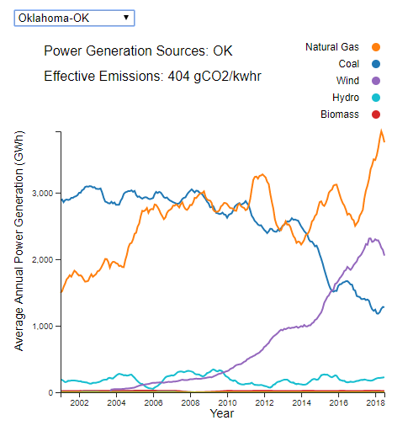
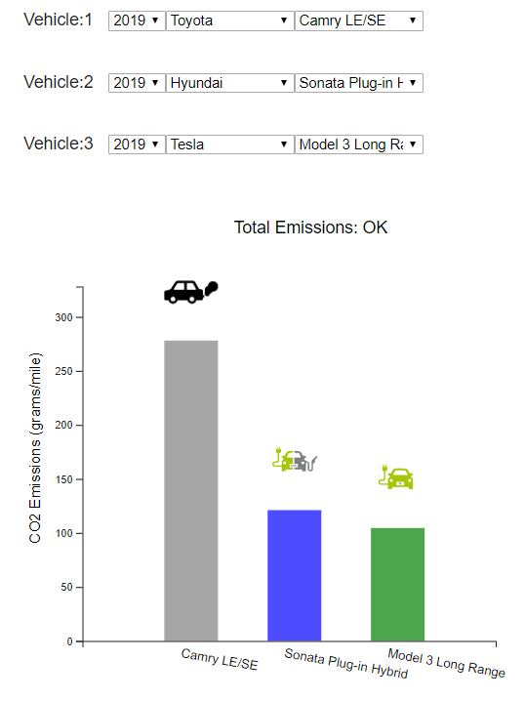
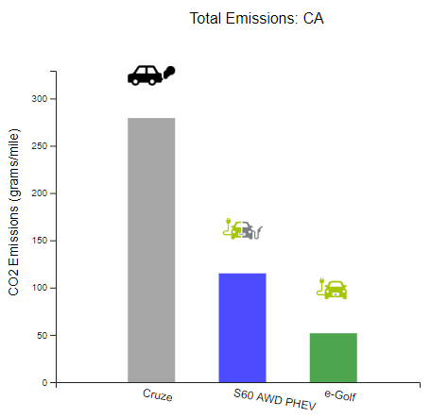
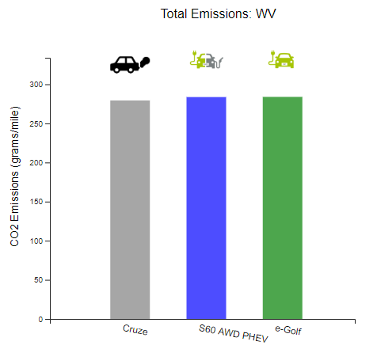
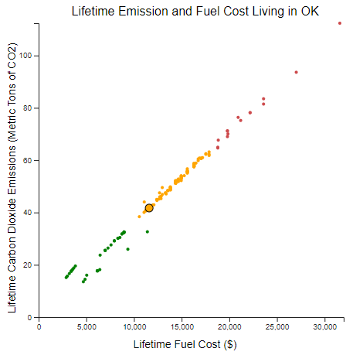
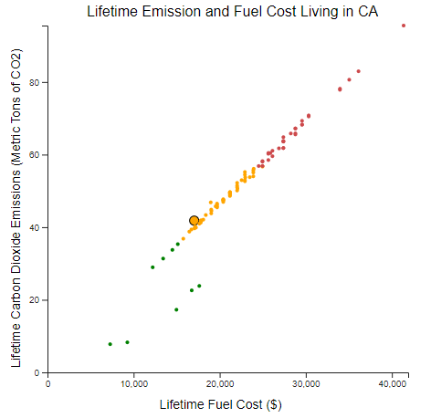
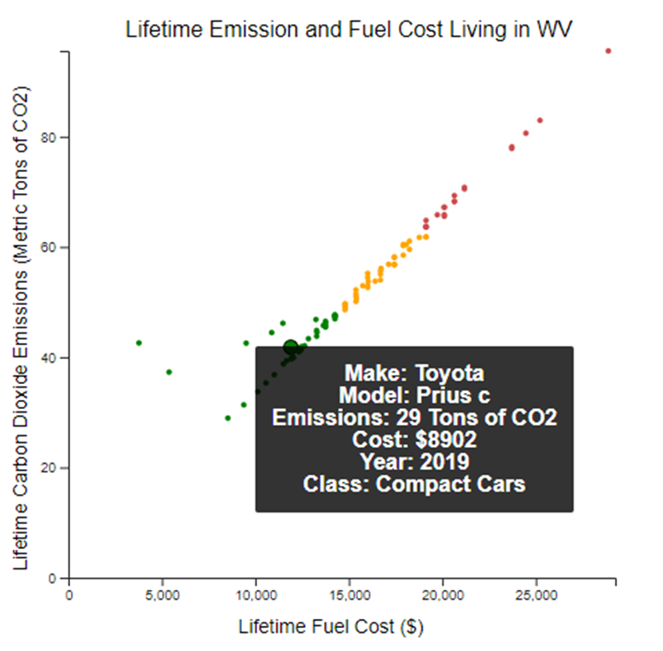
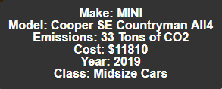
Vehicle Lifecycle Cost and Emission Impact Tool
Vyshnavi Govindankutty
Michael Karsten
Corey McCann
Erich Rasch
Check it out at:
github.gatech.edu/pages/Keeping-It-On-The-DL/EVEmissionsCalc/
Introduction
Data
Experiments & Results
Transportation is a major source of pollution in the US, contributing up to 29% of CO2 emissions according to the EPA[1]. This tool is aimed at educating consumers about the vehicle emissions and the corresponding fuel cost incurred during the vehicle’s lifecycle. The tool accounts for emissions generated from electricity used in charging electric vehicles and hybrids depending on the source of electricity, which varies with each state. The tool calculates the lifecycle emissions and cost and then visually shows how it compares to other vehicles in its class. It gives the consumers a personalized view and more clarity on both the environmental and financial impact of their choice.
Data was collected from three sources, then cleaned and formatted with a Python script. The data is read directly into the tool through a JavaScript function based on the state and/or vehicle selected.
State | Car Class | Vehicles | Total Emissions (tons CO2) |  |  | Total Cost ($)
 |  |  | Gas | Hybrid | EV | Gas | Hybrid | EV
CA | Compact Cars | Gas: Chevrolet Cruze Hybrid: Volvo S60 AWD PHEV Electric: Volkswagen e-Golf | 42 | 17 | 8 | 17570 | 15510 | 7809
 | Mid-Size Sedan | Gas: Toyota Camry LE/SE Hybrid: Hyundai Sonata Plug-in Hyrbrid Electric: Tesla Model 3 Mid Range | 42 | 35 | 7 | 18328 | 9353 | 7111
 | Performance Sedans | Gas: Audi A6 Hybrid: Porsche Panamera 4 e-Hybrid Electric: Tesla Model S P100D | 47 | 30 | 9 | 20946 | 22648 | 9497
 | Standard SUV | Gas: BMW X5 xDrive40i Hybrid: Volvo XC90 AWD PHEV Electric: Tesla Model X P100D | 59 | 25 | 11 | 26659 | 20097 | 10866
WV | Compact Cars | Gas: Chevrolet Cruze Hybrid: Volvo S60 AWD PHEV Electric: Volkswagen e-Golf | 42 | 43 | 43 | 12268 | 9878 | 4143
 | Mid-Size Sedan | Gas: Toyota Camry LE/SE Hybrid: Hyundai Sonata Plug-in Hyrbrid Electric: Tesla Model 3 Mid Range | 42 | 35 | 41 | 12797 | 7374 | 4007
 | Performance Sedans | Gas: Audi A6 Hybrid: Porsche Panamera 4 e-Hybrid Electric: Tesla Model S P100D | 47 | 58 | 52 | 14625 | 14679 | 5039
 | Standard SUV | Gas: BMW X5 xDrive40i Hybrid: Volvo XC90 AWD PHEV Electric: Tesla Model X P100D | 59 | 53 | 59 | 18614 | 13011 | 5765
 | Assumptions: | 1. Car year is 2019 (except for Performance Sedans, 2018) 2. 8 years of use 3. 150,000 miles
Source | Connection | Description | Features | Attributes
EIA.gov [2] | API connection | Electric Grid Data | 10 | ~8,000
Fuel economy.gov [3] | Direct Download | Vehicle fuel economy data | 71 | ~41,000
AAA.Com [4] | Direct Download | Gas Prices | 4 | 50
Approach
Visualization & Interactivity
The tool is part of a webpage that can be used in Chrome and Firefox. It is composed of background information and three interactive plots.
The Approach
Present data in intuitive plots on a webpage built on a script written in D3, a JavaScript data visualization library with HTML and CSS components. Users are able to personalize the visual analysis based on their location and vehicle(s). The first plot shows average power generation by power source for each state, the second plot shows the average CO₂ emissions per mile for three selected vehicles and the third plot shows a cluster plot for lifecycle emission and fuel cost using a k-means clustering algorithm. The clustered scatterplot shows all cars in the same year and class as the vehicle chosen in the first dropdown.
The Implementation
The plots parse information from files for state-specific emissions, gas prices, vehicle information and electrical generation portfolios ultimately displaying the information as a line chart, bar chart or scatter plot using D3.
The Effectiveness
Provides users a simple interface to quickly digest vehicle emission and fuel cost information. Bar charts are a simple way to visually compare emission magnitudes for three vehicles of interest. The clustering in the scatter plot aids users in determining which vehicles are better from an emission and cost perspective.
The Innovation
Single “effective emissions per mile” metric across technologies.
Personalized results by location that reflect local fuel prices, energy prices, and mix of utility electric generation.
Interactively inform consumers of a vehicle’s environmental and financial cost.
Clustering algorithm groups different vehicles into categories with similar environmental and financial impacts.
Figure 2. Insert Figure description here
Fig. 4. Experiments were performed with the tool to evaluate lifecycle emissions and fuel cost for four different vehicle classes in a low emissions power generation state (California, 182 gCO2/kwhr) and a high emissions power generation state (West Virginia, 999 gCO2/kwhr).
California (CA)
Compact Cars
West Virginia (WV)
Fig. 1. Average annual power generation in a given state by source, which is used to calculate state effective emissions per kWhr.
Fig. 2. Direct vehicle emissions comparison based on selection from drop-down boxes. Emissions information factors in effective emission from state power generation shown in Fig. 1.
Figure 1 shows the energy-mix of the users state. Additionally, it calculates the states effective emissions for the previous year.
Figure 2 allows the compare vehicle emissions. Electric and hybrid vehicles use the effective emissions from Figure 1 to calculate how much emissions are generated in creating the electricity used to charge the vehicles.
Figure 3 shows the K-means clustering for all vehicles in the given class and year as Vehicle 1 in Figure 2. A tool tip allows the user to gain information on the data points to quickly identify vehicles with better or worse cost and emissions.
Acknowledgments
Fig. 5. Specific case study was performance on the compact car class in California and West Virginia. It can be seen in the right bar chart that the high effective emissions of WV results in all cars having the same amount of emissions, whereas there is a large disparity in CA. The tool tip in the bottom right plot illustrates the use of the tool tip to identify the compact car with the lowest lifecycle emissions.
Many thanks to Professor Polo Chau and the CSE 6242
TA’s during the Spring 2019 semester.
Fig. 3. K-means clustering plot with tool tip. Large circle represents vehicle 1 from Fig. 2. All other points are vehicles in the same year and class. Tool tip allows quickly for extracting information on other data points allowing the user to find other options.
References
[1] Greenhouse Gas Emissions. (2019, April 11). (United States Environmental Protection Agency) Retrieved April 23, 2019, from https://www.epa.gov/ghgemissions/sources-greenhouse-gas-emissions
[2] AAA Gas Prices. (2019, April 23). Retrieved from Gas Prices: https://gasprices.aaa.com/
[3] FuelEconomy.gov Web Services. (2019, April 23). Retrieved from www.fueleconomy.gov: https://www.fueleconomy.gov/feg/download.shtml
[4] Net Generation by Energy Source. (2019, March 26). Retrieved from U.S. Energy Information Administration: https://www.eia.gov/electricity/monthly/epm_table_grapher.php?t=epmt_1_01

