Slide 1
JAVA FULL STACK
Project Title: Employee Management System
Presented By: Abhinav Teja Thota
Roll No: 23951A1204

Slide 2
Abstract
The Employee Management System (EMS) is a full-stack web application designed to simplify and automate employee data handling within an organization. It provides functionalities such as adding, updating, viewing, and deleting employee details, along with managing departments and roles.
Built with React.js for an interactive and responsive user interface and Spring Boot (Maven build) for a robust backend, the system ensures efficient data flow and management. It helps HR and administrators maintain accurate employee records, improve operational efficiency, and reduce manual errors.

Slide 3
Literature Survey
Existing Solutions:
Many organizations still use manual or outdated software for employee record management, leading to data redundancy, slow processing, and security issues. Lack of integration between frontend and backend systems causes inconsistencies and inefficiencies.
Proposed Solution:
Develop an integrated Employee Management System using React.js and Spring Boot to manage employee information efficiently. The application will support CRUD operations, secure data storage, and easy scalability. Using RESTful APIs, it ensures smooth communication between frontend and backend. The use of Maven simplifies build and dependency management for the backend.

Slide 4
Technologies
Frontend:
React.js – For creating a dynamic and user-friendly interface.
JavaScript – To add interactivity and handle frontend logic.
CSS / Tailwind CSS – For responsive design and styling.
Backend:
Spring Boot – For developing RESTful APIs and managing backend logic efficiently.
Java – Core backend language for business logic.
MySQL – For storing employee data securely.
Build & Tools:
Maven – For dependency management and project build automation.
Postman – For testing backend APIs.
Git & GitHub – For version control and collaboration.

Slide 5
Algorithms
CRUD Operations Algorithm
Implemented Create, Read, Update, and Delete operations for managing employee records efficiently.
Authentication & Authorization Logic
Used secure login validation and session handling to ensure only authorized users can access sensitive employee data. Passwords encrypted before storage using hashing techniques
Search Algorithm
Real-time employee search implemented using case-insensitive substring matching.
Efficient lookup through indexed MySQL queries for faster performance.
Implemented using Spring Data JPA’s Pageable interface.
Error Handling & Validation Logic
Implemented form validation on frontend (React.js) and backend (Spring Boot).
Prevents invalid data entry and ensures smooth user experience.

Slide 6
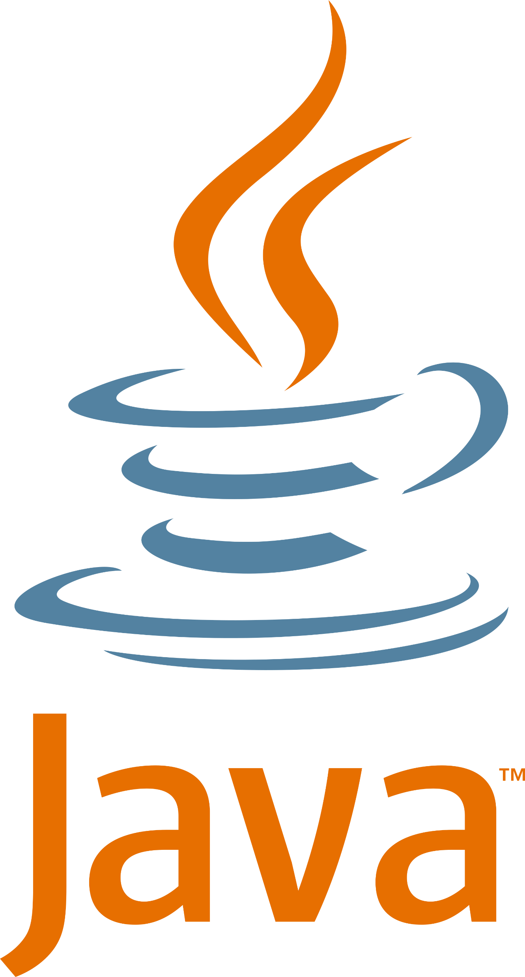


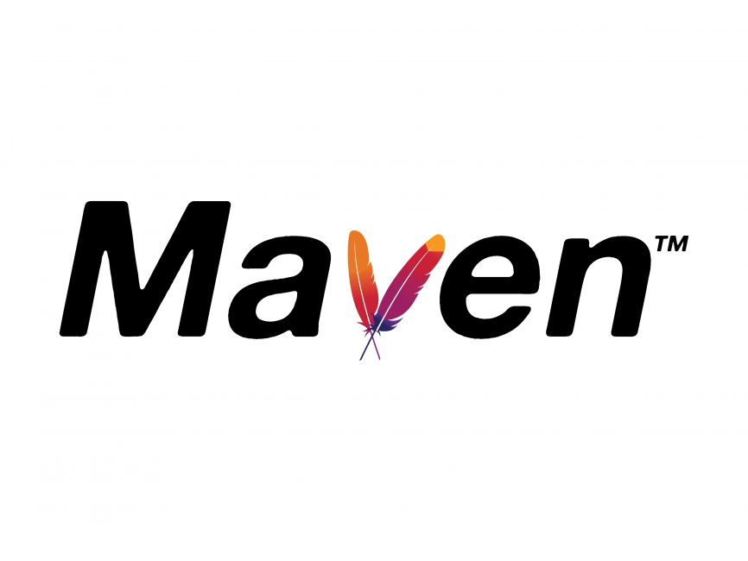





Workflow
Handles database connectivity and data persistence
Core backend language
Remote repository for managing source code
Version control
Dependency management and build automation tool
API testing and validation
Sends backend responses
Sends HTTP requests
Provides modern and responsive styling

Slide 7
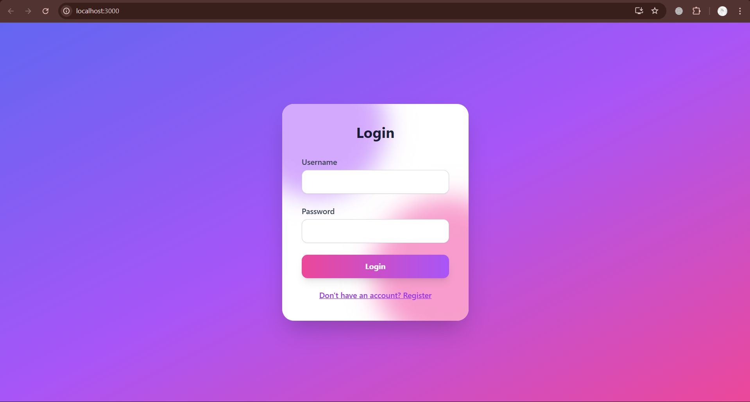
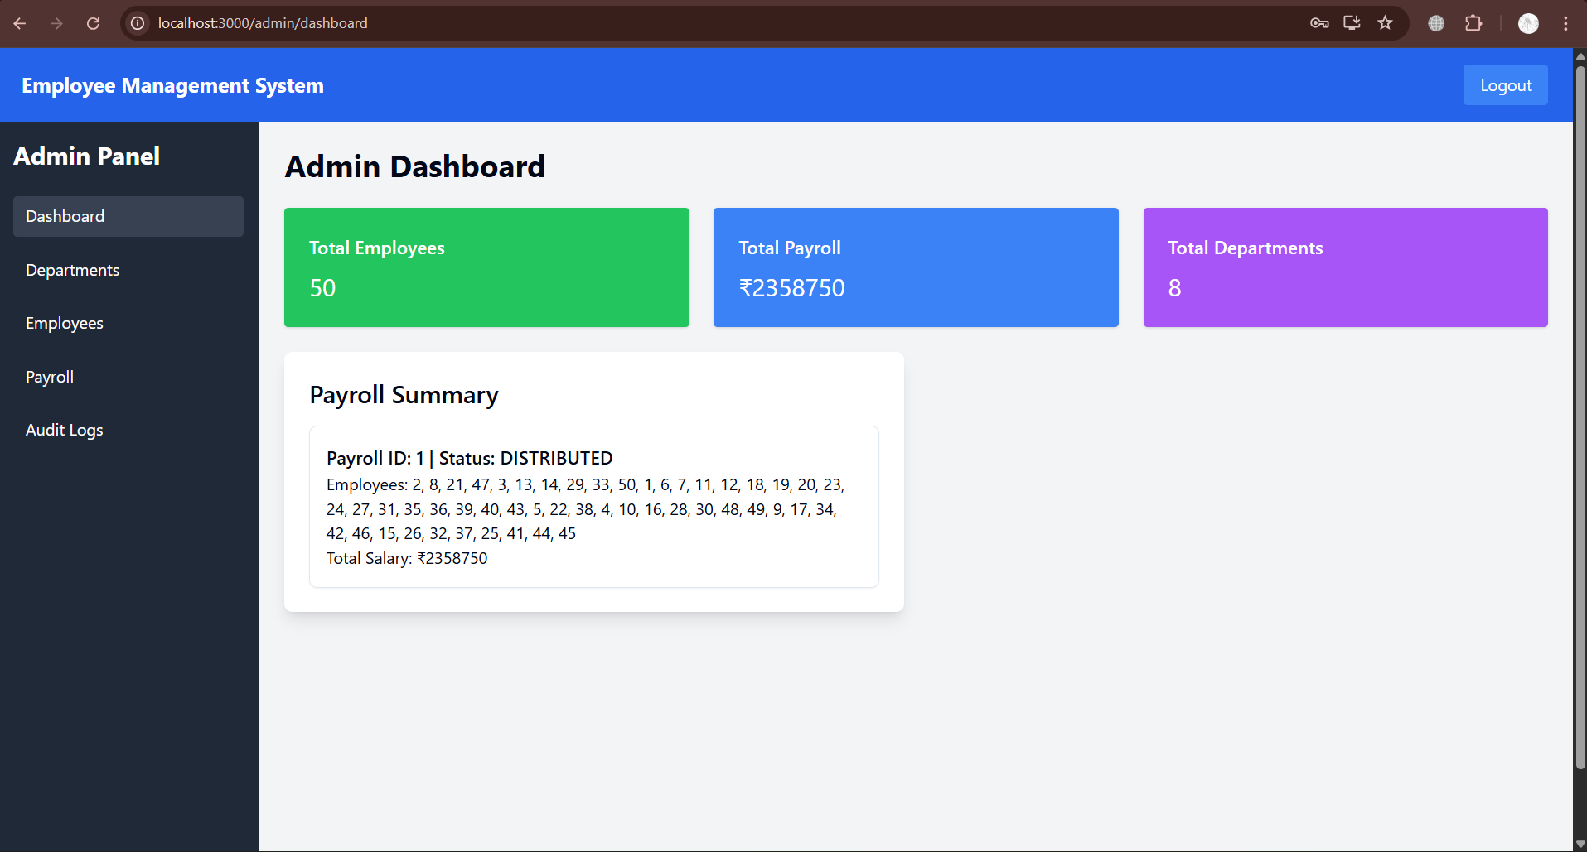
Output

Slide 8
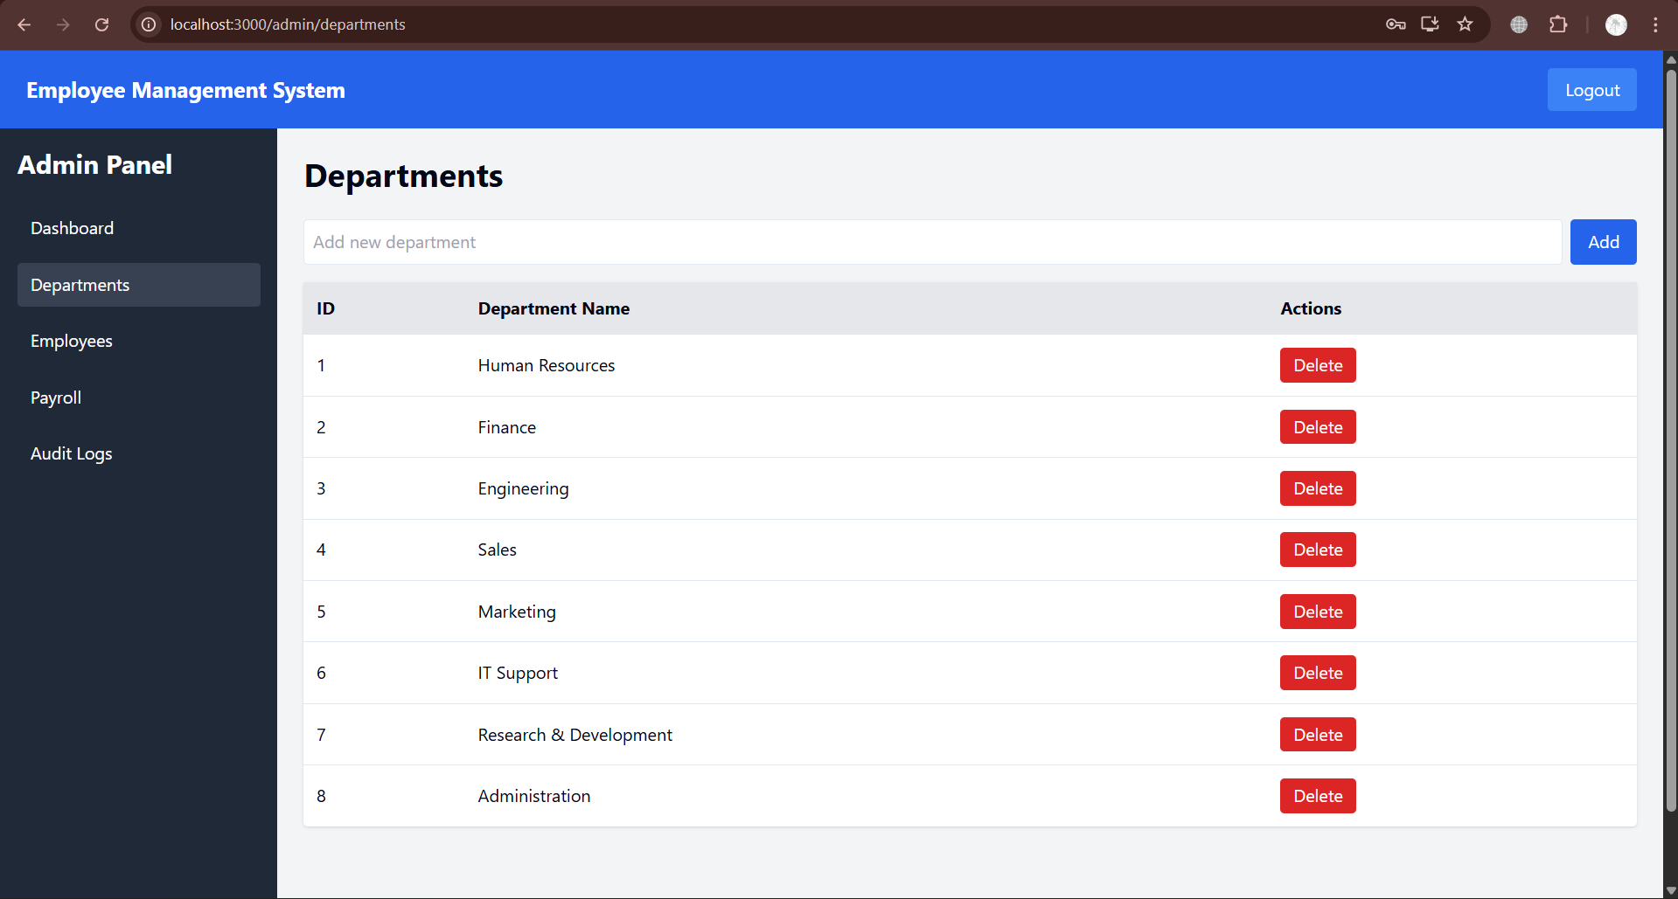
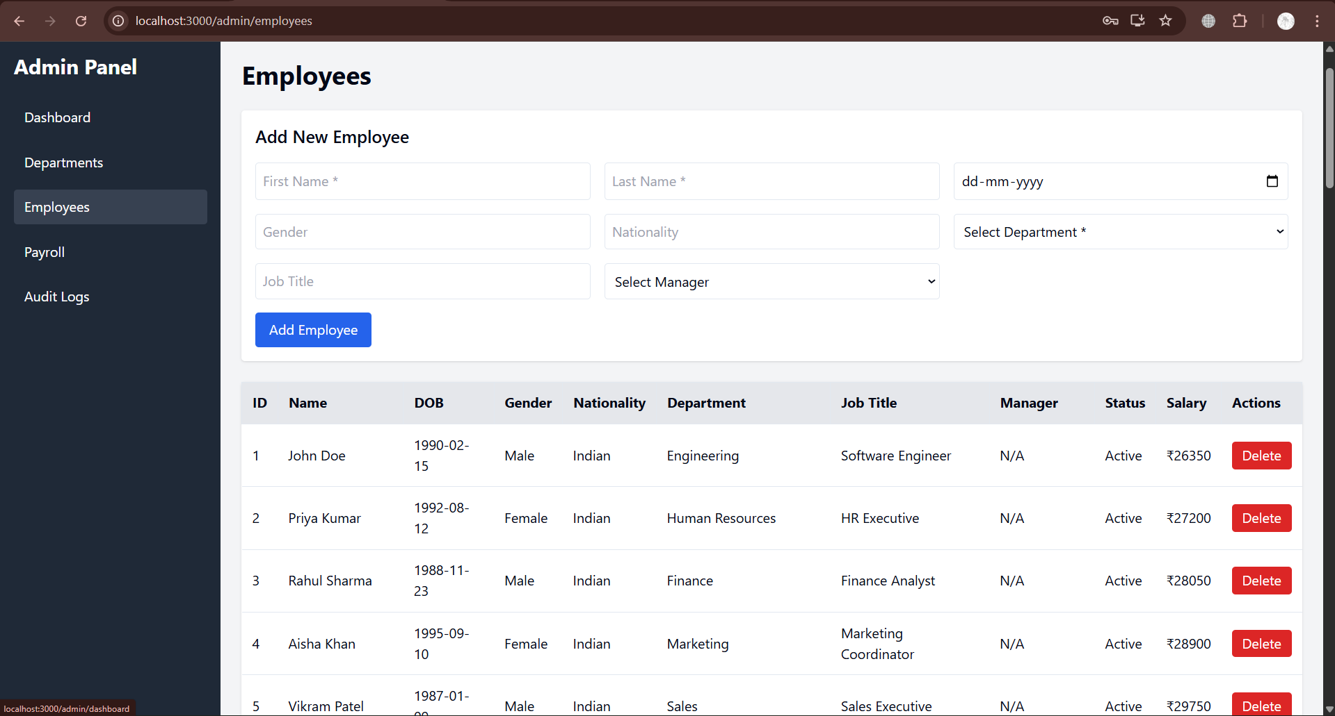

Slide 9
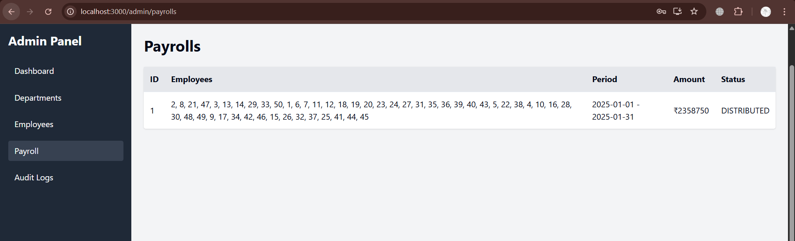
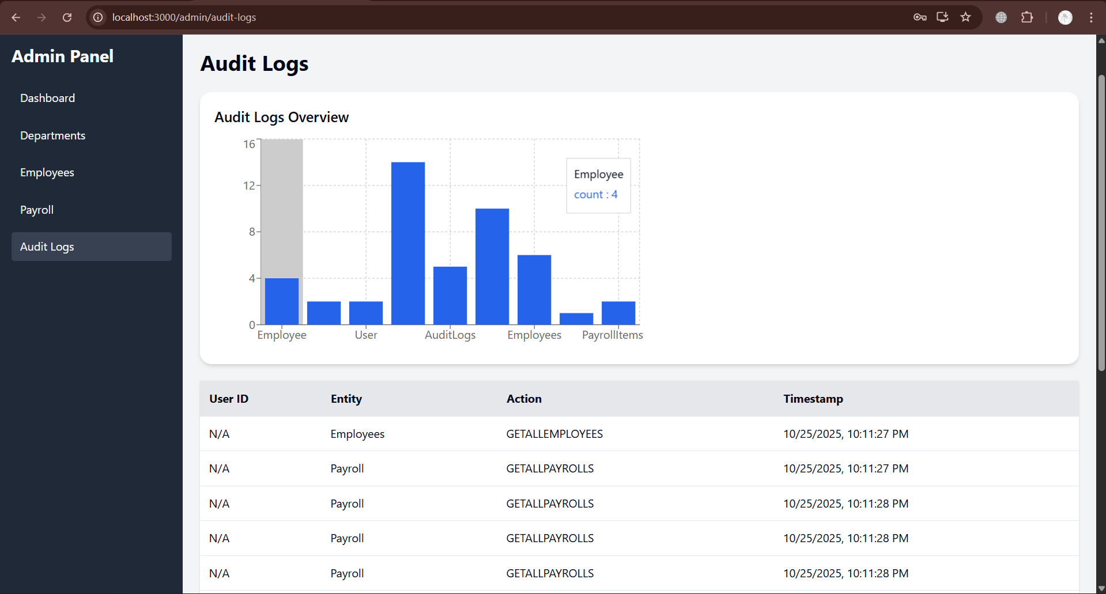
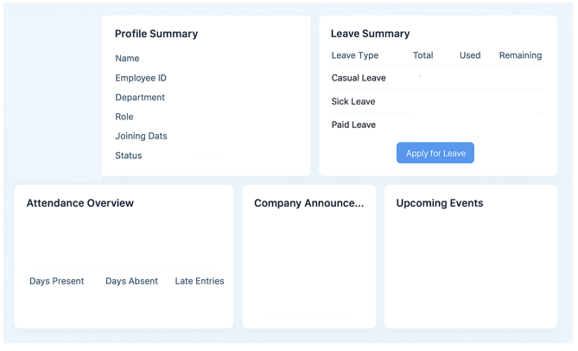
User Dashboard:

Slide 10
Conclusion
The Employee Management System streamlines HR operations by automating employee record management. It enhances data accuracy, reduces administrative workload, and provides a secure, user-friendly experience. Integration of React.js and Spring Boot ensures a smooth, fast, and scalable system. Overall, it enables organizations to maintain structured and efficient employee information systems.

Slide 11
Thank You

