Slide 1
Opinion mining for political disclosure
.

Slide 2
Team members
REETHIKA.G - 2303A51190
VYSHNAVI.M - 2303A51205
VYSHNAVI.R - 2303A51216
SREEJA.T - 2303A51220

Slide 3
Introduction
Project Overview:
Analyzes political discussions on social media using sentiment analysis.
Identifies public opinions on political topics and figures.
Importance:
Helps understand voter sentiments.
Supports policy making and campaign strategies.

Slide 4
PROBLEM STATEMENT
In today's digital age, a significant portion of political discourse occurs on platforms like Twitter. These platforms offer real-time and large-scale access to public opinion but are also noisy and unstructured.
The key challenge is how to accurately extract, interpret, and analyze these sentiments to provide meaningful insights into public views on policies, events, and political figures.
We aim to answer: How can sentiment and opinion mining techniques be used to accurately gauge public sentiment about political issues and candidates in a dynamic and fast-evolving online environment?

Slide 5
OBJECTIVES
Collect a dataset of political tweets from Kaggle.
Preprocess the dataset to clean and prepare it for analysis.
Use sentiment analysis to classify the opinions as positive, negative, or neutral.
Visualize the distribution of sentiments and identify trends over time.
Derive actionable insights from the analysis that can support political decision-making.

Slide 6
Dataset Description
Source: Kaggle - Trump Twitter Archive
Description: The dataset contains tweets posted by Donald Trump. Each entry includes tweet content, timestamp, device used, and engagement metrics.
Usage: The dataset helps analyze how public reactions differ based on content, time, and political events.
URL: https://www.kaggle.com/datasets/rohanrao/trump-tweets

Slide 7
Tools and Libraries
Python: The programming language used for scripting and analysis.
Pandas: Used for loading, cleaning, and manipulating data in tabular format.
Matplotlib & Seaborn: Visualization libraries used to generate graphs and charts to explore trends.
TextBlob: A simple NLP tool used to perform sentiment classification and text processing.
Additional tools like Regex for text cleaning and Jupyter/Colab for implementation.

Slide 8
Data Processing
Step 1: Load the dataset using Pandas.
Step 2: Clean the tweet content by removing URLs, special characters, and converting text to lowercase.
Step 3: Apply sentiment analysis using TextBlob to calculate polarity.
Step 4: Classify tweets into Positive, Negative, or Neutral based on polarity score.
Step 5: Save the processed data for visualization and modeling.

Slide 9
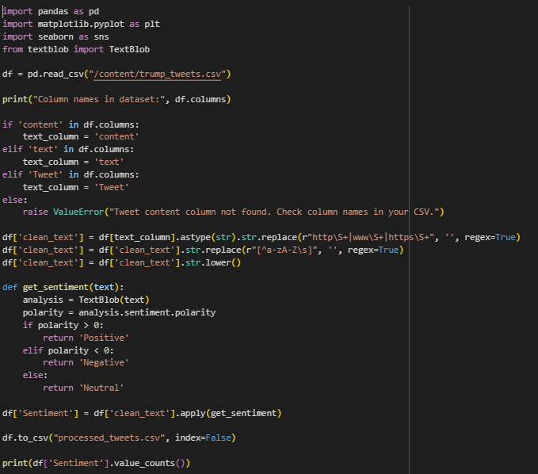
Code Snippet - Data Processing

Slide 10
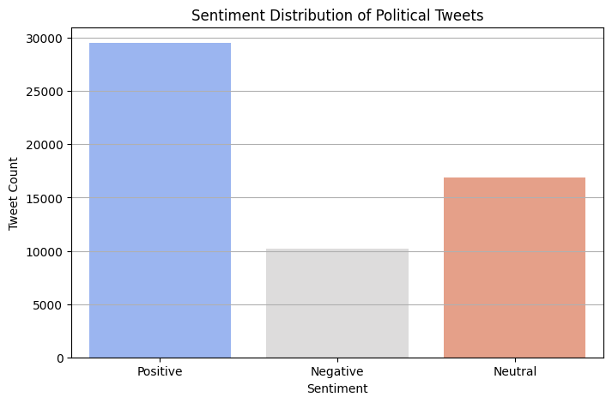
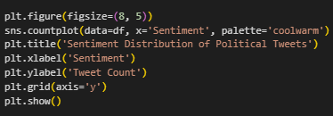
Exploratory Data Analysis

Slide 11
CONCLUSION
Sentiment analysis is a useful tool for analyzing political discourse.
TextBlob can classify public opinion into sentiments effectively.
Opinion mining helps political entities understand public reactions and adjust their communication.
The project demonstrates how data mining and NLP techniques can provide deep social insights.

Slide 12
THANK YOU

