Slide 1
ORDER PROCESSING
Operations Dashboard
SYSTEM
Total Orders
Completed
128
112
Concurrent order handling with inventory locking,
retries and a live operations dashboard.
Processing
Failed
8
8
1
2
3
4
Order
Process
Stock
Result
Project Presentation
Team TechNova • Acentra Health
Order Processing System
Team TechNova

Slide 2
Problem & Project Objective
02
What the system is designed to solve
The problem
Our objective
• Orders can arrive at the same time and need safe processing.
• Inventory must not become negative when multiple orders use the same stock.
• Temporary failures need controlled retries instead of manual intervention.
• Operations teams need a clear view of order and inventory status.
• Accept an order quickly and process it in the background.
• Use database row locking while reserving stock.
• Retry failed orders up to 3 times.
• Move permanently failed orders to a Dead-Letter Queue.
• Push live updates to the dashboard using WebSocket/STOMP.
Order Processing System
Team TechNova

Slide 3
System Architecture
03
Frontend, backend, database and real-time communication
FRONTEND
React + Vite • Dashboard • Order Form • Inventory • DLQ
BACKEND
Spring Boot 3.2.5 • REST APIs • Async Thread Pool • JPA
WebSocket / STOMP notifications
DATA
PostgreSQL
CONCURRENCY
10 core / 20 max threads
Orders • Inventory • Dead-letter orders
Queue capacity: 50 tasks
Order Processing System
Team TechNova

Slide 4
Order Processing Flow
04
From order placement to completion or recovery
1
2
3
4
5
Place Order
Pending
Process
Reserve Stock
Complete
POST /api/orders
Saved immediately
Background thread
Pessimistic lock
Update + notify
If stock reservation fails
Retry → retry count increases → after 3 failed attempts → Dead-Letter Queue
A DLQ item can be re-processed as a new order after inventory is restored.
Order Processing System
Team TechNova

Slide 5
Key Features
05
Main functions implemented in the application
Concurrent processing
Inventory protection
Orders are dispatched to a Spring ThreadPoolTaskExecutor so processing can happen in parallel.
Pessimistic row locking prevents concurrent orders from using stale stock values.
Retry handling
Dead-Letter Queue
Failed orders return to PENDING and are retried with a maximum of 3 attempts.
Orders that exhaust retries are stored with the failure reason and retry count.
Live dashboard
Restocking
STOMP/WebSocket updates keep order, inventory and statistics views current.
The dashboard can add 50 units to an inventory item with one action.
Order Processing System
Team TechNova

Slide 6
Dashboard & User Flow
06
Simple view of the main screens and operations
Operations Dashboard
Typical user flow
Orders
Pending
Completed
Failed
128
6
112
8
1
Select product + quantity
2
Click Place Order
ORDER STREAM
ID
Product
Qty
Status
Retry
3
Watch status change
#104
Laptop
2
COMPLETED
—
4
Inventory updates
CURRENT INVENTORY
5
Review failed orders in DLQ
Keyboard
180
Mouse
95
Monitor
22
Order Processing System
Team TechNova

Slide 7
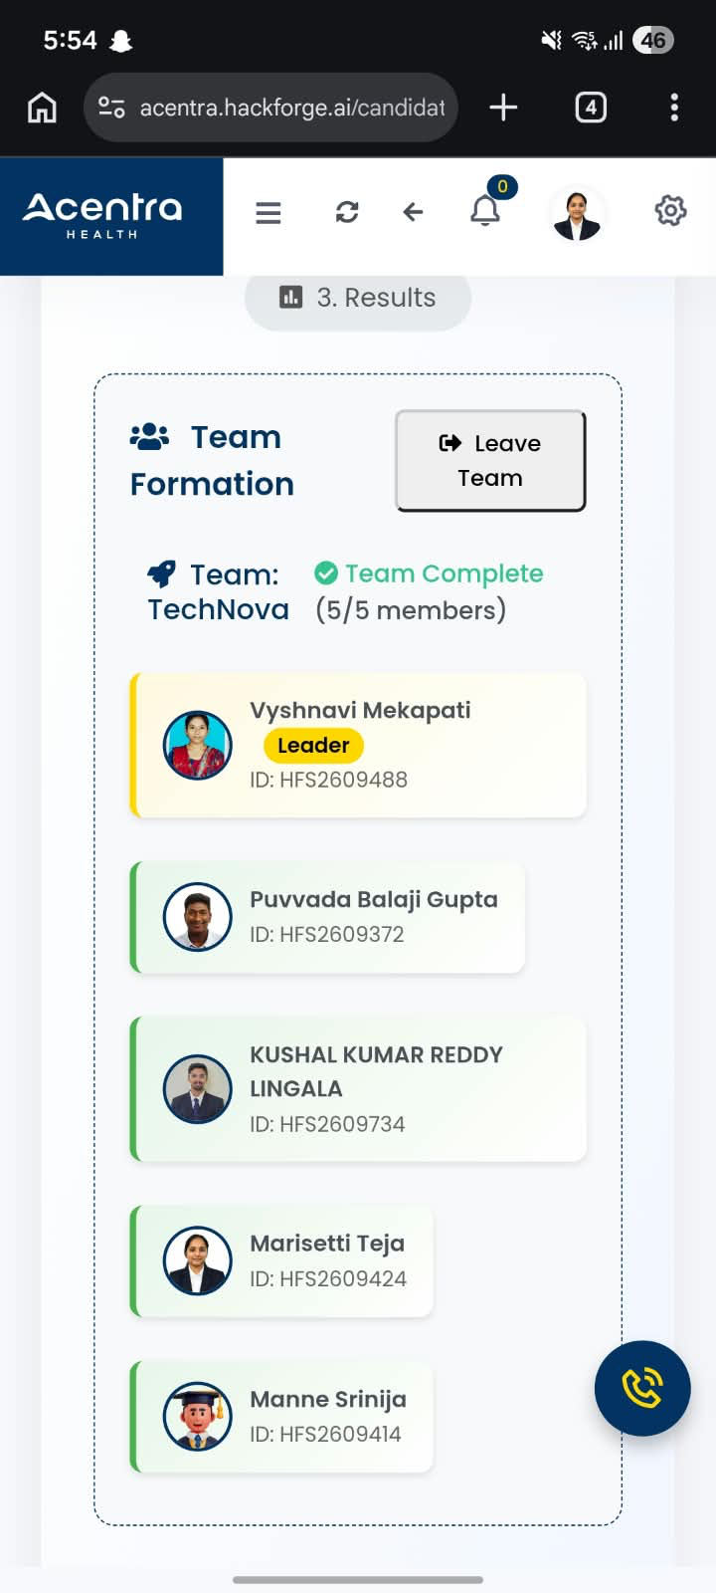
Team TechNova
07
Project team and member IDs
Team formation
Members
Vyshnavi Mekapati
HFS2609488
Leader
Puvvada Balaji Gupta
HFS2609372
Member
Kushal Kumar Reddy Lingala
HFS2609734
Member
Marisetti Teja
HFS2609424
Member
Manne Srinija
HFS2609414
Member
5 / 5 members • Team complete
Order Processing System
Team TechNova

