Slide 1
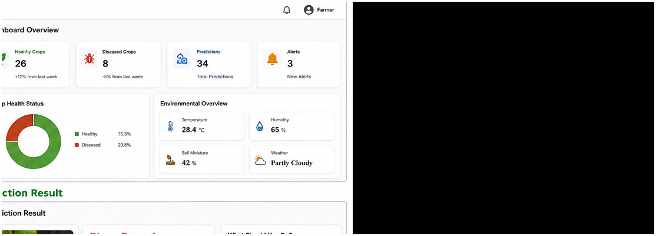
AI-Powered Smart Agriculture
Monitoring and Crop Disease
Prediction Platform
ENGINEERING CAPSTONE PROJECT – 1 | REVIEW – 2
Smart • Predictive • Data-driven
Review-2 | A.Y. 2026–2027
B. Vaishnavi — 2420090026
S. Lahari Krishna — 2420090055
Guide: Ms. G. Lavanya
1

Slide 2
Problem Statement
Why an integrated smart agriculture platform is needed
1
Delayed disease detection
2
Environmental uncertainty
3
Inefficient decisions
Manual inspection can delay identification of crop diseases and affect crop health.
Temperature, humidity and soil conditions need continuous monitoring for better decisions.
Irrigation, fertilizer and disease-management decisions may rely heavily on manual judgement.
Core Problem
Farmers need a single, intelligent platform that can combine crop-image analysis, environmental monitoring, historical insights and actionable recommendations.
2

Slide 3
Objectives
What the project is designed to achieve
AI-based disease prediction
Environmental monitoring
Actionable recommendations
Detect crop diseases from uploaded leaf images.
Track temperature, humidity, soil moisture and light intensity.
Support irrigation, fertilizer and disease-management decisions.
Historical analysis
Interactive dashboard
Scalable platform
Maintain previous predictions and crop-health information.
Present crop health, alerts, trends and prediction insights.
Prepare the system for backend, cloud, CI/CD and ML lifecycle integration.
3

Slide 4
Existing System vs Proposed System
Moving from isolated/manual monitoring to an integrated platform
Existing Approach
Proposed Approach
• Manual crop inspection
• Disease detection may be delayed
• Environmental data handled separately
• Limited historical analysis
• Manual irrigation/fertilizer decisions
• No unified recommendation workflow
• AI-assisted image prediction
• Fast disease result + confidence
• Centralized environmental monitoring
• Prediction history and analytics
• Data-driven recommendations
• Single farmer dashboard
4

Slide 5
Proposed System
End-to-end farmer workflow
01 Login / Register
02 Upload Leaf Image
03 AI Prediction
04 Monitor Environment
Secure entry to the farmer platform
Submit a clear crop/leaf image
Identify healthy/diseased crop and disease type
View temperature, humidity, soil and light data
05 Analyze
06 Recommend
07 Track
Combine prediction with environmental context
Generate irrigation, fertilizer and disease-management guidance
View history, alerts and analytics
Core flow: Image + Environmental Data → AI/ML → Analysis → Recommendations → Dashboard
5

Slide 6
Technology Stack
Tools and technologies selected for the platform
Frontend | React
Backend | FastAPI
Database | PostgreSQL
Interactive farmer dashboard and user interfaces
API layer and application services
Users, crops, sensor data and prediction records
AI / ML | Deep Learning / ML
Containerization | Docker
CI/CD | GitHub Actions
Crop disease classification and prediction
Consistent development and deployment
Automated build and delivery workflows
ML Lifecycle | MLflow
Cloud | AWS
Security | DevSecOps
Model tracking and lifecycle management
Scalable cloud deployment
Security-aware development practices
6

Slide 7
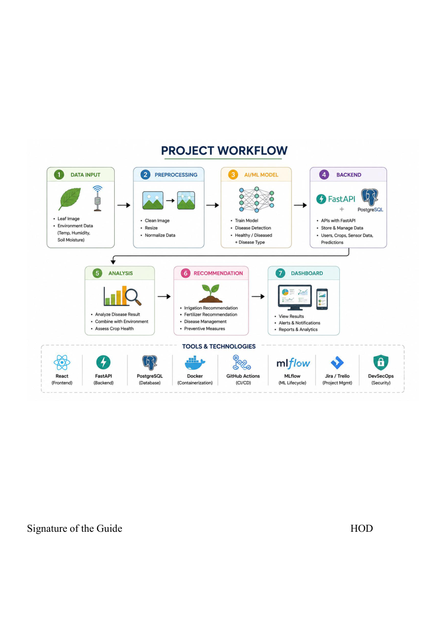
System Workflow
Workflow from data input to dashboard and recommendations
7

Slide 8
Modules
Main functional areas of the proposed platform
Authentication
Dashboard
Login, registration, user profile
Crop health, predictions, alerts, environment overview
Image Prediction
Environmental Monitoring
Upload leaf image and obtain disease result
Temperature, humidity, soil moisture, light
History
Recommendations
Previous crop predictions and timestamps
Irrigation, fertilizer and disease management
Administration
Dataset, disease information, user and system oversight
8

Slide 9
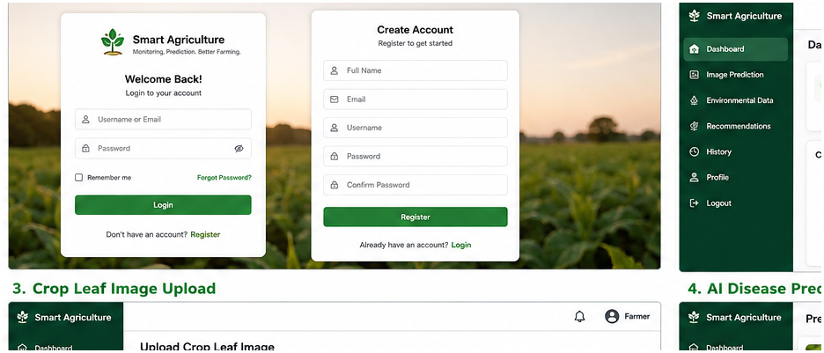
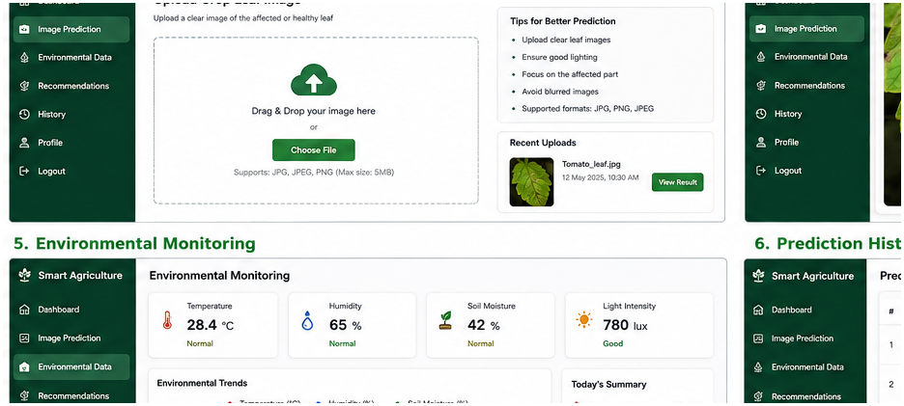
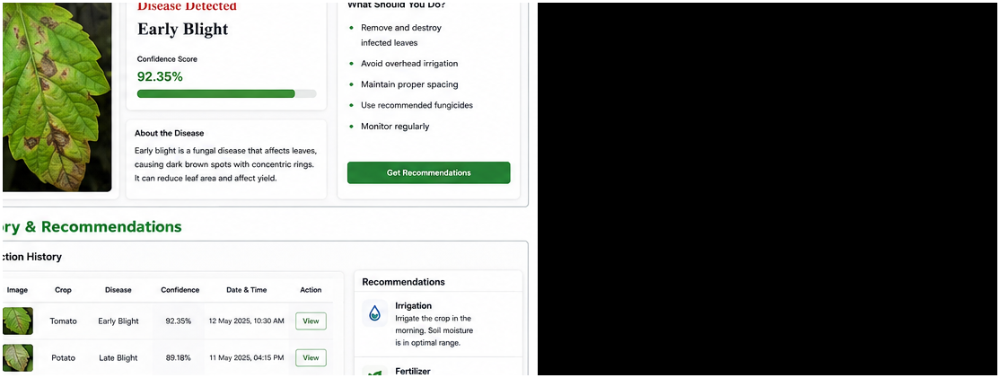
Implementation – User & Prediction Modules
Actual project UI progress
Login / Registration
Crop Leaf Upload
AI Prediction Result
Authentication UI
Image Input
Prediction View
Login and registration forms are designed for farmer access.
Drag-and-drop / file selection interface for crop leaf images.
Disease name, confidence score, description and action guidance.
Implementation evidence: supplied project UI screenshots. Prediction values shown in the prototype should be treated as sample output unless connected to the trained model.
9

Slide 10
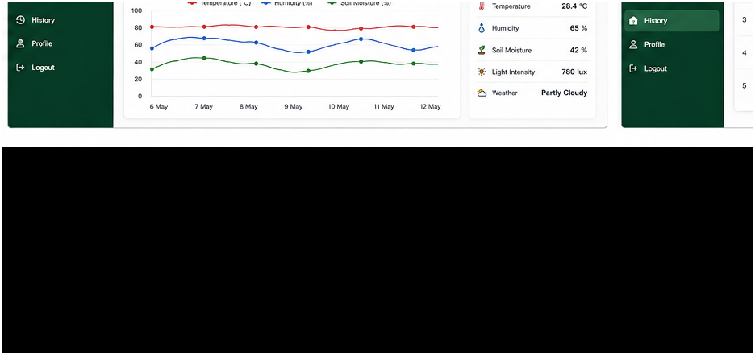
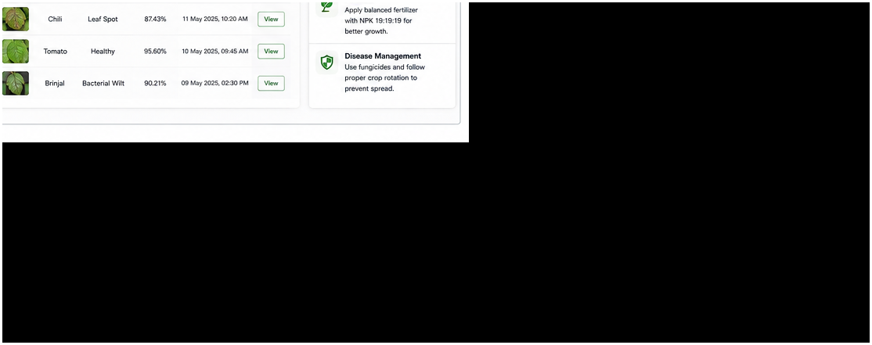
Implementation – Monitoring, History & Recommendations
Actual project UI progress
Smart Agriculture Dashboard
Environmental Monitoring
Prediction History & Recommendations
Dashboard
Monitoring
History + Guidance
Health statistics, prediction count, alerts and environmental overview.
Current readings and trend visualization for environmental parameters.
Historical predictions with irrigation, fertilizer and disease-management recommendations.
10

Slide 11
Implementation Status
Review-2 progress based on the supplied project material
Project workflow & architecture
Completed
Major UI screens
Completed
Login / Registration UI
Completed
Dashboard UI
Completed
Image upload & prediction UI
Completed
Environmental monitoring UI
Completed
History & recommendation UI
Completed
Backend API integration
In progress
Database integration
In progress
Trained ML model integration
In progress
IoT / real sensor integration
Future
Docker / AWS / CI-CD / MLflow
Planned integration
Status labels should be updated to match the team's live repository and working backend/model before the final presentation.
11

Slide 12
Conclusion & Future Scope
Current achievement and next development phase
Conclusion
Future Scope
The project has progressed from architecture and workflow design to a functional set of major user-facing screens. The current prototype demonstrates the intended farmer journey from authentication and image upload to prediction, environmental monitoring, history and recommendations.
• Integrate trained disease-prediction model with the application.
• Connect FastAPI services with PostgreSQL.
• Add real-time IoT environmental sensor data.
• Improve recommendation logic using crop and environmental context.
• Deploy the platform using Docker and AWS.
• Introduce GitHub Actions and MLflow for continuous development and model lifecycle management.
13

Slide 13
LIVE DEMONSTRATION
Login → Dashboard → Upload Leaf → Prediction → Environment → Recommendations → History
14

