Slide 1

AgriShield – Smart Crop & Farmer Support System
SOA Project Review-1
26 August 2026
SOA Programming and Microservices (24SDCS03)
Under the Guidance of
Team Members
Ms. Navyatha
Department of Computer Science and Engineering
KLH CSE Bowrampet Campus
Vaishnavi B — 2420090026
Lahari Krishna S — 2420090055

Slide 2
Outline of Project Work
Introduction & Problem
Project Objectives
Literature Context
Problem Gap
Innovation & Novelty
Feasibility & Project Plan
Conclusion & Future Work
References

Slide 3
Problem Statement
Current Challenges
Impact
• Delayed crop disease detection
• Unpredictable weather conditions
• Inefficient irrigation practices
• Limited access to real-time agricultural insights
• Manual crop inspection is time-consuming
• Increased production costs
• Risk of reduced crop yield
• Farmers need faster, data-driven decisions
Proposed Response
A unified AI-powered platform combines crop-leaf image analysis with temperature, humidity and
soil-moisture data to support disease detection, monitoring and actionable farming recommendations.
Goal: support precision farming through predictive analytics and real-time agricultural insights.

Slide 4
Objectives
1
Automated Disease Detection
2
Real-Time Monitoring
Detect crop diseases from uploaded leaf images using
deep learning.
Track temperature, humidity through current location automatically
by weather report
3
Intelligent Recommendations
4
Interactive Dashboard
Generate recommendations for irrigation, fertilizer usage
and disease management.
Present disease reports, environmental analytics, historical predictions
and personalized recommendations.
5
Reliable Platform
Apply DevOps, DevSecOps and MLOps practices for secure deployment and continuous model improvement.
Outcome: an efficient, secure and intelligent solution for sustainable agriculture.

Slide 5
Literature Survey / Existing-Practice Context
Existing Practice | Current Limitation | Project Motivation
Manual crop inspection | Time-consuming; may delay disease detection | Automated leaf-image disease detection
Separate environmental observations | Weather uncertainty and inefficient irrigation | Integrated temperature, humidity and soil-moisture monitoring
Limited real-time agricultural insight | Slower decisions; possible yield/cost impact | Dashboard + predictive analytics + personalized recommendations
Note: The abstract does not provide named research papers; this slide uses only the existing-practice context stated in the abstract.
Note: The abstract does not provide named research papers; this slide uses only the existing-practice context stated in the abstract.

Slide 6
Problem Gap Identification
Gap 01
Disease Detection
Gap 02
Data Integration
Manual inspection can delay identification of crop diseases.
Crop health and environmental conditions need to
be considered together.
Gap 03
Actionable Decisions
Gap 04
Operationalization
Monitoring alone is insufficient without irrigation, fertilizer
and disease-management recommendations.
A practical solution needs secure deployment, monitoring
and continuous ML improvement.
Identified gap → integrate AI disease prediction + sensor monitoring + recommendations
+ cloud-native engineering in one platform.

Slide 7
Innovation, Creativity, and Novelty
INPUT
AI/ML
ANALYTICS
ACTION
DELIVERY
→
→
→
→
Leaf images + sensor data
Disease detection & prediction
Combine disease +
environment
Irrigation / fertilizer /
disease guidance
Dashboard, reports & alerts
Integrated Intelligence
Continuous Improvement
Cloud-Native Delivery
Disease status + environmental data
are analyzed together.
MLOps with MLflow supports model
lifecycle management.
Docker, GitHub Actions and AWS
support reliable deployment.
Novelty is the end-to-end integration of prediction, monitoring, recommendations and engineering practices in one platform.

Slide 8
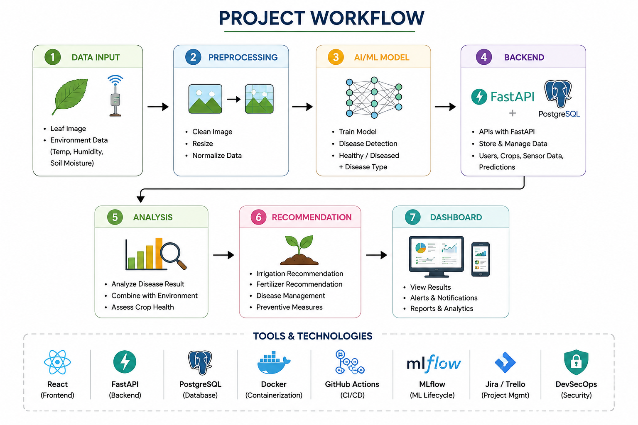
Feasibility and Project Plan
Feasibility
• Software: React, FastAPI, PostgreSQL
• AI/ML: Deep learning + MLflow
• Deployment: Docker, GitHub Actions, AWS
• Security & delivery: DevSecOps practices
Proposed Phase Timeline
1
2
3
4
5
6
Requirements
Data & ML
Backend & DB
Dashboard
DevOps/
MLOps
Testing &
Deployment
The timeline is a proposed phase plan derived from the project scope; dates are not specified in the abstract.

