Slide 1

AgriShield – Smart Crop & Farmer Support System
SOA Project Review-2
September 2026
SOA Programming and Microservices (24SDCS03)
Under the Guidance of
Team Members
Ms. Navyatha
Department of Computer Science and Engineering
KLH CSE Bowrampet Campus
Vaishnavi B — 2420090026
Lahari Krishna S — 2420090055
SOA Programming & Microservices • Review-2

Slide 2
Outline of Project
1
Problem Statement
2
Project Objectives
3
Project Design
4
Methodology Adopted
5
Technical Soundness
6
Conclusion & Future Work

Slide 3
Problem Statement
Current Challenges
Impact
• Delayed crop disease detection through manual inspection
• Unpredictable weather conditions affect farming decisions
• Inefficient irrigation practices due to limited real-time context
• Limited access to integrated agricultural insights
• Manual crop inspection is time-consuming
• Increased production costs and risk of reduced yield
• Farmers need faster, data-driven decisions
Proposed Response
A unified AI-powered platform combines crop-leaf image analysis with automatic environmental data to support disease detection, monitoring and actionable farming recommendations.
Goal: support precision farming through predictive analytics and real-time agricultural insights.

Slide 4
Project Objectives
1
Automated Disease Detection
2
Real-Time Monitoring
Detect crop diseases from uploaded leaf images using deep learning.
Automatically obtain current environmental conditions through the Weather API.
3
Intelligent Recommendations
4
Interactive Dashboard
Generate irrigation, fertilizer and disease-management recommendations.
Present disease reports, environmental analytics, historical predictions and recommendations.
5
Reliable Platform
Support modular deployment and future DevOps/MLOps practices.
Outcome: an integrated, intelligent solution for sustainable agriculture.

Slide 5
Project Design
System Architecture & Major Modules
1
Farmer / Browser
2
React Frontend
3
FastAPI Backend
4
AI Service
5
PostgreSQL
→
→
→
→
User interaction
Dashboard + prediction
REST + business logic
Disease prediction
Users + history
1
Automatic Weather API
2
Recommendation Engine
3
Dashboard / History
Temperature • Humidity • Rain • Cloud • Wind
Disease + Environment → Action + Why
Analytics + stored decisions
Core design principle: separate UI, API/business logic, AI inference, external weather data, recommendation logic and database persistence.

Slide 6
Methodology Adopted
1
Location
2
Weather
3
Image
4
Prediction
Get farm/user location
Automatically fetch current conditions
Upload crop leaf image
Deep-learning disease classification
5
Context
6
Explain
7
Store
8
Dashboard
Combine prediction + environment
Generate recommendation + reason
Save prediction and context
Display analytics and history
Key change from Review-1 concept: environmental conditions are automatically obtained instead of requiring repeated manual entry.

Slide 7
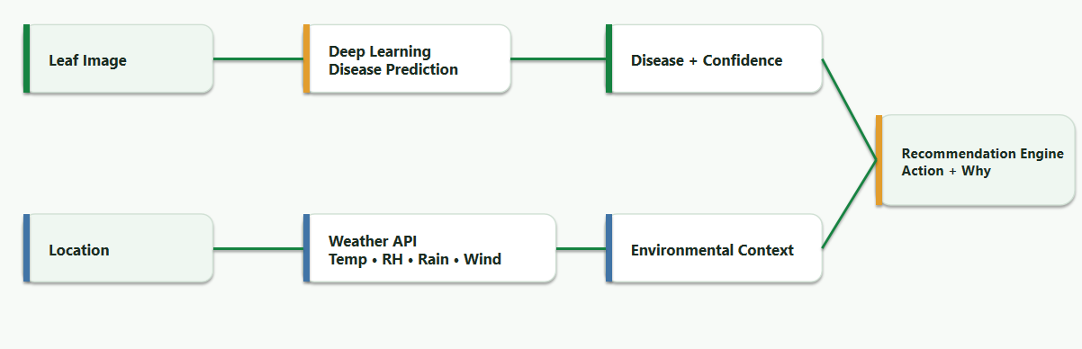
Methodology Adopted — AI + Automatic Weather

Slide 8
Technical Soundness of the Project
1
React + Vite
2
FastAPI
3
Python AI Service
Frontend and dashboard
REST APIs and business logic
Disease inference
4
PostgreSQL
5
Weather API
6
Docker
Users, predictions and history
Automatic environmental context
Reproducible multi-service deployment
7
GitHub Actions + AWS
CI/CD and deployment path
API operations: authentication, environment data, image prediction, prediction history, dashboard analytics and administration.
Technical outcome: traceable prediction → context → recommendation → history.

Slide 9
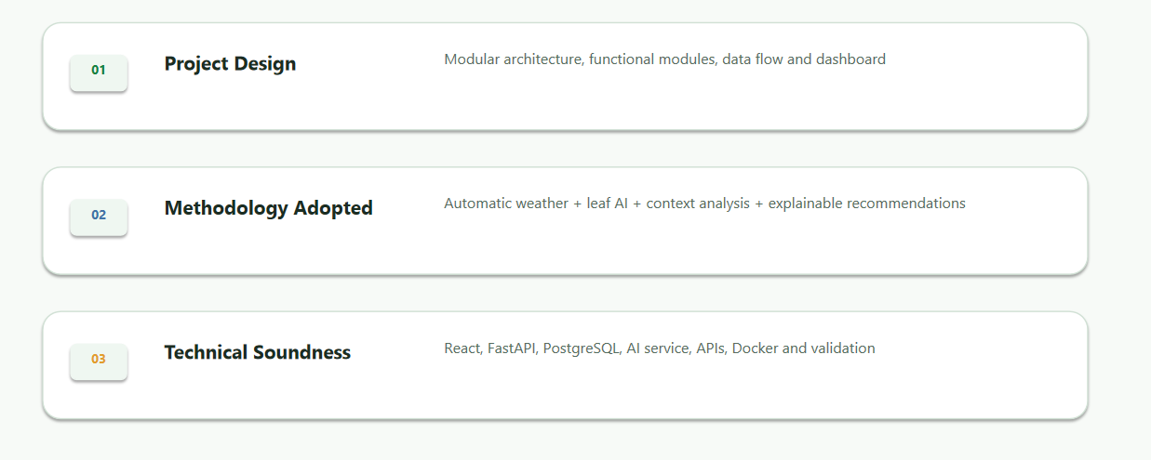
Conclusion & Future Work
Review–2 Summary
Design → Methodology → Technical Implementation → Decision-Support System

