Slide 1
Analysis on Spark Funds Investment
18CN627 – Big Data Framework for Data Science
Submitted By
Vyshnav MT
(CB.EN.P2CEN18021)

Slide 2
Introduction
An asset management company Spark funds wants to make investments in a few companies.
The CEO of spark funds wants to understand global trends in investments to take effective investment decision.
Investment constraints of Spark funds:
To invest between 5-15 billion USD per round of investment.
To invest only in English speaking countries for ease of communication.

Slide 3
Dataset Description
Based on the real time investment data taken from crunchbase.com.
Dataset has three data files [1, 2, 3]:
Companies.txt - basic data on companies.
rounds2.csv - funding round details.
mapping.csv - sector based classification of data.

Slide 4
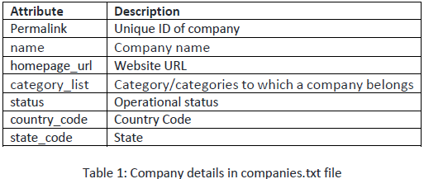
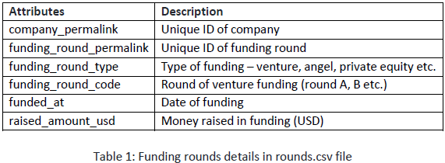
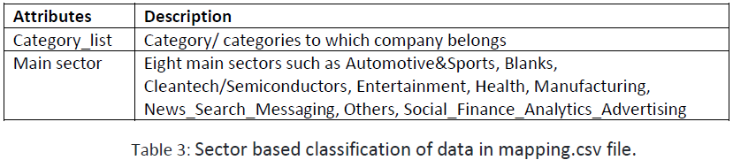

Slide 5
Objective
To identify best sectors, countries and a suitable investment type for Spark funds for making investments in order to make maximum profit.

Slide 6
Methodology
The analysis is done in three different stages as follows:
Investment type analysis:
Comparing the typical investment amounts in different funding types.
Funding types depend on the type of the company (start-up, corporate, etc.), its stage (early stage start-up, funded start-up, etc.), the amount of funding (a few million USD to a billion USD), etc.
Most common start-up funding types:
Seed/angel - early stage start-ups.
venture - occurs after seed or angel stages and involves a relatively higher amount of investment.
Private equity - associated with much larger companies and involve much higher investments than venture type.

Slide 7
2. Country Analysis:
This stage identifies the countries which have been most heavily invested in the past.
According to the spark funds constraints, the top English speaking countries with highest amount of funding needs to be found.
Sector Analysis:
Understanding the distribution of investments across the eight main sectors.
Sub-sectors of companies and rounds data are mapped to its main sector.
Find the most heavily invested main sectors in each of the best English speaking countries for best identified funding types in the range of 5 to 15 million USD.

Slide 8
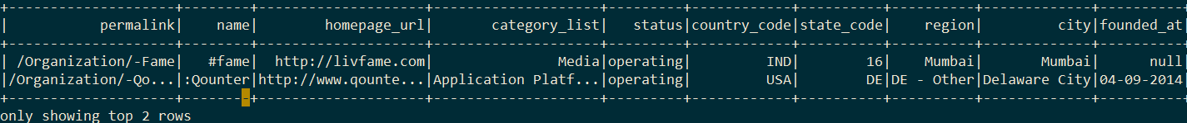
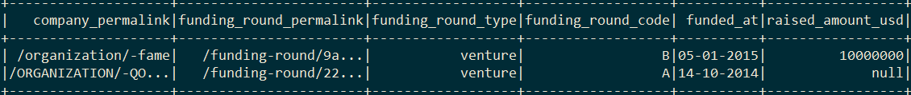
Experiments and Results
Read the companies and rounds data files.
Figure 1: company details in companies.txt.
Figure 2: Funding rounds details in rounds.csv.

Slide 9
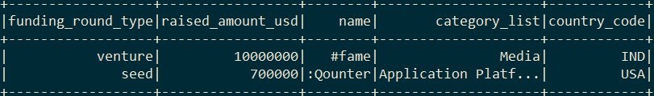
Stage 1 (Investment Type Analysis):
Merge the companies data with rounds data on lowercased values of attribute ‘permalink’.
Merge operation done by intersection of keys from both dataframes to get resultant dataframe (DF) master_frame.
Clean the DF master_frame by dropping all non-contributing attributes and null values.
Figure3: Master_frame sample data.

Slide 10
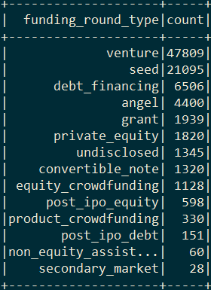
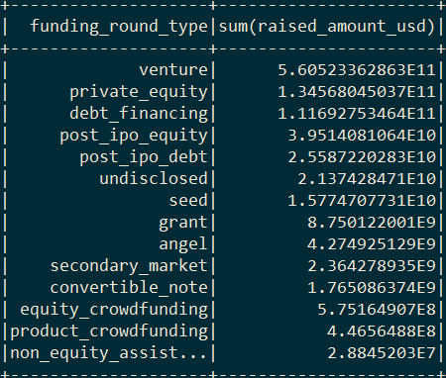
Analyse the cleaned DF master_frame to obtain funding type with highest investment amounts.
Calculate the number of investment and the sum of investment for each funding type in the master_frame.
(a)
(b)
Figure 4: Investment type analysis for master_frame: (a) number of investment per type, (b) investment amount for each type.

Slide 11
Stage 1 result and outcome:
Venture has the highest number of investments as well as highest investment amount.
Filter out the master_frame with investment type as venture.

Slide 12
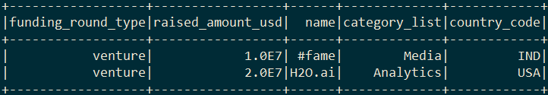
Stage 2 (Country Analysis):
As per spark funds constraint, the investment need to be done in top English speaking countries
The english speaking countries are short listed as United States of America (USA), Britain (GBR), India (IND), by manual analysis of the list provided for english as official language list.
Figure 5: Filtered master_frame with investment type venture and english speaking countries USA, GBR, IND.

Slide 13
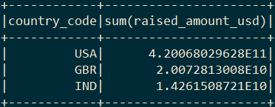
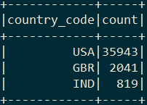
Calculate the number of investments and the sum of investment amount for top 3 English speaking countries in the master_frame.
(a)
(b)
Figure 6: Master_frame country analysis: (a) investment amount for each country, (b) number of investment per country.

Slide 14
Stage 3 (Sector Analysis):
Read the mapping.csv file and map each primary sectors of master_frame to the eight main sectors in mapping data.
Filter out the mapped master_frame to investment amount between 5-15 million USD, as per the constraint of spark funds.
Figure 7: Sector details in mapping.csv.

Slide 15
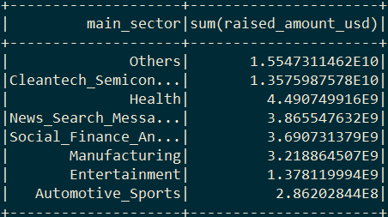
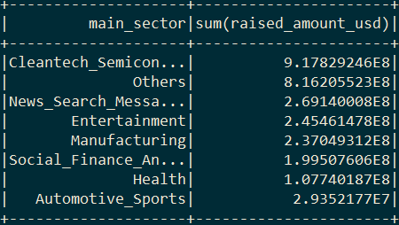
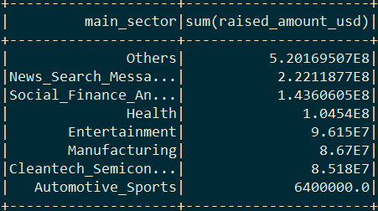
Create 3 dataframes D1, D2, D3 from master_frame for each country identified.
Perform sector analysis on the mapped data.
(a)
(b)
(c)
Figure 8: Total investment amounts of each main sectors in countries: (a) USA, (b) GBR, (c) IND

Slide 16
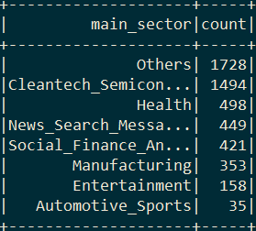
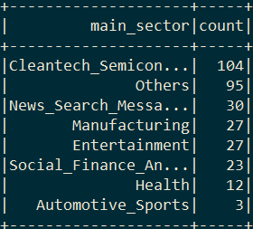
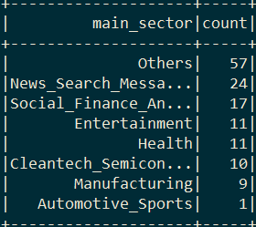
(a)
(b)
(c)
Figure 9: Total number of investments in each main sectors in countries: (a) USA, (b) GBR, (c) IND.

Slide 17
Conclusion
Based on the data analysis performed, Spark funds should invest in:
Funding type – Venture.
Countries – USA, Britain, India.
Top two sectors to invest – Others and Cleantech/semiconductors.

Slide 18
References
[1] https://www.kaggle.com/goyalshalini93/data, accessed on October 2019.
[2] https://github.com/santhoshpkumar/Spark-Funds-Investment-CaseStudy/blob/master/Spark%20Funds%20Presentation.pdf , accessed on October 2019.
[3] https://github.com/anupammajhi/Sparks-Funds-Investment-Case-Study, accessed on October 2019.

Slide 19
Codes
Task 1: Reading, merging and Data cleaning:
var companies = spark.read.format("csv").option("sep","\t").option("header","True"). option("encoding","ISO-8859-1").load("companies.txt")
companies = companies.withColumn("permalink",lower(col("permalink")))
companies.select("permalink").distinct.count()
var rounds =spark.read.format("csv").option("header","True").option("encoding","ISO-8859-1").load("rounds2.csv")
rounds = rounds.withColumn("company_permalink",lower(col("company_permalink")))
rounds.select("company_permalink").distinct.count()
rounds = rounds.withColumnRenamed("company_permalink","permalink")
var master_frame = rounds.join(companies, Seq("permalink"), "inner")
var master = master_frame.drop("funding_round_code", "funding_round_permalink", "funded_at","permalink", "homepage_url","state_code","region", "city", "founded_at","status")
master.count()
master = master.na.drop()
master.count()

Slide 20
Task 2: Funding Type Analysis: Observing the unique funding_round_type
master.groupBy("funding_round_type").count().orderBy(desc("count")).show
master = master.withColumn ("raised_amount_usd",$"raised_amount_usd".cast("float"))
master.groupBy("funding_round_type"). agg(sum("raised_amount_usd")).orderBy(desc("sum(raised_amount_usd)")).show
master.groupBy("funding_round_type").agg(avg("raised_amount_usd")). orderBy(desc("avg(raised_amount_usd)")).show
val fil = List("venture", "angel", "seed", "private_equity")
master.filter($"funding_round_type".isin(fil:_*)).show(3)
master.groupBy("funding_round_type").agg(avg("raised_amount_usd")). orderBy(desc("avg(raised_amount_usd)")).show
master.groupBy("funding_round_type").count().show
master = master.filter($"funding_round_type"==="venture")

Slide 21
Task 3: Country Analysis: creating new dataframe with highest funding countries
master.groupBy("country_code").agg(avg("raised_amount_usd")).orderBy(desc("avg(raised_amount_usd)")).show
master.groupBy("country_code").count().orderBy(desc("count")).show
master.groupBy("country_code").agg(sum("raised_amount_usd")).orderBy(desc("sum(raised_amount_usd)")).show
val top9_country = List("USA", "CHN", "GBR", "IND", "CAN", "FRA", "ISR", "DEU", "JPN")
var top9 = master.filter($"country_code".isin(top9_country:_*))
top9.groupBy("country_code").agg(sum("raised_amount_usd")).orderBy(desc("sum(raised_amount_usd)")).show
Identify the top three English-speaking countries in the data frame top9. The countires has been short listed by manual analysis of the list provided for english as offical lanaguage list
val english = List("USA", "GBR", "IND")
var top3_english = top9.filter($"country_code".isin(english:_*))
top3_english.show(2)
top3_english.groupBy("country_code").agg(sum("raised_amount_usd")).orderBy(desc("sum(raised_amount_usd)")).show
top3_english.groupBy("country_code").count().orderBy(desc("count")).show

Slide 22
Task 4: Sector Analysis 1
var mapping = spark.read.format("csv").option("header","True").option("encoding","ISO-8859-1").load("mapping.csv")
mapping = mapping.selectExpr("category_list","stack(9,'Automotive_Sports',Automotive_Sports,'Blanks',Blanks,'Cleantech_Semiconductors',Cleantech_Semiconductors,'Entertainment',Entertainment,'Health',Health,'Manufacturing',Manufacturing,'News_Search_Messaging',News_Search_Messaging,'Social_Finance_Analytics_Advertising',Social_Finance_Analytics_Advertising,'Others',Others)").withColumnRenamed("col0","main_sector").withColumnRenamed("col1","value").filter($"value"=!=0).filter($"category_list".isNotNull)
mapping = mapping.drop("value")
var top3 = top3_english.join(mapping, Seq("category_list"), "left")
Drop all rows whose investment is not between 5 and 15 million
top3 = top3.filter($"raised_amount_usd"> 5000000)
top3 = top3.filter($"raised_amount_usd"< 15000000)
top3 = top3.na.drop()
var d1 = top3.filter($"country_code"==="USA")
var d2 = top3.filter($"country_code"==="GBR")
var d3 = top3.filter($"country_code"==="IND")
d1.groupBy("main_sector").agg(sum("raised_amount_usd")).orderBy(desc("sum(raised_amount_usd)")).show
d2.groupBy("main_sector").agg(sum("raised_amount_usd")).orderBy(desc("sum(raised_amount_usd)")).show
d3.groupBy("main_sector").agg(sum("raised_amount_usd")).orderBy(desc("sum(raised_amount_usd)")).show
d1.groupBy("main_sector").count().orderBy(desc("count")).show
d2.groupBy("main_sector").count().orderBy(desc("count")).show
d3.groupBy("main_sector").count().orderBy(desc("count")).show

Slide 23
Thank You

