Slide 1
Repartitions
*Re-distribute data across partitions
*Partitions are processed in parallel
*Spark decides how data is split by default, but not always optimally

Slide 2
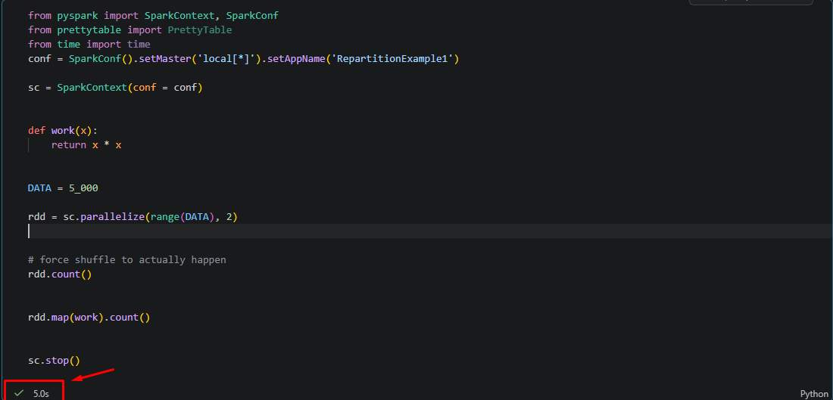
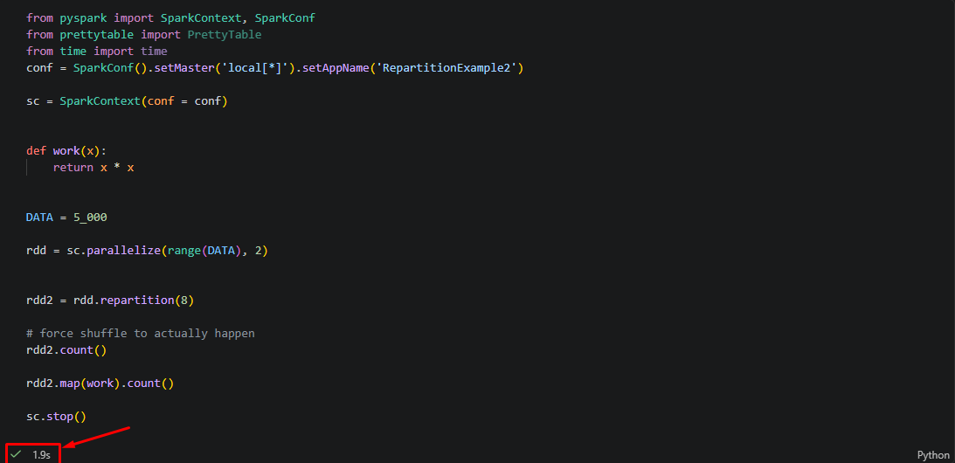
Working with Repartitions Examples
Created in partnership with Chip and Dan Heath, authors of the bestselling book Made To Stick, this template advises users on how to build and deliver a memorable presentation of a new product, service, or idea.
Example 1: No partitions
Example 2: With repartition

Slide 3
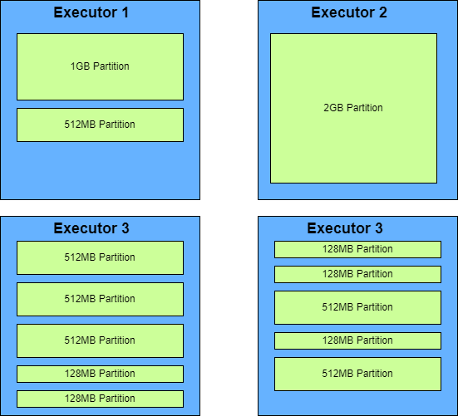
Concerns / Use Cases
*Repartition takes time in and of itself
*Repartition involves a full shuffle
*Not always faster

